Slide 1
Network Cabling
Making connections with Cat5/Cat5e

Slide 2
Overview
What cable types are available?
How do cables work?
How are cables used in networking?
How are connections made?

Slide 3
Learning Objectives
List common cable types used in networking
Describe how UTP cables are made
Explain how UTP cables are used in Ethernet networks
Demonstrate the ability to make a working patch cable
Name the two wiring standards used for wired Ethernet networks and their uses

Slide 4
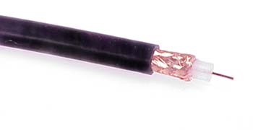
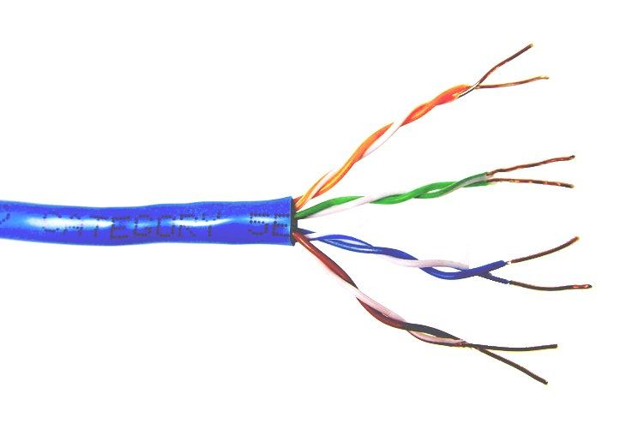
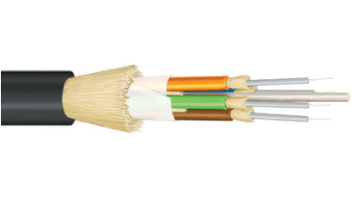
Common network cable types
Coaxial cable
Unshielded
twisted pair
Fiber optic

Slide 5
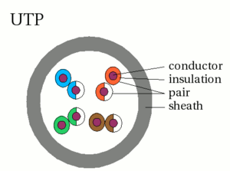
UTP characteristics
Unshielded
Twisted (why?) pairs of insulated conductors
Covered by
insulating sheath

Slide 6
UTP categories
Category 1 | Voice only (Telephone)
Category 2 | Data to 4 Mbps (Localtalk)
Category 3 | Data to 10Mbps (Ethernet)
Category 4 | Data to 20Mbps (Token ring)
Category 5 Category 5e | Data to 100Mbps (Fast Ethernet) Data to 1000Mbps (Gigabit Ethernet)
Category 6 | Data to 2500Mbps (Gigabit Ethernet)

Slide 7
Cat5/Cat5e cable
100/1000Mbps data capacity
For runs of up to 90 meters
Solid core cable ideal for structural installations (PVC or Plenum)
Stranded cable ideal for patch cables
Terminated with RJ-45 connectors

Slide 8
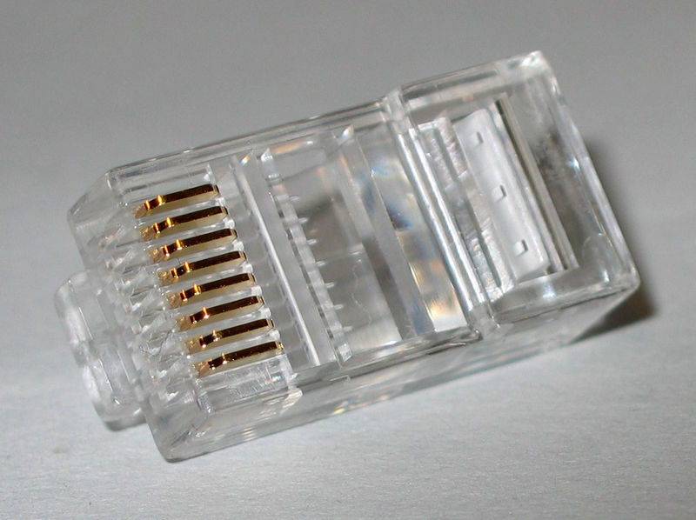
RJ45 connector

Slide 9

Making connections - Tools
Cat5e cable
RJ45 connectors
Cable stripper
Scissors
Crimping tool

Slide 10
Making connections - Steps
Strip cable end
Untwist wire ends
Arrange wires
Trim wires to size
Attach connector
Check
Crimp
Test

Slide 11
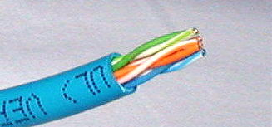
Step 1 – Strip cable end
Strip 1 – 1½” of insulating sheath
Avoid cutting into conductor insulation

Slide 12
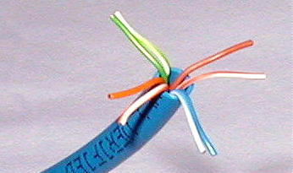
Step 2 – Untwist wire ends
Sort wires by insulation colors

Slide 13
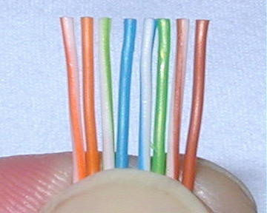
Step 3 – Arrange wires
TIA/EIA 568A: GW-G OW-Bl BlW-O BrW-Br
TIA/EIA 568B: OW-O GW-Bl BlW-G BrW-Br

Slide 14
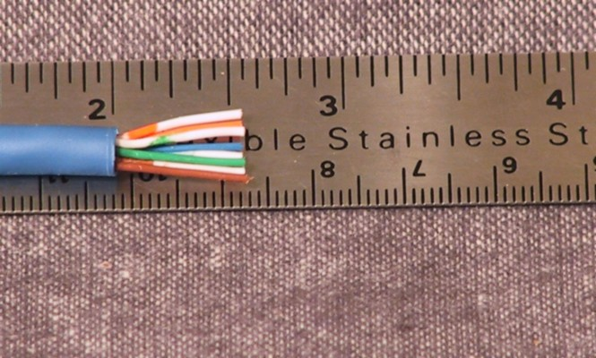
Step 4 – Trim wires to size
Trim all wires evenly
Leave about ½” of wires exposed

Slide 15
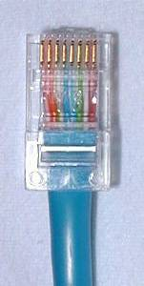
Step 5 – Attach connector
Maintain wire order, left-to-right, with RJ45 tab facing downward

Slide 16
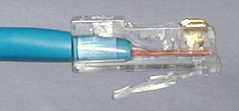
Step 6 - Check
Do all wires extend to end?
Is sheath well inside connector?

Slide 17
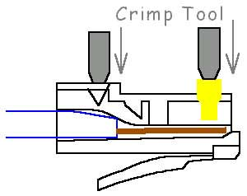
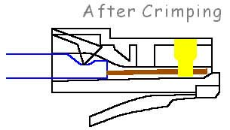
Step 7 - Crimp
Squeeze firmly to crimp connecter
onto cable end (8P)

Slide 18
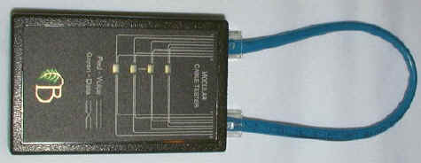
Step 8 – Test
Does the cable work?

Slide 19
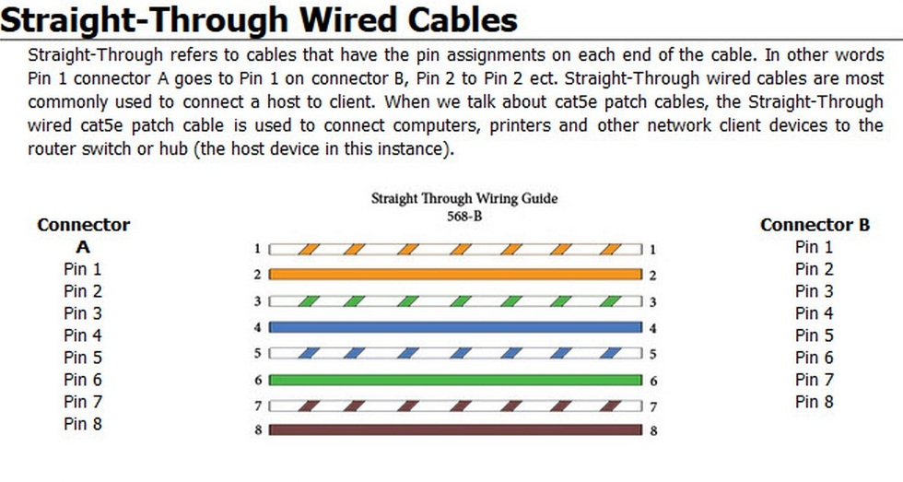

Slide 20
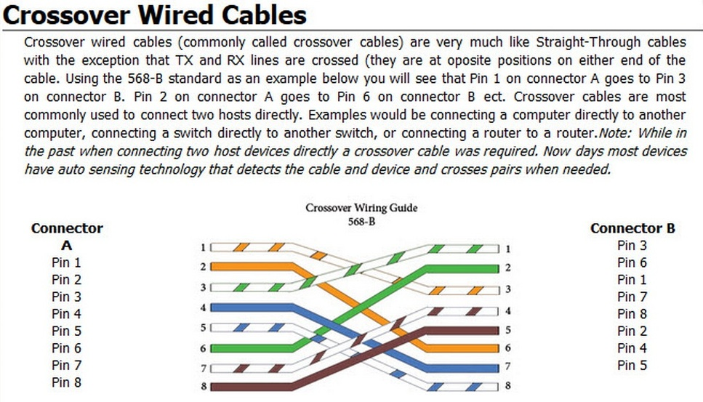

Slide 21
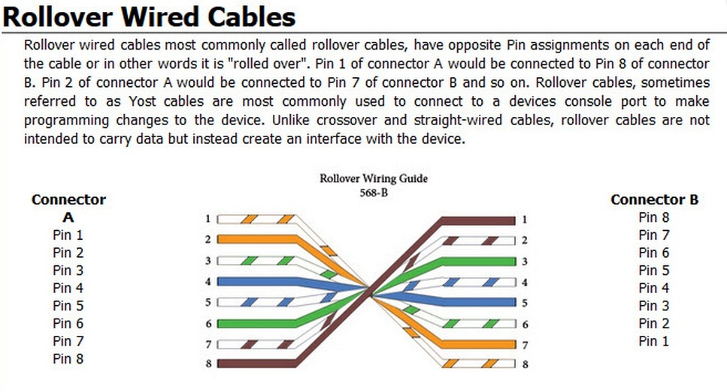

Slide 22

Let’s go to work!

