Slide 1


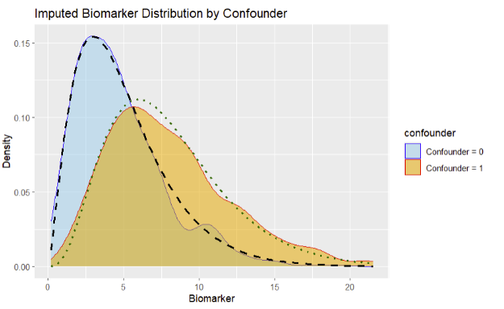
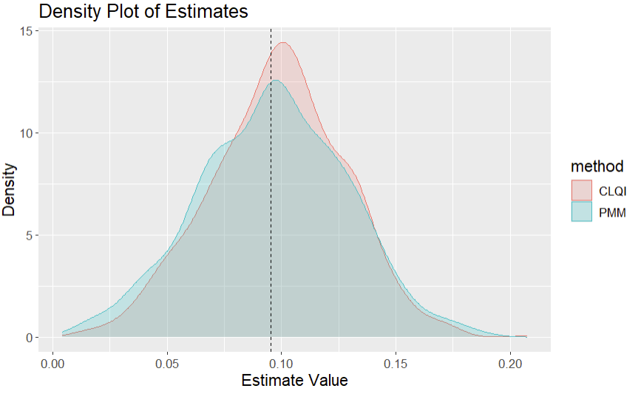
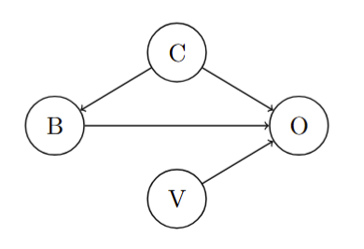
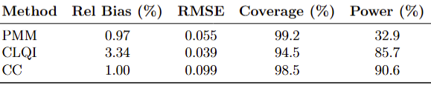

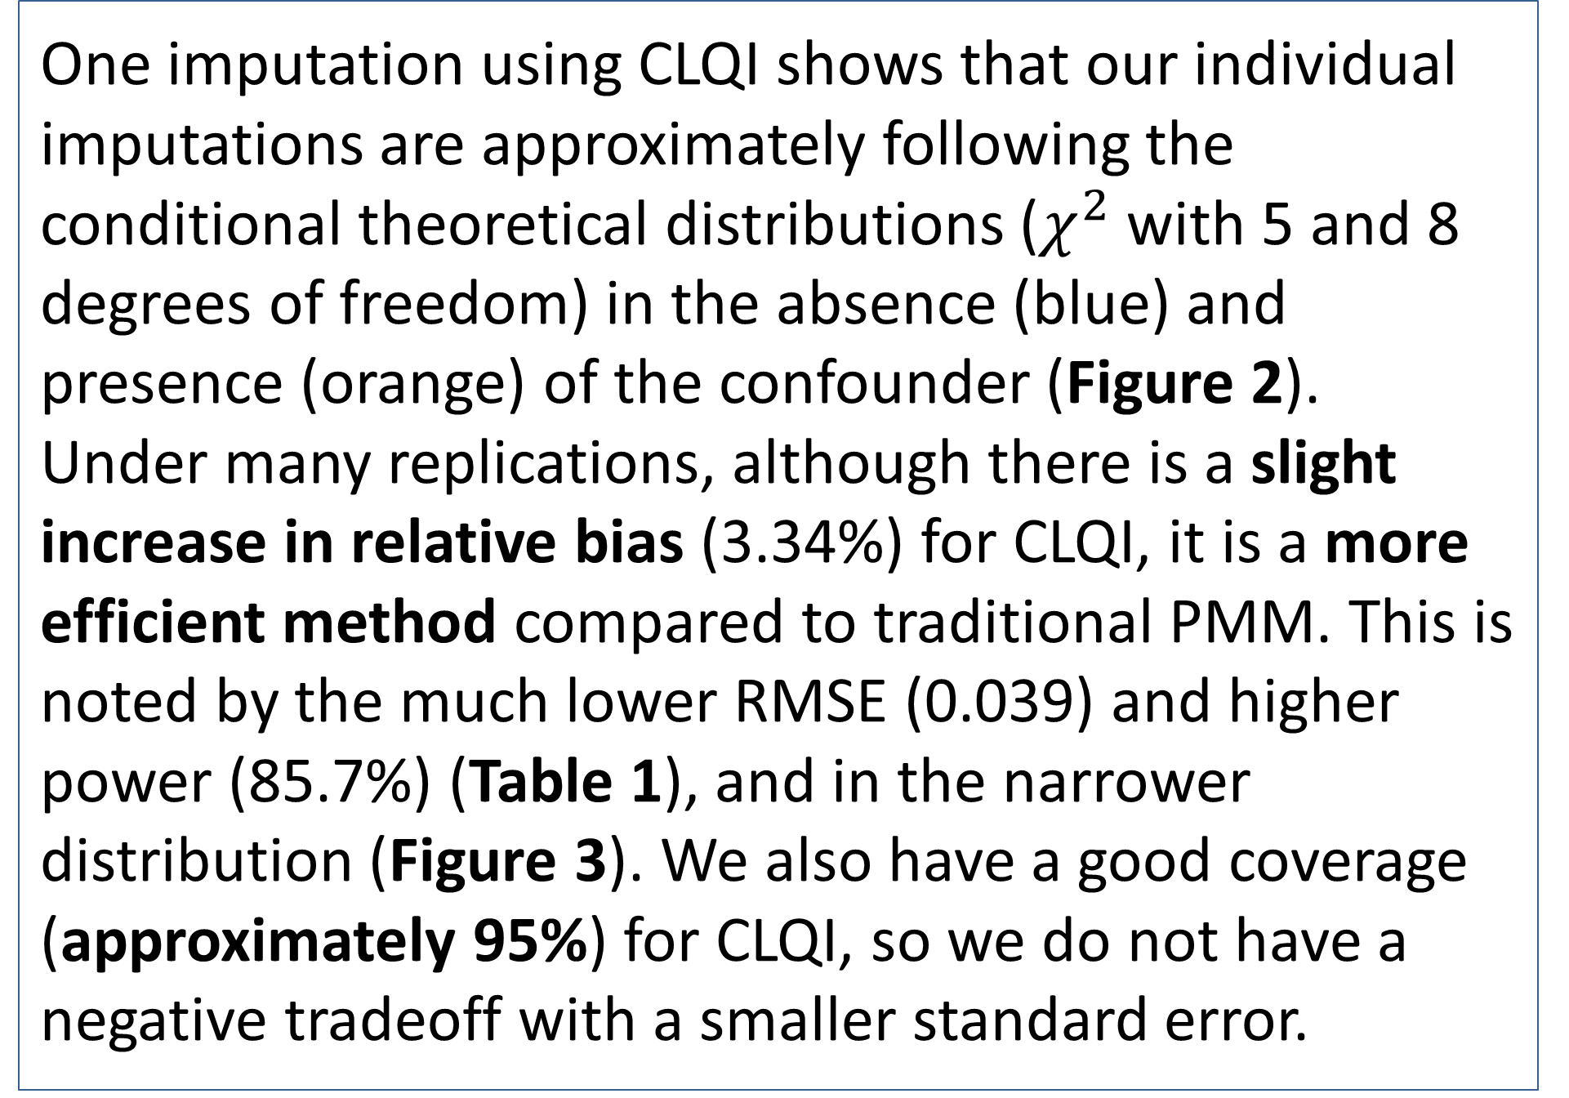
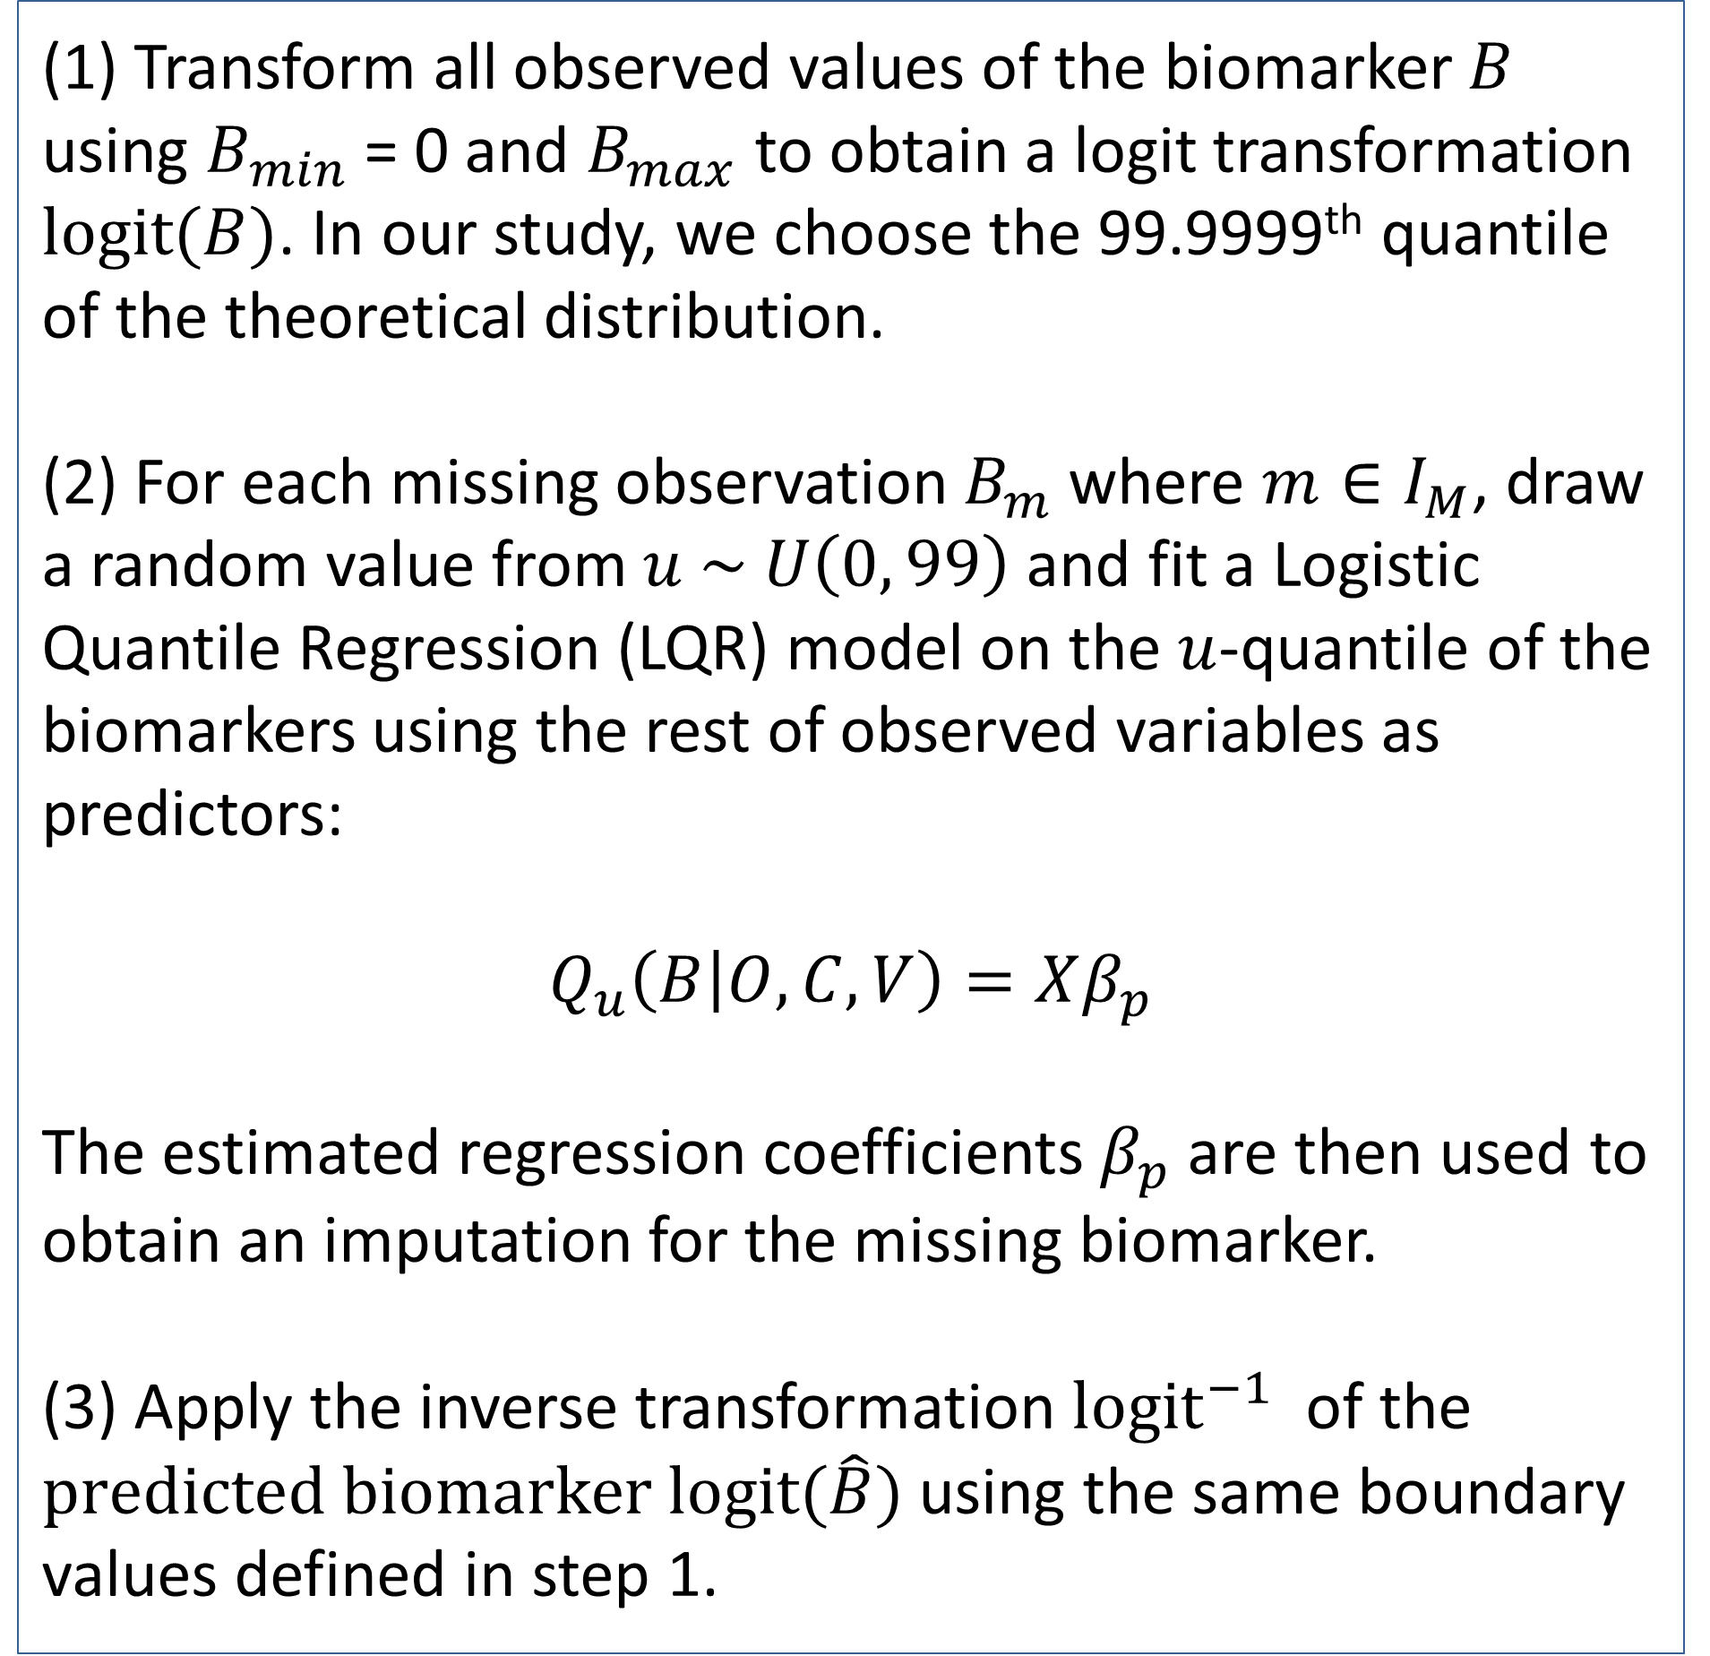
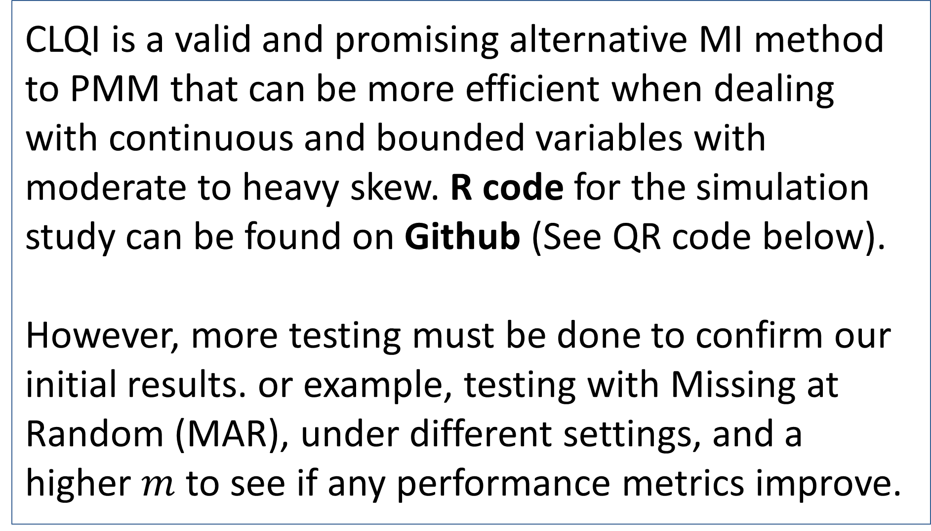
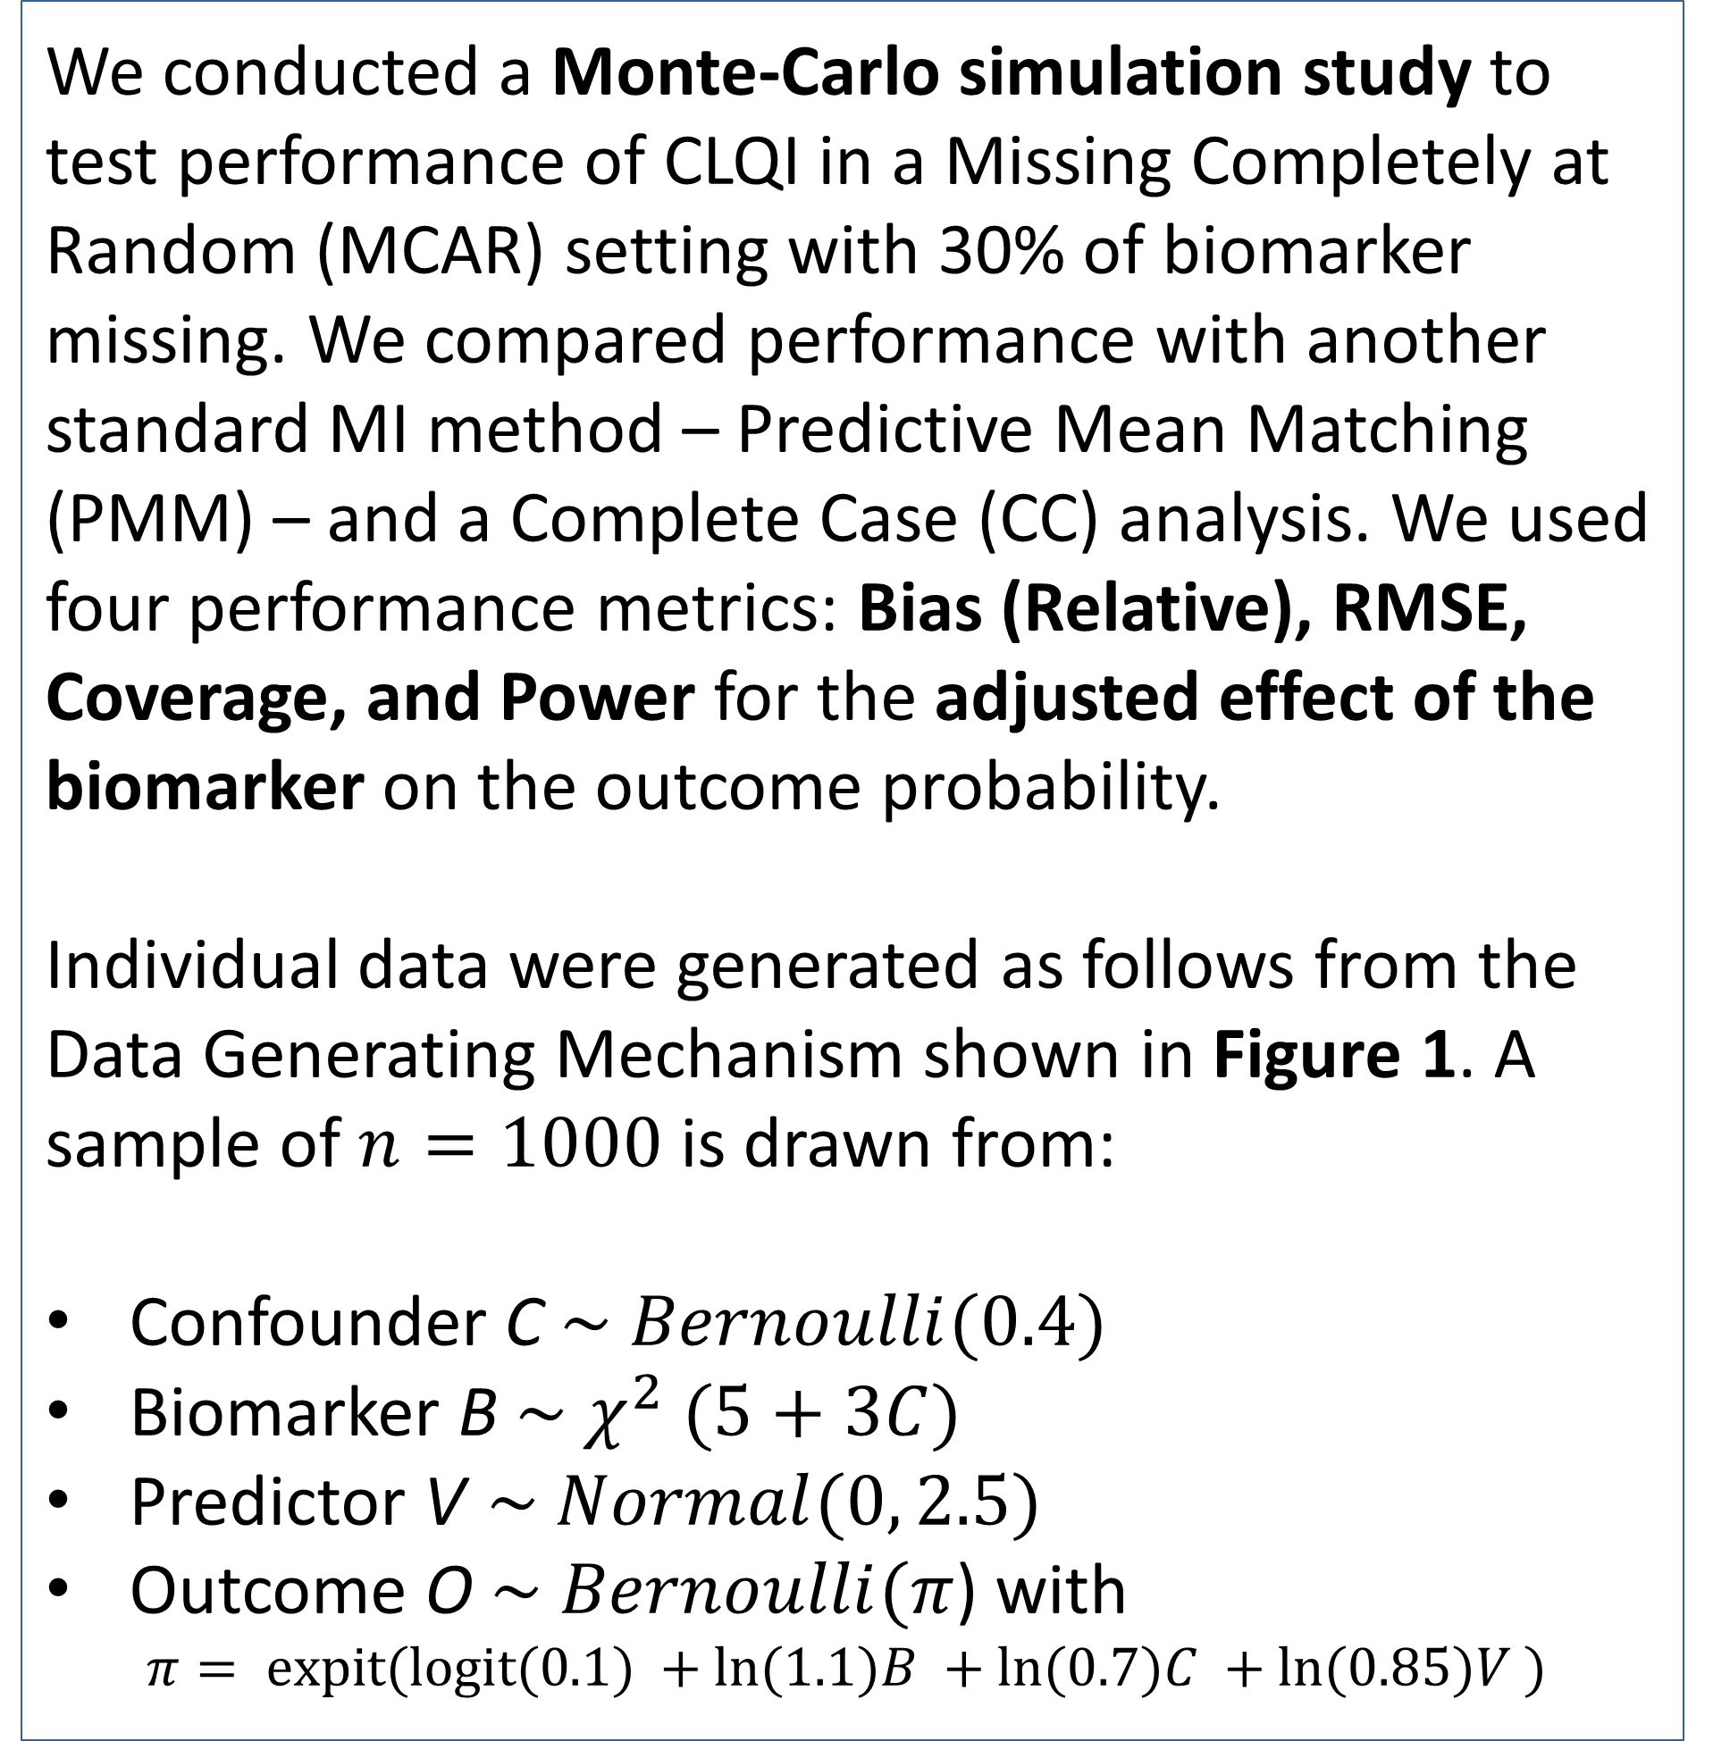
Conditional Logistic Quantile Imputation for Continuous and Bounded Variables with Moderate to Heavy Skew
Daniel Jang¹; Robert Theismeier²; Nicola Orsini²
¹Amherst College, ²Karolinska Institutet: Dept. Global Public Health
Conclusion
Methods
Conditional Logistic Quantile Imputation (CLQI) – under random missing data scenario – is unbiased and efficient in drawing statistical inference. Comparisons with Predictive Mean Matching show that CLQI is more efficient with continuous, bounded variables with skew.
We conducted a Monte-Carlo simulation study to test performance of CLQI in a Missing Completely at Random (MCAR) setting with 30% of biomarker missing. We compared performance with another standard MI method – Predictive Mean Matching (PMM) – and a Complete Case (CC) analysis. We used four performance metrics: Bias (Relative), RMSE, Coverage, and Power for the adjusted effect of the biomarker on the outcome probability.
Individual data were generated as follows from the Data Generating Mechanism shown in Figure 1. A sample of $n=1000$ is drawn from:
Confounder C $\sim Bernoulli(0.4)$
Biomarker B $\sim χ^{2} (5+3C)$
Predictor V $\sim Normal(0, 2.5)$
Outcome O $\sim Bernoulli(π$) with
$$π= expit(logit(0.1) +ln⁡(1.1)B +ln⁡(0.7)C +ln⁡(0.85)V )$$
Introduction
Biomarker data, though critical in epidemiological and clinical research, are costly and difficult to measure. Thus, they are collected in only a subset of participants, losing fully observed information.
Moreover, biomarkers are continuous, bounded, skewed measures that make it difficult for Multiple Imputation (MI) Algorithms to capture extremes without imputing implausible values.
We present the first simulation study evaluating a novel method called Conditional Logistic Quantile Imputation (CLQI) for a missing biomarker, demonstrating its ability to produce unbiased and efficient estimates of the parameter of interest.
Figure 2: Distribution of Imputed Values (solid color) from CLQI and Theoretical Distributions (dotted lines) faceted by the binary confounder
Description of CLQI
Figure 3: Distribution of Estimates for the Biomarker given by PMM and CLQI respectively over 1000 simulations for 30% missing data, with a line at the set parameter value of ln(1.1)=0.095.
(1) Transform all observed values of the biomarker $B$ using $B_{min}$ = 0 and $B_{max}$ to obtain a logit transformation $logit(B)$. In our study, we choose the 99.9999th quantile of the theoretical distribution.
(2) For each missing observation $B_{m}$where $m∈I_{M}$, draw a random value from $u \sim U\left(0, 99\right)$ and fit a Logistic Quantile Regression (LQR) model on the $u$-quantile of the biomarkers using the rest of observed variables as predictors:
$$Q_{u}\left(B | O, C, V\right)=Xβ_{p}$$
The estimated regression coefficients $β_{p}$are then used to obtain an imputation for the missing biomarker.
(3) Apply the inverse transformation ${logit}^{−1}$ of the $predicted biomarker logit(\hat{B})$ using the same boundary values defined in step 1.
Figure 1: Causal Diagram of Data Generating Mechanism (DGM) of the simulated study
Results
One imputation using CLQI shows that our individual imputations are approximately following the conditional theoretical distributions ($χ^{2}$with 5 and 8 degrees of freedom) in the absence (blue) and presence (orange) of the confounder (Figure 2).
Under many replications, although there is a slight increase in relative bias (3.34%) for CLQI, it is a more efficient method compared to traditional PMM. This is noted by the much lower RMSE (0.039) and higher power (85.7%) (Table 1), and in the narrower distribution (Figure 3). We also have a good coverage (approximately 95%) for CLQI, so we do not have a negative tradeoff with a smaller standard error.
Table 1: Results of Simulation with Performance metrics for 30% missing data
Discussion
CLQI is a valid and promising alternative MI method to PMM that can be more efficient when dealing with continuous and bounded variables with moderate to heavy skew. R code for the simulation study can be found on Github (See QR code below).
However, more testing must be done to confirm our initial results. or example, testing with Missing at Random (MAR), under different settings, and a higher $m$ to see if any performance metrics improve.
References
Rubin, D. B. (1987). Multiple imputation for nonresponse in surveys. John Wiley & Sons.
Kleinke, K. (2017). Multiple imputation under violated distributional assumptions: A systematic evaluation of the assumed robustness of predictive mean matching. Journal of Educational and Behavioral Statistics, 42(4), 371–404. https://doi.org/10.3102/1076998616687084
Thiesmeier, R., Bottai, M., & Orsini, N. (2024). Systematically missing data in distributed data networks: Multiple imputation when data cannot be pooled. Journal of Statistical Computation and Simulation, 94(17), 3807–3825. https://doi.org/10.1080/00949655.2024.2404220
Bottai, M., Cai, B., & McKeown, R. E. (2010). Logistic quantile regression for bounded outcomes. Statistics in Medicine, 29(2), 309–317. https://doi.org/10.1002/sim.3781
QR code to Github Repository

