Slide 1


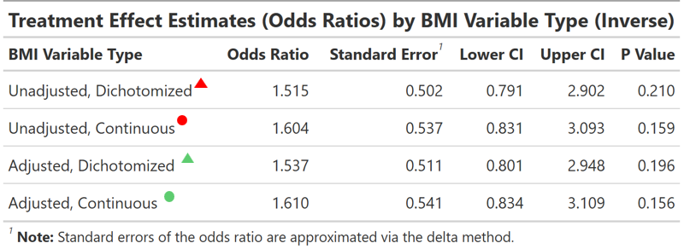
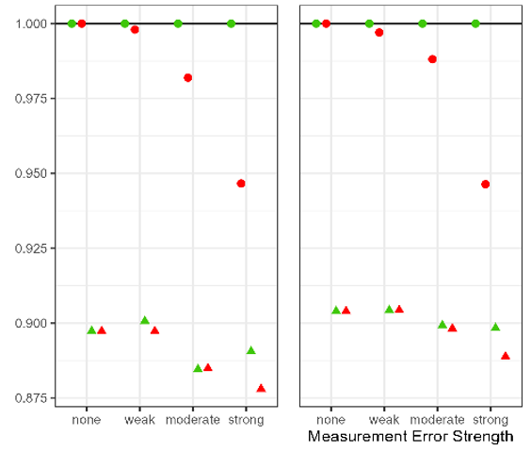
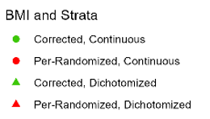
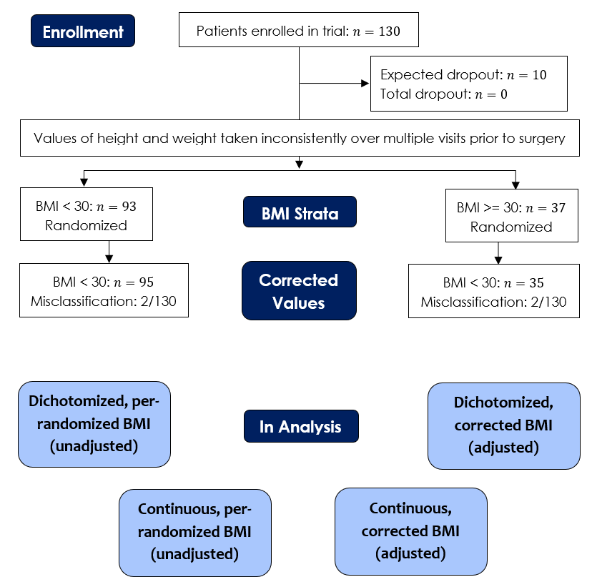
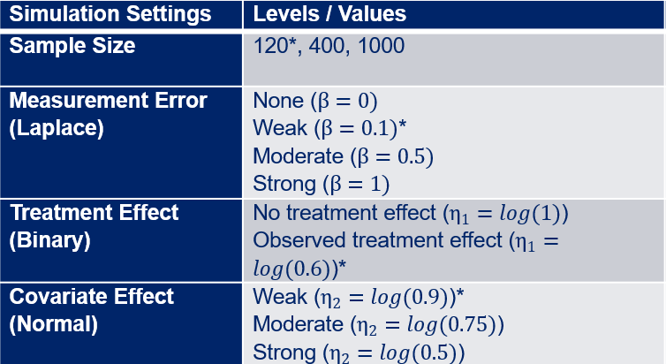
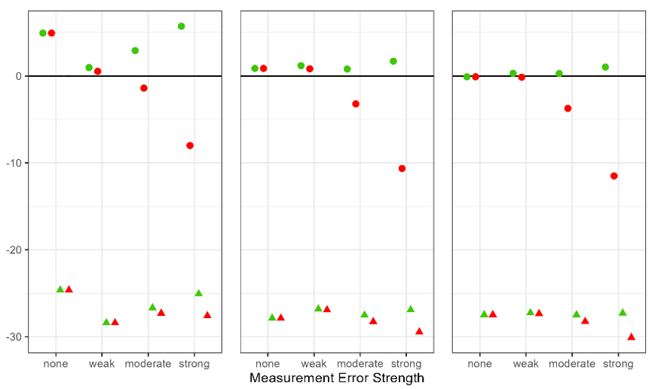






Errors in Stratified Randomization with a Continuous Prognostic Factor and an Ordinal Outcome:
A Simulation Study Motivated by a Prostatectomy Trial
Daniel Jang¹, Kay See Tan²
Amherst College¹, Memorial Sloan Kettering Cancer Center²
Main Objective
Methods
Results
Results
Assess how errors in stratified randomization with a dichotomized prognostic factor affect the performance of the treatment effect estimator under an ordinal outcome
A simulation study was performed using Ordinal Logistic Regression as our model to evaluate the performance of the treatment effect estimator under different degrees of measurement error.
Outcome: Validated categorization² of average postoperative pain: 0-2 (no/mild), 3-4 (moderate), 5+ (severe)
Errors: The distribution of the difference between corrected and per-randomized BMI data approximately matched a Laplace distribution
Stratification: (BMI + error) data were stratified into BMI >= 30 and BMI < 30 groups, then randomized 50/50 to each treatment arm
Performance: Relative Bias, Coverage, Power, and Empirical/Model-Based Standard Errors were used
The simulation results informed which model to interpret
Standard Error: We discovered a counterintuitive result with ordinal logistic regression and measurement error. Both Empirical and Model-Based Standard Error decreased as measurement error on the covariate (BMI) increased. This result was consistent with the clinical data. Previous work has hinted at the non-collapsibility issue with (ordinal) logistic regression³
Motivation
A stratified RCT was conducted to compare deep v.s. moderate neuromuscular blockade (NMB) for reducing average postoperative pain in minimally-invasive prostatectomies. The prognostic factor (BMI) was measured inconsistently, and these values were used for stratified randomization. Later, corrected values were discovered, which makes it unclear which BMI data should be used for the statistical analysis
Existing literature doesn’t cover our scenario, which means that we need to do all this work for us to be sure.
Table 2: Treatment Effect Estimates with Different BMI Variable Types
$$n=120$$
$$n=400$$
Conclusion
Clinical Trials that use stratified randomization on dichotomized factors should report models with continuous covariates and provide both unadjusted and adjusted analyses for transparency. Furthermore, the reduction of standard errors when using the per-randomized data is not indicative of an issue with the corrected data
Following this advice, our data showed that patients who received Deep NMB had 1.5 (95% CI: 0.79, 2.90) to 1.6 (95% CI: 0.83, 3.11) the odds of lower categories of postoperative pain compared to moderate NMB
Strong Covariate Effect
Consort Diagram
Figure 1: Simulation SE Ratios with Corrected and Continuous BMI as a baseline
$$n=120$$
$$n=400$$
$$n=1000$$
References
Strong Covariate Effect
1. Kahan, B. C., & Morris, T. P. (2012). Improper analysis of trials randomised using stratified blocks or minimisation. Stat in med, 31(4), 328–340. https://doi.org/10.1002/sim.4431
2. Gerbershagen, H. J., et al. (2011). Determination of moderate-to-severe postoperative pain on the numeric rating scale: a cut-off point analysis applying four different methods. Br J Anaesth.,107(4), 619–626.
3. Robinson, L. D., & Jewell, N. P. (1991). Some Surprising Results about Covariate Adjustment in Logistic Regression Models. Int Stat Rev., 59(2), 227–240. https://doi.org/10.2307/1403444
Table 1: All Simulation Settings for the Simulation Study loosely based on trial data
Results
Figure 2: Relative Bias with varying measurement error and dichotomization
Relative Bias, Coverage Rate, Power: With larger sample sizes, the relative bias increased, and the coverage rate and power decreased as measurement error and the covariate effect increased. Smaller sample results were inconclusive (MCSE)
GitHub QR Code for more details
Acknowledgements
Table 1: Consort Diagram and Four types of BMI data to be used in Statistical Analysis
QSURE is funded by NCI (R25 CA214255) and MSK Society.
Special thanks to Dr. Margaret Du, Dr. Colin Begg, and Richard Koppenaal for making this project possible

