Slide 1

When Stratified Randomization goes wrong: Analyzing postoperative pain with deep neuromuscular blockade in robot-assisted prostatectomies
Daniel Jang
Amherst College
Mentor: Dr. Kay See Tan
Dept of Epidemiology and Biostatistics
Aug 7, 2025
Notes:
Hi everyone, my name is Daniel Jang. I am a rising senior at Amherst college, and this summer, I worked on a project analyzing _________ where stratified randomization went wrong.

Slide 2
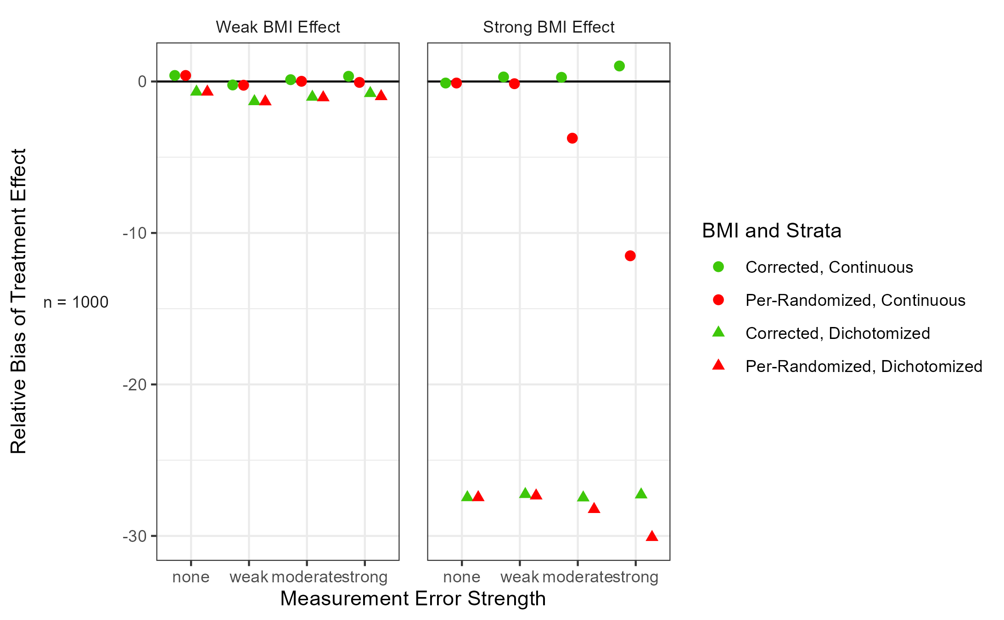

We addressed a specific issue in stratified randomization errors in the context of ordinal logistic regression for an MSK clinical trial
Clinical Trial Design
1
2
MSK: Deep v.s. Moderate Neuromuscular Blockade Trial
3
What were the issues?
How did we address them so that we can present the results of the trial?
4
Notes:
In this presentation, I will discuss how we addressed a specific issue in stratified randomization…
First, second (CLICK), third, fourth (CLICK)

Slide 3
Stratified randomization is often used in clinical trials to balance treatment arms based on influential characteristic(s)
Randomization
Strata
☺☺☺
Control Arm
Participants
☺☺☺☺☺☺
Control Arm
☺☺☺☺☺
☺☺☺☺☺☺☺☺☺☺
☺☺☺
Treatment Arm
☺☺
Treatment Arm
☺☺☺☺
Control Arm
☺☺☺☺☺
☺☺
Treatment Arm
Stratified Randomization balances treatment arms:
imagine if we randomize without stratifying?
☹☹☹☹☹
Control
If there is a significant difference between the arms, how would we know if it’s because of the treatment or by the green factor?
☹☹☹☹☹
Treatment
Notes:
Green and blue represent different characteristics that are influential on the outcome we are interested in for the clinical trial
The control arm, aka the standard of care, and the new experimental treatment
Imagine if we randomize without stratifying? We get treatment imbalance

Slide 4
Deep neuromuscular blockade (NMB) has been associated with lower postoperative pain in minimally invasive surgeries
Standard of care
New Treatment
Moderate NMB
Light Sleep
(n = 67)
Deep NMB
Deep Sleep
(n = 63)
Special interest in minimally invasive robot-assisted surgeries (such as prostatectomies)
Median Age: 63
man going into surgery anesthesia - Search Images
Notes:
START: With that background, let me introduce you to the clinical trial that motivated this project.
Patients were randomized to the standard of care and new treatment: for patients who underwent this type of surgery

Slide 5
MSK conducted a clinical trial comparing moderate and deep NMB, but errors in stratified randomization with BMI occurred
Patients’ BMI recorded at multiple timepoints
BMI can have an impact on our outcome: postoperative pain
Will use as a covariate in analysis*
Inconsistent timepoints used for stratification
Per-Randomized covariate with so-called “measurement error”
Discovered consistent timepoint after surgeries
Corrected covariate
*Kahan, B. C., & Morris, T. P. (2012). Improper analysis of trials randomised using stratified blocks or minimisation. Statistics in medicine, 31(4), 328–340. https://doi.org/10.1002/sim.4431
Notes:
[title]. Recall the stratified randomization I talked about. In this clinical trial, we stratified by BMI, as BMI can have an impact on our outcome of postoperative pain. However, since BMI is a continuous value, we define a cutoff value of 30 to create the strata. Group 1 is below 30 and group 2 is equal to or above 30.
Patients BMI were recorded at multiple timepoints, from one month to 24 hours before surgery. Since cancer patients can quickly change in weight, even in a one month span, this can result in problems when it comes to dichotomization for stratification. When stratified randomization happened for this trial, this inconsistency was not known. This data will be referred to as the per-randomized covariate with measurement error.
After surgeries, this inconsistency was discovered and corrected, hence the corrected covariate.

Slide 6
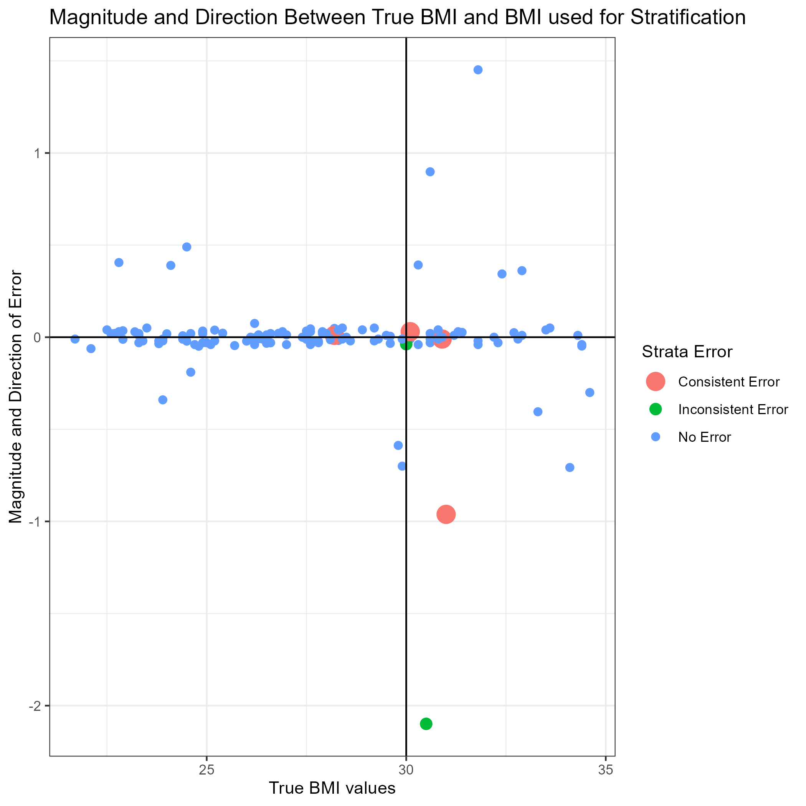
MSK conducted a clinical trial comparing moderate and deep NMB, but errors in stratified randomization with BMI occurred
Most patients have very little measurement error
Magnitude and Direction of Error
Corrected Data: ~31
Per-Randomized Data: <30
Different Strata!
True BMI Values
Notes:
The x axis represents the corrected values discovered after surgeries and the y axis represents the magnitude and direction of the difference between these corrected values and the per-randomized values.
The vertical line at 30 represents the cutoff point between our strata. The red and green dots represent stratification that changes when switching which values for BMI we use

Slide 7
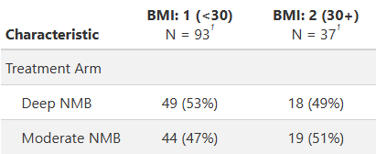
MSK conducted a clinical trial comparing moderate and deep NMB, but errors in stratified randomization with BMI occurred
Dichotomization for Stratified Randomization done with Per-Randomized Values
When using corrected BMI values, we see treatment imbalance between the two arms, i.e., not ~50% balance
Per-Randomized covariate for an Unadjusted Analysis
Corrected covariate for an Adjusted Analysis
Should we dichotomize the covariate like we did for stratified randomization in analysis?
Notes:
Treatment imbalance…
We’re now left with a few questions: do we use the per-randomized covariate for an unadjusted analysis or …
Additionally, should we dichotomize this variable like we did for stratified randomization?
These questions formed the basis and motivation behind the bulk of the project via a simulation study

Slide 8
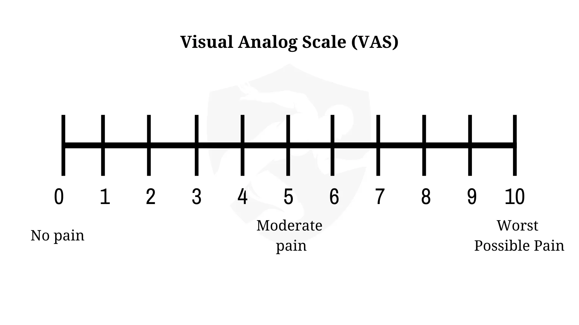
There are multiple ways to model average postoperative pain
Average Postoperative Pain ~ Treatment Arm + BMI
Quantify this relationship via a regression model
Summarize multiple timepoints via mean of Area Under the Curve (AUC)
https://brookbushinstitute.com/_next/image?url=https%3A%2F%2Fcdn.sanity.io%2Fimages%2Fobhirpvy%2Fproduction%2F30ec90740dfe84198a5924d298281ae8c011f3f4-1920x1080.png&w=3840&q=75
AUC mean described in Supplemental 7
Notes:
Before we discuss which BMI value to use as a covariate, we first need to find a suitable model for our data.
I’m sure we’ve seen this scale at a doctor’s office before. This is a version of a numeric rating scale (NRS) called a visual analog scale. After surgery, patients were asked to rate their pain on a scale from 0-10 at 15 to 30 minute time intervals up to 6 hours after surgery.
To get a value for the average postoperative pain, we used the mean of the area under the curve.

Slide 9
There are multiple ways to model average postoperative pain
Average Postoperative Pain ~ Treatment Arm + BMI
Quantify this relationship via a regression model
Continuous
(Linear)
Binary
(Logistic)
Count
(Poisson)
Categorical
(Ordinal Logistic)
Pain can be any real number
No Pain (0)
Yes Pain (else)
0,1,2,…,10
No/Mild Pain
Moderate Pain
Severe Pain
Notes:
Cut time here.
We can treat pain as a continuous value with a linear model, binary value with a logistic model, count value with a poisson or negative binomial model, and the version we ended up choosing: categorical, ordinal

Slide 10
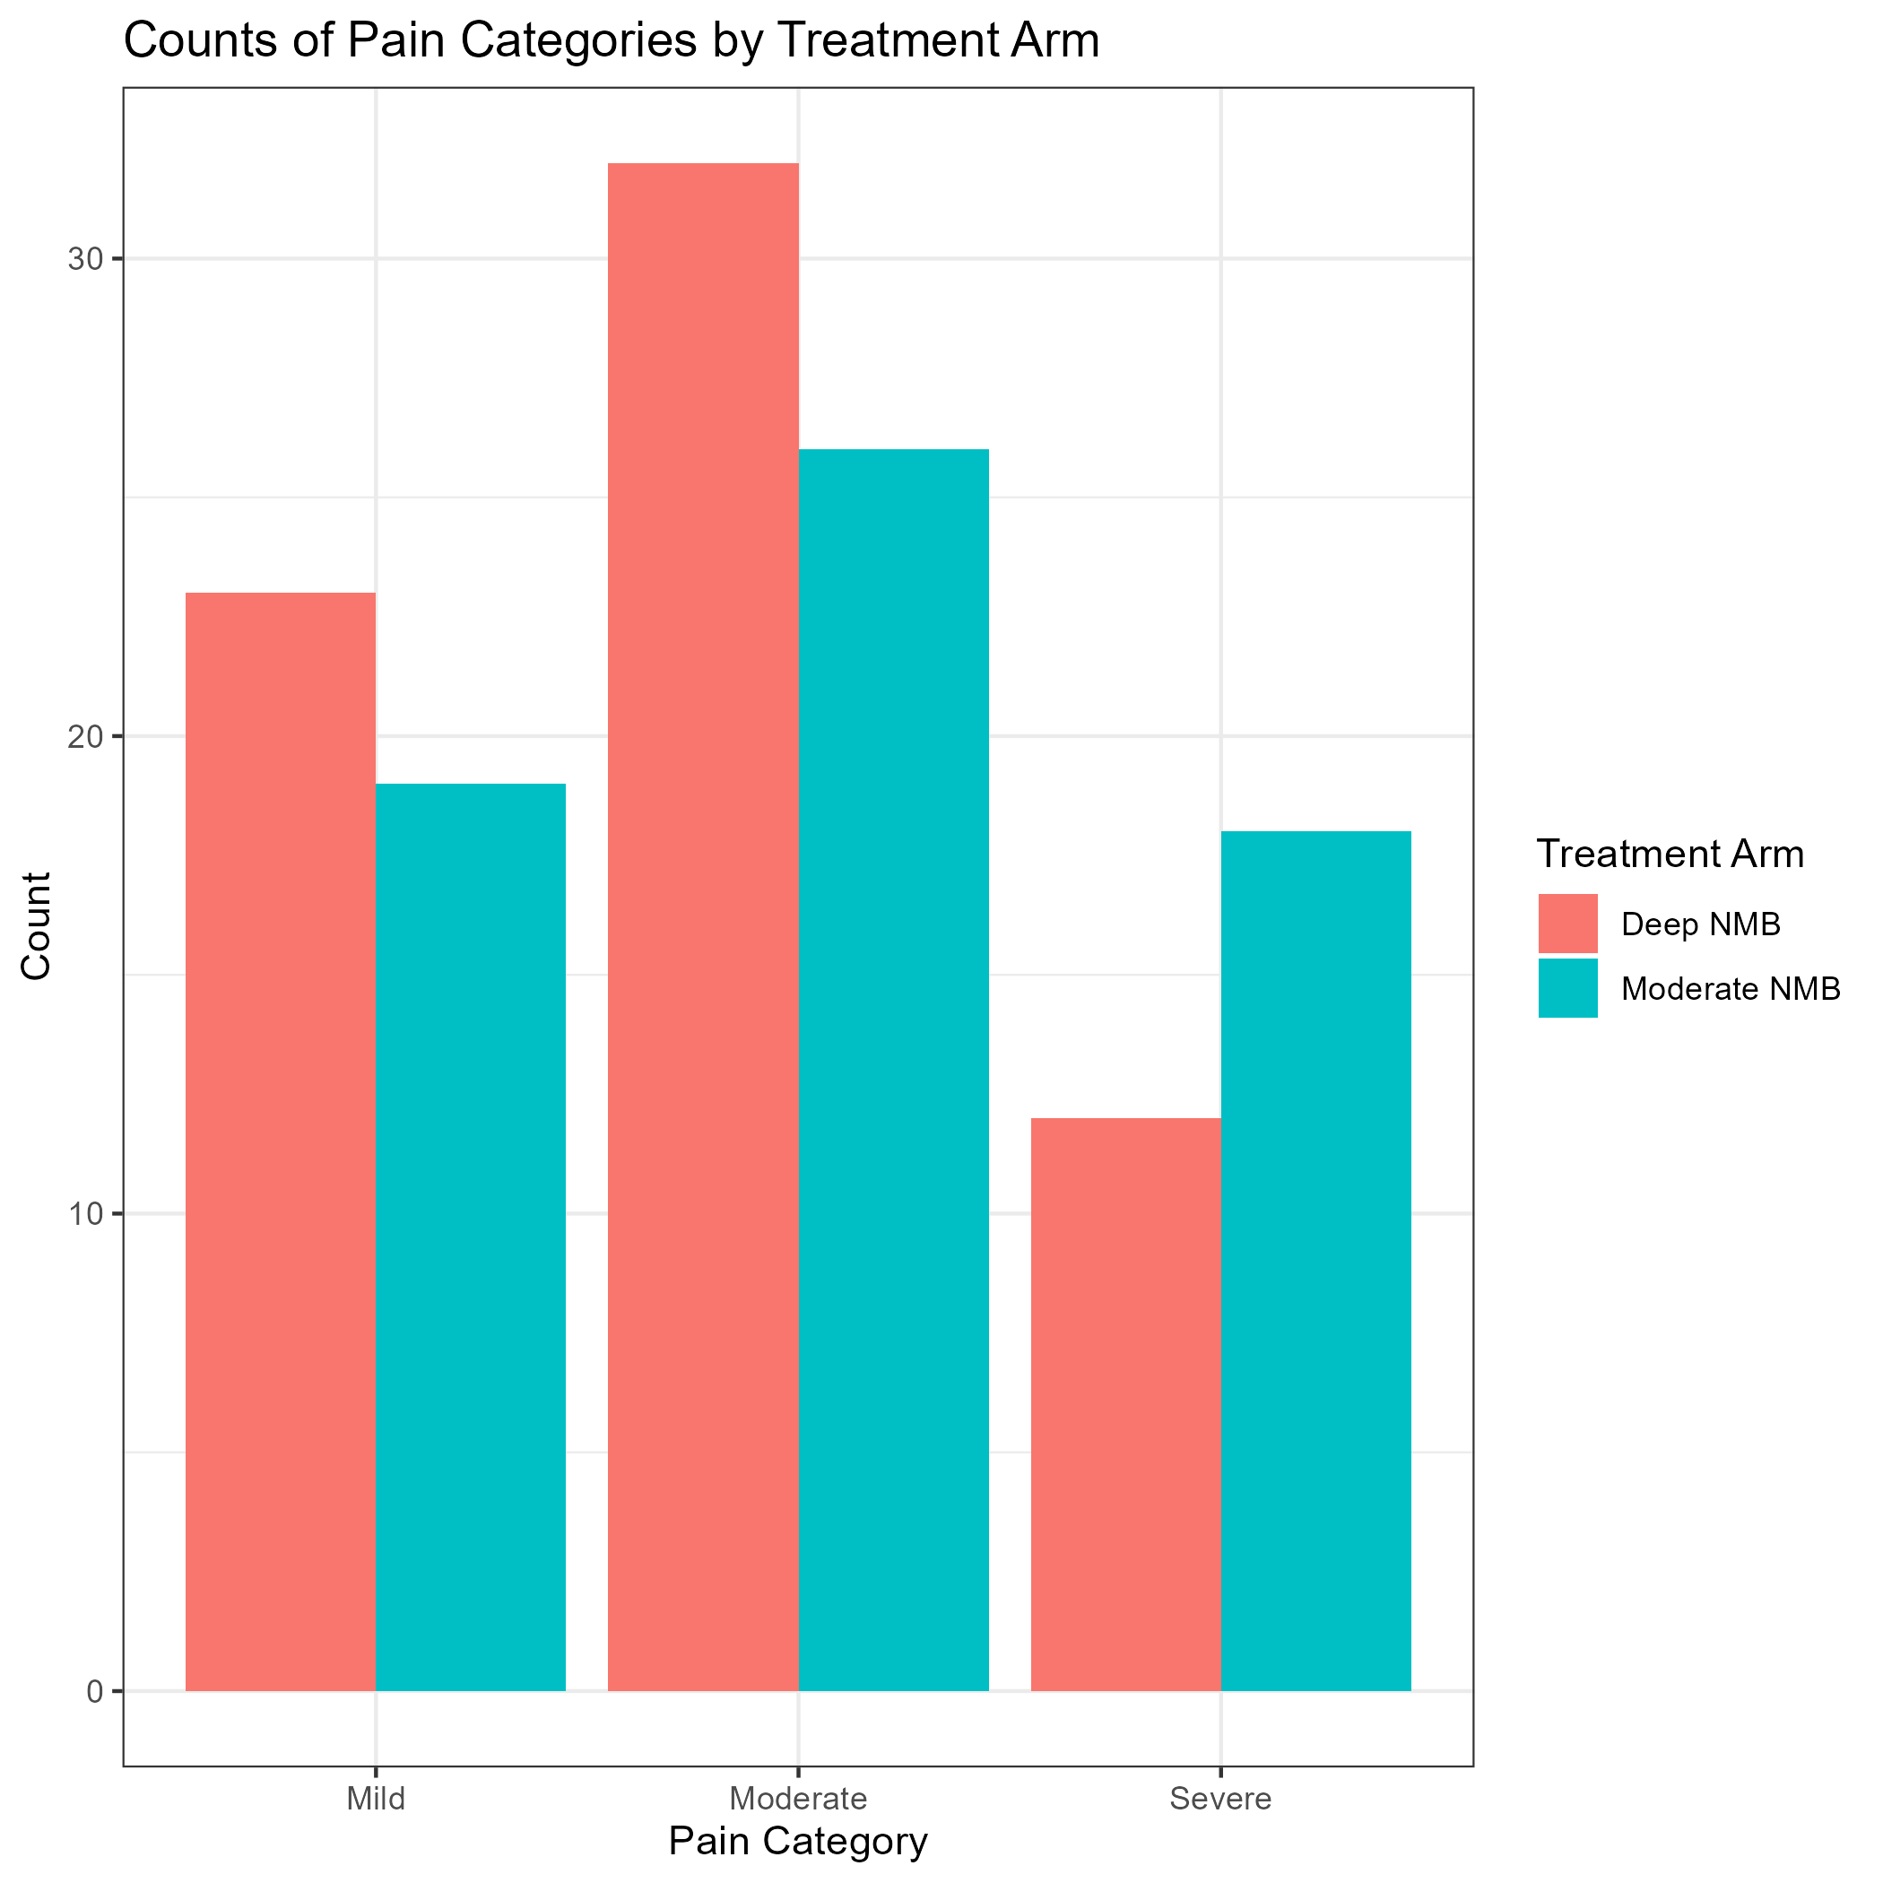
Ordinal logistic regression is a valid statistical model for average postoperative pain data under certain assumptions
Pain Category Validated* | Average Post-Operative Pain (on 0-10 scale based on NRS)
No/Mild Pain | 0-2
Moderate Pain | 3-4
Severe Pain | 5+
1. Categorization must make sense
2. Categories must be ordered
3. Model must pass Proportional Odds Assumption
Satisfied (Brant test)
* Gerbershagen, H. J., Rothaug, J., Kalkman, C. J., & Meissner, W. (2011). Determination of moderate-to-severe postoperative pain on the numeric rating scale: a cut-off point analysis applying four different methods. British journal of anaesthesia, 107(4), 619–626. https://doi.org/10.1093/bja/aer195
Supplemental 2 describes the ordinal logistic regression model as an extension from the binary logistic regression model
Notes:
Now we have all the components we need to start understanding our errors
GO INTO THE FIGURE !!!!: The red represents the deep NMB and blue represents moderate. The x axis represents the pain categories, from left to right we have no/mild, moderate, and severe. As you can see, deep NMB is more right skewed.

Slide 11
We performed a simulation study to better understand the effect of stratified randomization error in the trial
Strength of Treatment Effect
(Strong)
Strength of BMI Effect to outcome
(Weak)
Sample Size
(n = 120)
Strength of Measurement Error on BMI
(Weak)
Initial Parameters for Simulation Study
We varied each these parameters to give us a wide range of potential scenarios (72)
8000 iterations for each of the 72 scenarios
Supplemental 1 has the Data Generating Mechanism for the simulation study listed out
Supplemental 4 has the 72 scenarios listed out

Slide 12
Ordinal logistic regression is sensitive to errors in stratified randomization when true covariate strength is strong
Results: Simulation Study (Relative Bias)
Small effect size
Relative Bias of 5% is already concerning
Shape and colors
Sample size of 1000 to reduce simulation noise
X axis: Degree of measurement error
Notes:
Two shapes to represent continuous or dichotomized. The circle is continuous, like smooth, while the triangle is dichotomized, since we have that cutoff. Next, apologies to the red-green colorblind people in the audience, but we label green with the corrected covariate and red with the per-randomized covariate.
The x axis represents the degree of measurement error on BMI, from none to strong. For each of these strengths, you can see the BMI and strata categories from left to right. These will remain consistent throughout the next few figures
On the Y axis, we have the relative bias of the treatment effect
Weak BMI did not exhibit significant drop-offs in the bias for the treatment effect estimate, but if we consider a strong BMI effect on the outcome, there is a different story.

Slide 13
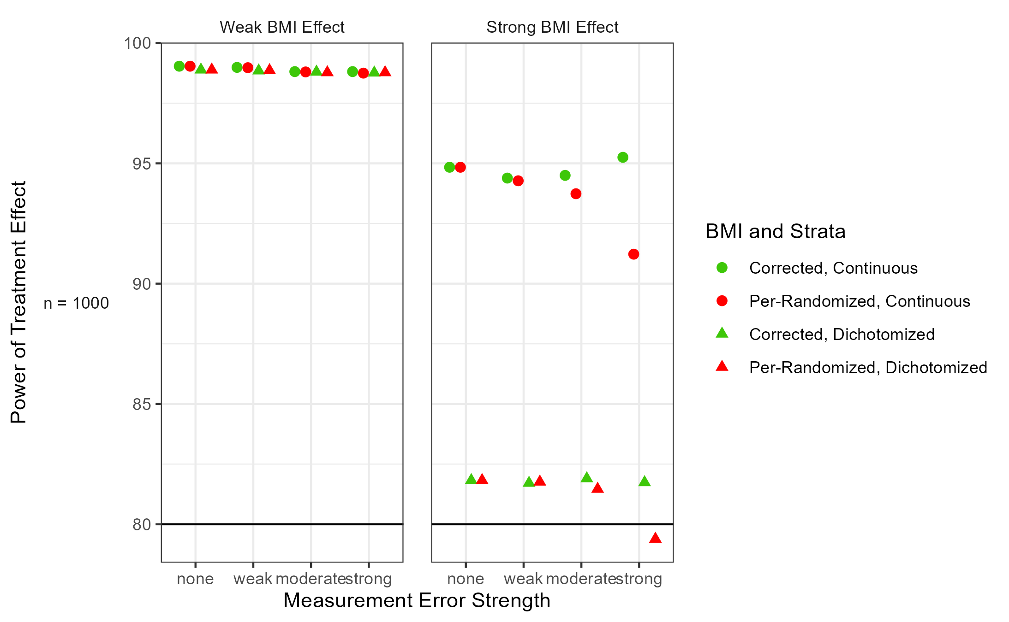
Ordinal logistic regression is sensitive to errors in stratified randomization when true covariate strength is strong
Results: Simulation Study (Power)
Little change
Gap between dichotomization is concerning
Power of 80% is a standard goal
Results for coverage are in Supplemental 5
Notes:
Next, we looked at power. We can see little change happened with weak BMI, but with strong BMI, it’s a different story

Slide 14
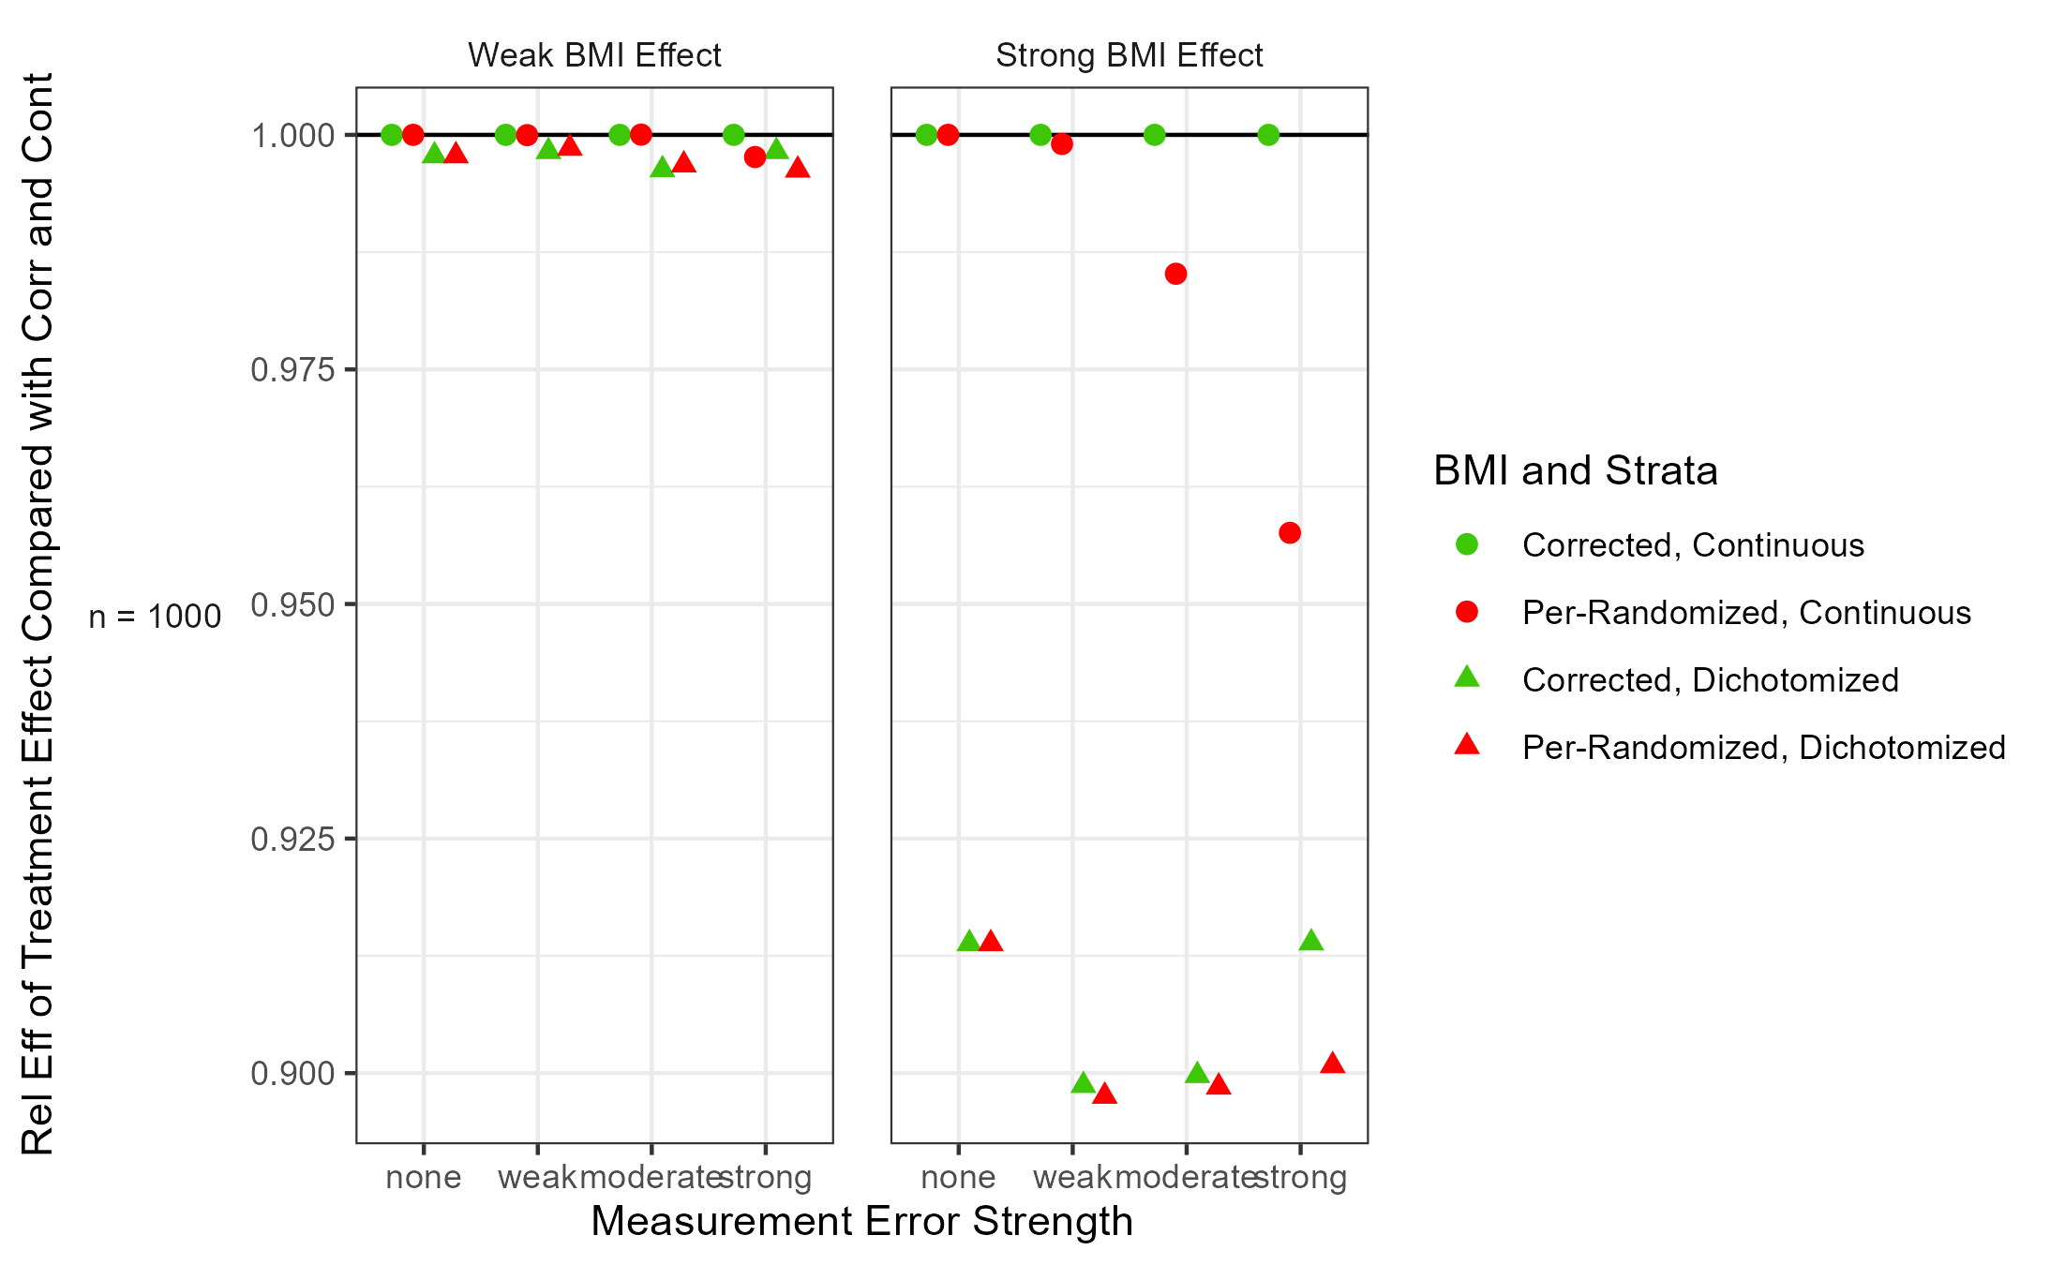
Ordinal logistic regression provides a surprising result when it comes to the precision of our treatment effect estimate
Results: Simulation Study (Relative Efficiency)
Greater than 1: ● more efficient
Less than 1: ● less efficient
Shouldn’t using “noisier” or “less informative” values for BMI make our treatment effect estimates less efficient?
Turns out, probably not for (ordinal) logistic regression
Similar proof by Robinson and Jewell*
*: Robinson, L. D., & Jewell, N. P. (1991). Some Surprising Results about Covariate Adjustment in Logistic Regression Models. International Statistical Review / Revue Internationale de Statistique, 59(2), 227–240. https://doi.org/10.2307/1403444
Notes:
A drop in standard error by using corrected and continuous in an adjusted analysis isn’t a red flag for model selection
SKIP UNLESS ASKED: Ordinal logistic regression is part of a family of models called generalized linear models. We use the logit link function, which due to its geometry, makes the model noncollapsible, i.e. even nonconfounding variables that have a relationship with the outcome must be included to avoid biasing the effect you’re interested in. However, when adjusting for these variables, the efficiency of the effect you’re interested in drops.
In our case, when we adjust for less informative covariates or less correct covariates compared to the correct covariates, this same phenomena happens. To our knowledge, this isn’t well-documented

Slide 15
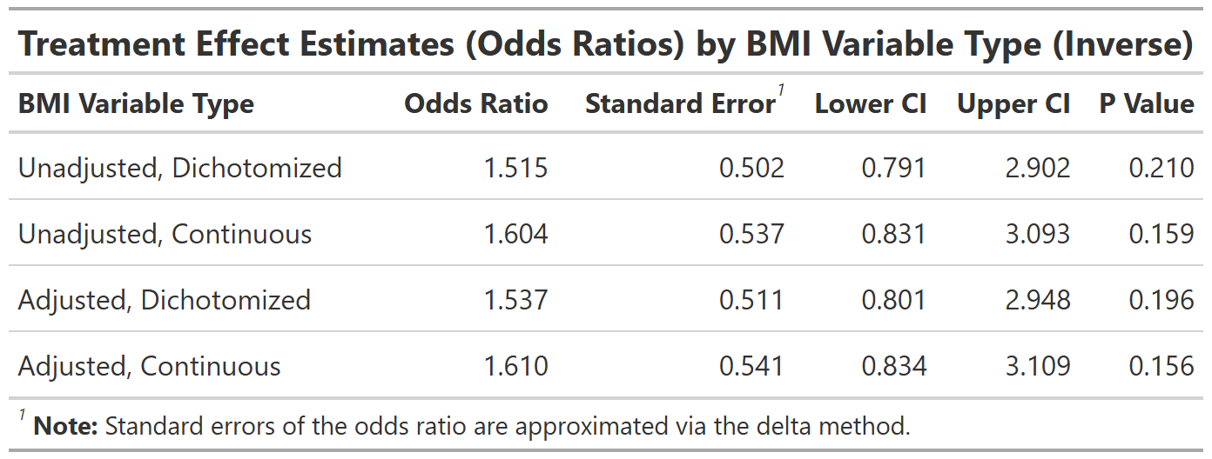
On average, the odds of patients under deep NMB being in lower post-op pain is 1.6 times that of patients under moderate NMB
Results: From Clinical Data
Strict def of “analyze as randomized”
Best performing from simulations
In our case, report fourth line as sensitivity analysis and transparency of errors made in stratified randomization
There is clinical significance! If you had to get a prostatectomy, which NMB would you take?
Supplemental 8: In case you’re curious about the BMI Effect, although not what we’re interested in
Notes:
In our interpretation, we chose the treatment effect of the model that used the corrected and continuous value of BMI, which performed best from our simulations.
However, some people would argue that we should “analyze as randomized”, i.e. we should use the dichotomized values used for randomization. Our simulations indicate that having a weak BMI effect and small amounts of errors doesn’t change the estimates drastically. We are essentially penalizing for the errors made in the trial by having a smaller (i.e. conservative) treatment effect estimate.
We report both the adjusted and continuous analysis and unadjusted and dichotomized analysis for sensitivity analysis and for transparency of errors made in stratified randomization in the trial.
In either case, there is clinical significance!

Slide 16
Limitations and Future Directions
Did not directly address treatment imbalance
Results may not generalize to other regression models (i.e. Cox Proportional Hazards)
Limitations
Main Future Direction
Extension project motivated by counterintuitive relative efficiency result: looking at bias-variance tradeoff for popular noncollapsible models in health research with measurement error on a non-confounding covariate
Supplemental 3 has a conjecture for the ordinal logistic model (formalized)

Slide 17

Acknowledgements
The QSURE Team
Other
The clinicians / collaborators for the deep v.s. moderate trial
Dr. Kay See Tan
+
QSURE 2025 Interns
(only those who joined me on my walk down Manhattan)
Just kidding you’re all great
Dr. Margaret Du
Richard Koppenaal
Dr. Colin Begg
NCI Grant: R25 CA214255 and MSK Society

Slide 18
References
1. Kahan, B. C., & Morris, T. P. (2012). Improper analysis of trials randomised using stratified blocks or minimisation. Statistics in medicine, 31(4), 328–340. https://doi.org/10.1002/sim.4431
2. Gerbershagen, H. J., Rothaug, J., Kalkman, C. J., & Meissner, W. (2011). Determination of moderate-to-severe postoperative pain on the numeric rating scale: a cut-off point analysis applying four different methods. British journal of anaesthesia, 107(4), 619–626. https://doi.org/10.1093/bja/aer195
3. Robinson, L. D., & Jewell, N. P. (1991). Some Surprising Results about Covariate Adjustment in Logistic Regression Models. International Statistical Review / Revue Internationale de Statistique, 59(2), 227–240. https://doi.org/10.2307/1403444

Slide 19
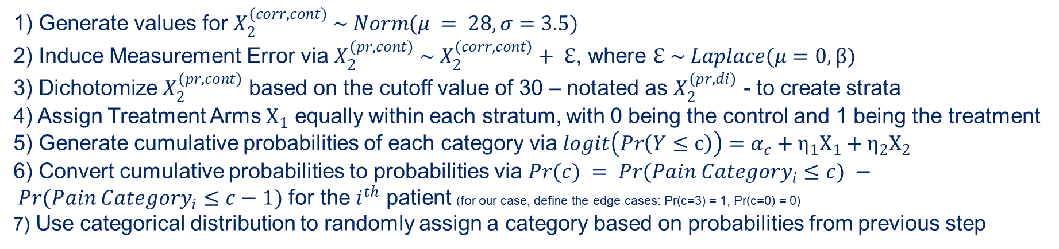
Supplementary 1: Data Generating Mechanism
1) Generate values for $X_{2}^{(corr,cont)} \sim Norm(μ = 28, σ=3.5)$
2) Induce Measurement Error via $X_{2}^{(pr,cont)} \sim X_{2}^{(corr,cont)}+ ℇ$, where $ℇ \sim Laplace(μ=0, β)$
3) Dichotomize $X_{2}^{(pr,cont)}$ based on the cutoff value of 30 – notated as $X_{2}^{(pr,di)}$ - to create strata
4) Assign Treatment Arms $X_{1}$ equally within each stratum, with 0 being the control and 1 being the treatment
5) Generate cumulative probabilities of each category via $logit\left(Pr\left(Y≤c\right)\right)=α_{c}+η_{1}X_{1}+η_{2}X_{2}$
6) Convert cumulative probabilities to probabilities via $Pr(c) = Pr({Pain Category}_{i}≤c) − Pr({Pain Category}_{i}≤c−1)$ for the $i^{th}$ patient (for our case, define the edge cases: Pr(c=3) = 1, Pr(c=0) = 0)
7) Use categorical distribution to randomly assign a category based on probabilities from previous step

Slide 20
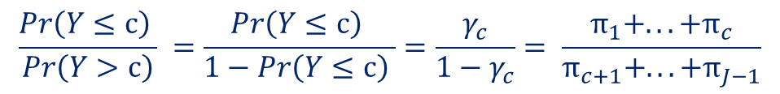
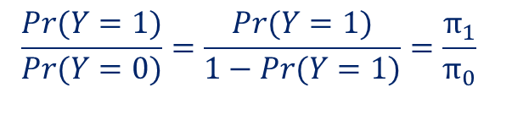
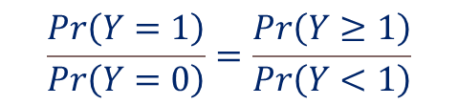
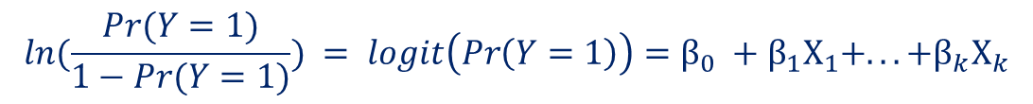
Supplementary 2: Ordinal Logistic Regression Model
Binary Logistic
$$\frac{Pr(Y=1)}{Pr(Y=0)}=\frac{Pr(Y=1)}{1−Pr(Y=1)}=\frac{π_{1}}{π_{0}}$$
$$ln(\frac{Pr(Y=1)}{1−Pr(Y=1)}) = logit\left(Pr\left(Y=1\right)\right)=β_{0} +β_{1}X_{1}+...+β_{k}X_{k}$$
$$\frac{Pr\left(Y=1\right)}{Pr\left(Y=0\right)}=\frac{Pr\left(Y≥1\right)}{Pr\left(Y<1\right)}$$
Ordinal Logistic
$$\frac{Pr\left(Y≤c\right) }{Pr\left(Y>c\right)} =\frac{Pr\left(Y≤c\right) }{1−Pr\left(Y≤c\right) }=\frac{γ_{c}}{1−γ_{c}}= \frac{π_{1}+...+π_{c}}{π_{c+1}+...+π_{J−1}}$$
$$γ_{c}=\frac{exp\left(α_{c}−\left(β_{1}X_{1}+...+β_{k}X_{k}\right)\right)}{1+exp\left(α_{c}−\left(β_{1}X_{1}+...+β_{k}X_{k}\right)\right)}=σ\left(α_{c}−\left(β_{1}X_{1}+...+β_{k}X_{k}\right)\right)$$
$$ln\left(\frac{Pr\left(Y≤c\right) }{1−Pr\left(Y≤c\right) }\right) = logit\left(Pr\left(Y≤c\right)\right)=α_{c}+η_{1}X_{1}+...+η_{k}X_{k}$$

Slide 21
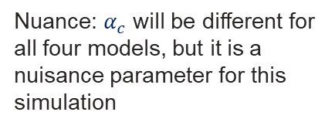
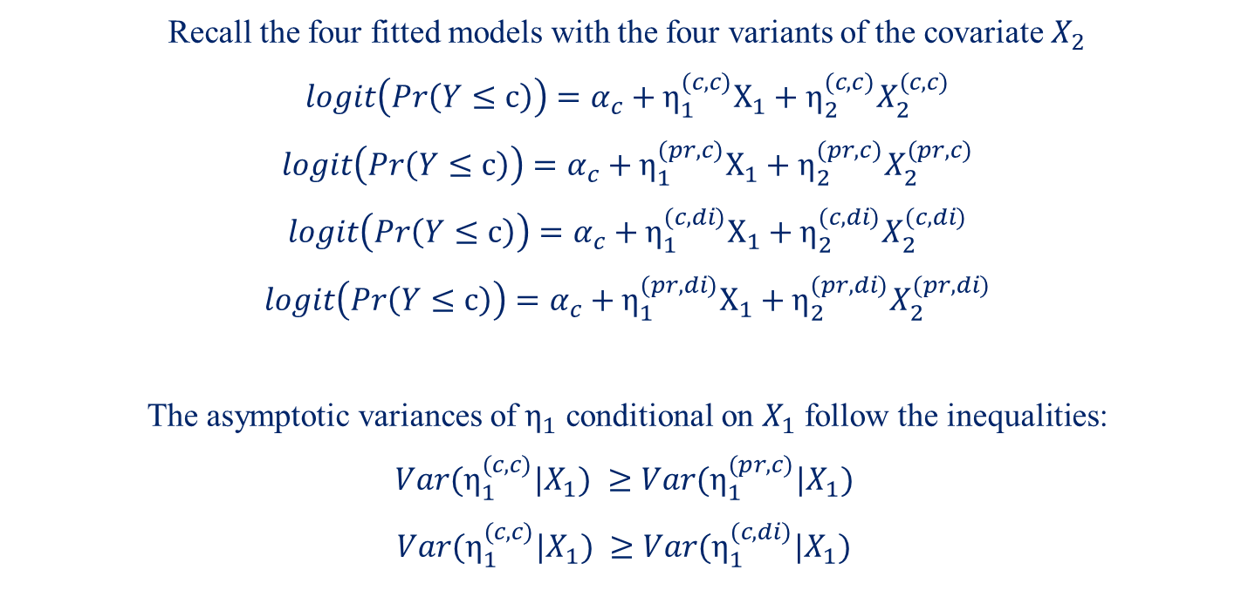
Supplementary 3: Conjecture
Recall the four fitted models with the four variants of the covariate $X_{2}$
$$logit\left(Pr\left(Y≤c\right)\right)=α_{c}+{η_{1}^{(c,c)}X}_{1}+η_{2}^{(c,c)}X_{2}^{(c,c)}$$
$$logit\left(Pr\left(Y≤c\right)\right)=α_{c}+η_{1}^{(pr,c)}X_{1}+η_{2}^{(pr,c)}X_{2}^{(pr,c)}$$
$$logit\left(Pr\left(Y≤c\right)\right)=α_{c}+η_{1}^{(c,di)}X_{1}+η_{2}^{(c,di)}X_{2}^{(c,di)}$$
$$logit\left(Pr\left(Y≤c\right)\right)=α_{c}+η_{1}^{(pr,di)}X_{1}+η_{2}^{(pr,di)}X_{2}^{(pr,di)}$$
The asymptotic variances of $η_{1}$ conditional on $X_{1}$ follow the inequalities:
$$Var(η_{1}^{(c,c)}|X_{1}) ≥Var(η_{1}^{(pr,c)}|X_{1})$$
$$Var(η_{1}^{(c,c)}|X_{1}) ≥Var(η_{1}^{(c,di)}|X_{1})$$
Nuance: $α_{c}$ will be different for all four models, but it is a nuisance parameter for this simulation
i.e. the less informative the covariate, the more precise the treatment effect estimate (says nothing about bias of the estimand)

Slide 22
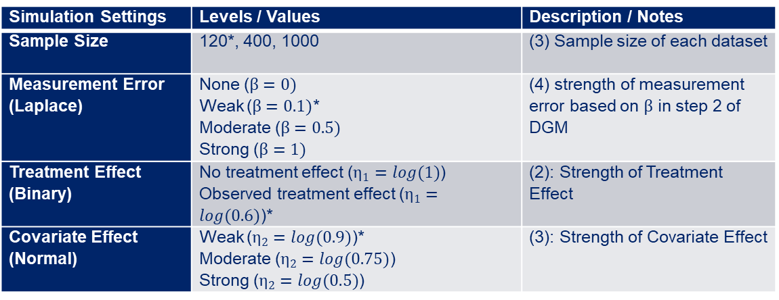
Supplemental 4: Simulation Settings
Simulation Settings | Levels / Values | Description / Notes
Sample Size | 120*, 400, 1000 | (3) Sample size of each dataset
Measurement Error (Laplace) | None ($β=0)$ Weak ($β=0.1)$* Moderate ($β=0.5)$ Strong ($β=1)$ | (4) strength of measurement error based on $β$ in step 2 of DGM
Treatment Effect (Binary) | No treatment effect ($η_{1}=log(1)$) Observed treatment effect ($η_{1}=log(0.6)$)* | (2): Strength of Treatment Effect
Covariate Effect (Normal) | Weak ($η_{2}=log(0.9)$)* Moderate ($η_{2}=log(0.75)$) Strong ($η_{2}=log(0.5)$) | (3): Strength of Covariate Effect

Slide 23
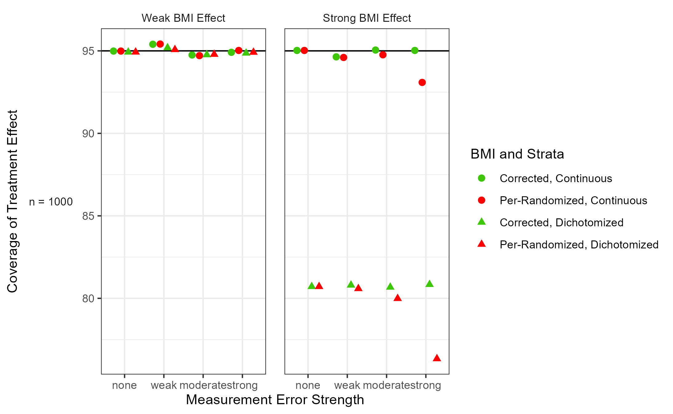
Supplemental 5: Coverage result

Slide 24


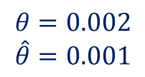
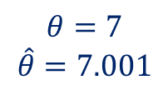
Supplemental 6: What is Relative Bias?
$$θ=7$$
$$\hat{θ}=7.001$$
Bias: -0.001
Rel Bias: -0.014%
$$Bias\left(\hat{θ}\right)=θ−\hat{θ}$$
$$RelBias\left(\hat{θ}\right)=\frac{θ−\hat{θ}}{\hat{θ}}∗100$$
$$θ=0.002$$
$$\hat{θ}=0.001$$
Bias: -0.001
Rel Bias: 100%

Slide 25
Supplemental 7: Mean of Area Under the Curve (AUC)

Slide 26
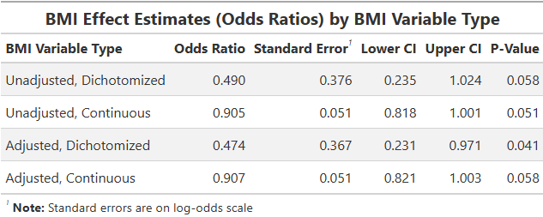
Supplemental 8: BMI Effects

