Slide 1
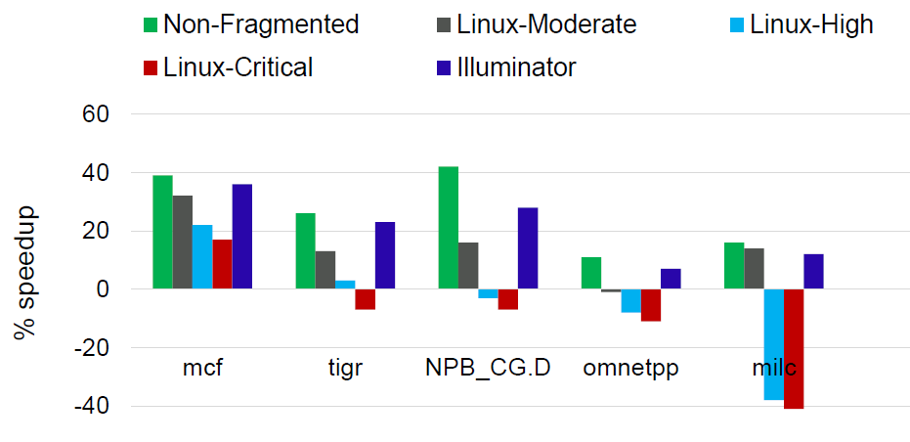
Making Huge Pages Actually Useful
Papers
Ashish Panwar, Aravinda Prasad, and K. Gopinath
The 23rd ACM International Conference on Architectural Support for Programming Languages and Operating Systems (ASPLOS), 2018
Motivation and Solution
TLB miss overheads are expensive
Efficient address translation with huge pages
➔ Map large regions in TLB entries -> Less TLB misses
Challenges
Huge pages are not effective!!
➔ Must be mapped contiguously
➔ Difficult to allocate because of fragmentation as the system ages
➔ Defragmentation(Memory compaction) can become a bottleneck
Not all pages can be moved ➔ Unmovable pages : User space – page tables / Kernel pages
Solution
Illuminator: Manages hybrid pageblocks explicitly
➔ Preventing unnecessary fragmentation
➔ Eliminating LIU(Latency-inducing unsuccessful) migration
Conclusion
Illuminator: A simple solution to make huge pages actually useful!

Slide 2
Hang Doctor: Runtime Detection and Diagnosis of Soft Hangs for Smartphone Apps
Papers
Marco Brocanelli and Xiaorui Wang
The 21st European Conference on Computer Systems (EuroSys), 2018
Motivation and Solution
Smartphones are user-oriented devices
➔ Apps must be responsive to user action
Challenges
Soft hang
➔ Occur when the app’s response time is longer than a user-perceivable delay
Existing solutions
➔ Offline app code examination to fine previously known blocking operations and move them off the main thread
➔ Fail to identify blocking operations that are previously unknown or hidden
Solution
Hang Doctor
➔ Check response time and performance event counters for detecting possible soft hang bugs with small overheads
➔ Performs stack trace analysis when diagnosis is necessary
Conclusion
Hang Doctor has identified 34 new soft hang bugs that are previously unknown to their developers.

