Slide 1
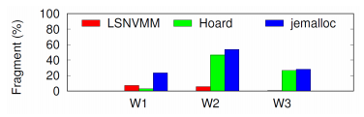
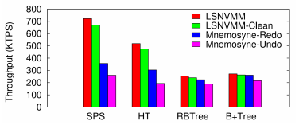
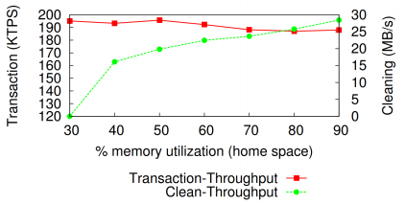
Log-Structured Non-Volatile Main Memory
Papers
Qingda Hu, Jinglei Ren, Anirudh Badam, Jiwu Shu, and Thomas Moscibroda
The USENIX Annual Technical Conference (ATC), 2017
Motivation and Solution
Problem of NVMM
➔ Inefficient use of memory space
Traditional dram allocators incur high memory fragmentation
➔ Inefficient support for crash consistency
Write-twice in long and home
Solution
Log-Structured NVMM
➔ Internal fragmentation: Compact append
➔ External fragmentation: Log cleaning
Tree-Based Address Mapping
➔ Two-layer mapping
➔ Hot tree node cache
Conclusion
Applying the log-structured approach to NVMM can largely reduce
memory fragmentation and improve system performance.

Slide 2
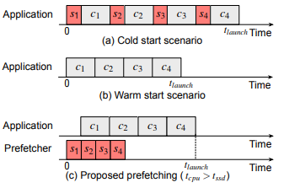
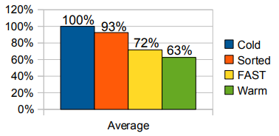
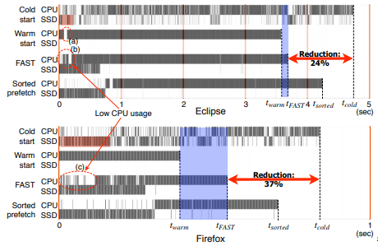
FAST: Quick Application Launch on Solid-State Drives
Papers
Yongsoo Joo, Junhee Ryu, Sangsoo Park, and Kang G. Shin
The 9th USENIX Conference on File and Storage Technologies (FAST), 2011
Motivation and Solution
Needs increase for launch optimization on SSDs
➔ Applications are getting heavier
➔ Traditional HDD optimizer does not work for SSDs
Challenges
Cold start
➔ The worst-case application launch performance
Warm start
➔ All the code blocks necessary for launch have been found in the page cache
Solution
FAST: Fast Application STarter
➔ Overlap CPU computation with SSD accesses
Prefetcher
➔ LBA-to-inode mapping
Conclusion
FAST achieved a 28% reduction on SSDs with no additional overhead.

Slide 3
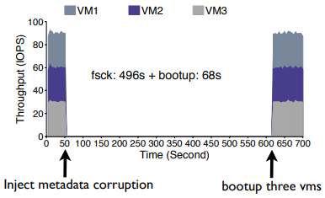
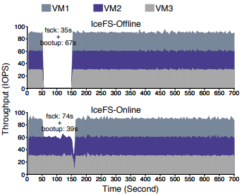
Physical Disentanglement in a Container-Based File System
Papers
Lanyue Lu, Yupu Zhang, Thanh Do, Samer Al-Kiswany, Andrea C. Arpaci-Dusseau, and Remzi H. Arpaci-Dusseau
The 11th USENIX Symposium on Operating Systems Design and Implementation (OSDI), 2014
Motivation and Solution
Isolation is important
File system lack isolation
➔ Physical entanglement in local file systems
Challenges
Three problems due to entanglement
➔ Global failures
➔ Slow recovery
➔ Bundled performance
Solution
IceFS
➔ Propose a data container abstraction: cube
➔ Disentangle data structures and transations
Benefits
➔ localized reaction to faults, fast recovery, and concurrent file system updates
Conclusion
IceFS shows benefits within a Vmware-based virtualized environment and within Hadoop distributed file system.

