Slide 1
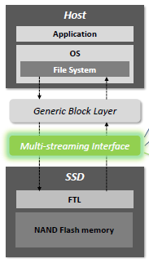
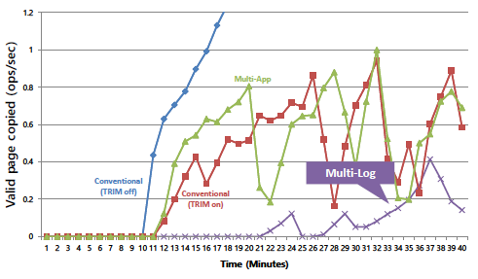
The Multi-streamed Solid-State Drive
Papers
Jeong-Uk Kang, Jeeseok Hyun, Hyunjoo Maeng, and Sangyeun Cho
The 6th USENIX Workshop on Hot Topics in Storage and File Systems (HotStorage), 2014
Motivation and Solution
Garbage Collection(GC) is expensive
NAND flash memory require “erase-before-update”
➔ Valid page copying followed by an erase operation
Has a large impact on SSD lifetime and performance
➔ Reduce memory consumption when duplication exists
Idea: Multi-streamed SSD
Co-exists with the existing block layer
General & concrete interface
Host-provided stream information guides desirable data placement within SSD
Mapping data with different lifetime to different streams
Experience
Cassandra’s GC overhead
System data vs Commit-Log vs Flushed data vs Compaction data
Conclusion
Multi-stream interface can be standard for using SSD more efficiently

