Slide 1
Reducing File System Tail Latencies with Chopper
Papers
Jun He, Duy Nguyen, Andrea C. Arpaci-Dusseau, and Remzi H. Arpaci-Dusseau
The 13th USENIX Conference on File and Storage Technologies (FAST), 2015
Motivation and Solution
Motivation
Important to avoid long latencies at every node in the data center
Important to avoid long latencies in local file systems
Challenges
Find problematic corner cases in file system block allocator
➔ File system input space is huge
Solution
The unexpected behaviors in ext4 can be explained by four design issue
➔ Special End Policy
: Treat non-ending and ending extents equally
➔ Scheduler Dependency
: Choose locations based on inode number, instead of CPU id
Conclusion
Policies for different circumstances should be harmonious with one another
Policies should not depend on environmental factors that may change and are outside the control of the file system

Slide 2
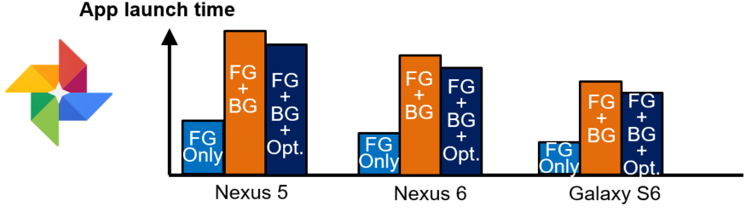
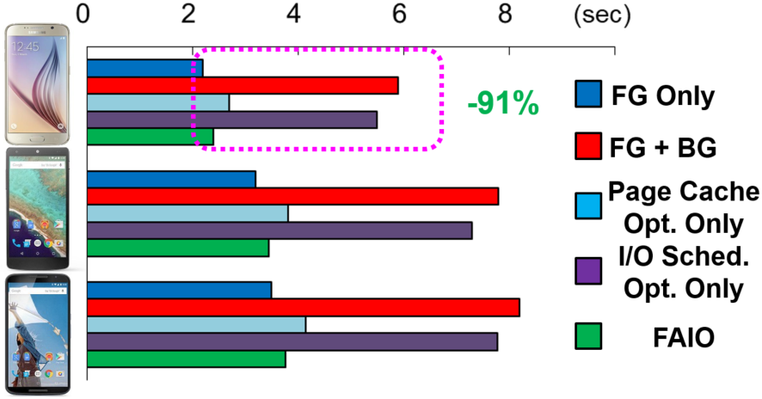
Improving User Experience of Android Smartphones Using Foreground App-Aware I/O Management
Papers
Sangwook Shane Hahn, Sungjin Lee, Inhyuk Yee, Donguk Ryu, and Jihong Kim
The 8th ACM SIGOPS Asia-Pacific Workshop on Systems (APSys), 2017
Motivation and Solution
Motivation
BG I/Os degrade foreground app performance + BG I/Os occur frequently and long-lasting
➔ BG I/Os harm Android user experience
Linux I/O scheduler dispatches block I/O without distinguishing FG I/O from BF I/O
Challenges
I/O scheduler optimization with foreground app information
➔ Detects I/O requests from FG app at Android platform
➔ Gives high priority to FG I/O in I/O scheduler
Page cache does not flush FG I/O and BG I/Os concurrently
➔ Preempt BG process’ operation in page cache when FG process accesses the page cache
Solution
FG app-aware I/O management (FAIO)
➔ Creates a quick I/O path for latency-sensitive FG I/O
by preempting BG I/Os in both page cache & I/O scheduler
Conclusion
FAIO can reduce camera app launch time delay from BG I/O by up to 91%

Slide 3
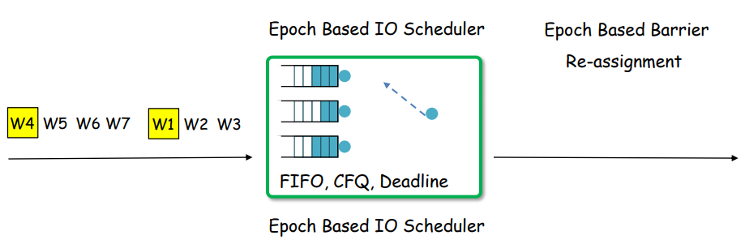
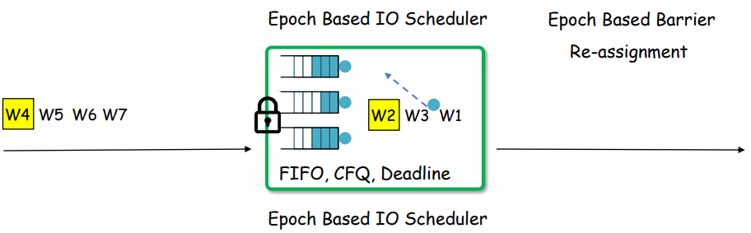
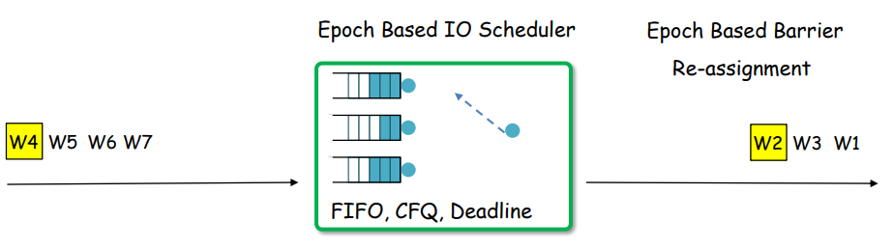
Barrier-Enabled IO Stack for Flash Storage
Papers
Youjip Won, Jaemin Jung, Gyeongyeol Choi, Joontak Oh, Sedongbase Son, Jooyoung Hwang, and Sangyeun Cho
The 16th USENIX Conference on File and Storage Technologies (FAST), 2018
Motivation and Solution
Motivation
Moder IO stack is fundamentally driven by the legacy of rotating media.
Application need to control the storage order.
Challenges
In flash storage, the persist order can be controlled while in HDD, it cannot.
Solution
Barrier-enabled IO stack
➔ New request types
: farrier(), fdatabarrier()
➔ Order Preserving Dispatch
: control storage order without Transfer-and-Flush
➔ Epoch Based IO scheduling
: OP requests between the barriers can be freely scheduled, but they does not cross barrier boundary.
Conclusion
Eliminating the transfer overhead is critical.
Concurrent journaling makes journaling more scalable.
Barrier enabled IO stack gets more effective as the parallelism of the Flash storage increases.

Slide 4
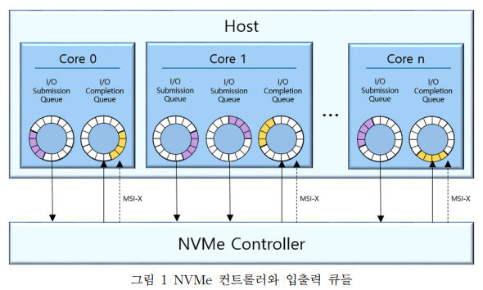
NVMe (Non-Volatile Memory express)
NVMe 규격의 SSD에서는 64K개의 큐를 제공하고 각 큐당 64K개의 명령어를 저장할 수 있어 기존의 논리 장치 인터페이스 규격보다 빠른 속도를 제공
NVMe 드라이버는 각 CPU 코어에 대해서 환형 큐 형태의 SQ와 CQ의 쌍을 관리
SQ(Submission Queue): 입출력 요청 제출
CQ(Completion Queue): 입출력 완료 통지를 받음
여러 개의 코어들은 병렬적으로 입출력 요청들을 제출할 수 있고 그 완료 통지들을 병렬적으로 받을 수 있음
[1] 박종우, 이주현, 서대화, “NVMe SSD에서 쓰기 간섭 현상 완화를 위한 멀티 큐 블록 입출력 기법,” KICS 2017.
[2] 조민정, 강형석, 김강희, “멀티큐 SSD를 위해 멀티코어 확장성을 제공한 입출력 스케줄링,” Journal of KIISE, Vol. 44, No. 5, pp. 469-475, 2017. 5.

Slide 5
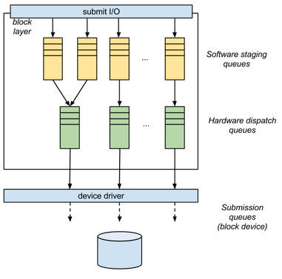
Blcok-mq Layer
NVMe SSD 사용을 위해 Linux에서 제공하는 새로운 Block Layer
파일 시스템에서 생성된 bio request들은 block-my layer의 큐들을 거쳐 NVMe 드라이버의 SQ에 도달
SSQ(Software Staging Queue): 코어마다 하나씩 생성
HDQ(Hardware Dispatch Queue): NVMe 드라이버의 SQ마다 하나씩 생성
1:1 vs 1:N vs N:1
각 코어마다 개별적인 락 (lock)을 가지고 있음
/block/blk-mq.h
[1] 박종우, 이주현, 서대화, “NVMe SSD에서 쓰기 간섭 현상 완화를 위한 멀티 큐 블록 입출력 기법,” KICS 2017.
[2] 조민정, 강형석, 김강희, “멀티큐 SSD를 위해 멀티코어 확장성을 제공한 입출력 스케줄링,” Journal of KIISE, Vol. 44, No. 5, pp. 469-475, 2017. 5.

