Slide 1
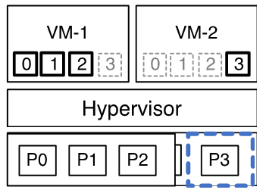



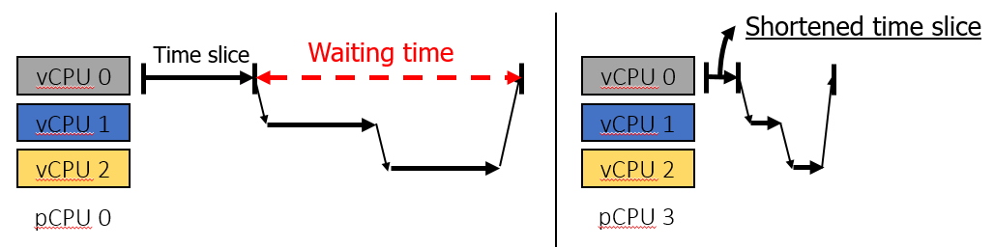
Accelerating Critical OS Services in Virtualized Systems with Flexible Micro-sliced Cores
Papers
Jeongseob Ahn, Taekyung Heo, Chang Hyun Park, Haehyuk Huh
The European Professional Society on Computer Systems (Eurosys), 2018
Motivation and Solution
Motivation
Consolidation improves system utilization
➔ However, resources are contended
The execution of a guest OS is periodically interrupted, while the guest OS may
not be aware of the discontinuity of virtual time against real time
➔ interrupt handing or lock processing
Challenges
Shortening time slice is very simple and powerful
➔ but the overhead of frequent context switches is significant
Solution
Dividing CPUs in to two pools
➔ Normal pool
: serving the main work of applications
➔ Micro-sliced pool
: serving critical OS services to minimize the waiting time
Conclusion
Introduced a new approach to mitigate the virtual time discontinuity problem
Overhead is very low for applications which do not frequently use OS services

Slide 2
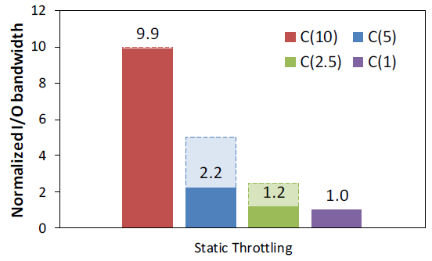
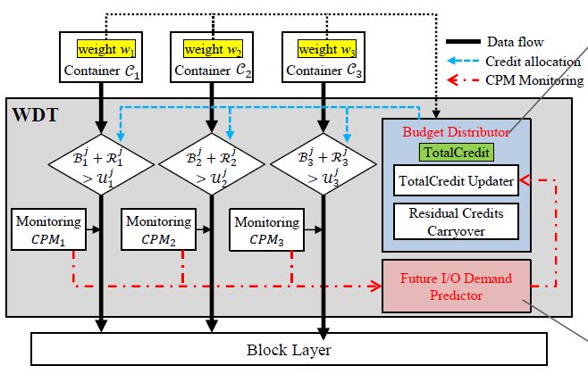
Improving I/O Resource Sharing of Linux Cgroup for NVMe SSDs on Multi-core System
Papers
Sungyoung Ahn, Kwanghyun La, and Jihong Kim
The 8th USENIX Workshop on Hot Topics in Storage and File Systems (HotStorage), 2016
Motivation and Solution
Motivation
For HDDs and SSDs, proportional I/O resource sharing has been supported
Current Cgroup implementation does not adequately support I/O resource sharing for NVMe SSDs
Challenges
First attempt: using the existing static throttling
➔ Static throttling is not enough to support the proportional I/O
➔ I/O workloads fluctuate with time
Solution
WDT(Weighted-based dynamic throttling technique)
➔ Dynamically adjust I/O bandwidth
➔ Future I/O Demand Predictor
Conclusion
Proposed the weight-bsed dynamic throttling scheme to support proportional I/O
sharing for NVMe SSDs
Proposed the per-container locks for scalable performance

Slide 3
Improving Docker Registry Design Based on Production Workload Analysis
Papers
Ali Anwar, Mohamed Mohamed, Vasily Tarasov, Michael Littley, Lukas Rupprecht, Yue Cheng, Nannan Zhao, Dimitrios Skourtis, Amit S. Warke, Heiko Ludwig, Dean Hildebrand, and Ali R. Butt
The 16th USENIX Conference on File and Storage Technologies (FAST), 2018
Motivation and Solution
Motivation
Performance Implications of file systems
Focus on storage virtualization layer
Investigate nested file system’s performance implication
Guest and Host file system dependency
Evaluation
What is the distribution of request types?
What is the manifest size distribution?
What is the layer size distribution?
Is there spatial locality?
Can future requests be predicted?
When on file system (guest) runs on top of another file system (host), their nested interactions can have unexpected and significant performance implications (as much as 67% degradation)
Conclusion
There is a significant opportunity for caching the layers
Strong correlation between requests
➔ GET layers requests can be predicted
➔ opportunity for layer prefetching

