Slide 1
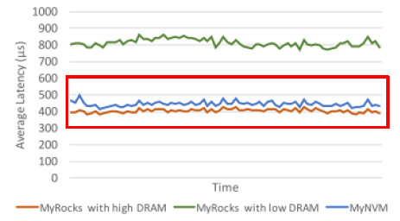
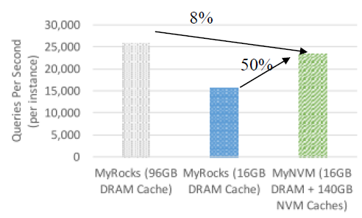
Reducing DRAM Footprint with NVM in Facebook
Papers
Assaf Eisenman, Darryl Gardner, Islam AbdelRahman, Jens Axboe, Siying Dong, Kim Hazelwood, Chris Petersen, Asaf Cidon, and Sachin Katti
The 21st European Conference on Computer Systems (EuroSys), 2018
Motivation and Solution
Motivation
Modern SSD-based key-value stores are highly dependent on DRAM
➔ DRAM is still faster than Flash
DRAM faces major scaling challenges
Challenges
Bandwidth bottleneck
Endurance limitation
Low latency relative to other block devices
Solution
NVM is used as a second level block cache
➔ Reduce block size : only to read top-level index and loaded to memory
➔ Only stores blocks in NVM that are not likely to get quickly evicted
➔ Hybrid polling: the process sleeps for a fixed time threshold after that I/O was issued until it starts polling
Conclusion
MyNVM reduces the size of the DRAM cache from 96GB to 16GB, and incurs a negligible impact on latency and queries-per-second compared to MyRockcs.

Slide 2
Preemptive, Low Latency Datacenter Scheduling via Lightweight Virtualization
Papers
Wei Chen, Jia Rao, and Xiaobo Zhou
The USENIX Annual Technical Conference (ATC), 2017
Motivation and Solution
Motivation
Long jobs help improve hardware utilization while short jobs are important to QoS
Short jobs have higher priority and most preempted(evicted) tasks belong to long jobs
Challenges
Overhead of Kill-based Preemption
➔ MapReduce jobs experience various degrees of slowdowns
➔ Spark jobs suffer from more slowdowns due to frequent inter-task synchronization and the re-computation of failed RDDs
➔ Fail to identify blocking operations that are previously unknown or hidden
Solution
Container-based task preemption
Preemptive fair share scheduler
Conclusion
Big-C maintains short job latency close to reservation-based scheduling while achieving similar long job performance compared to FIFO scheduling

Slide 3
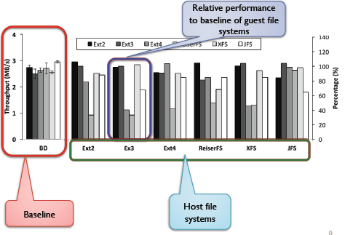
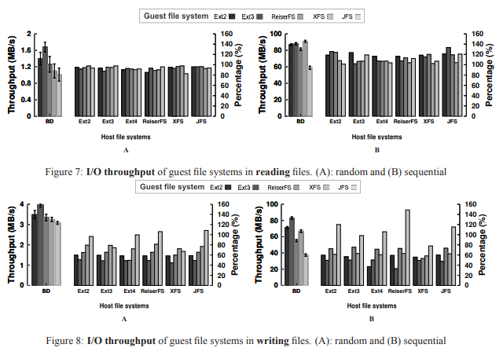
Understanding Performance Implications of Nested File Systems in a Virtualized Environment
Papers
Duy Le, Hai Huang, and Haining Wang
The 10th USENIX Conference on File and Storage Technologies (FAST), 2012
Motivation and Solution
Motivation
Latency is sensitive to nested file systems
Observations
Read dominated workloads
➔ Unaffected performance by nested file systems
Write dominated workloads
➔ Heavily affected performance by nested file systems
Findings and Advice
Read dominated workloads workloads
➔ Minimum impact on I/O throughput
Write dominated workloads
➔ Journaling degrades performance
I/O sensitive workloads
➔ I/O latency increased by 10-30%
Data allocation scheme
➔ Pass-through host file system is even better
Tuning file system parameters

Slide 4
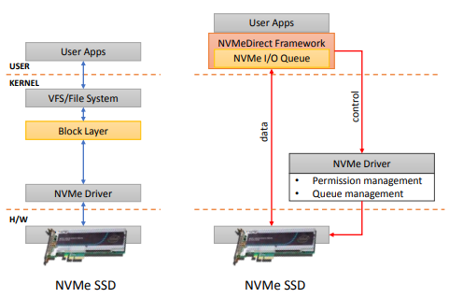
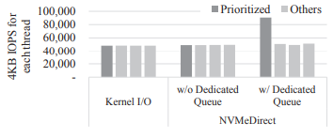
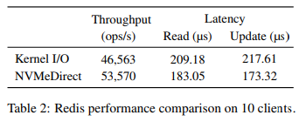
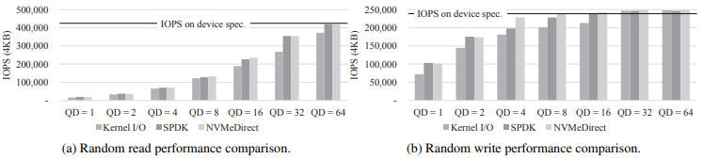
NVMeDirect: A User-space I/O Framework for Application-specific Optimization on NVMe SSDs
Papers
Hyeong-Jun Kim, Young-Sik Lee, and Jin-Soo Kim
The 8th USENIX Workshop on Hot Topics in Storage and File Systems (HotStorage), 2016
Motivation and Solution
Motivation
The complex I/O stack of the kernel impedes utilizing the full performance of NVMe SSD
Challenges
The application-specific optimization is difficult on kernel
➔ should be general to provide an abstraction layer
➔ cannot implement any policy that favors a certain application
➔ requires a constant effort to port application-specific optimizations
Solution
NVMe Direct
➔ Allows user-specific applications to directly access NVMe SSDs without any hardware modifications
➔ Support various I/O policies
Conclusion
NVMe Direct outperforms the kernel-based I/O by up to 30% on microbenchmarks and by up to 15% on Redis
NVMe Direct can provide the differentiated I/O service without any software overhead

Slide 5
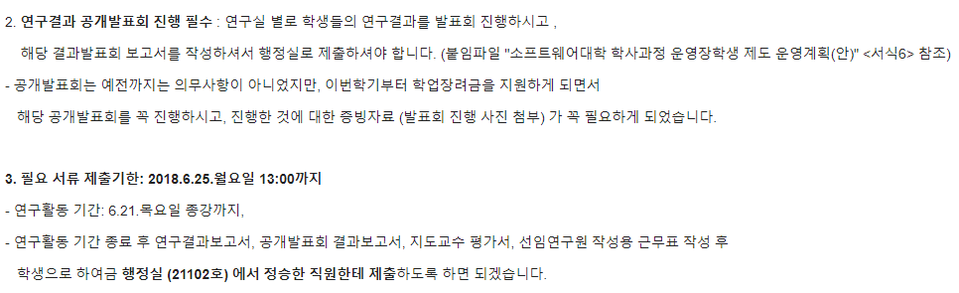
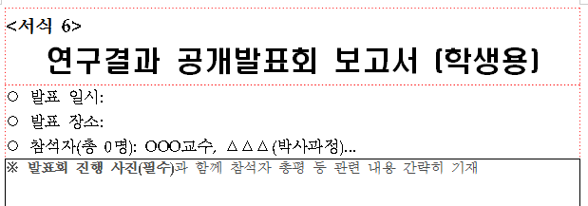
연구결과 공개발표회…

