Slide 1
DynamoDB Global Secondary Index (GSI)
A Global Secondary Index (GSI) is an index with a partition key and an optional sort key that can differ from the base table’s.
It allows querying data using alternate attributes, supporting new access patterns without duplicating tables.

Slide 2
Why Use a GSI?
• Query on non-primary key attributes
• Optimize read performance for specific access patterns
• Avoid full table scans
• Provide flexibility as query requirements change

Slide 3
How GSI Works
• GSI has its own partition and optional sort key schema
• DynamoDB automatically keeps GSI data synchronized with the base table
• Updates are asynchronous (eventually consistent)
• You can project selected attributes into the index for faster queries

Slide 4
Design Considerations
• Choose keys that match high-frequency queries
• Use attribute projection to limit index size
• Each GSI has its own read/write capacity units – It double the cost!
• Monitor GSI activity separately using CloudWatch

Slide 5
Example: GSI in Action
Base Table: 'Orders' (PK: OrderID)
GSI: 'CustomerIndex'
• Partition Key: CustomerID
• Sort Key: OrderDate
Query Example:
Get all orders for CustomerID = 'CUST100' between two dates
→ Query 'CustomerIndex' with CustomerID and OrderDate range

Slide 6
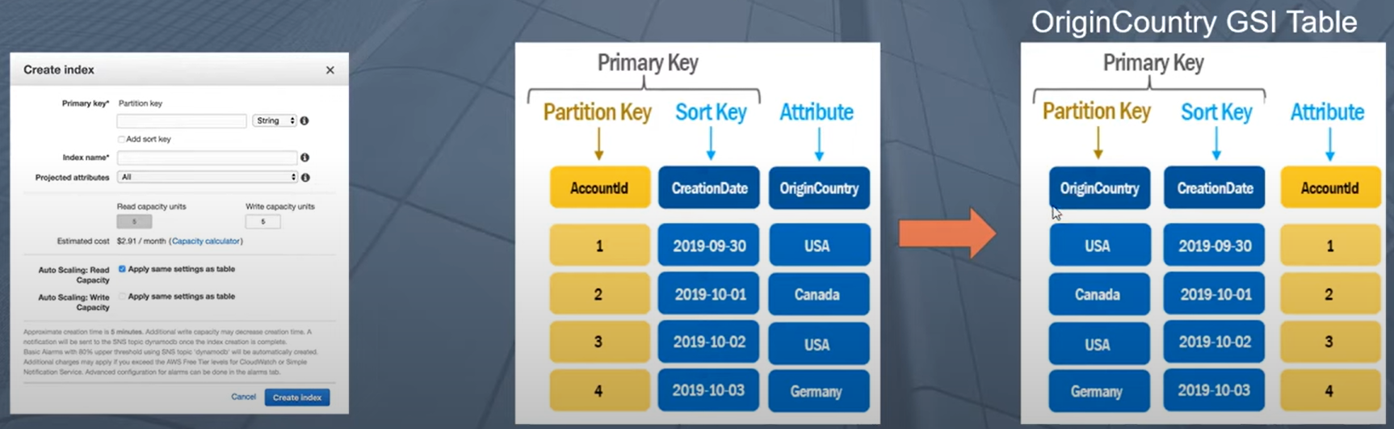
GSI index in Action

