Slide 1

NoSQL Databases
Lecture 1
Overview, differences vs SQL, types, use cases, and a DynamoDB deep dive

Slide 2
Agenda
What is NoSQL?
SQL vs NoSQL at a glance
Core NoSQL data models
When to use (and avoid) NoSQL
Popular databases to know
Amazon DynamoDB deep dive
Best practices & takeaways

Slide 3
What is NoSQL?
Non‑relational, purpose‑built databases for specific data models
Flexible schemas; designed to scale horizontally
Optimized for performance at scale and rapid development

Slide 4
Why NoSQL now?
Modern apps ingest large, diverse, rapidly changing data
Rigid schemas can cause duplication and slow iteration
NoSQL fits semi‑structured/unstructured data and varied access patterns

Slide 5
SQL vs NoSQL — quick comparison
Relational tables + SQL vs flexible models (key‑value, document, graph, wide‑column)
Predefined schema vs dynamic schema
Vertical scaling vs horizontal sharding/partitioning
Strong ACID by default vs selective trade‑offs for scale/availability

Slide 6
Core NoSQL data models
Key‑value
Document (JSON‑like)
Wide‑column (a.k.a. column‑family)
Graph

Slide 7
Key‑value stores — strengths & use cases
Highly partitionable; simple get/put by key
Extreme horizontal scale, very low latency
Use cases: gaming leaderboards, ad tech events, session stores, IoT data

Slide 8
Document databases — strengths & use cases
Store semi‑structured documents (often JSON); each can evolve independently
Natural fit with application objects; flexible indexing & queries
Use cases: catalogs, user profiles, CMS, product content

Slide 9
Wide‑column stores — strengths & use cases
Rows with sparse, dynamic columns grouped into families
Excellent for time‑series and large‑scale write/read workloads
Use cases: telemetry, log analytics, time‑series, recommendation feeds

Slide 10
Graph databases — strengths & use cases
Nodes + edges to model relationships; traversals answer relationship‑heavy queries
Use cases: social networks, fraud detection, recommendations, knowledge graphs

Slide 11
SQL vs NoSQL — schemas & queries
SQL: predefined schema, strong joins, complex queries
NoSQL: dynamic schemas; query models vary by database type
Design starts with access patterns, not just entities

Slide 12
SQL vs NoSQL — scaling
SQL typically scales up; replicas help reads
NoSQL scales out via sharding/partitioning across clusters
Trade‑off: operational simplicity vs distributed design upfront

Slide 13

Where NoSQL shines
Large, rapidly growing datasets with high write/read throughput
Low‑latency user experiences at global scale
Evolving data models requiring fast iteration

Slide 14

When to prefer SQL
Complex multi‑row transactions and joins
Mature analytics with standardized SQL and BI tooling
Strict ACID requirements and strong consistency by default

Slide 15
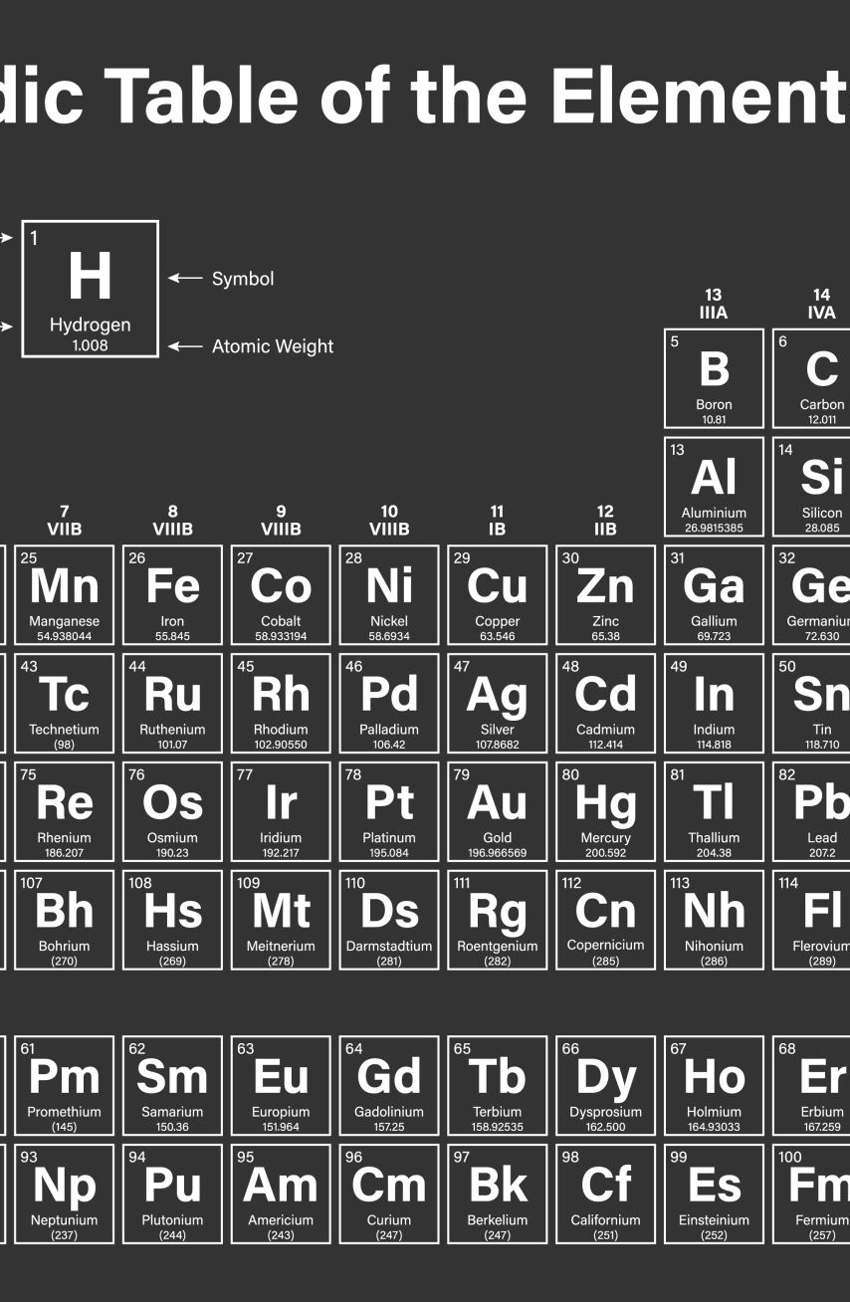
Popular NoSQL databases to know (8)
MongoDB (document)
Cassandra (wide‑column)
Redis (key‑value/in‑memory)
Amazon DynamoDB (key‑value)
HBase (wide‑column)
Google Bigtable (wide‑column)
Neo4j (graph)
CouchDB (document)

Slide 16
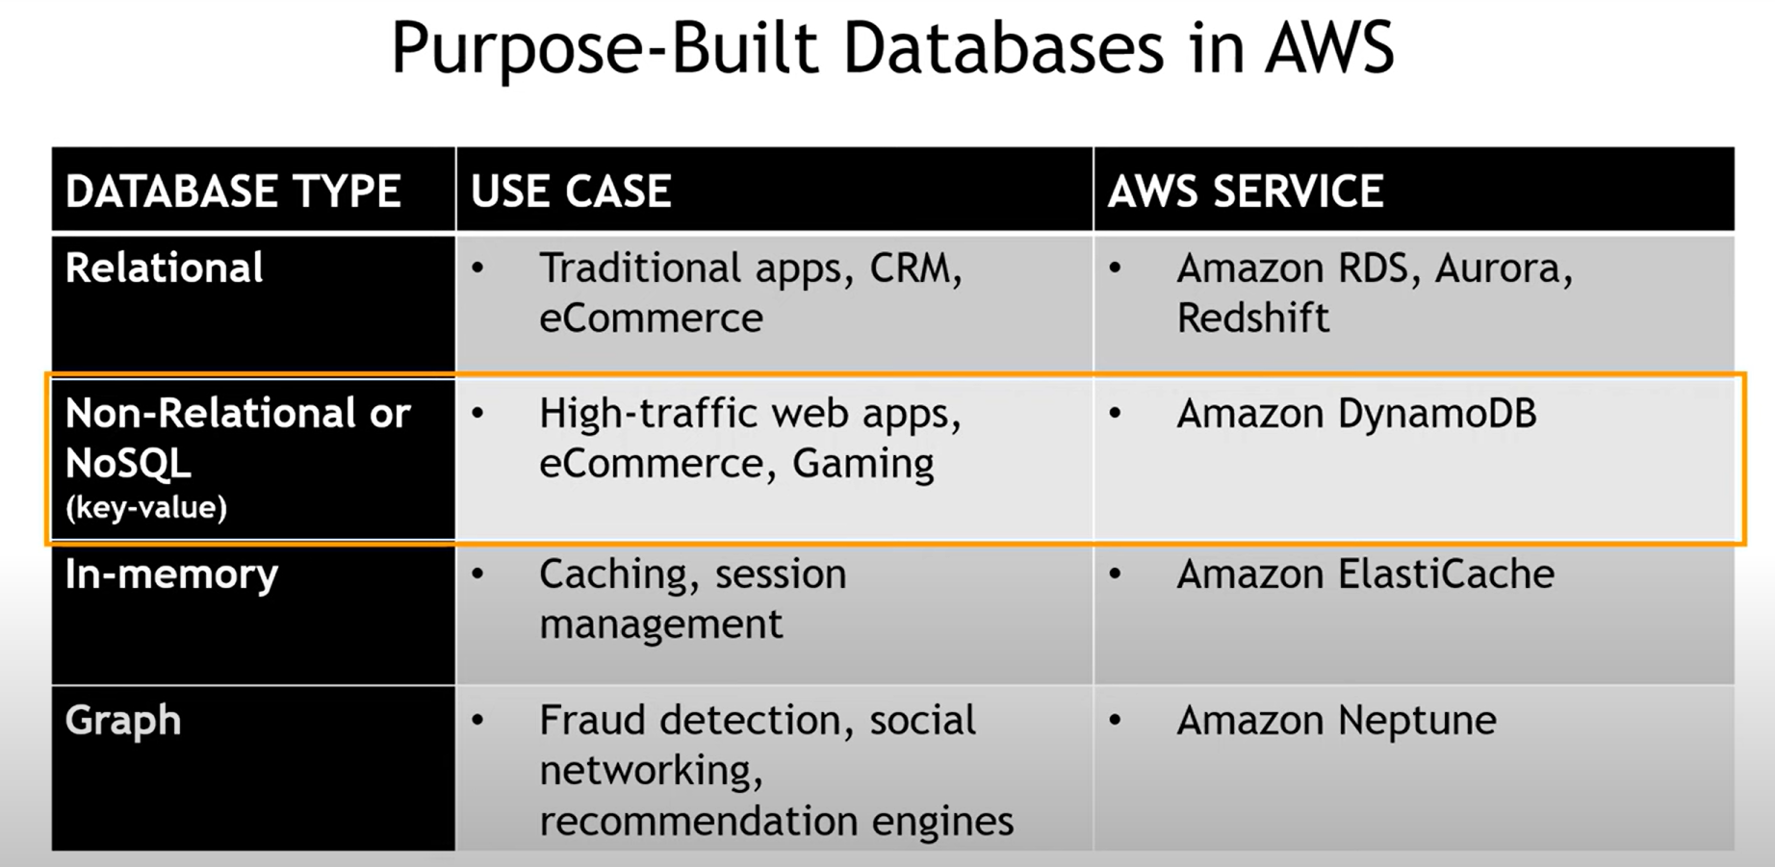

Slide 17

Amazon DynamoDB — overview
Serverless, fully managed, distributed key‑value NoSQL database
Single‑digit millisecond performance at any scale
Pay‑per‑request billing; no maintenance windows or version upgrades

Slide 18
DynamoDB – Red Flags
Scenario | DynamoDB? | Better Alternative
Complex joins & transactions | ❌ | RDS / Aurora (Postgres/MySQL)
Ad-hoc analytics | ❌ | Athena / Redshift / BigQuery
Graph relationships | ❌ | Neptune / Neo4j
Text search | ❌ | OpenSearch / Elasticsearch
Predictable key-value access | ✅ | DynamoDB
Global scale, low latency | ✅ | DynamoDB Global Tables
Rapidly changing schema, JSON docs | ⚙️ | MongoDB / DocumentDB

Slide 19

Disney+ and NoSQL (DynamoDB) in Action
Disney+ uses NoSQL (Amazon DynamoDB and similar systems) to power large-scale, low-latency workloads.

Slide 20
Disney+ and NoSQL (DynamoDB) in Action
Architecture Highlights:
  • Global tables replicate user data (watchlists, playback state) across AWS regions.
  • Each user’s state (e.g., continue watching, preferences) stored as key-value items.
  • DynamoDB Streams trigger AWS Lambda for real-time synchronization across devices.
  • Data exported to S3 and analytics pipelines (Kinesis, Databricks) for recommendations and insights.
  • Integrated with caching layers (CloudFront, Redis) for ultra-low-latency content delivery.

Slide 21
Disney+ and NoSQL (DynamoDB) in Action
Benefits Achieved:
  • Millisecond read/write performance globally.
  • Schema flexibility for evolving features (profiles, watchlists, personalization).
  • Fully managed scaling for unpredictable traffic (launches, premieres, live events).

Slide 22
DynamoDB — core concepts
Tables, items, attributes; partition key (+ optional sort key)
Primary key shapes drive scalability and query patterns
Indexes: Global Secondary Index (GSI), Local Secondary Index (LSI)

Slide 23
KEY - VALUE
{
"PK": "USER#123",
"SK": "PROFILE",
"name": "Ada Lovelace",
"email": "ada@example.com",
"isActive": true,
"loginCount": 42,
"prefs": { "theme": "dark", "lang": "en" },
"tags": ["founder", "beta"],
"expiresAt": 1750000000
}

Slide 24
DynamoDB — capacity & scaling
On‑demand (pay‑per‑request) or provisioned capacity with auto scaling
Horizontal partitioning for throughput; adaptive capacity smooths hotspots
Burst capacity and warm throughput to avoid cold starts

Slide 25
DynamoDB — performance patterns
Design for access patterns (single‑table design common)
Use GSIs to add query dimensions; avoid unbounded partitions
Caching with DAX or application caches to reduce read latency

Slide 26
DynamoDB — resilience & global scale
Global tables: multi‑Region, multi‑active; up to 99.999% availability targets
Backups: on‑demand + point‑in‑time recovery
Streams integrate with Lambda for event‑driven patterns

Slide 27
DynamoDB — security & compliance
Encryption at rest and in transit; fine‑grained IAM access
VPC endpoints (PrivateLink) and monitoring via CloudWatch/CloudTrail
Meets numerous compliance programs (e.g., SOC, PCI, ISO)

Slide 28
DynamoDB — common use cases
User profiles, carts, and session data for retail & e‑commerce
Media metadata stores for streaming/interactive workloads
Gaming state, leaderboards, and event histories

Slide 29
Top clients
Amazon / Amazon Ads / Prime Video
Amazon uses DynamoDB for various internal systems (e.g. “Herd”) and Amazon Ads reportedly uses it to process > 100 billion events (peaks of ~90M reads & 5M writes/sec)
Disney / Disney+
Uses DynamoDB Global Tables for watchlists, video bookmarking, recommendations, etc.
Netflix
Listed among companies using DynamoDB (for parts of their stack)

Slide 30
Pitfalls & anti‑patterns
Treating DynamoDB like a relational DB (ad‑hoc joins)

Slide 31
Best practices & next steps
Start with access patterns; model primary keys + GSIs explicitly
Choose capacity mode per workload; monitor and adjust
Leverage streams, TTL, and backups; add DAX if read‑heavy
Pilot with a representative workload; measure latency and cost

Slide 32
Sources
AWS — What is NoSQL? (aws.amazon.com/nosql)
Integrate.io — SQL vs NoSQL: 5 Critical Differences
Instaclustr — NoSQL Databases: Types, Use Cases, and 8 Databases to Try
AWS — Amazon DynamoDB (aws.amazon.com/dynamodb)

