Slide 1

HTML게임 발표 2014858052 박창민
2019.10.23.

Slide 2
소스코드
실행
Notes:
http://minheeblog.tistory.com/category/PPT

Slide 3
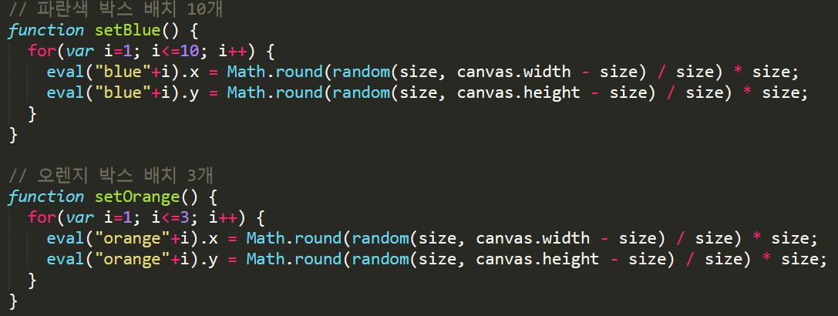
게임프로그래밍
01
Notes:
http://minheeblog.tistory.com/category/PPT

Slide 4
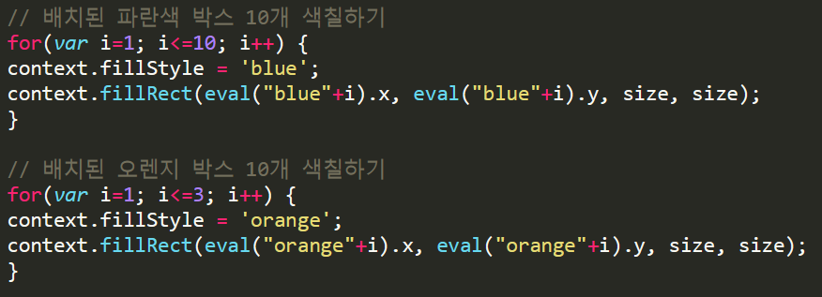
게임프로그래밍
01
Notes:
http://minheeblog.tistory.com/category/PPT

Slide 5
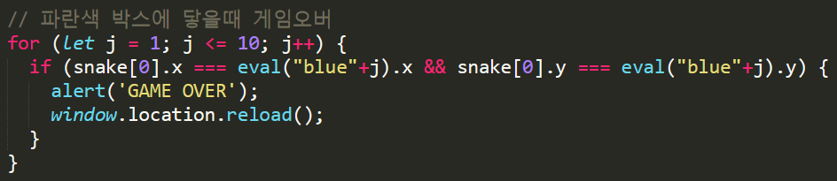
게임프로그래밍
01
Notes:
http://minheeblog.tistory.com/category/PPT

Slide 6
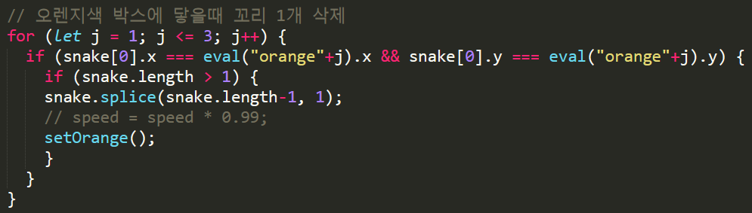
게임프로그래밍
01
Notes:
http://minheeblog.tistory.com/category/PPT

Slide 7
게임프로그래밍
01
개발환경
HW : MacBook Pro with Retina Display Dual Core i5 2.7Ghz 13”
macOS(Mojave 10.14.6)
SW : VScode + Chrome
Notes:
http://minheeblog.tistory.com/category/PPT

Slide 8
게임프로그래밍
출처
11
https://www.youtube.com/watch?v=oY-WEIXNIvI
https://github.com/valnub/snake
https://github.com/chrokh/fp-games
https://hjw1456.tistory.com/23
Notes:
http://minheeblog.tistory.com/category/PPT

Slide 9
THANK
YOU
2014858052 박창민
게임프로그래밍
Notes:
http://minheeblog.tistory.com/category/PPT

