Slide 1
Healthcare Claims Payment Integrity
& Cost Intelligence Platform
End-to-end analytics engineering with Python, SQL, SAS,
Microsoft Fabric, Looker Studio, and Power BI

Slide 2
Three questions drive the platform
Why did healthcare claims costs change?
Which payments merit explainable human review?
Did the simulated claims-review policy change outcomes?
How can every result remain reproducible, governed, and privacy-safe?
Synthetic and public-use data only • Review leads are not fraud determinations

Slide 3
A governed path from claims data to decisions
Data foundation
Public-use ingestion
Synthetic operations
Controlled anomalies
Governed analytics
Trusted claims model
Payment-integrity rules
Cost and policy analysis
Independent validation
Python and SQL tests
SAS reconciliation
Microsoft Fabric execution
Decision delivery
Looker Studio
Power BI validation
Explainable review queue
Versioned contracts • Deterministic builds • Privacy controls • Ground-truth isolation

Slide 4
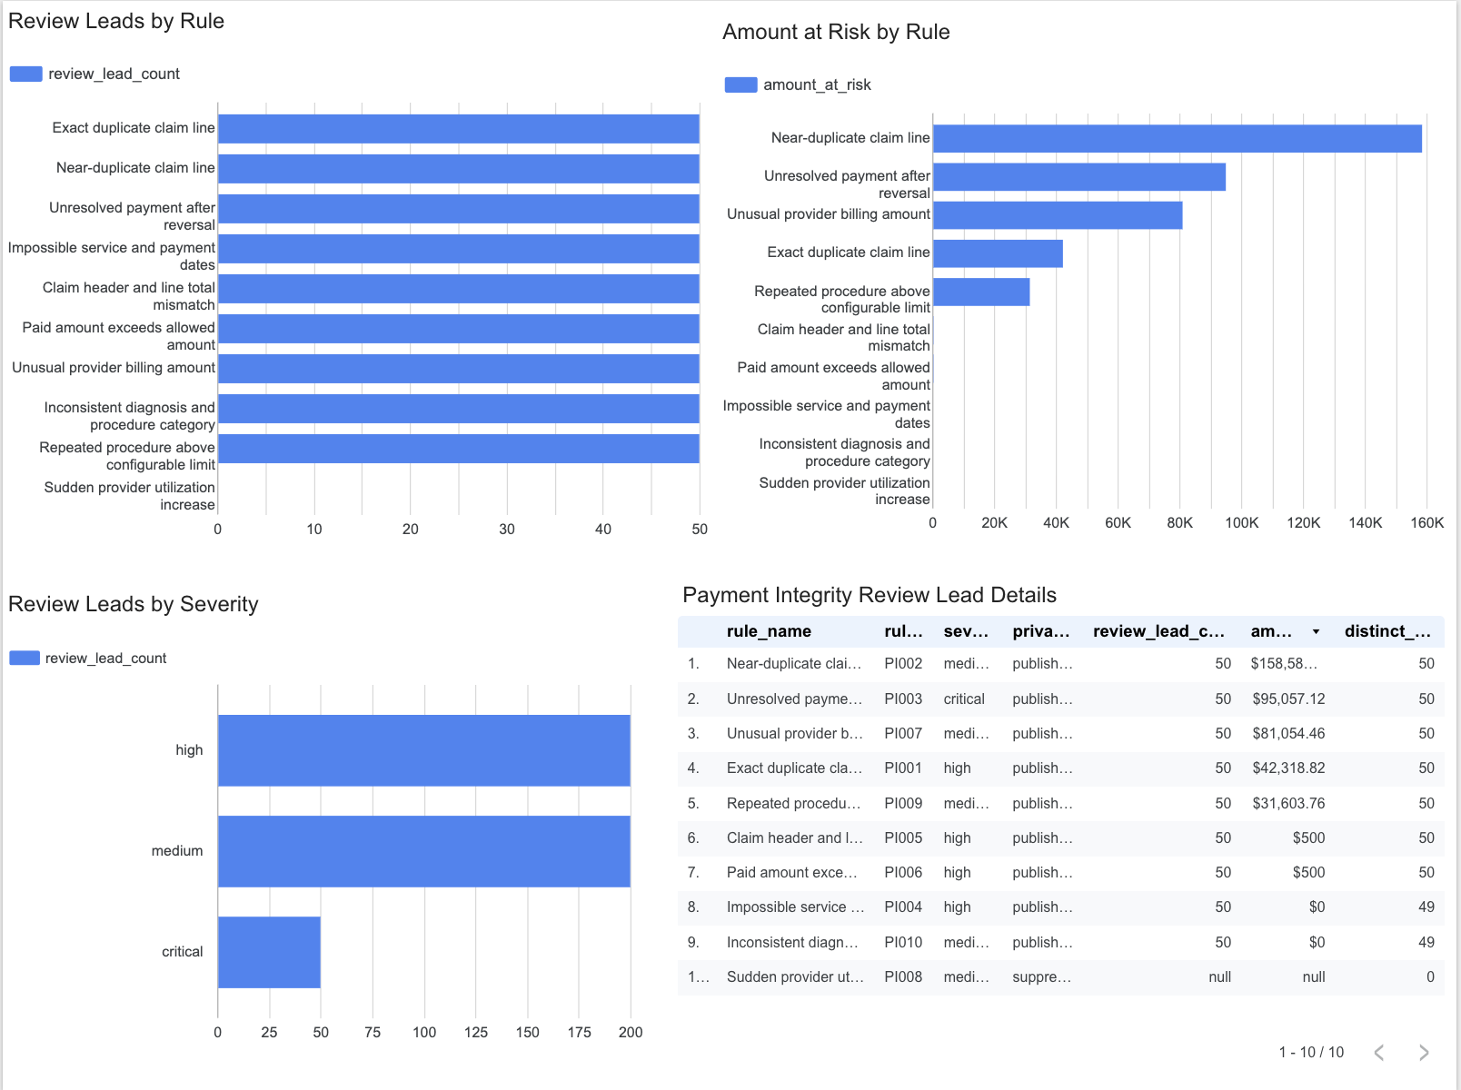
Explainable review prioritization with strong test performance
10 explainable rules
500 controlled labels
88% precision
88% recall
0.01% false-positive rate
99.46% exposure recall
$14.83M detected expected exposure
Controlled synthetic evaluation • Findings require human review

Slide 5
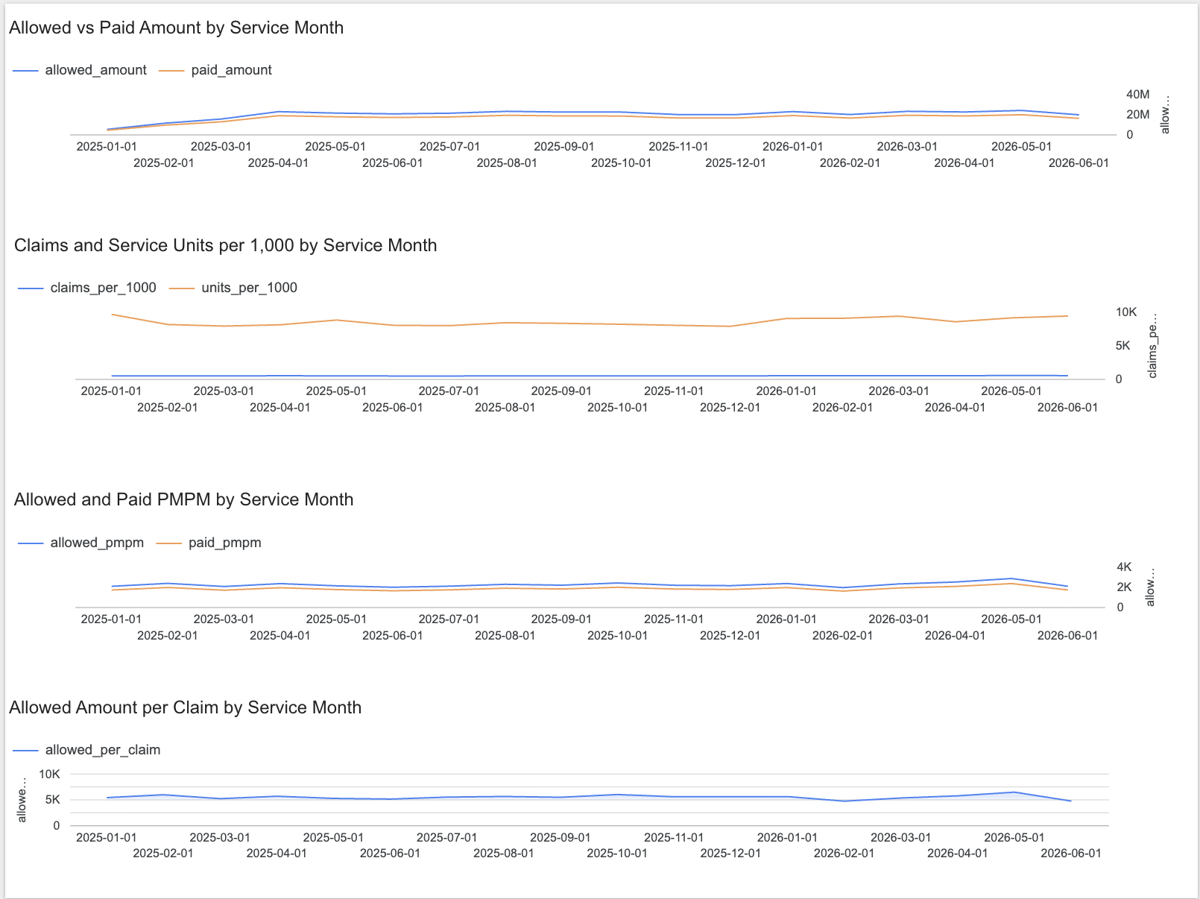
Separate care utilization from payment cash flow
PMPM and per-1,000 rates • Concentration • Price-utilization-mix decomposition • Early-warning signals
20 quality checks passed • Cost decomposition reconciles within $0.01

Slide 6
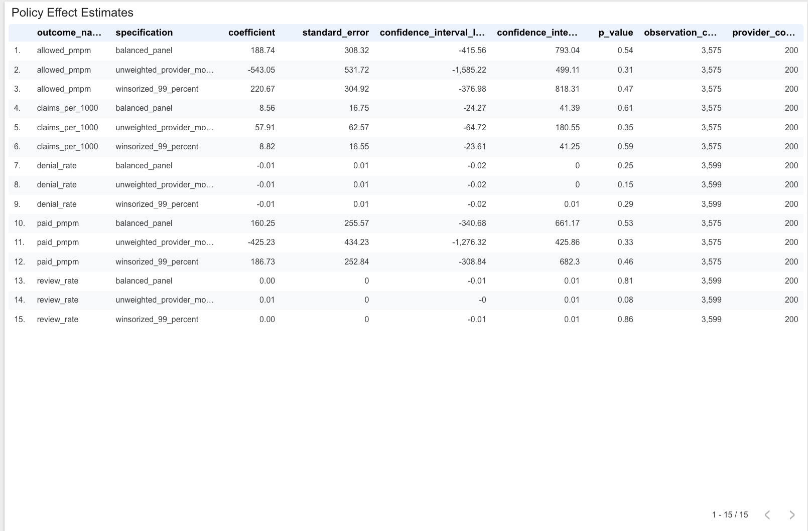
A statistically disciplined result can be “no demonstrated effect”
3,600 provider-month observations
200 providers
5 evaluated outcomes
No statistically significant primary estimate
All pre-trend tests passed
All placebo tests passed
Exposure weighting affected some estimates
Synthetic analytical evidence, not a production causal claim

Slide 7
Independent validation from local analytics to cloud execution
SAS reconciliation
181 comparisons passed
0 failures
0 missing SAS values
Independent reproduction of governed analytical references
Microsoft Fabric
26 governed tables
23 ordinary • 3 restricted
33 reconciliation checks passed
Notebook and pipeline succeeded
$0 paid cloud-resource cost
Evaluation ground truth remained isolated from ordinary analytical features

Slide 8
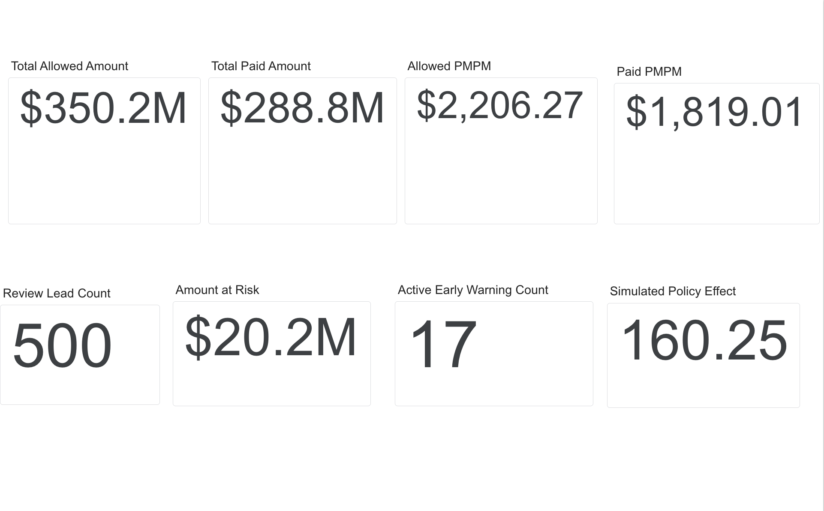
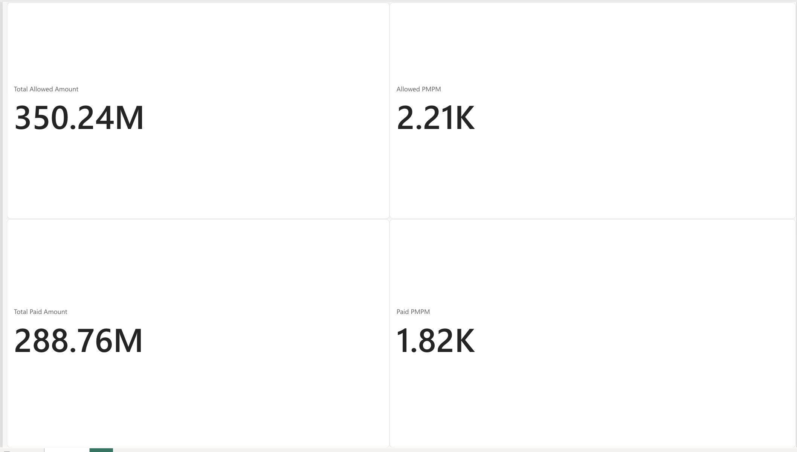
One governed metric layer, validated across two BI tools
Looker Studio • Six-page primary dashboard
Power BI • Independent four-KPI validation
7 extracts • 14 governed KPIs • Exact count matches • Financial differences ≤ $0.01 • 11-member privacy threshold

Slide 9
What this project demonstrates
Analytics engineering and dimensional claims modeling
Explainable payment-integrity review rules
Cost intelligence and statistical policy evaluation
Python, SQL, SAS, and Microsoft Fabric validation
Looker Studio and Power BI delivery
Automated testing, privacy governance, and reproducible evidence
A reproducible platform that explains cost changes, prioritizes review leads, evaluates policy effects honestly, and delivers governed results across multiple tools.

