Slide 1
Homomorphic Encryption: A Survey
Daniel Okunbor,phd
Fayetteville state university
In collaboration with chekad sarami, phd

Slide 2
Motivation
Homomorphic encryption is gaining traction, particularly in cloud computing
Although there are several survey papers in homomorphic, many don’t have comparison results. Subsequent work will have comparison results
Provide understanding of this complex concept
Goal: comprehensive homomorphic encryption library in python

Slide 3
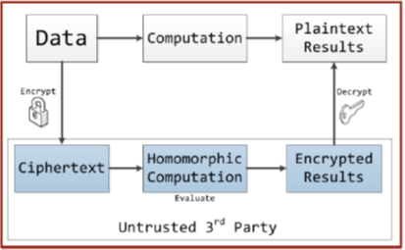
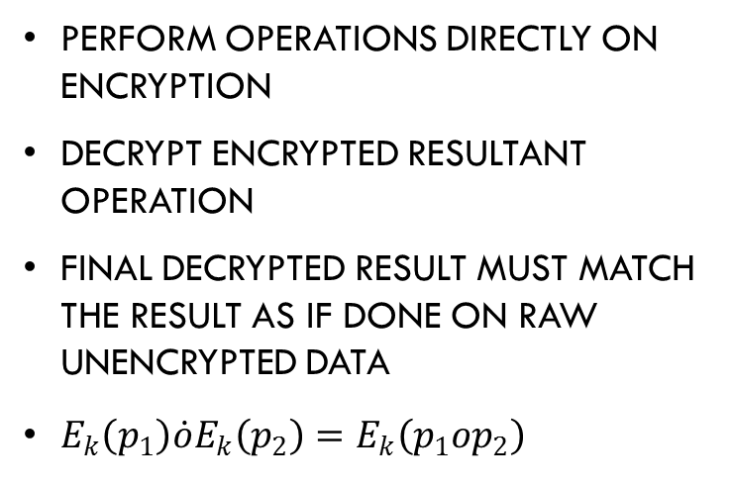
Homomorphic encryption (HE) defined
Perform operations directly on encryption
Decrypt encrypted resultant operation
Final decrypted result must match the result as if done on raw unencrypted data
$E_{k}\left(p_{1}\right)\dot{ο}E_{k}\left(p_{2}\right)=E_{k}\left(p_{1}οp_{2}\right)$

Slide 4
Why he?
Privacy
Man-in-the-middle attack (MITM)
Cloud computing (untrusted third party)
E-voting
E-commerce

Slide 5
Historical perspective
Homomorphism in algebra
Application of homomorphism in encryption: Rivest, Adelman and dertouzos (1978) – RSA + others (pioneer of homomorphic encryption)
Between 1978 and 2008: Goldwasser and micali; paillier; el-gamal, boneh, dgoh, and nissim; okamoto and uchiyama; Ishai and Paskin; Yao; Sander, Young, and M. Yung; Benaloh; etc.
2009 and beyond: Gentry; Brakerski and Vaikuntanathan; van Dijk, Gentry, Halevi, and Vaikuntanathan; López-Alt, Tromer, and Vaikuntanathan; etc.

Slide 6
Historical Perspective
Types of HE: Partial (PHE), Somewhat (SWHE) and fully (FHE)
Pictorial representation (source: ACAR, AKSU, and AULUAGAC, 2017)

Slide 7
Types of Homomorphic encryption
Partially Homomorphic Encryption (PHE) allows only one type of operation with an unlimited number of times (i.e., no bound on the number of usages).
Somewhat Homomorphic Encryption (SWHE) allows some types of operations with a limited number of times.
Fully Homomorphic Encryption (FHE) allows unlimited number of operations with unlimited number of times.

Slide 8
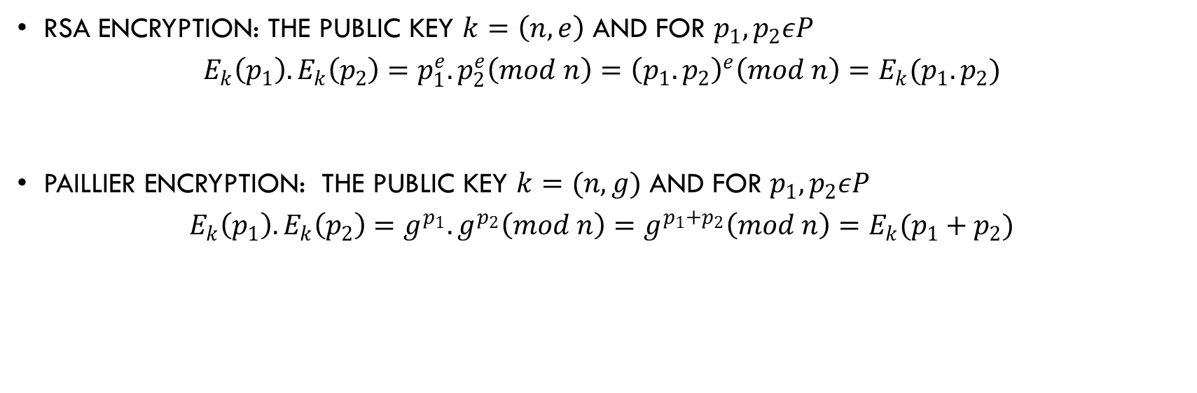
EXAMPLEs of Homomorphic encryption
RSA Encryption: The public key $k=\left(n,e\right)$ and for $p_{1},p_{2}εP$
$$E_{k}\left(p_{1}\right).E_{k}\left(p_{2}\right)=p_{1}^{e}.p_{2}^{e}\left(mod n\right)={\left(p_{1}.p_{2}\right)}^{e}\left(mod n\right)=E_{k}(p_{1}.p_{2})$$
Paillier Encryption: The public key $k=(n,g)$ and for $p_{1}, p_{2}εP$
$$E_{k}\left(p_{1}\right).E_{k}\left(p_{2}\right)=g^{p_{1}}.g^{p_{2}}\left(mod n\right)=g^{p_{1}+p_{2}}\left(mod n\right)=E_{k}(p_{1}+p_{2})$$

Slide 9
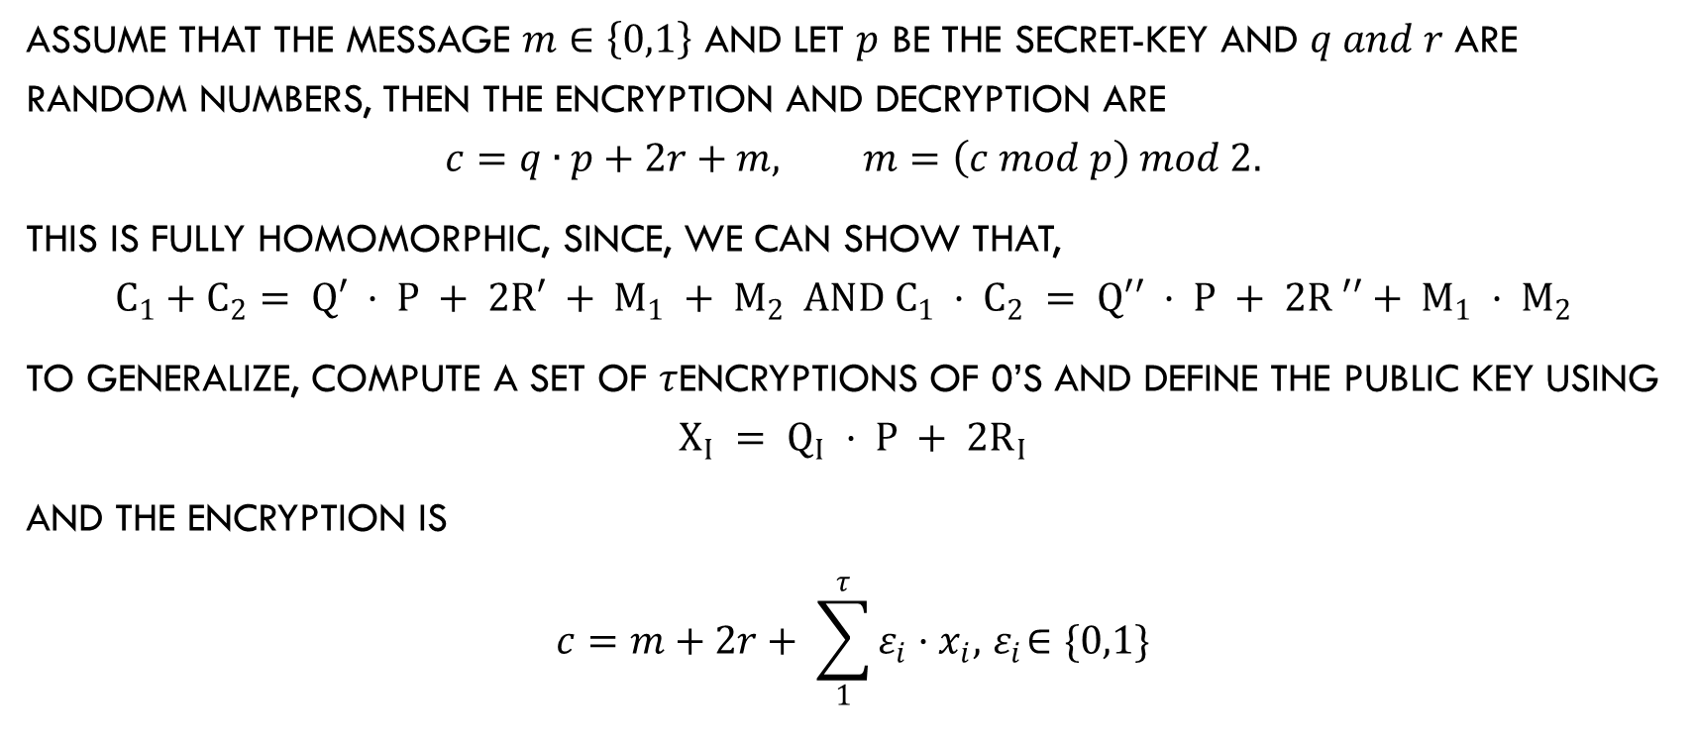
FULLY Homomorphic encryption
Assume that the message $m∈\left\{0,1\right\}$ and let $p$ be the secret-key and $q and r$ are random numbers, then the encryption and decryption are
$$c=q∙p+2r+m, m=\left(c mod p\right) mod 2.$$
This is fully homomorphic, since, we can show that,
$$c_{1}+c_{2}= q′ · p + 2r′ + m_{1} + m_{2} and c_{1} · c_{2} = q′′ · p + 2r ′′+ m_{1} · m_{2}$$
To generalize, compute a set of $τ$encryptions of 0’s and define the public key using
$$x_{i} = q_{i} · p + 2r_{i}$$
and the encryption is
$$c=m+2r+ \sum_{1}^{τ}{ε_{i}}·x_{i}, { ε}_{i}∈\{0,1\}$$

Slide 10
DEMONSTRATIONs
RSA encryption
Enter the first prime number: 53
Enter the second prime number: 59
Enter a message: 34
Plaintext = 34 Ciphertext = 1780
Enter a message: 45
34 * 45 = 1530
Plaintext = 45 Ciphertext = 442
Product 1780 * 442 = 786760
786760 encrypted = 1530

Slide 11
DEMONSTRATIONs
DGHV encryption
enter the public key r: 5
enter the message 0 or 1: 1
enter the public key p: 8
enter message 0, or 1: 1
1 encrypted = 83
1 encrypted = 83
1 + 1 = 0
83 + 83 decrypted= 0
1 * 1 = 1
83 * 83 decrypted= 1

Slide 12
DEMONSTRATIONs
DGHV encryption
enter the public key q: 9
enter the public key r: 5
enter the message 0 or 1: 1
enter the public key p: 8
enter message 0, or 1: 0
1 encrypted = 83
0 encrypted = 82
1 + 0 = 1
83 + 82 decrypted= 1
1 * 0 = 0
83 * 82 decrypted= 0

Slide 13
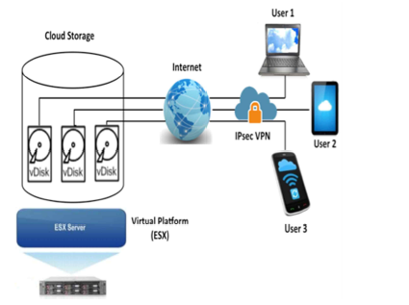
Homomorphic encyption for cloud computing
Source: Tebaa
and Hajii (2013)

Slide 14
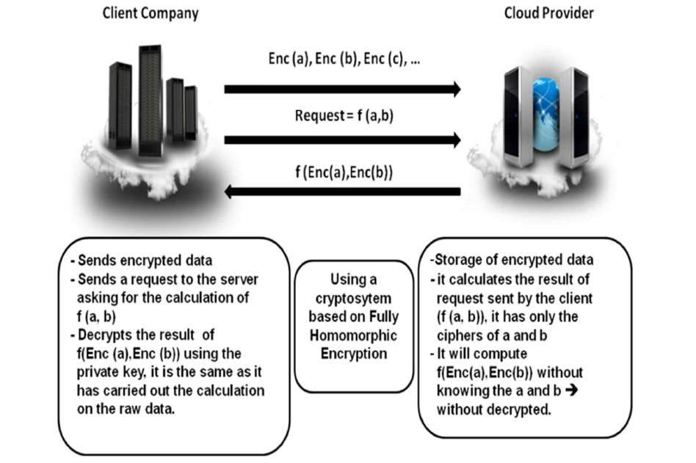
HE & Cloud Computing
Source: Tebaa and Hajii(2013)

Slide 15
Looking Ahead
Implementation of Homomorphic encryption
Standard libraries for homomorphic encryption, like crypto or crypto++
Floating-point operations and homomorphic encryption
Parallel implementation, Including gpus
Software vs hardware implementation of homomorphic encryption
Application to e-voting and cloud computing
Application to e-commerce
Application to search engines

