Slide 1
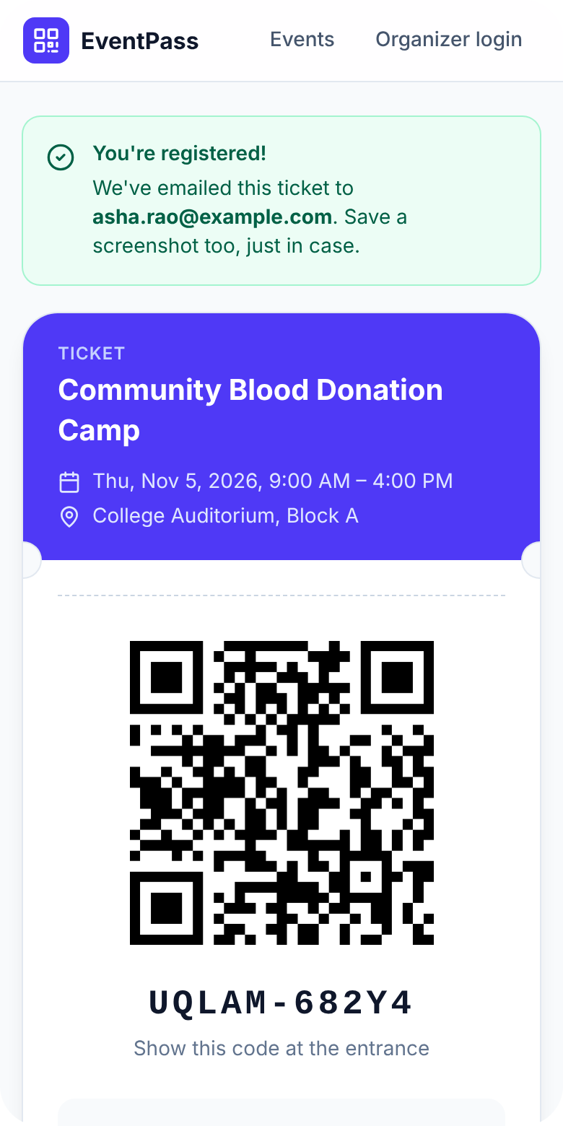

COMMUNITY SERVICES · 3RD SEMESTER
EventPass
Register in seconds. Check in instantly.
A mobile-first platform for event registration, QR tickets and live attendance tracking
Checked in
Presented by Team EventPass
Notes:
EventPass is our Community Services project: a web platform that lets people register for events from their phone, emails them a QR ticket, and lets organizers check them in by scanning the code. This deck walks through the problem, our objectives, the solution, the technology, and how we verified it.

Slide 2




Entry queues are a system problem, not a people problem
“
Long queues at the gate
Paper and desktop-only forms
There is a critical need for a streamlined, mobile-responsive solution that simplifies onboarding and automates on-site attendance tracking.
Names are checked against printed lists one by one; every attendee waits for the slowest lookup.
Registration lives on paper or on one laptop. Attendees cannot sign up from where they are – their phone.
Lost and duplicated data
No live picture for organizers
— Problem statement, project proposal
Re-typing registrations into spreadsheets causes typos, double entries and missing records.
How many people have arrived? Nobody knows until the counting is done after the event.
Notes:
Most events we looked at still register people on paper or on a single desktop, and check them in by searching a printed list. That creates queues, typing errors, duplicate records and – for the organizers – no idea how many people have actually arrived.

Slide 3






Six objectives
01
02
03
Seamless mobile registration
No entry queues
Automated QR attendance
A fast, responsive sign-up form that works on any phone.
Drastically reduce waiting time at check-in.
Generate secure QR tickets and scan them in a second.
04
05
06
Real-time dashboard
Less admin, zero paper
Secure participant data
Total registrations and live footfall for organizers.
Remove manual data entry and the errors that come with it.
Collect, store and manage attendee data safely.
Notes:
These six objectives come straight from the proposal. Click to reveal them two at a time: mobile registration and no queues; QR automation and a live dashboard; less administration and secure data. Every later slide maps back to one of these.

Slide 4



How EventPass works
STEP 1
STEP 2
STEP 3
Register
Get a QR ticket
Scan at the gate
Name, email, phone – three fields, no account needed. Capacity and duplicates are checked instantly.
A unique ticket code is generated, shown on screen and emailed with the QR image attached.
The organizer scans the code with a phone camera; the ticket is verified and marked as arrived.
Under a minute on a phone
Instant · also in your inbox
About one second per person
Every scan updates the live dashboard. Organizers see registrations, arrivals and attendance rate refresh every five seconds – from any device.
Notes:
Three steps. The attendee registers in a form with three fields and immediately gets a QR ticket, which is also emailed. At the event the organizer scans it – with the phone camera or a hardware scanner – and the attendance database updates at once. The final click shows how that feeds the live dashboard.

Slide 5
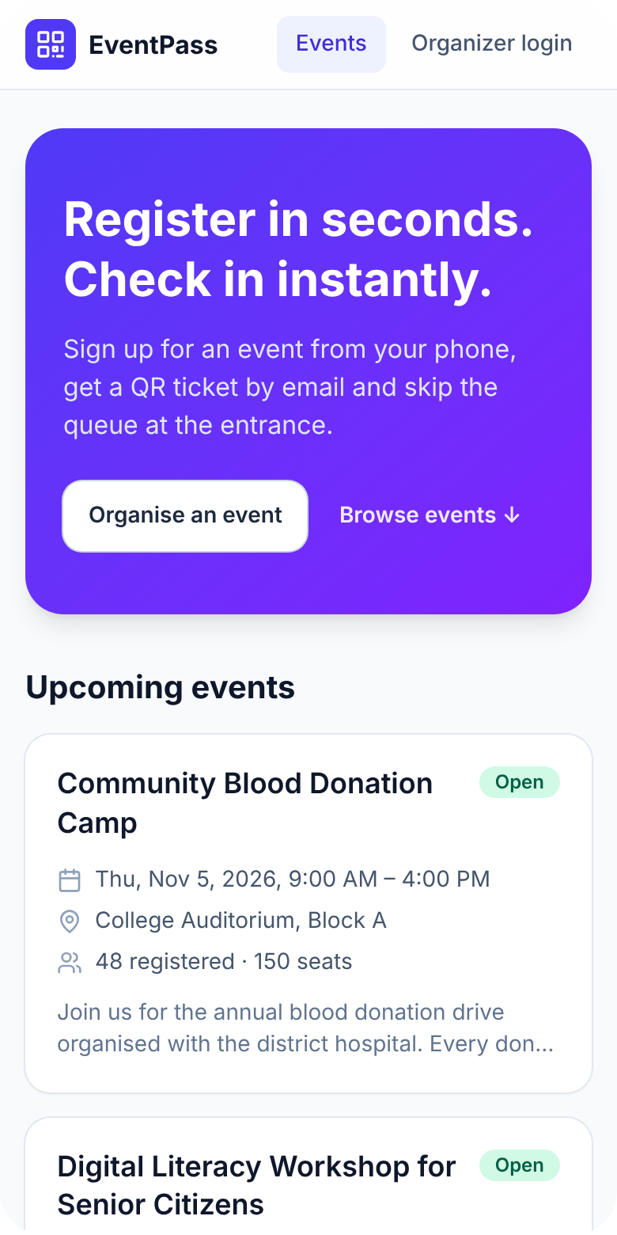
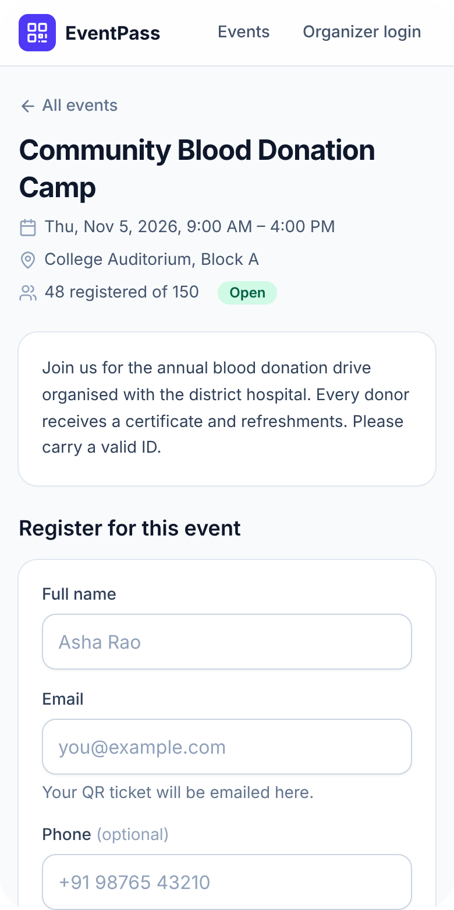
The attendee journey: under a minute
Browse events
Register in three fields
Your QR ticket
Published events, seats left and dates – designed for one thumb.
Validation happens inline; duplicates and full events are caught before submitting.
Shown immediately and emailed. Save a screenshot or add it to the home screen.
Screens captured from the running application
Notes:
This is the real app, not a mock-up. Home page with upcoming events, the event page with the registration form, and the ticket page with the QR code and ticket code. The whole flow takes well under a minute on a phone.

Slide 6
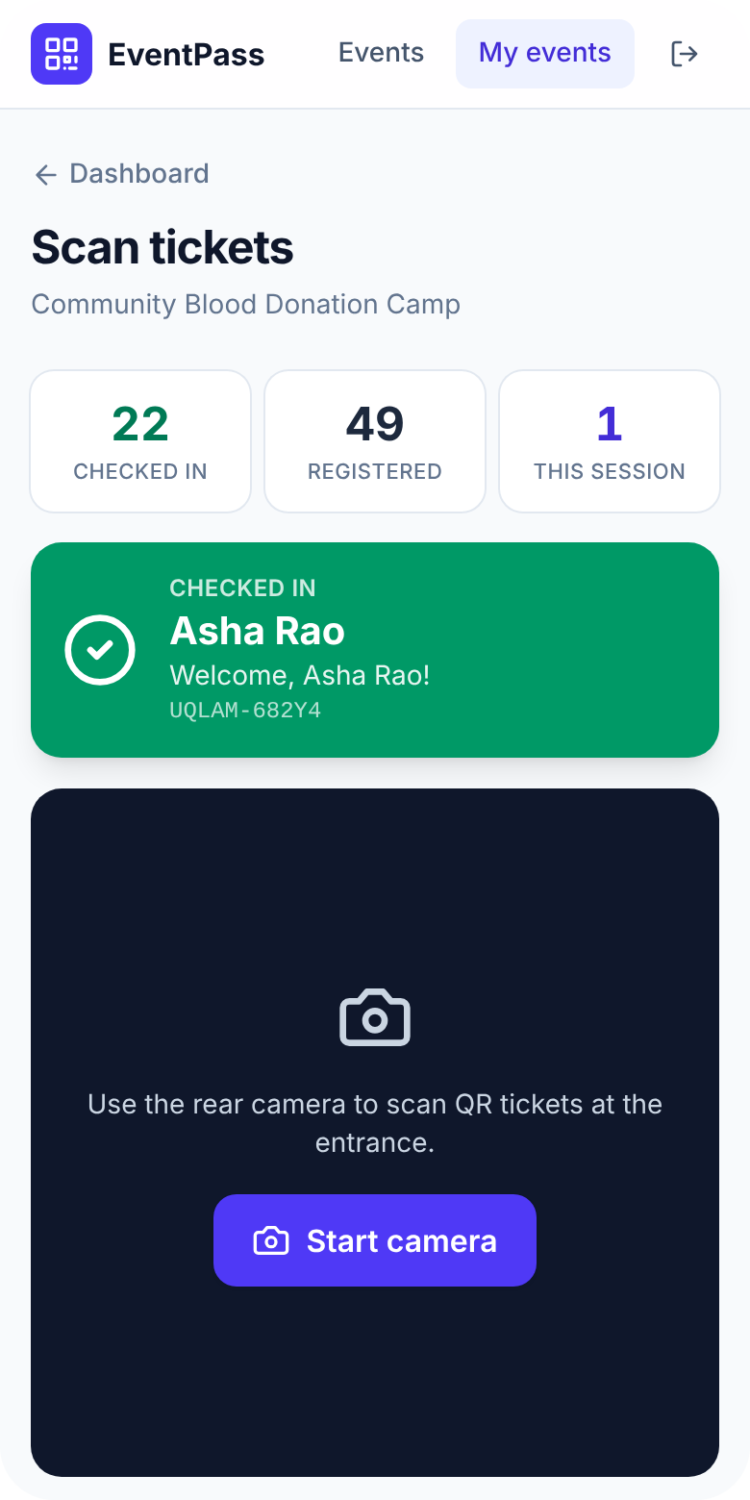
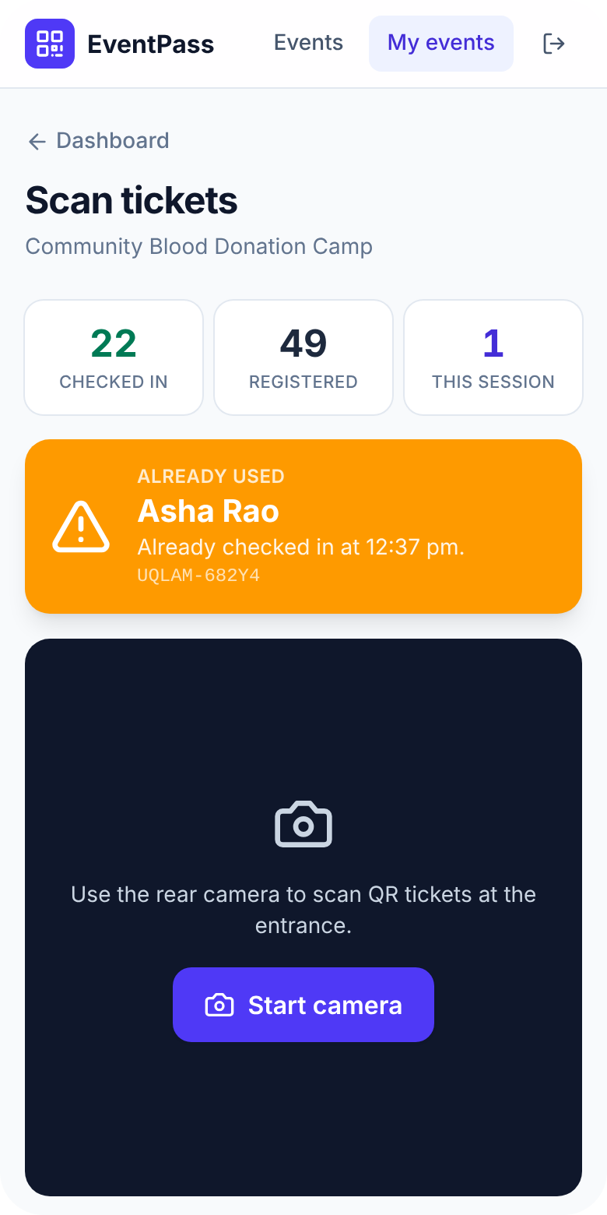

At the gate: one scan, one second
Checked in
Valid ticket – attendance recorded, name shown, short beep.
Already used · wrong event
A second scan of the same ticket is refused with the original check-in time.
Invalid · cancelled
Unknown codes and cancelled registrations never get through.
Phone camera or USB scanner
Beep + vibration feedback
Duplicate scans rejected
Works as a home-screen app
Notes:
The scanner page gives colour-coded feedback: green for a successful check-in, amber for a ticket that was already used or belongs to another event, red for invalid or cancelled tickets. Staff hear a beep and feel a vibration, so they never have to look away from the queue. If the camera is unavailable, codes can be typed or entered with a USB scanner.

Slide 7
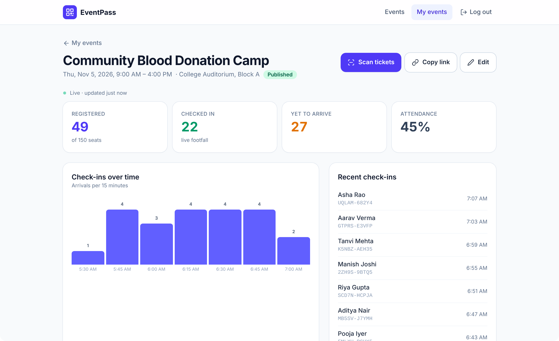
A live view for organizers
49
registered · 150 seats
22
checked in – live footfall
45%
attendance rate
Every 5 s
CSV export
Figures from the demo dataset
Notes:
Organizers get a dashboard that refreshes every five seconds: registered versus capacity, how many have checked in, who is still to arrive, attendance rate, arrivals per 15 minutes and the most recent check-ins. Registrations are searchable, can be checked in or cancelled manually, and exported to CSV in one click.

Slide 8











Under the hood
Attendees & organizers
React 19 web app
JSON over HTTPS
Express 5 API
PostgreSQL 16
Any phone or laptop browser
Vite · Tailwind CSS 4 · html5-qrcode
Node.js 22 · zod · qrcode · nodemailer
SQL migrations
SMTP
QR ticket emails
SECURITY BUILT IN
bcrypt password hashing
JWT sessions (HS256)
Helmet + Content-Security-Policy
zod input validation
Parameterised SQL only
Rate limiting on public routes
Notes:
A simple, conventional architecture: a React single-page app talks JSON to an Express API, which stores everything in PostgreSQL and sends ticket emails through SMTP. In production one process serves both the API and the built app. Security is built in: hashed passwords, signed sessions, strict headers, validated inputs, parameterised SQL and rate limits.

Slide 9


Built to be trusted
42
8
15/15
100%
server tests against a real PostgreSQL database
client component & unit tests
end-to-end checks on the production build
commits green in continuous integration
Independent security review
Code review pass
One-click deployment
Two confirmed findings fixed – a cross-organizer data leak and a placeholder secret – each with a regression test.
Nine defects fixed, from time-zone bugs in emails to scanner request flooding, before the first release.
Render blueprint, Docker image and CI pipeline – from pull request to a live HTTPS site in minutes.
Notes:
We did not just build it – we tested it. 42 server tests run against a real database, including concurrency tests that try to take the last seat or scan the same ticket twice at the same moment. An automated browser run exercises the full flow on the production build, and CI runs on every commit. We also ran an independent security review and fixed what it found.

Slide 10
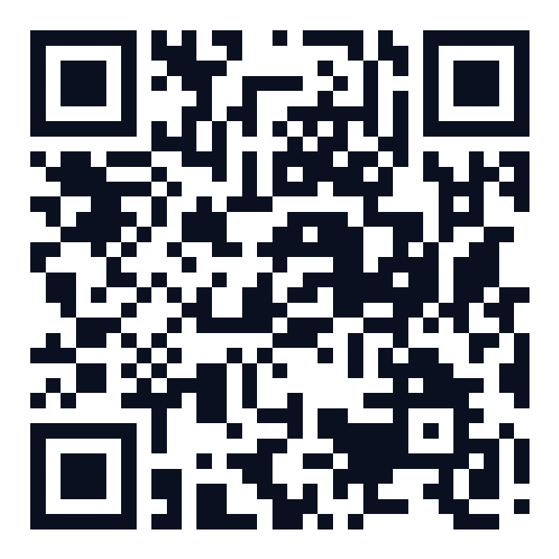



Thank you
Questions, feedback and pull requests welcome
WHAT COMES NEXT
Push updates (WebSockets) for very large events
Multiple staff accounts per event
Waiting lists and self-service cancellation
Scan for the source code
Offline ticket display with a service worker
github.com/jangra-coder/
community-services-3rd-sem
EventPass · Community Services · 3rd semester
Notes:
Thank you. The whole project – code, tests, documentation and deployment configuration – is on GitHub; the QR code on this slide opens the repository. Next steps we are considering: push updates instead of polling for very large events, multiple staff accounts, waiting lists and offline tickets. Happy to take questions.

