Slide 1
Visualizator
Project for PB138 seminar at FI MUNI

Slide 2
Presentation structure
Project Introduction
Team introduction
Demonstration
Question-time

Slide 3
Presentation structure
Project Introduction
Team introduction
Demonstration
Question-time

Slide 4
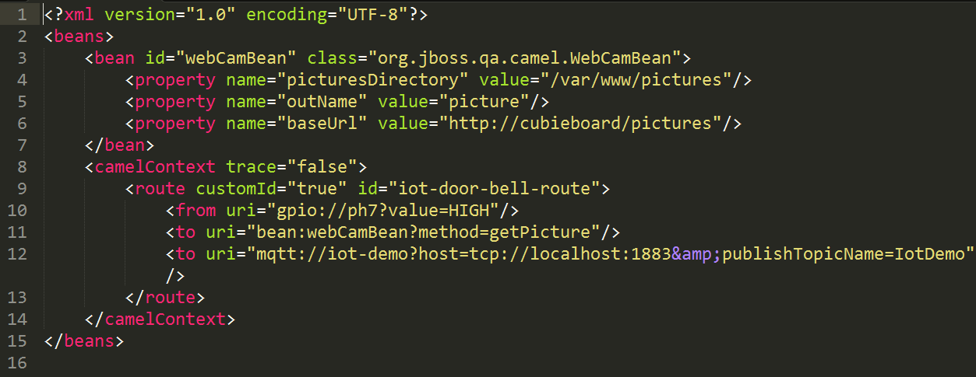
Project Introduction | Main Task

Slide 5
Project Introduction | Main Task
XSLT

Slide 6
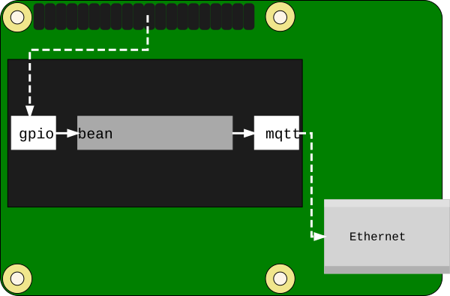
Project Introduction | Main Task
XSLT

Slide 7
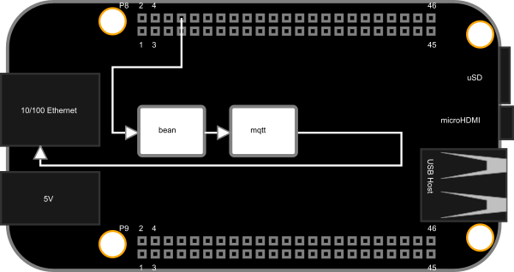
Project Introduction | Main Task
XSLT

Slide 8
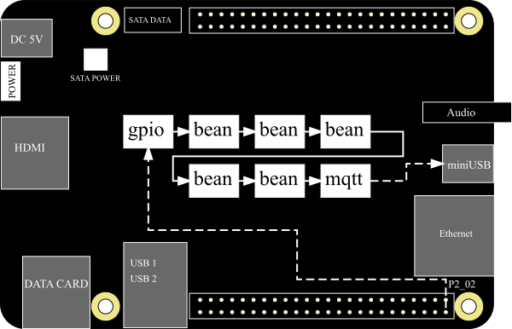
Project Introduction | Main Task
XSLT

Slide 9
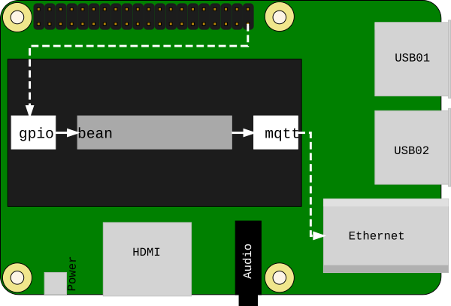
Project Introduction | Main Task
XSLT

Slide 10
Presentation structure
Project Introduction
Team introduction
Demonstration
Question-time

Slide 11
Team Introduction | Maroš Šeleng

Slide 12
Team Introduction | Maroš Šeleng
Team leader

Slide 13

Team Introduction | Maroš Šeleng
Team leader

Slide 14

Team Introduction | Maroš Šeleng
Team leader

Slide 15
Team Introduction | Maroš Šeleng
Team leader
<XSLT/>

Slide 16
Team Introduction | Jan Grundmann

Slide 17

Team Introduction | Jan Grundmann

Slide 18
Team Introduction | Jan Grundmann
<XSLT/>

Slide 19
Team Introduction | Adam Vondráček

Slide 20

Team Introduction | Adam Vondráček

Slide 21
Team Introduction | Adam Vondráček
<XSLT/>

Slide 22
Team Introduction | Jaroslav Bončo

Slide 23

Team Introduction | Jaroslav Bončo

Slide 24
Team Introduction | Jaroslav Bončo
<XSD/>

Slide 25
Presentation structure
Project Introduction
Team introduction
Demonstration
Question-time

Slide 26
Demonstration
Web application:
http://visualizator-marosseleng.rhcloud.com/
Github repository:
https://github.com/maroselo/visualizator
Project’s wiki:
https://github.com/maroselo/visualizator/wiki
Travis CI:
https://travis-ci.org/maroselo/visualizator

Slide 27
Presentation structure
Project Introduction
Team introduction
Demonstration
Question-time

Slide 28
Question-time

Slide 29
Thank you for your attention

