Slide 1
Atlas RAN Twin
Development guide
Code dependencies, Graft, SQLite and the developer workflow
Repository working-tree snapshot
2 October 2026
1
Notes:
Audience assumption: new contributors. Delivery assumption: an English, self-paced technical reference with a worked extension example. Source inspection and local validation support the guide.
Source snapshot: 2 October 2026. Repository: /Users/parkjangwon/Project/UI_UX_Mockup_Typescript. Base commit 46c34d9 with uncommitted and untracked development changes. Source files and cited spans describe the working tree rather than a released version.
Source: README.md:1-15
Source: AGENTS.md

Slide 2
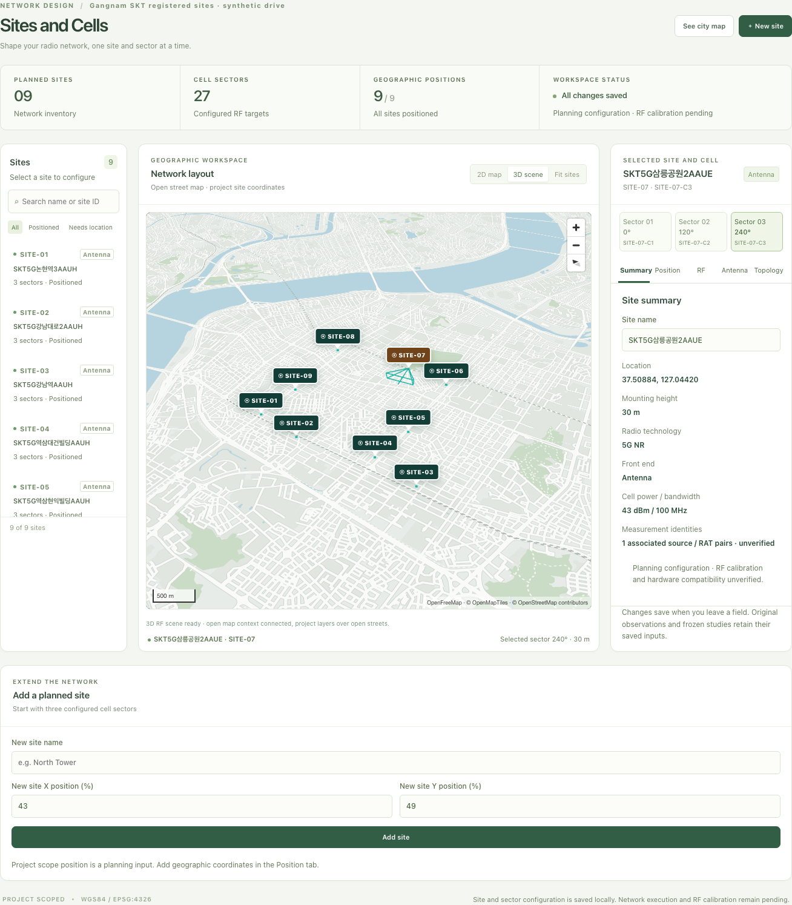
Project scope
Implemented locally
React workspaces, WGS84 scenes, measurement evidence, SQLite and retained studies.
Optional execution
A bounded Sionna-RT path worker runs in a separate Python environment.
Further integration
Live RAN adapters, RF calibration and GH200 resource control need additional implementation.
2
Notes:
Repository design-review capture, retained without presenting it as a fresh runtime screenshot. It shows the project planning UI and geographic context. The optional local solver produces uncalibrated path results. Connected RAN execution, UE execution, calibrated acceptance verdicts and hardware discovery remain outside the implemented scope.
Source snapshot: 2 October 2026. Repository: /Users/parkjangwon/Project/UI_UX_Mockup_Typescript. Base commit 46c34d9 with uncommitted and untracked development changes. Source files and cited spans describe the working tree rather than a released version.
Source: README.md:1-15
Source: docs/design-review/planner-commercial/gangnam-3d-desktop.png

Slide 3
Engineering workflow
The navigation follows the engineering task. Projects provide the shared scope
Workspace section | Main routes | Development concern
Overview | overview | Context, readiness and source status
Data and Twin Setup | study, measurements, map | Definitions, evidence and geometry
Network Design | planner, radio, scenarios | Site/cell edits and retained alternatives
Simulation and Experiments | ray, ab, data | Captured inputs and execution boundaries
Validation and Optimization | drive | KPI availability, sample analysis and provenance
Operations and Reports | runs, artifacts, tasks, schedule | Run history, exports and planned work
3
Notes:
Source snapshot: 2 October 2026. Repository: /Users/parkjangwon/Project/UI_UX_Mockup_Typescript. Base commit 46c34d9 with uncommitted and untracked development changes. Source files and cited spans describe the working tree rather than a released version.
Source: src/app/workflowNavigation.ts
Source: src/app/routeRegistry.ts:1-47
Source: README.md:5-13

Slide 4
Code ownership by layer
Start in the layer that owns the behavior, then trace its callers with Graft
Layer | Starting files | Responsibility
React shell | src/main.tsx src/app/ and src/legacy/ActivityPreview.tsx | Entry, routing, layout and global project context
Feature workspaces | src/features/<area>/ | Rendering, local sessions and command adapters
Domain rules | model.mjs, workspaces.mjs dm.mjs, study.mjs, measurement library | Pure transformations, validation and evidence identity
Transport | src/api/ serve.py | JSON contracts, HTTP boundaries and job orchestration
Persistence and worker | storage.py, *_storage.py rt_worker.py | SQLite transactions, retained records and local solving
4
Notes:
Source snapshot: 2 October 2026. Repository: /Users/parkjangwon/Project/UI_UX_Mockup_Typescript. Base commit 46c34d9 with uncommitted and untracked development changes. Source files and cited spans describe the working tree rather than a released version.
Source: src/main.tsx
Source: src/app/App.tsx
Source: src/legacy/ActivityPreview.tsx:1-100
Source: src/app/AppController.ts:51-179
Source: serve.py:221-384
Source: storage.py:27-92

Slide 5
Runtime dependency chain
A persisted feature change crosses these interfaces in order
Owner | Depends on | Contract at the boundary
React feature | Feature command + local session | Validated user intent and project ID
AppController.dispatch | Domain helpers + workspaceSchema | Immutable workspace snapshot
workspaceApi.writeWorkspace | Artifact index + fetch + schemas | PUT { revision, workspace, artifacts }
serve.py handler | ProjectStore | HTTP 200, 400 or 409 result
storage.py | sqlite3 + evidence validators | Atomic revisioned transaction
Optional path execution | JobManager + rt_worker.py | Frozen request and retained run evidence
5
Notes:
Source snapshot: 2 October 2026. Repository: /Users/parkjangwon/Project/UI_UX_Mockup_Typescript. Base commit 46c34d9 with uncommitted and untracked development changes. Source files and cited spans describe the working tree rather than a released version.
Source: src/main.tsx
Source: src/app/App.tsx
Source: src/legacy/ActivityPreview.tsx:1-100
Source: src/api/workspaceApi.ts:34-50
Source: scripts/atlas.mjs:22-52
Source: serve.py:341-357
Source: storage.py:181-218

Slide 6
Pinned package dependencies
The lockfile defines the install. The launcher resolves the project-local tools
Package | Declared version | Purpose
React / React DOM | 19.3.0 / 19.3.0 | Rendering and subscriptions
MapLibre GL | 5.23.0 | Open 2D/3D geographic context
Zod | 4.6.5 | Runtime transport parsing
TypeScript | 5.9.3 | Strict frontend type checks
Vite / React plugin | 8.3.1 / 6.1.1 | Development proxy and production build
Vitest / jsdom | 4.1.11 / 27.2.0 | Component and API tests
Playwright | 1.63.0 | Chromium workflow tests
6
Notes:
Versions come from the checked-in package declarations in the inspected working tree. They describe this project, not the latest versions available from vendors. npm run setup uses npm ci with development and optional dependencies.
Source snapshot: 2 October 2026. Repository: /Users/parkjangwon/Project/UI_UX_Mockup_Typescript. Base commit 46c34d9 with uncommitted and untracked development changes. Source files and cited spans describe the working tree rather than a released version.
Source: package.json:1-50
Source: package-lock.json

Slide 7
Development environment
Tool | Repository requirement / configuration | Observed locally
Node.js | ^22.12.0 or >=24.0.0 CI uses Node 24 | 26.10.0
Python + SQLite | Python 3.10+ with stdlib sqlite3 CI uses Python 3.13 | Python 3.14.7
npm | Use the checked-in package-lock.json | 12.1.0
Graft CLI | Separate installation on PATH | 0.21.1
Optional RT | uv + Python 3.13 + Sionna-RT 2.1.0 Compatible native backend required | Check separately with test:rt
7
Notes:
Local observed tools on 2 October 2026: Node v26.10.0, npm 12.1.0, Python 3.14.7, Graft 0.21.1. CI configuration uses Node 24 and Python 3.13. This guide does not claim that the remote CI workflow ran or that Windows execution was independently verified. Graft is a separately installed CLI, not a package.json dependency.
Source snapshot: 2 October 2026. Repository: /Users/parkjangwon/Project/UI_UX_Mockup_Typescript. Base commit 46c34d9 with uncommitted and untracked development changes. Source files and cited spans describe the working tree rather than a released version.
Source: package.json:5-8
Source: scripts/runtime.mjs:15-34
Source: .github/workflows/cross-platform.yml
Source: README.md:17-46

Slide 8
First local run
Run these commands from the checkout root on macOS, Linux or Windows
1. Install the pinned dependencies
npm run setup
npm start
npm run help
Include the optional native bindings required by the current platform.
2. Build and start the application
The launcher serves the React bundle and Python/SQLite API together.
3. Use the server’s printed URL
The normal address is http://127.0.0.1:8765/. Automatic fallback can select another port.
Windows: npm.cmd works when PowerShell blocks npm.ps1.
The base app needs no additional Python packages.
8
Notes:
Source snapshot: 2 October 2026. Repository: /Users/parkjangwon/Project/UI_UX_Mockup_Typescript. Base commit 46c34d9 with uncommitted and untracked development changes. Source files and cited spans describe the working tree rather than a released version.
Source: package.json:10-25
Source: scripts/atlas.mjs:22-83
Source: README.md:17-72

Slide 9
Frontend development and local API
Terminal A: Python/SQLite API
Terminal B: Vite frontend
npm run api
npm run dev
Setting | Meaning
ATLAS_API_ORIGIN | Vite proxy target. Default: http://127.0.0.1:8765
ATLAS_DB_PATH | SQLite file location. Use a separate file for development fixtures.
ATLAS_PYTHON | Python executable path, without additional arguments
PLAYWRIGHT_PORT | Browser-test Vite port. Default: 5174
9
Notes:
Source snapshot: 2 October 2026. Repository: /Users/parkjangwon/Project/UI_UX_Mockup_Typescript. Base commit 46c34d9 with uncommitted and untracked development changes. Source files and cited spans describe the working tree rather than a released version.
Source: vite.config.ts:1-30
Source: scripts/runtime.mjs:106-114
Source: README.md:41-62
Source: playwright.config.ts

Slide 10
Graft orientation
AGENTS.md requires graph context before source searches or edits
graft map
graft ask "KPI trend sample sequence" --source
graft skeleton src/app/AppController.ts
graft callers dispatch
graft grep "dm-trend"
Install the team’s approved Graft version separately.
Observed tool: @nanonets/graft 0.21.1.
10
Notes:
The repository AGENTS.md requires graph context before source searches or reads. The installed CLI is @nanonets/graft 0.21.1. Deterministic graft build and the listed structural commands need no LLM API key. An optional deep build uses an external model and is a separate workflow. The graph is local generated context and does not replace code validation or tests.
Source snapshot: 2 October 2026. Repository: /Users/parkjangwon/Project/UI_UX_Mockup_Typescript. Base commit 46c34d9 with uncommitted and untracked development changes. Source files and cited spans describe the working tree rather than a released version.
Source: AGENTS.md
Source: graft/INDEX.md

Slide 11
Dependency tracing with Graft
Question | Command | Use the result
Where is the behavior? | graft ask "commitDriveImport" --source | Open only the relevant returned spans
What does it depend on? | graft callers commitDriveImport --direction out | Identify the domain and persistence path
Who will a change affect? | graft callers dispatch --depth 2 | Review callers and their contracts
Where are all occurrences? | graft grep "dm-trend" | Search every indexed match
Is the graph current? | graft build graft check | Refresh and verify local context
11
Notes:
Examples were queried in this task. commitDriveImport has outgoing calls to retainMeasurementDataset, dispatch, appendWorkspaceLog and updateWorkspaceProject. Graft ranked ask results are top-N, so they cannot establish exhaustive occurrence coverage. graft grep is exhaustive over indexed files. Open exact returned spans when truncated. Use raw rg only for genuinely unindexed files. Rebuild graph context after substantial code changes and use graft check to check freshness.
Source snapshot: 2 October 2026. Repository: /Users/parkjangwon/Project/UI_UX_Mockup_Typescript. Base commit 46c34d9 with uncommitted and untracked development changes. Source files and cited spans describe the working tree rather than a released version.
Source: AGENTS.md
Source: src/features/drive/driveImportCommands.ts:9-22
Source: src/app/AppController.ts:142-179
Source: storage.py:181-218

Slide 12
React entry points and route wiring
File | Role when adding a workspace
src/main.tsx | Mount App under StrictMode and load shared styles
src/app/App.tsx | Choose the initial route and preview launcher behavior
src/legacy/ActivityPreview.tsx | Own the controller, select the feature route and wire actions
src/app/routeRegistry.ts | Register the stable route ID and URL aliases
src/app/workflowNavigation.ts | Place the workspace in the engineering menu
src/app/PreviewWorkspaceShell.tsx | Connect shell layout, context and navigation
Route IDs remain usable through ?workspace=drive and the registered aliases.
12
Notes:
ActivityPreview.tsx lives under legacy/ but coordinates the production React workspace. Its imports and route switch are the active integration surface. Do not infer that it is unused from its directory name. /frontend-preview.html remains a test fixture with a launcher. The root path serves the production React shell.
Source snapshot: 2 October 2026. Repository: /Users/parkjangwon/Project/UI_UX_Mockup_Typescript. Base commit 46c34d9 with uncommitted and untracked development changes. Source files and cited spans describe the working tree rather than a released version.
Source: src/main.tsx
Source: src/app/App.tsx
Source: src/legacy/ActivityPreview.tsx:1-100
Source: src/app/routeRegistry.ts:1-47
Source: src/app/PreviewWorkspaceShell.tsx:15-74
Source: src/app/workflowNavigation.ts

Slide 13
State ownership
Persist engineering inputs through AppController. Keep view preferences in feature sessions
State | Owner | Lifetime
Projects, plans, evidence, studies | AppController + ProjectStore | SQLite workspace snapshot
Map extent, selected sample/site, layers | ProjectMapSession | Current owner/project/scope session
Drive playback and analysis selection | DriveSession | Transient view state
Artifacts and run query results | AppController query state | Refreshable project-scoped cache
Confirmed-save browser backup | AppController.backup | Migration source only when SQLite is empty
13
Notes:
Source snapshot: 2 October 2026. Repository: /Users/parkjangwon/Project/UI_UX_Mockup_Typescript. Base commit 46c34d9 with uncommitted and untracked development changes. Source files and cited spans describe the working tree rather than a released version.
Source: src/app/AppController.ts:111-179
Source: src/features/city-map/ProjectMapSession.ts:9-49
Source: src/features/drive/DriveSession.ts
Source: storage.py:163-218

Slide 14
Revisioned save pipeline
Step | Owner | Behavior
1 | Feature command | Create a project-scoped transformation
2 | AppController.dispatch | Clone, validate and queue the new workspace
3 | workspaceApi.writeWorkspace | Verify evidence and submit the current revision
4 | ProjectStore.save_workspace | BEGIN IMMEDIATE, compare revision and write atomically
5 | Controller confirmation | Advance revision and back up the confirmed save
Conflict | HTTP 409 / WorkspaceConflictError | Keep the local draft and block further queued saves
Read-only comparison and an explicit reload decision help resolve conflicting tabs.
14
Notes:
Source snapshot: 2 October 2026. Repository: /Users/parkjangwon/Project/UI_UX_Mockup_Typescript. Base commit 46c34d9 with uncommitted and untracked development changes. Source files and cited spans describe the working tree rather than a released version.
Source: src/app/AppController.ts:142-179
Source: src/api/workspaceApi.ts:34-50
Source: serve.py:341-357
Source: storage.py:181-218

Slide 15
SQLite schema
Table | Key / relationship | Stored evidence
workspace_meta | Singleton id = 1 | Active project and global workspace revision
projects | id | Identity, status and project_json
activity | project_id + position | Ordered project activity
tasks | project_id + task_id | Planned task payload and schedule
artifacts | project_id + artifact_id | Generated/exportable file content
task_runs | id, project_id, retry_of | Captured request, result and lifecycle
run_events | run_id + sequence | Ordered state transitions
Studies and measurement versions remain inside projects.project_json.
15
Notes:
Default location: state/atlas-ran-twin.sqlite3, created by ProjectStore. ATLAS_DB_PATH can select another location. Foreign keys enforce cascades. WAL supports the local workload. The startup migration checks task_runs columns before adding retry_of and cancel_requested_at. Measurement libraries and studies live within projects.project_json, not in separate named SQL tables.
Source snapshot: 2 October 2026. Repository: /Users/parkjangwon/Project/UI_UX_Mockup_Typescript. Base commit 46c34d9 with uncommitted and untracked development changes. Source files and cited spans describe the working tree rather than a released version.
Source: storage.py:27-92
Source: storage.py:181-218
Source: serve.py:224

Slide 16
SQLite development workflow
A separate database for local experiments
Default: state/atlas-ran-twin.sqlite3. Set ATLAS_DB_PATH for a separate development database.
Read-only inspection
Open SQLite with mode=ro. Inspect schema, revision and project-scoped run counts.
A consistent backup
Use SQLite backup support for a running WAL database. Test the restored copy.
A tested schema change
Update ProjectStore initialization, compatibility logic and storage/API tests together.
16
Notes:
Example shell commands only. They do not read or copy the user database while this deck is created. Unix example: ATLAS_DB_PATH=/absolute/path/dev.sqlite3 npm run api. PowerShell: $env:ATLAS_DB_PATH = "C:\Atlas Data\dev.sqlite3" then npm.cmd run api. If using Python to inspect, open sqlite3.connect("file:/absolute/path/dev.sqlite3?mode=ro", uri=True). For a live WAL database, use the SQLite backup API or SQLite CLI .backup rather than copying only the main database file. Verify a restored copy before schema experiments. Schema evolution needs an explicit, tested migration and backward compatibility for retained evidence.
Source snapshot: 2 October 2026. Repository: /Users/parkjangwon/Project/UI_UX_Mockup_Typescript. Base commit 46c34d9 with uncommitted and untracked development changes. Source files and cited spans describe the working tree rather than a released version.
Source: storage.py:27-92
Source: serve.py:224
Source: README.md:91-97

Slide 17
Local HTTP contracts
Endpoint group | Payload / result | Development contract
GET /api/workspace | revision + workspace | Hydrate the persisted owner
PUT /api/workspace | revision, workspace, artifacts | 200 confirmed, 400 rejected, 409 conflict
GET /api/projects/{id}/… | tasks, artifacts or runs | Project-scoped lists and pagination
GET /api/runs/{runId} | input, result and events | Retained evidence after restart
GET /api/rt/capability | Runtime availability + actions | Detect availability before execution
POST /api/rt/jobs | Captured job + projectId | 202 accepted with retained run record
POST /api/rt/jobs/{id}/… cancel or retry | { projectId } | Retry the retained inputs
The API enforces local-client and Origin checks. Database files stay outside static serving.
17
Notes:
Source snapshot: 2 October 2026. Repository: /Users/parkjangwon/Project/UI_UX_Mockup_Typescript. Base commit 46c34d9 with uncommitted and untracked development changes. Source files and cited spans describe the working tree rather than a released version.
Source: serve.py:249-265
Source: serve.py:267-318
Source: serve.py:341-384
Source: src/api/schemas.ts:1-86

Slide 18
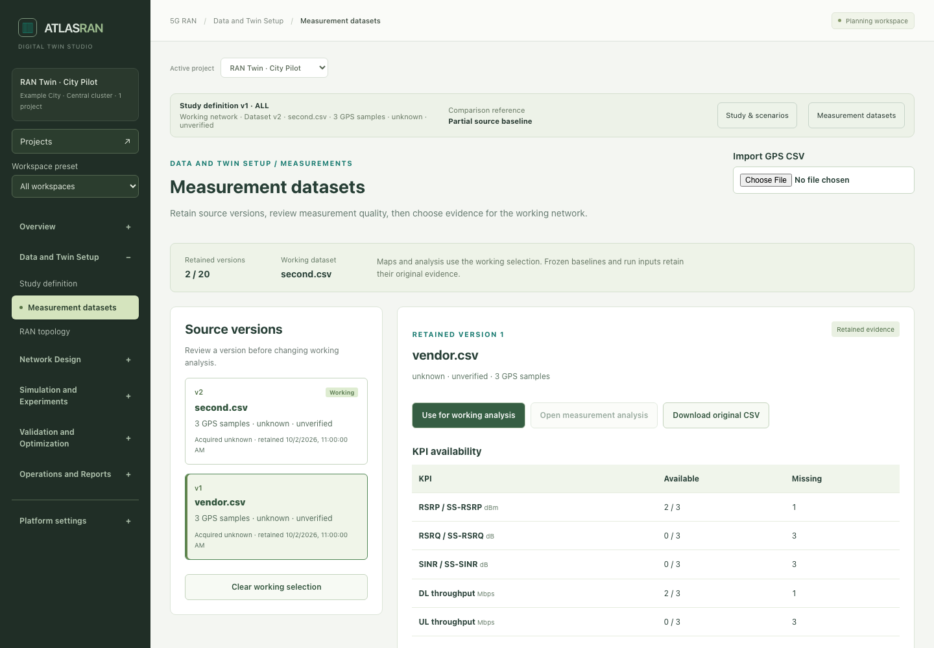
Measurement evidence dependencies
Import review
Map columns and units, declare origin/date and inspect missing KPIs.
Retained version
Keep original CSV, normalization recipe and source identity.
Working selection
Share one dataset across analysis and map workspaces.
18
Notes:
Existing repository design-review capture. Pipeline: column/unit mapping and source declaration, normalized preview, retained measurement snapshot, working selection and shared map views. Source CSV, SHA-256 and mapping evidence stay attached. Browser and Python validation enforce retained evidence and replay consistency. A declared field-measured origin does not independently certify calibration. The library permits at most 20 versions / 2 MB within the project snapshot limit, rejecting exceeded bounds instead of pruning evidence.
Source snapshot: 2 October 2026. Repository: /Users/parkjangwon/Project/UI_UX_Mockup_Typescript. Base commit 46c34d9 with uncommitted and untracked development changes. Source files and cited spans describe the working tree rather than a released version.
Source: src/features/drive/DriveImportReview.tsx:7-100
Source: src/features/drive/driveImportCommands.ts:9-70
Source: measurement-library.mjs:17-87
Source: drive_storage.py:47-152
Source: measurement_storage.py:36-81
Source: docs/design-review/measurement-library/library-desktop.png

Slide 19
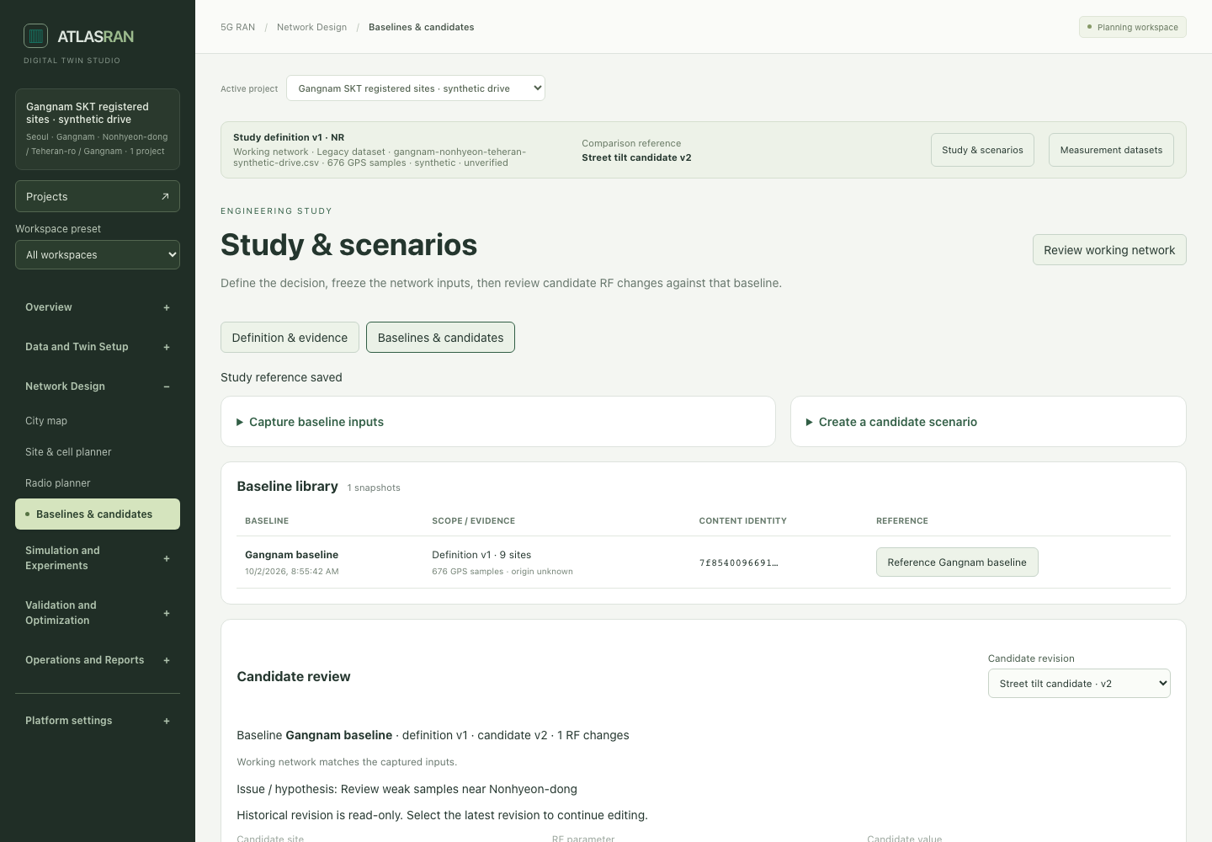
Frozen studies and candidates
Definition history
Record the decision, RAT, carrier and review window.
Baseline and revision
Retain inputs and append changes with content digests.
Execution support
Candidate input edits must fit the current solver’s supported model.
19
Notes:
Existing repository design-review capture. Study definitions are versioned. CaptureBaseline retains engineering inputs and a digest, and candidate revisions retain explicit deltas. resolveRunInputs chooses the working network, baseline or a retained candidate revision. JS and Python transition validators preserve prior definitions/baselines/revisions. The isotropic local path model currently rejects unsupported antenna/cell changes in candidate run preparation and enforces changes that the selected-transmitter model can actually represent. SHA-256 describes input identity, not physical truth.
Source snapshot: 2 October 2026. Repository: /Users/parkjangwon/Project/UI_UX_Mockup_Typescript. Base commit 46c34d9 with uncommitted and untracked development changes. Source files and cited spans describe the working tree rather than a released version.
Source: study.mjs:50-142
Source: study.mjs:150-205
Source: study-run.mjs:6-44
Source: study_storage.py:34-141
Source: docs/design-review/ran-study/candidate-desktop.png

Slide 20
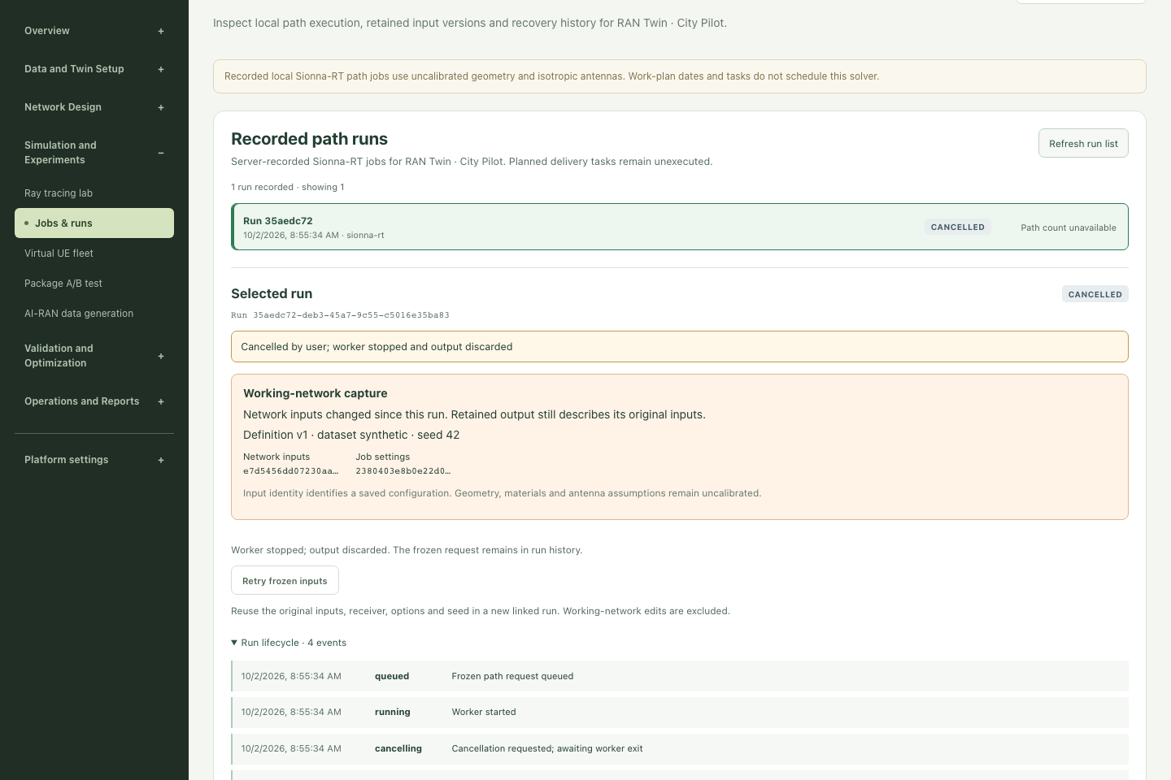
Run lifecycle and recovery
Retained lifecycle
SQLite stores the captured request, result and ordered events.
Cancellation
Keep the worker slot until the worker has stopped.
Exact retry
Create a linked run from frozen inputs, excluding working-network edits.
20
Notes:
Existing repository design-review capture. The server persists queued, running, cancelling, cancelled, complete, failed and interrupted states. Only one worker occupies the active slot. Cancelling retains the slot until worker exit. Startup transitions queued/running/cancelling runs to interrupted. Exact retry applies only to failed/interrupted/cancelled retained path runs with compatible frozen inputs and records retry_of. Terminal evidence remains immutable. Planned delivery tasks are a separate persisted planning object without an executor.
Source snapshot: 2 October 2026. Repository: /Users/parkjangwon/Project/UI_UX_Mockup_Typescript. Base commit 46c34d9 with uncommitted and untracked development changes. Source files and cited spans describe the working tree rather than a released version.
Source: serve.py:51-218
Source: storage.py:256-364
Source: study_run.py:67-142
Source: src/features/artifacts/RunRecoveryActions.tsx
Source: docs/design-review/ran-runs/recovery-desktop.png

Slide 21
Optional Sionna-RT environment
npm run rt:setup
npm run test:rt
npm start
Separate Python 3.13 environment
Sionna-RT 2.1.0
Working native CPU/GPU backend
Bound | Current worker contract
Input geometry | Up to 100 WGS84 building footprints
Solver request | Depth 0–4, 1,000–200,000 samples per source
Execution | One active worker, bounded timeout
Result semantics | Single-link paths with uncalibrated material/antenna assumptions
21
Notes:
Source snapshot: 2 October 2026. Repository: /Users/parkjangwon/Project/UI_UX_Mockup_Typescript. Base commit 46c34d9 with uncommitted and untracked development changes. Source files and cited spans describe the working tree rather than a released version.
Source: scripts/atlas.mjs:53-70
Source: scripts/runtime.mjs:35-61
Source: rt-job.mjs:3-32
Source: rt_worker.py:152-224
Source: README.md:103-125

Slide 22
Extension points and code dependencies
Change area | Primary code | Related validation
KPI chart / analysis | DrivePreviewLeaf.tsx dm.mjs + dm-trend.mjs + dm-ui.mjs | Unit, component and drive browser tests
Site / cell editing | SiteInspector.tsx sitePlannerCommands.ts + radioCommands.ts | Model, command and planner tests
CSV evidence | driveImport.ts + driveImportCommands.ts measurement-library.mjs | Replay, digest and Python validators
Frozen studies | study.mjs + study-run.mjs src/features/study/ | JS/Python transition and capture contracts
Local path execution | rt-job.mjs + rt_worker.py serve.py JobManager | Lifecycle/API tests and optional real RT
Reports / artifacts | artifacts.mjs src/features/artifacts/ | Generated-content and save parity tests
22
Notes:
Source snapshot: 2 October 2026. Repository: /Users/parkjangwon/Project/UI_UX_Mockup_Typescript. Base commit 46c34d9 with uncommitted and untracked development changes. Source files and cited spans describe the working tree rather than a released version.
Source: src/features/site-planner/sitePlannerCommands.ts:25-75
Source: src/features/drive/driveImportCommands.ts:9-70
Source: study.mjs
Source: study-run.mjs
Source: src/features/artifacts/artifactCommands.ts:6-26
Source: src/features/ray-tracing/RayTracingPreviewLeaf.tsx

Slide 23
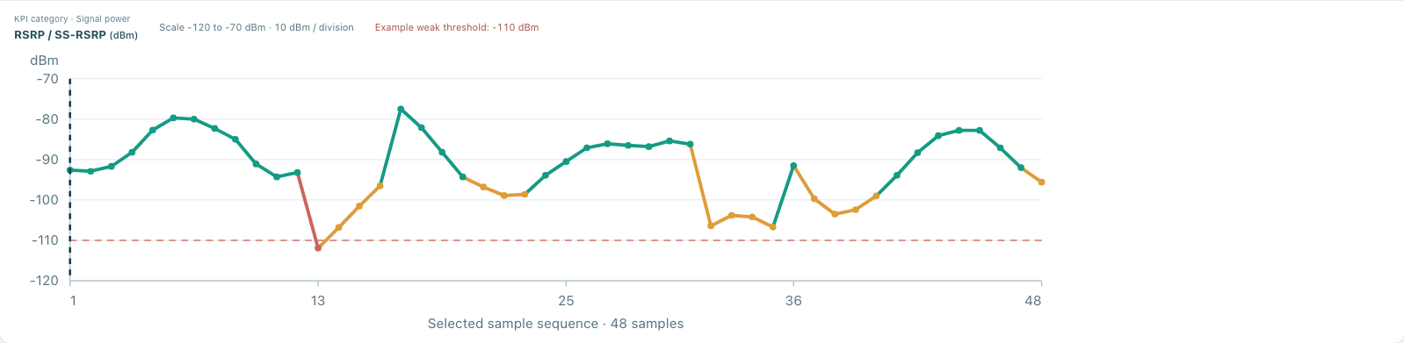
Worked example: the KPI trend chart
Responsibility | Files to change
Metric metadata and exact axes | dm.mjs + dm-trend.mjs
Both presenters and responsive layout | DrivePreviewLeaf.tsx + dm-ui.mjs + dm.css
Behavior and visual regressions | dm-trend.test.mjs; DrivePreviewLeaf.test.tsx Browser: drive-kpi-trend.spec.ts
23
Notes:
The chart image is a browser-test capture from the preceding KPI enhancement in this conversation. The development example uses the actual shared scale helper. DM_METRICS supplies metric/category/unit/threshold metadata. dmTrendScale provides common bounds, ticks, positions and the final sampled observation. Both React and the template presenter depend on it. CSS removes centered letterboxing and preserves a readable scrollable chart on mobile. Missing-value and filtered-sample gaps remain visible.
Source snapshot: 2 October 2026. Repository: /Users/parkjangwon/Project/UI_UX_Mockup_Typescript. Base commit 46c34d9 with uncommitted and untracked development changes. Source files and cited spans describe the working tree rather than a released version.
Source: dm.mjs:2-8
Source: dm-trend.mjs:2-20
Source: dm-ui.mjs:28-44
Source: src/features/drive/DrivePreviewLeaf.tsx:203-308
Source: dm.css
Source: dm-trend.test.mjs
Source: tests/e2e/drive-kpi-trend.spec.ts
Source: docs/design-review/kpi-trend/rsrp-wide.png

Slide 24
Adding a persisted feature
A field inside project_json can still require validation and compatibility changes across languages
Change | Implementation responsibility
Domain contract | Add defaults, bounds, upgrade behavior and export semantics
UI and command adapter | Keep draft state local and dispatch a project-scoped change
Transport contract | Parse the envelope and validate domain/evidence content
Python storage validation | Reject invalid or unsupported persisted claims
Historical evidence | Preserve captured studies, measurement records and terminal runs
Tests and graph | Exercise save/reload/conflict paths and refresh Graft
24
Notes:
Source snapshot: 2 October 2026. Repository: /Users/parkjangwon/Project/UI_UX_Mockup_Typescript. Base commit 46c34d9 with uncommitted and untracked development changes. Source files and cited spans describe the working tree rather than a released version.
Source: src/app/AppController.ts:142-179
Source: src/api/schemas.ts:1-86
Source: model.mjs
Source: workspaces.mjs:209-233
Source: src/api/workspaceApi.ts:34-50
Source: storage.py:95-218

Slide 25
Test layers
Layer | Command | What it establishes
Domain + Python API | npm test | Root .test.mjs plus selected unittest suites
Strict types | npm run typecheck | TypeScript contracts and component call signatures
Component / API contracts | npm run test:ui | Vitest under jsdom
Production / Vite integration | npm run test:integration | Build, serving, save and conflicts
Real browser workflows | npm run test:e2e | Chromium navigation, input and visual behavior
Optional real solver | npm run test:rt | Installed Sionna-RT backend execution
Combined local gate | npm run check | Tests, types, components, build and syntax
25
Notes:
Source snapshot: 2 October 2026. Repository: /Users/parkjangwon/Project/UI_UX_Mockup_Typescript. Base commit 46c34d9 with uncommitted and untracked development changes. Source files and cited spans describe the working tree rather than a released version.
Source: scripts/atlas.mjs:9-19
Source: scripts/atlas.mjs:34-71
Source: vitest.config.ts
Source: playwright.config.ts
Source: .github/workflows/cross-platform.yml

Slide 26
Focused validation commands
node --test dm-trend.test.mjs
npm run test:ui -- src/features/drive/DrivePreviewLeaf.test.tsx
npm run test:e2e -- tests/e2e/drive-kpi-trend.spec.ts
Full local gate
Browser installation
npm run check
npm exec --no -- playwright install chromium
26
Notes:
Run the smallest relevant behavior test first. Then run the full local gate. Browser tests and the real optional RT smoke test are separate from npm run check. Browser testing installs Chromium with npm exec --no -- playwright install chromium. A different PLAYWRIGHT_PORT avoids occupying an existing development port. Shell environment-variable syntax differs between Unix and PowerShell.
Source snapshot: 2 October 2026. Repository: /Users/parkjangwon/Project/UI_UX_Mockup_Typescript. Base commit 46c34d9 with uncommitted and untracked development changes. Source files and cited spans describe the working tree rather than a released version.
Source: package.json:10-25
Source: scripts/atlas.mjs:9-19
Source: playwright.config.ts
Source: tests/e2e/drive-kpi-trend.spec.ts

Slide 27
Validation snapshot: 2 October 2026
Stage | Observed result | Status
JavaScript domain tests | 124 passed | Passed
Python tests | 38 passed | Passed
Strict TypeScript | SiteInspector / RadioField signature mismatches | Failed
Component tests | Sequential gate stopped before this stage | Not run
Production integration / build | Sequential gate stopped before this stage | Not run
Browser suite / real RT | Separate commands, outside this validation run | Not run
Resolve the reported call/type mismatch and repeat the gate before treating this snapshot as ready.
27
Notes:
Evidence comes from the fresh make check run while preparing this guide. 124 Node tests and 38 Python tests passed. The gate then stopped at TypeScript with six diagnostics: TS2554 at SiteInspector.tsx(30,103) and TS2339/TS2353 on prop on Omit<RadioField,"siteId"> at lines 42,45,72,73. This is a working-tree snapshot amid concurrent development, not a release status. Component, frontend integration/build and subsequent Make syntax checks were not reached in that run. The full browser suite and real RT smoke test were not invoked as part of this deck task. The prior KPI turn passed its focused two browser tests and a prior full gate, but that older result is not relabeled as current.
Source snapshot: 2 October 2026. Repository: /Users/parkjangwon/Project/UI_UX_Mockup_Typescript. Base commit 46c34d9 with uncommitted and untracked development changes. Source files and cited spans describe the working tree rather than a released version.
Source: Makefile:35-66
Source: src/features/site-planner/SiteInspector.tsx:26-73
Source: src/features/radio/radioCommands.ts
Source: /private/tmp/atlas-development-guide-check.log

Slide 28
Cross-platform CI configuration
Configuration | Current workflow
Operating systems | windows-latest and ubuntu-latest
Toolchain | Node 24 and Python 3.13
Path compatibility | Checkout directory: atlas workspace
Install | npm run setup
Main gate | npm run check
Browser gate | Install Chromium with OS dependencies, then test:e2e
These are workflow settings. Confirm the actual run result in CI for each change.
28
Notes:
The inspected workflow configures Windows and Ubuntu jobs with Node 24 and Python 3.13. It checks out into atlas workspace, including a space in the path, installs development and optional dependencies, runs npm run check, installs Chromium with OS dependencies, then runs browser workflows. No remote CI run was queried. The slide describes configured behavior, not a verified remote pass.
Source snapshot: 2 October 2026. Repository: /Users/parkjangwon/Project/UI_UX_Mockup_Typescript. Base commit 46c34d9 with uncommitted and untracked development changes. Source files and cited spans describe the working tree rather than a released version.
Source: .github/workflows/cross-platform.yml:1-45
Source: scripts/runtime.mjs:15-34
Source: README.md:41-62

Slide 29
Troubleshooting
Symptom | Check | Repair direction
Connection refused | Printed URL and server process | Start the correct server or use its selected port
Vite API request fails | ATLAS_API_ORIGIN matches Python port | Restart Vite with the correct local target
SQLite cannot open | ATLAS_DB_PATH and parent directory access | Use an accessible intended database location
Save conflict / dirty draft | Server revision and comparison view | Reconcile the draft through the controller
Missing native binding | Node architecture and lockfile binding | Install platform-specific optional dependencies
UI change absent | Source checkout, dist build and browser cache | Rebuild the production bundle and reload
29
Notes:
Guidance focuses on concrete failure paths. A stale-revision draft requires comparison and controlled reconciliation rather than forced overwrite. If a Rolldown platform binding is missing, first confirm Node architecture and exact lockfile binding. Reinstall the declared optional dependencies on the target platform, and use only the matching locked package if a targeted repair is needed. Development servers use current source, while the Python server serves the built dist bundle. API errors should be diagnosed before browser backup recovery.
Source snapshot: 2 October 2026. Repository: /Users/parkjangwon/Project/UI_UX_Mockup_Typescript. Base commit 46c34d9 with uncommitted and untracked development changes. Source files and cited spans describe the working tree rather than a released version.
Source: README.md:41-77
Source: scripts/runtime.mjs:15-34
Source: scripts/runtime.mjs:106-114
Source: src/app/AppController.ts:111-179
Source: serve.py:446-490
Source: package.json:10-25

Slide 30
Additional development guide
Next development area | Required code / evidence work
Stabilize the current branch | Resolve type errors, complete local and browser gates
Broader radio-model support | Represent antenna/cell settings in the solver and test captures
Calibration and comparison | Align nonsynthetic evidence and retain comparable completed runs
Connected observation | Add authenticated adapters with timestamped source status
Controlled changes | Implement a reviewed change adapter and rollback contract
For each feature: identify its state owner, trace dependencies, preserve evidence, validate the result and refresh Graft.
30
Notes:
These are recommended development areas, not implemented capabilities. A radio-model extension needs accurate antenna/reference-signal semantics, compatible retained request contracts, calibration evidence and tests. A connected observation adapter needs authenticated read access, timestamped collector provenance and explicit freshness handling. Controlled network changes require a separately reviewed adapter, approval and rollback implementation. This deck is a development reference and does not authorize external network actions or source-file transfer.
Source snapshot: 2 October 2026. Repository: /Users/parkjangwon/Project/UI_UX_Mockup_Typescript. Base commit 46c34d9 with uncommitted and untracked development changes. Source files and cited spans describe the working tree rather than a released version.
Source: docs/ran-digital-twin-enhancement-plan.md
Source: docs/ran-enhancement-implementation.md
Source: src/features/mission-control/studyReadiness.ts:12-38
Source: AGENTS.md

