Slide 1
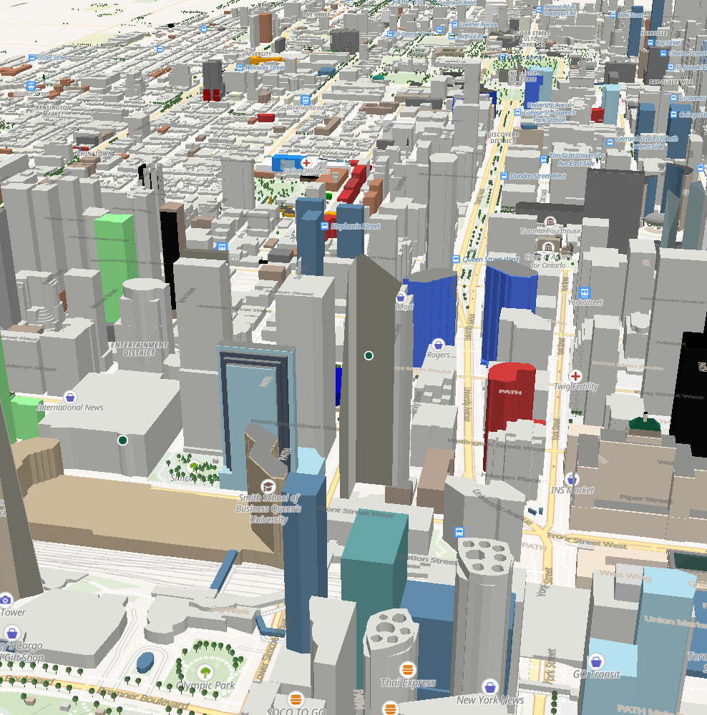
CONGITV NDT
Network
Digital Twin
3D visualization
Implementation & UX design
Toronto & New York City
12 NOVEMBER 2026
Notes:
A 30-slide implementation and UX design review grounded in the current toronto-ndt checkout. Sources: README.md; ndt/README.md; docs/FEATURE_DESCRIPTION.typ; docs/SOFTWARE_DESIGN.typ. Cover image: current MapLibre and Three.js scene in downtown Toronto, captured with application controls temporarily hidden for composition. No city geometry was added or retouched. The model is schematic. Basemap: OpenFreeMap, OpenMapTiles and OpenStreetMap contributors. Terrain: Mapterhorn. Proposed UX changes are explicitly labeled in subsequent slides.

Slide 2
Spatial context for network planning
A city view
with traceable
planning inputs
Spatial understanding
Buildings, terrain and street context explain where sites and routes sit.
Planning workflows
Project membership, Task routes and virtual UE locations retain local context.
Evidence boundaries
Source records, assumptions and modeled outputs remain distinguishable.
Current scope: local visualization and planning. Live network control is outside this implementation.
CURRENT IMPLEMENTATION
02
Notes:
Network Digital Twin implementation and UX design review. Snapshot: 12 November 2026.
Repository sources: README.md, ndt/README.md and docs/FEATURE_DESCRIPTION.typ, product scope and limitations. The product currently provides regional visualization, planning data and a local drive-test workspace. It does not demonstrate live network synchronization, production control or calibrated physical propagation.

Slide 3
Users and decisions
User role | Primary decision | UX need
Radio planner | Which sites and bearings deserve review? | Visible assumptions and stable selection
Drive-test engineer | Which saved route and speed cases apply? | Clear project, Task and route context
Technical reviewer | What supports the result? | Sources, frozen inputs and explicit limits
Platform engineer | Where do data and state belong? | Inspectable modules and service contracts
Working roles inferred from the current planning and review workflows.
DESIGN ASSUMPTIONS
03
Notes:
Network Digital Twin implementation and UX design review. Snapshot: 12 November 2026.
Design synthesis based on implemented workflows in ndt/README.md, project and Task views, integrated Drive tests and software design. Roles and UX needs are design assumptions, not validated user-research results.

Slide 4
The planning journey
01
Choose context
Select a region and a project.
02
Inspect the scene
Navigate the city, then select sites and reported bearings.
03
Prepare a drive
Save a Task route and one or more speed cases.
04
Run or import
Execute a supported planning experiment or import a capture.
05
Review evidence
Replay, compare and export results with their input context.
CURRENT IMPLEMENTATION
04
Notes:
Network Digital Twin implementation and UX design review. Snapshot: 12 November 2026.
Sources: ndt/README.md; ndt/dist/index.html; ndt/dist/drive-test/index.html. Navigation carries region/project/Task/route context into Drive tests. Route execution requires a saved route, speed cases and usable planning transmitters. Imports and measured capture workflows have distinct data requirements.

Slide 5
Implementation scope
Capability | Current behavior | Boundary
3D regional scene | Toronto and New York views | External map and elevation services
Network exploration | Toronto ISED records and planning fans | Licensed records do not prove live service
Project planning | Sites, Tasks, routes and static virtual UEs | Local persistence, no collaborative merge
Virtual drives | UMa mean-power estimates on saved routes | Eligible Toronto inputs only
Advanced propagation | Unavailable | No calibrated ray tracing or interference engine
Visual fidelity and numerical model fidelity have separate limits.
CURRENT IMPLEMENTATION
05
Notes:
Network Digital Twin implementation and UX design review. Snapshot: 12 November 2026.
Sources: README.md; docs/FEATURE_DESCRIPTION.typ (RF-09, UE-01, VDT-04, VDT-05); docs/SOFTWARE_DESIGN.typ, integrated DM architecture. No production telemetry ingestion or closed-loop network control is claimed.

Slide 6
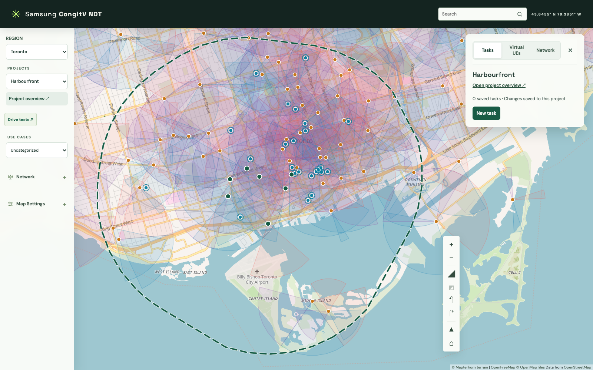
Desktop workspace anatomy
Left: context
Region, project and layer controls establish the working scope.
Center: scene
The map carries spatial relationships and planning overlays.
Right: detail
Tasks, virtual UEs and network inspection share one context panel.
CURRENT IMPLEMENTATION
06
Notes:
Network Digital Twin implementation and UX design review. Snapshot: 12 November 2026.
Sources: ndt/dist/index.html; docs/SOFTWARE_DESIGN.typ, UI MVVM boundaries and context-panel behavior. Harbourfront project screenshot. The wide project hull is a planning boundary, not verified RF coverage.
Screenshot: 02-workspace.png, captured from the current checkout with live external map services. No generated illustration. Basemap and terrain attribution are retained in the capture.

Slide 7
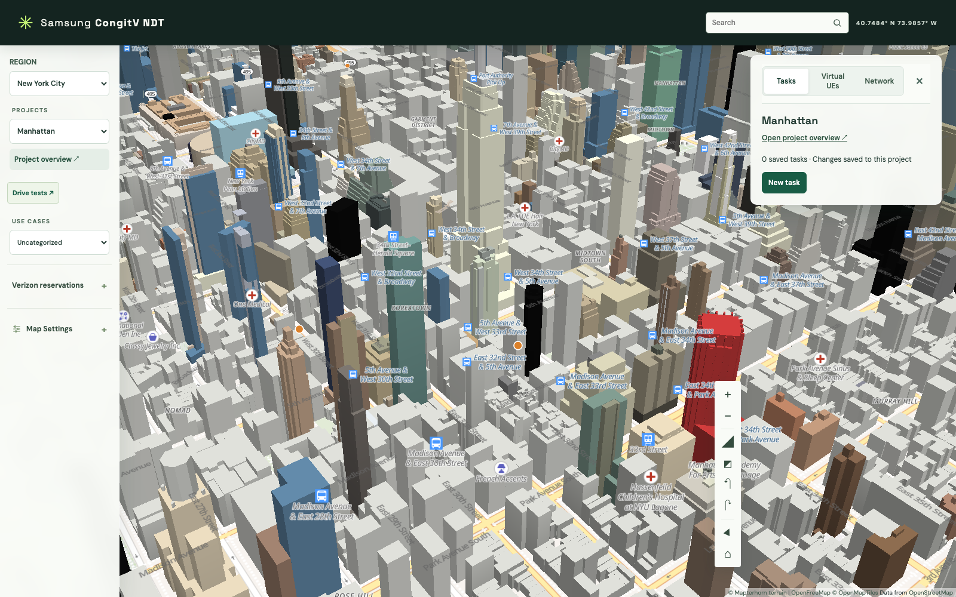
Regional context and data meaning
Shared navigation
The same scene and project controls work across both regions.
Different adapters
Toronto uses ISED radio records. New York uses pole reservations.
Different claims
A reservation status does not establish an operating radio site.
CURRENT IMPLEMENTATION
07
Notes:
Network Digital Twin implementation and UX design review. Snapshot: 12 November 2026.
Sources: ndt/regions.json; ndt/README.md; ndt/dist/reservations-model.mjs; docs/SOFTWARE_DESIGN.typ, regional network adapters. New York proposed reservations remain searchable but are hidden from the map. New York records lack directional and frequency attributes for the planning propagation workflow.
Screenshot: 16-nyc.png, captured from the current checkout with live external map services. No generated illustration. Basemap and terrain attribution are retained in the capture.

Slide 8
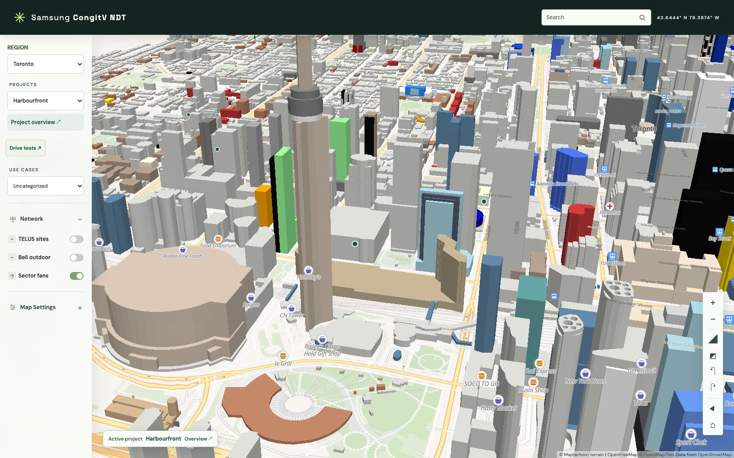
3D camera interaction
Direct exploration
Drag to pan, right-drag to rotate and scroll to zoom.
Visible alternatives
Dedicated controls expose zoom, tilt, rotation and north reset.
Orientation recovery
Home restores the regional overview when users lose context.
CURRENT IMPLEMENTATION
08
Notes:
Network Digital Twin implementation and UX design review. Snapshot: 12 November 2026.
Sources: ndt/README.md, camera controls; ndt/dist/index.html; ndt/dist/map-controls-view.mjs. Current downtown Toronto scene with network layers disabled for visual clarity. Camera controls support keyboard and touch. Camera framing is visual, not a propagation input.
Screenshot: 03-camera.png, captured from the current checkout with live external map services. No generated illustration. Basemap and terrain attribution are retained in the capture.

Slide 9
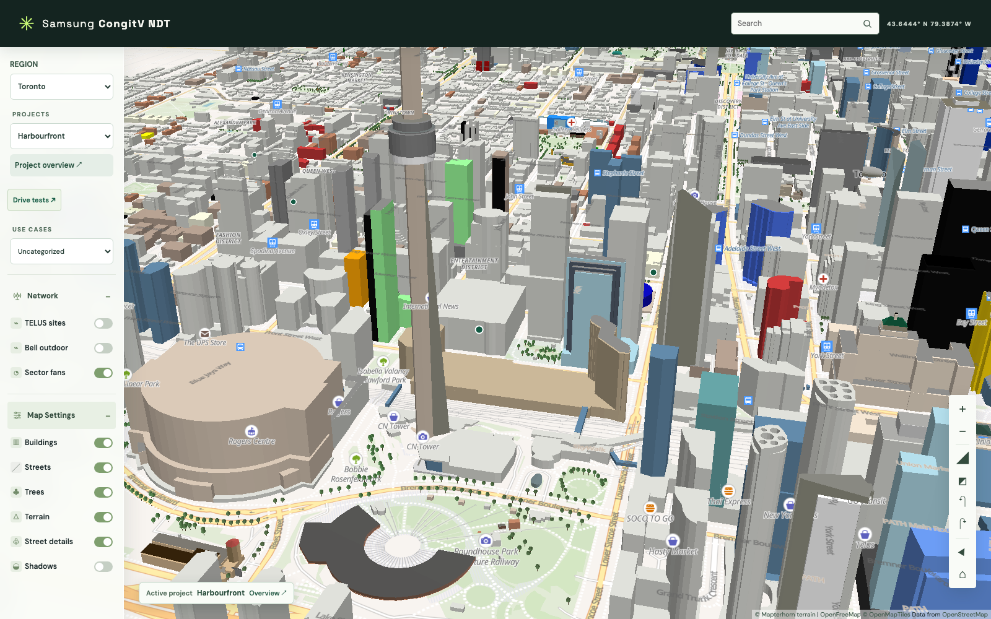
Layer controls and visual hierarchy
Independent layers
Buildings, streets, trees, terrain and street details toggle separately.
Optional shadows
Shadows start off and remain an illustrative scene effect.
Design recommendation
Inspection should favor the selected site when dense fans obscure streets.
Current controls. Selection focus is a proposed default.
CURRENT IMPLEMENTATION
09
Notes:
Network Digital Twin implementation and UX design review. Snapshot: 12 November 2026.
Sources: ndt/dist/index.html; docs/FEATURE_DESCRIPTION.typ, map settings; docs/SOFTWARE_DESIGN.typ, lighting and network display. The current app provides selected-site-only fans and a fan intensity control. Changing the default is a UX proposal, not an implemented modification.
Screenshot: 04-layers.png, captured from the current checkout with live external map services. No generated illustration. Basemap and terrain attribution are retained in the capture.

Slide 10
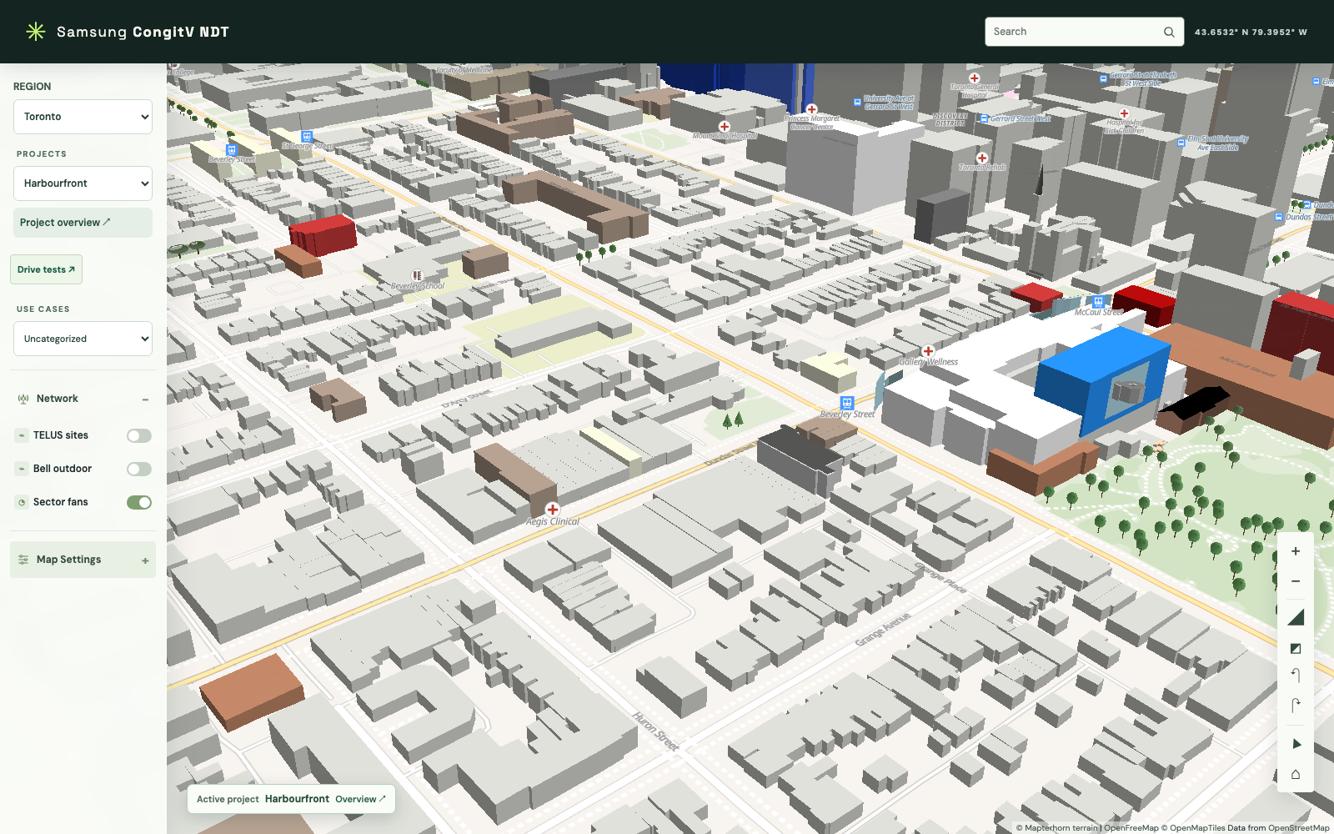
Buildings and roof detail
Native base
MapLibre extrudes building footprints from available tile attributes.
Selective replacement
Three.js adds supported mapped roof forms at closer zooms.
Safe fallback
Missing heights, unsupported shapes or failed matches retain native buildings.
CURRENT IMPLEMENTATION
10
Notes:
Network Digital Twin implementation and UX design review. Snapshot: 12 November 2026.
Sources: docs/SOFTWARE_DESIGN.typ, Building extrusions and roof replacement; ndt/dist/roof-layer.mjs; ndt/dist/roof-geometry.mjs. Roof detail begins at zoom 15. Supported forms include skillion, gabled, hipped, pyramidal, dome, cone and onion, subject to geometry restrictions. OSM-derived details are schematic and incomplete. The live tile date may differ from the prepared extract date.
Screenshot: 05-roofs.png, captured from the current checkout with live external map services. No generated illustration. Basemap and terrain attribution are retained in the capture.

Slide 11
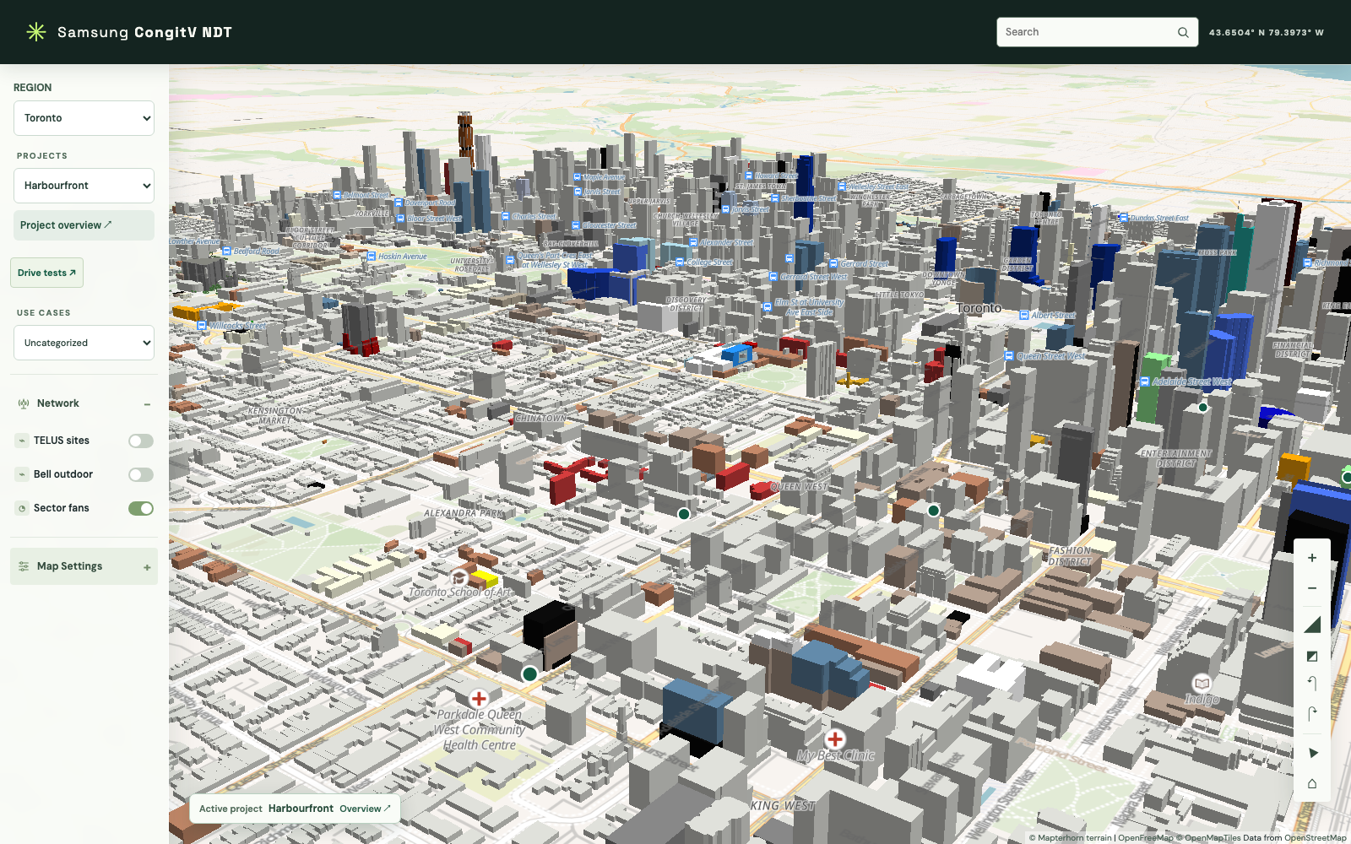
Terrain and vertical alignment
One elevation frame
Terrain uses Mapterhorn DEM tiles at 1× exaggeration.
Ground-aware detail
Custom layers place objects using available terrain samples.
Visible uncertainty
Unavailable elevation can delay or omit detailed objects.
CURRENT IMPLEMENTATION
11
Notes:
Network Digital Twin implementation and UX design review. Snapshot: 12 November 2026.
Sources: docs/SOFTWARE_DESIGN.typ, Data sources and scene composition; ndt/dist/map-scene-view.mjs. Mapterhorn source uses Terrarium encoding, tileSize 512, maxzoom 12. The scene is not independently surveyed. When terrain is off, custom layer code uses zero ground elevation. DEM rendering does not feed UMa propagation.
Screenshot: 07-terrain.png, captured from the current checkout with live external map services. No generated illustration. Basemap and terrain attribution are retained in the capture.

Slide 12
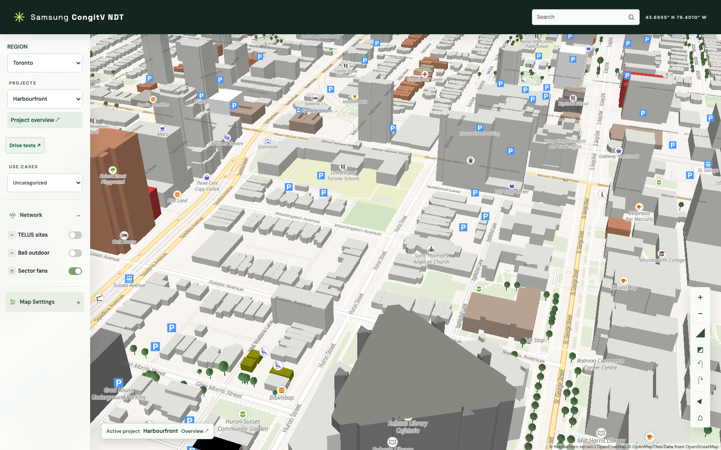
Vegetation and street detail
Context at close range
Instanced trees and street furniture add scale to the 3D scene.
Mapped and estimated
Tree-row sampling can create estimated tree positions.
Schematic geometry
Lamps, benches and tree forms illustrate context rather than surveyed assets.
CURRENT IMPLEMENTATION
12
Notes:
Network Digital Twin implementation and UX design review. Snapshot: 12 November 2026.
Sources: docs/SOFTWARE_DESIGN.typ, Tree extraction and rendering, Street detail selection and lighting; ndt/dist/tree-layer.mjs; ndt/dist/street-detail.mjs. Trees switch to custom 3D rendering at zoom 15. Street detail begins at zoom 17, limits selection to approximately 1.2 km and 1,000 objects, and omits instances without finite terrain samples when terrain is enabled.
Screenshot: 06-street.png, captured from the current checkout with live external map services. No generated illustration. Basemap and terrain attribution are retained in the capture.

Slide 13
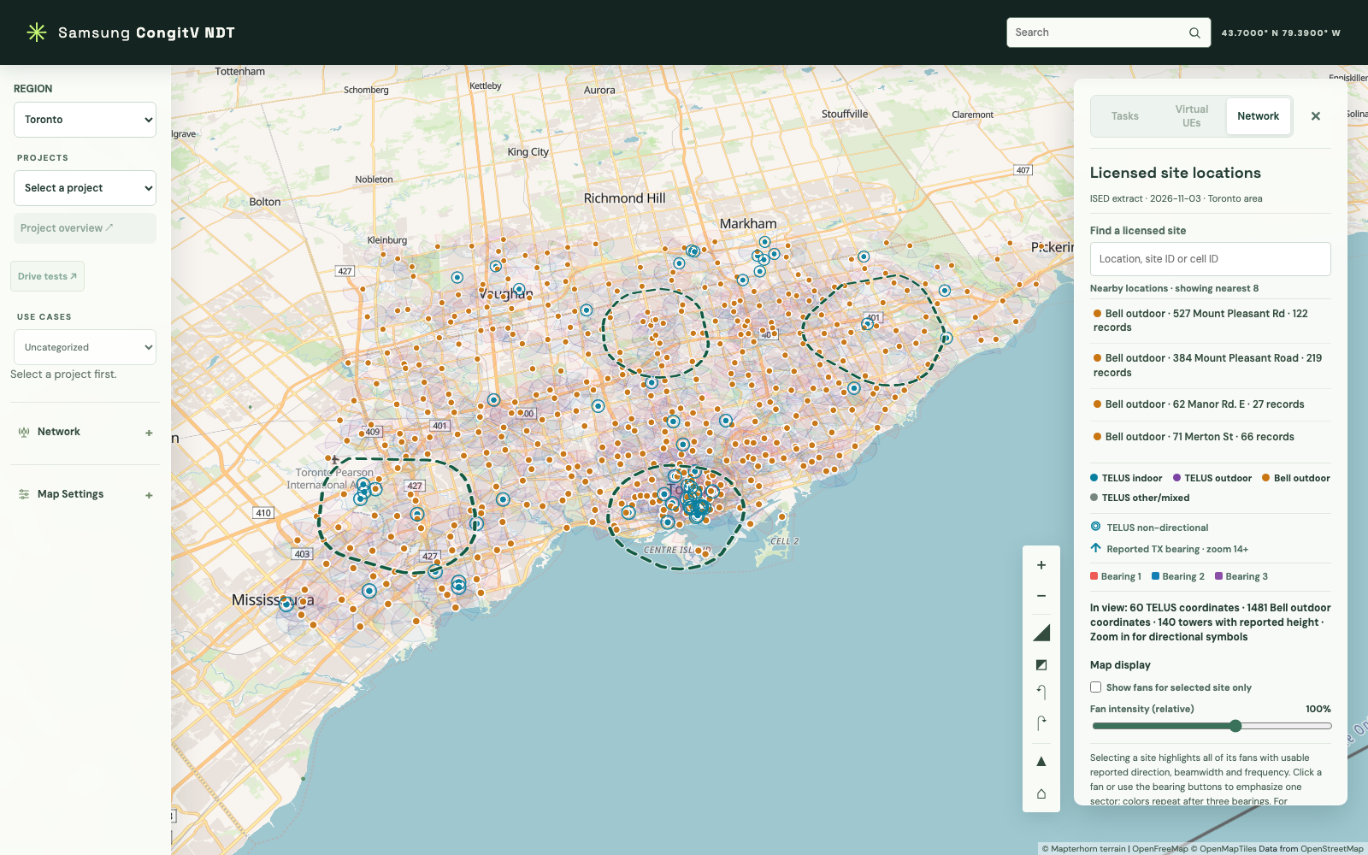
Network overlays in the city scene
Reported locations
TELUS and Bell records share the geographic scene.
Layer meaning
Site symbols describe source categories. Fan colors describe bearing order.
Clutter control
Layer visibility, fan intensity and selection focus reduce overlap.
CURRENT IMPLEMENTATION
13
Notes:
Network Digital Twin implementation and UX design review. Snapshot: 12 November 2026.
Sources: ndt/README.md, Toronto network exploration; ndt/dist/network-view.mjs; docs/SOFTWARE_DESIGN.typ, Regional network adapters. TELUS indoor teal, outdoor purple and other/mixed grey. Bell outdoor orange. A reported directional bearing can group multiple records and does not establish a unique physical sector. ISED license data does not verify TELUS use of a particular Bell site.
Screenshot: 01-citywide.png, captured from the current checkout with live external map services. No generated illustration. Basemap and terrain attribution are retained in the capture.

Slide 14
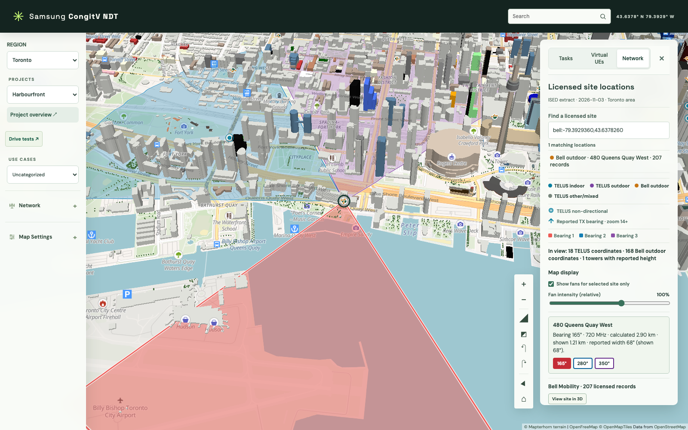
Site inspection and selection
One selected context
A location selection links the map to reported site attributes.
Readable evidence
The detail view exposes identifiers and available radio attributes.
Focused exploration
Selected-site-only fans remove competing overlays while reviewing bearings.
CURRENT IMPLEMENTATION
14
Notes:
Network Digital Twin implementation and UX design review. Snapshot: 12 November 2026.
Sources: ndt/dist/network-view.mjs; ndt/dist/network-view-model.mjs; ndt/README.md. Current screenshot selects a Bell location from the nearby list and enables the existing selected-site-only control. Closing the panel preserves selection and visible fan state. Schematic towers and map symbols are not validated physical equipment inventories.
Screenshot: 09-site-details.png, captured from the current checkout with live external map services. No generated illustration. Basemap and terrain attribution are retained in the capture.

Slide 15
Sector fans: geometry and meaning
Visual element | Encoding | Interpretation
Fan direction | Reported TX azimuth | A directional source attribute
Fan width | Widest reported beamwidth, minimum display 15° | Display may be wider than the report
Fan radius | 5/12 of the calculated boresight radius | Full calculated radius remains in details
Fan color | Bearing order, repeating after three | Color does not identify a cell or RAT
Planning fans illustrate assumptions. The screen shape does not establish measured coverage.
CURRENT IMPLEMENTATION
15
Notes:
Network Digital Twin implementation and UX design review. Snapshot: 12 November 2026.
Sources: ndt/README.md, sector fans and selected-sector details; ndt/dist/network-data.mjs; ndt/dist/radio-model.mjs. Overview fans require exactly three usable bearing groups. Selected-site detail can show other bearing counts with usable attributes. The project hull uses full-radius geometry, independently of the 5/12 display radius.

Slide 16
Radio model inputs and limits
Input or output | Implemented policy | UX implication
Assumptions | LOS/NLOS, EIRP and receive threshold | Keep editable assumptions beside results
Fixed heights | Base station 25 m, UE 1.5 m | Show fixed values as model constraints
Distance domain | 10 m to 5 km | Expose out-of-range or capped results
Virtual-drive metric | predicted_rx_dbm | Label modeled power separately from RSRP
Excluded effects | Patterns, interference and building occlusion | 3D objects do not imply RF interaction
Current defaults: NLOS, 46 dBm EIRP and −100 dBm receive threshold.
CURRENT IMPLEMENTATION
16
Notes:
Network Digital Twin implementation and UX design review. Snapshot: 12 November 2026.
Sources: ndt/dist/radio-model.mjs; ndt/dm/simulation.py; README.md; docs/SOFTWARE_DESIGN.typ, simulation contracts. The implementation uses UMa mean path loss and isotropic planning transmitters. Site-level frequency selection uses the lowest usable reported frequency for a virtual drive. Fan calculations use the lowest usable frequency per bearing. No calibrated ray tracing, interference, mobility, throughput or latency model is implemented.

Slide 17
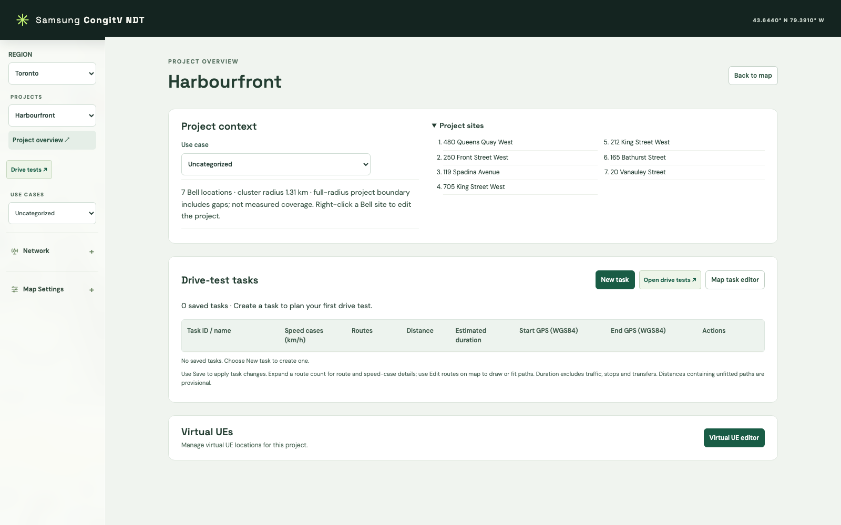
Project overview and task management
Project scope
A dedicated page exposes membership and the active project context.
Task register
The lower table connects speed cases, routes, distance and endpoints.
Map continuity
Back to map restores geographic work without changing the project.
CURRENT IMPLEMENTATION
17
Notes:
Network Digital Twin implementation and UX design review. Snapshot: 12 November 2026.
Sources: ndt/dist/project-view.mjs; ndt/dist/task-table-view.mjs; docs/SOFTWARE_DESIGN.typ, UI MVVM boundaries. Overview makes the obscured map, camera and search inert. Escape or Back to map restores them and returns focus. Screenshot uses a fresh disposable planning database, so the Task register is initially empty.
Screenshot: 10-overview.png, captured from the current checkout with live external map services. No generated illustration. Basemap and terrain attribution are retained in the capture.

Slide 18
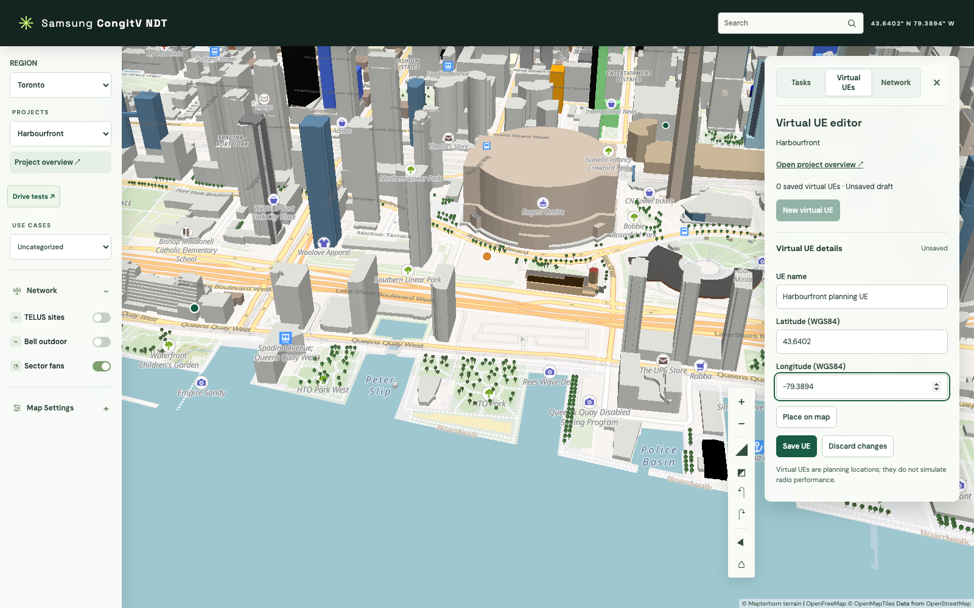
Static virtual UE planning
Project locations
Users name a UE and enter WGS84 coordinates or place it on the map.
Explicit save
Saved locations persist in SQLite under the region and project.
Clear boundary
Static virtual UEs do not move along drive routes or simulate radio behavior.
Illustrative unsaved draft in the current UE editor
CURRENT IMPLEMENTATION
18
Notes:
Network Digital Twin implementation and UX design review. Snapshot: 12 November 2026.
Sources: ndt/dist/virtual-ue-view.mjs; ndt/server.py, virtual_ues persistence; docs/FEATURE_DESCRIPTION.typ UE-01. The screenshot is an unsaved design-review example. Failed saves retain drafts for retry. No screenshot data was written to the user planning database.
Screenshot: 11-ue-editor.png, captured from the current checkout with live external map services. No generated illustration. Basemap and terrain attribution are retained in the capture.

Slide 19
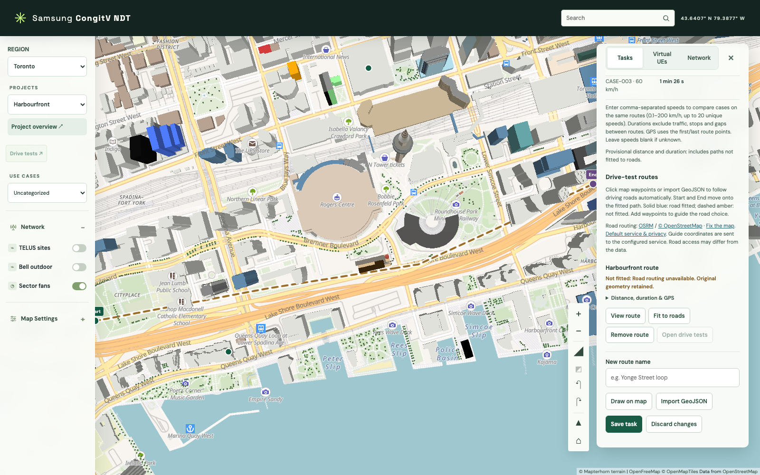
Route planning and road-fit states
Geometry entry
Draw a path or import LineString and MultiLineString GeoJSON.
Fitting feedback
Routing progress, fitted status and failure messages keep the path state visible.
Honest estimates
An unfitted path produces provisional distance and duration.
Unsaved illustrative route. A controlled routing failure demonstrates the fallback state.
CURRENT IMPLEMENTATION
19
Notes:
Network Digital Twin implementation and UX design review. Snapshot: 12 November 2026.
Sources: ndt/dist/task-view-model.mjs; ndt/road_routing.py; docs/SOFTWARE_DESIGN.typ, road routing adapter and validation. Screenshot captures an unsaved route with an injected 503 routing response. Original geometry is retained. OSRM fitting does not prove intended-road correctness, current access or physical driveability. External requests disclose numeric route coordinates to the configured routing provider.
Screenshot: 12-route-editor.png, captured from the current checkout with live external map services. No generated illustration. Basemap and terrain attribution are retained in the capture.

Slide 20
Speed cases on one shared route
Illustrative route | Constant speed | Calculated drive time
1.0 km | 20 km/h | 3 minutes
1.0 km | 40 km/h | 1 minute 30 seconds
1.0 km | 60 km/h | 1 minute
Time = distance ÷ speed. Traffic, stops, acceleration and transfers are excluded.
ILLUSTRATIVE CALCULATION
20
Notes:
Network Digital Twin implementation and UX design review. Snapshot: 12 November 2026.
Illustrative arithmetic, not a saved project measurement or a performance benchmark. For a 1.0 km route, time is 1/20 h = 180 s, 1/40 h = 90 s, 1/60 h = 60 s. Implementation sources: ndt/task_store.py; docs/SOFTWARE_DESIGN.typ, drive_speed_cases and drive_route_case_details. Saved metrics come from SQLite views. The client uses draft estimates before save. Up to 20 unique speed cases are supported between 0.1 and 200 km/h.

Slide 21
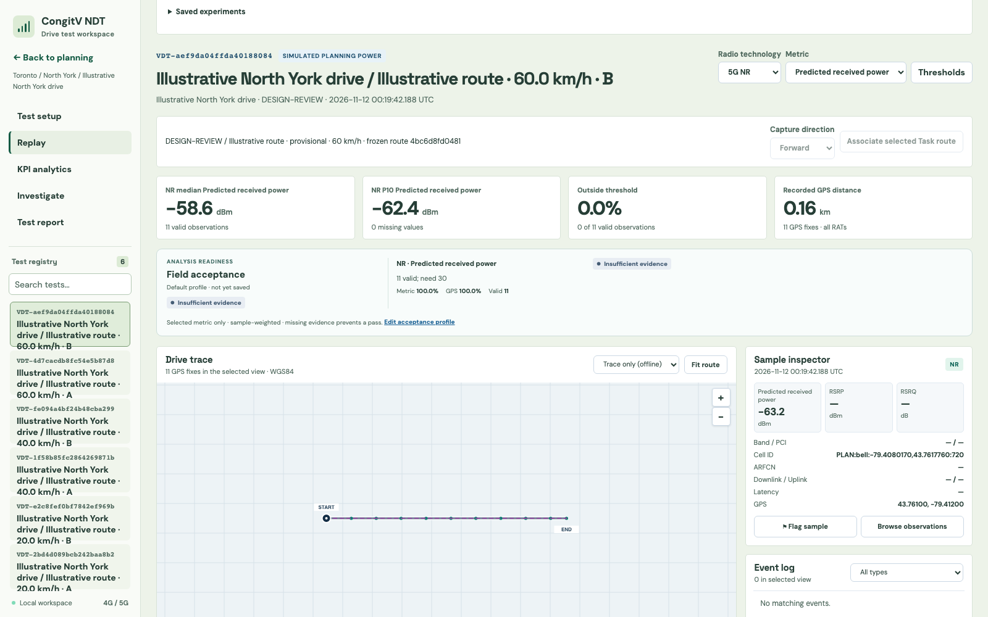
Integrated drive-test workspace
Context continuity
The workspace retains the planning project, Task and route.
Two entry paths
Import a normalized capture or execute a supported virtual drive.
One review surface
Replay, KPI analytics, investigation and reports share the registry.
Current workspace with a simulated illustrative route in a disposable test registry
CURRENT IMPLEMENTATION
21
Notes:
Network Digital Twin implementation and UX design review. Snapshot: 12 November 2026.
Sources: README.md, Drive tests; ndt/dist/drive-test/index.html; docs/SOFTWARE_DESIGN.typ, Integrated DM architecture. Screenshot shows a real local virtual-drive execution using an illustrative saved Task in a disposable database. It is a planning simulation, not a measured capture. The source label and predicted_rx_dbm metric must remain distinguishable from field measurements.
Screenshot: 18-virtual-replay.png, captured from the current checkout with live external map services. No generated illustration. Basemap and terrain attribution are retained in the capture.

Slide 22
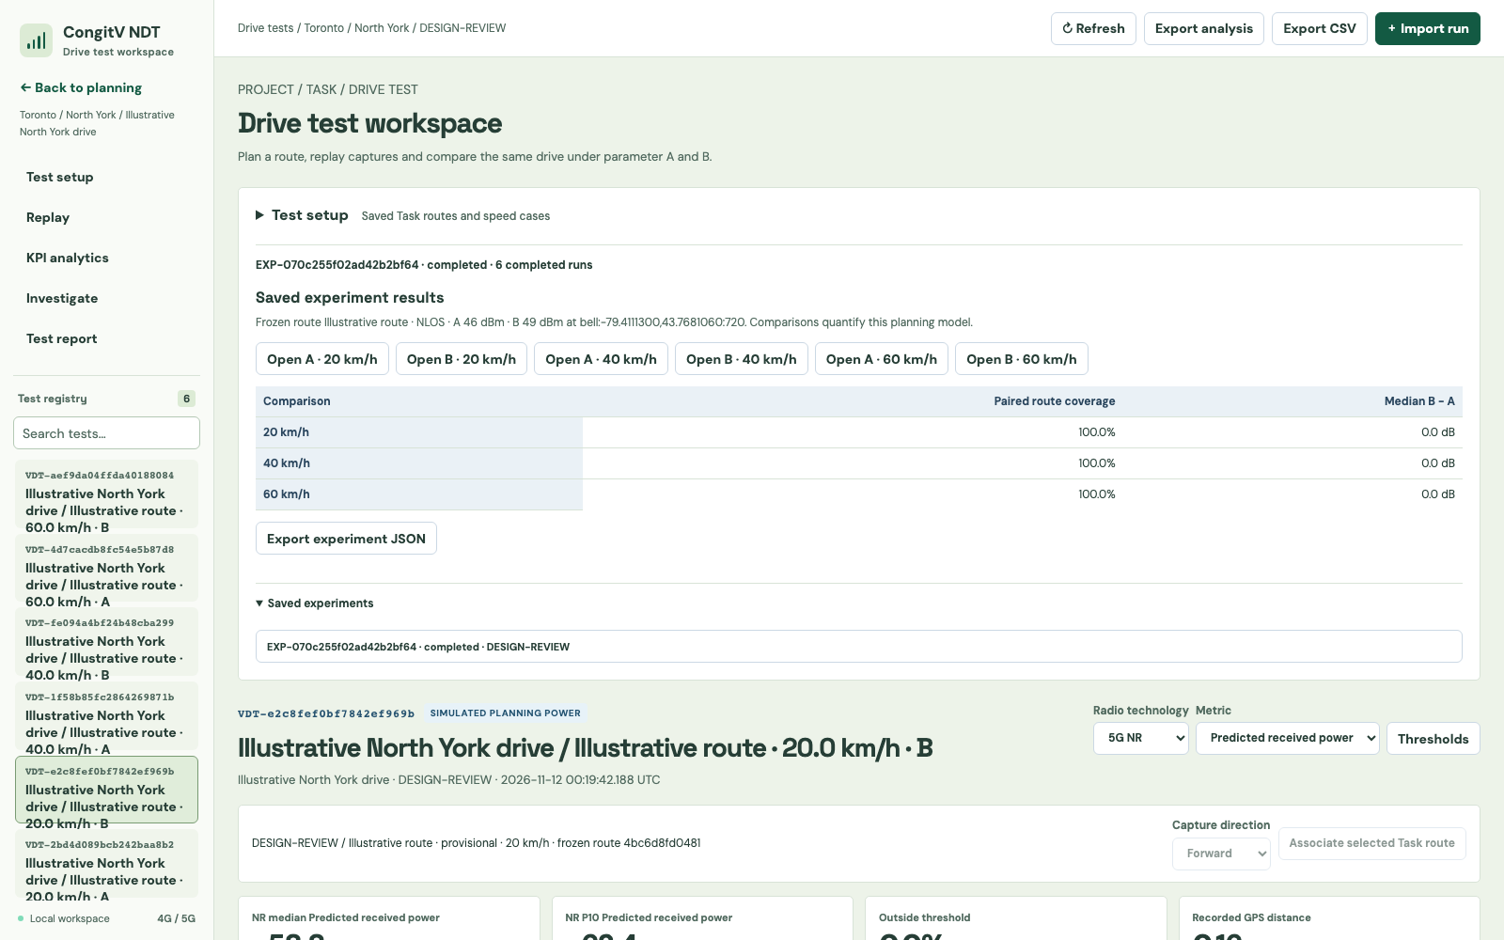
Controlled planning power A/B
Shared basis
A and B use the same frozen route, speed and sampling grid.
One controlled change
A sets baseline power. B changes the selected planning transmitter.
Reviewable result
Paired comparisons retain effective inputs and exportable experiment context.
Actual execution of an illustrative model experiment. No field improvement is claimed.
CURRENT IMPLEMENTATION
22
Notes:
Network Digital Twin implementation and UX design review. Snapshot: 12 November 2026.
Sources: ndt/dm/experiments.py; ndt/dm/simulation.py; docs/SOFTWARE_DESIGN.typ, execution contracts and alignment. Three selected speed cases create six runs and three A/B pairs. A uses common EIRP across eligible planning transmitters. B changes one transmitter only. Model comparison is not causal evidence of a field-network improvement. No tilt or mobility parameter engine is provided.
Screenshot: 19-parameter-ab.png, captured from the current checkout with live external map services. No generated illustration. Basemap and terrain attribution are retained in the capture.

Slide 23
Evidence and provenance
Evidence class | What it contains | Presentation rule
Source records | Reported site attributes and reservation status | Retain source identity and date
User assumptions | Power, environment, speeds and route choice | Keep assumptions visible and editable
Modeled output | Predicted mean received power | Use an explicit simulation label
Imported capture | Normalized observations with raw GPS | Keep source and metric meaning intact
Comparison | Controlled model A/B or observational alignment | State the comparison basis
A visually detailed city scene does not increase the certainty of an RF estimate.
CURRENT IMPLEMENTATION
23
Notes:
Network Digital Twin implementation and UX design review. Snapshot: 12 November 2026.
Sources: README.md; docs/SOFTWARE_DESIGN.typ, integrated DM provenance and alignment contracts; ndt/dist/drive-test/test-model.mjs. Imported A/B comparisons are observational. Frozen context and raw observations retain lineage. The app does not label predicted_rx_dbm as measured RSRP. The UX rules in the right column are design guidance consistent with these implemented distinctions.

Slide 24
3D rendering architecture
Stage | Implementation | Constraint
Geographic base | MapLibre vector layers, terrain and extrusions | Provider data and tile availability
Custom 3D detail | Three.js roofs, trees, furniture and towers | Schematic geometry with safe fallbacks
Coordinate transform | Mercator origin with local meter scaling | One projection and elevation frame
Shared rendering | One map canvas and WebGL context | Renderer state resets before custom draws
Planning overlays | GeoJSON markers, fans, routes and hulls | Display geometry stays separate from RF math
MapLibre owns geographic navigation. Custom layers follow the map camera.
CURRENT IMPLEMENTATION
24
Notes:
Network Digital Twin implementation and UX design review. Snapshot: 12 November 2026.
Sources: ndt/dist/map-scene-view.mjs; ndt/dist/roof-layer.mjs; ndt/dist/tree-layer.mjs; ndt/dist/network-layer.mjs; docs/SOFTWARE_DESIGN.typ, OpenStreetMap-based 3D visualization. This table describes the implemented composition. Geometry is not a separate photorealistic scene or an input to calibrated physical propagation.

Slide 25
State, services and persistence
Boundary | Responsibility | Data flow
Model | Validate data and call the local API | Sources and services supply typed domain state
ViewModel | Own observable selection, drafts and commands | State changes describe what the view should show
View | Bind DOM controls and map effects | Events invoke commands, state drives display
Planning database | Regions, assets, sites, Tasks and static UEs | SQLite persists accepted project edits
Drive-test registry | Captures, snapshots, experiments and results | A separate SQLite file retains analysis history
Drafts remain in session memory until Save succeeds. Saved Task metrics come from SQL views.
CURRENT IMPLEMENTATION
25
Notes:
Network Digital Twin implementation and UX design review. Snapshot: 12 November 2026.
Sources: docs/SOFTWARE_DESIGN.typ, UI MVVM boundaries, Persistence and service contract, Integrated DM architecture; ndt/server.py; ndt/task_store.py. Planning database defaults to regions.sqlite3 and the test registry to drive_tests.sqlite3 beside it, with a documented legacy fallback. Boundary tests enforce ViewModel independence from DOM/network/renderers. Whole-project saves currently retain last-writer behavior, with no collaborative conflict merge.

Slide 26
Detail loading and render limits
Scene detail | Implemented policy | Design effect
Roofs and 3D trees | Close detail starts at zoom 15 | Overview avoids unnecessary detail
Street furniture | Starts at zoom 17, up to 1,000 objects | Street detail appears at a useful scale
Tile loading | Up to eight pending detail requests | Work stays bounded while navigating
Detail cache | Inactive eviction above 48 entries | Previously visited areas can remain responsive
Building shadows | Up to 1,500 input polygons, height cap 150 m | Illustration cost has a known upper bound
These are implementation limits. No FPS, memory or latency benchmark is claimed.
CURRENT IMPLEMENTATION
26
Notes:
Network Digital Twin implementation and UX design review. Snapshot: 12 November 2026.
Source: docs/SOFTWARE_DESIGN.typ, Building extrusions and roof replacement, Tree extraction and rendering, Street detail selection and lighting. Tree and street layers use separate caches, retain active tiles and evict inactive entries above their threshold. These bounds describe policy and do not prove responsiveness on a target device.

Slide 27
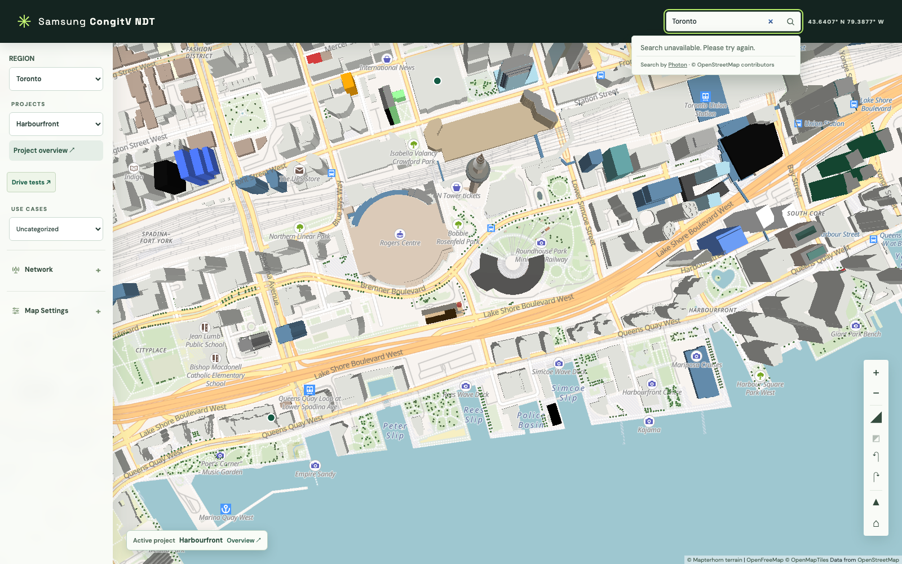
Failure states and recovery
Local failure scope
An unavailable search service should not erase the loaded scene.
Actionable recovery
Search, map startup, terrain and save failures expose distinct feedback.
Draft preservation
Failed edits keep user input available for retry or discard.
Current search error state, captured with a controlled upstream 503 response
CURRENT IMPLEMENTATION
27
Notes:
Network Digital Twin implementation and UX design review. Snapshot: 12 November 2026.
Sources: ndt/dist/search-view-model.mjs; ndt/dist/map-scene-view-model.mjs; ndt/dist/task-view-model.mjs; docs/SOFTWARE_DESIGN.typ, Failure handling and operational boundaries. The screenshot deliberately injects a failed Photon response to show the existing recovery state. Region and map startup have separate reload paths. A missing terrain service does not establish that terrain data is complete or current.
Screenshot: 20-search-recovery.png, captured from the current checkout with live external map services. No generated illustration. Basemap and terrain attribution are retained in the capture.

Slide 28
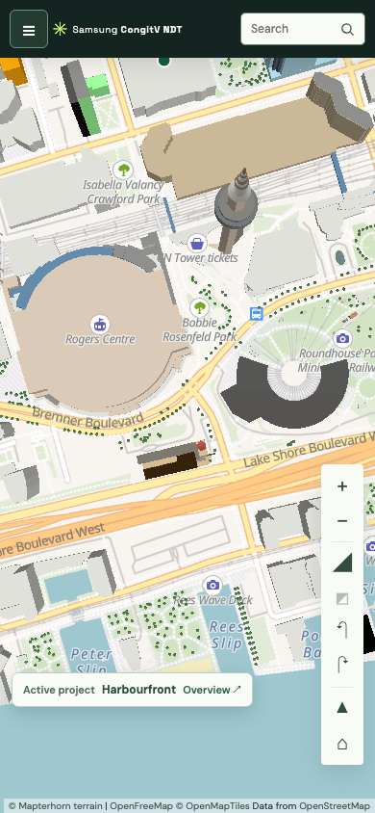
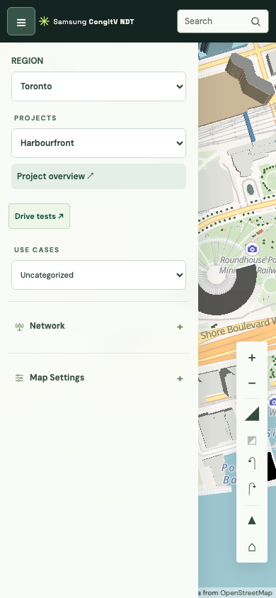
Responsive and accessible interaction
Narrow-screen behavior
Navigation becomes a drawer. Detail panels scroll within the viewport.
Keyboard continuity
Visible controls, native inputs and focus return support repeated map tasks.
Validation focus
Zoom, keyboard-only journeys, screen readers and touch reach remain release checks.
CURRENT IMPLEMENTATION
28
Notes:
Network Digital Twin implementation and UX design review. Snapshot: 12 November 2026.
Sources: ndt/dist/navigation-view.mjs; ndt/dist/context-panel.mjs; ndt/dist/style.css; ndt/tests/ui/app.spec.cjs; docs/SOFTWARE_DESIGN.typ, UI MVVM boundaries. Current 390px-wide screen captures show the map and navigation drawer. At 700px or less, selecting a project closes navigation. Implemented features include labeled controls, focus restoration, Escape cancellation and explicit statuses. These screenshots do not constitute a complete accessibility conformance audit.

Slide 29
Visual language and component rules
Calm map surfaces
Existing palette
Primary #135A43
Ink #263E36
Paper #F9FBF7
Network meaning carries the strongest color.
Text, spacing and state labels support inspection.
Proposed component rule
Every numeric field should show its unit, domain and save state.
DM Sans
Body and interface text
Proposed evidence rule
Space Grotesk
Selection, prediction and source status should use text labels as well as color.
Current UI heading family
CURRENT TOKENS + DESIGN GUIDANCE
29
Notes:
Network Digital Twin implementation and UX design review. Snapshot: 12 November 2026.
Current UI token source: ndt/dist/design-tokens.css. Body font is DM Sans and heading font is Space Grotesk, subject to network font availability and system fallbacks. Primary #135A43, ink #263E36, paper #F9FBF7 and background #EDF3E9. The lower component rules are proposed design guidance. The presentation itself uses Arial for PowerPoint portability.

Slide 30
UX implementation priorities
Priority | Proposed change | Acceptance evidence
1. Inspection clarity | Default dense views toward selected-site review | Users can name the site, bearing and assumptions
2. Evidence clarity | Keep source, model and comparison basis visible | Users distinguish prediction from measurement
3. Journey continuity | Strengthen project, Task and route breadcrumbs | Users return to the same planning context
4. Release qualification | Test target devices and real map providers | Record task success, recovery and frame behavior
Retain the current architecture while qualifying the experience with users and target hardware.
PROPOSED UX WORK, NOT IMPLEMENTED
30
Notes:
Network Digital Twin implementation and UX design review. Snapshot: 12 November 2026.
Design recommendations derived from the implementation reviewed in this deck. These are proposed changes and acceptance checks, not completed feature work or measured usability results. Source register: README.md; ndt/README.md; docs/FEATURE_DESCRIPTION.typ; docs/SOFTWARE_DESIGN.typ; ndt/regions.json; ndt/dist/index.html; ndt/dist/map-scene-view.mjs; ndt/dist/radio-model.mjs; ndt/dist/design-tokens.css; ndt/server.py; ndt/task_store.py; ndt/dm/experiments.py. Source snapshot: current working tree on 12 November 2026, including uncommitted changes. No production system certification is asserted.

