Slide 1


HLS GTM & ARCHITECTURE PROPOSAL
×
Building the Evidence Layer for
Employer Dental Benefits
ICLO turns employee dental-benefit navigation into claims-confirmed, privacy-governed evidence.
Employee navigation
Governed evidence plane
Employer evidence
Understand benefits
Request support
Eligibility + plan + events + claims
Aggregate outcomes
No individual PHI
CONFIRMED DIRECTION
DESIGN PRINCIPLE
TO VALIDATE
SNOWFLAKE ASK
01
Notes:
ICLO를 ' 치아 사진 AI '로 소개하지 않는다. 앞단은 직원의 치과복지 이해와 이용을 돕는 경험이고, 뒷단은 그 여정을 eligibility와 claims로 확인하는 evidence layer라는 점을 먼저 고정한다. 이번 미팅의 목적은 제품 판매가 아니라 Snowflake 내 sales play, 기술 검증 세션, account-level 검증 경로를 합의하는 것이다.
[Sources]
- /Users/jk0307/Documents/obsidian_vault1/J-Dub S-Brain/20_Business/25_iclo/01_strategy/2026-07-30-iclo-us-employer-oral-health-report-v2.md
- /Users/jk0307/Documents/obsidian_vault1/J-Dub S-Brain/20_Business/25_iclo/01_strategy/2026-07-30-iclo-snowflake-korea-3pager-v2.md
- https://jangwookimbusiness-dev.github.io/iclo-us-employee-dashboard/

Slide 2
HLS GTM & ARCHITECTURE PROPOSAL
HYPOTHESIS / TO BE VALIDATED
The Employee Problem Is Not Coverage Alone - It Is Navigation
Plan, network and operational context shape whether coverage becomes usable care.
Coverage
Plan rules
Usable care
Eligible employee
Network
Deductible + max
Availability
Understood OOP
Provider economics
Directory + booking
NETWORK
BENEFIT DESIGN
OPERATIONS
Provider choice may be constrained or economically penalized by plan rules.
Deductible, coinsurance, annual maximum and covered procedures vary.
Directory status, appointment availability and final EOB may differ from expectations.
×
External proposal · discussion material
02
Notes:
보험이 있어도 모든 직원에게 동일한 이용경험이 생기는 것은 아니라는 문제를 설명한다. 다만 '계약 치과만 갈 수 있다'처럼 절대화하지 않는다. friction의 크기와 구매 우선순위는 아직 고객 데이터와 인터뷰로 검증해야 하므로 hypothesis로 명시한다.
[Sources]
- /Users/jk0307/Documents/obsidian_vault1/J-Dub S-Brain/20_Business/25_iclo/01_strategy/2026-07-30-iclo-us-employer-oral-health-report-v2.md
- /Users/jk0307/Documents/obsidian_vault1/J-Dub S-Brain/20_Business/25_iclo/02_meetings/2026-08-04-unknown-re-미국-임직원-복지-프로그램-시안-대시보드-포함.md
- https://www.healthcare.gov/coverage/dental-coverage/
- https://www.deltadental.com/about-us/terms-of-use/

Slide 3
HLS GTM & ARCHITECTURE PROPOSAL
CONFIRMED ICLO DIRECTION
ICLO PRODUCT DESIGN PRINCIPLE
ICLO Connects Plan Context to Employee-Initiated Action
Employee dental-benefit navigation in the front; a governed evidence layer in the back.
01
02
03
04
Employee experience
Benefit + provider context
Employee-initiated action
Claims evidence
Concern + benefit understanding
Optional oral-image capture
Eligibility + network
Plan rules + availability
Provider search
Appointment support
Completion + claim line
Employer aggregate only
SHADOW SIGNAL
Raw disease probabilities are not shown to employees or employers. Model-derived signals do not automatically determine provider, urgency or treatment pathway.
Design redline: separate signal, navigation and referral tables; timestamp employee action and consent.
UNDERSTAND
MATCH
VERIFY
Concerns, benefits and optional image capture.
Eligibility, plan, network and operational context.
Preventive visits and claims at aggregate employer level.
×
External proposal · discussion material
03
Notes:
Employee Experience, Benefit and Provider Context, Action, Claims Evidence의 네 단계를 보여준다. 초기 이미지 모델 출력은 shadow mode에 두고 직원 행동, urgency, provider 또는 treatment pathway를 자동 결정하지 않는다. employee-initiated 또는 human-assisted navigation은 현재 ICLO의 잠정 product redline이며 미국 규제 자문을 거쳐 확정할 사안이다.
[Sources]
- /Users/jk0307/Documents/obsidian_vault1/J-Dub S-Brain/20_Business/25_iclo/01_strategy/2026-07-30-iclo-us-employer-oral-health-report-v2.md
- /Users/jk0307/Documents/obsidian_vault1/J-Dub S-Brain/20_Business/25_iclo/02_meetings/2026-08-04-unknown-re-미국-임직원-복지-프로그램-시안-대시보드-포함.md

Slide 4
HLS GTM & ARCHITECTURE PROPOSAL
CONFIRMED ICLO DIRECTION
HYPOTHESIS / TO BE VALIDATED
The Economics Begin with a J-Curve, Not a Year-One Savings Promise
Year-one utilization and plan-paid claims may rise before treatment-mix change becomes measurable.
Illustrative shape only - not an ICLO outcome
Year 1
LOW
TURNOVER
Preventive use rises
New treatment is discovered
Years 2-3
Treatment mix + run-out
become measurable
Validate
Baseline
Direction unknown
Plan-year start
HIGH
TURNOVER
Multi-year value lens
Employee experience lens
UTILIZATION
COST ALLOCATION
CONTRACT PRINCIPLE
Preventive use can raise plan-paid claims.
Allowed, plan-paid and employee OOP can move differently.
ICLO will not contract on a year-one savings guarantee.
×
External proposal · discussion material
04
Notes:
초기 preventive utilization과 발견 치료가 비용을 올릴 수 있음을 먼저 인정한다. 이후 mix 변화는 가설이며 고객 데이터로 검증해야 한다. Allowed, plan-paid, employee OOP를 분리하고 저이직 기업은 장기 회수 가능성, 고이직 기업은 employee experience와 retention 논리를 별도로 검토한다. 숫자를 실제 ICLO outcome처럼 제시하지 않는다.
[Sources]
- /Users/jk0307/Documents/obsidian_vault1/J-Dub S-Brain/20_Business/25_iclo/01_strategy/2026-07-30-iclo-us-employer-oral-health-report-v2.md
- /Users/jk0307/Documents/obsidian_vault1/J-Dub S-Brain/20_Business/25_iclo/02_meetings/2026-08-04-unknown-re-미국-임직원-복지-프로그램-시안-대시보드-포함.md

Slide 5
HLS GTM & ARCHITECTURE PROPOSAL
ICLO PRODUCT DESIGN PRINCIPLE
REQUEST TO SNOWFLAKE
Snowflake Is the Governed Evidence Plane
Structured evidence is governed in Snowflake; raw images and employee-level routing remain outside employer views.
RAW-IMAGE PATH
STRUCTURED EVIDENCE PATH
Raw oral image
App events
HRIS eligibility
Plan + provider context
TPA / carrier claims
Controlled U.S. object storage / PHI vault
Snowflake U.S. governed evidence layer
Canonical model
Quality + controls
Outcome layer
member-month + plan + event + claim
reconciliation + purpose access + lineage
experiment assignment + claims-confirmed outcomes
Shadow inference
URI + metadata + model version + approved derived signal only
Employer aggregate dashboard
No employee-level health signals or routing
PHI platform prerequisite: Business Critical + appropriate Snowflake BAA. This does not make ICLO as a whole HIPAA-compliant.
×
External proposal · discussion material
05
Notes:
Snowflake는 database hosting이 아니라 canonical model, data-quality reconciliation, policy-based access, lineage, outcome calculation과 account collaboration을 담당하는 evidence plane으로 설명한다. Raw oral image는 별도 controlled U.S. object storage 또는 PHI vault에 두고 Snowflake에는 URI, metadata, model version과 승인된 derived signal만 적재하는 경계를 제안한다. Business Critical과 적절한 BAA는 PHI 처리 시 플랫폼 전제이지 ICLO 전체 HIPAA 준수의 완성 조건이 아니다.
[Sources]
- /Users/jk0307/Documents/obsidian_vault1/J-Dub S-Brain/20_Business/25_iclo/01_strategy/2026-07-30-iclo-us-employer-oral-health-report-v2.md
- /Users/jk0307/Documents/obsidian_vault1/J-Dub S-Brain/20_Business/25_iclo/01_strategy/2026-07-30-iclo-snowflake-korea-3pager-v2.md
- https://docs.snowflake.com/en/user-guide/intro-editions
- https://docs.snowflake.com/en/user-guide/data-sharing-intro
- https://docs.snowflake.com/en/user-guide/security-row-intro

Slide 6
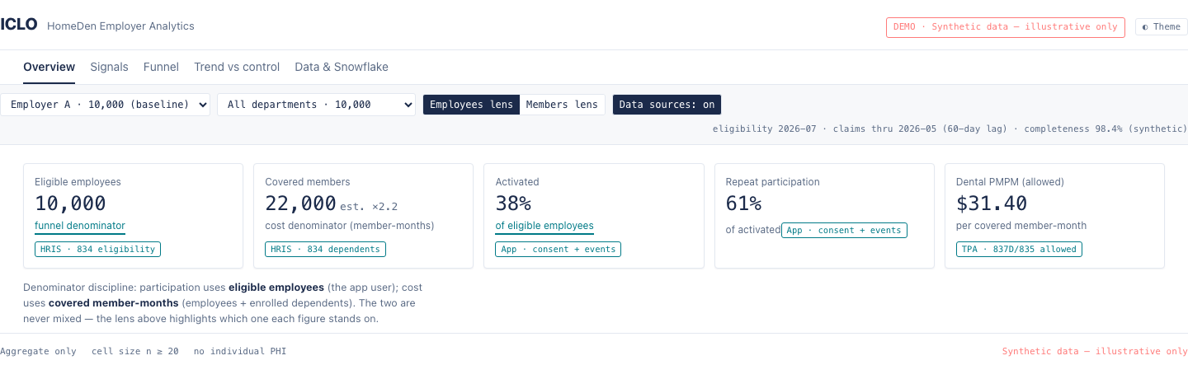
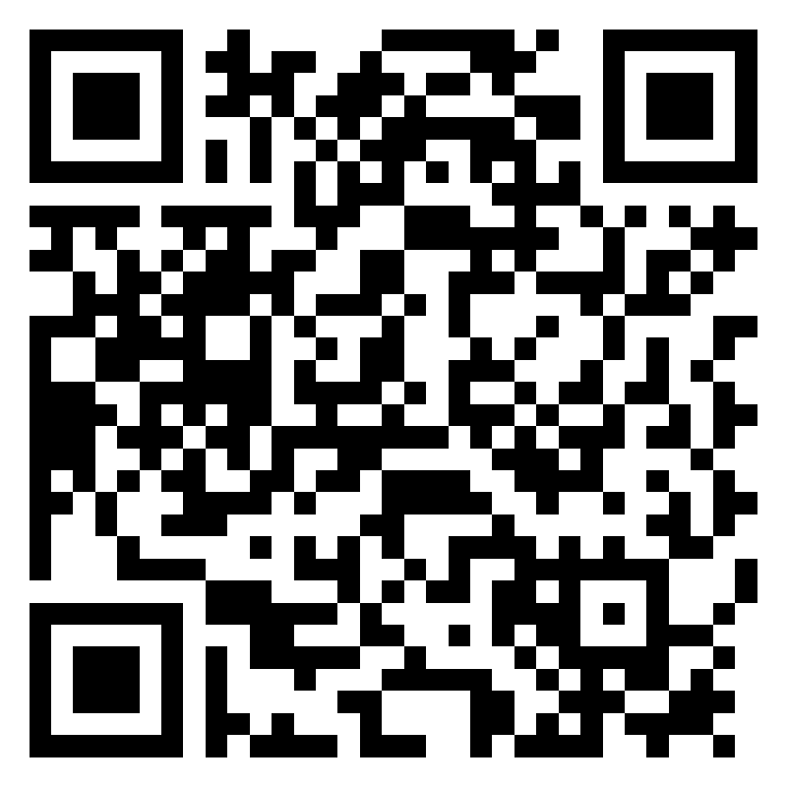
HLS GTM & ARCHITECTURE PROPOSAL
ICLO PRODUCT DESIGN PRINCIPLE
The Dashboard Makes Privacy and Data Quality Visible
This is not a performance claim. It shows how denominator, freshness, privacy and claims completeness become visible to the buyer.
SYNTHETIC
DENOMINATOR
FRESHNESS
PRIVACY
LIVE DEMO
Illustrative only
Employees / members
Dates + claims lag
Aggregate · n ≥ 20 · no PHI
Synthetic dashboard
×
External proposal · discussion material
06
Notes:
화면의 수치는 ICLO 성과가 아니라 buyer가 metric 정의와 data quality를 검증하는 방식의 데모다. 직원 기준 참여 분모와 covered member-month 기준 비용 분모를 분리하고, 기준일, claims lag, completeness, suppression을 동시에 노출한다. employer는 개인 PHI나 개인별 routing 정보를 보지 않는다. 가로로 긴 원본 화면을 한 번만 크게 보여주고, 설명은 아래 가로 annotation strip으로 읽히게 배치했다.
[Sources]
- /Users/jk0307/Documents/GitHub/iclo/iclo-us-employee-dashboard/index.html
- /Users/jk0307/Documents/GitHub/iclo/iclo-us-employee-dashboard/README.md
- https://jangwookimbusiness-dev.github.io/iclo-us-employee-dashboard/

Slide 7
HLS GTM & ARCHITECTURE PROPOSAL
HYPOTHESIS / TO BE VALIDATED
REQUEST TO SNOWFLAKE
The Opportunity Is Account-Specific - Not "Delta" or "Blue" as a Whole
Procurement, workloads and incumbents must be validated at the legal-entity and business-unit level.
Delta Dental: 39 independent companies
BCBS: 33 independent, locally operated companies
Organization / unit | Public incumbent signal | Dental data in Snowflake | Potential ICLO whitespace
Delta Dental of Washington | Dentistry.One | VALIDATE | VALIDATE
Parts of the Delta ecosystem | Toothpic / quip (historical) | VALIDATE | VALIDATE
BCBS Massachusetts | Teledentistry.com; Toothpic (historical) | VALIDATE | VALIDATE
No Snowflake dental workload is assumed. Public vendor presence does not prove enterprise-wide capability or eliminate ICLO whitespace.
×
External proposal · discussion material
07
Notes:
Delta Dental은 39개 독립 회사, Blue는 33개 독립·지역 운영 회사 구조다. association 또는 parent 관계만으로 실제 procurement, dental workload, region, vendor 관계를 추정하지 않는다. 공개된 incumbent 사례는 account-specific signal일 뿐이며, 기능 범위와 ICLO whitespace는 diligence question으로 남긴다.
[Sources]
- https://www.deltadental.com/about-us/delta-dental-member-companies/
- https://www.deltadental.com/about-us/terms-of-use/
- https://www.bcbs.com/about-us/blue-cross-blue-shield-system
- https://www.deltadentalwa.com/our-company/community/DentistryOne-Press-Release
- https://www.prnewswire.com/news-releases/quip-acquires-teledentistry-company-toothpic-to-become-first-360-degree-oral-health-service-and-improve-dental-care-access-for-over-40-million-people-301528398.html
- https://home.bluecrossma.com/collateral/sites/g/files/csphws1571/files/acquiadam-assets/55-003112164_Dental_Blue_Teledentistry.com_Member_Fact_Sheet.pdf

Slide 8
HLS GTM & ARCHITECTURE PROPOSAL
REQUEST TO SNOWFLAKE
What We Need from Snowflake GTM
We need industry fit, internal coordination and account-path sponsorship - not generic introductions.
01
FIT
Which HLS sales play fits naturally: payer claims analytics, benefits navigation, healthtech applications or secure collaboration?
02
PEOPLE
Name the HLS architect, solution engineer, security/compliance owner and startup/partner lead.
03
ACCOUNTS
Select one payer/TPA account team to validate dental data and unmet need before any introduction.
04
PATH
Provide written credits/support scope and readiness criteria for partner, co-sell and application paths.
Not asking Snowflake for: legal opinions, compliance certification, generic customer introductions or a savings guarantee.
×
External proposal · discussion material
08
Notes:
GTM specialist에게 구현을 맡기는 것이 아니라 industry fit, 내부 조정과 account-path sponsorship을 요청한다. 특히 '고객 소개'를 먼저 요구하지 않는다. 한 payer/TPA account team이 dental eligibility 또는 claim-line data의 실재, architecture 적합성과 unmet need를 확인하는 순서를 요청한다.
[Sources]
- /Users/jk0307/Documents/obsidian_vault1/J-Dub S-Brain/20_Business/25_iclo/01_strategy/2026-07-30-iclo-us-employer-oral-health-report-v2.md
- https://www.snowflake.com/en/why-snowflake/startup-program/
- https://www.snowflake.com/en/why-snowflake/startup-program/startup-accelerator/
- https://docs.snowflake.com/en/developer-guide/native-apps/native-apps-about

Slide 9
HLS GTM & ARCHITECTURE PROPOSAL
REQUEST TO SNOWFLAKE
A 90-Day Joint Validation Plan
The outcome is a validated architecture and one account-team use-case review, not a co-sell commitment.
DAYS 0-30
DAYS 31-60
DAYS 61-90
CONDITIONAL
ALIGN
DESIGN
VALIDATE
EXPAND
Sales play
Named stakeholders
U.S. account / region / BAA path
Architecture workshop
Ingestion pattern
2.5K / 10K / 25K sizing
Security reference
Account matrix v1
One payer/TPA account-team review
Partner checklist
Next / no-go decision
Native App
Multi-party Clean Room
Federated learning
Joint story / design partner
We are not asking Snowflake to validate our dental AI or make ICLO compliant. We are asking Snowflake to help us determine whether this can become a repeatable, governed payer/TPA data-collaboration pattern—and what ICLO must prove to make that partnership commercially real.
×
External proposal · discussion material
09
Notes:
90일 후 남아야 하는 것은 소개 약속이 아니라 reference architecture, sizing, account matrix, one-account validation과 partner criteria다. Native App, Clean Room, federated learning과 공동 발표는 핵심 ingestion·governance 패턴과 고객 증거가 확인된 뒤에만 검토한다.
[Sources]
- /Users/jk0307/Documents/obsidian_vault1/J-Dub S-Brain/20_Business/25_iclo/01_strategy/2026-07-30-iclo-us-employer-oral-health-report-v2.md
- https://docs.snowflake.com/en/user-guide/data-sharing-intro
- https://docs.snowflake.com/en/user-guide/cleanrooms/introduction
- https://docs.snowflake.com/en/developer-guide/native-apps/native-apps-about

Slide 10
APPENDIX
ICLO PRODUCT DESIGN PRINCIPLE
REQUEST TO SNOWFLAKE
Data and Responsibility Matrix
Platform responsibility, operating responsibility and legal judgment remain separate.
Domain | ICLO | Employer / TPA / partner | Snowflake | Outside Snowflake scope
Employee navigation | Product, events, consent UX | Employee action; operational support | Govern event data by purpose | Licensure / referral-law analysis
Eligibility + plan + network | Map and use context | Provide under contract | Canonical model + reconciliation | Data-rights determination
Claims + outcomes | Attribution logic | Claims, run-out, completion | Aggregate calculation + access | Savings validation
Raw images + models | Vault, inference, validation | Clinical role as applicable | URI + metadata + approved signal | Model endpoint validation
Governance + compliance | App controls + incident operations | Source-system controls | RBAC, masking, row policy, history | ICLO-wide compliance conclusion
×
External proposal · discussion material
10
Notes:
ICLO, employer/TPA/clinical partner, Snowflake, 외부 법률·규제 자문의 책임을 분리한다. Snowflake에 FDA status, consent sufficiency, data rights 또는 ICLO incident response 전체를 요구하지 않는다.
[Sources]
- /Users/jk0307/Documents/obsidian_vault1/J-Dub S-Brain/20_Business/25_iclo/01_strategy/2026-07-30-iclo-us-employer-oral-health-report-v2.md
- https://docs.snowflake.com/en/user-guide/intro-editions
- https://docs.snowflake.com/en/user-guide/security-row-intro

Slide 11
APPENDIX
REQUEST TO SNOWFLAKE
Detailed Snowflake Technical Questions
Resolve the pilot pattern first; treat application packaging and multi-party ML as conditional.
PRIORITY NOW
CONDITIONAL / LATER
1
What is the practical U.S. account, cloud/region, Business Critical and BAA path?
Native App
When does customer-account execution create repeatability beyond a connector pattern?
2
When should we use same-region Direct Share versus controlled SFTP/API staging?
Clean Room
3
What tenancy, purpose-access, masking, row-policy and access-history pattern do you recommend?
What real multi-party payer / TPA / employer collaboration would justify it?
4
How should we size 2.5K / 10K / 25K populations and measure post-credit unit economics?
Federated learning
Does this mean true local training and parameter aggregation, or collaborative ML inside a Clean Room, Native App or customer-account execution pattern?
5
What must ICLO prove for startup, partner, Powered by Snowflake or co-sell readiness?
Not required for the first employer pilot.
×
External proposal · discussion material
11
Notes:
현재 pilot의 우선순위는 ingestion, canonical data, aggregate views와 반복 가능한 TPA integration이다. Clean Room은 단일 employer/TPA pilot의 기본 구조가 아니며, federated learning도 복수 기관의 이미지 데이터 파트너가 생긴 뒤 검토할 future option이다. 정확한 질문: When Snowflake refers to federated learning for this use case, does it mean true local model training and parameter aggregation across institutions, or collaborative ML inside a Snowflake-controlled environment such as a Clean Room, Native App or customer-account execution pattern?
[Sources]
- https://docs.snowflake.com/en/user-guide/intro-editions
- https://docs.snowflake.com/en/user-guide/data-sharing-intro
- https://docs.snowflake.com/en/user-guide/secure-data-sharing-across-regions-plaforms.html
- https://docs.snowflake.com/en/user-guide/cleanrooms/introduction
- https://docs.snowflake.com/en/developer-guide/native-apps/native-apps-about
- https://docs.snowflake.com/en/user-guide/cost-controlling

Slide 12
APPENDIX
HYPOTHESIS / TO BE VALIDATED
Employer J-Curve Simulation - Inputs and Outputs
A governed planning heuristic should expose assumptions, scenario versions and uncertainty.
POPULATION
Employee/dependent age distribution
Turnover + average tenure
OUTPUTS
Preventive utilization increase
ACCESS
Workforce geography
Network overlap + provider availability
Newly discovered treatment spend
GOVERNED
SCENARIO MODEL
Allowed / plan-paid / employee OOP separation
Year 1 / Year 2 / Year 3 scenarios
PLAN
Plan design + annual maximum
Employer contribution + paid/OOP split
Lineage + version + uncertainty
Turnover sensitivity
Network-access sensitivity
BASELINE + TIMING
Utilization + historical claims
Untreated need/incidence + run-out
Expected data uncertainty
Planning heuristic - calibrate with customer data; not an ICLO outcome.
×
External proposal · discussion material
12
Notes:
시뮬레이션은 고객별 planning heuristic이다. 초기 내부 가정이나 고정 상승률을 외부 예측으로 쓰지 않는다. Snowflake에서 입력 lineage, scenario version, uncertainty와 claims run-out을 추적하는 분석 use case로 제안한다.
[Sources]
- /Users/jk0307/Documents/obsidian_vault1/J-Dub S-Brain/20_Business/25_iclo/02_meetings/2026-08-04-unknown-re-미국-임직원-복지-프로그램-시안-대시보드-포함.md
- /Users/jk0307/Documents/obsidian_vault1/J-Dub S-Brain/20_Business/25_iclo/01_strategy/2026-07-30-iclo-us-employer-oral-health-report-v2.md

Slide 13
APPENDIX
REQUEST TO SNOWFLAKE
Named-Account Diligence Template
Replace market-level assumptions with legal-entity, workload and readiness evidence.
ACCOUNT IDENTITY + DATA
Organization / legal entity | Account type | Self-funded dental admin? | Dental eligibility in Snowflake? | Claim-line data in Snowflake? | Cloud / region
COMMERCIAL + TECHNICAL READINESS
Current navigation / teledentistry vendor | Potential ICLO whitespace | Snowflake account owner | Technical validation ready? | Customer introduction ready?
No statement that 'many TPAs are on Snowflake' should be used before this matrix contains account evidence.
×
External proposal · discussion material
13
Notes:
'Snowflake 고객인 TPA가 많다'는 추정 대신 account evidence를 쌓는 템플릿이다. 데이터 실재와 기술 검증 준비도가 먼저이며 customer introduction readiness는 별도 필드로 둔다.
[Sources]
- /Users/jk0307/Documents/obsidian_vault1/J-Dub S-Brain/20_Business/25_iclo/01_strategy/2026-07-30-iclo-us-employer-oral-health-report-v2.md
- https://www.deltadental.com/about-us/delta-dental-member-companies/
- https://www.bcbs.com/about-us/blue-cross-blue-shield-system

