Slide 1


U.S. SELF-FUNDED EMPLOYER DENTAL POC
×
U.S. Self-Funded Employer
Dental-Benefit PoC
This proposal converts ICLO's existing Snowflake startup support into a structured 90-day joint validation.
Employee navigation
Claims-verified evidence layer
Employer decisions
Understand coverage
Find care + request support
Eligibility + plan + network
App events + dental claims
Plan + administrator fit
Access + claims + OOP
01

Slide 2
ICLO FRAMING / U.S. MARKET CONTEXT
Four Decisions Stand Between Coverage and Care
A dental benefit becomes usable only after four separate decisions are resolved.
ELIGIBILITY
Am I covered today?
Employee + dependent status
USABLE CARE
Eligibility confirmed
NETWORK
Which dentist fits my plan?
In-network status + distance
In-network option found
EMPLOYEE
DECISION
Plan rules understood
Expected OOP bounded
PLAN RULES
What will the plan pay?
Deductible + coinsurance + max
Coverage → choice → action
Appointment available
Support requested
AVAILABILITY
Can I actually book?
Directory status + appointment
Visit prepared
The product reduces decision friction; it does not expose raw clinical probabilities.
×
External proposal · discussion material
02

Slide 3
CONFIRMED ICLO DIRECTION / ICLO PRODUCT DESIGN PRINCIPLE
From Dental Benefit to Verified Use
Navigation in front; a governed, claims-verified evidence layer in back.
1
2
3
4
Employee experience
Benefit + provider context
Employee-initiated action
Claims-verified evidence
Concern + benefit understanding
Optional oral image
Eligibility + network
Plan rules + availability
Provider search
Appointment support
Completion + claim line
Employer aggregate only
SHADOW SIGNAL
Raw disease probabilities are not shown to employees or employers. Model-derived signals do not automatically determine provider, urgency or treatment pathway.
Design redline: separate signal, navigation and referral tables; timestamp employee action and consent.
×
External proposal · discussion material
03

Slide 4
CONFIRMED ICLO DIRECTION / POC SCOPE
One U.S. Dental-Benefit Lane
The U.S. market contains multiple funding models; this proposal validates only self-funded employer dental benefits.
Lens | Korea baseline | U.S. market | This PoC | Why it matters
Coverage base | NHIS-centered; dental is partly supplemental | Dental benefit may be a separate plan | Employer-sponsored dental | Rights and data paths differ
Funding risk | Not this proposal's comparator | Fully insured, self-funded, public and individual coexist | Employer funds dental claims | Employer has a direct stake
Administration | National operating context differs | Carrier/TPA may run eligibility, network and claims | One administrator lane | Cooperation is required
Employee task | Coverage and price questions | Network, plan rules, OOP and availability | Employees + dependents | Benefit must become usable care
Evidence | Not assumed comparable | Data sit across employer, administrator and providers | Aggregate employer evidence | No employee-level PHI in employer views
×
External proposal · discussion material
04

Slide 5
U.S. DENTAL MARKET CONTEXT / CURRENT POC SCOPE
The U.S. Dental-Benefit Operating Chain
Funding arrangement, administrator, beneficiary and claim path are separate questions; the PoC covers one specific lane.
CONTRACTING + CHOICE
COVERAGE + FUNDING SEGMENTS
Coverage buyer / sponsor
Employer
fully insured
Employer
self-funded / ASO
Individual / family
Marketplace or direct
Medicaid / CHIP
state + MCO
Broker / benefits consultant
Dental benefit operating layer
FUNDING ROLE
ADMINISTRATION
CLAIMS + DATA
Who bears dental claim cost
Eligibility + benefits + network
Adjudication + EOB + claim lines
Carrier / TPA / MCO contract
Sets funding, network, benefit rules and data rights
Beneficiaries + dental providers
Members receive care; dentists submit claims
CURRENT POC SCOPE: U.S. SELF-FUNDED EMPLOYER + DENTAL CARRIER/TPA + EMPLOYEES/DEPENDENTS
×
External proposal · discussion material
05

Slide 6
ICLO PRODUCT DESIGN PRINCIPLE / REQUEST TO SNOWFLAKE
The Governed Evidence Layer Runs on Snowflake
Structured evidence can be governed in Snowflake; raw images and employee-level routing stay outside employer views.
RAW-IMAGE PATH
STRUCTURED EVIDENCE PATH
Raw oral image
App events
HRIS eligibility
Plan + provider context
TPA / carrier claims
Controlled U.S. object storage / PHI vault
Snowflake U.S. governed evidence layer
Canonical model
Quality + controls
Outcome layer
member-month + plan + event + claim
reconciliation + purpose access + lineage
claims-confirmed outcomes (arm assignment pending legal + protocol sign-off)
Shadow inference
No image binaries. Person-linked references and signals do enter
Employer aggregate dashboard
No employee-level health signals or routing
For PHI in Snowflake: Business Critical + executed BAA are platform prerequisites - not ICLO-wide HIPAA compliance.
×
External proposal · discussion material
06

Slide 7
CONFIRMED ICLO DIRECTION / HYPOTHESIS / TO BE VALIDATED
Year One May Cost More
Year-one utilization and dental plan-paid claims may rise before treatment-mix change becomes measurable.
Illustrative shape only - not an ICLO outcome
LOW TURNOVER
Multi-year value lens
Year 1
Years 2-3
Validate
Baseline
Preventive use rises
New treatment is discovered
Treatment mix + run-out
become measurable
Direction unknown
HIGH TURNOVER
Employee experience lens
Plan-year start
UTILIZATION
COST ALLOCATION
CONTRACT PRINCIPLE
Preventive use can raise plan-paid claims.
Allowed, plan-paid and employee OOP can move differently.
ICLO will not contract on a year-one savings guarantee.
×
External proposal · discussion material
07

Slide 8
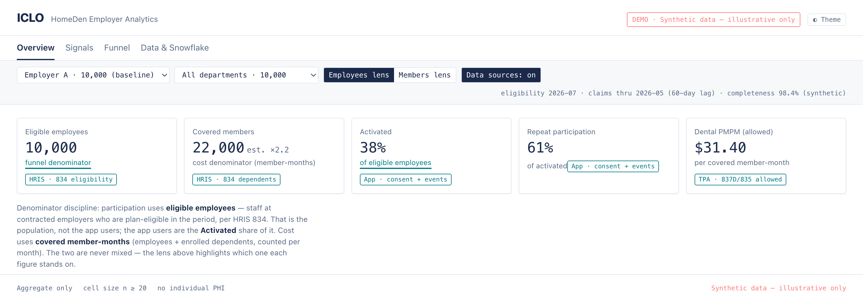
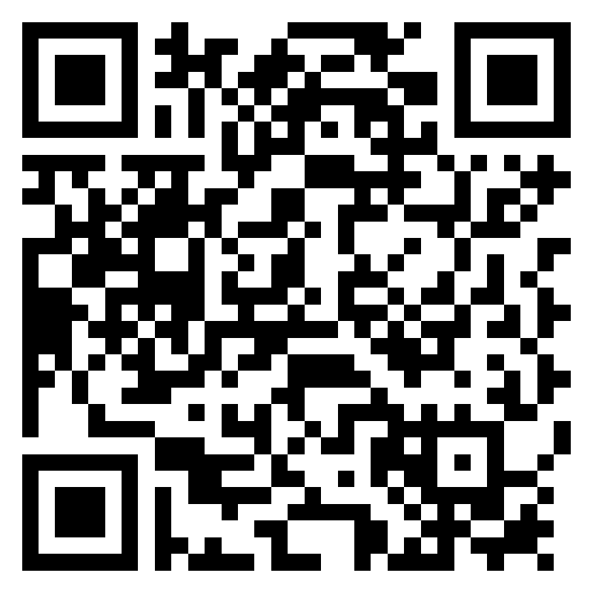
ICLO PRODUCT DESIGN PRINCIPLE
What the Buyer Can Verify
Not a performance claim: the denominator, freshness, claims lag and privacy rules stay visible.
SYNTHETIC
DENOMINATOR
FRESHNESS
PRIVACY
LIVE DEMO
Illustrative only
Employees / members
Dates + claims lag
Aggregate only · min cell by distinct person · employer isolation
Synthetic dashboard · jangwookimbusiness-dev.github.io/iclo-us-employee-dashboard
×
External proposal · discussion material
08

Slide 9
REQUEST TO SNOWFLAKE
Route the Existing Support Relationship
Step 0 is routing: the current Korea startup sponsor names the U.S. HLS GTM and architecture owners before technical work begins.
STEP 0
ROUTE
Confirm the official support-program name; the current Korea sponsor routes ICLO to U.S. HLS GTM and architecture.
FIT + PEOPLE
Confirm the primary sales play and name the HLS architect, SE, security/compliance and startup/partner leads.
ACCOUNT
Complete one account diligence row by Day 30; run a separate account-team use-case review by Day 75.
PATH
Document account/region/BAA, credits/support and partner/co-sell readiness criteria.
Not asking Snowflake for: legal opinions, compliance certification, generic customer introductions or a savings guarantee.
×
External proposal · discussion material
09

Slide 10
REQUEST TO SNOWFLAKE
A 90-Day Validation Plan · Route and Design
Step 0 through Day 60: name the owners, then design the architecture.
STEP 0 + DAYS 0-30
DAYS 31-60
ROUTE + ALIGN
DESIGN
SNOWFLAKE
SNOWFLAKE
Route to HLS; confirm play, owners and the U.S. account / BAA path.
Size workload; co-draft the security reference and account matrix.
ICLO
ICLO
Provide current-state pack; run workshop and cadence.
Provide source map, ingestion test and sizing inputs.
GATE · Sponsor, owners and route in writing
GATE · Architecture + matrix v1 accepted
×
External proposal · discussion material
10

Slide 11
REQUEST TO SNOWFLAKE
A 90-Day Validation Plan · Validate and Expand
Day 61 to Day 90, plus conditional expansion. ICLO owns the cadence and decision log.
DAYS 61-90
CONDITIONAL
VALIDATE
EXPAND
SNOWFLAKE
SNOWFLAKE
Sponsor one account-team review; issue the partner-readiness checklist.
Assess Native App, Clean Room or federated learning only if needed.
ICLO
ICLO
Run review; recommend go / no-go.
Build only after multi-party demand is confirmed.
GATE · Use case + evidence minimum agreed
TRIGGER · Account review confirms multi-party need
OPERATING MODEL · ICLO runs weekly written status and one decision log.
CONSUMPTION MODEL · ICLO supplies the sizing inputs (employers, member-months, ingestion / transform / outcome-refresh frequency, data volume, warehouse size and runtime); the Snowflake SE calculates annual credits in the Day-30 sizing session.
×
External proposal · discussion material
11

Slide 12
APPENDIX
ICLO PRODUCT DESIGN PRINCIPLE / REQUEST TO SNOWFLAKE
Data and Responsibility Boundaries
Platform responsibility, operating responsibility and legal judgment remain separate.
Domain | ICLO | Employer / TPA / partner | Snowflake | Outside Snowflake scope
Employee navigation | Product, events, consent UX | Employee action; operational support | Enforce purpose-based access on event data | Licensure / referral-law analysis
Eligibility + plan + network | Map and use context | Provide under contract | Canonical model + reconciliation | Data-rights determination
Claims + outcomes | Attribution logic | Claims, run-out, completion | Aggregate calculation + access | Savings validation
Raw images + models | Vault, inference, validation | Clinical role as applicable | URI + metadata + approved signal | Model endpoint validation
Governance + compliance | App controls + incident operations | Source-system controls | RBAC, masking, row policy, history | ICLO-wide compliance conclusion
×
External proposal · discussion material
12

Slide 13
APPENDIX
REQUEST TO SNOWFLAKE
Technical Decisions for the Pilot
Resolve the pilot pattern first; treat application packaging and multi-party ML as conditional.
PRIORITY NOW
CONDITIONAL / LATER
1
What is the practical U.S. Business Critical and BAA path for ICLO's current Snowflake account?
Native App
When does customer-account execution beat a connector pattern?
2
When should we use same-region Direct Share versus controlled SFTP/API staging?
Clean Room
3
What tenancy, masking, row-policy and access-history pattern do you recommend?
Which multi-party payer / TPA / employer collaboration justifies it?
4
How should we size 2.5K / 10K / 25K populations and measure post-credit unit economics?
Federated learning
True local training with parameter aggregation, or collaborative ML in a Clean Room, Native App or customer account?
5
What must ICLO prove for startup, partner, Powered by Snowflake or co-sell readiness?
Not required for the first employer pilot.
×
External proposal · discussion material
13

Slide 14
APPENDIX
HYPOTHESIS / TO BE VALIDATED
What the Scenario Model Needs
A governed planning heuristic should expose assumptions, scenario versions and uncertainty.
POPULATION
Employee/dependent age distribution
Turnover + average tenure
OUTPUTS
Preventive utilization increase
ACCESS
Workforce geography
Network overlap + provider availability
Newly discovered treatment spend
GOVERNED
SCENARIO MODEL
Allowed / plan-paid / OOP separation
Lineage + version + uncertainty
Year 1 / Year 2 / Year 3 scenarios
PLAN
Plan design + annual maximum
Employer contribution + paid/OOP split
Turnover sensitivity
Network-access sensitivity
BASELINE + TIMING
Utilization + historical claims
Untreated need/incidence + run-out
Expected data uncertainty
Planning heuristic - calibrate with customer data; not an ICLO outcome.
×
External proposal · discussion material
14

Slide 15
APPENDIX
REQUEST TO SNOWFLAKE
Account Evidence Required Before Outreach
Validate the employer, dental administrator, data workload, rights and technical readiness account by account.
ACCOUNT IDENTITY + DATA
Organization / legal entity | Account type | Self-funded dental admin? | Dental eligibility in Snowflake? | Claim-line data in Snowflake? | Cloud / region
COMMERCIAL + TECHNICAL READINESS
Current navigation / teledentistry vendor | Potential ICLO whitespace | Snowflake account owner | Technical validation ready? | Customer introduction ready?
Blank template, to be completed with the account team. No statement that 'many TPAs are on Snowflake' should be used before this matrix contains account evidence.
×
External proposal · discussion material
15

Slide 16
APPENDIX
COMPLETION REQUIRED
ICLO: Confirmed and Still to Verify
Program selections and a defined product/data boundary support validation; current Snowflake status must be confirmed before release.
ICLO AT A GLANCE
1
COMPANY
ICLO Co., Ltd. · Jeju, Republic of Korea · Commercial in the Korean market, B2C and B2B · 12 core team
2
PRODUCT
HomeDen SaaS (PMS / EMR / CRM) plus employer dental-benefit navigation and claims-evidence design
3
PROGRAMS
Selected: Fintech Cube Cohort 9; Shinhan Future's Lab Cohort 12
4
SNOWFLAKE STATUS
To confirm with Snowflake: official program name, sponsor, account, cloud, region, credits and support owner
5
NEXT PROOF
One U.S. self-funded employer dental-data path plus one account-team review
The Snowflake row is the ask in this meeting. Korean commercial stage and program selection do not prove insurer integration, underwriting, adjudication or U.S. outcomes.
×
External proposal · discussion material
16

