Slide 1
STOR 320.1 Data Ethics

Slide 2
Why Data Science?
Fields
Math
Statistics
Computer Science
On-Demand Job Market
LinkedIn Workforce Report: Shortage in All Cities (2018)
Article by Gregory Piatetsky
Applicable Across All Areas
Bigger Data Requires Better Skills
People are Scared Because Analytics is Coming
Notes:
This course is about data science. This is an inter-disciplinary field that involves many research areas such as, math, statistics and computer science.
Data science skills are applicable across all areas. Every area has data and with the new technology, large amounts of data are collected every second.
To make use of the big data and extract useful information from it, better data science skills are required. Analyzing big data requires different skills from analyzing small data set. In this class, you build some basic skills of analyzing data, but there are much more to learn, if you would like to become a data scientist or researcher in the future.
Data science provides huge opportunities to improve private and public life, as well as our environment. Unfortunately, such opportunities are also coupled with significant ethical challenges.

Slide 3

Data Privacy
Location history: iOS, Android
Notes:
Let’s have a look at this video and see what’s the problem of big data.
(Watch the video)
Apparently, when we are leveraging the advantages of big data, we are also sacrificing something, such as privacy. In this age, your smartphone may know you better than you know yourself.
Thinking of how many hours you spend on your phone and computer. Currently, we are doing a lot things with these smart devices and they keep track of your life.
Like the video suggested, you searched for something online and these behaviors are recorded so that companies can make personalized recommendation for you.
Check “Significant locations” on iPhone.

Slide 4
Data Privacy
People Have Data and Need Us to Analyze the Information to Answer Their Questions
Decisions Based on Our Analyses Can Affect Others
We Must Operate Ethically
Fairness and Privacy
Notes:
People have concerns about the big data thing and are scared that the new technology is an invasion of privacy. As data scientist, we should be careful with data ethics and avoid damaging other people’s interests when doing our job.
The algorithm, tools and reports produced by us can affect others. For example, all of you know this new technology of face recognition. It is used as face id by many smart phones.
Some countries are considering using similar technology to do identity check at borders and even use it to do criminal identification. If you are researchers that develop this method, data ethics are important issues you should consider. How to make sure that the method is fair and protect people’s privacy.
In fact, people are paying more attention to data privacy and fairness now. Many research are done to study how to protect data and formulate morally good solutions.

Slide 5
Hippocratic Oath for Data Scientists
I solemnly pledge to practice my profession with conscience and dignity;
To respect the privacy of the people whose data is confided in me;
To maintain the utmost respect for the individuals whose data I am analyzing;
To be transparent, open, and honest about the type of analysis I am applying to their data;
To never use my knowledge to violate human rights and civil liberties, even under threat.
-- Marie Wallace
Notes:
There is Hippocratic Oath that taken by physicians as they are dealing with people’s lives.
As data scientist, our jobs can also influence other people’s lives and interests. Marie Wallace, who is a leading researcher at IBM, wrote this Hippocratic Oath for Data Scientist.
It emphasizes privacy, respect and transparency when analyzing data.
This is a good example of what we should keep in mind when analyzing data.

Slide 6
Data Fraud
Appropriate Data Analysis
Let the Data Speak for Itself
Hypotheses Before Analyses
Transparency
Data Imputation
Handling of Outliers
Data Transformations
Statistical Methods
Necessary Assumptions
Variables Included and Excluded
Notes:
Speaking of data transparency, there is another issue of data science: data fraud. It is a violation of data transparency and respect.
Appropriate data analysis should let the data speak for itself. We don’t force the data to speak for our hypothesis.
We can make some hypotheses before analysis but when the data does not prove your hypothesis, you should not manipulate the data and force the conclusion to support your hypothesis.
In data analysis, we can make some changes to the data but when making changes, we should follow the transparency rule. That means all the changes should be disclosed and reasonable.
When there are missing values, we can do data imputation to replace missing data with reasonable values.
If there are outliers, it is also ok to remove them or replace them.
It is also ok to do data transformation or use some statistical methods to modify the data as long as these modifications are transparent.
In conclusion, we can modify the data, but all the modifications should be transparent and reasonable.

Slide 7
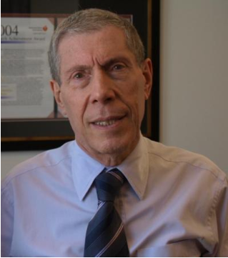
Data Fraud
Recent Incident at Harvard (2018)
Dr. Piero Anversa
31 Publications
Stem Cell Research
Showed the Heart Has the Ability to Regenerate
Fraudulent Data
Article by NY Times
Notes:
There was a data fraud incident at Harvard in 2018. Some 31 studies by Dr. Piero Anversa contain fabricated or falsified (/ˈfɔlsɪˌfaɪd/) data.
Dr. Piero was a heart researcher at Harvard Medical School. His research suggests that damaged heart muscle could be regenerated with stem cells. These findings led to formation of start-up companies to develop new treatments for heart attacks and got funding from NIH.
However, other labs could not reproduce his findings. Co-authors of Dr. Piero later wrote to a journal saying that the data in the paper were not data they had generated.
This is an example of fabricating data to support some hypotheses that may not be true.
Since the paper published, many patients are involved in the clinical trial of the proposed treatments. It could have a bad effect on their health.

Slide 8

Data Fraud
Thought Provoking Questions
Why Does This Happen?
Are You Capable of This?
How Does This Apply to You in Your Group Projects?
Notes:
We should think of the following questions:
Why does this happen?
Are you capable of this?
And how does this apply to you in your group project?
In general, data fraud involves modifying data or results to prove something that may not be true. People do this because it can bring them benefits, such as fame, money, power, etc (/et ˈset(ə)rə/).
You are also capable of this. For example, you can modify your final project data to prove some hypothesis you pre-assumed or to improve model performances. However, we don’t grade your project based on whether the results are good or not, whether your hypothesis is proved. This behavior is not encouraged.
Doing these things may bring you temporary benefits, but it harms more and will eventually be discovered.
Another famous example is the Theranos Fraud, which was a big disaster to silicon valley.

Slide 9
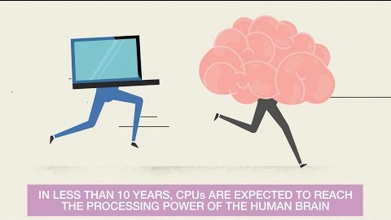
Data is Coming
The Expansion of Data
Notes:
Besides these issues, people have some other concerns of big data and artificial intelligence. Deep learning is the core technique for existing and emerging AI research. In fact, the idea of deep neural networks was proposed several decades ago. It is popular now because we can easily get access to a large amount of data and the computation ability of computer is much stronger.
With big data and super computation power, machines are getting smarter. For example, alphaGo and many other AI models beat human in games.
While we are enjoying the convenience brought by artificial intelligence, there are also some concerns.
(Watch video)
Some people say that artificial intelligence is driving the new industrial revolution. Many countries are investing more and more every year in artificial intelligence.
For us, this trend will also have large impact on our lives. One simple example, there is a large shortage of data scientists who have expertise in machine learning and deep learning. Obviously that people who have such expertise will find a job easier and earn more money. On the other hand, people who do not follow the trend may fall behind.

Slide 10
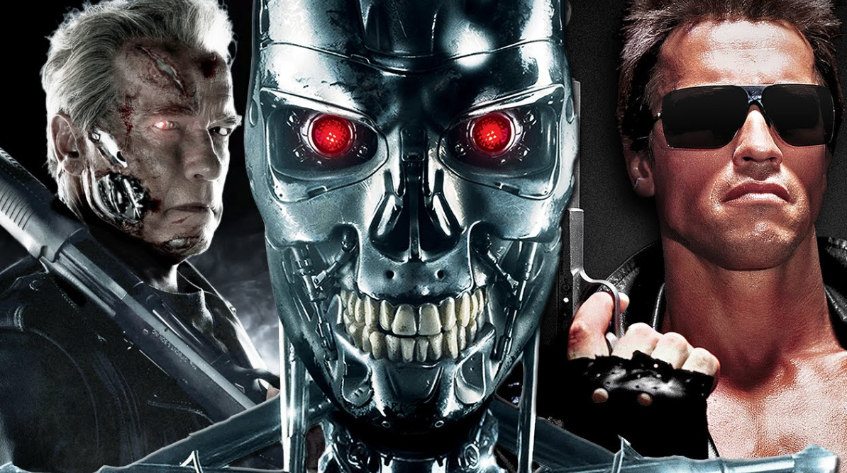

Data are Coming
How About Now?
Notes:
Besides these concerns, some claim that artificial intelligence is dangerous. They may take over the world, like in the movie: Terminator.
I would say it is still far from that but some of the techniques may not be safe. My research is about the security of machine learning models. Ant it turns out that they can be easily attacked and fooled.
For example, people can fool a self-driving car by sticking some small patches to the stop sign and it will take the stop sign as some other traffic sign. This can easily kill the passenger in the car.
Researchers even invented one kind of T-shirt. By wearing it, the people recognition system will take you as something else, such as a bike or tree. So you will be invisible to these systems. These technologies can be leveraged by criminals.
Anyway, I didn’t see the trend of AI taking over the world, but I can see the trend of new criminal and fraud. There are always two sides of a coin.

Slide 11
Values of Data
How Much is Data Worth?
In 2016, Microsoft Purchased LinkedIn for $26.2 Billion
In 2016, Caesar’s Total Rewards Program Was Valued at $1 Billion During Bankruptcy
Article in MIT Sloan Magazine
Notes:
Another thing I’d like to discuss is the value of data. I think everyone in the class knows that data is valuable. But how much is data worth?
In 2016, Microsoft acquired the LinkedIn for 26.2 billion dollars. Why did Microsoft consider LinkedIn to be so valuable?
Globally, LinkedIn had 433 million registered users and approximately 100 million active users per month prior to the acquisition. Simple math tells us that Microsoft paid about $260 per monthly active user.
In fact, the data asset is becoming more and more valuable now. For many companies, it might the most valuable asset. For example, Caesars Entertainment Operating Corporation went bankrupt in 2016 and the Total Rewards program data was worth 1 billion dollars.
Many high tech companies are data driven company and data is definitely their most valuable asset. For example, google, Facebook, amazon and all these companies are using user information to recommend ads, make decisions and design products.

Slide 12
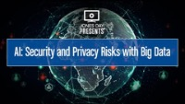
Values of Information
Thought Provoking Questions
Are You Worried About Data Privacy?
Regulation?
Notes:
This goes back to the original question. Many of these valuable data are collected from us. So data privacy and security could be problems. And how to address these problems is also important.
Correct regulation is important.
Here’s a video discussing these issues.
(Watch Video)

Slide 13
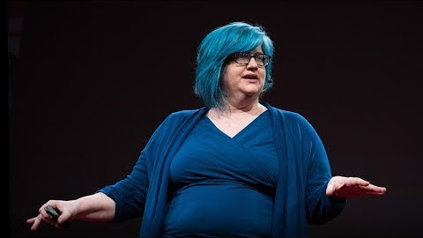
Modern Data Ethics
Weapons of Math Destruction
Author: Cathy O’Neil
Blog: mathbabe.org
Worked on Wall Street
Saw the Dark Side of Using Algorithms on Big Data to Make Business Decisions
Leader in Data Ethics
Notes:
In the last part, I’d like to share a Ted Talk video with you. This talk is called `Weapons of Math Destruction` which is given by Cathy O’Neil. She’s a leader in data ethics, algorithm fairness. The talk is about algorithm fairness and data ethics.

Slide 14
Thank You!

