Slide 1
Lecture 8

Slide 2
Probability models: Finite sample spaces with equally likely outcomes
If we can assume that all possible outcomes are equally likely, then the assignment of probabilities to individual outcomes is easy:
If the sample space S has k outcomes in all, then each must have probability 1/k.
So in the case of equally likely outcomes, if A is any event, then
P(A) = (number of outcomes in A) / k .

Slide 3
Probability models: Example 6 Assigning probabilities when the sample space is finite
Roll 3 fair dice, count the number of 6’s that come up. Sample space is S = {0,1,2,3}.
An appropriate assignment of probabilities to the four outcomes:
no. of 6’s | 0 | 1 | 2 | 3
probability | .579 | .347 | .069 | .005
Probability that there are 2 or 3 sixes:
Probability that there is at least one six:
Notes:
.069 + .005 = .074
1 - .579 = .421
Use R code to estimate
n=100000
k=3
set.seed(1231)
x=numeric(n)
for (i in 1:n){
throw=sample(6,3,replace=T)
x[i]=sum(throw==6)
}
counts=tabulate(x+1,4)
estimatedprob=counts/n
print(estimatedprob)

Slide 4
Random variables
Random variables and probability distributions
Discrete random variables
(Continuous random variables)

Slide 5
Random variables
The term random variable refers to a numerical outcome of a random phenomenon.
Example A: Toss a coin 3 times and let X be the number of heads.
X is a random variable whose possible values are 0, 1, 2, and 3.
Example B: Let Y be a number chosen using R’s runif(n) function.
Y is a random variable whose possible values are the numbers between 0 and 1.
Example C: Take a SRS of size 25 from the population of UNC undergrads and let W be the average GPA of the sampled students.
W is a random variable whose possible values are the numbers in the interval from 0.00 to 4.00.

Slide 6
Random variables
Any random variable has a set of possible values. Subsets of that set are events, and probabilities are assigned to the events.
Just like a probability model, except that the sample space must be a set of numbers.
This assignment of probabilities is the probability distribution of the random variable.
There are two kinds of random variable:
A discrete random variable has a finite set of possible values.
A continuous random variable has a set of possible values that is an interval of real numbers.

Slide 7
Random variables
To specify the probability distribution of a discrete random variable, we list the possible values along with the probability assigned to each.
Just like a finite sample space, except that with a random variable, the outcomes are always numbers.

Slide 8
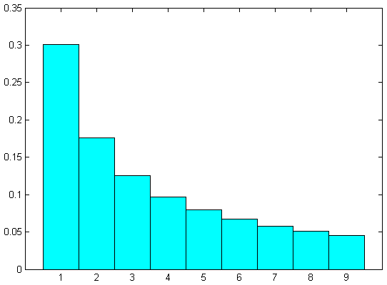
Discrete random variables
Example 1a (based on Ex. 4.12, p. 238): Choose a number at random from a table of data that follows Benford’s Law. Let X = first digit.
Then X is a discrete random variable. Its possible values X are 1,2,3,4,5,6,7,8,9, and the probability distribution is:
Value of X | 1 | 2 | 3 | 4 | 5 | 6 | 7 | 8 | 9
Probability | .301 | .176 | .125 | .097 | .079 | .067 | .058 | .051 | .046
A probability
histogram of
the distribution:

Slide 9
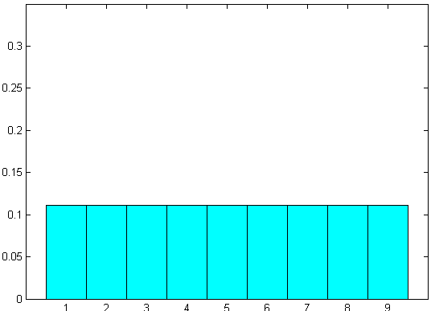
Discrete random variables
Example 1b : Choose a digit at random. If 0, discard and draw again. Let Y be the digit chosen.
Then the possible values of Y are 1,2,3,4,5,6,7,8,9, and the probability distribution is:
Value of Y | 1 | 2 | 3 | 4 | 5 | 6 | 7 | 8 | 9
Probability | 1/9 | 1/9 | 1/9 | 1/9 | 1/9 | 1/9 | 1/9 | 1/9 | 1/9
A probability
histogram of
the distribution:

Slide 10
Discrete random variables
Toss a fair coin 4 times, and let X be the number of heads.
The possible values of X are 0,1,2,3, and 4.
To find their probabilities, we look at the sample space for the random phenomenon (i.e., 4 tosses of a coin), and we find the probabilities of the events “X=0”, “X=1”, etc.
Sample space has 16 outcomes:
HHHH HHHT HHTH HHTT HTHH HTHT HTTH HTTT
THHH THHT THTH THTT TTHH TTHT TTTH TTTT
Probabilities assigned to these: 1/16 each.
We are interested in the probabilities of the five events “X = 0,” “X = 1,” etc.
What are these events?
“X = 1,” for example, is the event {HTTT, THTT, TTHT, TTTH}.
Continued →

Slide 11
Discrete random variables
Example 4.23, continued:
The 16 outcomes:
HHHH HHHT HHTH HHTT HTHH HTHT HTTH HTTT
THHH THHT THTH THTT TTHH TTHT TTTH TTTT
Arranged by the value of X (X = number of H’s):
X = 0: TTTT
X = 1: HTTT THTT TTHT TTTH
X = 2: HHTT HTHT HTTH THHT THTH TTHH
X = 3: HHHT HHTH HTHH THHH
X = 4: HHHH
So the probability distribution of X is:
Value of X | 0 | 1 | 2 | 3 | 4
Probability

Slide 12
Discrete random variables
Example: X = number of rooms in a randomly-chosen house occupied by owner (San Jose, CA, 1998).
Probability distribution of X:
Value of X | 1 | 2 | 3 | 4 | 5 | 6 | 7 | 8 | 9 | 10
Probability | .003 | .002 | .023 | .104 | .210 | .224 | .197 | .149 | .053 | .035
Express the event “unit has 6 or more rooms” in terms of X and give its probability.
Express the event “X > 6” In words and give its probability.
c. What important fact about discrete random variables is illustrated by these two probabilities?
Notes:
From IPS6e – Exercises 4.53 and 4.55, p. 268

Slide 13
Continuous random variables
A continuous random variable has all the numbers in an interval as its possible values.
Events are subsets of that interval.
The distribution of a continuous random variable is given by a density curve – a curve above the interval of possible values with a total area of 1.
The probability of any event is the area under the density curve and above values in the event.

Slide 14
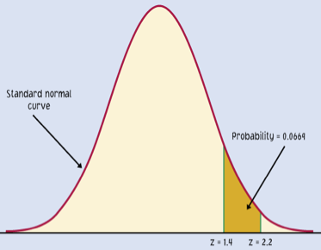
Continuous random variables
One distribution that a continuous random variable might have: Standard Normal.
Suppose Z has this distribution. Then probabilities of events involving Z are areas under the standard Normal density curve.
Example: The probability that Z is between 1.4 and 2.2 is
pnorm(2.2) –pnorm(1.4) = 0.0669 ,
because that is the area under the standard Normal curve above the interval from 1.4 to 2.2.

Slide 15
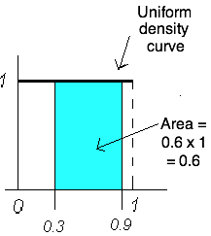
Continuous random variables
Another distribution that a continuous random variable might have: uniform between 0 and 1. If X has this distribution, then probabilities of events involving X are areas under the horizontal ‘curve’ shown.
Example: The probability that X is between 0.3 and 0.9 is 0.6, because that is the area under the uniform density curve above the interval from 0.3 to 0.9.

Slide 16
Distributions
Relation between data distributions (Section 1.3) and probability distributions (Section 4.3):
Suppose the distribution of values in a population has a certain density curve. (That is, its histogram is well approximated by that curve.)
If X is a random value taken from the population, then the probability distribution of X has that same density curve.
So probabilities for X (i.e., for one “random draw” from the population) are the same as proportions in the population.
For example, P(X < 50) is just the proportion of values under 50 in the population.

Slide 17
Discrete vs. continuous random variables
A discrete random variable X can take on any value in a finite set of possible values, and each value in the set has a positive probability.
A continuous random variable X can take on any value in an interval of possible values, but the probability of any single value in the interval is zero!.
Example 1: If X is the number of heads in 4 tosses of a fair coin, then
X is discrete. Its possible values are 0,1,2,3,4.
P(X = 2) = 6/16, and therefore P(X ≥ 2) and P(X > 2) are different.
(They differ by 6/16).
Example 2: If X is the height of a randomly-chosen adult male, then
X is continuous. Its possible values fill an interval (from the smallest possible height to the largest).
P(X = 72”) = 0 (no one is exactly 72.000000000000… inches tall), and therefore P(X ≥ 72) and P(X > 72) are equal.

Slide 18
The mean of a random variable
Example: Suppose the distribution of X is
If we repeat the random phenomenon many times and record all the values of X that we observe, what can we expect the average of our observations to be?
Will it be the average of the possible values of X? That is (0+1+2)/3 = 1. Would our observations have an average of 1?
NO!
The average of many observations of X can be expected to be close to
(0)(0.5) + (1)(0.3) + (2)(0.2)
= 0 + 0.3 + 0.4 = 0.7.
Value | 0 | 1 | 2
Probability | 0.5 | 0.3 | 0.2
Why? →

Slide 19
The mean of a random variable
If the distribution is
why would we expect the average of many observations to be
(0)(0.5) + (1)(0.3) + (2)(0.2)?
Because a large number of observations of X will include about 50% zeroes, 30% ones, and 20% twos.
Imagine making 10,000 observations of X and recording the results. The list of observed values would include about
________ zeroes, ________ ones, and ________ twos.
The average of those 10,000 observed values would be about _______________________________.
Value | 0 | 1 | 2
Probability | .5 | .3 | .2
Mean of a random variable represents its
expected long-run average value.

Slide 20
The mean of a discrete random variable
If X is a discrete random variable, the mean (or expected value) of X is denoted μ_{X} and defined as
μ_{X} = x₁p₁ + x₂p₂ + x₃p₃ + ∙∙∙ + x_{k}p_{k}
where x₁, x₂, …, x_{k} are the possible values of X and p₁, p₂, …, p_{k} are their probabilities.
The sum above is sometimes written as Σx_{i} p_{i} .

Slide 21
The mean of a discrete random variable
Example 1: If you bet a dollar in a certain version of the game Chuck-a-luck, and X is your net gain or loss from that bet, then the distribution of X is
So your expected gain or loss is μ_{X} = ____________.
If you play many times, you can expect to lose an average of about ______ per play.
If you play 1000 times, you can expect to lose about __________.
value | – 1 | 1 | 2 | 5
probability | 0.579 | 0.347 | 0.069 | 0.005

Slide 22
Example
Analize a bet using expected value language.
What is the expected winning/loss?
What probability P(A)=p leads to positive expected winning? (p>0.1)
Notes:
9p – 1(1-p)
Solve for 9p – 1(1-p)>0 for p.
p>1/10.

Slide 23
Simplified roulette
European roulette has numbers (00) 0,1,…36.
https://www.youtube.com/watch?v=4OeYU3_xD0s
https://en.wikipedia.org/wiki/Roulette
If you bet x on a number you get 35x if win on –x if loss.
What is the expected loss and s.d. of various bets?

Slide 24
Dubins & Savage Problem
You are given initial wealth $100
You can place any bets on the simplified roulette (European)
Play until either bust or reach $500
What strategy would you use?

