Slide 1
Lecture 9

Slide 2
The mean of a discrete random variable
If X is a discrete random variable, the mean (or expected value) of X is denoted μ_{X} and defined as
μ_{X} = x₁p₁ + x₂p₂ + x₃p₃ + ∙∙∙ + x_{k}p_{k}
where x₁, x₂, …, x_{k} are the possible values of X and p₁, p₂, …, p_{k} are their probabilities.
The sum above is sometimes written as Σx_{i} p_{i} .

Slide 3
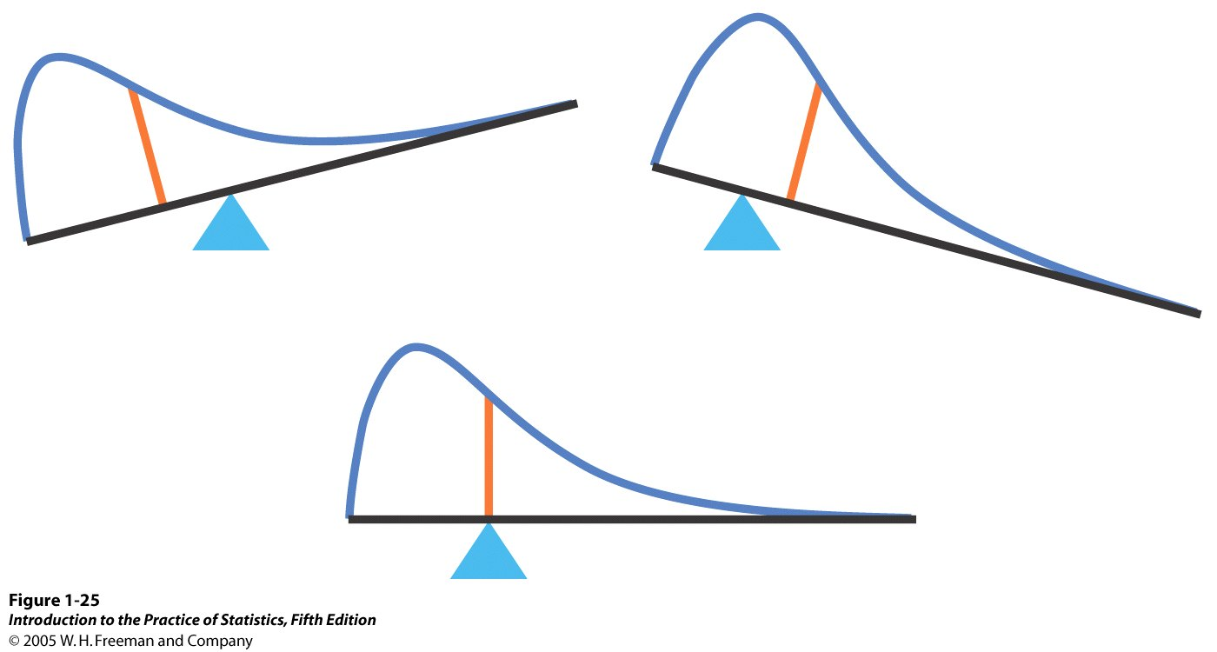
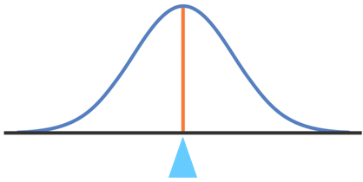
The mean of a continuous random variable
The mean of a continuous random variable is the ‘balance point’ of its density curve.
As with a discrete random variable, the mean represents the expected long-run average value.
When the curve is symmetric (as with Normal distributions), the mean is the point of symmetry.
(If not, it is found using integral calculus,)

Slide 4
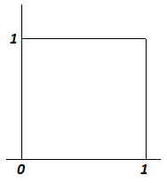
The mean of a continuous random variable
R’s =runif(1) function produces a random number X that is uniformly distributed between 0 and 1. Density curve is shown.
What is μ_{X}?

Slide 5
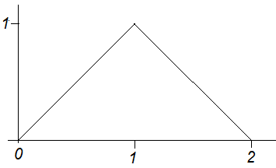
The mean of a continuous random variable
Example 2: If Y is the sum of two random numbers by R’s =sum(runif(2)), then the density curve of Y turns out to be as shown.
What is μ_{Y}?

Slide 6
Statistical estimation and the
law of large numbers
If X is the value of a variable for a random individual from a population with mean µ, then µ_{X} = µ.
Note that X (one random draw) cannot be expected to be close to μ. X will have different values for different individuals, and some values may be quite far from μ.
But:
We can expect the average of many independent observations of X to be close to μ_{X} – i.e., close to μ.
So the average, x, of a large sample from a population will give us an estimate of the population mean μ.
The law of large numbers is a theorem that makes this precise.
_

Slide 7
Statistical estimation and the
law of large numbers
Let X be the value of some variable for an individual drawn at random from a population. Conceptually, we have three means to think about:
μ – the population mean;
μ_{X} – the mean of random variable X, a single random
draw from the population;
x – the sample mean of a SRS from the population.
The first two are different in concept, but are always equal:
μ = μ_{X}. In practice this number is unknown.
The third, x, is known when we take a sample, and the law of large numbers says that it will be close to the unknown value of μ if the sample is large enough.
_
_
How large is “large enough”? →

Slide 8
Statistical estimation and the
law of large numbers
How large is “large enough”? That depends on the distribution of the population.
We can only make statements about the probability that x will be within a certain tolerance of μ.
This depends on the sample size and on the amount of variability in the population.
There is no “law of small numbers”.
We cannot expect x to be close to μ for small samples.
We cannot expect the sample mean to move closer to μ by adding a few observations. It is only in the long run that the law of large numbers has an effect.
_
_
_

Slide 9

The variance of a random variable
For a discrete random variable X with possible values x₁, x₂, x₃, …, x_{k} having probabilities p₁, p₂, p₃, …, p_{k} , the variance is
The standard deviation σ_{X} is the square root of σ²_{X}.
For any random variable X, the variance σ²_{X} is the mean of the random variable (X – μ_{X})².
For a continuous random variable the variance would be computed as an integral involving the density function.

Slide 10
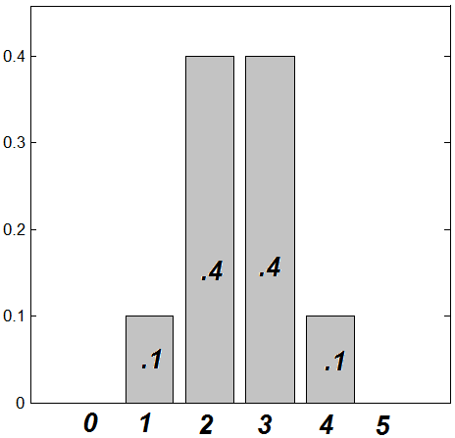
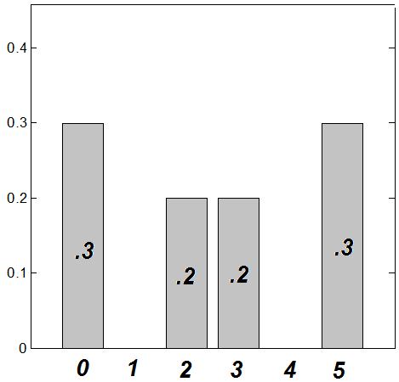
The variance of a random variable:
two examples
Mean = 2.5
Variance =
(1 - 2.5)²(.1) + (2 - 2.5)²(.4)
+ (3 - 2.5)²(.4) + (4 - 2.5)²(.1)
= 0.65
Standard deviation = √0.65 = 0.8062
Mean = 2.5
Variance =
(0 - 2.5)²(.3) + (2 - 2.5)²(.2)
+ (3 - 2.5)²(.2) + (5 - 2.5)²(.3
= 3.85
Standard deviation = √3.85 = 1.9621
Variance is a measure of spread.

Slide 11
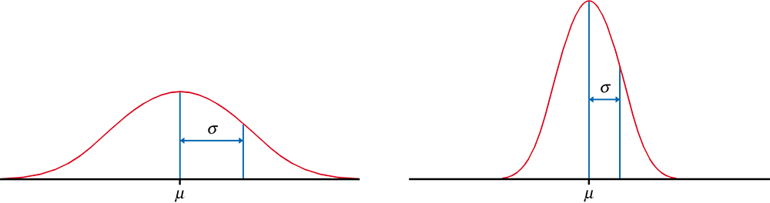
Variance is a measure of spread
Two normal probability distributions:
Larger variance
Smaller variance
(same as for normal data distributions)

Slide 12
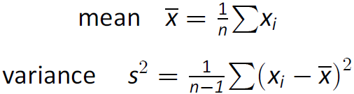
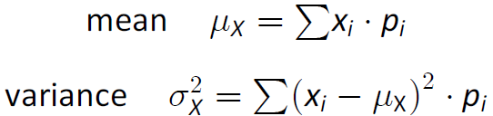
Formulas for means and variances of samples and random variables
For a sample consisting of values x₁, x₂, … , x_{n} :
For a discrete random variable with possible values
x₁, x₂, … , x_{n} having probabilities p₁, p₂, … , p_{n} :

Slide 13
Exercise:
The probability distribution of X is
Find the mean and the standard deviation of X.
value | 1 | 2 | 3 | 4
prob. | 0.2 | 0.3 | 0.4 | 0.1
Notes:
mean: 2.4
standard deviation: √0.84 = 0.917

Slide 14
Simplified roulette
European roulette has numbers (00) 0,1,…36.
https://www.youtube.com/watch?v=4OeYU3_xD0s
https://en.wikipedia.org/wiki/Roulette
If you bet x on a number you get 35x if win on –x if loss.
What is the expected loss and s.d. of various bets? (Notice the basket bet)

Slide 15
“Systems”
Martingale: When betting on red double your bet after every loss.
When you win you get all back and them some
When you loose you loose everything you have
https://en.wikipedia.org/wiki/Martingale_(betting_system)

Slide 16
Dubins & Savage Problem
You are given initial wealth $100
You can place any bets on the simplified roulette (European)
Play until either bust or reach $500
What strategy would you use?
Ignore complications due to minimum and maximum bet.
R experiments

