Slide 1
Lecture 16

Slide 2
Project 2
Select and analyze a game of chance
Use calculation, R or other mean to make QUANTITATIVE observations about the game
Write a 5 page paper. Include:
Description of the game
Your analysis
Conclusions
References
DUE: on November 10.
Come to my office to discuss what makes a suitable project!

Slide 3
Part 3 - statistics
In previous part of the course we learned the ideas of probability:
Describe a random phenomenon using mathematical or software tools
Given a random phenomenon (game,…) find the best strategy.
Investigate risks (variance, probability something bad happens)

Slide 4
Statistics
Main ideas of statistics
Given multiple plausible models select one (or several) that is (are) the most consistent with the observed data
Quantify a measure of belief in our solution
The main idea is that if something looks like a very unlikely coincidence we would prefer another more likely explanation

Slide 5
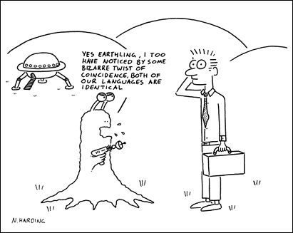
☺

Slide 6
Chapter 3 Introduction: Sources of data
Anecdotal data
Available data
Observational studies
Experiments (not covered)

Slide 7
Chapter 3 Introduction: Sources of data
Anecdotal data: Individual cases that we recall or learn about.
Examples:
“Several of my friends text while driving and none of them has had an accident.”
Newspaper article about a person who suffered complications of arthroscopic knee surgery
More examples?

Slide 8
Chapter 3 Introduction: Sources of data
Available data: Found on the Web, in magazines and newspapers, etc.
May or may not be useful for the question at hand…
Example: Obamacare enrolled 12.7 million people.
Various interest groups might point to this as “things are working”.
The rise might be due to various combinations of reasons, and more study would be needed to discover what is going on.
Notes:
Overall approval rating rose 1%, from 46% to 47%.

Slide 9
Chapter 3 Introduction: Sources of data
Observational studies and experiments
Data from both include values of explanatory and response variables for a number of subjects.
The difference: in an experiment, the values of one or more of the explanatory variables are controlled by the experimenter.

Slide 10
3.2 Sampling design: Terminology
Sample survey: Take a sample from a population and measure the values of one or more variables (usually categorical). Examples:
Opinion polls. (Sampling units are people, variables are opinions.)
Sample items off an assembly line, inspect for defects (variable: defective or not)
Take a sample of grocery stores in a city and measure the prices of certain ‘market-basket’ items

Slide 11
3.2 Sampling design: kinds of design
Key questions for a sample survey:
What is the population from which individuals are sampled?
What variables are measured?
What’s the design? That is, how was the sample selected?

Slide 12
3.2 Sampling design: Examples of bad designs
Convenience sampling – e. g., choose people in the Pit between noon and 1 pm some day.
Why bad?
Nonrandom sampling by someone with an interest in the outcome
Technician sampling steel for quality control avoids bad looking samples
Political organization stops ‘random’ people on the street to ask opinions
Voluntary response samples – the worst!! Examples:
CNN.com “Quick Vote” or ESPN.com “SportsNation”
Ann Landers “poll” of parents: If you had it to do over again, would you have children?
American Family Association poll (2004) on gay marriage
Notes:
Both types sample a population that isn’t the one we might want to study
Example: AFA online poll on same-sex marriage. After liberal groups found out about it, AFA got about 850,000 responses, 60% in favor.
Ann Landers: about 10,000 responses. 70% said they wouldn’t. In a later random sample, 91% said they would.

Slide 13
3.2 Sampling design
Random sampling is necessary to reduce bias of different kinds:
experimenter bias
bias due to effects of lurking variables
etc.
Kinds of random sampling:
Simple random sampling
Stratified sampling
Multistage sampling

Slide 14
Simple random sampling
Simple random sample (SRS) of size n: chosen in such a way that every set of n individuals in the population has the same chance to be the sample selected.
Conceptually: Put all names in the population on slips of paper in a hat, mix them, and draw out n of them.
In practice: use random digit tables, computer-generated random numbers, or other methods.

Slide 15
Stratified sampling
Problem: a SRS from a large population spread over a wide area may (just by chance) underrepresent some demographic category.
E.g., rural voters may be underrepresented compared to urban and suburban.
Solution: first divide the population into strata.
Examples of stratification: into geographical areas, ethnic groups, genders, economic categories, etc.)
Then take a SRS from each stratum, and combine them to make the sample.
The sizes of the samples can be adjusted to reflect the population shares of the strata.
Note similarity to block designs in comparative experiments.
Both control for a categorical variable.
Notes:
Experiment: population of size 10,000 of about 20% rural, 80% urban households. Took several samples of size 100 from this population. Most had around 20 rural, but one had just 14.

Slide 16
Multistage sampling
Commonly used to get samples from the population of all households or people in the nation, where SRS would be essentially impossible.
One form of multistage sampling is used by the US Bureau of the Census in its Current Population Survey.
Examples of results from 2010 survey:
2009 poverty rate was 14.3%, up from 13.2% in 2008
Median household income in 2009 was $49,777, about the same as in 2008

Slide 17
The Census Bureau’s multistage sampling method for the Current Population Survey
Divide the nation into a large number of primary sampling units (PSUs). These are counties or sometimes other geographic units; they do not cross state lines.
Take a SRS of PSUs. Within each sampled PSU:
Divide the PSUs into blocks (actual city blocks, or other divisions in smaller towns or rural areas). Organize the blocks into strata (based on urban vs. rural and on racial or ethnic characteristics).
Take a stratified sample of blocks. Within each sampled block:
Divide the block into clusters. Each cluster consists of four nearby housing units.
Take a SRS of clusters. Within each sampled cluster, interview all four households.

Slide 18
Random-digit dialing (another kind of multistage sampling)
Used by most major public-opinion polling organizations (Gallup, Harris, NORC, Pew, Zogby, etc.)
Goal is to get a random sample of all US households that have telephones.
Based on phone numbers: 1-XXX-YYY-ZZWW
XXX-YYY is the exchange
ZZ is the bank (up to 100 telephones in a bank)
Start with
a list of all exchanges
a list of all banks in each exchange, with number of telephones in each bank

Slide 19
Random-digit dialing based on 1-XXX-YYY-ZZWW
Take a SRS of exchanges (XXX-YYY).
Within each sampled exchange, take a SRS of banks (ZZ).
Number of banks sampled depends on number of banks in the exchange.
Within each sampled bank, take a SRS of telephones (WW).
Number of phones sampled depends on no. of phones in the bank.

Slide 20
Internet polling
Survey Monkey (with targeted audience)
Sample from people who have take suveymonkey poll in the past
reweights
Qualtrics
Mechanical Turk (amazon)
People bid on jobs – get paid for answering questions

Slide 21
What can go wrong in sample surveys (even when sampling is random)
Undercoverage
when one or more groups in the population are left out or underrepresented in the sampling process. For example, unless care is taken
Sampling by housing units may miss the homeless
Sampling by telephone may miss mobile-phone users without landlines
Nonresponse
when sampled individuals can’t be contacted or refuse to respond
Response bias
when respondents lie (to please the interviewer, to hide certain behaviors, etc.)
Poor wording of questions
Notes:
Response bias
exit polls
race or sex of interviewer can influence response
Wisians

Slide 22
Importance of wording of questions
Survey of high-school students:
“Which is easier for someone of your age to buy: cigarettes, beer, or marijuana?” (35%, 18%, 34%)
“Which is easier for someone of your age to obtain: cigarettes, beer, or marijuana?” (39%, 27%, 19%)
Ex. 3.27, p. 197:
“Is US spending too much on assistance to the poor?” (13%)
“Is US spending too much on welfare?” (44%)
Notes:
Ex. 3.30: Heterosexual, homosexual, or bisexual? “It’s just me and my husband, so bisexual.”
Wisians: When asked for impressions of various ethnic groups, 30% had an opinion about the Wisians, ranking them above several other real groups.

Slide 23
Note on stratified vs. multistage sampling
In stratified sampling we divide the population into strata and take a SRS from every stratum. (Not a random selection of strata.)
In multistage sampling. there is random selection at every stage. Examples:
Divide population into blocks. Choose a SRS of blocks, then a SRS from each block in the SRS
Method used by CPS: PSU’s, blocks within PSU’s, clusters within blocks. Interview every individual in a cluster
Random-digit dialing: Exchanges, banks, phones within banks. Call a SRS of phones in each bank.

Slide 24
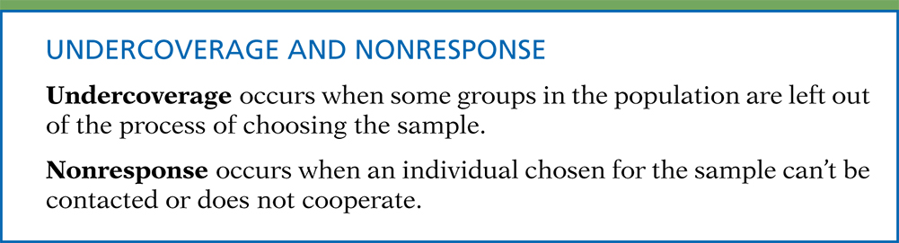
Definition, pg 204
Introduction to the Practice of Statistics, Sixth Edition
© 2009 W.H. Freeman and Company
Example: the homeless.
If the sampling design fails to include a way to survey them, then there is likely to be undercoverage bias.
If the design does include a way to survey them, but some of them can’t be found or don’t respond, then there may be nonresponse bias.
Example: “Some of the units chosen for a sample cannot be found or contacted. There are some of these missing units in all segments of the population.” This is nonresponse.

