Slide 1
Lecture 17

Slide 2
Final Project
Design your own survey!
Find an interesting question and population
Design your sampling plan
Collect Data
Analyze using R
Write 5 page paper on your results
Due April 21

Slide 3
Final presentation
During the last class (April 26) all students will be required to give a short presentation
Select one of the three projects
Make a powerpoint presentation (no more than 3-5 slides)
Present your results to the class

Slide 4
Final Project
Design your own survey!
Find an interesting question and population
Design your sampling plan
Collect Data
Analyze using R
Write 5 page paper on your results
Due December 1

Slide 5
Final presentation
All are required to give a short presentation
Last two classes (December 1 and 6)
Select one of the three projects
Make a powerpoint presentation (no more than 3-5 slides)
Present your results to the class

Slide 6
Statistics
Main ideas of statistics
Given multiple plausible models select one (or several) that is (are) the most consistent with the observed data
Quantify a measure of belief in our solution
The main idea is that if something looks like a very unlikely coincidence we would prefer another more likely explanation

Slide 7
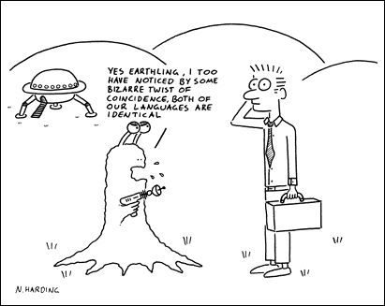
☺

Slide 8
Example 1
There is one model we favor and want to check if a particular feature of the data is consistent with it (hypotheses testing).
The UK National Lottery is 6/49 Genoese lottery.
In the first 1240 drawings since 2000 there has been a lucky number 38 (drawn 181 times) and unlucky number 20 (drawn 122 times). [All things being equal we would expect each number to be drawn 151.8]
Similarly number 17 took a staggering break of 72 drawings in a row!
Is this consistent with the assumption that the lottery is random and all numbers are equally likely?

Slide 9
Idea
Generate similar data from the known distribution and compare with the results observed.
Statistics: number of times “luckiest number” drawn, number of times “unluckiest number” drawn, size of the biggest gap

Slide 10
R simulation
Code Loterry1240.R
What is our conclusion?

Slide 11
Example 2
Premier League 2006/2007
20 teams – playing home and away (total 380 matches)
3 points for victory, 1 point each for a draw
At the end Manchester United ended up with 89 points, Chelsea with 83, Watford with 28
Could we view this as random
http://plus.maths.org/content/understanding-uncertainty-premier-league?src=aop

Slide 12
R simulation
Data
http://en.wikipedia.org/wiki/2006–07_Premier_League
Statistic
Max (89), min (28), variance (238.7)
Issue
it is known that there is a big difference between home and away.
Simple model: (p-home,p-draw,p-away)
If all things were equal we can estimate this to be (48%,26%,26%)
Conclusion?

Slide 13
Other issues
In sports – successive trials are probably not independent
Can we test this? What would we need?
Data
Statistics (numerical measurement that caries information about the feature we are interested in)
Simulation scheme/model

Slide 14
Other statistical problems
Having several models and deciding how likely each model is given data.
Bayesian statistics
Need prior believe in each model
Update the believe based on data

Slide 15
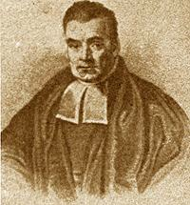
Deciding between several models
One option is to use Bayesian approach

Slide 16
Bayesian statistics
A method for updating and combining information expressed in terms of probabilities (data and prior believes)
Recent notable uses
Nate Silver http://fivethirtyeight.com
Search for Air France Flight 447 http://en.wikipedia.org/wiki/Air_France_Flight_447

Slide 17
Example 1:
Testing for disease or drug.
Two models:
Subject has the disease (uses drugs) – Test is positive with probability q1 (sensitivity)
Subject does not have the disease (is clean) – Test is negative with probability q2 (specificity)
Prior information
Certain proportion p of the population has the disease

Slide 18
It is claimed that a DrugWipe5 has sensitivity of 91% and specificity of 95%
About 4% of the population uses
A randomly selected worker tested positive.
What is the chance he is a user?
http://www.drugwarfacts.org/cms/Drug_Testing

Slide 19
Excel Calculation

Slide 20
A spotter has a 30% success rate in spotting workers who use. A person selected by a spotter was tested positive. Is there a difference?
Comments?

Slide 21
The rule of succession
Derived by Laplace (1814)
We have an experiment that can end up in success or failure
We performed n experiments and all of them were successes. What is the chance that the next one will be success?

Slide 22
Consider N models
Chance of success
p=0/(N-1),1/(N-1),…,(N-1)/(N-1)
Observed data n out of n successes
Prior – all models equally likely
Posterior probability

Slide 23
Example 2b
What if we observed s out of n successes?
Other priors?

