Slide 1
Lecture 19

Slide 2
Bootstrap for mean
We learned about what to do if our data is categorical (yes/no)
A lot of data are numerical measurements
What is the population average?
What is the relationship between several variables?
How to compare two groups?

Slide 3
Inference for Mean
Numerical data: height, speed, temperature…
Mean and standard deviation is meaningful
Example: speed of cars in 1920
4 4 7 7 8 9 10 10 10 11 11 12 12 12 12 13 13 13 13 14 14 14 14 15 15 15 16 16 17 17 17 18 18 18 18 19 19 19 20 20 20 20 20 22 23 24 24 24 24 25
Sample mean = 15.4 mph
Population mean = ?

Slide 4
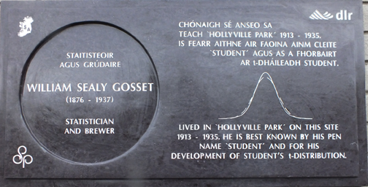
T solution
There is a T based confidence interval

Slide 5
Bootstrap solution
Pretend a population is like sample
Create bootstrap samples by sampling from the fake population
From each bootstrap sample compute mean
Idea: The variability in the bootstrap samples is similar to the uncertainty in the original sample

Slide 6
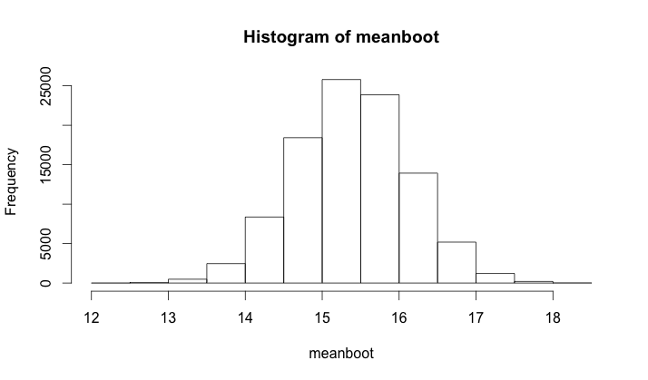
Solution
Interval [13.9, 16.8]

Slide 7
Linear regression
Each member of the population has two measurements (x,y)
Example speed and distance to stop
We are interested in a linear relationship between the variables
Use lm(distance~speed) to fit
Use abline to draw line

Slide 8
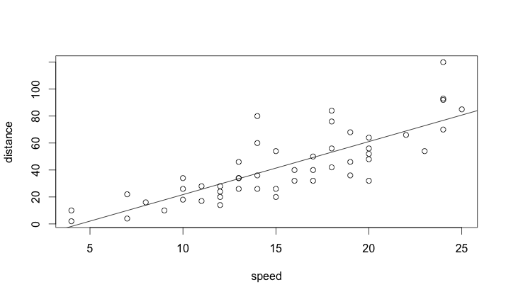
Data
Data collected in 1920 ☺

Slide 9
Fit
Best linear fit distance distance = -17.5+3.9*speed
To assess uncertainty – we will use bootstrap.
Resample individuals (pairs of measurement) from the sample.
For each bootstrap sample fit a line
Get a bootstrap confidence interval

Slide 10
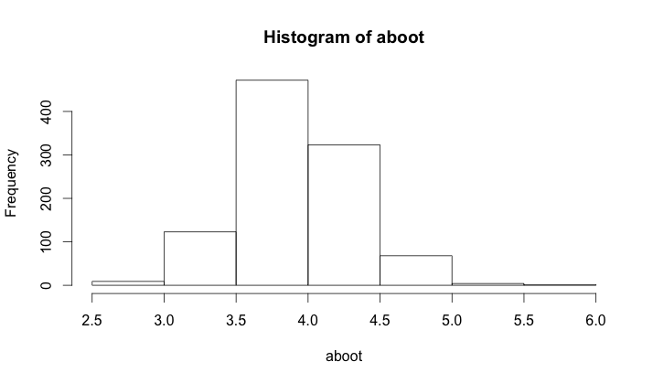
Bootstrap slope
Slope [3.2,4.7]

Slide 11
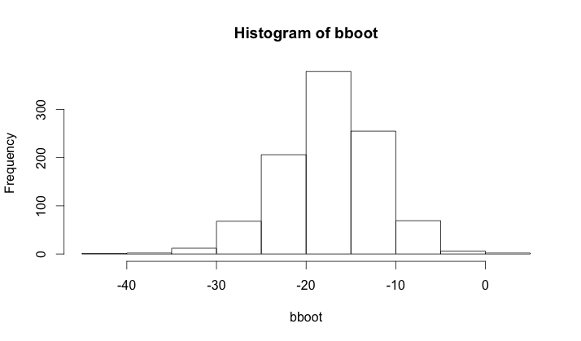
Bootstrap intercept
Intercept [-29.0,-7.9]

Slide 12
Model missfit
Intercept is negative ?!?
Based on physics the relationship should be quadratic!
Bootstrap confidence intervals
Intercept [-19.5,24.9]
Linear [-2.49, 4.46]
Quadratic [-0.03, 0.22]
Shall we drop linear & intercept term?

Slide 13
Compartison of two groups
We have two groups (treatment/control)
Question: Is there a difference between groups?
Example
Group1: 1,4,3,2,5,3,2,4
Group 2: 4,5,3,4,5,6,7,4,8
Difference between means -2.11
Is this due chance?

Slide 14
Bootstrap (permutation) solution
If the two groups are the same, we can randomly reassign people.
The value of the test statistics should not change too much!
Compare the observed difference and many reassigned differences.

