Slide 1
Lecture 20

Slide 2
Final Project
Design your own survey!
Find an interesting question and population
Design your sampling plan
Collect Data
Analyze using R
Write 5 page paper on your results
Due December 1

Slide 3
Final presentation
All are required to give a short presentation
Last two classes (December 1 and 6)
Select one of the three projects
Make a powerpoint presentation (no more than 3-5 slides)
Present your results to the class

Slide 4
Capture recapture
How many fish are in the lake?
How many bighorn sheep live in a given area?
…

Slide 5
Idea
Two stage sampling procedure:
Trying to estimate unknown population size N
Capture K members of the population; mark them and release
Let them mix well with the rest of the population
Capture n members at random and count the number of marked ones k in the sample
Notice K/N ≈ k/n

Slide 6
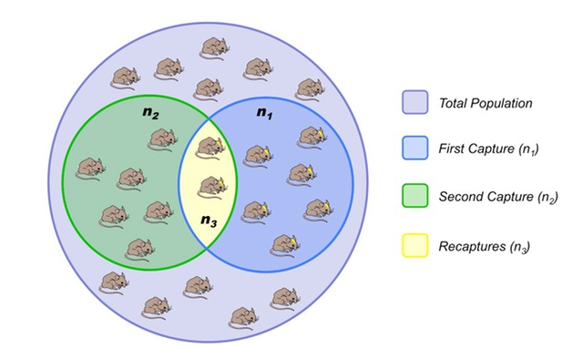

Slide 7
Example
How many fish in a pond?
First stage: we capture and mark 20 fish.
Second stage: catch 30 fish and 5 are marked.
Point estimator: 20/N ≈ 5/30; N ≈ 120
Uncertainty?

Slide 8
Which models agree?
Consider various models – Nfish=50,51,…,400

Slide 9
Find cutoffs
Models selected using cutoffs .025 and .975 Nfish=[66,240]

Slide 10
Bootstrap solution
Use estimated fake truth Nfish=20*30/5=120
Estimated number of fish [66,300]

Slide 11
Bayesian solutions
All of these problems have Bayesian solutions
Idea
Consider all the models and give them prior probability
Compute the posterior probability given the data (see the tree on the board for calculation)
Plot or find credible intervals

Slide 12
SRS Example
Recall SRS problem:
2016 estimate of the number of eligible voters is 225,778,000.
We sampled 603 people at random and got 314 dog lovers

Slide 13
Bayes
Bayes approach:
several possible models (p=.001,.002,…,.999)
Assign prior – equally likely
Compute posterior: Credible interval [.481,.559]

Slide 14
Recall Example
How many fish in a pond?
First stage: we capture and mark 20 fish.
Second stage: catch 30 fish and 5 are marked.
Point estimator: 20/N ≈ 5/30; N ≈ 120
Uncertainty?

Slide 15
Bootstrap solution
Use estimated fake truth Nfish=20*30/5=120
Bootstrap is somewhat imprecise

Slide 16
Capture Recapture
Bayes approach
Possible models (N=40, 41, …, 1000)
Assign prior (equally likely)
Compute posterior: Credible interval [79,454]

Slide 17
Issues
Choice of prior
If 40,41,…,10000; credible interval [79,462]
Problem: equally likely is not quite right

Slide 18
Prior selection
Different prior
Big values are not trusted the same as small
q^N (q should be close to 1 – try 1-q=1/120) Credible set [74,273]

