Slide 1
STOR 455 STATISTICAL METHODS I
Jan Hannig

Slide 2
Registration Issues
Contact Charlotte Rogers at Hanes 321.
Fill out some paperwork with her to be put on the waiting list.

Slide 3
Syllabus
www.unc.edu/~hannig/STOR455
Book – downloadable from the web
SAS is an important part
Free for students
No Mac Version
Possible to use “emerald”
I will show you when the time comes

Slide 4
Jan Hannig
335 Hanes Building
jan.hannig@unc.edu
(919) 962-7511
Personal webpage http://www.unc.edu/~hannig
Office hours
Tuesday 3:30-4:30pm (after class)
Wednesday 10:30-11:30am

Slide 5
Where am I from?

Slide 6
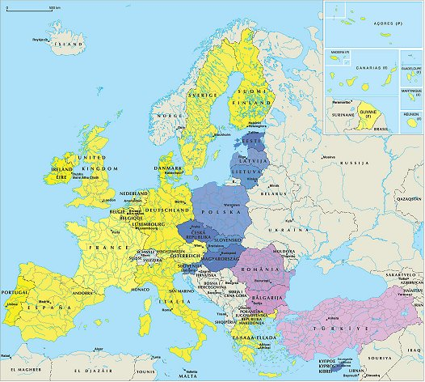
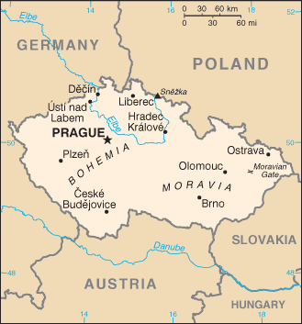

Czech Republic

Slide 7

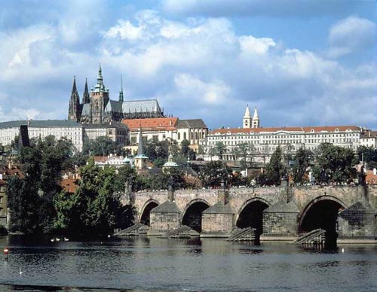
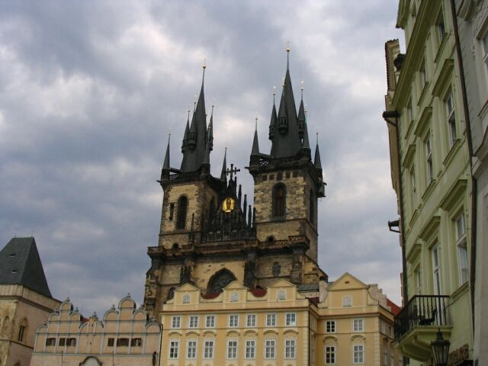
Prague

Slide 8


Michigan State

Slide 9
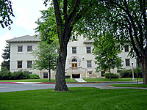


Colorado State

Slide 10
Interests
Skiing
Mountain biking
My church (Greenleaf Vineyard)
Of course
Research
Teaching

Slide 11
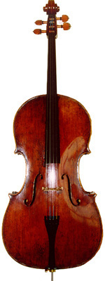

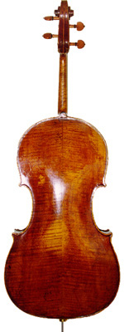
Cello

Slide 12
What is Statistics?
Statistics: the science of collecting, organizing, and interpreting data.
Population
Inference about population (using statistical tools)
Sample of data

Slide 13

Popular stats

Slide 14
Quick review
Stats
Population/sample
Point Estimation
Confidence Intervals
Hypothesis Tests
Gaussian (Normal) Distribution
Math
Functions
Elementary matrix arithmetic

Slide 15
Fundamental Concepts (Section 1.2)
Population: the entire group of individuals that we want information about.
All students (who are about to take SAT)
Sample: a part of the population that we actually examine in order to gather information.
those students selected into the study
Sample size: number of observations/individuals in a sample.
50
Statistical inference: to make an inference about a population based on the information contained in a sample.
Based on the data from the study, to infer whether a stricter classroom atmosphere increases SAT scores in general.

Slide 16
Fundamental Concepts
A model is mathematical description of the quantities of interest
Gaussian with unknown mean and variance
A parameter is a value that describes the population. It’s fixed but unknown in practice.
the mean and variance of the SAT score of all the students, who are about to take it.
A statistic is a value that describes a sample. It’s known once a sample is obtained.
The mean and variance SAT score of all the students, who are selected into the study.
A sample analogy of the parameter.
Statistics is a course about lots of statistics!!! ☺

Slide 17
Types of Populations (Section 1.3)
Population of items
All US Taxpayers that who paid tax in 2009
All farms in Nebraska and Iowa in 2010
All cars made by GM in 2011
All plastic containers that can be made using all possible process temperature between 300F and 400F
The set of all measured values of breaking strength of a given metal rod
Remarks
Population items must be precisely defined
Finite vs. infinite
Real vs. conceptual (future and imagined)

Slide 18
Populations
Population of numbers (each item has one or more number of interest)
The interest income reported by US Taxpayers that who paid tax in 2009
The size of the farm and profit of farms in Nebraska and Iowa in 2010
Number of miles and maintenance cost for all cars made by GM in 2011 during its first year.
The strength of the plastic container and the temperature at which it was made.
All measured values of breaking strength of a given metal rod
Remarks
Univariate vs multivariate
These are the inputs of the statistical procedures

Slide 19
Populations
Target populatiom
Population of interest
Sometimes unavailable (future/imagined)
Study Population
Available population that resembles the target population (cars of 2009)
Judgment calls need to be made by the investigator
We will always talk work with the study population in this course

Slide 20
Models (Section 1.4)
There are many possible model distributions
Gaussian distribution
Binomial distribution
Poisson distribution
Gamma distribution
…
In this class we will almost exclusively use Gaussian Distribution

Slide 21
Density Curve
Define a probability density function f(x).
The curve that plots f(x) is called the corresponding density curve.
f(x) satisfies:
f(x)>=0;
The total area under the curve representing f(x) equals 1.

Slide 22
Density Curves
Describe the overall shape of distributions
Idealized mathematical models for distributions
Show patterns that are accurate enough for practical purposes
Always on or above the horizontal axis
The total area under the curve is exactly 1
Areas under the curve represent relative frequencies of observations

