Slide 1

Weekly Branch Dashboard
Weekly Review of Sales, Meetings & Pipeline Metrics
Group 1
Chaithra S V
Janhavi Dusad
Akshay Annaji Sawant
Susmita Das
Srishti
Koppisetti suseela venkata durga

Slide 2
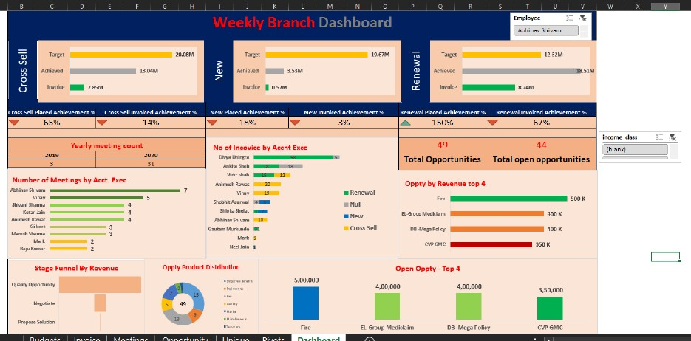
WEEK 1 - EXCEL DASHBOARD

Slide 3
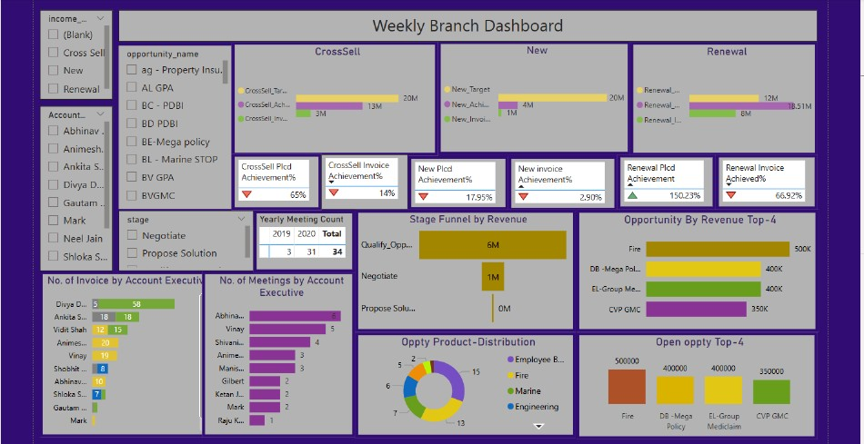
WEEK 2 - POWER BI DASHBOARD

Slide 4
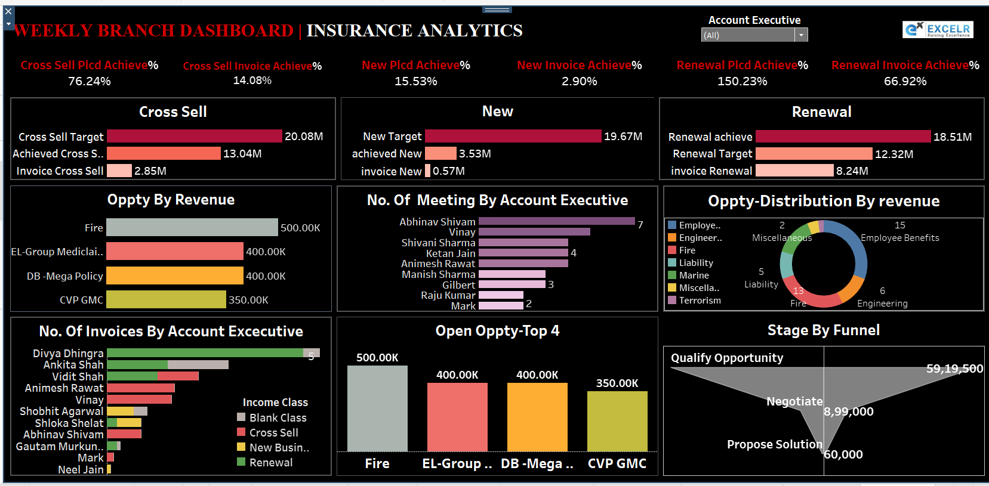
WEEK 3 - TABLEAU DASHBOARD

Slide 5
WEEK 4 - My SQL Query

Slide 6
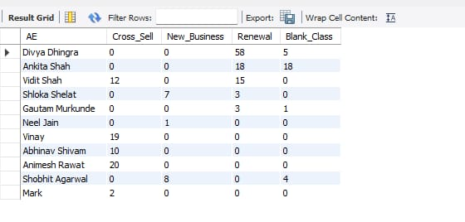
KPI 1 – No. of Invoice by Account Exec.
SELECT * FROM invoice.invoice1;
select invoice_number from invoice1;
SELECT COUNT(*) AS total_invoices, AE FROM invoice1 GROUP BY AE ORDER BY total_invoices DESC;
ALTER TABLE invoice1 CHANGE `Account Executive` AE VARCHAR(100);
SELECT AE, income_class, COUNT(*) AS total_invoices FROM invoice1 GROUP BY AE, income_class ORDER BY AE, income_class;
SELECT DISTINCT AE,
SUM(CASE WHEN income_class = 'Cross Sell' THEN 1 ELSE 0 END) AS Cross_Sell,
SUM(CASE WHEN income_class = 'New' THEN 1 ELSE 0 END) AS New_Business,
SUM(CASE WHEN income_class = 'Renewal' THEN 1 ELSE 0 END) AS Renewal,
SUM(CASE WHEN income_class IS NULL OR income_class = '' THEN 1 ELSE 0 END) AS Blank_Class
FROM invoice1 GROUP BY AE ORDER BY AE desc;

Slide 7
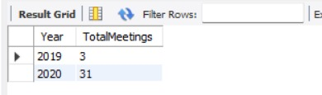
KPI 2 – Yearly Meeting Count
CREATE TABLE meeting_clean ( account_exe_id INT, account_executive VARCHAR(100),
branch_name VARCHAR(100), global_attendees VARCHAR(100), meeting_date DATE);
USE classicmodels;
Yearly meeting count
SELECT
Account Executive,
COUNT(*) AS NoOfMeetings
FROM meeting_final
GROUP BY Account Executive
ORDER BY NoOfMeetings DESC;

Slide 8
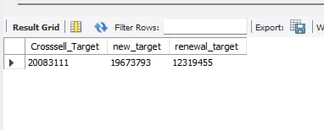
KPI 3 – Cross Sell, New, Renewal
select sum(cbudget)
AS Crosssell_Target,
sum(budget) as new_target ,
sum(rbudget) as renewal_target
from budget ;

Slide 9
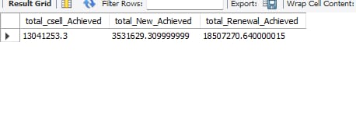
fees + brokerage
select (select SUM(CASE WHEN income_class = 'Cross Sell' THEN Amount ELSE 0 END) AS achieved_fees from fees) +
(select SUM(CASE WHEN income_class = 'Cross Sell' THEN Amount ELSE 0 END) AS brokerage_cross_sell from brokerage )
as total_csell_Achieved,
(select SUM(case when income_class="New" then amount else 0 end)as Total_New from fees)+
(select Sum(case when income_class="New" then amount else 0 end)as Total_New from brokerage)
as total_New_Achieved,
(select SUM(case when income_class="Renewal" then amount else 0 end)as Total_New from fees)+
(select Sum(case when income_class="Renewal" then amount else 0 end)as Total_New from brokerage)
as total_Renewal_Achieved;

Slide 10
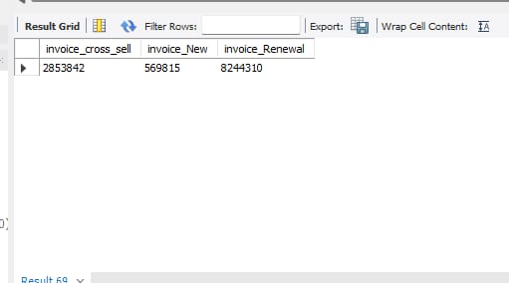
invoice cross sell,new, renewal
SELECT
SUM(CASE WHEN income_class = 'Cross Sell' THEN Amount ELSE 0 END) AS invoice_cross_sell,
Sum(case when income_class="New" then amount else 0 end)as invoice_New,
sum(case when income_class="Renewal" then amount else 0 end) as invoice_Renewal
FROM invoice1;

Slide 11
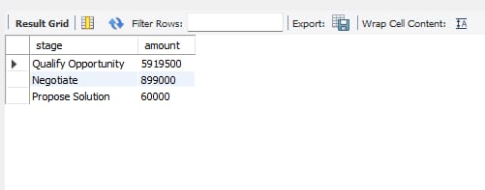
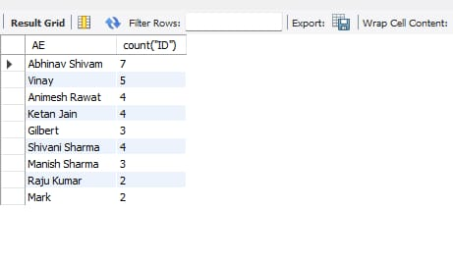
KPI 4 – Stage Funnel by Revenue
select stage,sum(revenue_amount)
from opportunity
group by stage
order by sum(revenue_amount) desc;
KPI 5 – No. of Meeting By Account Exec.
select * from meeting;
select AE, count("ID") as "Meetings"
FROM meeting
GROUP BY AE
ORDER BY COUNT("ID") desc;

Slide 12
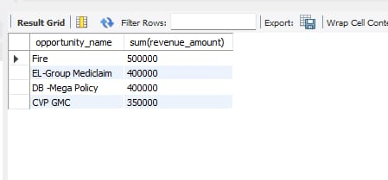
KPI 6 – Top Open Opportunity
SELECT
opportunity_name, revenue
FROM
opportunity
ORDER BY
revenue DESC
LIMIT 4;

Slide 13
Sales Target vs Achievement
Sales Performance Overview (Cross Sell | New | Renewal)
Charts Shown:
Bar graphs for each category showing:
Target
Achieved
Invoiced Revenue
📌 Key Points:
Cross Sell: Achieved ₹13M of ₹20M target; Invoice is just ₹2.8M
New Business: Underperforming — Achieved ₹3.5M of ₹19.6M target
Renewal: Overachieved — Achieved ₹18.5M against a target of ₹12.3M
Highest invoiced revenue also in Renewal.

Slide 14
Meetings & Engagement Metrics
Client Engagement Activity (Meetings)
Yearly comparison (2019 vs 2020)
Meeting count by Account Executive
📌 Key Points:
Strong growth in meeting activity: from 3 (2019) to 31 (2020)
Top performers: Abhinav Shivam (7), Vinay (5), Shivani Sharma (4)
Stronger engagement correlates with invoicing performance

Slide 15
Invoicing by Account Executive
Revenue Contribution by AE
Horizontal stacked bar chart showing number of invoices by AE across:
Cross Sell
New
Renewal
📌 Key Points:
Divya Dhingra leads by a wide margin (Renewal heavy)
Consistent performers across multiple categories: Ankita Shah, Vidit Shah
Some AEs have only 1–2 invoices — indicates underutilization

Slide 16
Opportunity Funnel & Top Revenue Drivers
Pipeline Health & Revenue Potential
Funnel chart: Stage-wise revenue (Qualify, Negotiate, Propose)
Bar chart: Top 4 Opportunities by value
Pie: Product distribution (Fire, Mediclaim, Liability, etc.)
📌 Key Points:
49 total opportunities, 44 still open — only 10% closed
Deals heavily stacked in early funnel stages
Highest-value deals in Fire and EL-Group Mediclaim (₹500K+)

Slide 17
Strategic Insights & Recommendations
Key Insights and Next Steps
Strength: Renewal performance and top 3 AEs are consistent
Weakness: New Business & Cross Sell invoicing lagging
Opportunity: 44 open deals — urgent push needed
Recommendation:
Weekly follow-ups on high-value opps
Cross-sell training for underperforming Aes
Continue meeting activity momentum

Slide 18
OUR APPROACH
We chose to work without a formal team leader.
Every member took individual responsibility for their assigned tasks.
We divided the work collaboratively and stayed connected throughout the process.
It took some time to understand each other’s working styles, but…
Through patience, communication, and accountability, we made it work.
In the end, we functioned both as independent contributors and a unified team.

Slide 19
CHALLENGES
In excel dashboard, we faced challenge to link all tables to slicers and create a relation of same
The results which were displayed in the reference PPT were different than which we used to get , thus need to recheck every time
Importing SQL data to Tabeleu
While working on KPI3 in Power BI, infinity was the answer we were getting, thus we then learnt about error function

Slide 20


