Slide 1
IBM University Engagement Project Submission
“Exploring the Power of Agentic AI with IBM Granite and IBM Bob”

Slide 2

Project Tile – EduSimplify: AI-Powered Course Content Simplification Agent
Domain of Project – Education
Student Name | Recent Passport Photo | Email ID | Mobile number [WhatsApp]
Janhavi Garg |  | janhavigarg875@gmail.com/ gargjanhavi5@gmail.com | 8982805243

Slide 3
Problem Statement -
Problem Statement : Course Content Simplification Agent
The Challenge
Students often struggle with complex academic content, especially when technical terminology, long explanations, or language barriers make learning difficult.
.
The Objective
Build an AI agent that simplifies academic course content into clear, student-friendly explanations while supporting different difficulty levels and English/Hindi output.
Key needs: simplified explanations, key points, important terms, examples, summaries and practice questions.

Slide 4
Proposed Solution -
Proposed Solution: EduSimplify
EduSimplify is an IBM Granite-powered learning assistant developed using IBM Bob.
The system accepts academic text and transforms it into an easier learning format based on the student's selected difficulty level and language.
Core workflow:
Input academic content → Validate input → Prompt IBM Granite → Generate simplified explanation → Extract key points/terms → Add real-world example → Generate summary and practice questions → Display results.

Slide 5
Technology Used
IBM Bob – AI-assisted software development, project planning, implementation and testing.
IBM Granite 4 H Small – Core generative AI model for simplification, explanation, summarization and question generation.
IBM watsonx.ai – Model/API access and AI platform integration.
Python + FastAPI/Flask – Backend API layer (as implemented in the project).
HTML/CSS/JavaScript – Student-facing web interface.
Environment variables – Secure API-key configuration.
Git/GitHub – Version control and project submission.

Slide 6
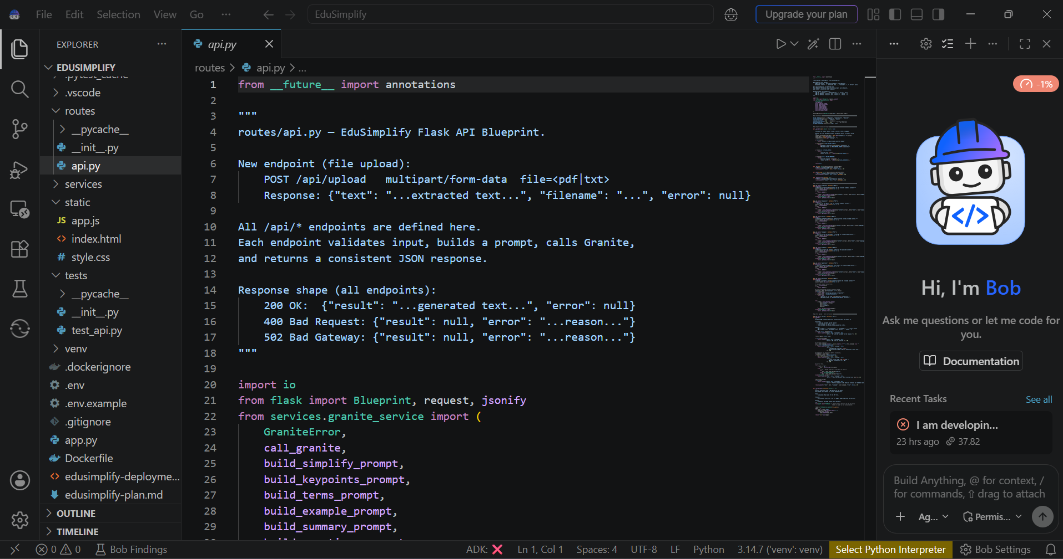
Required Files created using IBM bob -

Slide 7
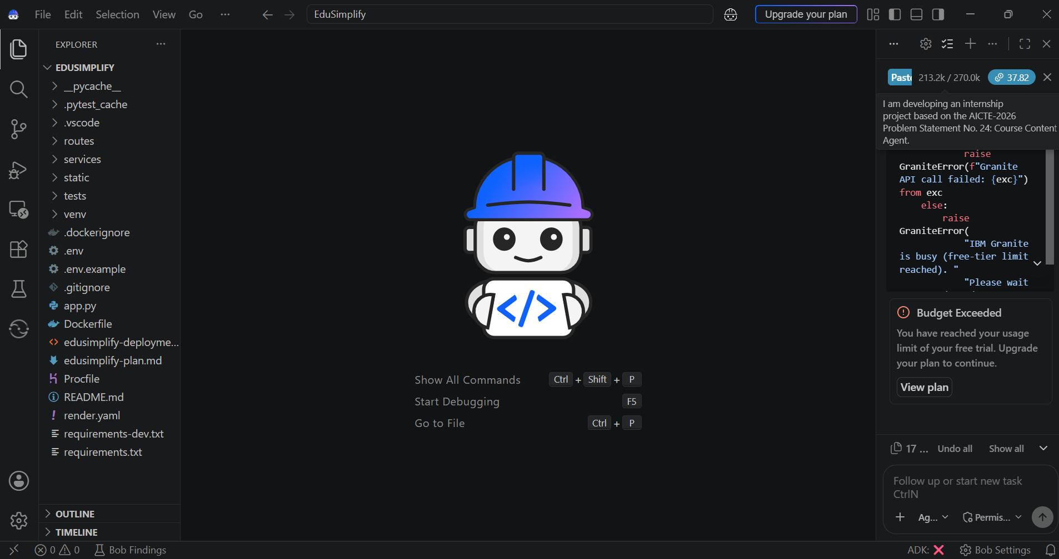
IBM Bob Screenshots:

Slide 8
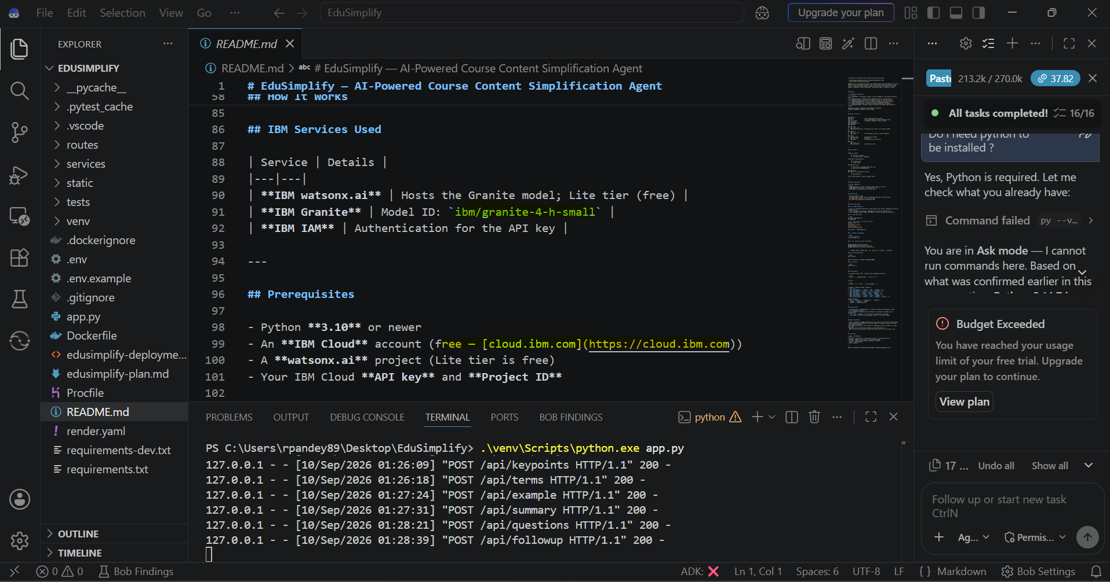

Slide 9
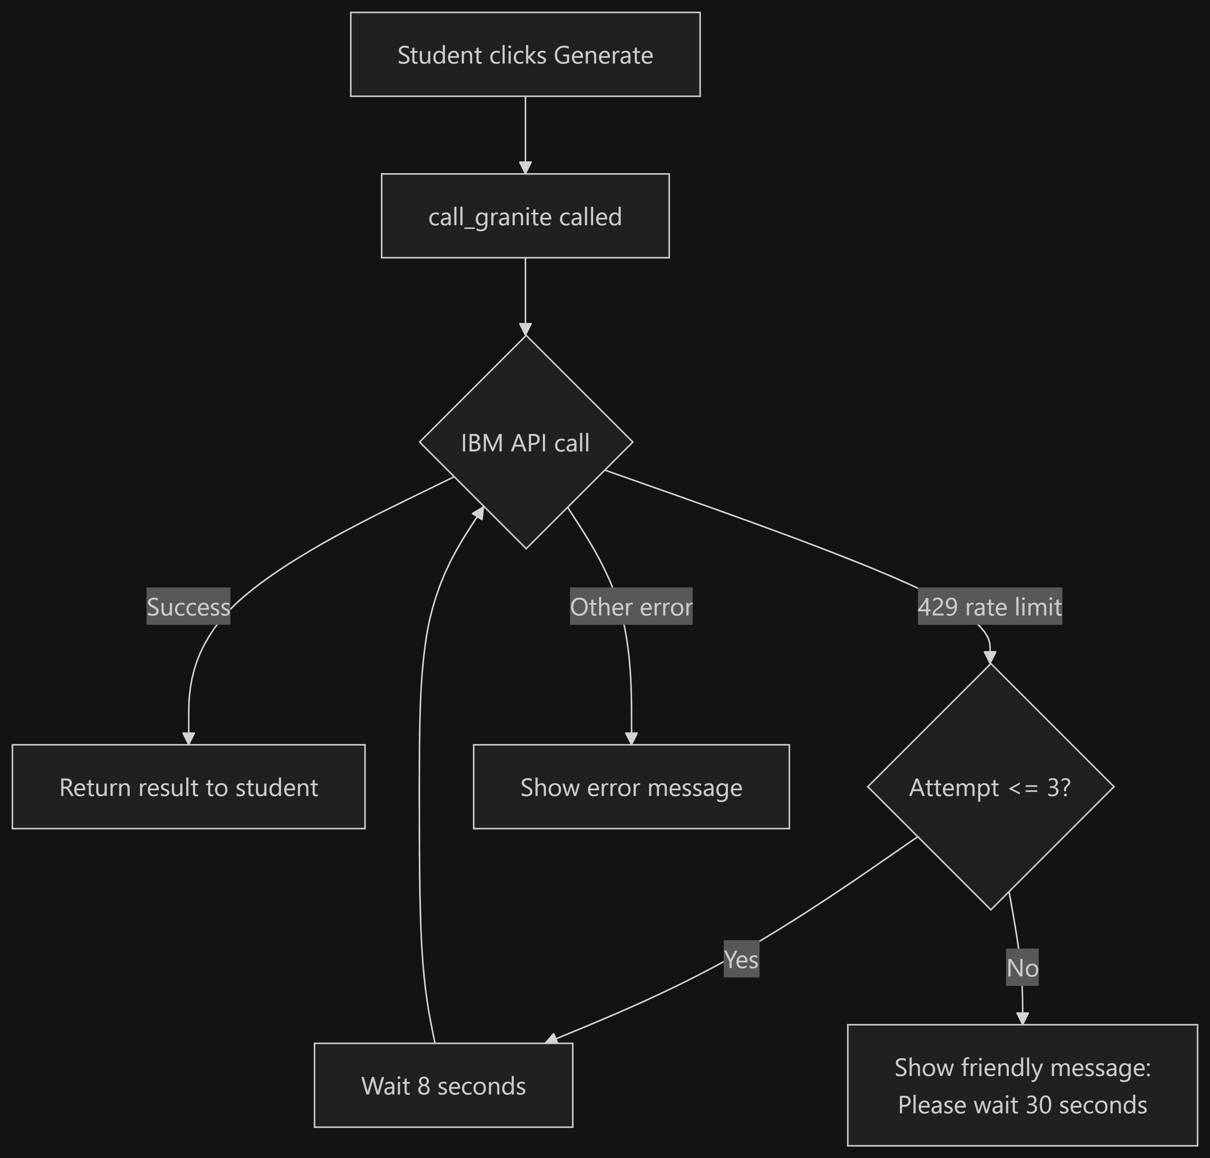
Architecture blueprint for IBM bob:

Slide 10

Role of Agentic AI in the solution
Role of Agentic AI in Nutrition Agent
Agentic AI enables EduSimplify to go beyond a basic chatbot by coordinating multiple steps toward a learning goal.
The workflow can interpret the student's request, validate the input, select the requested language/difficulty, construct the appropriate prompt, call Granite, validate the response structure, and present the final learning material.
This makes the system goal-driven, reusable and easier to extend with features such as quizzes, topic history and additional languages.

Slide 11
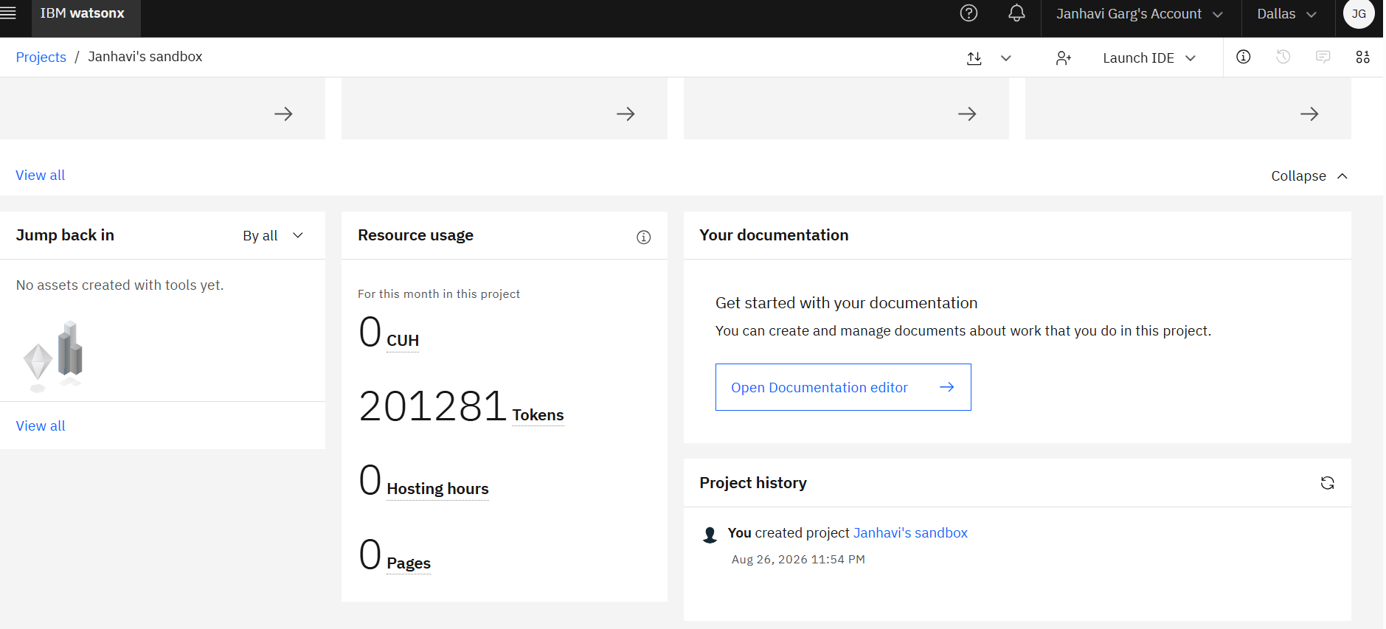
Token Usage
Total token usage in IBM watsonx.ai project: 201,281 Tokens
·
·
·

Slide 12
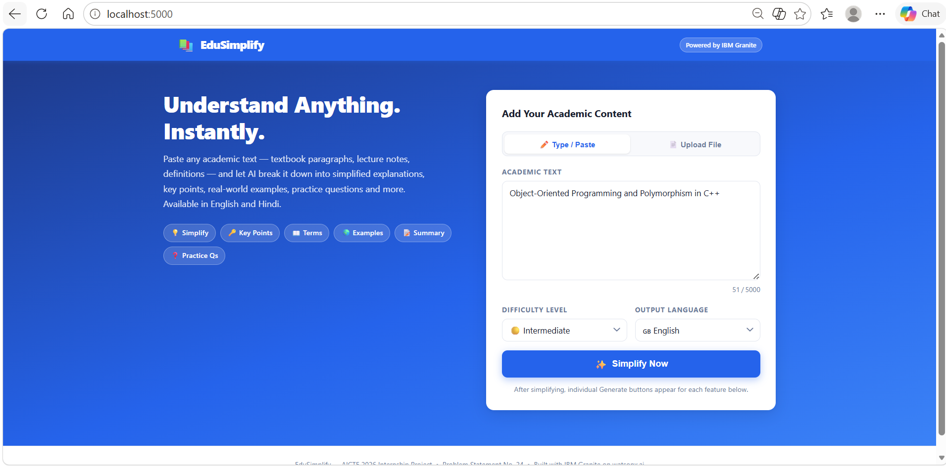
Project Output Screenshot
Please put IBM Bob output screenshots with 2-3 prompts.
You can take 2-3 more slides for each screenshot
·
·
·

Slide 13
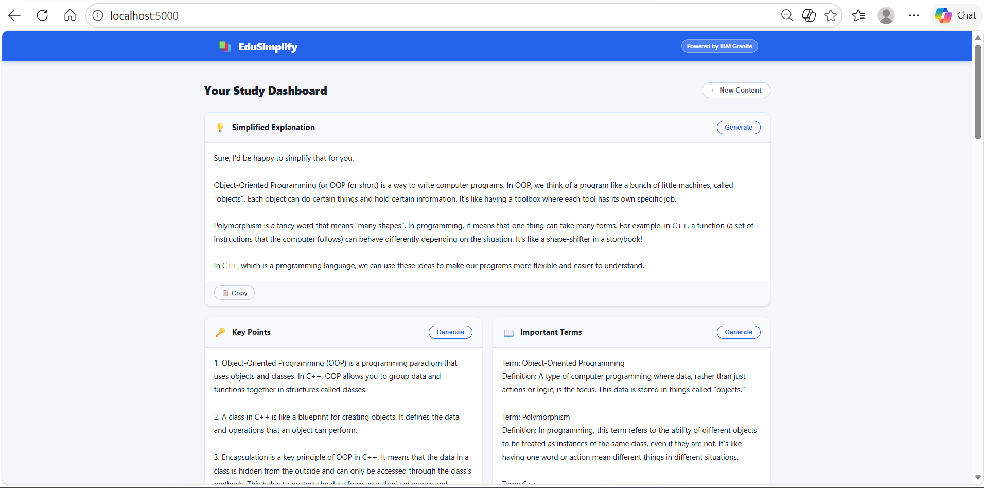
Project Output Screenshot
·
·
·

Slide 14
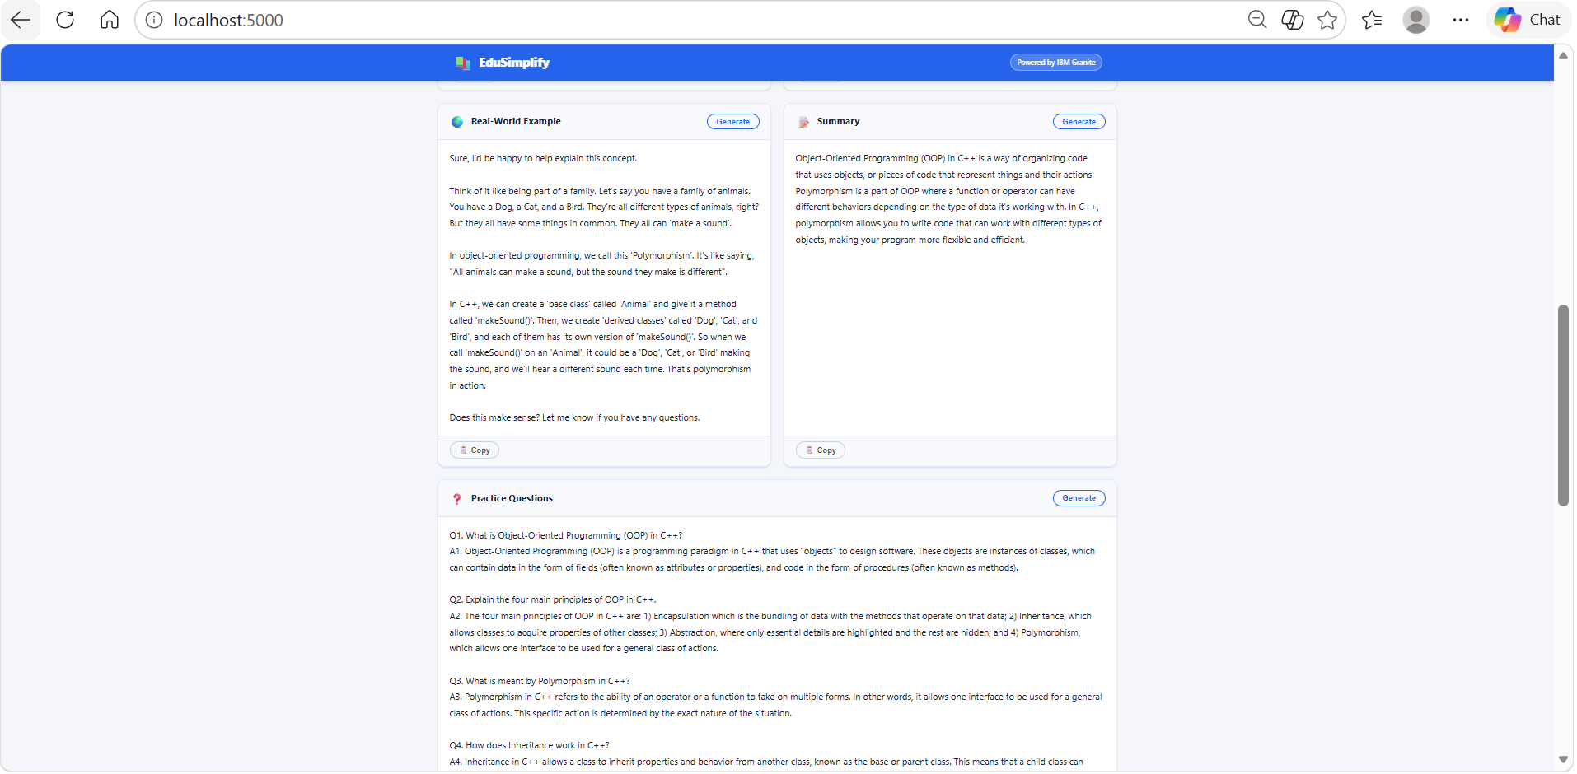
Project Output Screenshot
·
·
·

Slide 15
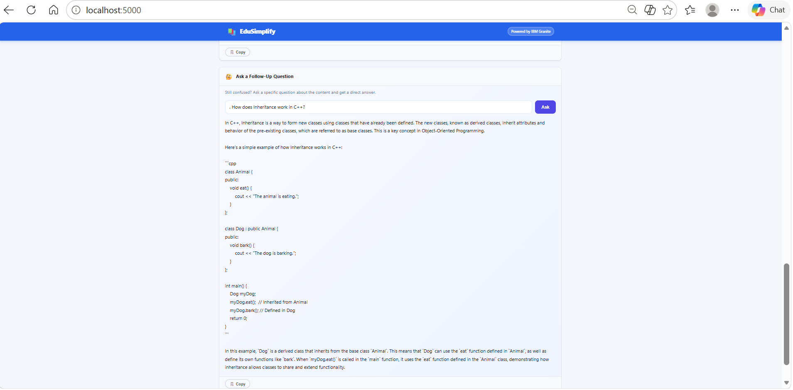
Project Output Screenshot

Slide 16
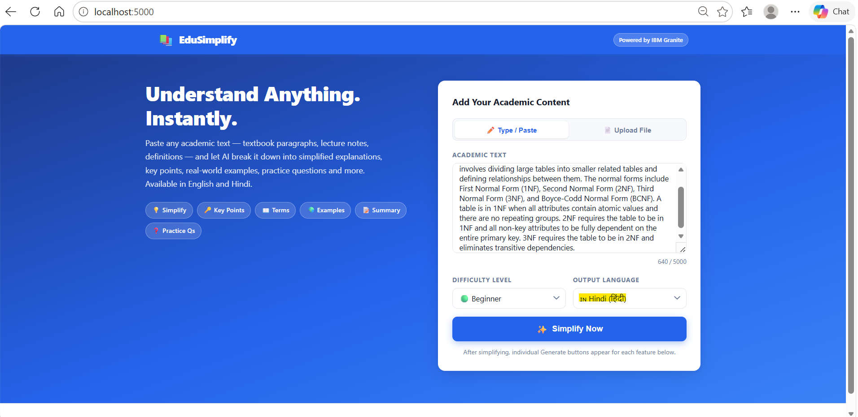
Project Output Screenshot

Slide 17
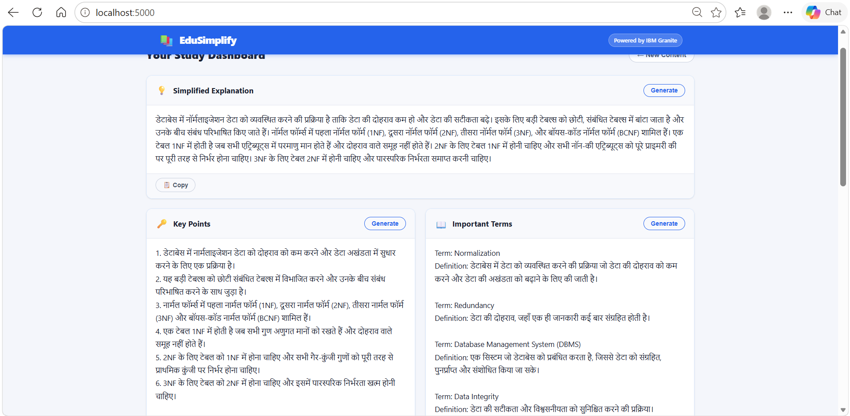
Project Output Screenshot

Slide 18
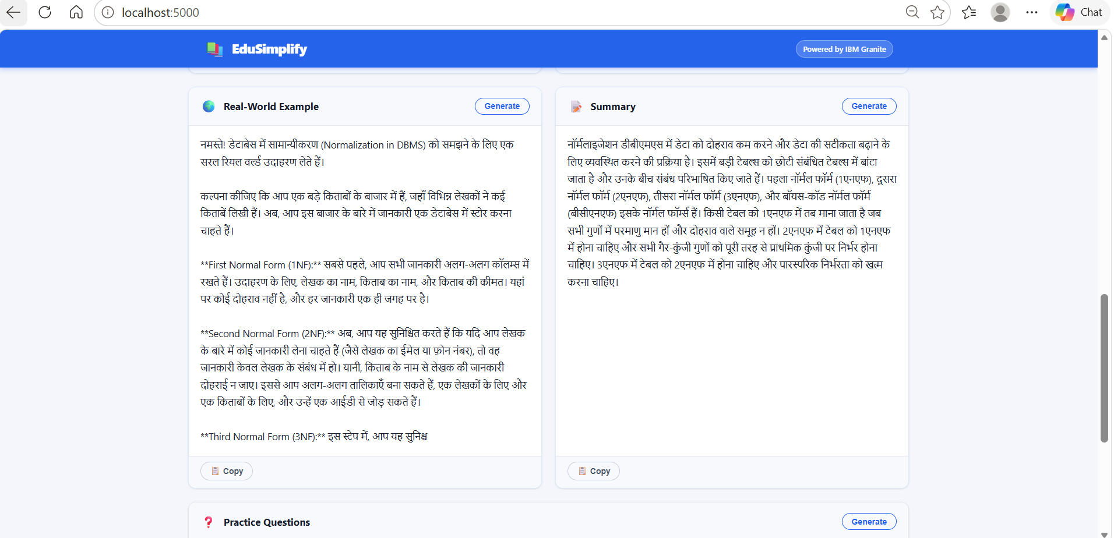
Project Output Screenshot

Slide 19
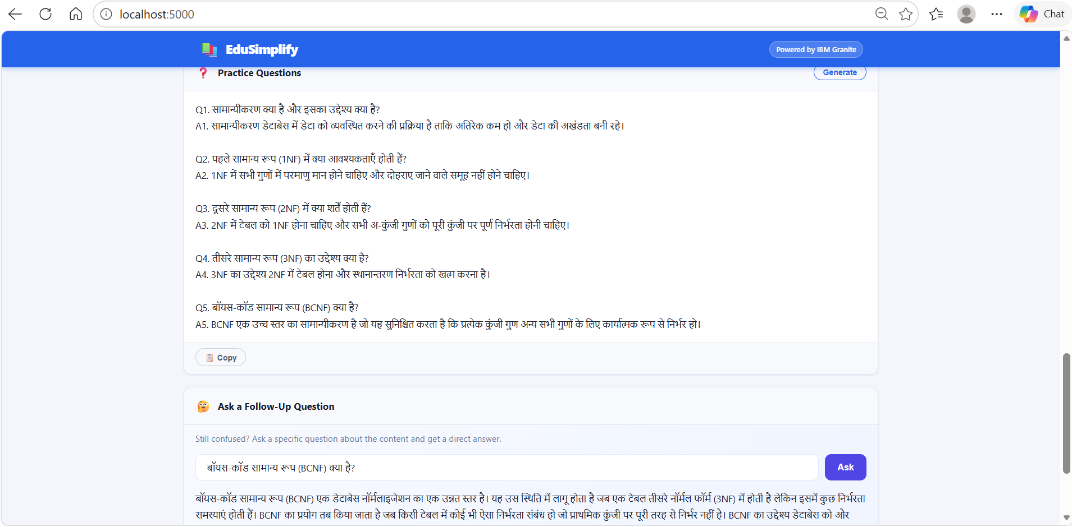
Project Output Screenshot

Slide 20
Novelty and Uniqueness
EduSimplify combines academic simplification with personalized learning controls.
• Difficulty-aware output – Beginner, Intermediate and Advanced
• Multilingual learning – English and Hindi
• Structured learning response – explanation, key points, terms, example, summary and questions
• Technical-subject friendly – suitable for DBMS, DSA, C++, Python and other course topics
• IBM Granite integration – real generative AI rather than a static response system
• Agentic workflow – multiple reasoning/processing steps toward a learning goal
• Extensible architecture – ready for future quiz, PDF and additional-language features

Slide 21
Git Hub Link
Github URL – https://github.com/janhavigarg875-dotcom/EduSimplify.git
Render URL- https://edusimplify-8mdv.onrender.com
File | Description
app.py | Main file that runs the application.
routes/ | Contains API routes.
services/ | Contains AI and application logic.
tests/ | Contains application testing files.
static/ | Contains static project resources.
requirements.txt | Lists required Python libraries.
README.md | Provides project overview and setup details.
Dockerfile | Defines Docker deployment setup.
render.yaml | Contains Render deployment configuration.
EduSimplifyAI_Presentation.pptx | Contains project PPT presentation.
EduSimplify.pdf | Contains project Comprehensive Feature & Functionality Testing
SB4UniversityEngagement_AI... | Contains the project problem statement/reference.
·
·
·

Slide 22
Future Scope
PDF / document-based learning – upload notes or course material for simplification.
More Indian languages – extend beyond English and Hindi.
Interactive quiz mode – generate quizzes from the simplified content and track scores.
Learning history – save topics and allow students to revisit previous explanations.
Subject-specific modes – specialized prompts for DBMS, programming, mathematics and other subjects.
Voice-based learning – add speech input/output for accessibility.
·
·
·

Slide 23
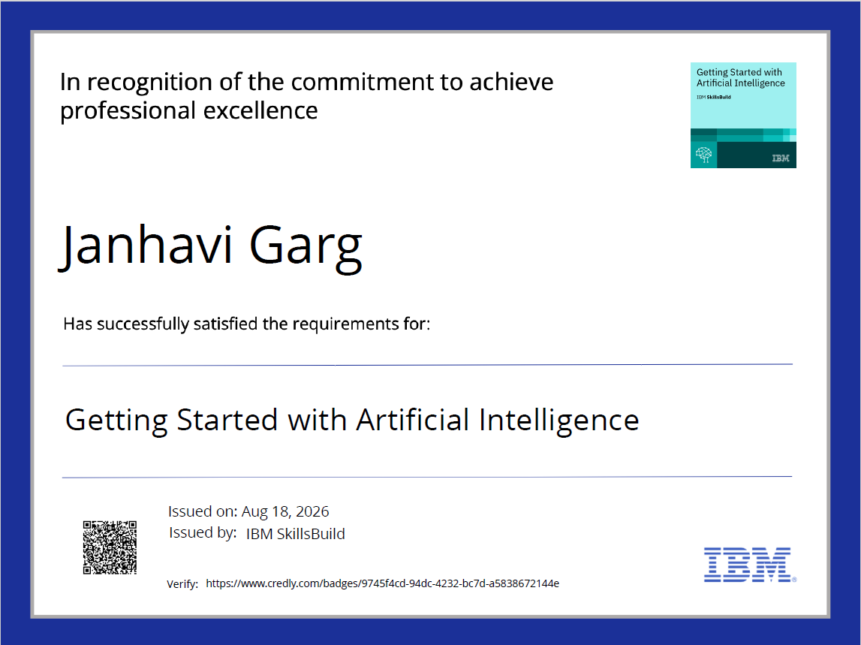
Certificates Earned:

Slide 24
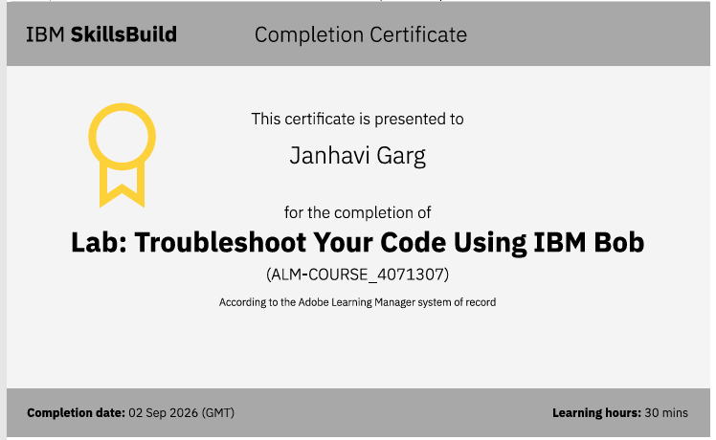
Certificates Earned:​

Slide 25


