Slide 1
Smart solar water heater valve control system
Team Members :
31. Janhavi Jaipurkar
101.Ankit Kalbele
102. Mayur Jivatode
104. Ruchi Dumbhare
Project Guide: Prof. N.M. Borkar
Department of Electronics & Communication Engg.

Slide 2
Outline
1. Introduction
2. Literature Survey
3. Proposed Methods
4. Performance Analysis
5. Conclusion
6. References

Slide 3
Introduction
In today's world, efficient resource management of non-renewable using renewable resources is crucial. This project aims to develop an automated water flow control system that utilizes various sensors and solenoid valves to ensure optimal water usage. The system leverages water level sensors to detect the status of the tank and temperature sensors to monitor the water temperature. Additionally, a light-dependent resistor (LDR) is employed to determine daylight conditions, allowing the system to differentiate between day and night. By integrating these components, the project ensures that water is supplied only when necessary, preventing waste and promoting sustainable practices. The implementation of this automated system not only enhances the efficiency of water usage but also provides a reliable solution for managing water resources in various applications.

Slide 4
Objective
The objective of this project is to design and implement an automated water flow control system that efficiently manages water supply based on real-time data from water level sensors, temperature sensors, and ambient light detection. The system aims to optimize water usage by controlling solenoid valves, ensuring water is only dispensed when necessary, and preventing overflow or waste.
This project seeks to provide:
A sustainable solution for water management,
Adaptable to various environments, such as agricultural fields, water tanks, or irrigation systems, thereby promoting resource conservation and operational efficiency.

Slide 5
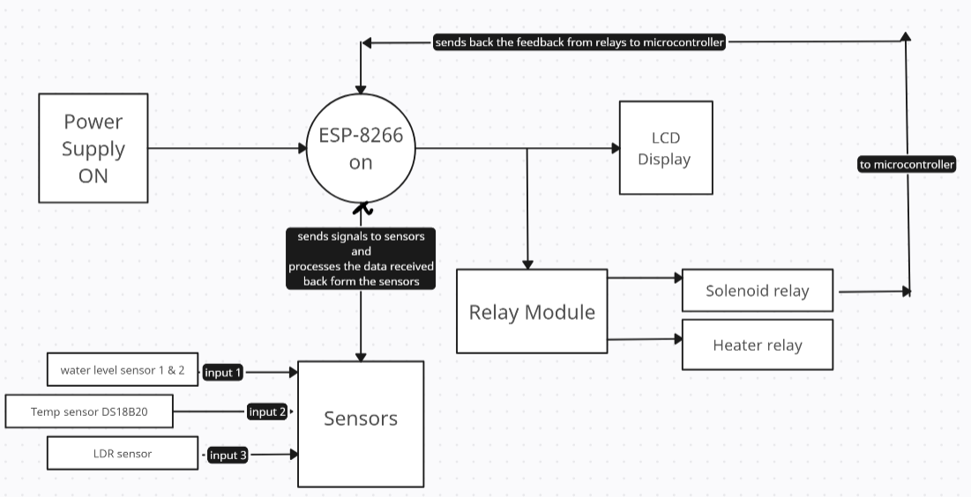
3. Generalized Block Diagram

Slide 6
Literature Survey
Sr. NO. | Paper/ Patent Title | Year of Publication | Author | Remarks
1. | Solar Water Heating Automatic Control System Based on Internet of Things Technology | July 2020 | Yunlong Yang Wei Wu | The project implements a solar hot water control system with remote monitoring and control via Android, using sensors and wireless communication for real-time management.
2. | The impact of electronic control systems on improving the performance of the solar heater | January 2024 | EH Alaskaree, YF Breesam | This study demonstrated that integrating an electronic control system (ECS) into a solar heater made from recycled materials significantly improved its thermal efficiency and energy output while reducing heat loss and regulating water temperature.
3. | Design, implementation and performance of a controller for uninterruptible solar hot water system | October 2011 | M. R. Hasan; K. Arifin; A. Rahman; A. Azad | This paper presents an automatic control system for solar hot water systems, using an ATmega32-based controller to manage water flow from a solar collector or electric heater, with temperature and water level monitoring for domestic and industrial use.
4. | Design and development of an automatic solar water heater controller | July 2016 | Washima Tasnin; Pradyumna Kumar Choudhury | This work designs a control mechanism for solar water heating systems that maintains desired water temperatures by regulating flow rates from hot and cold sources, reducing energy consumption through a hybrid solar-electric heating approach.

Slide 7
Proposed Method
The proposed methodology involves utilizing a microcontroller (ESP8266) to integrate various sensors and components for efficient monitoring and control of the solar water heater. The ESP8266 serves as the central processing unit, enabling real-time data collection and remote connectivity. Temperature sensors are strategically placed to monitor the water temperature and ambient conditions. Water level sensors ensure optimal filling of the tank while preventing overflow, maximizing efficiency. Light-dependent resistors (LDRs) will assess ambient light levels to adjust the operation based on solar availability, activating the Gyser solenoid when necessary. Automated algorithms will analyze sensor readings to manage solenoid valves, ensuring optimal water filling and heating. This system offers users the ability to monitor and control operations. Additionally, a feedback mechanism allows dynamic adjustments to maintain desired temperature levels, ensuring effective and efficient performance of the solar water heater.

Slide 8
Performance Analysis
SESNOR | CONDITION | Relay 1 (INPUT SOLENOID) | Relay 2 (OUTPUT SOLENOID)
LDR | < 600 NIGHT > 600 DAY | OFF (CHECK WATER LEVEL) ON (IF DAY) | --
TEMPERATURE SENSOR | < 45° > 45° | -- | ON (TILL TEMPERATURE > 45°)
WATER LEVEL | MIN MAX | ON (TILL MAX) OFF (TILL MIN) (ON AGAIN IF MIN | --

Slide 9
Conclusion
The smart solar water heater system integrates multiple sensors and actuators with a microcontroller to automate the water heating process, ensuring efficient use of solar energy. By utilizing temperature sensors, water level sensors, and light-dependent resistors (LDRs), the system dynamically adjusts the water flow and heating based on real-time conditions. The use of threshold values, such as the LDR threshold for detecting daylight and temperature limits for heating control, enhances system performance. This solution not only maximizes energy savings by relying on solar energy during the day but also ensures that hot water is available as needed by automatically activating an electric heater during low sunlight periods. Through this design, the smart solar water heater optimizes energy consumption, reduces manual intervention, and provides a sustainable approach to water heating.

Slide 10
Future scope
Enhanced Automation: Incorporating AI algorithms for predictive analysis can optimize water heating based on weather patterns and user habits, leading to increased efficiency.
Integration with Smart Home Systems: Developing compatibility with smart home ecosystems (like Google Home or Amazon Alexa) will allow users to control the system via voice commands or mobile apps.
Data Analytics: Implementing advanced data analytics to provide users with insights on energy consumption, cost savings, and system performance over time can encourage efficient usage.
Renewable Energy Integration: Combining the system with additional renewable energy sources, such as wind or biomass, can create a more sustainable and resilient energy solution.
Remote Monitoring and Maintenance: Introducing remote diagnostics and maintenance features will enable proactive servicing, reducing downtime and ensuring optimal performance.

Slide 11
Impact of project on Societal issues :-
The smart solar water heater project promotes sustainable energy use by leveraging solar power, reducing reliance on conventional electricity, and lowering carbon emissions. It contributes to environmental conservation by optimizing energy efficiency and reducing wastage. Additionally, the system can improve accessibility to affordable hot water in rural or off-grid areas, enhancing quality of life and supporting green technology adoption. By addressing energy and resource efficiency, this project aids in mitigating climate change and fostering eco-friendly practices in households and industries.

Slide 12
References
1. A. K. Saxena, M. Srivastava, and S. Tiwari, “Performance Analysis of Solar Water Heater Integrated with Phase Change Material,” *IEEE Access*, vol. 8, pp. 191986–191995, 2020. doi: 10.1109/ACCESS.2020.3032640.
2. M. M. Ali, A. Ali, and M. S. Bhatti, “Design and Performance Analysis of Solar Water Heating System Using Hybrid Photovoltaic-Thermal (PVT) Collector,” *IEEE Transactions on Sustainable Energy*, vol. 12, no. 4, pp. 2019–2029, Oct. 2021. doi: 10.1109/TSTE.2021.3088814.
3. V. R. Parmar, V. Patel, and K. Choudhury, “Smart Solar Water Heater Using IoT,” *2021 International Conference on Intelligent Computing and Control Systems (ICICCS)*, Madurai, India, 2021, pp. 953-958. doi: 10.1109/ICICCS51141.2021.9432185.
4. M. G. S. Jansen, A. B. Bhaskar, and N. Kumar, “Energy-Efficient Solar Water Heating System with Embedded IoT Monitoring for Residential and Industrial Applications,” *2020 International Conference on Emerging Trends in Information Technology and Engineering (ic-ETITE)*, Vellore, India, 2020, pp. 1-6. doi: 10.1109/ic-ETITE47903.2020.280314.

