Slide 1
GRADUATE CAPSTONE PRESENTATION
Comparative Frameworks
for 3D Path Planning
3D geometry creation· Algorithm Selection · Sensitivity Analysis
Framework 1: VG + Dijkstra
Framework 2: Buffered A*
Zhaoyao Bao
Janhavi Gaikwad
Notes:
[0:45] Slide 1 — Title
Good [morning/afternoon]. I am Janhavi Gaikwad. Today I present my graduate capstone: Comparative Frameworks for 3D Path Planning in dense urban airspace.
In this project I have compared two complete frameowrks for 3d path finder in urban environment
Using visibility graph and djkstra
2nd is buffered A*
The thread through the talk is: how we approximate the city, how we enforce safety in terms of no fly zone compliance, which algorithm we chose and why, and which framework fits city-scale UAM versus high-fidelity local planning.

Slide 2
SECTION A — GOAL
Presentation Roadmap
Goal
A
Problem motivation, objectives
Comparative Analysis
D
Output comparison, Model setup comparison
Framework 1 — VG + Dijkstra
B
3D city model, algorithm selection, sensitivity analysis
Conclusions
E
Conclusion, recommendations.
Framework 2 — Buffered A*
C
3D city model, algorithm selection, sensitivity analysis
COMPARATIVE FRAMEWORKS FOR 3D URBAN PATH PLANNING | CAPSTONE PRESENTATION
Notes:
[0:40] Slide 2 — Roadmap
Here is the roadmap for this presentation.
Section A states the problem and objectives.
Section B walks Framework 1 end to end.
Section C does the same for Framework 2.
Section D compares outputs and computational trade-offs.
Section E concludes with recommendations, especially for a Hong Kong–style dense city.

Slide 3
SECTION A — GOAL
Why Urban 3D Path Planning Matters
73%
12×
3D
↑ Safety
Urban Population by 2050
Drone Delivery Growth Projected
Navigation Complexity vs 2D
No-Fly Zone Compliance Critical
Urban airspace is rapidly becoming contested as autonomous delivery systems proliferate.
3D obstacle avoidance in dense cityscapes demands computationally efficient, robust path planners.
Regulatory frameworks require explicit no-fly zone modeling — a constraint 2D planners cannot satisfy.
Algorithm selection must balance path optimality, runtime performance, and safety margins simultaneously.
COMPARATIVE FRAMEWORKS FOR 3D URBAN PATH PLANNING | CAPSTONE PRESENTATION
Notes:
[1:15] Slide 3 — Why Urban 3D Path Planning Matters
Before we start we need to understand …. Why Urban 3D Path Planning Matters
Urban airspace is getting crowded. By 2050, most people will live in cities; drone delivery is projected to grow sharply. That means planners must work in three dimensions, not on a flat map.
Three points matter for this project. First, 3D obstacle avoidance in street canyons is harder than 2D routing.
Second, regulators require no-fly zones—buffers around buildings and low-altitude restrictions—that 2D tools cannot represent.
Third, we cannot optimize only for shortest distance; we need safety margins, runtime, and repeatable routes for operations.

Slide 4
SECTION A — GOAL
Goal
Compare visibility-graph Dijkstra and buffer-field 3D A* on a dense urban model with five OD pairs and four clearance levels, and recommend VG + Dijkstra for Hong Kong–style city-scale UAM and buffer + A* for shorter, grid-refined routes.
O1
Understand Pipeline A : cuboid NFZs → visibility graph → Dijkstra
O2
Understand Pipeline B : height & buffer raster → 3D A*
O3
Understanding which pipeline is suitable for this use case.
COMPARATIVE FRAMEWORKS FOR 3D URBAN PATH PLANNING | CAPSTONE PRESENTATION
Notes:
[1:10] Slide 4 — Goal
The goal of this project is to compare these two frameworks on the same urban model HongKong section with 73 buildings, five origin–destination pairs, and four clearance levels—3, 5, 10, and 15 metres.
Objectives: O1—understand Pipeline A: cuboid NFZs, visibility graph, Dijkstra.
O2—understand Pipeline B: height and buffer rasters, 3D A\.
O3—decide which pipeline fits this use case.

Slide 5
SECTION B — FRAMEWORK 1
Framework 1 :
VG + Dijkstra
COMPARATIVE FRAMEWORKS FOR 3D URBAN PATH PLANNING | CAPSTONE PRESENTATION
Notes:
[0:20] Slide 5 — Framework 1 title
Section B: Framework 1—visibility graph plus Dijkstra. I will cover geometry approximation, NFZ creation, algorithm selection, the planner itself, and sensitivity results.

Slide 6
SECTION B — FRAMEWORK 1
Landscape Approximation - Concept
Concept
IMPLEMENTATION
Represent the city footprint as a 2D raster grid.
Cells with height greater than zero indicate occupied building area; zero = open sky / ground-level space.
The city is approximated by a set of 3D axis-aligned cuboids, not meshes or footprints per cell.
Input
Text grid file (row, column :xy location, values: height)
Mask
grid > 0 → occupied cells
Clustering
scipy.ndimage.label(..., structure=3×3 ones) → 8-connected components = one “building” per cluster
✓ Approximation assumptions
XY: min/max row/col indices → footprint box
Z: max cell value inside that cluster → flat roof heigh
Per Cluster
One cuboid per connected component: touching or 8-neighbor adjoined tall cells collapse into one tight bounding box.
Flat roof: roof height is the maximum grid value in the cluster → no setbacks or stepped crowns inside the bbox.
Integer grid indices: positions are discrete cell corners (int(x_min), …).
No sub-cell geometry: finer than one cell detail is lost.
Output Vertex
8 vertices per building: bottom square at z = 0, top at z = z_max
OUTPUT
building_cuboids.json — list of { building_id, peak_height, vertices }
COMPARATIVE FRAMEWORKS FOR 3D URBAN PATH PLANNING | CAPSTONE PRESENTATION
Notes:
[1:20] Slide 6 — Landscape approximation (concept)
We start from a text grid: each cell has row, column, and height. Any cell with height greater than zero is occupied.
Buildings with nonzero height is clustered together in single cluter—each cluster is one building. Per cluster we take the axis-aligned footprint in X–Y and the maximum height as a flat roof. Each building becomes one cuboid with eight vertices: bottom at z equals zero, top at z equals peak height.
To summarise Assumptions are: touching buildings merge into one box; roofs are flat; positions snap to integer grid corners—so sub-cell detail is lost.
This is a deliberate conservative simplification: fast to build, compatible with box–box visibility tests, but not architectural mesh fidelity.

Slide 7
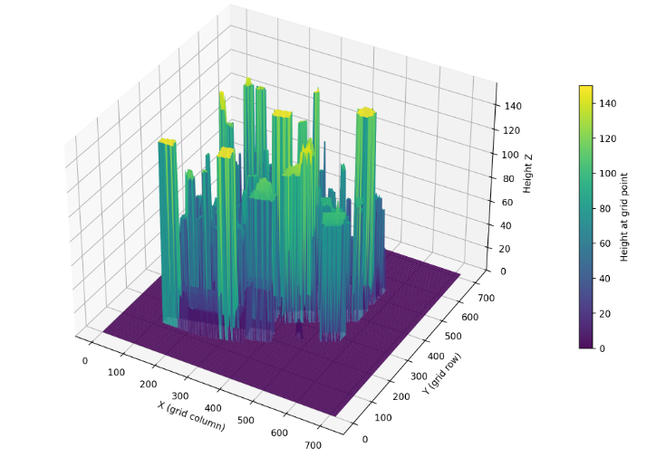
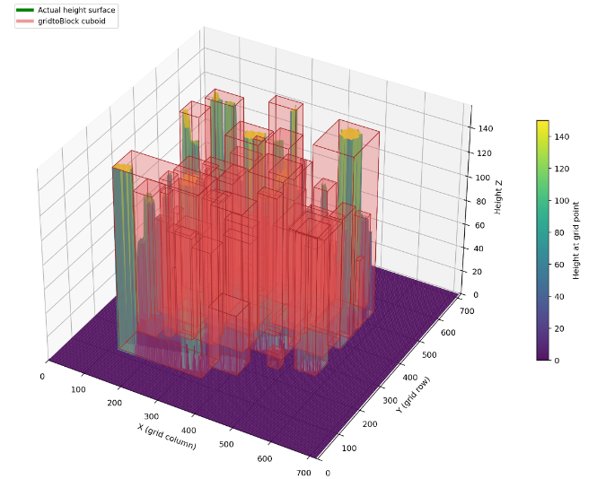
SECTION B — FRAMEWORK 1
Landscape Approximation
Original Geometry
Simplified Geometry
COMPARATIVE FRAMEWORKS FOR 3D URBAN PATH PLANNING | CAPSTONE PRESENTATION
Notes:
[0:35] Slide 7 — Landscape approximation (visual)
On the left: original raster geometry. On the right: cuboid approximation. You can see footprints tighten into boxes and roofs flatten. The planner will never fly through these boxes; it routes around corners of the expanded NFZs we add next.

Slide 8
SECTION B — FRAMEWORK 1
No Fly Zone Addition
Concept
IMPLEMENTATION
After gridtoBlock cuboids → add forbidden flight volumes (NFZ)
Building NFZ: buffer around each building cuboid
Ground NFZ: low slab over full map footprint (z = 0 … param_ground)
NFZ = axis-aligned 3D boxes (same as pathfinder geometry)
Output: only_nfz_map_*.json → used for VG + Dijkstra
Input
Read building_cuboids.json
Expand
Building
Per building: expand box by param_building → nfz_vertices
Ground No Fly Zone
Build ground cuboid: map XY × [0, param_ground]
✓ Approximation assumptions
Formula
x' ∈ [x_min−b, x_max+b], y' ∈ [y_min−b, y_max+b], z' ∈ [0, z_max+b]
Ground: [0, param_ground] over map footprint
Uniform buffer param_building in ±X, ±Y and +Z above roof
NFZ built from cuboid geometry, not raw grid cells
Building NFZ base always at z = 0
Ground XY = extent of all buildings (not separate map border)
Conservative: overlapping NFZs allowed in dense areas
Limitation: static boxes only — no curved corridors or dynamic rules
OUTPUT
only_nfz_map_*.json — NFZ only (ground_nfz + building_nfzs) for routing
COMPARATIVE FRAMEWORKS FOR 3D URBAN PATH PLANNING | CAPSTONE PRESENTATION
Notes:
[1:15] Slide 8 — No-fly zone addition (concept)
NFZs wrap each building cuboid with a uniform buffer param_building in X, Y, and above the roof in Z. A ground NFZ is a low slab from z equals zero up to set height over the map extent where buildings exist.
Formally, each building NFZ expands the box; the ground NFZ blocks horizontal flight near the surface.
Limitations: static axis-aligned boxes only—no curved corridors, no time-varying rules.

Slide 9
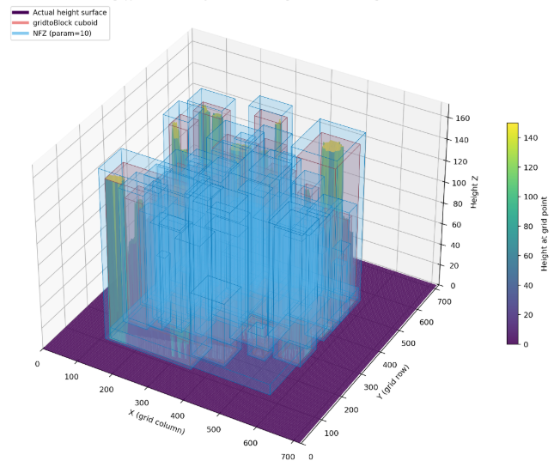
SECTION B — FRAMEWORK 1
No Fly Zone Addition
Approximated Geometry
No Fly Zone
COMPARATIVE FRAMEWORKS FOR 3D URBAN PATH PLANNING | CAPSTONE PRESENTATION
Notes:
[0:35] Slide 9 — No-fly zone (visual)
Left: approximated buildings. Right: NFZs in red and gray—building buffers and ground slab. Routes must stay outside interiors of these volumes; grazing edges is allowed only where visibility tests permit.

Slide 10
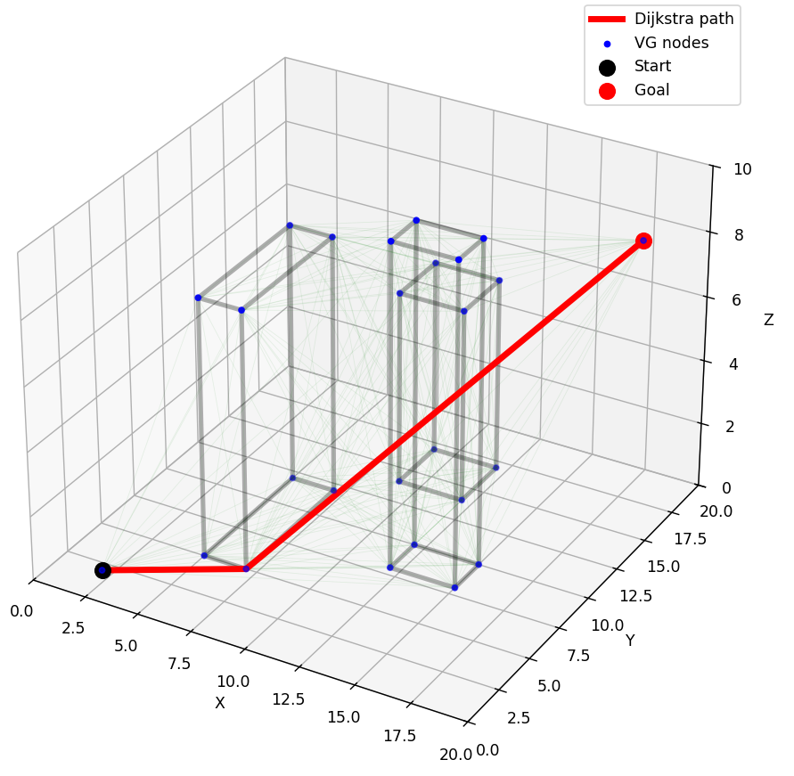
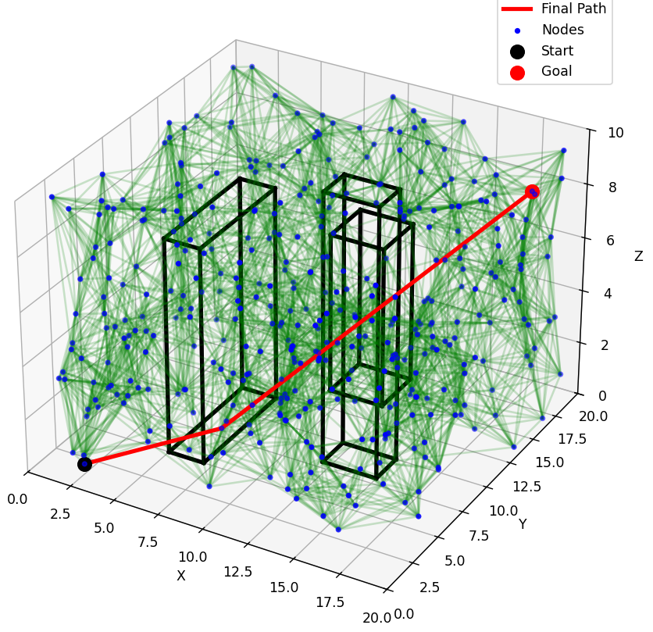
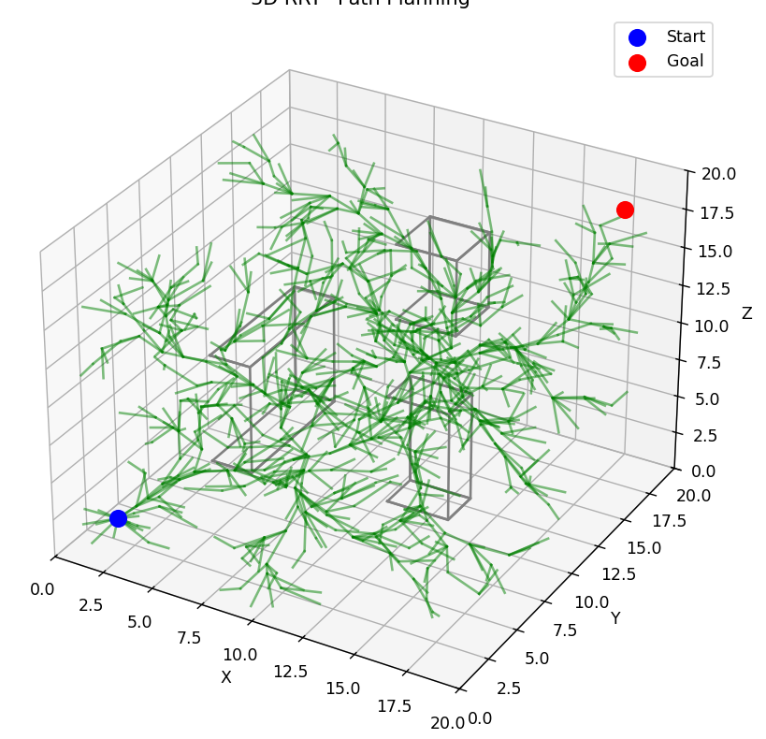
SECTION B — FRAMEWORK 1
Pathfinder method I - Graph & sampling methods
Visibility Graph + Djkstra
PRM
RRT*
Pro:
Short, near-optimal geometric path;
Few waypoints;
Deterministic
Pro:
Works in cluttered 3D without explicit corners;
Probabilistically complete (enough samples)
Pro:
Good for complex spaces;
Asymptotically optimal (RRT*);
Handles continuous 3D
Limitation :
Tuning samples / k-neighbors;
Not guaranteed shortest
Limitation :
Graph size grows with obstacles;
Slow for many buildings
Limitation :
Stochastic and can be slow;
Jagged paths unless post-smoothed;
Parameter-sensitive
COMPARATIVE FRAMEWORKS FOR 3D URBAN PATH PLANNING | CAPSTONE PRESENTATION
Notes:
[0:55] Slide 10 — Pathfinder methods I (graph & sampling)
Once we got our simplified geometry..for this simplification type we had several methods for path finder algorithm.
I evaluated total 6 pathfinder method for this use case.
Visibility graph + Dijkstra: short, near-optimal piecewise-linear paths, few waypoints, deterministic—but the graph grows with obstacle corners.
PRM samples free space but does not guarantee the shortest path without many samples.
RRT* also needs to sample free space and handles continuous 3D and complex spaces but paths can be jagged and runs are stochastic.

Slide 11
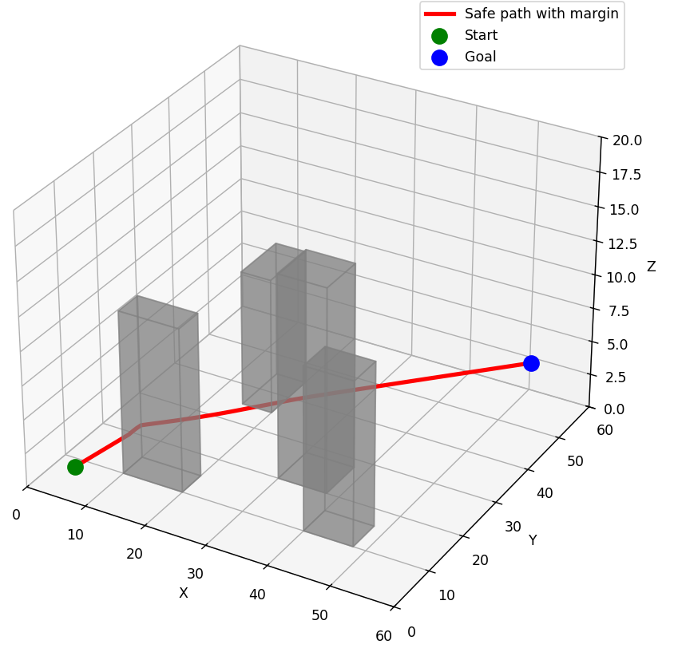
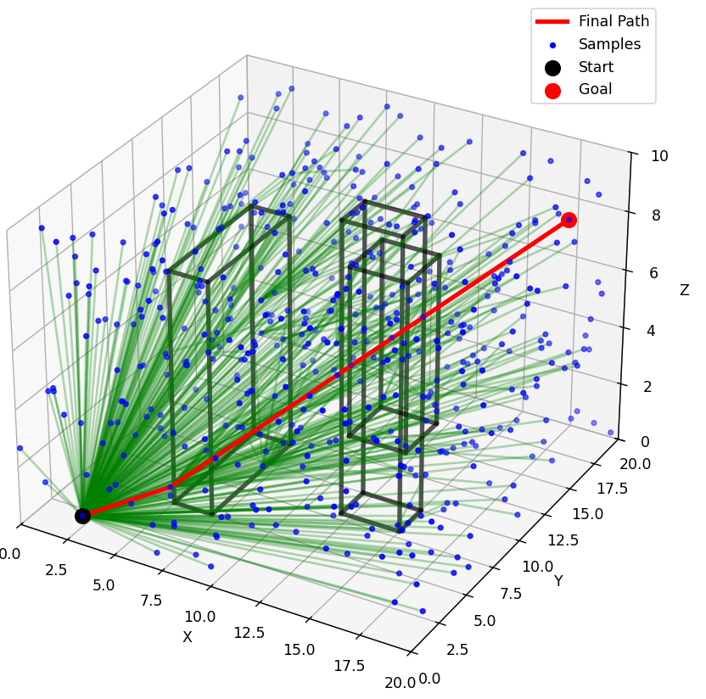
SECTION B — FRAMEWORK 1
Pathfinder method II - Field & grid methods
Potential Field
Eikonal
FMT*
Pro :
Very fast, easy to implement;
Smooth-looking path in open areas
Pro :
Global distance field on a grid;
Smooth path from gradient descent;
Natural safety margin on voxels
Pro :
Batch sampling , often faster than naive PRM in practice;
Structured optimality toward FMT*
Limitation :
Grid resolution fixes accuracy;
Memory cost in 3D;
Less natural for sparse cuboid JSON
Limitation :
Still sampling-based;
3D tuning (radius, samples);
Quality depends on collision check step size
Limitation :
Local minima in gaps;
May not reach goal
COMPARATIVE FRAMEWORKS FOR 3D URBAN PATH PLANNING | CAPSTONE PRESENTATION
Notes:
[0:45] Slide 11 — Pathfinder methods II (field & grid)
We also evaluated few field and grid methods like potential field, eikonal FMT star
Potential fields are fast but suffer local minima in narrow gaps.
Eikonal / fast marching give global distance fields on voxels—accurate on grids but heavy in 3D and awkward for sparse cuboid JSON.
FMT* batches sampling and can beat naive PRM in practice, but still needs careful 3D tuning.
These are strong tools; they scored lower on cuboid geometry fit and sparse waypoint requirements for UAM dispatch.

Slide 12
SECTION B — FRAMEWORK 1
Pathfinder method selection
Criterion | Weight | VG + Dijkstra | PRM | RRT* | Potential field | Eikonal / FMM | FMT*
Shortest-path guarantee (geometric) | 15% | 5 | 3 | 3 | 1 | 4 | 3
Few waypoints (sparse path) | 15% | 5 | 3 | 2 | 2 | 3 | 3
Deterministic / repeatable | 12% | 5 | 2 | 1 | 3 | 5 | 2
Fit to cuboid / corner geometry | 15% | 5 | 4 | 4 | 2 | 2 | 4
Scales to many buildings (e.g. 73) | 12% | 3 | 3 | 2 | 4 | 2 | 3
Implementation complexity | 8% | 4 | 3 | 3 | 5 | 2 | 2
Reliability in narrow urban gaps | 12% | 4 | 4 | 4 | 1 | 4 | 4
No grid / continuous (x,y,z) | 11% | 5 | 5 | 5 | 5 | 1 | 5
Score | 100% | 4.45 | 3.15 | 2.65 | 2.35 | 2.90 | 3.10
★ SELECTED: Visibility Graph + Dijkstra
Selected on the basis of guaranteed path optimality, explicit 3D waypoint support, and highest composite trade score. Runtime complexity is acceptable given urban-scale problem sizes.
COMPARATIVE FRAMEWORKS FOR 3D URBAN PATH PLANNING | CAPSTONE PRESENTATION
Notes:
[1:10] Slide 12 — Pathfinder selection (trade study)
Based on evaluation observations we evaluated all 6 methods and and evaluated them against all criteria (measured in likert scale)
Some of the criterias were: shortest path, few waypoints, repetable, scalable
VG + Dijkstra scores 4.45—highest—driven by geometric shortest-path on the visibility graph, sparse paths, and corner geometry. Next are Eikonal and FMT; RRT\ and potential field trail.
Selected: Visibility Graph + Dijkstra—repeatable, corner-based, acceptable runtime for tens of buildings per query after NFZ preprocessing.

Slide 13
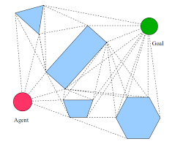
SECTION B — FRAMEWORK 1
Visibility Graph I - Concept
IMPLEMENTATION
Load NFZ
ground_nfz + building_nfzs from JSON
Collect Nodes
A, B, building corners (inside map XY); ground top corners in full planner
Test Visibility
is_visible() → line_intersects_box() (slab method) for each NFZ
All pairs (i,j) visible → undirected edge list
Built edges
Idea: Represent free 3D space as a graph where nodes are key points and edges are straight, collision-free sight lines.
Node set: Start, goal, and corners of each building NFZ cuboid (8 vertices per building).
Edge rule: Connect two nodes only if the segment does not pass through the interior of any NFZ (ground or building).
Extra Rule
No horizontal segment on z ≈ 0 ground plane
OUTPUT
All feasible ways between origin and destination
COMPARATIVE FRAMEWORKS FOR 3D URBAN PATH PLANNING | CAPSTONE PRESENTATION
Notes:
[1:15] Slide 13 — Visibility graph (concept)
So here is the brief idea of the visibility graph…in which we represent 3d space as network not passing through obstacle
Implementation: load ground and building NFZs from JSON.
Nodes were mainly : start, goal, and all NFZ corners—eight per building—plus ground-layer corners where needed.
Edges: connect two nodes only if the straight segment does not intersect any NFZ interior;
To enable non intersection we use a slab method line_intersects_box.
Extra rule: no horizontal segment on the ground plane at z ≈ 0—forcing vertical lift from surface vertiports.
Output: the feasible visibility graph—not yet the shortest route.

Slide 14
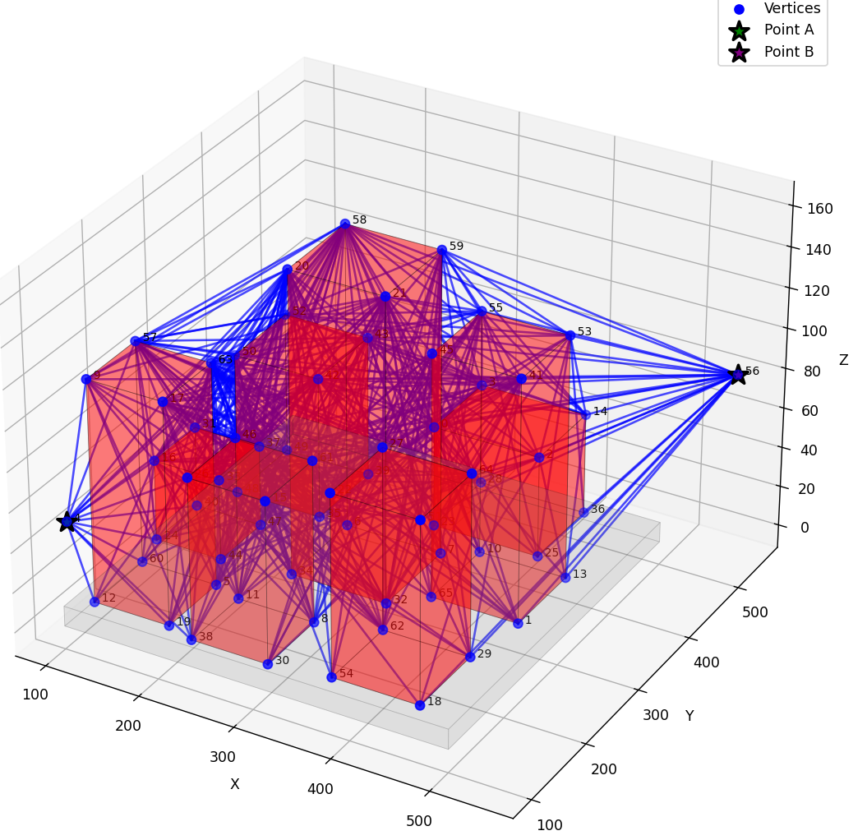
SECTION B — FRAMEWORK 1
Visibility Graph II - Result
Legend
Symbol | Meaning
Blue line | Visibility edge
Blue dot | Node
Green ★ | Start A
Purple ★ | Goal B
Red box | Building NFZ
Gray box | Ground NFZ
✓ Output
Each edge is a feasible straight flight segment that does not cut through NFZ interiors.
The graph is dense near obstacles and links corner points where routes typically bend.
This structure defines all allowed moves; it is not the final route yet.
★ Outputs from visibility graph will be used in Djkstra to find optimum path.
COMPARATIVE FRAMEWORKS FOR 3D URBAN PATH PLANNING | CAPSTONE PRESENTATION
Notes:
[0:50] Slide 14 — Visibility graph (result)
The plot shows the graph: blue edges are visibility, blue dots nodes, green and purple stars are start and goal, red and gray boxes NFZs.

Slide 15
SECTION B — FRAMEWORK 1
Dijkstra I - Concept
IMPLEMENTATION
Input
nodes, edges from build_visibility_graph()
Adjacency list
Each edge → both ends; weight = ‖p1 − p2‖
(distance, node) — pop minimum
Priority queue
Relax
Update neighbor if shorter path found
Problem: On the visibility graph, find the minimum total distance from start to goal.
Edge cost: Euclidean 3D length of each visible segment (non-negative).
Method: Greedy expansion from start; always process the closest unvisited node next (min-heap).
Guarantee: Shortest path when all weights ≥ 0 (true for distances).
Reconstruct
Backtrack from goal to start
Prechecks
Ground NFZ → vertical lift; building NFZ → invalid OD
OUTPUT
All feasible ways between origin and destination
★ Visibility graph is implemented in build_visibility_graph() in dijkstra.py.
COMPARATIVE FRAMEWORKS FOR 3D URBAN PATH PLANNING | CAPSTONE PRESENTATION
Notes:
[1:10] Slide 15 — Dijkstra (concept)
On that graph we run Dijkstra. Edge weight is Euclidean 3D length. A min-heap expands from the start; when all non-negative weights are used, we get the shortest path on this graph.
Prechecks: if start or goal sit inside ground NFZ, we require vertical lift first; invalid ODs on building NFZ are rejected.
Implementation lives in build_visibility_graph() and Dijkstra in dijkstra.py. Output: ordered waypoints and total distance.

Slide 16
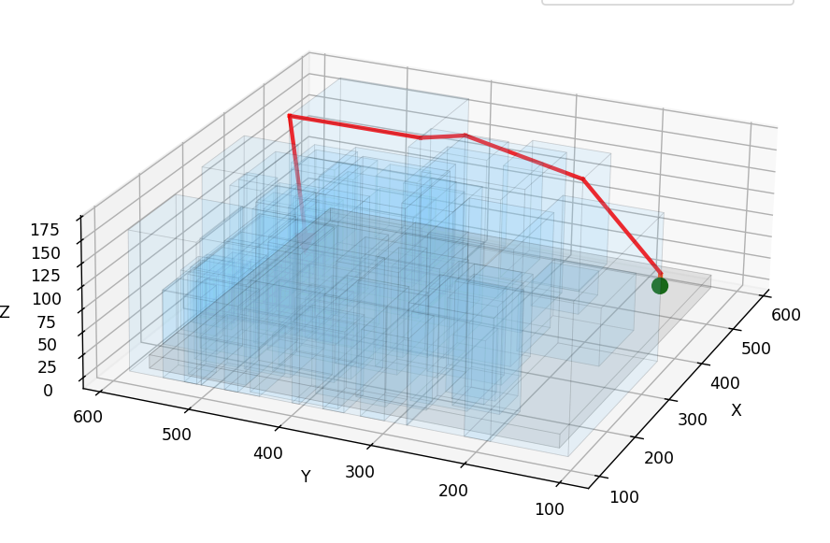
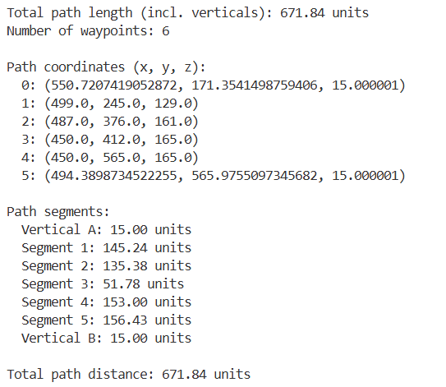
SECTION B — FRAMEWORK 1
Dijkstra II - Result
Legend
Symbol | Meaning
Red line | Optimized route
Green ★ | Start
Red ★ | Goal
Blue box | Building NFZ
Gray box | Ground NFZ
✓ Interpretation
Ordered waypoints (few segments)
Total path length (m)
Per-segment distances
COMPARATIVE FRAMEWORKS FOR 3D URBAN PATH PLANNING | CAPSTONE PRESENTATION
Notes:
[0:45] Slide 16 — Dijkstra (result)
Red line: optimized route—few long segments between visible corners. The table gives total metres and per-segment lengths.
Compared to the full visibility graph, the route is sparse—typically four to seven waypoints in sensitivity runs—good for UAV command and human review.

Slide 17
SECTION B — FRAMEWORK 1
Sensitivity Analysis I – Study Design
Goal : Understand the effect of different no fly zones on the distance need to be travelled
Question:
How does ground NFZ height affect routes when OD points start on the ground?
Constants:
Same 73-building map, same 5 OD pairs, VG + Dijkstra
Variable :
Ground NFZ top height → 3 m, 5 m, 10 m, 15 m
Origin Destination Pairs:
Rank | Origin X | Origin Y | Origin Z | Dest X | Dest Y | Dest Z | Distance
1 | 448.5643 | 125.2468 | 0.0 | 351.3167 | 449.0989 | 0.0 | 338.1380
2 | 341.1944 | 451.9773 | 0.0 | 381.4345 | 122.0160 | 0.0 | 332.4060
3 | 566.3802 | 183.0086 | 0.0 | 487.0879 | 568.6081 | 0.0 | 393.6677
4 | 341.1312 | 449.5192 | 0.0 | 567.1557 | 149.3834 | 0.0 | 375.7241
5 | 550.7207 | 171.3541 | 0.0 | 494.3899 | 565.9755 | 0.0 | 398.6216
COMPARATIVE FRAMEWORKS FOR 3D URBAN PATH PLANNING | CAPSTONE PRESENTATION
Notes:
[0:55] Slide 17 — Sensitivity I (Framework 1 design)
Once framework 1 is done implementing we performed sensitivity analysis to understand…
Question: How does ground NFZ height affect routes when origin and destination points start on the ground?
Constants: same 73-building map, same five OD pairs, VG + Dijkstra. Variable: ground clearance top at 3, 5, 10, 15 m.
The table lists the five pairs with Euclidean ground distances about 330–400 m—the straight-line baseline. Actual flyable paths are longer because of lift and detours.

Slide 18
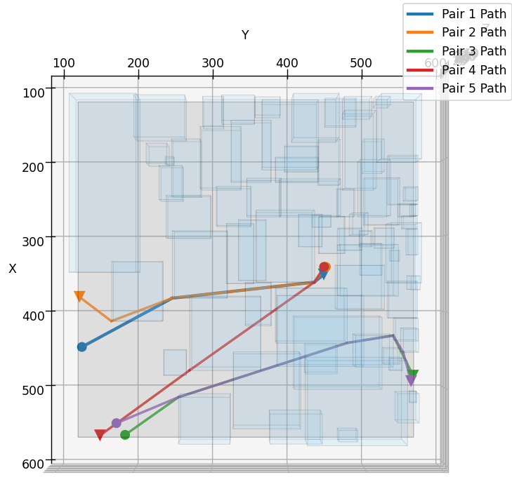
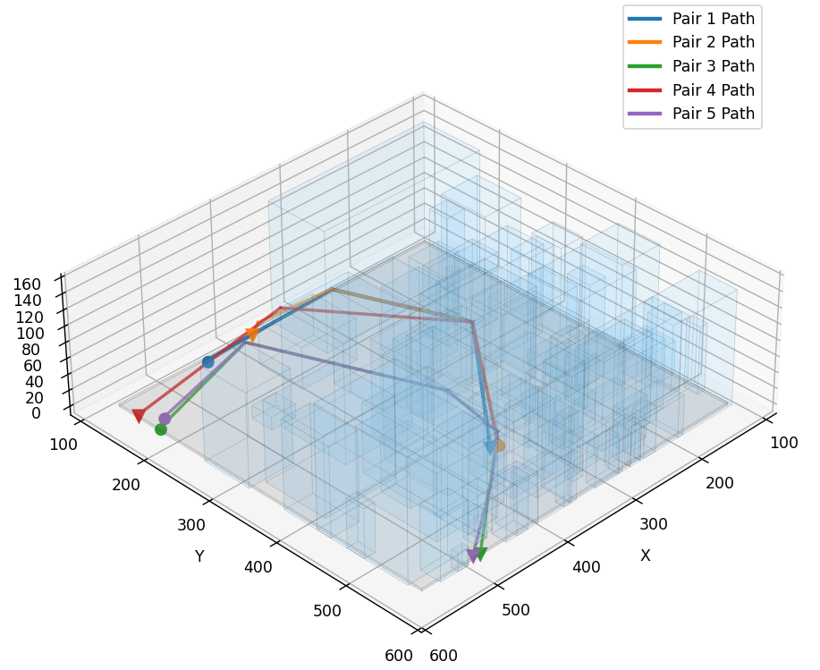
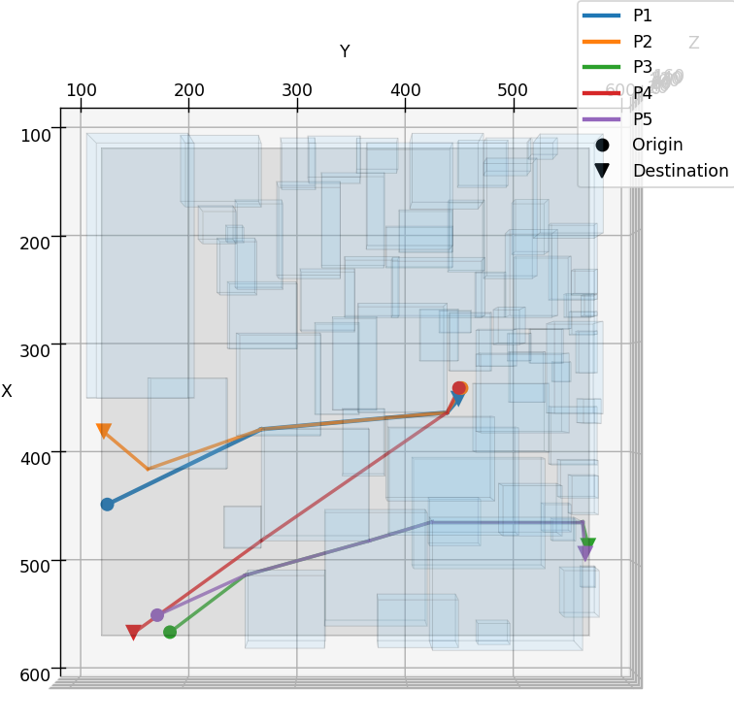
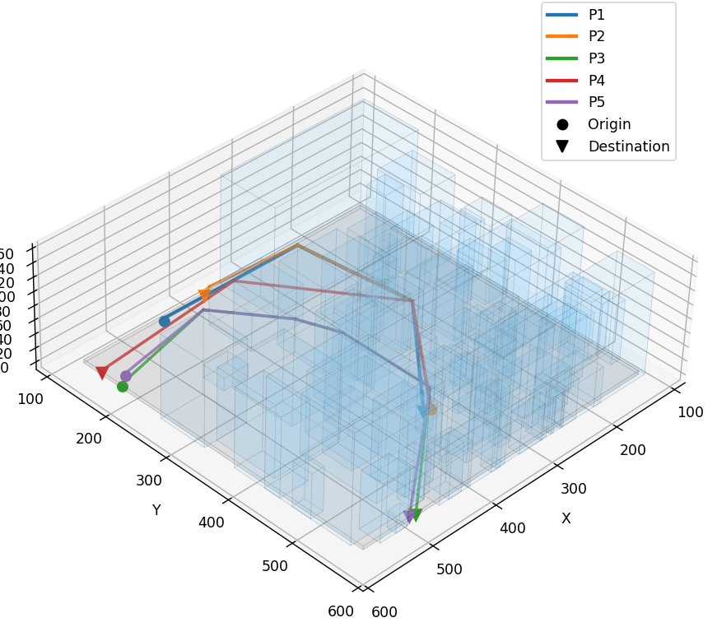
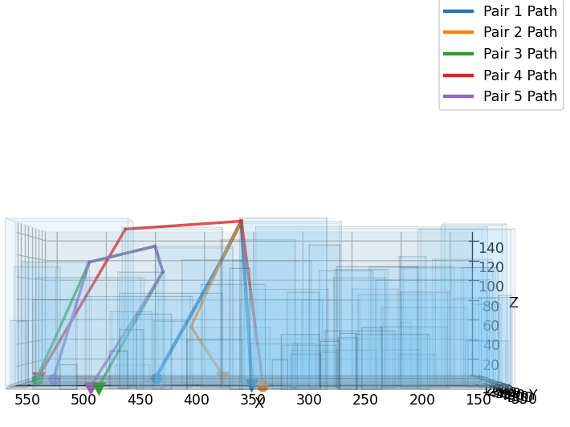
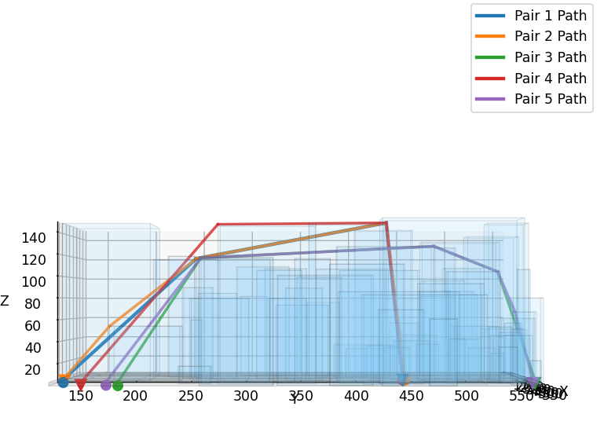
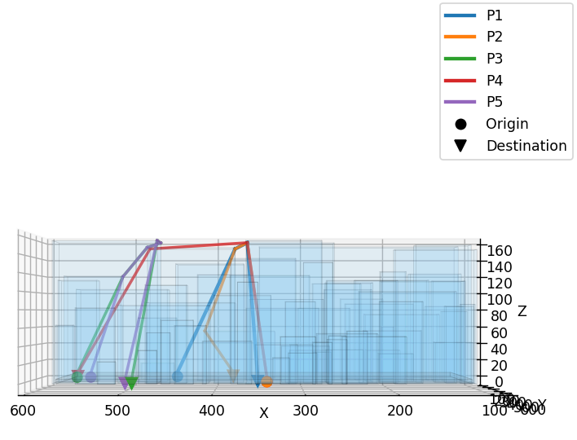
No Fly Zone = 3 m
No Fly Zone = 5m
Pair | Distance | Waypoints
1 | 527.22 | 4
2 | 530.39 | 5
3 | 570.08 | 5
4 | 567.29 | 4
5 | 574.56 | 6
Pair | Distance | Waypoints
1 | 544.21 | 4
2 | 549.24 | 5
3 | 621.09 | 6
4 | 572.61 | 4
5 | 623.24 | 6
↑ Interactive Image
↑ Interactive Image
Notes:
[1:10] Slide 18 — NFZ 3 m & 5 m results
3 m NFZ: Pair 1 flies about 527 m with four waypoints; pairs 3–5 are 570–575 m with five to six waypoints.
5 m: distances rise—Pair 1 about 544 m, pairs 3 and 5 about 621–623 m—
because aircraft must climb higher before horizontal legs.
Demo tip: open the interactive HTML for 3 m only if asked; otherwise use the tables.

Slide 19
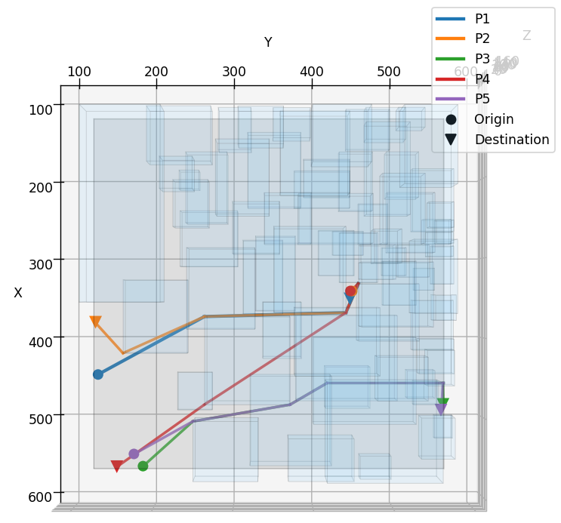
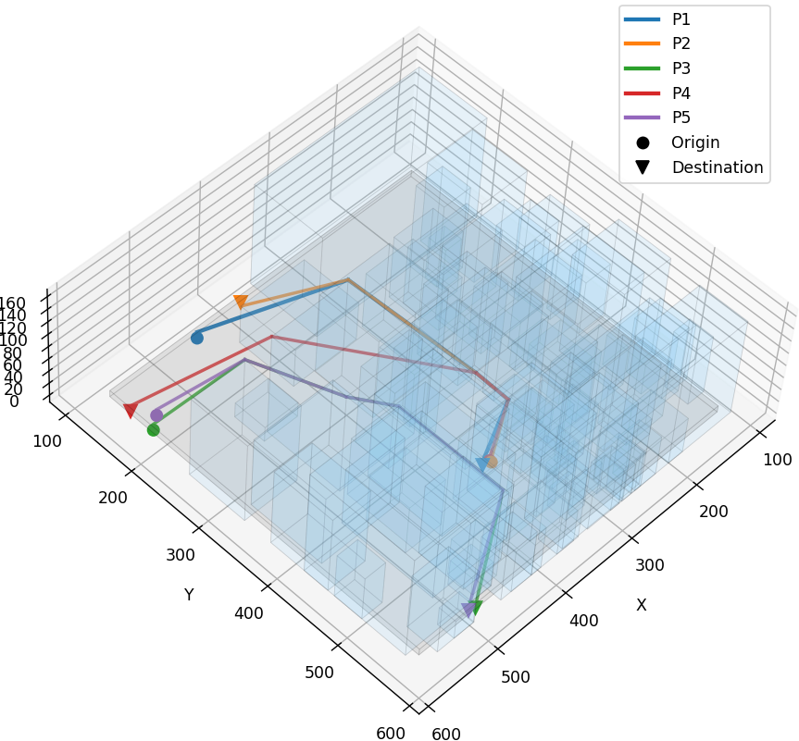
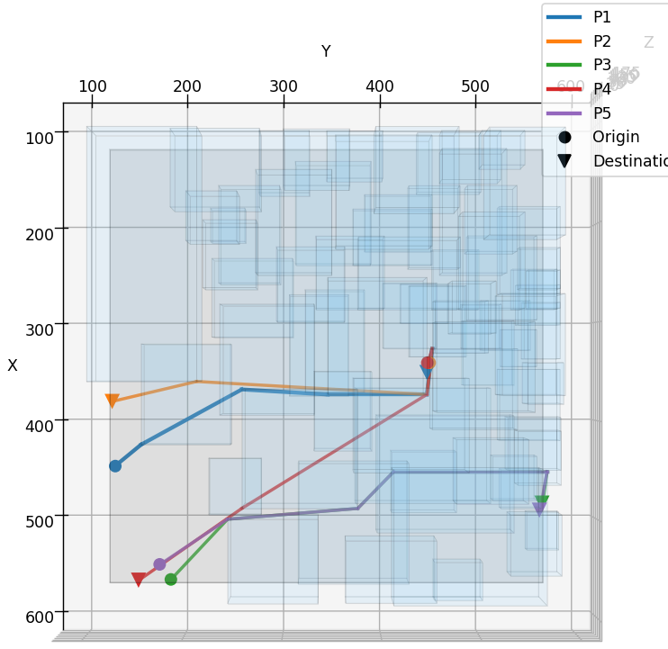
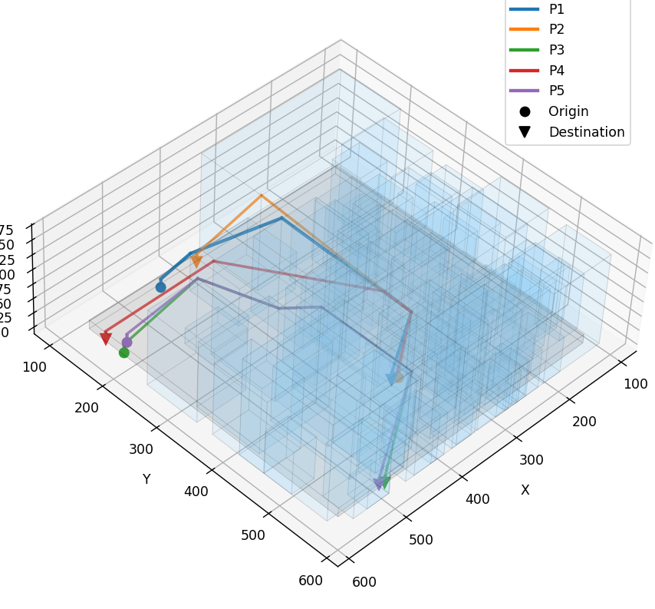
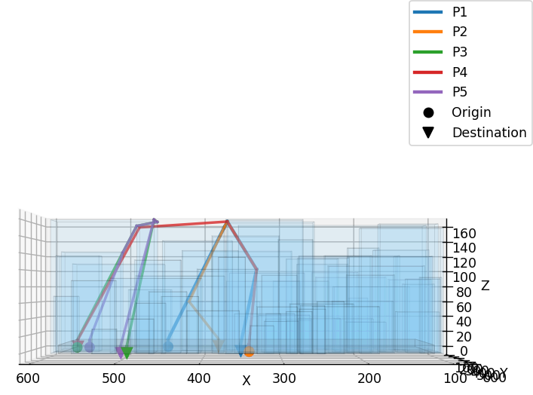
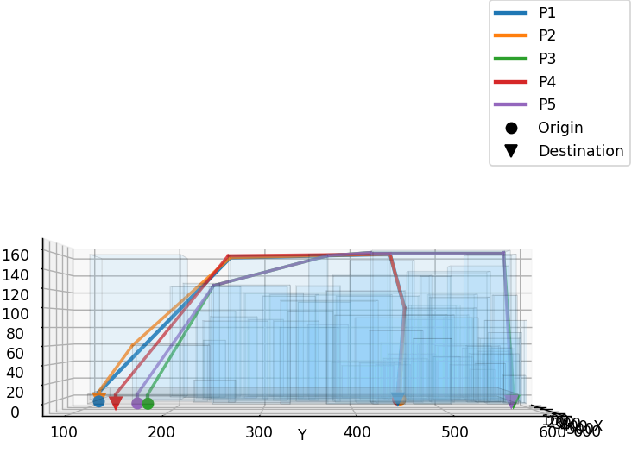
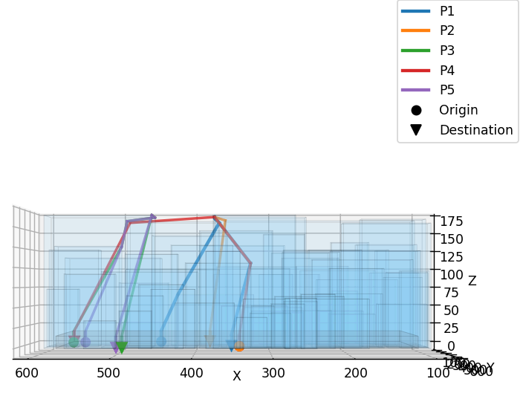
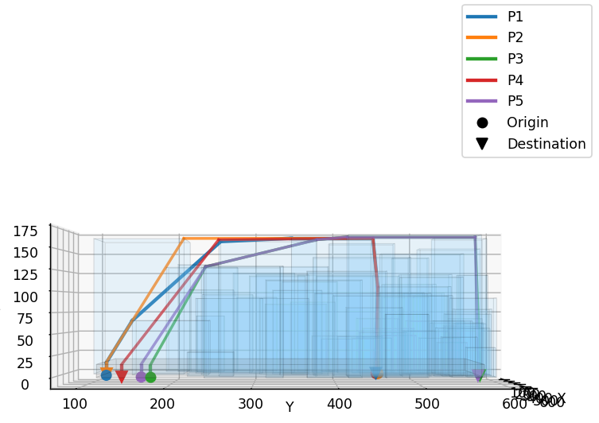
No Fly Zone = 10 m
No Fly Zone = 15m
Pair | Distance | Waypoints
1 | 575.43 | 5
2 | 581.42 | 6
3 | 643.40 | 6
4 | 596.61 | 5
5 | 644.93 | 6
Pair | Distance | Waypoints
1 | 600.65 | 7
2 | 605.39 | 5
3 | 670.94 | 6
4 | 614.55 | 5
5 | 671.84 | 6
↑ Interactive Image
↑ Interactive Image
Notes:
[1:10] Slide 19 — NFZ 10 m & 15 m results
10 m: Pair 1 575 m; longest pairs approach 645 m. 15 m: Pair 1 601 m; Pair 3 about 671 m.
Pattern: monotonic increase with clearance; the jump from 3 to 10 m is larger than from 10 to 15 m—diminishing returns at the top end.

Slide 20
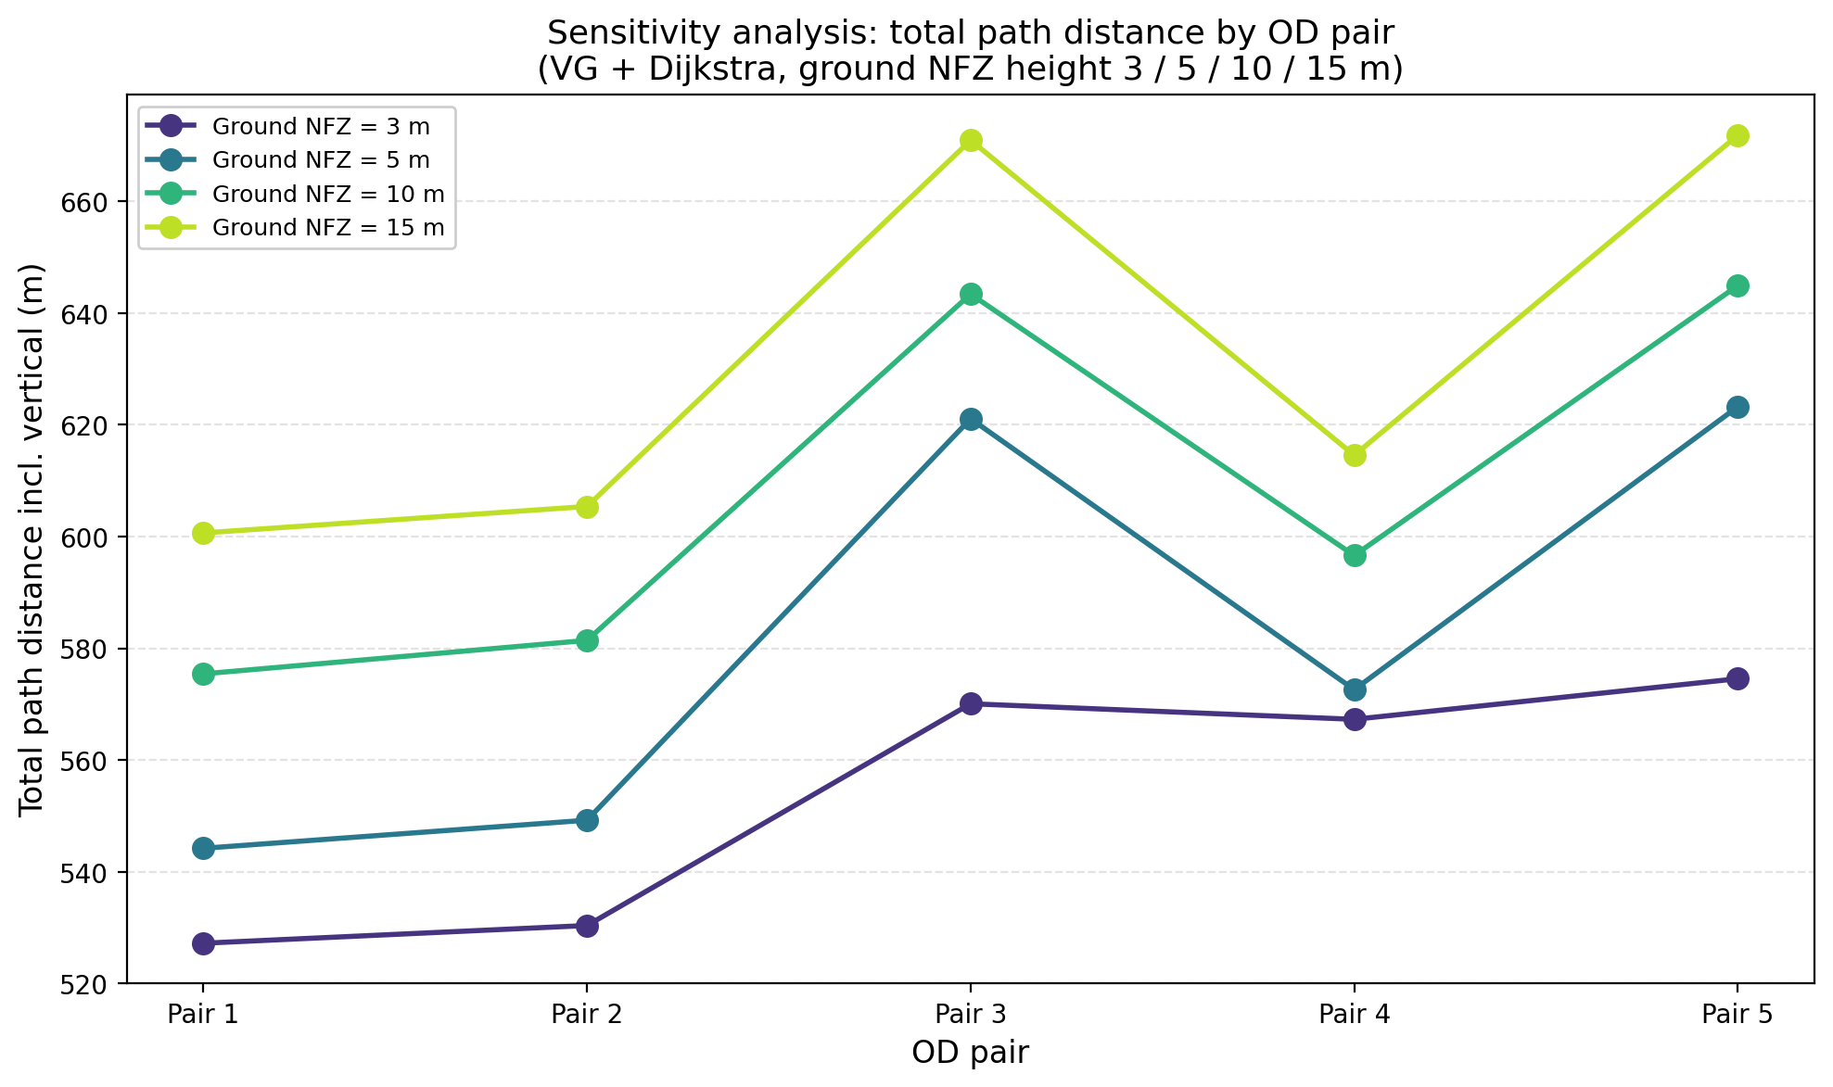
SECTION B — FRAMEWORK 1
Sensitivity Analysis - Result
✓ Observations
Higher NFZ → higher minimum flyable altitude → longer 3D paths even when horizontal routing is similar.
Vertical lift at OD dominates the gap between shortest and total paths; it grows predictably with ground clearance.
Also limited paths are available as NFZ increases hence aircraft needs to fly even higher.
Path topology (which corners are used) is similar across pairs; sensitivity is mainly altitude / length, not failure to find a path.
Operational implication: clearance is a first-order parameter for UAM routes from surface vertiports.
COMPARATIVE FRAMEWORKS FOR 3D URBAN PATH PLANNING | CAPSTONE PRESENTATION
Notes:
[0:50] Slide 20 — Framework 1 sensitivity summary
Observations: higher ground NFZ raises minimum flyable altitude and lengthens 3D paths even when horizontal routing is similar. Vertical lift at OD dominates the gap between ground distance and path length. Topology—which corners are used—stays similar; sensitivity is mainly altitude and metres, not failure to find paths.
Operational takeaway: ground clearance is a first-order parameter for vertiport-to-vertiport UAM.
### SECTION C — FRAMEWORK 2 (BUFFERED A*)

Slide 21
SECTION C — FRAMEWORK 2
Framework 2 :
Buffered A*
COMPARATIVE FRAMEWORKS FOR 3D URBAN PATH PLANNING | CAPSTONE PRESENTATION
Notes:
[0:20] Slide 21 — Framework 2 title
Now we will start with framework 2
Section C: Framework 2—buffer-field 3D A*. Same city and OD experiment design; different NFZ representation and search space.

Slide 22
SECTION C — FRAMEWORK 2
No Fly Zone Creation
Concept
IMPLEMENTATION
After building-height grid H is available (3d_structure or GeoTIFF), compute forbidden/low-safe flight altitudes as matrix B per cell.
Building influence: horizontal buffer around each positive-height cell; fly at least rooftop clearance above the tallest nearby building height.
Ground influence: cells not affected by buffered buildings get minimum altitude ground clearance (low-altitude NFZ analogue).
Representation: one scalar B[i,j] per raster cell (2.5D field), not axis-aligned 3D NFZ boxes.
Input
Read 3d_structure (text grid)
Clean
Replace NoData / NaN / inf with 0
Buffer
Buildings
Max-filter H over horizontal-buffer footprint → local max building height
✓ Approximation assumptions
Formula
B[i,j]=max(ground_clearance,max ( H[k]+rooftop_clearance))
Uniform horizontal_buffer_m (sideways buffer), rooftop_clearance_m, ground_clearance_m (three parameters, not cuboid ±X/Y/+Z).
Buffer built from raster cells, not gridtoBlock cuboids.
Horizontal reach uses cell_size_m and a conservative cell-intersection footprint.
Building cells: H > 0; ground cells contribute only via ground clearance unless inside building buffer.
Overlap in dense areas is implicit (max over neighborhood — conservative).
Static 2.5D field only; no curved corridors or dynamic rules.
OUTPUT
B : 3d_structure_nfz10.csv (min safe altitude m/cell)
H : 3d_structure_height.csv (original)
COMPARATIVE FRAMEWORKS FOR 3D URBAN PATH PLANNING | CAPSTONE PRESENTATION
Notes:
[1:20] Slide 22 — NFZ creation (raster buffer)
In this method we don’t create the cuboids rather we add buffer in 2d matrix itself
We have 3 bufferes, rooftop, sideways and ground
Rooftop buffer is tweaked by adding buffer value directly to cells
While sideways buffere is added by adding maximum buffere to adjecen cells
The total height for each cell then becomes the maximum height around that cell
Trade-off: finer than cuboids in plan view, but it is still an approximation
The sideways buffere is less flexible than the cuboid method

Slide 23
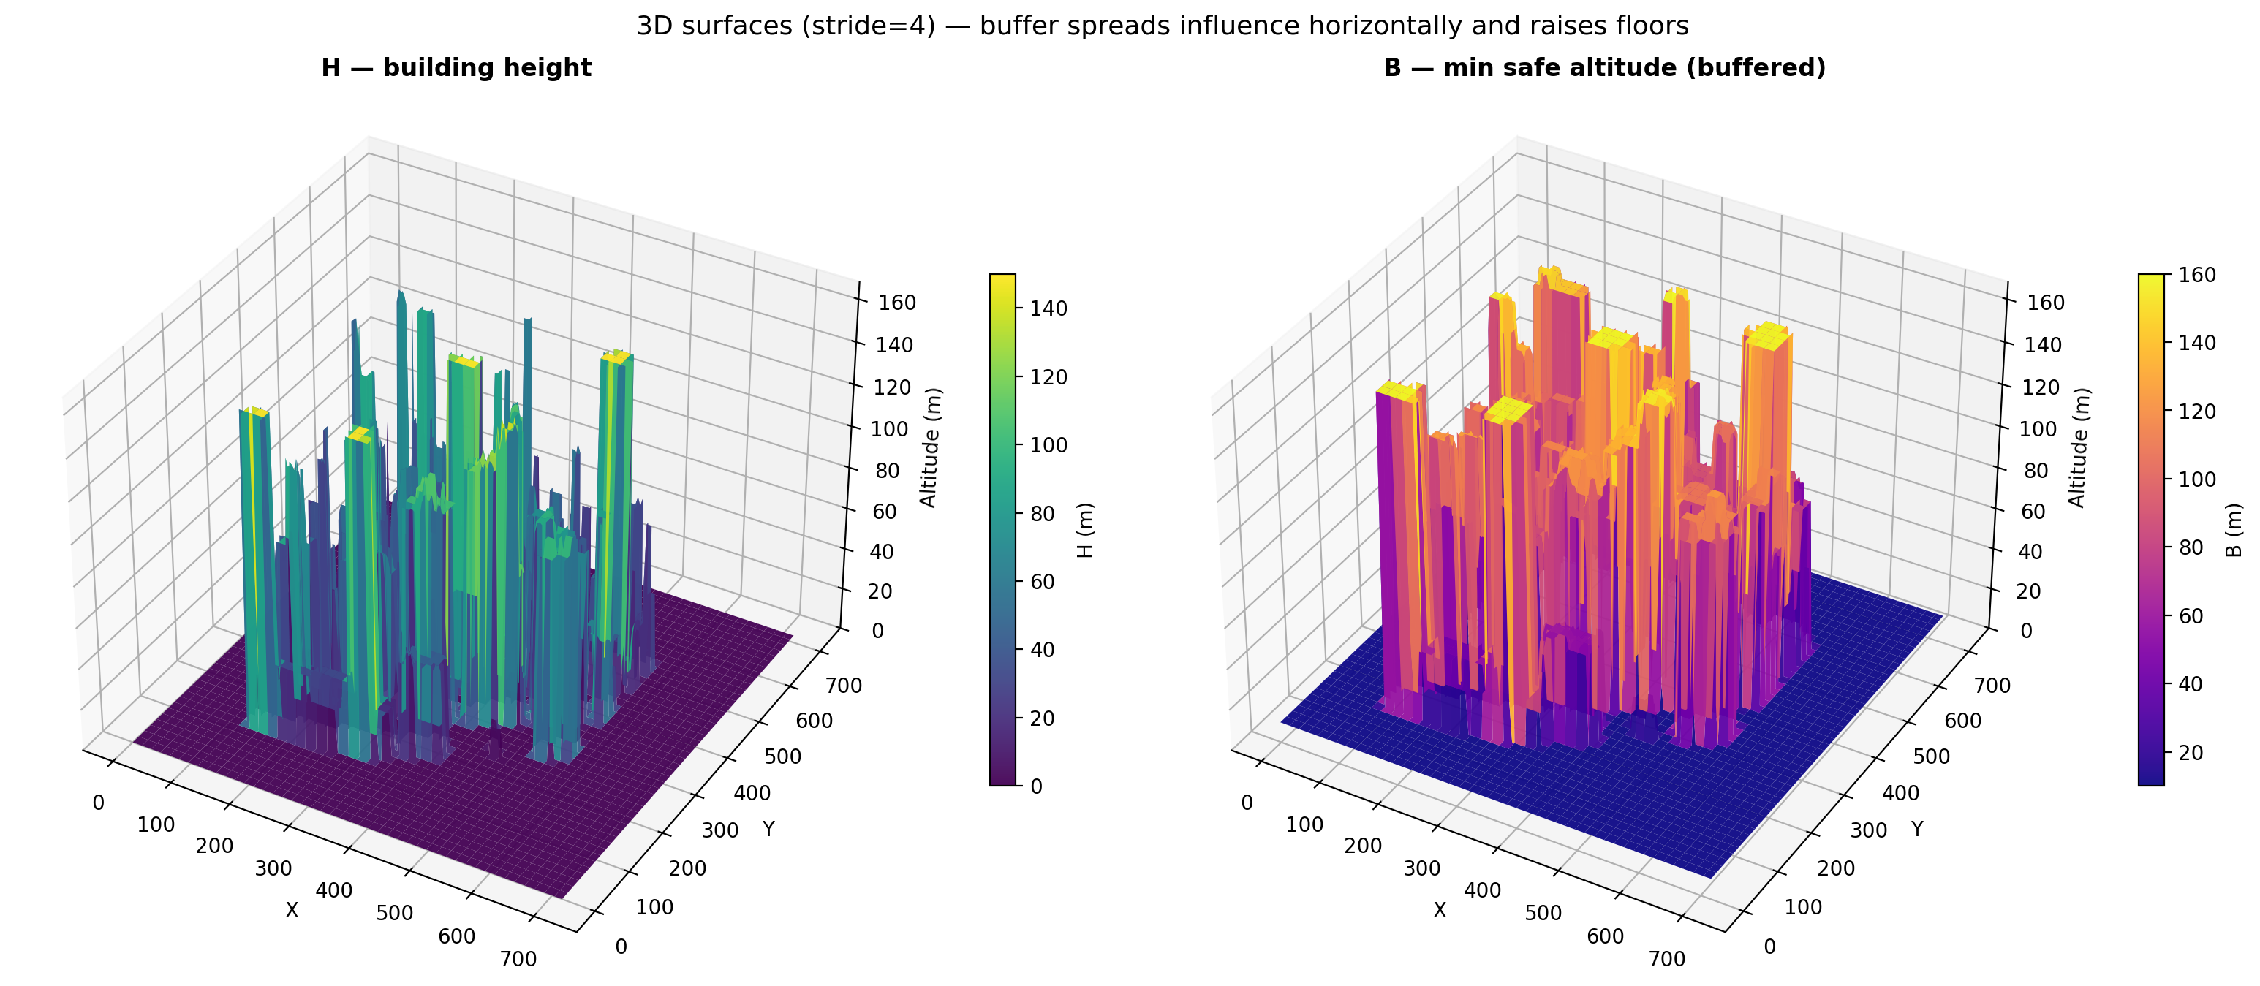
SECTION C — FRAMEWORK 2
No Fly Zone Addition
Original Geometry
No Fly Zone
COMPARATIVE FRAMEWORKS FOR 3D URBAN PATH PLANNING | CAPSTONE PRESENTATION
Notes:
[0:35] Slide 23 — NFZ visual (Framework 2)
Original heights versus buffer surface B. Orange shows building influence; grey shows ground-dominated clearance. A* will only fly at altitudes z ≥ B at each horizontal cell.

Slide 24
SECTION C — FRAMEWORK 2
A* - Concept
IMPLEMENTATION
Input
H CSV (building heights), B CSV (min safe altitude / NFZ ceiling)
Feasibility
Fly only if z ≥ B[row, col]; optional conservative edge_check
(f, counter, node) with f = g + h — pop minimum f
Priority queue
Relax
Update neighbor if shorter g found; push with new f
Problem: On a 3D cell graph, find minimum 3D path length from start to goal while staying at or above the buffer altitude field B.
Edge cost: Euclidean 3D distance between neighboring states (26-connectivity by default); all costs ≥ 0.
Method: Best-first search — always expand the node with smallest f = g + h (min-heap); g = cost from start, h = straight-line 3D distance to goal.
Guarantee: Optimal on this discretized graph when h is admissible (underestimates true cost); straight-line 3D h satisfies this.
Reconstruct
Backtrack from goal to start
Prechecks
OD only where H = 0; start/goal at B; on ground NFZ floor → vertical-only moves (like Dijkstra lift); no horizontal travel at clearance floor
OUTPUT
path_pair_XXXX.csv — waypoint list (row, col, altitude_m) + route_summary.csv metrics
COMPARATIVE FRAMEWORKS FOR 3D URBAN PATH PLANNING | CAPSTONE PRESENTATION
Notes:
[1:15] Slide 24 — A* concept
Forsuch geometry A* algorithm pathfinder method is used
Search: 3D grid with 26-neighbour connectivity (default). State is row, column, altitude. Feasible if z ≥ B[row,col]. Cost g is path length; heuristic h is 3D Euclidean to goal—admissible—so A* is optimal on this discretized graph.
Prechecks mirror Framework 1: ODs on open ground cells; start at B; on the ground NFZ floor, vertical-only moves until above clearance.
Outputs: path_pair_XXXX.csv and route_summary.csv with hundreds of waypoints per route.

Slide 25
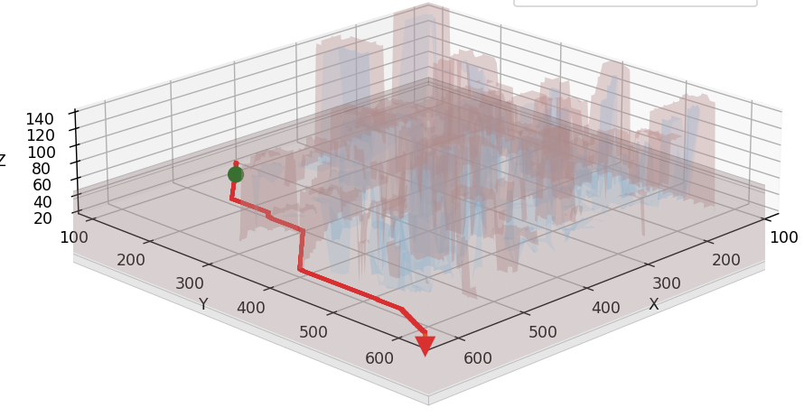

SECTION C — FRAMEWORK 2
A* - Result
Legend
Symbol | Meaning
Red line | Optimized route
Green ★ | Start
Orange ★ | Goal
Orange box | Building NFZ (B)
Blue box | Original Building (H)
Grey Box | Ground NFZ
✓ Output
Ordered waypoints (few segments)
Total path length (m)
Per-segment distances
COMPARATIVE FRAMEWORKS FOR 3D URBAN PATH PLANNING | CAPSTONE PRESENTATION
Notes:
[0:45] Slide 25 — A* result
Example optimal path in red—many small steps following the buffer surface. Orange is B; blue is raw building height H.
Message: paths hug the minimum feasible altitude field and thread corridors at 1 m horizontal resolution—closer to a geometric minimum in this model, at the cost of many waypoints and compute.

Slide 26
SECTION C — FRAMEWORK 2
Sensitivity Analysis I – Study Design
Goal : Understand the effect of NFZ on the path distance
Question:
How does ground NFZ height affect routes when OD points start on the ground?
Constants:
Same 73-building map, same 5 OD pairs, VG + Dijkstra
Variable :
Ground NFZ top height → 3 m, 5 m, 10 m, 15 m
Origin Destination Pairs:
Rank | Origin X | Origin Y | Origin Z | Dest X | Dest Y | Dest Z | Distance
1 | 448.5643 | 125.2468 | 0.0 | 351.3167 | 449.0989 | 0.0 | 338.1380
2 | 341.1944 | 451.9773 | 0.0 | 381.4345 | 122.0160 | 0.0 | 332.4060
3 | 566.3802 | 183.0086 | 0.0 | 487.0879 | 568.6081 | 0.0 | 393.6677
4 | 341.1312 | 449.5192 | 0.0 | 567.1557 | 149.3834 | 0.0 | 375.7241
5 | 550.7207 | 171.3541 | 0.0 | 494.3899 | 565.9755 | 0.0 | 398.6216
COMPARATIVE FRAMEWORKS FOR 3D URBAN PATH PLANNING | CAPSTONE PRESENTATION
Notes:
[0:40] Slide 26 — Sensitivity I (Framework 2 design)
Same question and five OD pairs as Framework 1. Constants: same 73-building map, Buffered 3D A*. Variable: ground clearance at 3, 5, 10, and 15 metres—the same four levels as Framework 1.

Slide 27
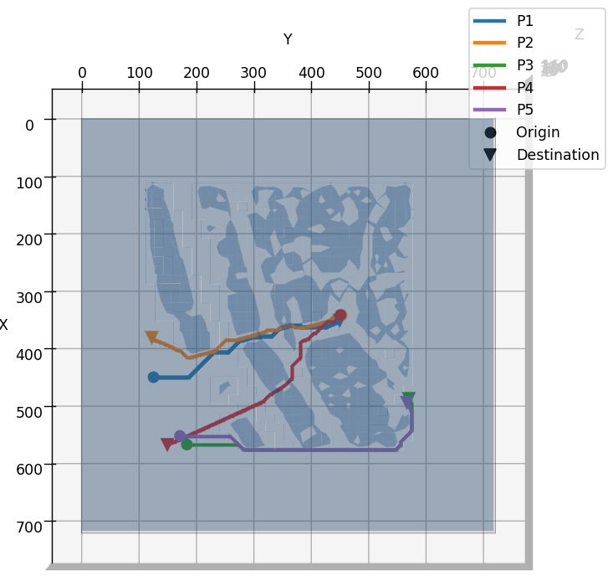
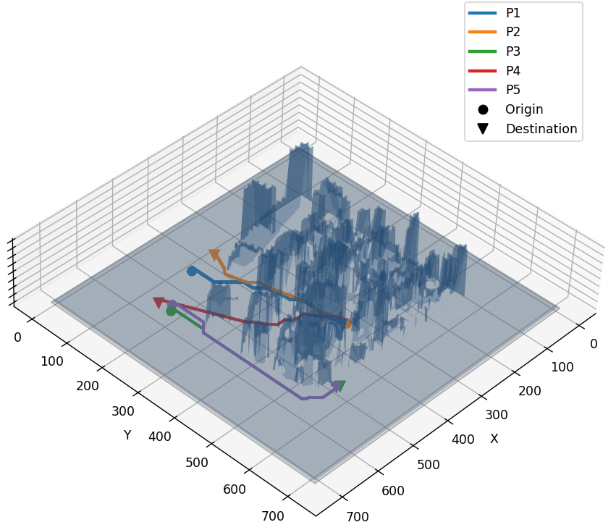
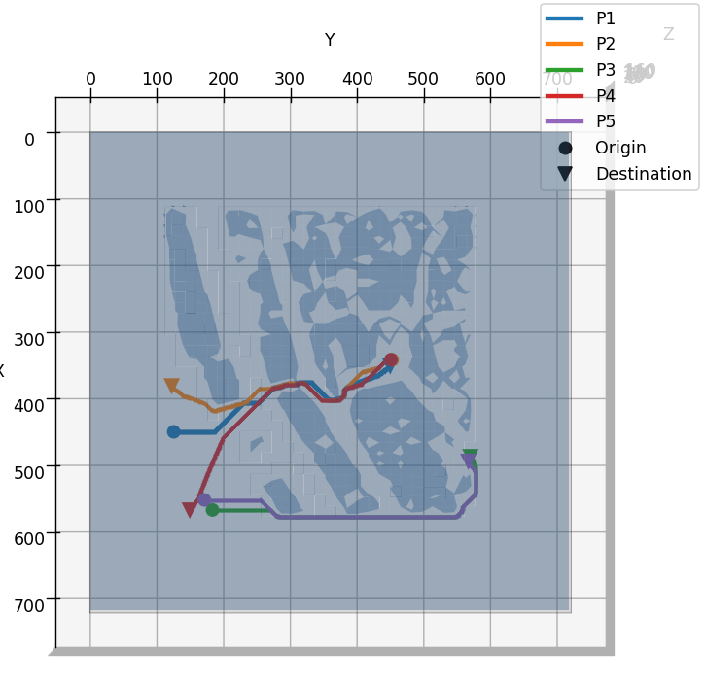
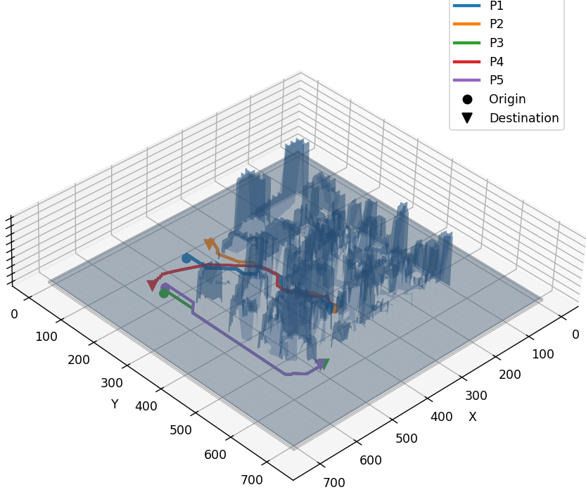
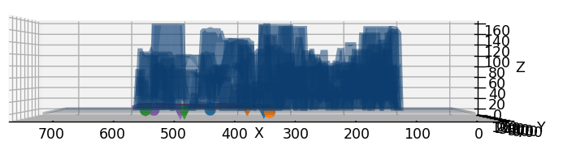
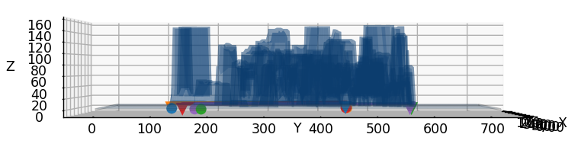
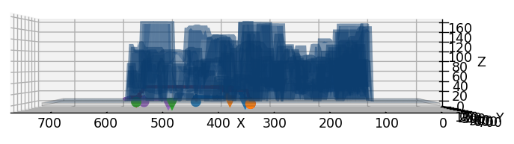
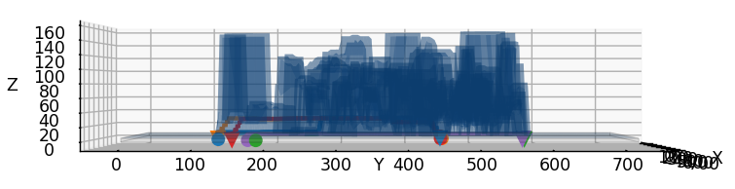
No Fly Zone = 3 m
No Fly Zone = 5m
Pair | Distance | Waypoints
1 | 387.08 | 329
2 | 397.22 | 335
3 | 488.15 | 457
4 | 442.14 | 353
5 | 500.61 | 462
Pair | Distance | Waypoints
1 | 441.07 | 337
2 | 452.87 | 343
3 | 493.22 | 460
4 | 505.07 | 372
5 | 505.68 | 465
↑ Interactive Image
↑ Interactive Image
Notes:
[1:10] Slide 27 — NFZ 3 m & 5 m (A*)
3 m: Pair 1 about 387 m, 329 waypoints—already near ground Euclidean distance because the grid can snake at low altitude in corridors.
5 m: Pair 1 441 m; Pair 4 505 m. Waypoint counts stay in the 330–460 range—much denser than Framework 1.

Slide 28
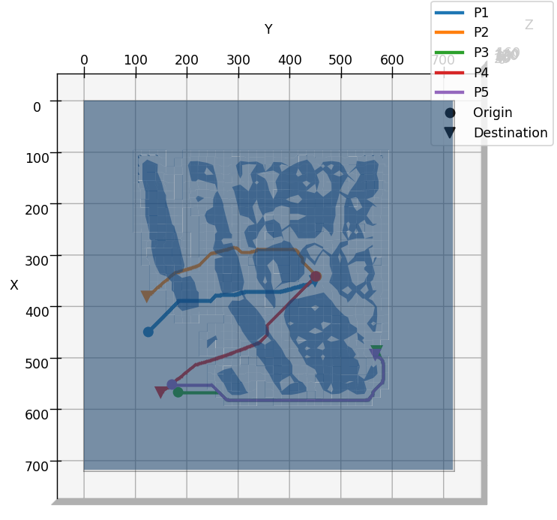
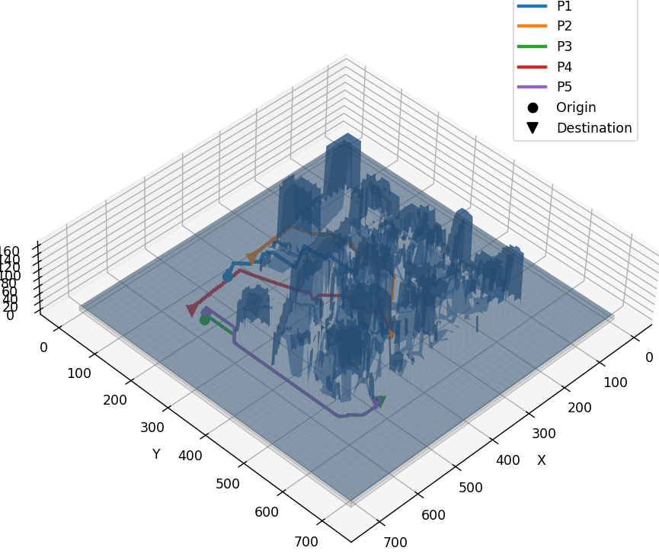
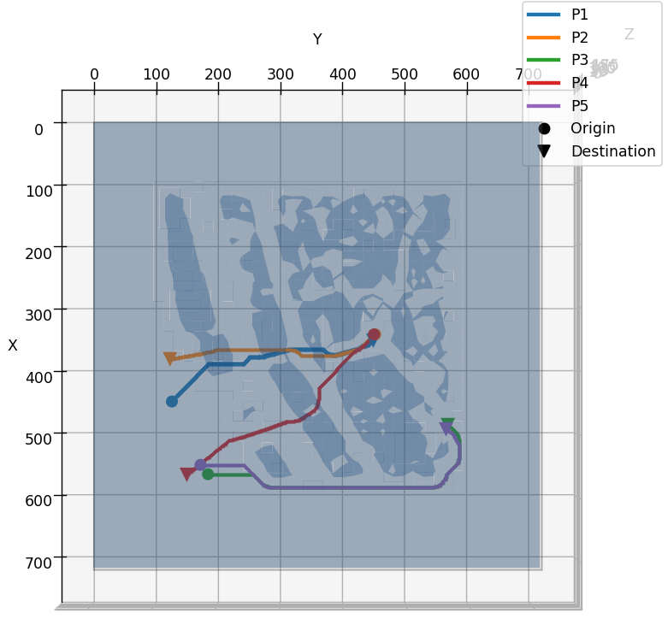
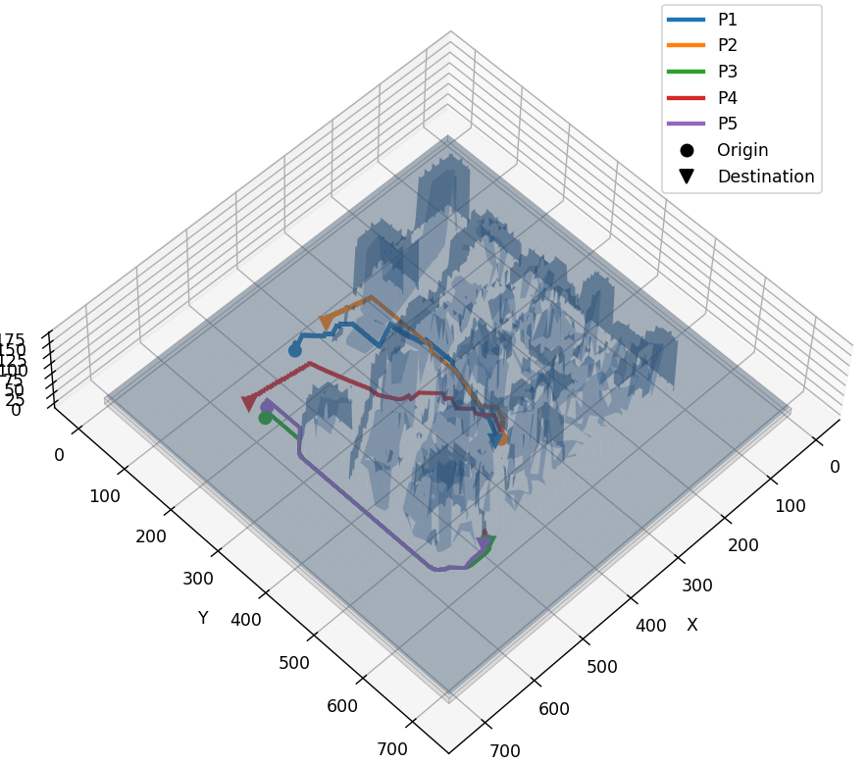
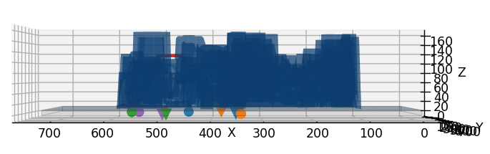
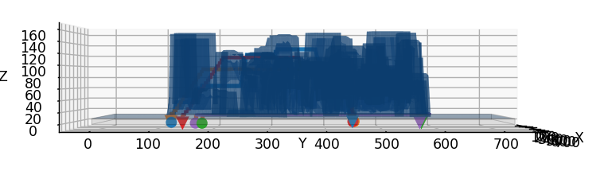
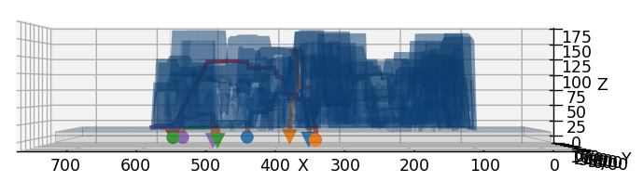
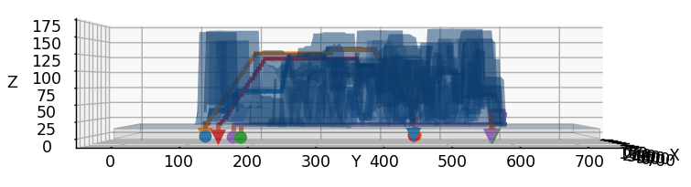
No Fly Zone = 10 m
No Fly Zone = 15m
Pair | Distance | Waypoints
1 | 569.51 | 329
2 | 553.98 | 345
3 | 515.61 | 467
4 | 586.43 | 324
5 | 530.41 | 476
Pair | Distance | Waypoints
1 | 586.33 | 329
2 | 578.74 | 335
3 | 538.58 | 475
4 | 604.37 | 337
5 | 587.34 | 482
↑ Interactive Image
↑ Interactive Image
Notes:
[1:10] Slide 28 — NFZ 10 m & 15 m (A*)
10 m: Pair 1 570 m; Pair 4 586 m. 15 m: Pair 1 586 m; Pair 4 604 m.
10 ≈ 15 for several pairs—plateau like Framework 1. Pair 1 is most sensitive (~387 → 586 m); Pair 5 is least (~501 → 587 m).

Slide 29
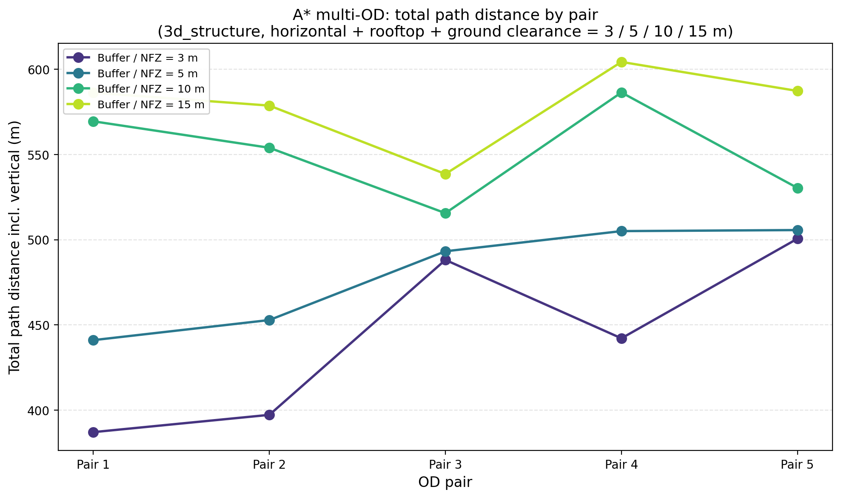
SECTION C — FRAMEWORK 2
Sensitivity Analysis - Result
✓ Observations
Higher buffer → longer paths for all 5 OD pairs (3 → 15 m).
Biggest jump: 3 m → 10 m; 10 m ≈ 15 m (little extra cost above 10 m).
Pair-dependent: Pair 1 most sensitive (~387 → 586 m); Pair 5 least (~501 → 587 m).
Pair 4 often longest at 10–15 m; Pair 3 long even at 3 m.
Takeaway: NFZ choice and which OD pair both strongly affect distance on this map.
COMPARATIVE FRAMEWORKS FOR 3D URBAN PATH PLANNING | CAPSTONE PRESENTATION
Notes:
[0:50] Slide 29 — Framework 2 sensitivity summary
Clearance increases path length for all pairs. Largest jump 3 → 10 m; marginal cost above 10 m. Pair-dependent effects matter—NFZ setting and OD choice both drive distance on this map.
### SECTION D — COMPARATIVE ANALYSIS

Slide 30
SECTION D — COMPARATIVE ANALYSIS
Comparative Analysis
COMPARATIVE FRAMEWORKS FOR 3D URBAN PATH PLANNING | CAPSTONE PRESENTATION
Notes:
[0:15] Slide 30 — Comparative analysis title
Once we got the result for the both framework we compared those with each other to find best method

Slide 31
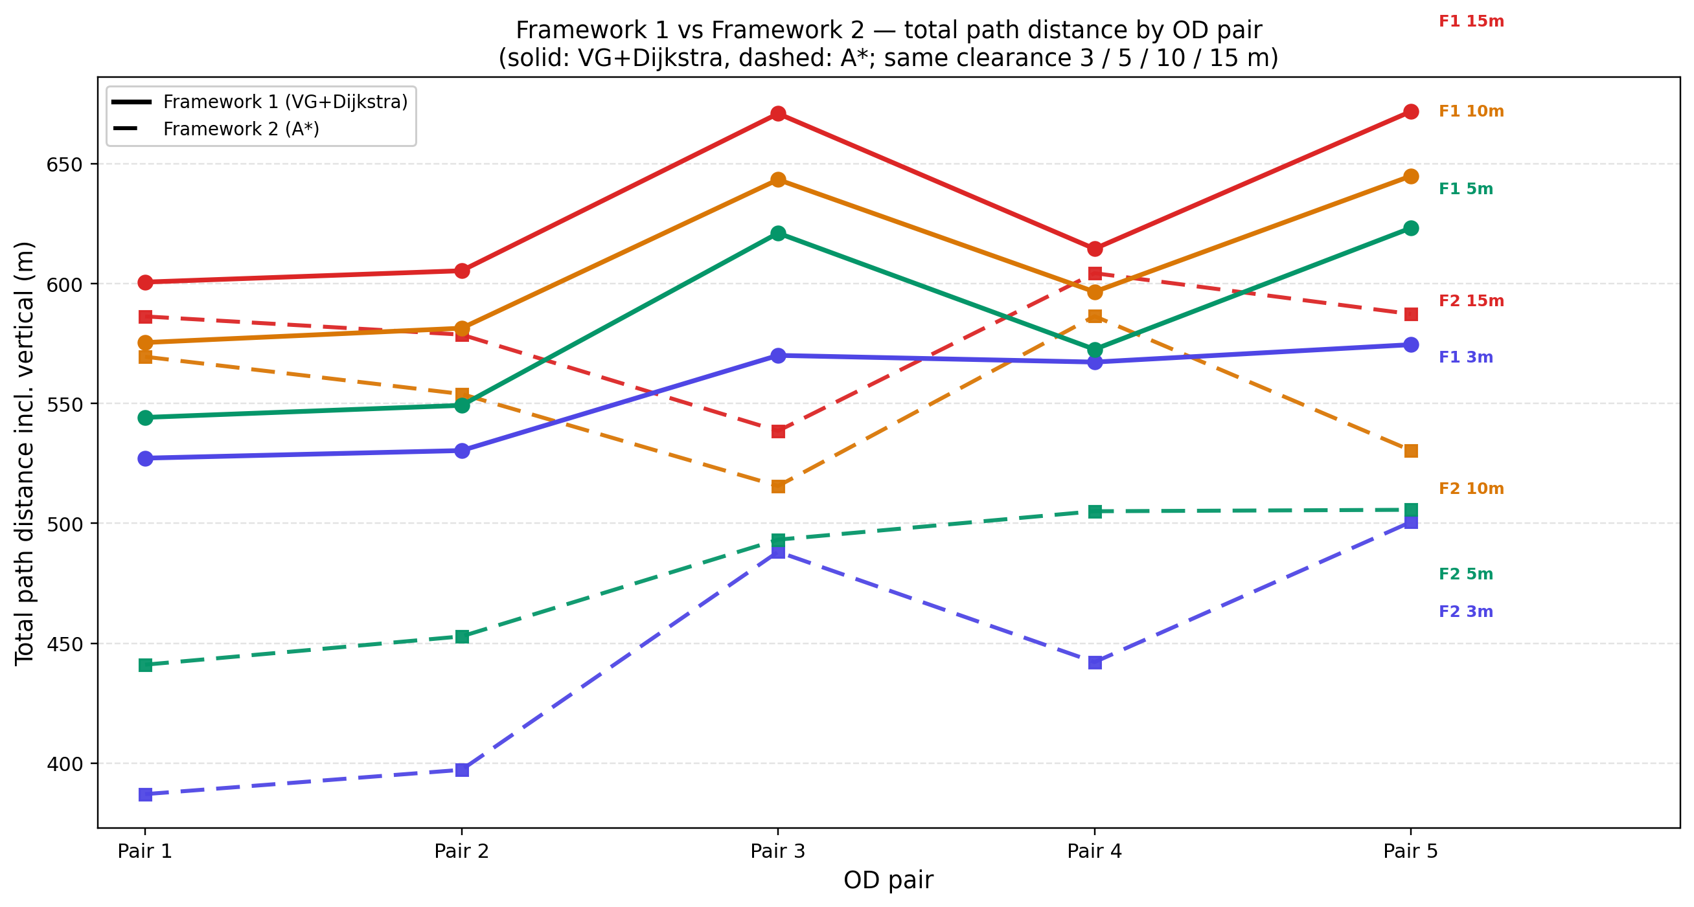
SECTION D — COMPARATIVE ANALYSIS
Sensitivity Analysis - Result
✓ Observations
Both show longer paths as clearance grows (3 m → 15 m); largest change is 3 m → 10 m; 10 m ≈ 15 m for most pairs.
F2 (dashed) is consistently lower in total distance — on average ~20% shorter at 3 m, ~8% at 15 m (e.g. Pair 1: 527 m vs 387 m at 3 m).
Why F2 looks “shorter”: searches a fine 3D grid (1 m cells, 5 m vertical steps) — ~330–480 waypoints vs F1’s sparse corner graph (far fewer nodes). More sampling → closer to a geometric minimum in this model.
Not apples-to-apples: F1 uses cuboid NFZ; F2 uses raster buffer B — trends align, but absolute metres differ.
F2’s lower distance comes with much higher search cost .
COMPARATIVE FRAMEWORKS FOR 3D URBAN PATH PLANNING | CAPSTONE PRESENTATION
Notes:
[1:20] Slide 31 — Comparative sensitivity chart
We overlayed sensitivity analysis results for both frameowrk
Both frameworks show longer paths as clearance grows; biggest change 3 → 10 m; 10 ≈ 15 m for most pairs.
Framework 2 (dashed) is consistentl;y lower in total metres—about 20% shorter at 3 m, about 8% at 15 m—e.g. Pair 1: 527 vs 387 m at 3 m.
Although F1 uses cuboid NFZ and a sparse corner graph;
F2 uses raster B and a fine 3D grid (~330–480 waypoints vs four to seven segments). F2 explores more of continuous space, so it finds shorter paths in its model—but with much higher search cost.

Slide 32
SECTION D — COMPARATIVE ANALYSIS
Framework Comparison
 | Framework 1 — VG + Dijkstra | Framework 2 — Buffer + A*
Preprocessing | Grid → cuboids → noFlyZone cuboids per scenario (3/5/10/15 m) | H CSV (grid)→ B buffer CSV per scenario (3/5/10/15 m)
Search space | Sparse: NFZ corners + OD only (** tens–low hundreds of nodes** per pair) | Dense: full 720×720 grid × altitude layers (26-neighbour 3D A*)
Per-pair compute (this study) | VG build + Dijkstra on small graph — light per query (not batch-logged) | ~4–38 s @ 3 m → ~41–147 s @ 10 m; ~0.1–1.8 M node expansions per pair
Scaling in dense city | NFZ build is heavy once; routing stays sparse → better for many OD pairs / replanning | Expansions grow sharply with tighter buffers and clutter → Hong Kong-scale grids need much more power
Path length | Longer (cuboid approximation + limited graph nodes) — demo range 527–672 m | Shorter (finer discretization) — demo range 387–604 m
Waypoints | Few — straight segments between visible corners | Many — ~330–480 grid steps per route
Framework 1: Few points to process → fast routing after NFZ is built; path is not the geometric minimum in the true city.
Framework 2: Many grid points explored → closer to minimum-distance path in the buffer model; needs significantly more CPU/memory/time, especially at 10–15 m clearance and in dense geometry.
COMPARATIVE FRAMEWORKS FOR 3D URBAN PATH PLANNING | CAPSTONE PRESENTATION
Notes:
[1:20] Slide 32 — Framework comparison table
Preprocessing: F1—grid to cuboids to JSON per clearance; F2—H to B CSV per scenario.
Search space: F1—tens to low hundreds of nodes; F2—720×720 horizontal grid times altitude layers, 26-neighbour 3D.
Compute (this study): F1—light per query after NFZ build; F2—about 4–38 s at 3 m up to ~41–147 s at 10 m, up to ~1.8M expansions per pair.
Scaling: F1—heavy NFZ build once, sparse replanning for many ODs; F2—expansions explode in clutter—Hong Kong-scale full grid A* is not real-time without acceleration.
Path quality: F1 longer but operationally cheap; F2 shorter but compute-heavy.
### SECTION E — CONCLUSION

Slide 33
SECTION E — CONCLUSION
Conclusion
COMPARATIVE FRAMEWORKS FOR 3D URBAN PATH PLANNING | CAPSTONE PRESENTATION
Notes:
[0:15] Slide 33 — Conclusion title
Section E—conclusions and Hong Kong recommendations.

Slide 34
SECTION E — CONCLUSION
Conclusion
Problem | What we tested
Dense urban cores: tight corridors, high buildings, strict NFZ | Same demo city (3d_structure), 5 OD pairs
Need safe 3D routes with tunable clearance | Framework 1: cuboids → NFZ → VG + Dijkstra
 | Framework 2: H → B buffer → 3D A*
For dense cities like Hong Kong, Framework 1 (VG + Dijkstra) is the more practical choice for city-scale UAM routing — lower compute per route, sparse graph, reusable NFZ geometry.
Framework 2 (buffer + A)* is better when minimum distance matters and heavy offline compute is acceptable (local corridors, pre-flight optimization).
COMPARATIVE FRAMEWORKS FOR 3D URBAN PATH PLANNING | CAPSTONE PRESENTATION
Notes:
[1:00] Slide 34 — Conclusion
We tested dense urban routing on 3d_structure with five ODs and tunable clearance. Framework 1: cuboids → NFZ → VG + Dijkstra. Framework 2: H → B → 3D A*.
Summary: For dense cities like Hong Kong, Framework 1 is the more practical choice for city-scale UAM—lower per-route compute, reusable NFZ geometry, sparse waypoints. Framework 2 wins when minimum distance matters and offline compute is acceptable—local corridors, pre-flight optimization.

Slide 35
SECTION E — CONCLUSION
Recommendation for Hong Kong
Primary recommendation
When Framework 2 still makes sense
Use Framework 1 (VG + Dijkstra) as the main pipeline for Hong Kong-style dense cities
City scale: Hong Kong’s built-up area implies millions of raster cells — full-grid A* does not scale for real-time or large batch OD sets (demo already: up to ~147 s / 1.8 M expansions on 720×720).
Operational fit: After one-time cuboid + NFZ build, each route uses very few graph nodes — suitable for dispatch, replanning, and multi-vertiport networks.
Acceptable trade-off: Paths are ~8–20% longer than buffer A* in our tests, but predictable and much cheaper to compute.
Limitations:
F1: cuboids over-approximate buildings → conservative, longer routes.
Offline mission planning in a local corridor (vertiport ↔ vertiport)
Fuel / range critical flights where minimum distance justifies compute
GIS raster workflow (DSM/TIF) with coarser grid or hierarchical A* (future work)
Limitations:
F2: 2.5D buffer, grid steps — accurate locally but too heavy city-wide without acceleration
VS
Hong Kong UAM routing: prefer VG + Dijkstra for city-scale operations; reserve buffer + A when high-fidelity, compute-rich local optimization is required.
COMPARATIVE FRAMEWORKS FOR 3D URBAN PATH PLANNING | CAPSTONE PRESENTATION
Notes:
[1:30] Slide 35 — Recommendation for Hong Kong
Primary: Deploy Framework 1 for Hong Kong-style operations. Built-up areas imply millions of raster cells; full-grid A\ already hits ~147 s and 1.8M expansions on a 720×720 demo—imagine city-wide batch OD sets.
After one-time cuboid + NFZ build, each route uses a small graph—suitable for dispatch, replanning, multi-vertiport networks. Paths are ~8–20% longer than buffer A star in our tests—an acceptable trade for predictability and cost.
When to use Framework 2: offline mission planning is available in a local corridor, fuel-critical flights, or GIS raster workflows—with hierarchical A\ or coarser grids as future work.
Limitations: F1 cuboids over-approximate; F2 is 2.5D and grid-heavy city-wide.
Closing line: Hong Kong UAM—prefer VG + Dijkstra at scale; reserve buffer + A\ for high-fidelity local optimization.

Slide 36
Thank You
Questions & Discussion
Visibility Graph + Dijkstra
Buffered A*
Trade Study
Sensitivity Analysis
Framework Comparison
Comparative Frameworks for 3D Urban Path Planning · Graduate Capstone Presentation
Notes:
[0:30] Slide 36 — Thank you
Thank you. I am happy to take questions on the visibility graph, buffer construction, sensitivity design, or the Hong Kong recommendation.

Slide 37
Realistic OD pair based on the use

