Slide 1


SMART INDIA HACKATHON 2026
Exclusive6
Problem Statement ID - SIH26083
Problem Statement Title -Extreme Heatwave Early Warning and Human Thermal Stress Index
Theme - Disaster Management
PS Category - Software
Team ID - 169785
Team Name (Registered on portal) - Exclusive6

Slide 2








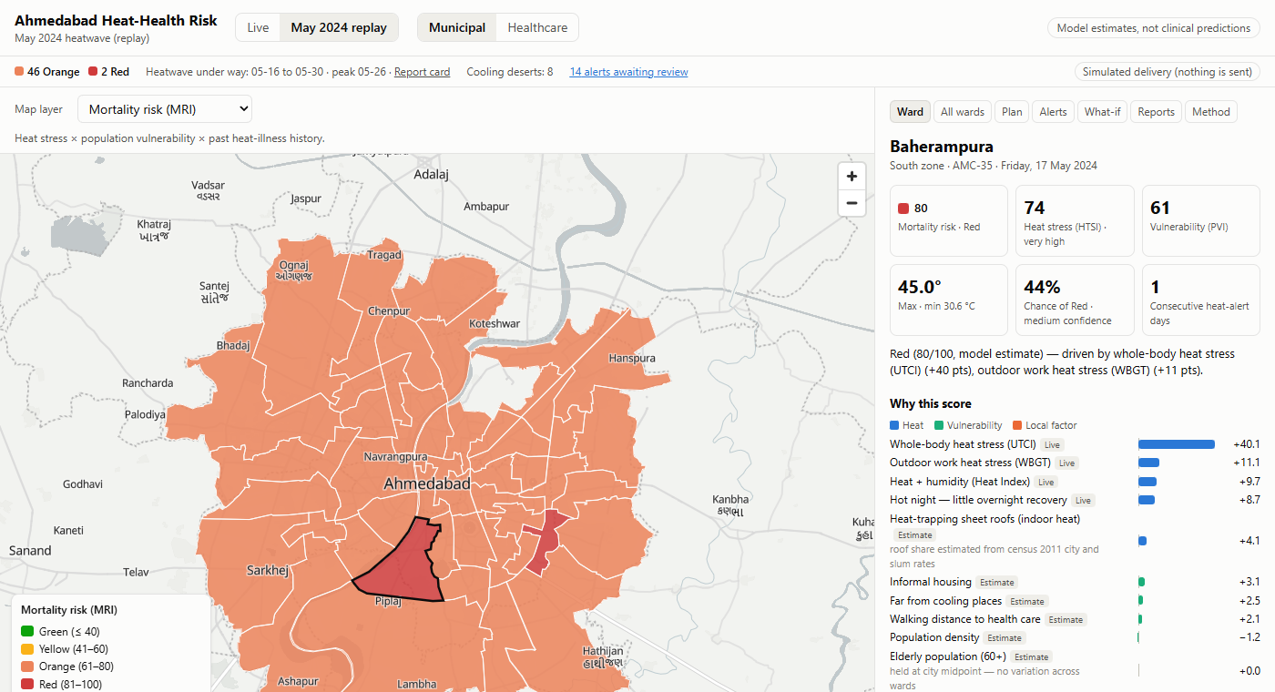
Exclusive6
Proposed Solution
Weather → ward heat exposure → body heat stress → who is exposed → health risk → approved warning → action
Solution workflow
What makes it different?
Every score explained
Probabilistic warning
Every score shows the points each factor adds and its data source
“67% chance of Red” from 3 forecast models, days before the heat
1 · Sense
2 · Score & explain
3 · Decide
4 · Alert & learn
122-run weather ensemble, satellite heat maps, census & slum data, street network
UTCI, WBGT, Heat Index + hot nights, sheet roofs → heat stress × vulnerability → ward risk
Heat Action Plan actions, safe work hours, cooling deserts, resource allocation
Officer-approved SMS / WhatsApp / voice + CAP; health-worker reports; what-if planning
Human in control
Closed loop
Nothing is sent without a named officer; full audit trail
Health-worker reports flag misses; what-if tests trees, cool roofs, centres
Comparison with existing systems
Prototype
✓ yes ◐ partly — no
Capability | IMD warnings | IMD Heat Index | City HAP | Weather apps | Our platform
Ward-level risk (48 wards) | — | — | ◐ | ◐ | ✓
Humidity + sun + wind (UTCI, WBGT) | — | ◐ | — | ◐ | ✓
Who is exposed (vulnerability) | — | — | ◐ | — | ✓
Chance of alert, 1–5 days ahead | ◐ | — | — | — | ✓
Recommended actions per ward | ◐ | — | ✓ | — | ✓
Approved local-language alerts | ◐ | — | ✓ | — | ✓
Ward detail: Baherampura's risk explained factor by factor

Slide 3




Exclusive6
Technical Approach
System architecture
Core technical features
USERS
Body-heat indices: UTCI and WBGT (Liljegren) with sun and wind, not temperature alone
Calibrated to the city: scores anchored to Ahmedabad Heat Action Plan thresholds
Ward downscaling: satellite night heat island adds up to ~1 °C per ward
Probabilistic alerts: whole model run on 122 forecast members, 5 days ahead
Explainable: exact points per factor, each labelled live / census / estimate
Street-network access: 15-minute walk to cooling places and health care
Human-approved alerts: en / hi / gu, SMS length checks, CAP 1.2, audit log
Tested: 163 automated tests; May 2024 heatwave replay
Municipal officers
Health dept & hospitals
Residents & workers
ASHA / health workers
approve alerts, plan
hospitalization risk
SMS · WhatsApp · voice
report cases (counts)
Web dashboard (React + MapLibre)
Alert delivery
Ward map · 8 layers · explanations · plan · alerts · what-if · reports · method
Human approval → SMS / WhatsApp / IVR voice (Twilio) · CAP 1.2 XML · WhatsApp ward bot
Backend API (FastAPI + SQLite + APScheduler)
Daily forecast refresh · replay of past heatwaves · audit log · role token for write actions
SCORING ENGINE (Python)
Technologies used
Ward downscaling (night heat island)
UTCI · WBGT · Heat Index
Heat stress + vulnerability → risk
Actions · work hours · cooling
Frontend
Backend
React · Vite · MapLibre · Recharts
Python · FastAPI · SQLite
DATA
Data / GIS
Delivery
Open-Meteo (ECMWF · GFS · ICON, 122 ensemble runs) · Google Earth Engine (Landsat, MODIS, Sentinel-2) · WorldPop · Census 2011 · AMC slum survey · OpenStreetMap street network · IMD airport station
Earth Engine · GeoPandas · OSMnx
Twilio · CAP 1.2 · TwiML

Slide 4



Exclusive6
Feasibility and Viability
Technical feasibility
What if…? and how we respond
Can we build it? It is built.
What if the forecast is uncertain?
Working prototype on open data · 163 automated tests · full May 2024 replay · 5-day ward forecast in ~4 minutes · what-if in ~1 second
?
122 forecast runs give a probability and a confidence level, not one guess
?
What if a ward has no data for some factor?
Operational viability
It is held at the city midpoint and the explanation says so; nothing is invented
Can the city run it?
Plugs into the existing Ahmedabad Heat Action Plan · named-officer approval and audit log · alerts in English, Hindi, Gujarati · delivery simulated until a sender is registered
?
What if an alarming alert is wrong?
A named officer reviews, edits or rejects every draft; every action is logged
?
What if the model under-rates a ward?
Deployment potential
Health-worker case reports flag it (e.g. Vatva: 6 cases vs 0.2 expected)
Can it scale?
Same code for any Indian city: ward boundaries + IMD / HAP thresholds + public data · one small server · main running cost is SMS / voice per message
?
What if residents have no smartphone?
SMS and voice calls in Gujarati / Hindi, with a keypad menu for cooling places

Slide 5








Exclusive6
Impact and Benefits
Replay of the May 2024 Ahmedabad heatwave, scored as the system would have run it
11 / 11
4 days
238 / 344
3 days
dangerous days caught
(Heat Action Plan Orange/Red), none missed
warning before IMD's
red alert (20–24 May)
Red ward-days flagged
3–5 days ahead
of Red avoided in Baherampura
(trees + cool roofs what-if)
Impacts
Benefits
Lives protected earlier
Municipal corporation
Warning days before the heat, ward by ward, with the peak hour
One screen: priorities, day plan, approved alerts, report card
Help where it is needed
Health system
Cooling units, ambulances and staff sent to the highest-risk wards
Hospitalization-risk view; early flags from ASHA case reports
Outdoor workers protected
Citizens
Safe work hours by workload, stricter for workers new to the heat
Advice in their language, with the nearest cooling places
Better long-term planning
Accountability
Test trees, cool roofs and new cooling centres before funding them
Audit log, post-event report card, limitations shown in-app
SOCIAL IMPACT
GOVERNANCE IMPACT
HEALTH & CLIMATE IMPACT
Vulnerable wards first · local languages · no-smartphone reach
Human approval · audit trail · evidence-based Heat Action Plan
Fewer heat deaths · cooler neighbourhoods · data for adaptation

Slide 6




Exclusive6
Research and References
Links
Research papers
GitHub repository
https://github.com/janhavitupe/Heat-Health-Warning-SIH
Prototype: runs locally (FastAPI + React), May 2024 replay built in
Prototype demonstration video: http://youtube.com/watch?v=V4f20cV1iZI
Azhar et al. 2014: excess mortality in the 2010 Ahmedabad heatwave (PLOS ONE)
https://journals.plos.org/plosone/article?id=10.1371/journal.pone.0091831
Knowlton et al. 2014: South Asia's first Heat Action Plan, Ahmedabad (IJERPH)
https://pmc.ncbi.nlm.nih.gov/articles/PMC4024996/
Anderson & Bell 2011: heatwave intensity vs duration and mortality (EHP)
https://pubmed.ncbi.nlm.nih.gov/21084239/
Armstrong et al. 2019: role of humidity in heat mortality (EHP)
https://ehp.niehs.nih.gov/doi/full/10.1289/EHP5430
Night-time heat and heatwave mortality, 2023 (EHP)
https://ehp.niehs.nih.gov/doi/full/10.1289/EHP13206
Vellingiri et al. 2020: cool roofs in Ahmedabad slums (IJOEM)
https://pubmed.ncbi.nlm.nih.gov/32435111/
Building toward the finals
Ward-level heat-illness counts and 60+ population from AMC Health Department, to validate ward rankings
Live SMS / WhatsApp through a DLT-registered sender (Twilio or a telecom gateway)
Native-speaker review of Hindi and Gujarati advisories; more languages
Replay the 2010, 2016 and 2019 heatwaves for stronger false-alarm statistics
LOI / MoU with AMC Health Department to pilot in the 2027 heat season
Technical references
Open-Meteo forecast & ensemble APIs
https://open-meteo.com/en/docs/ensemble-api
ACGIH heat-stress work/rest limits (via CCOHS)
https://www.ccohs.ca/oshanswers/phys_agents/heat/heat_control.html
FastAPI documentation
https://fastapi.tiangolo.com/

