Slide 1
Digital restoration of Finlay colour negatives from the Matson Photographic Collection at the Library of Congress
Jan Hubička
Joint work with Jan Bílý, Andrew Goodall, Eva Hubičková, and Mark Jacobs
Muzeum fotografie Šechtl a Voseček
Šechtl and Voseček Museum of Photography
Central European Archives – Image and Sound Restoration Practices
Warszawa 2017

Slide 2
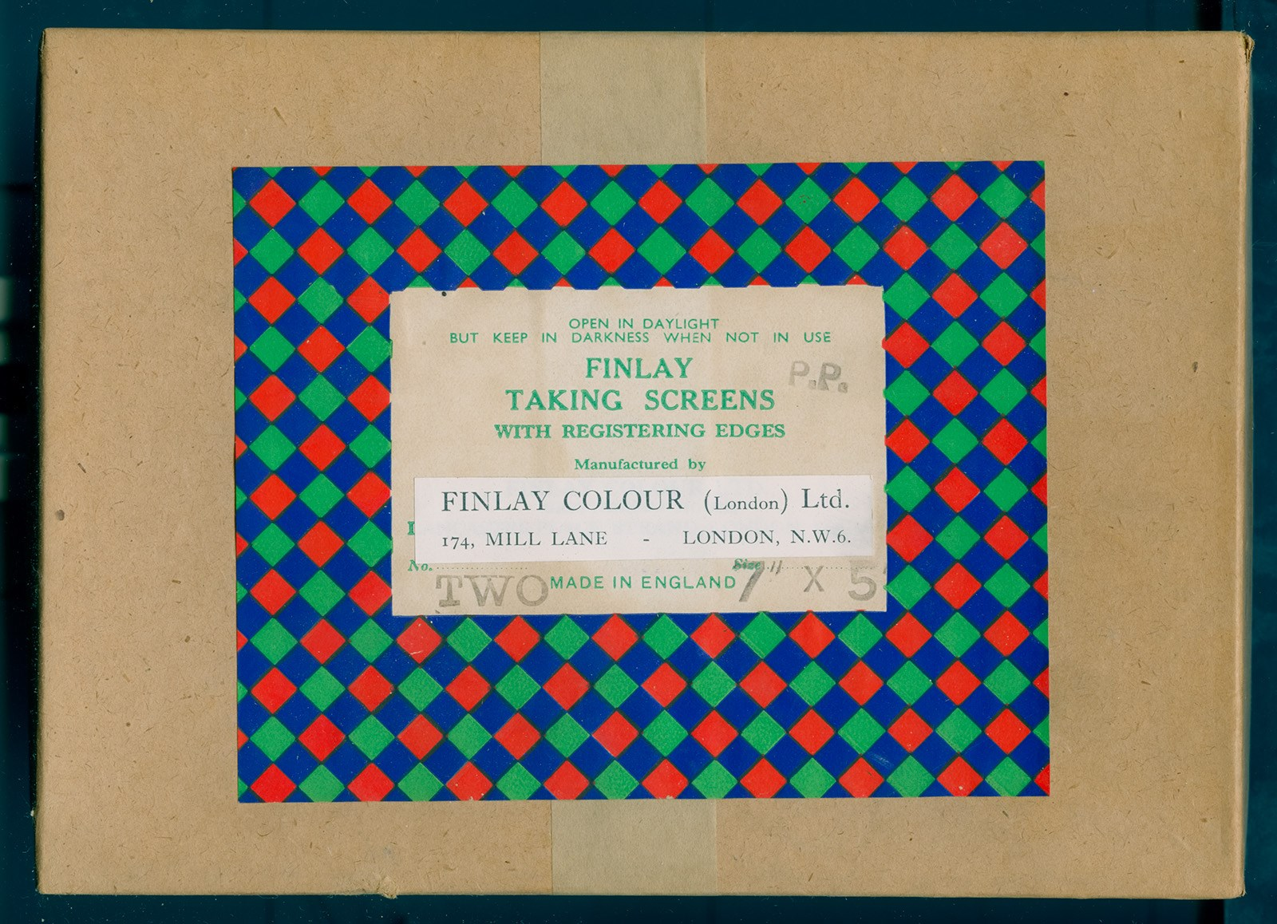

Slide 3
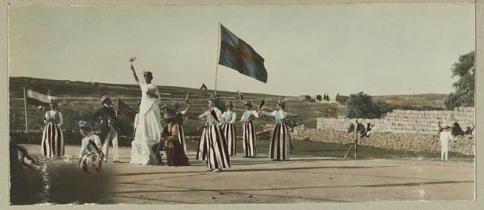
American colony in Jerusalem
In 1881 Pilgrims from Chicago led by Horatio Spafford (1828 – 1888) establish American Colony at “House in the Wall”.
In 1896 Dalarna Swedes from Nås, Sweden, join the American Colony, led by Henrik Olof Larsson.
In 2004 negatives was digitized by Library of Congress USA

Slide 4
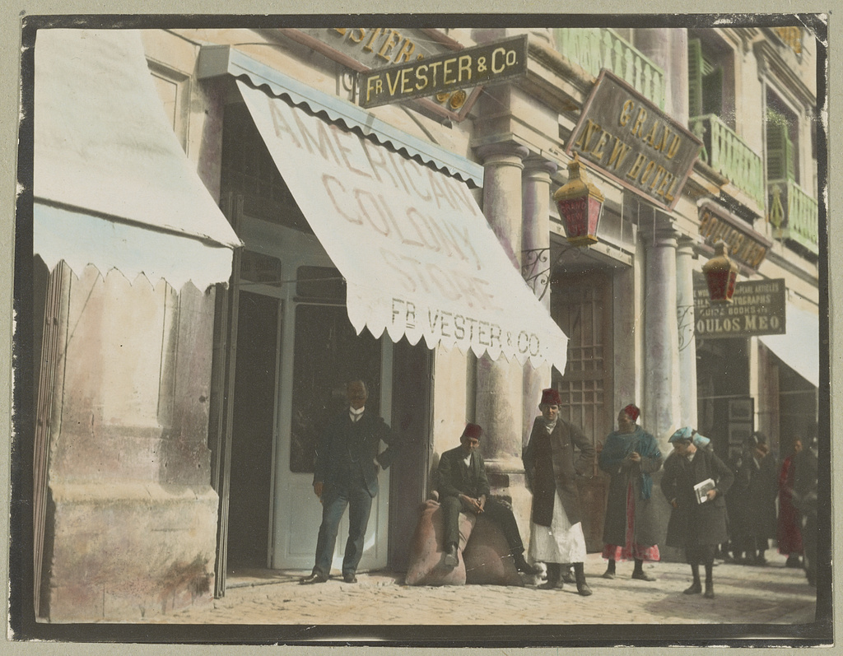
1905-1913

Slide 5
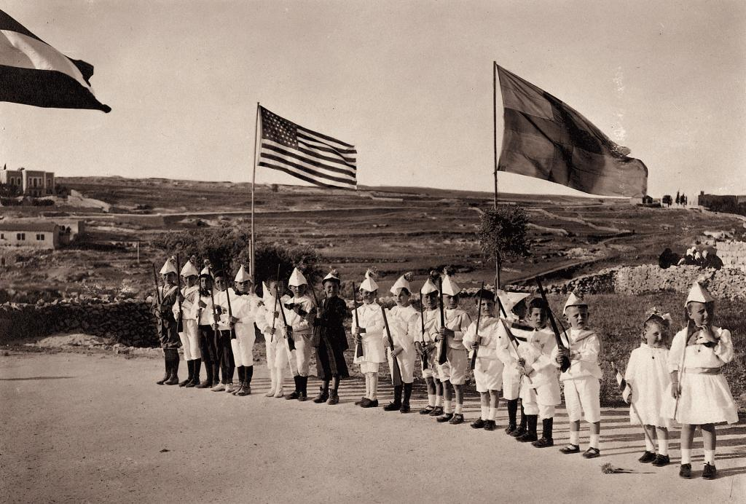

Slide 6
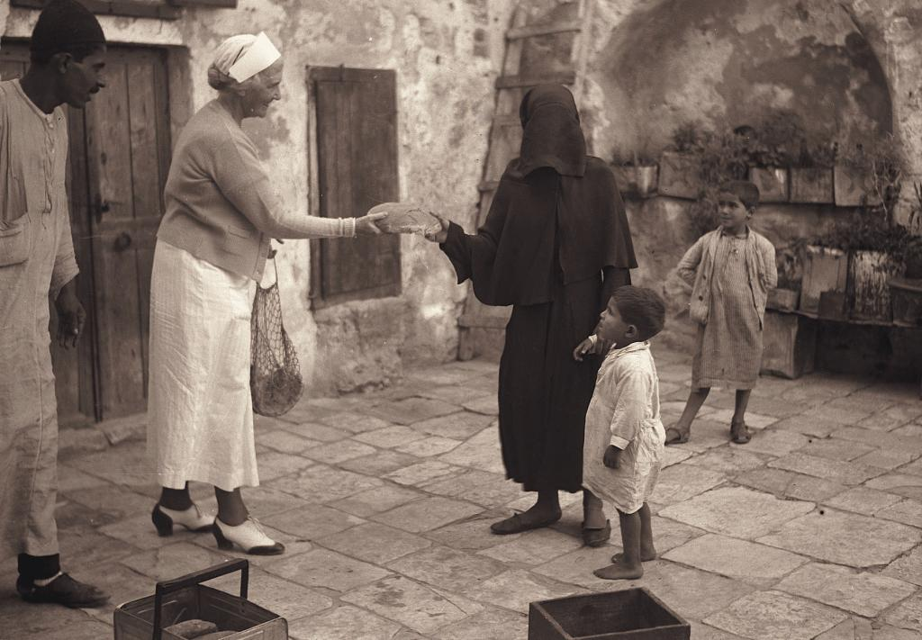
1938 - The raising of the siege of Jerusalem. Mrs. F. Vester, handing out a loaf of bread.

Slide 7
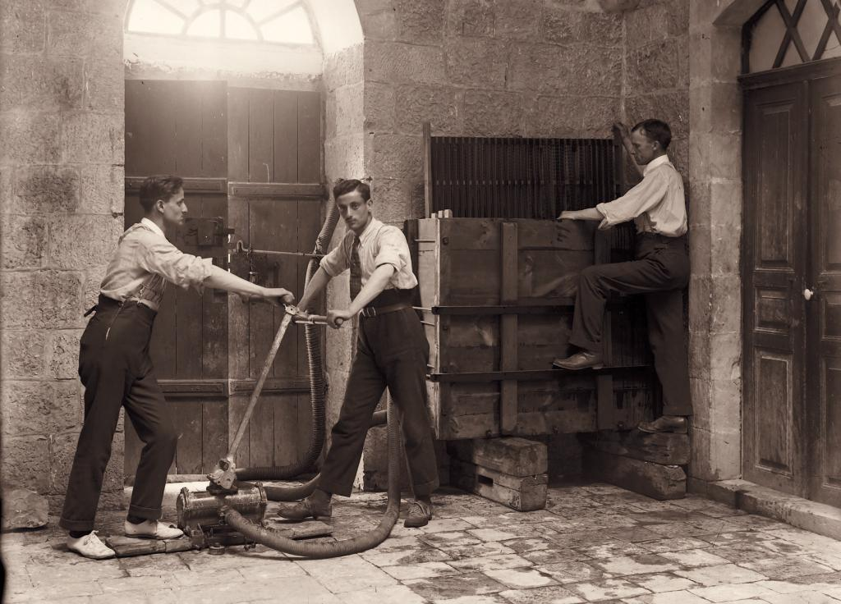
American Colony Photographers
Matson Photo Service
Elijah Meyers founds “American Colony Photographers”. Apprentices Lewis Larsson, Erik Lind, Fareed Naseef, Furman O. Baldwin.
Gamel Albina, Najeb Albina, Lewis Larsson

Slide 8
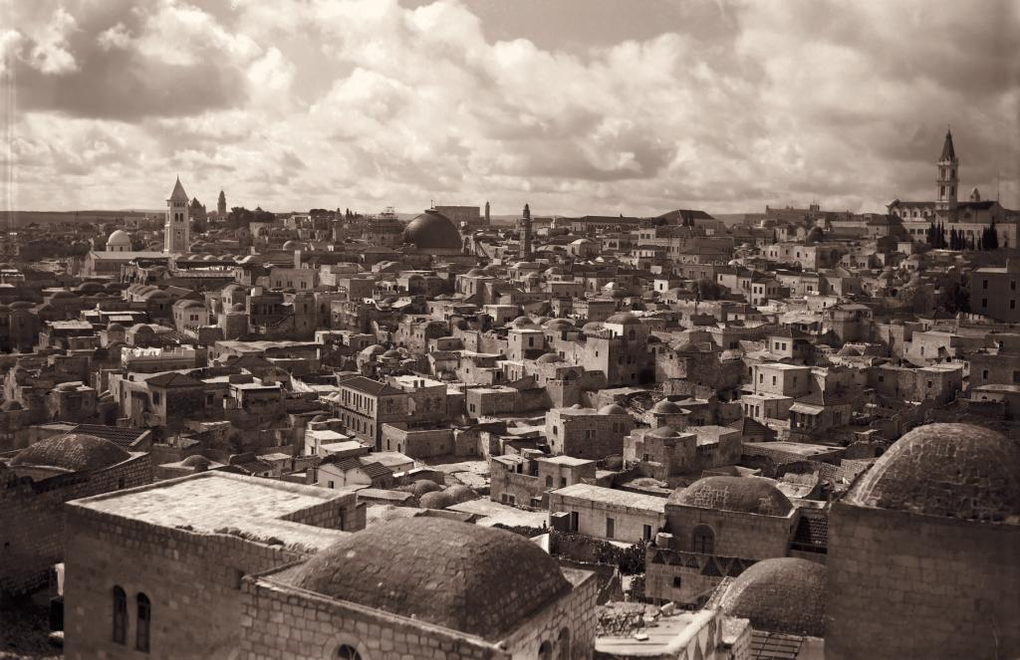

Slide 9
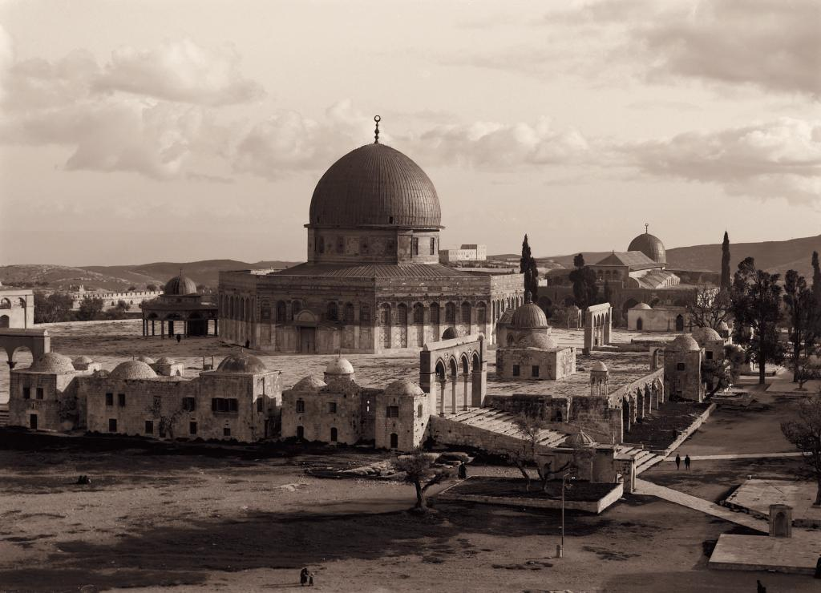

Slide 10
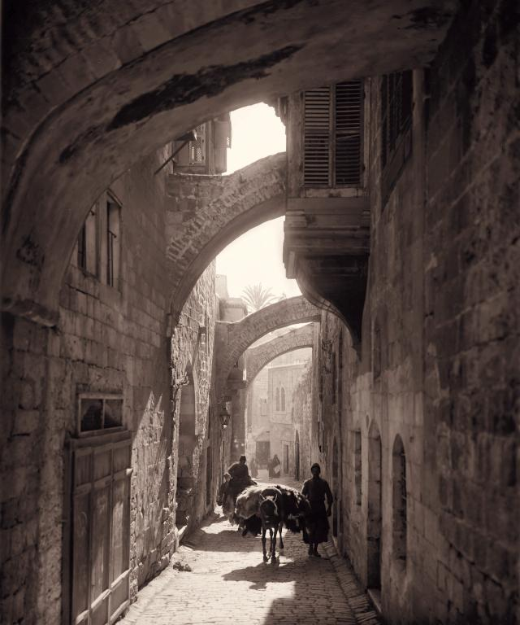

Slide 11
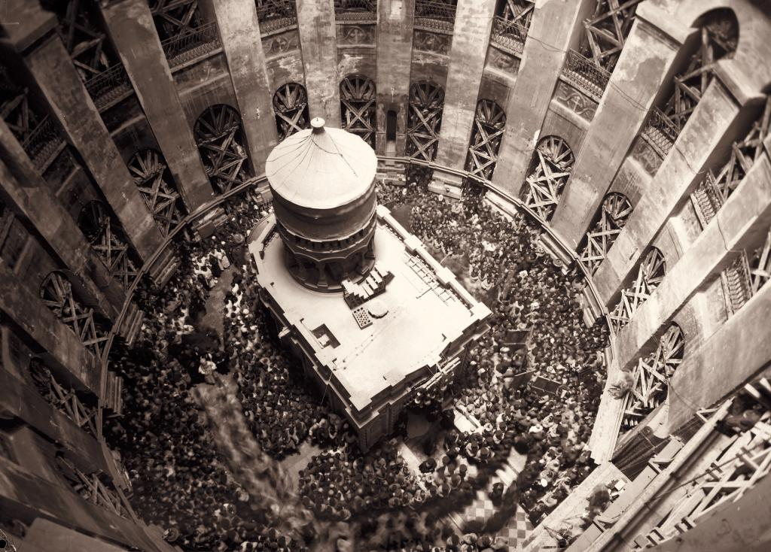

Slide 12
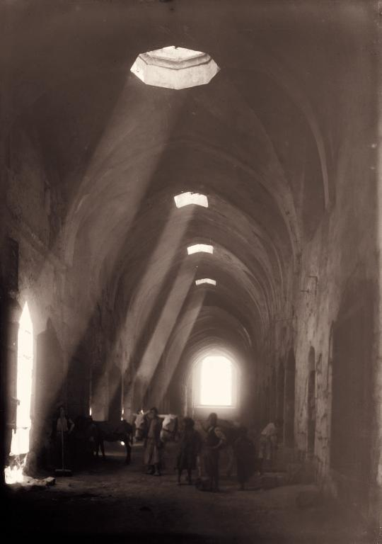

Slide 13
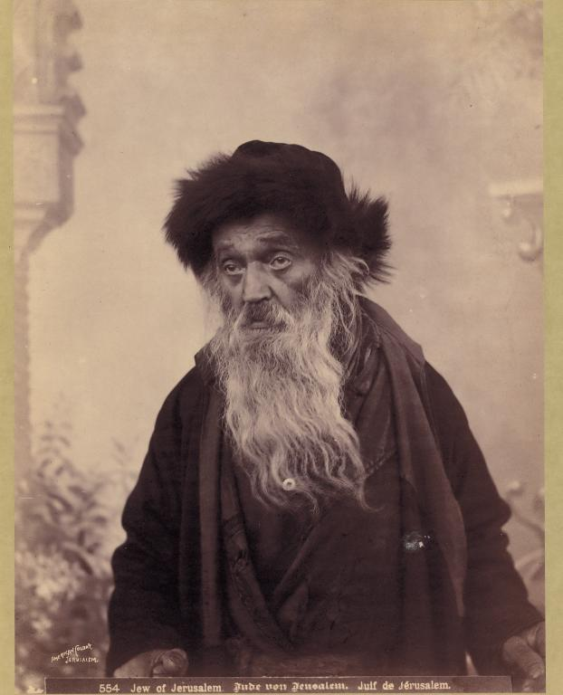

Slide 14
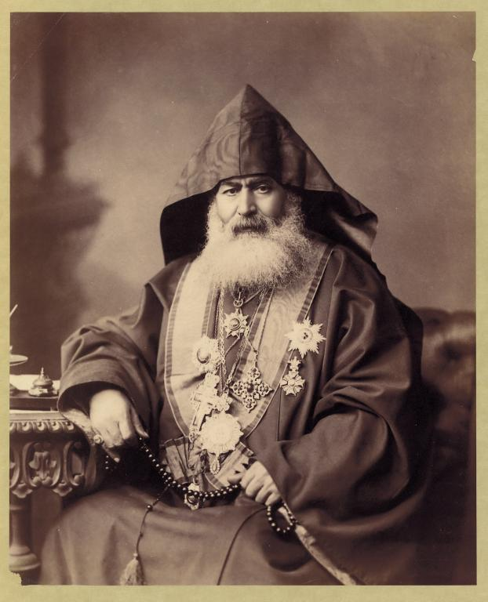

Slide 15
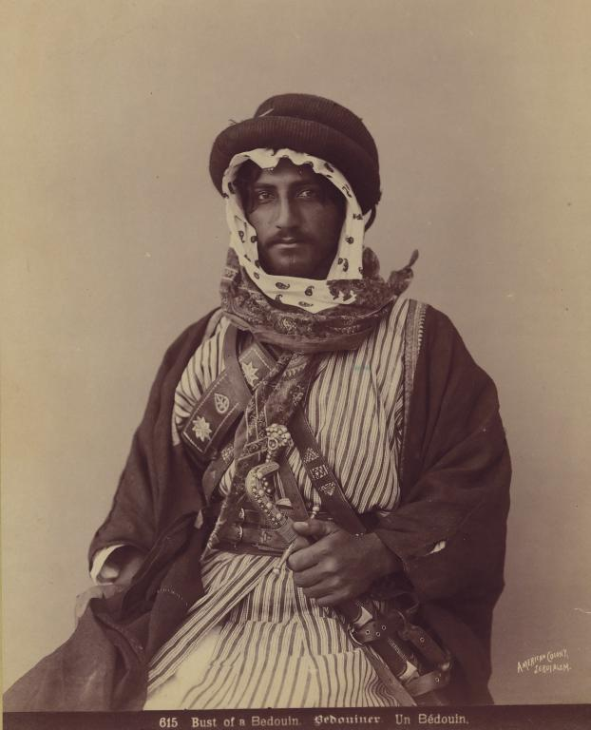

Slide 16
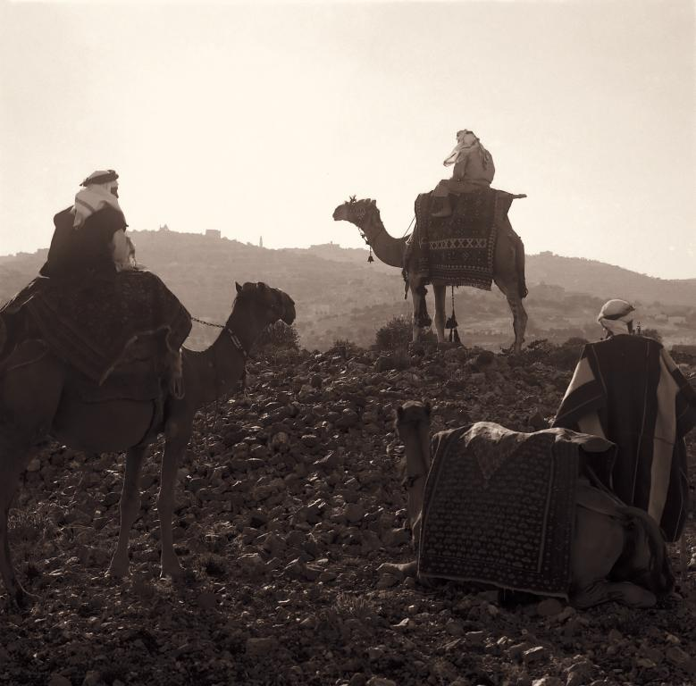

Slide 17
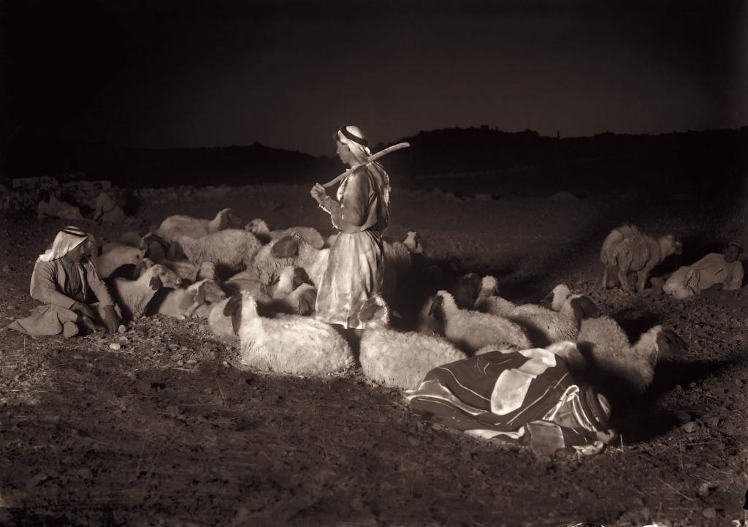

Slide 18
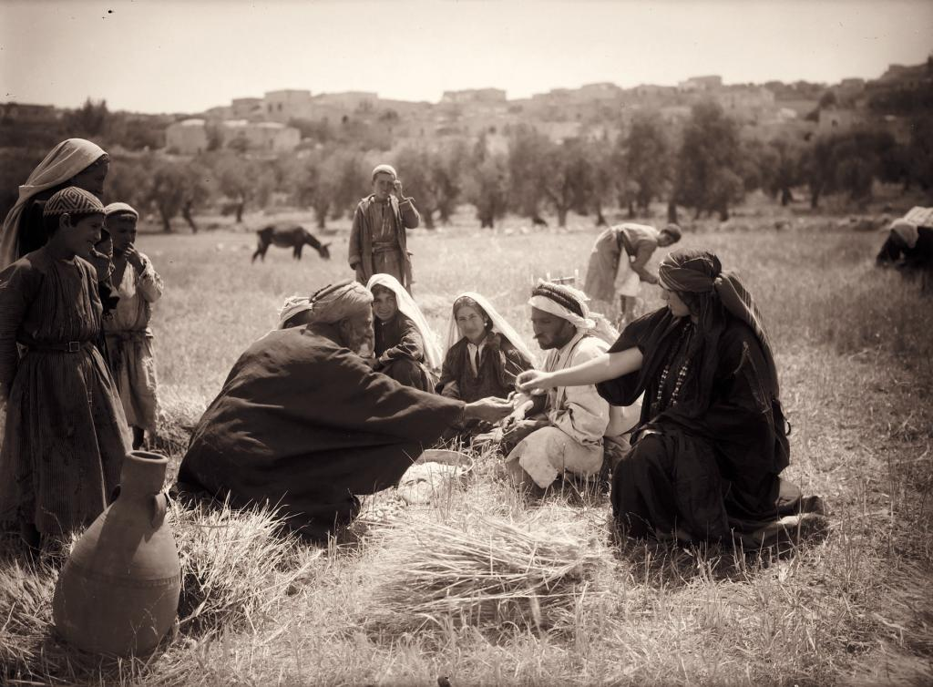

Slide 19
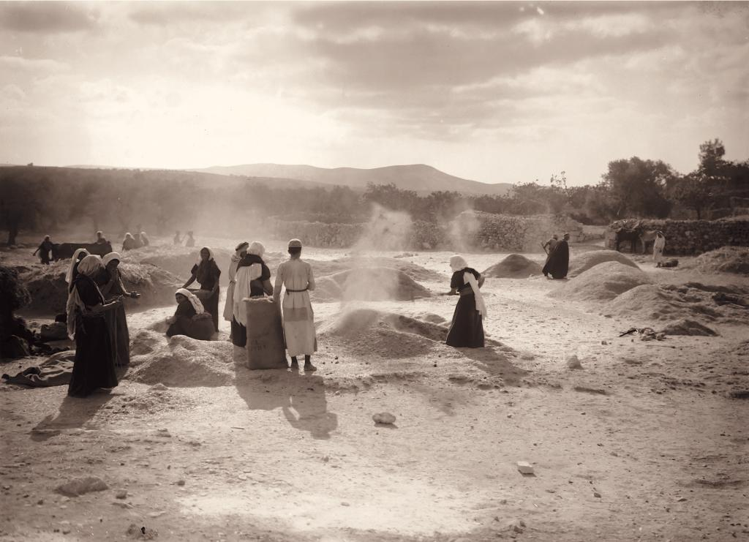

Slide 20
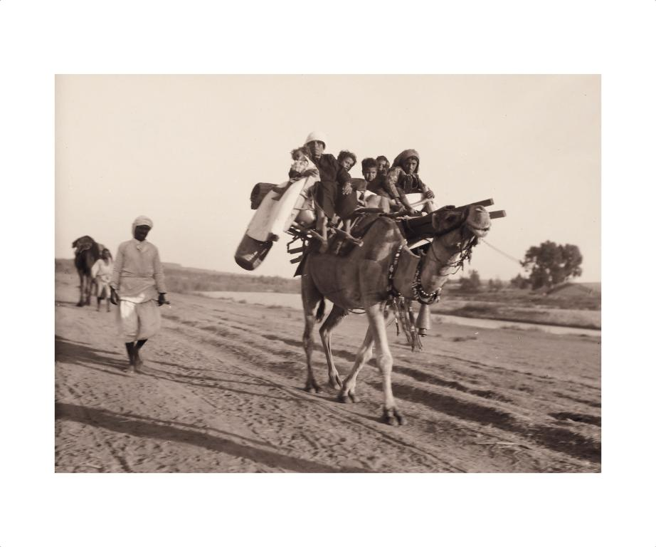

Slide 21
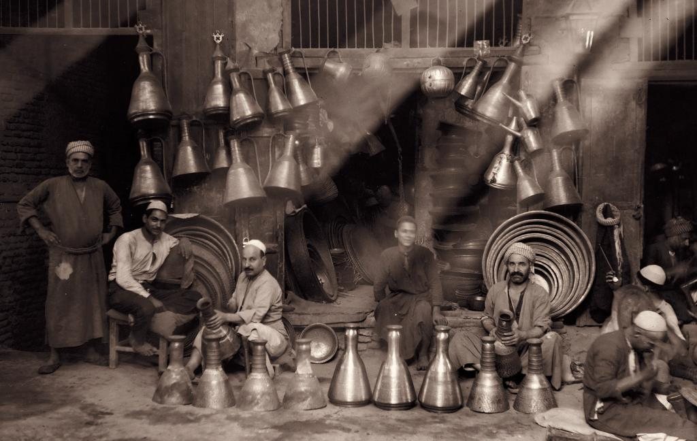

Slide 22
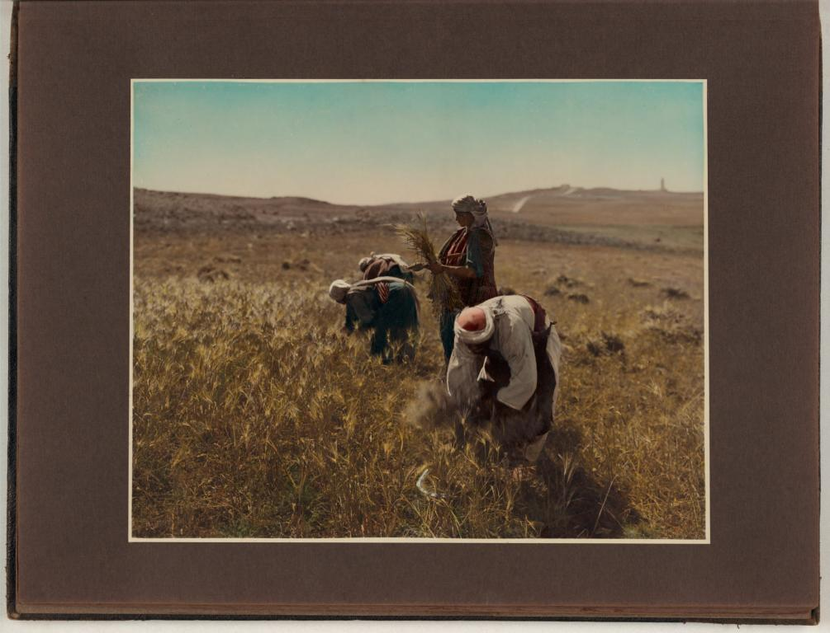

Slide 23
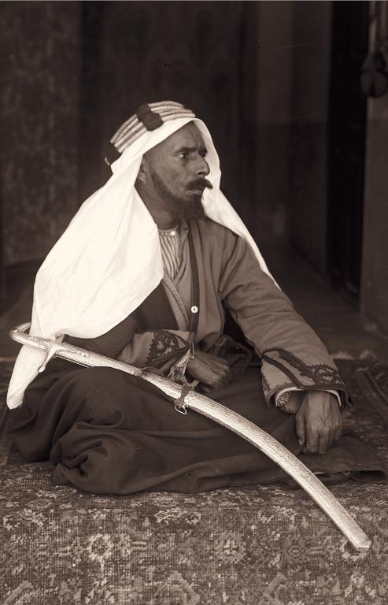
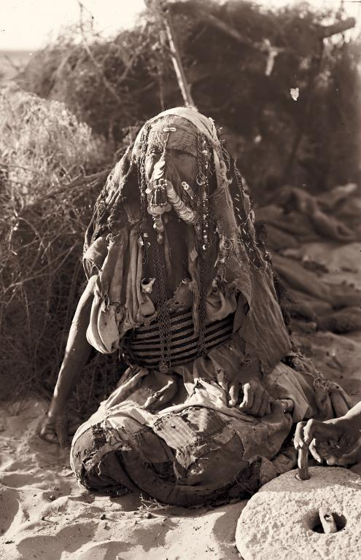

Slide 24
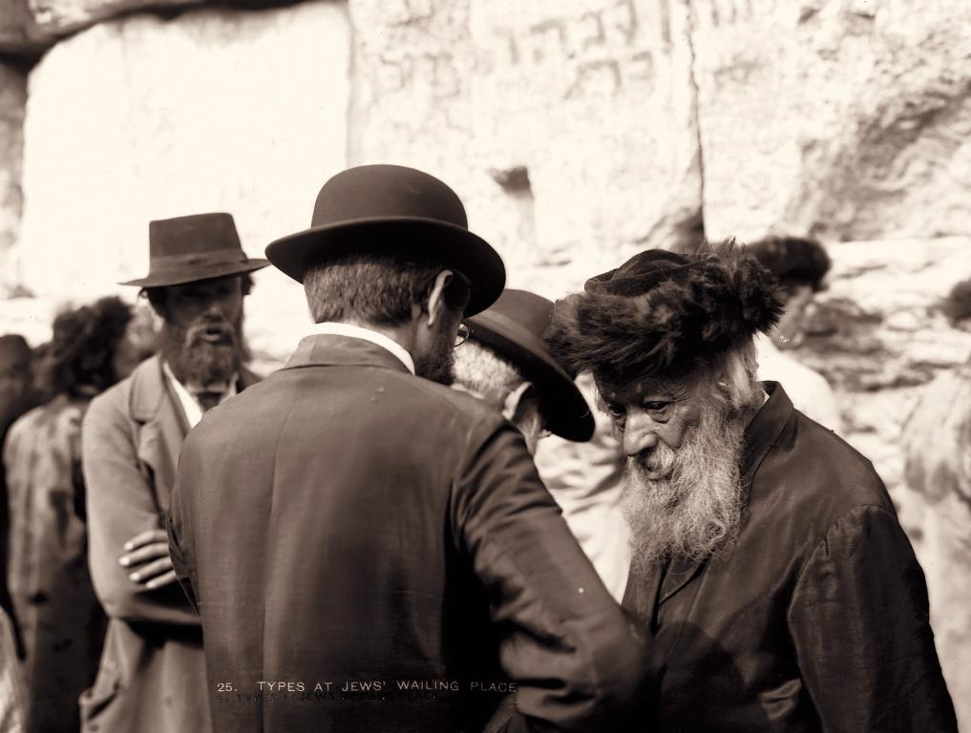

Slide 25
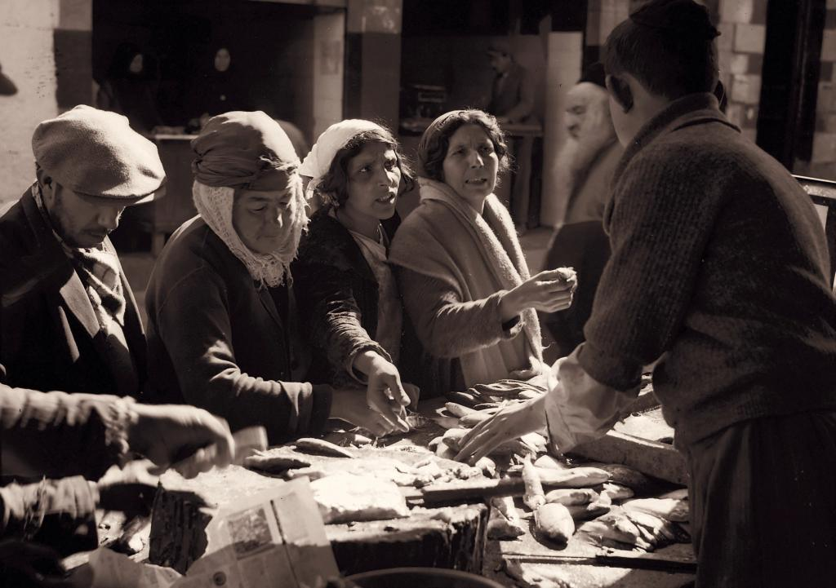

Slide 26
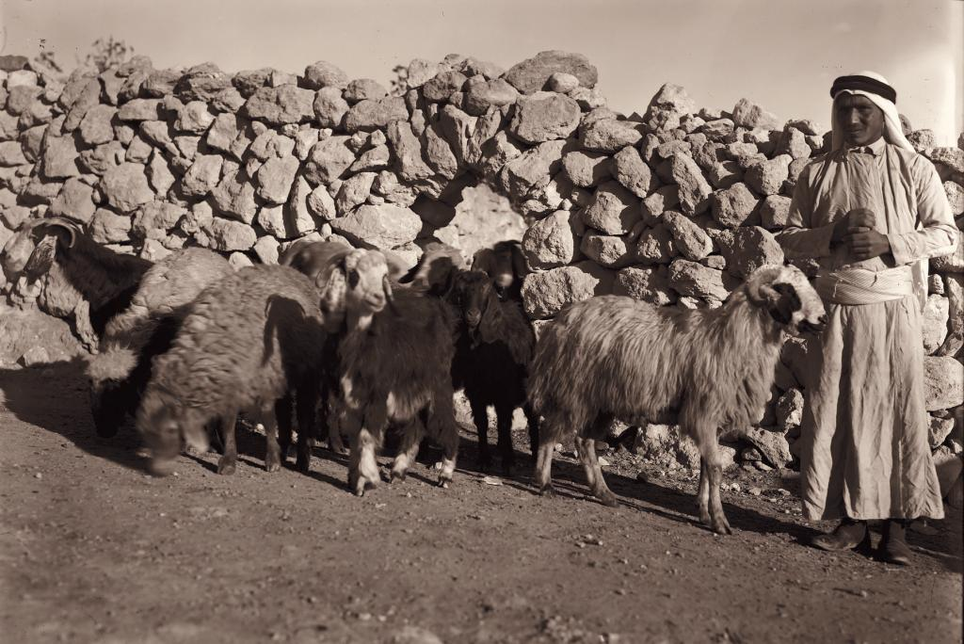

Slide 27
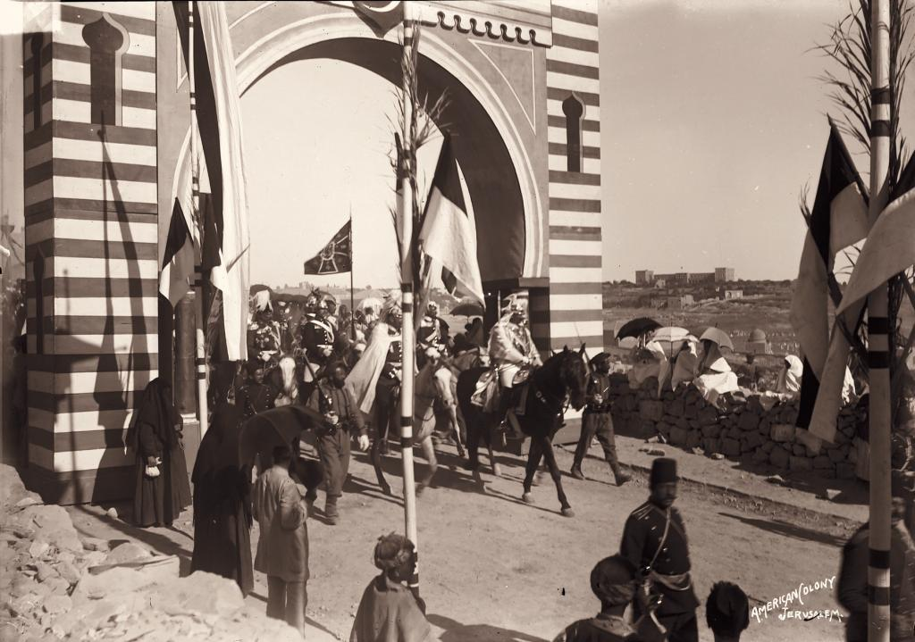
1898 – Visit of Kaiser Wilhelm II.

Slide 28
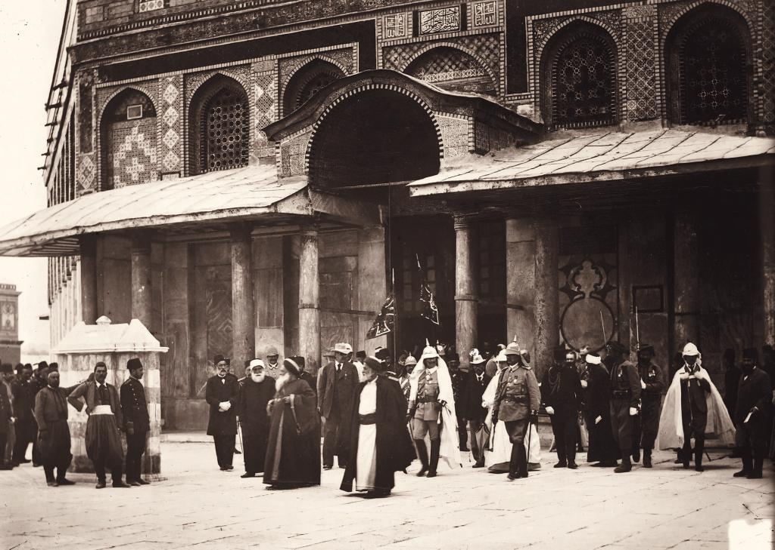

Slide 29
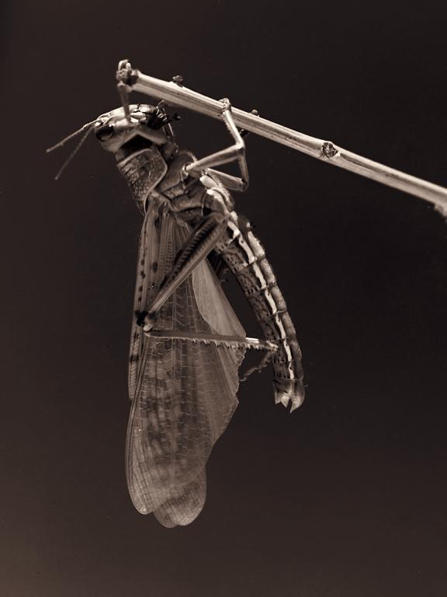
1915 - The terrible plague of locusts in Palestine

Slide 30
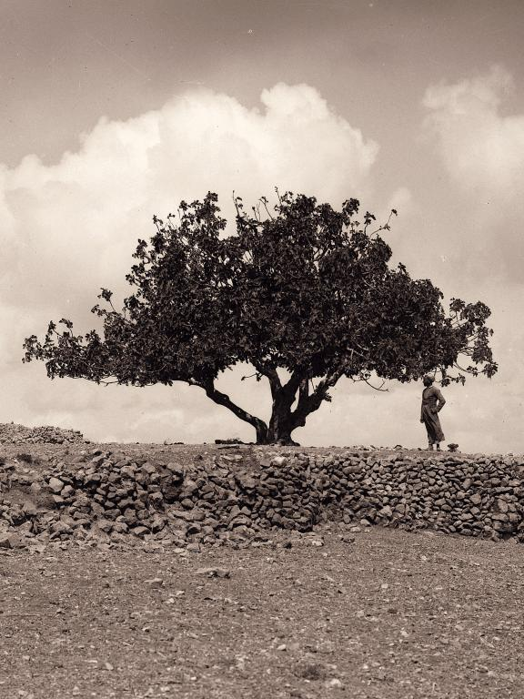

Slide 31
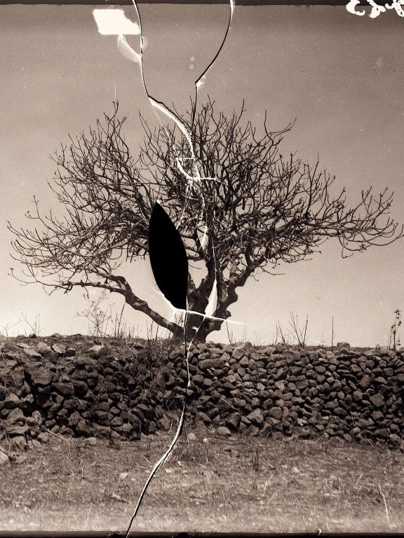

Slide 32
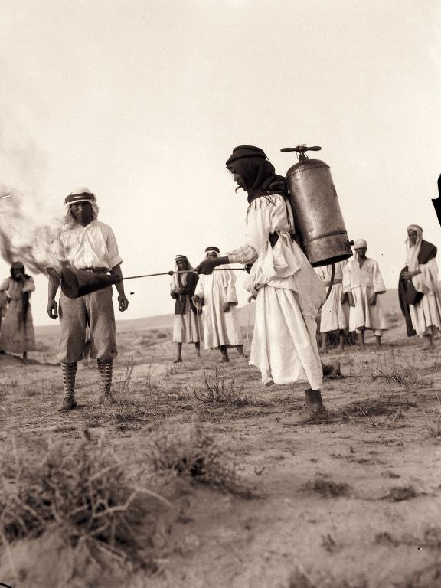

Slide 33
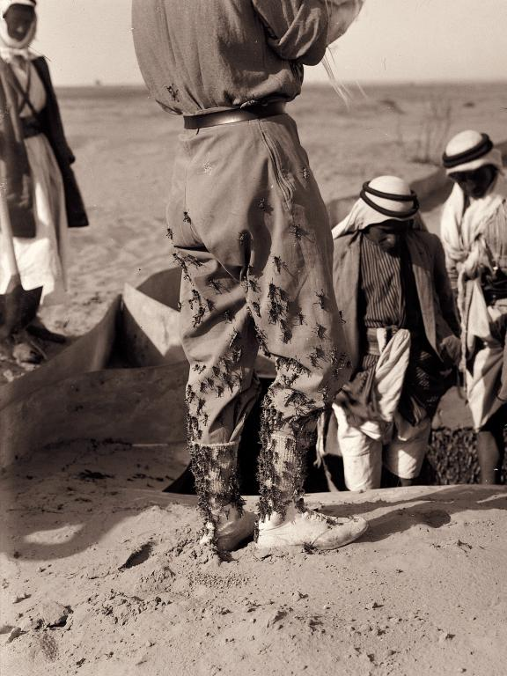

Slide 34
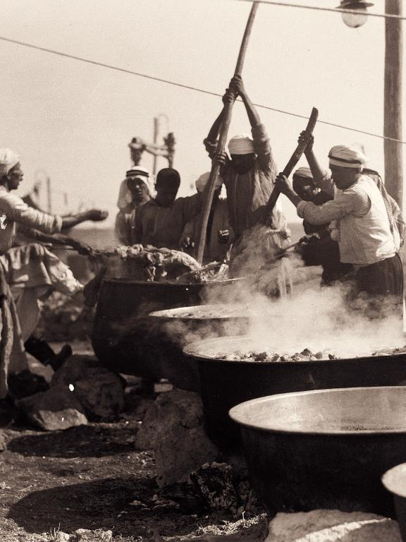

Slide 35
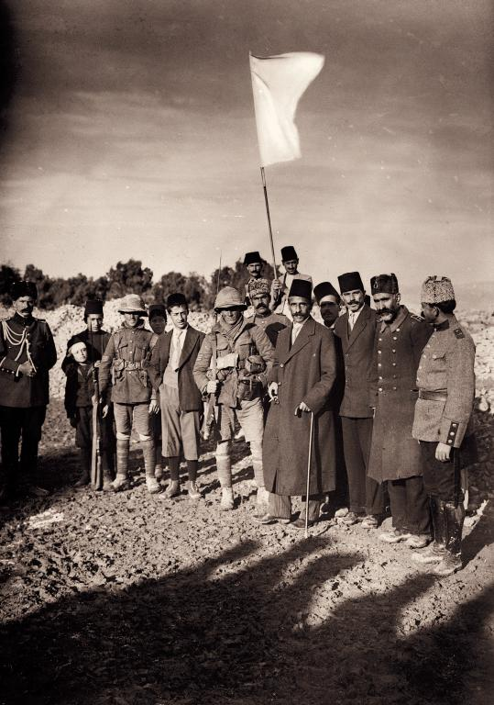
1917 – The surrender of Jerusalem to the British.

Slide 36
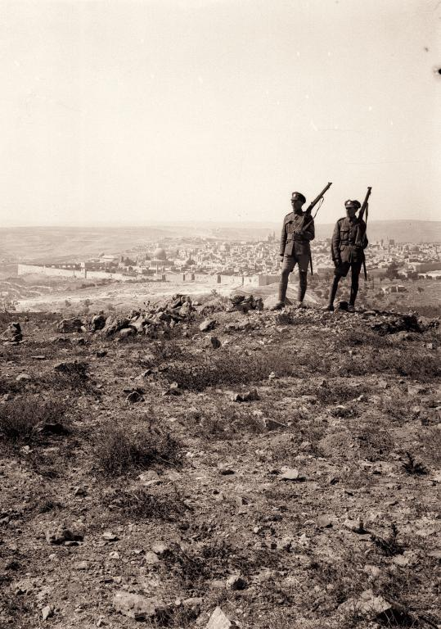

Slide 37
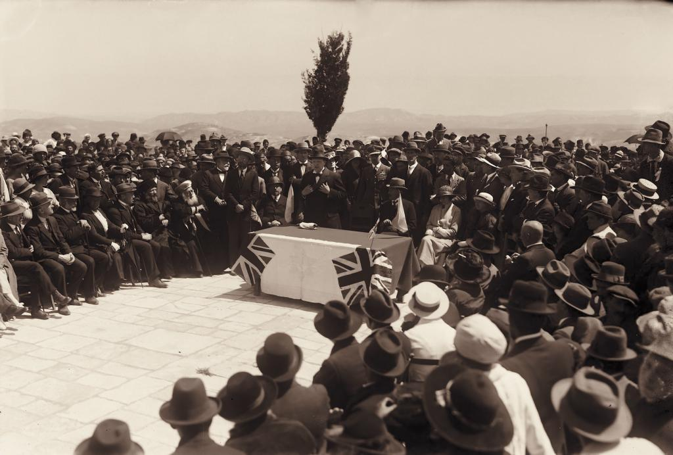
1921 – Winston Churchill at tree planting ceremony, on site of Hebrew University, Mount Scopus, Jerusalem.

Slide 38
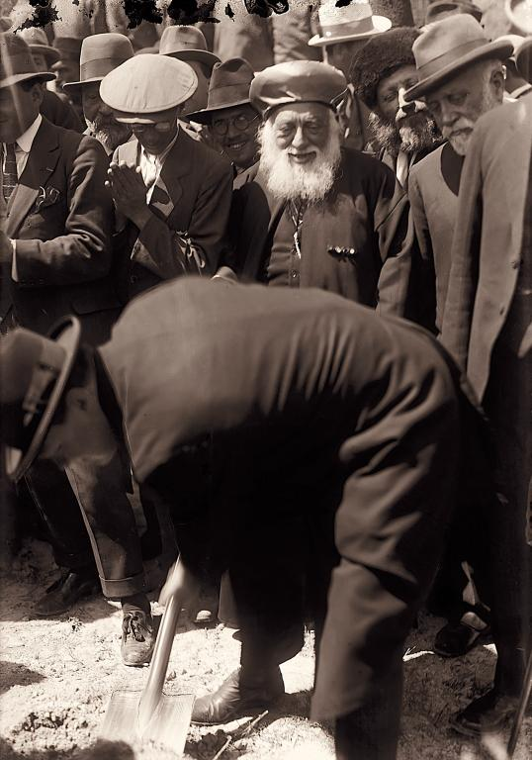

Slide 39
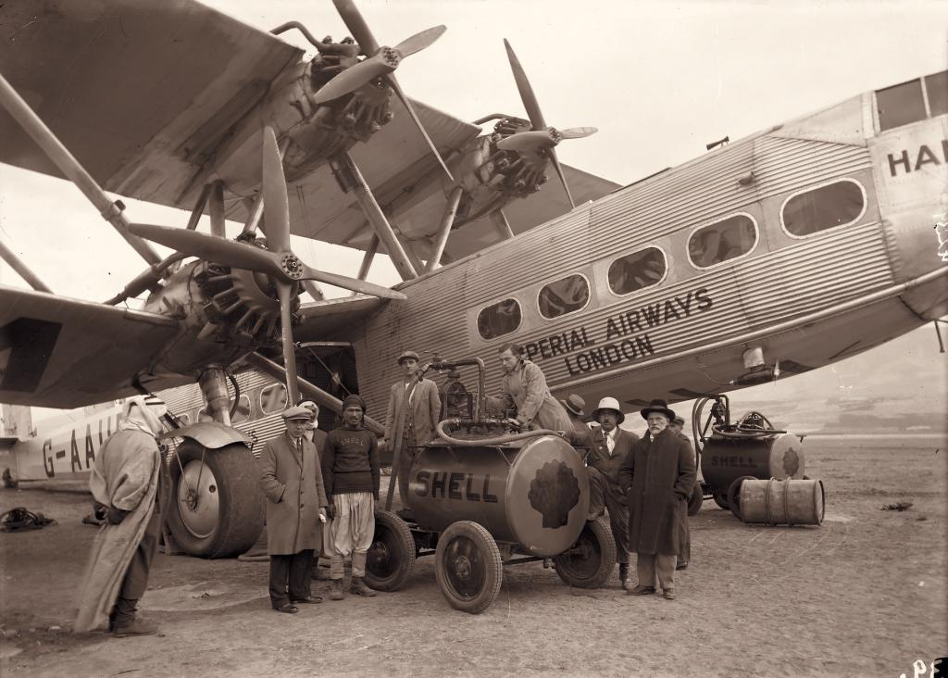
1936 – East African trip taken with Imperial Airways

Slide 40
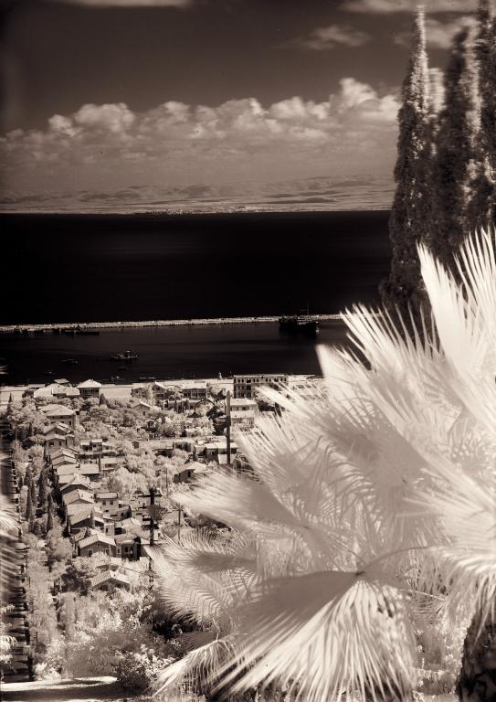

Slide 41
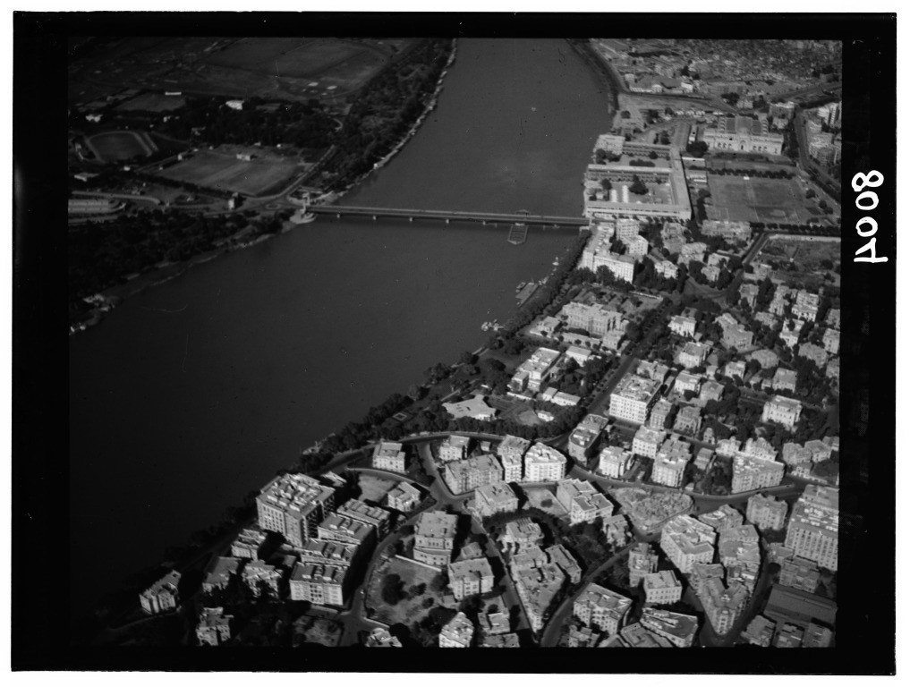

Slide 42
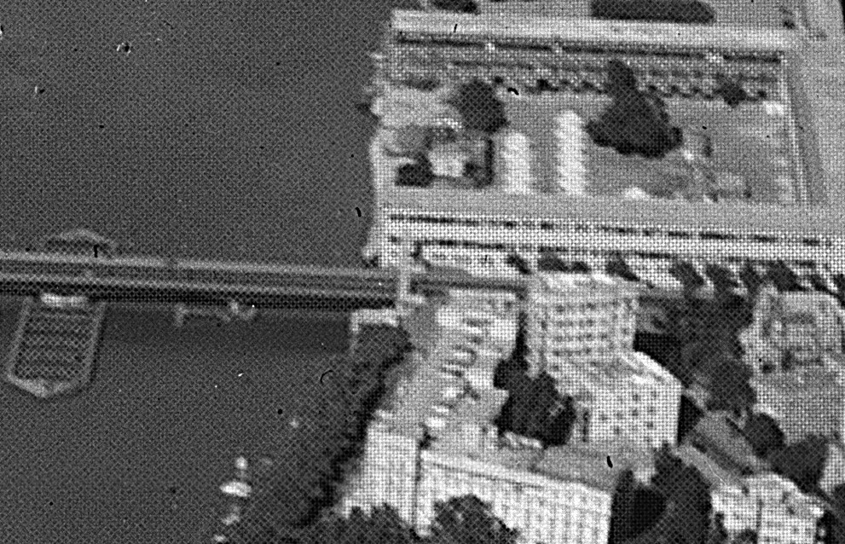

Slide 43


Finlaycolour
Clare L. Finlay
1909 „Thames plate“
1929 „Finlaycolour“
Taking screens to be used in camera with panchromatic negative.
Resulting negative is copied to transparency and viewing screen is attached.

Slide 44
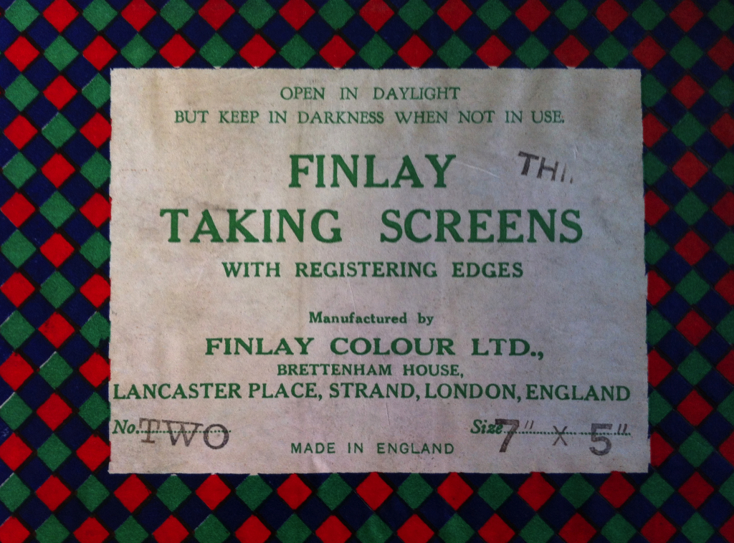

Slide 45
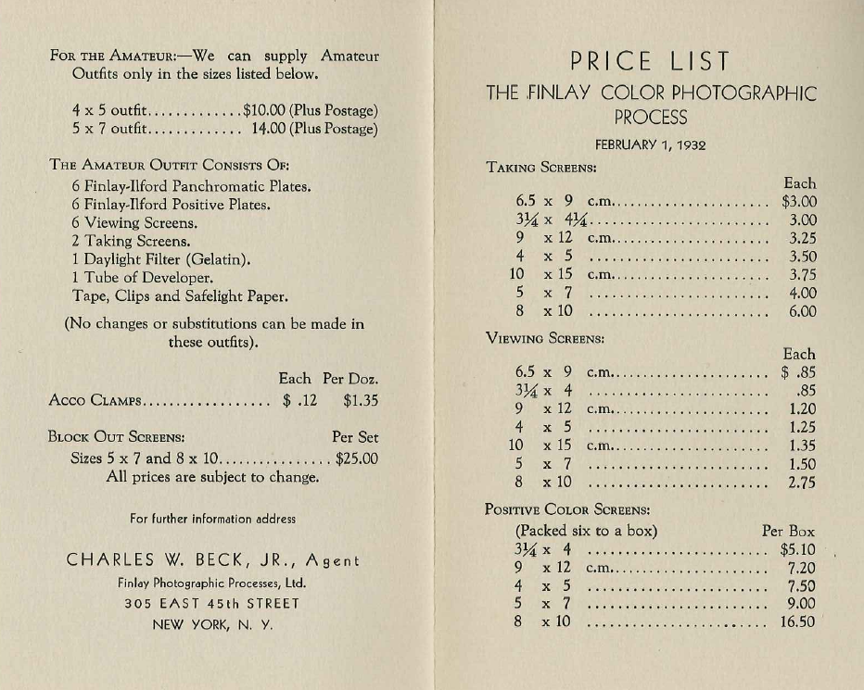

Slide 46
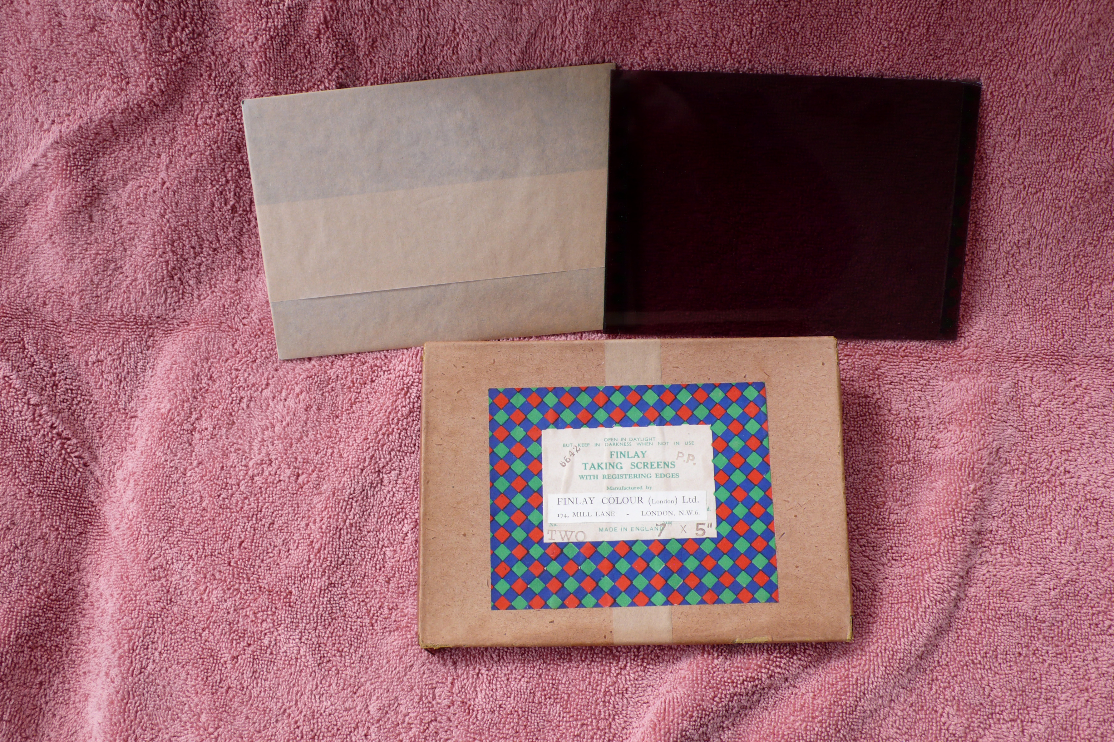

Slide 47


Detail 0.21mm

Slide 48
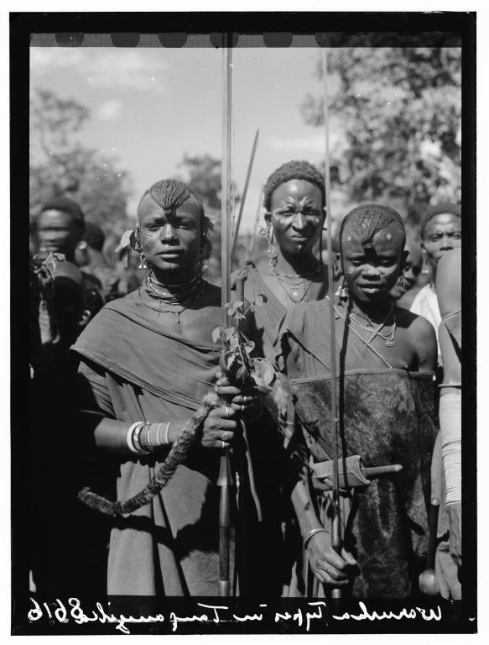
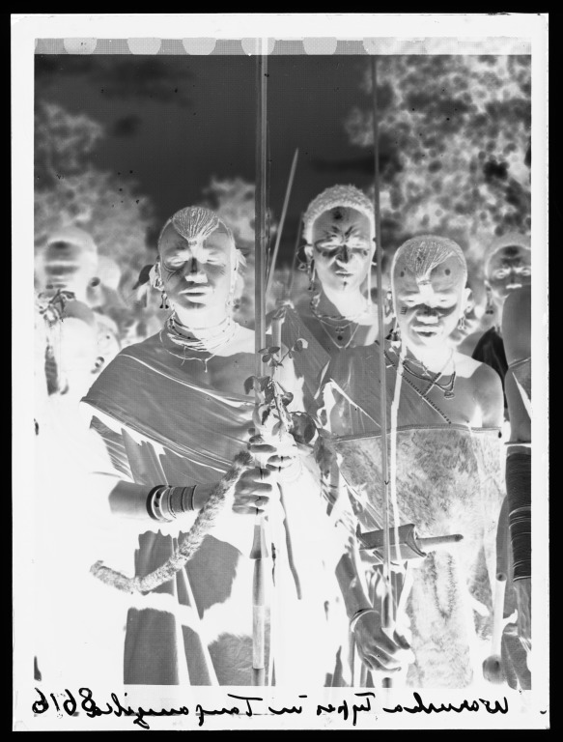

Slide 50
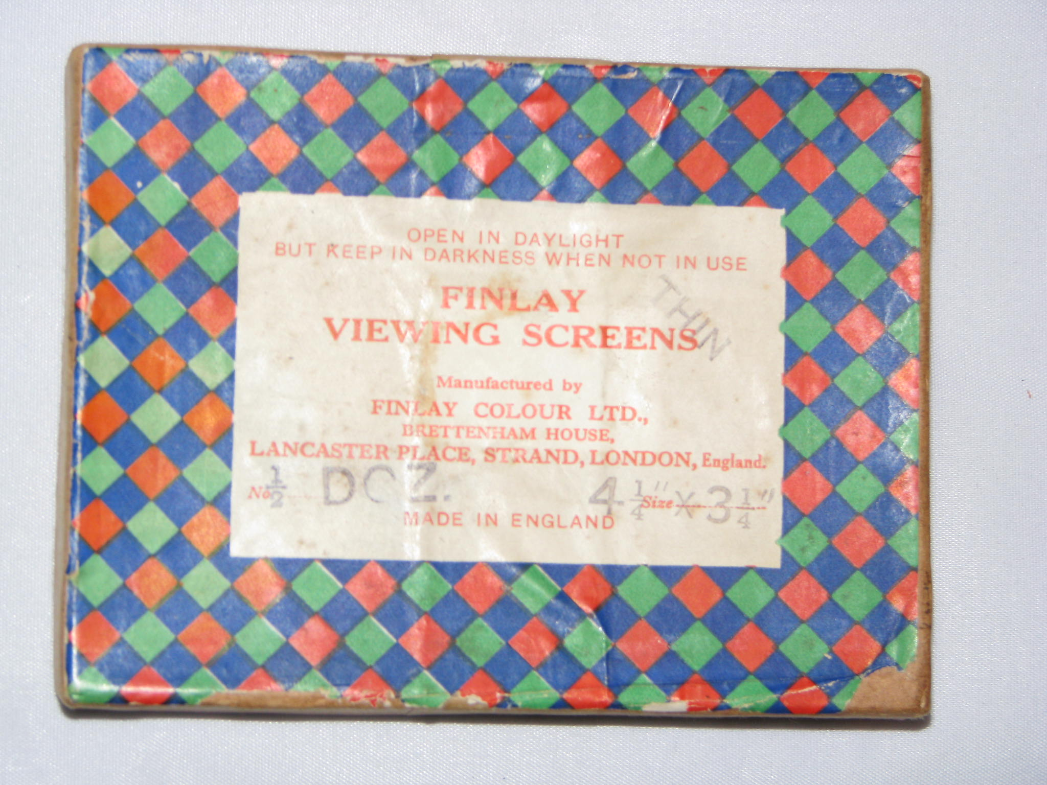

Slide 51
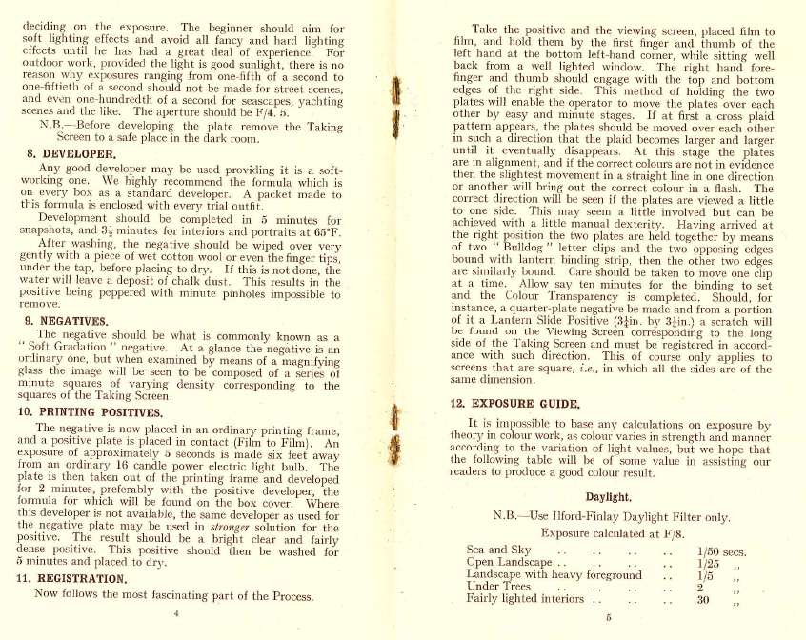

Slide 52
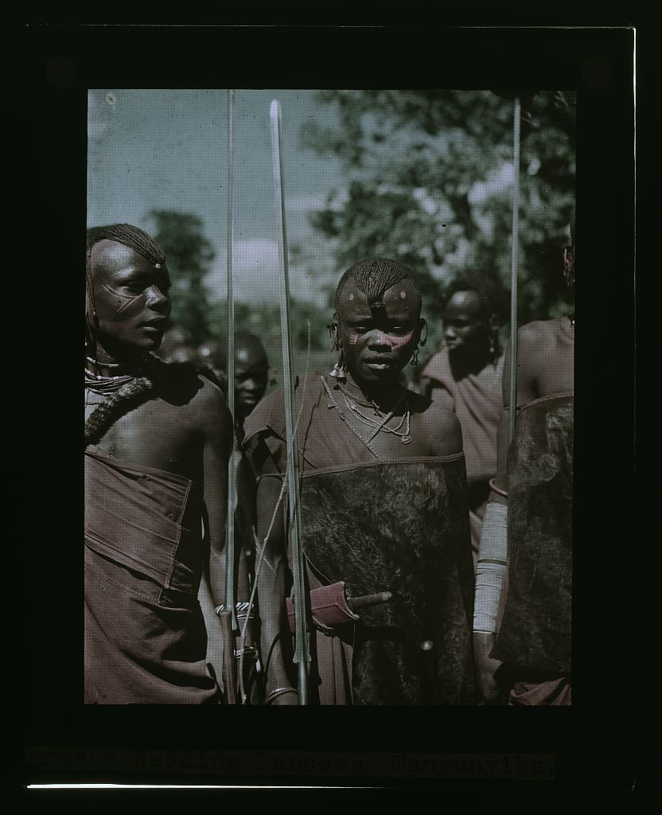

Slide 53


Aligning viewing screen
Find registration marks
Align left top corner
Hold by thumb top left corner and slowly rotate until the color squares disappear

Slide 54
3 degrees of freedom

Slide 55

Digital tool for adding the viewing screen
Nástroj na přidávání filtru digitálně

Slide 56
7 degrees of freedom?
hozirontal shift
vertical shift
rotation
horizontal scretch
vertical scretch
horizontal tilt
vertical tilt

Slide 57


Documenting digitization
Dokumentace digitalizci
During 2004 and 2005, JJT, Inc., of Austin, Texas, scanned the Matson Negatives. They used an overhead Sinar 54 digital camera to scan more than 13,700 glass negatives (measuring in sizes ranging between 4 x 5 inches or smaller and 10 x 12 inches). The images were captured in grayscale at a spatial resolution of approximately 5,000 pixels on the long side and a tonal resolution of 8 bits per pixel.
Spatial Resolution: 5,000 pixels on the long side with the short side scaled in proportion for file names ending in u.tif (10-73 megabytes)
Tonal (pixel depth) resolution: 8 bits per pixel (grayscale)
Image enhancement: None.
File format: TIFF

Slide 58



Approx. 8.750032x8.77628 pixels

Slide 60




Slide 61


Rendering final picture
Original
Digital

Slide 62



Sharpening / Doostření

Slide 63




Odstranění vzoru
Removing the pattern
Finlay screen filter 1929
Bayern filter, 1976

Slide 64



Bikubická interpolace
Bicubic interpolation

Slide 65



Slide 66


Slide 67
1936 – East African trip taken with Imperial Airways,
Finlay Colour pictures

Slide 68

Egypt. Cairo. Along the river, south of Kasr el-Nil

Slide 69


Slide 70

Egypt. Cairo. Rhoda Island

Slide 72

Egypt. Cairo. Rhoda Island

Slide 74


Slide 76

Egypt. Thebes, to southern border of Egypt. Temple of Deir El Bahre

Slide 78


Slide 80

Sudan. Khartoum. The palace from across the lawn

Slide 82


Slide 84

Sudan. Khartoum. Khartoum Zoo.
The Red Bill (Ephippiorhynchus senegalensis)

Slide 86

Sudan. Khartoum. Main mosque

Slide 88

Sudan. Omdurman. The main
mosque. The main entrance

Slide 90

Sudan. Omdurman. In the Khalifa's house.
The caretaker; typical of Mahdi's followers

Slide 92

Uganda. Entebbe. Government House
from across the lawn. Nubian guard

Slide 94

Sudan. Khartoum. Roman Catholic cathedral

Slide 96

Uganda. Bush fires

Slide 98

Uganda. From Hoima to Fort Portal.
Uganda boy and girl carrying jars

Slide 100

Uganda. From Hoima to Fort Portal.
Native types on Fort Portal Road

Slide 102


Slide 104


Slide 106

Kenya Colony. Nairobi. The Indian mosque

Slide 108

Kenya Colony. Rift Valley and en route
to Nairobi. The Thomsons Falls

Slide 110

Kenya Colony. Rift Valley and en route to Nairobi. In the Rift Valley. Lake Naivasha in distance. Mentioned in the writings of Rider Haggard

Slide 112


Slide 113

Kenya Colony. Nairobi. The Salisbury Hotel

Slide 115

Kenya Colony. Karatina. Native market under large trees

Slide 117

Kenya Colony. Plantations in Kenya colony.
Native woman picking coffee; with baby on her back

Slide 119

Kenya Colony. Karatina. Wakikuyu types. Men and women

Slide 121

Zanzibar. Native huts among the palms

Slide 123

Zanzibar. Garden of pineapples

Slide 125

Zanzibar. Banana stand in the market

Slide 127

Tanganyika. En route to Longido.
Longido girls with large ear ornaments

Slide 128

2010 rendering
2017 rendering

Slide 129

Tanganyika. En route to Longido.
Two girls loaded with brilliant neck rings

Slide 131

Uganda. Kampala. Two
soldiers on Jinja Road.s

Slide 132


Slide 133
Unsolved problems
Is it possible to recognize registration marks automatically?
Removal of regular pattern
ICC profile of Finlay filters
Automatical correction of geometrical problems of the scan
Is it possible to use infrared to scan finlay positives without the screen?

Slide 134
Future plans
Solve registration problem with Epson V750 scans
WWW exhibition at
http://sechtl-vosecek.ucw.cz/
Official release of the alignment tool

Slide 135
Thank you

