Slide 1
Izveštaj
Mentor: Natalija Dimić
Student: Matija Janić

Slide 2

Optimizacija brzine prenosa
podataka izmedju Host-a i
Guest virtuelne mašine

Slide 3


Optimizacija
Socket python modul
Rsync

Slide 4
Optimizacija / socket
Socket modul definiše Klijent - Server komunikaciju
’Soket’ je definisan IP adresom i portom: 192.168.100.100 : 95
Dva tipa soketa: SOCK_STREAM (TCP), SOCK_DGRAM (UDP)
UDP nepovoljan za prenos fajlova (gubici)

Slide 5
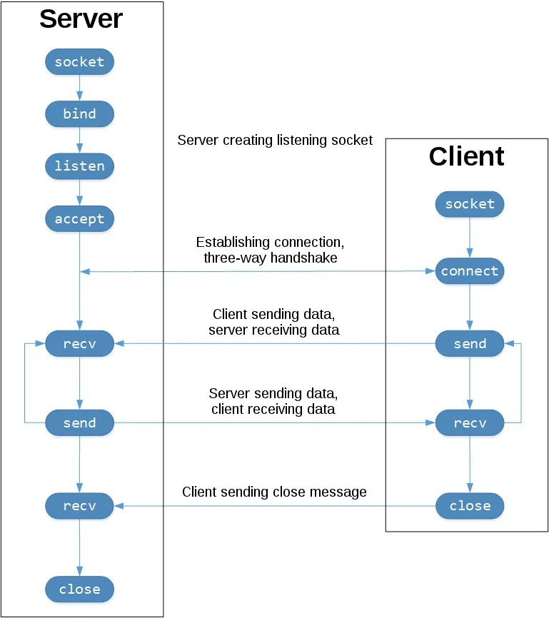
Optimizacija / socket / TCP
Pouzdan protokol (ACK, retransmisija)
Povećava prozor (cwnd) pri ACK
AIMD
Dozvoljeni algoritmi kontrole toka: cubic (podrazumevani i brži) i reno
TCP_NODELAY nema efekta na prenos
velikih podataka

Slide 6
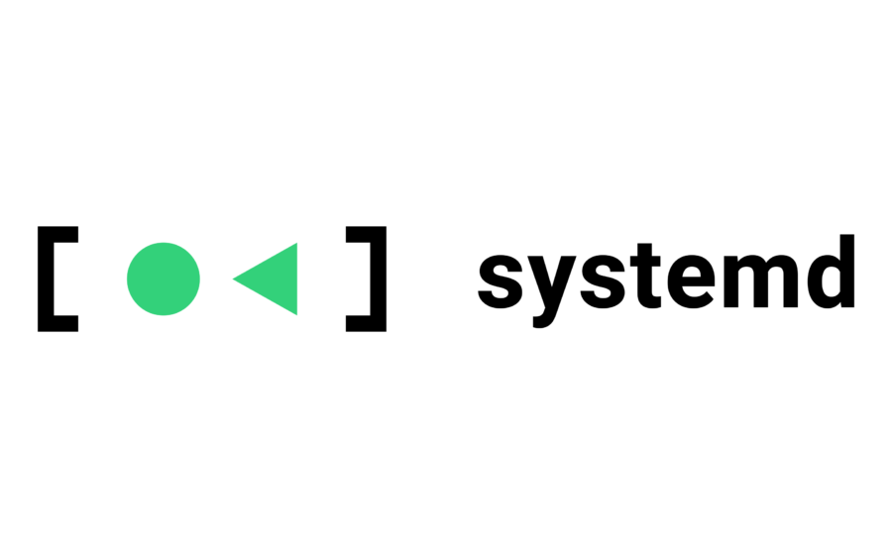

Optimizacija / socket / listening.service
Guest VM ’sluša’ kada se pokrene (Automatsko pokretanje skripte)
listening.service
[Unit] Description=Waiting Host After=network.target [Service] ExecStart=sudo /usr/bin/python3 dirFromHost.py WorkingDirectory=/bin StandardOutput=inherit StandardError=inherit Restart=always User=root [Install] WantedBy=multi-user.target
Koristi se systemd.service
listening.service se pokreće nakon startovanja
sistema (pokreće dirFromHost.py)
Guest u ulozi servera
$ sudo mv listening.service /etc/systemd/system
$ sudo mv dirFromHost.py /bin
$ sudo systemctl enable listening.service
$ sudo systemctl start listening.service

Slide 7
import platform import socket import os BUFF = 1_000_000_000 SERVER_HOST = "0.0.0.0" # any PORT = 9999 def recv_dir(folder, sock): from_client = sock os.makedirs(folder, exist_ok=True) with from_client, from_client.makefile('rb') as serverfile: while True: raw = serverfile.readline() if not raw: break filename = raw.strip().decode() length = int(serverfile.readline()) path = os.path.join(folder, filename) os.makedirs(os.path.dirname(path), exist_ok=True) with open(path, 'wb') as f: while length: buf = min(length, BUFF) data = serverfile.read(buf) if not data: break f.write(data) length -= len(data) else: continue from_client.close()
dirFromHost.py (Guest)
def main(): folder = '' # print(platform.uname().system) if platform.uname().system == 'Windows': folder = 'C:/ProgramData/tempdir/data' elif platform.uname().system == 'Ubuntu': folder = '/tempdir/data' server_sock = socket.socket() try: server_sock.setsockopt(socket.SOL_SOCKET, socket.SO_REUSEADDR, 1) server_sock.setsockopt(socket.SOL_SOCKET, socket.SO_RCVBUF, BUFF) server_sock.bind((SERVER_HOST, PORT)) server_sock.listen(65535) while True: client, address = server_sock.accept() recv_dir(folder, client) except: server_sock.close() if __name__ == "__main__": main()

Slide 8
import time import socket import os import subprocess start = time.time() BUFF = 1_000_000_000 HOST = "192.168.122.17" HOST2 = "192.168.100.231" HOSTWIN = "192.168.1.5" PORT = 9999
def active_ips(): addresses = [] command = 'virsh list --name' vms = str(subprocess.check_output(command.split()).decode("utf-8")).splitlines() for i in range(0, len(vms) - 1): command = 'virsh domifaddr ' + str(vms[i]) info = (str(subprocess.check_output(command.split()).decode("utf-8"))).splitlines() for i in range(2, len(info) - 1): addresses.append(info[i].split()[3].split('/')[0]) return addresses
dirToGuest.py
def send_dir(folder, sock): to_server = sock while True: with to_server: for path, dirs, files in os.walk(folder): for file in files: filename = os.path.join(path, file) relpath = os.path.relpath(filename, folder) filesize = os.path.getsize(filename) print(f'Sending {relpath}') with open(filename, 'rb') as f: to_server.sendall(relpath.encode() + b'\n') to_server.sendall(str(filesize).encode() + b'\n') while True: data = f.read(BUFF) if not data: break to_server.sendall(data) print('Done.') break
def main(): start_time = start send_to = [HOSTWIN] # send_to = active_ips() print(send_to) for ip in send_to: print(ip) client_sock = socket.socket() client_sock.setsockopt(socket.SOL_SOCKET, socket.SO_REUSEADDR, 1) client_sock.setsockopt( socket.SOL_SOCKET, socket.SO_SNDBUF, BUFF) client_sock.connect((ip, PORT)) send_dir('../data2', client_sock) client_sock.close() print(time.time() - start_time, end="\n\n") start_time = time.time() print(time.time() - start) if __name__ == "__main__": main()

Slide 9
Optimizacija / rsync
Rsync je alat koji se koristi za sinhronizaciju
Povoljniji za slučajeve gde se izvorna i odredišna destinacija razlikuju
u pojedinim folderima/fajlovima
Preduslov je omogućen ssh
Za Linux -> Windows se moraju koristiti pomoćni alati (cygwin, wsl )
Može se realizovati kao shell skripta

Slide 10
import sys import time import os import subprocess def active_ips(): addresses = [] command = 'virsh list --name' vms = str(subprocess.check_output(command.split()).decode("utf-8")).splitlines() for i in range(0, len(vms) - 1): command = 'virsh domifaddr ' + str(vms[i]) info = (str(subprocess.check_output(command.split()).decode("utf-8"))).splitlines() for j in range(2, len(info) - 1): addresses.append(info[j].split()[3].split('/')[0]) return addresses def main(): start = time.time() start_time = start if len(sys.argv) > 1 and os.path.isdir(sys.argv[1]): send_to = active_ips() print(send_to) for ip in send_to: print(ip) com = "rsync -a " + sys.argv[1] + " root@" + ip + ":/tempdir2" # os.system(com) subprocess.run(com.split()) print(time.time() - start_time, end="\n\n") start_time = time.time() print(time.time() - start) return print('rsync needs a path as argument') if __name__ == "__main__": main() # example: python3 rsyncToGuest.py /home/matija/Projects/socket-test/socket-test/data

Slide 11
Optimizacija / protokoli
UDT
Tsunami

Slide 12



Automatska sinhronizacija file servera

Slide 13
Sinhronizacija
PySyncIt
Dirsync

Slide 14

systemd.timer
[Unit] Description=Sync daily [Timer] OnCalendar=*-*-* 00:00:01 Unit=sync.service Persistent=true [Install] WantedBy=timers.target
[Unit] Description=Starting sync Wants=sync.timer [Service] Type=oneshot ExecStart=sudo /usr/bin/python3 sync.py WorkingDirectory=/bin User=root

Slide 15
Alternativa: Crontab

Slide 16
Hvala na pažnji!

