Slide 1
Approximation Algorithms
Advanced Algorithms Mark Floryan CLRS Ch. 35

Slide 2
Advanced Tree Structures
In this deck we will look at:
- Approximation Ratios - Vertex Cover Approximation - TSP Approximation - Set-Covering Approximation - Randomization and Linear Programming (maybe)

Slide 3
Introduction: Approximation

Slide 4


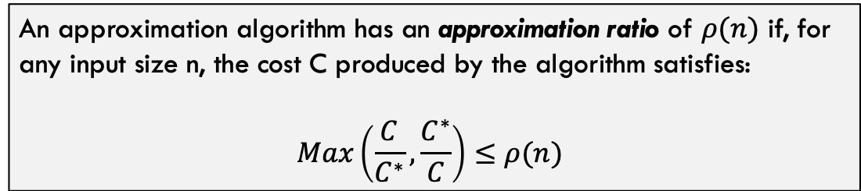

Approximation Ratios
$C^{∗}$ = Optimal Solution
Approximation Algorithm to Some Optimization Problem
$C$ = Approximated Solution
Input
$$NOT optimal solution(s)$$
Often, this problem is NP-Hard
An approximation algorithm has an approximation ratio of $ρ(n)$ if, for any input size n, the cost C produced by the algorithm satisfies:
$$Max\left(\frac{C}{C^{∗}},\frac{C^{∗}}{C}\right)≤ρ(n)$$

Slide 5


Some Definitions
$ρ(n)$-Approximation Algorithm
An approximation algorithm that achieves an approximation of $ρ(n)$ on all inputs
Approximation Scheme
An approximation algorithm that takes as input the instance of the problem and a value $ε>0$ such that for any fixed $ε$, the scheme is a $(1+ε)$-approximation algorithm.
Polynomial Time Approximation Scheme
A scheme is polynomial time if, for any fixed $ε>0$, the algorithm runs in polynomial time in terms of the input size n
Fully Polynomial Time Approximation Scheme
A scheme is fully polynomial time if it has a runtime that is polynomial in terms of $\frac{1}{ε}$.
For example, a fully polynomial time approximation scheme might have runtime $Θ\left({\left(\frac{1}{ε}\right)}^{2}n^{2}\right)$

Slide 6
Vertex-Cover

Slide 7
Recall Vertex-Cover
Given a Graph $G=(V,E)$, find the smallest set of nodes $V^{′}⊂V | ∀_{e=\left(u,v\right)∈E} \left(u∈V^{′}∨v∈V^{′}\right)$
This problem is NP-Hard
b
c
d
a
e
f
g
In other words, find the smallest set of nodes that touches every edge at least once
The purple nodes are the smallest solution for this graph

Slide 8
Proposed Algorithm for Vertex-Cover
Vertex-Approximation(G):
C = []
E’ = G.E
while E’ not empty:
let e=(u,v) be arbitrary edge from E’
C = C.append({u,v})
remove all edges in E’ incident on u or v
return C
b
c
d
a
e
f
g
Run this on the given graph a few times. What is the approximation ratio? Do we have a guaranteed ratio here?

Slide 9
Sample Execution
b
c
d
b
c
d
a
e
f
g
a
e
f
g
b
c
d
b
c
d
a
e
f
g
a
e
f
g
…last step is on next slide

Slide 10
Sample Execution
b
c
d
a
e
f
g

Slide 11
Sample Execution
Vertex-Approximation(G):
C = []
E’ = G.E
while E’ not empty:
let e=(u,v) be arbitrary edge from E’
C = C.append({u,v})
remove all edges in E’ incident on u or v
return C
b
c
d
a
e
f
g
This is just one way it could have turned out. Any thoughts on the limits of “how bad” or “how good” the approximation will be?

Slide 12

Approx-Vert-Cover: Analysis
Runtime is polynomial? Yes, it is $O({\left|E\right|}^{2})$
For each edge e we choose on this line, the solution definitely includes u or v, we always add both
Vertex-Approximation(G):
C = []
E’ = G.E
while E’ not empty:
let e=(u,v) be arbitrary edge from E’
C = C.append(e)
remove all edges in E’ incident on u or v
return C
We remove as many extra edges as we can here, but of course there could be 0 each time.

Slide 13
Approx-Vert-Cover: Analysis
Claim: Vertex-Approximation is a 2-approximation of vertex cover
Proof Part 1 (Correctness): The nodes returned by this algorithm are a valid vertex cover
Vertex-Approximation(G):
C = []
E’ = G.E
while E’ not empty:
let e=(u,v) be arbitrary edge from E’
C = C.append({u,v})
remove all edges in E’ incident on u or v
return C
This is self-evident. Every edge in E is either chosen in line 4 and both it’s nodes added to the solution OR removed in line 6 being incident to u or v.
Thus, every edge is incident on some node in the set C because we do not terminate until E’ is empty.
The algorithm returns a valid vertex-cover

Slide 14
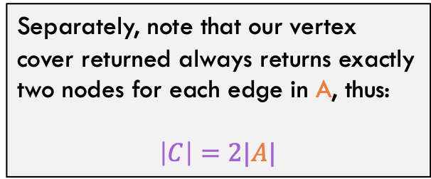
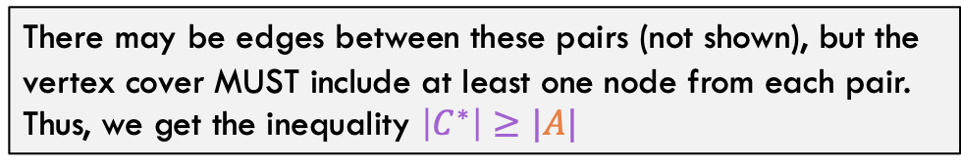

Approx-Vert-Cover: Analysis
Claim: Vertex-Approximation is a 2-approximation of vertex cover
Proof Part 2 (Ratio): The size of C is no more than twice the size of the optimal vertex-cover
Separately, note that our vertex cover returned always returns exactly two nodes for each edge in A, thus:
$$\left|C\right|=2|A|$$
Consider the set of edges A chosen in line 4 of the algorithm. Because other incident edges are removed in line 6, the lines in A form a set of disjoint pairs
a
b
c
d
e
f
Combining these equations we get:
$$\left|C\right|=2\left|A\right| \\ \left|C\right|≤2|C^{∗}|$$
There may be edges between these pairs (not shown), but the vertex cover MUST include at least one node from each pair. Thus, we get the inequality $\left|C^{∗}\right|≥|A|$

Slide 15
Traveling Salesperson

Slide 16
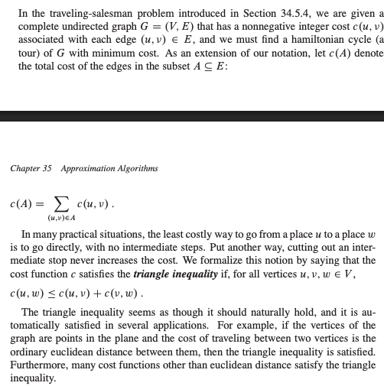
Recall Traveling SalesPerson Problem
How an example of the TSP problem…
Include triangle inequality assumption

Slide 17
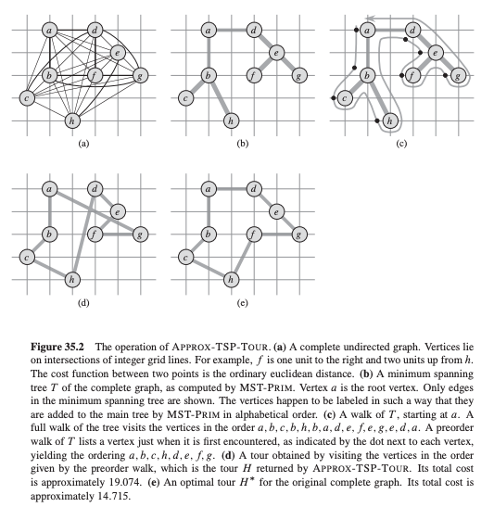
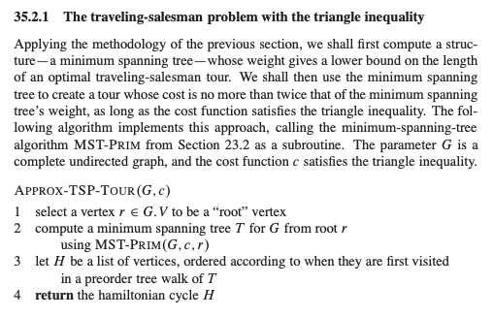
Approximation for TSP
Text Box

Slide 18
Approximation for TSP: Analysis
Runtime is polynomial? YES!!!

Slide 19
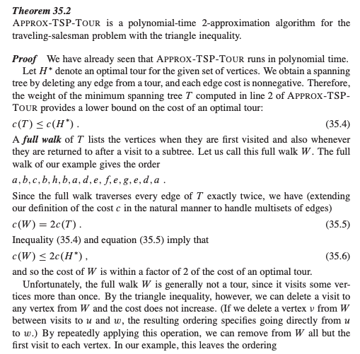
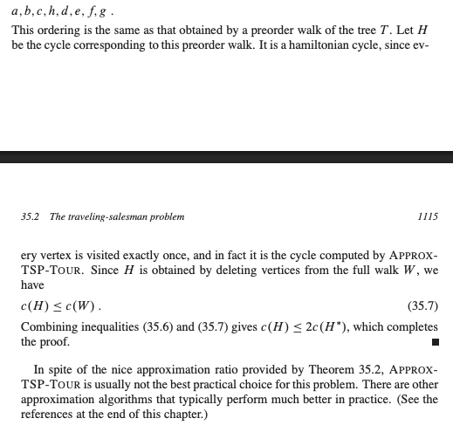
Approximation for TSP: Analysis
Approx ratio??

Slide 20
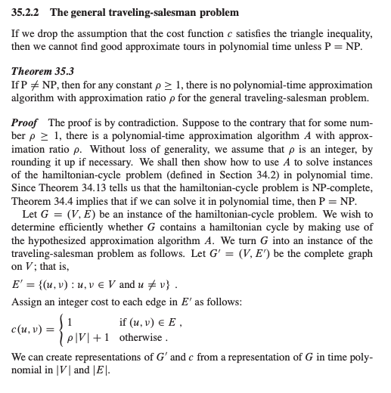
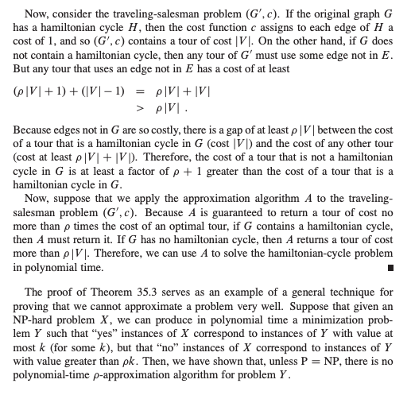
An Interesting Fact About This
Approx ratio??

Slide 21
Set Cover

Slide 22
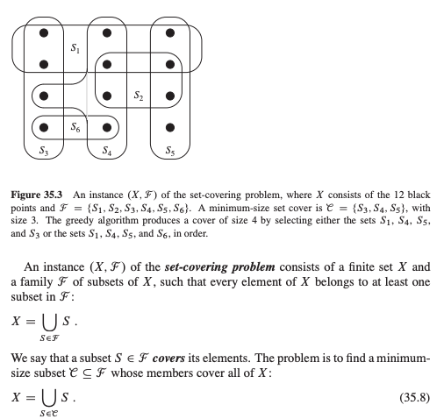
Set Cover Problem
Text Box

Slide 23
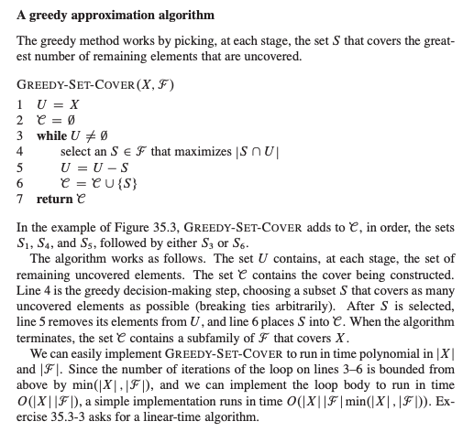
Approximating Set Cover
Text Box

Slide 24
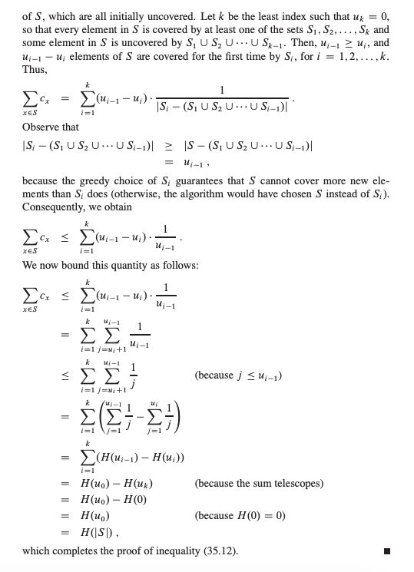
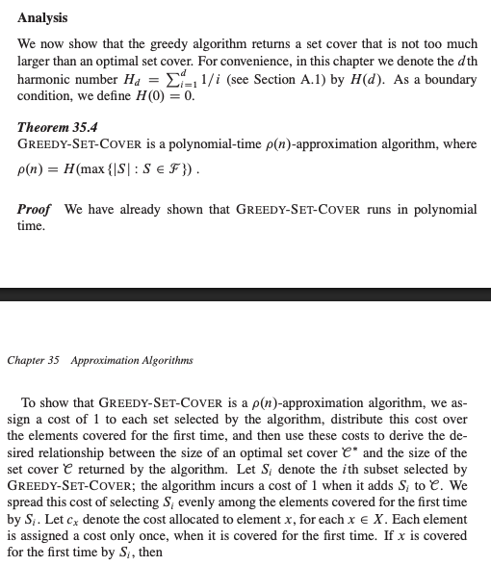
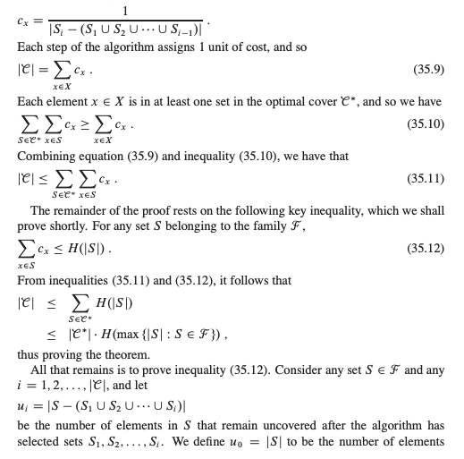
Analysis
Text Box

Slide 25
Randomization And Linear Programming

Slide 26
Conclusion

Slide 27
Conclusions
Van Emde Boas Tree:
Are very fast, and a function of the universe (u) size
Takes advantage of the binary representations of integers to improve runtime
Is NOT generalizable to sets of any objects / things

