Slide 1
Linear Programming
Advanced Algorithms Mark Floryan CLRS Ch. 29

Slide 2
The Simplex Algorithm

Slide 3
Simplex Algorithm Overview
Simplex Algorithm: The main idea is to iteratively increase a variable as much as possible, then re-arrange the linear program so that you can do this again. Algorithm Overview:
| Convert the Linear Program to Slack Form (if not already) | Calculate the Basic Solution to the Linear Program and see if it is feasible | If the Basic Solution is NOT feasible |---| Use a Pivot to convert the LP into a form in which basic solution is feasible | Loop until ALL coefficients of objective function are negative |---|Find a variable x_{e} with coefficient in objective function that is non-negative |---|Find constraint with basic variable x_{l} that most limits how much we can increase x_{e} |---|Use a call to Pivot to switch the roles of x_{e} and x_{l}
Several things we need to work out: What is a basic solution? A basic feasible solution? What is the Pivot operation? How do we choose x_{e} and x_{l}?

Slide 4

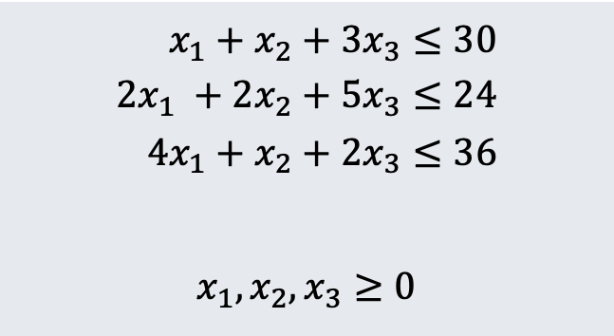
Simplex Algorithm Example
Maximize:
$$3x_{1}+x_{2}+2x_{3}$$
Subject To:
$$x_{1}+x_{2}+3x_{3}≤30 \\ 2x_{1} +2x_{2}+5x_{3}≤24 \\ 4x_{1}+x_{2}+2x_{3}≤36$$ $$x_{1},x_{2},x_{3}≥0$$

Slide 5

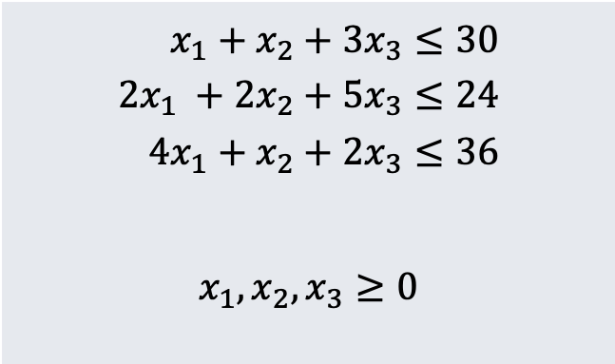

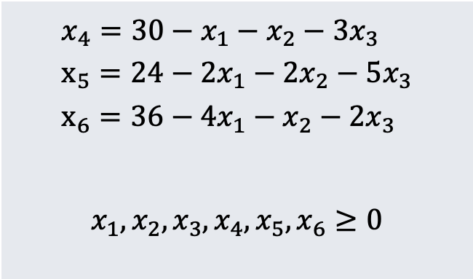
Simplex Algorithm Example
Step 1: Convert Linear Program to Slack Form
Maximize:
$$3x_{1}+x_{2}+2x_{3}$$
$$z=3x_{1}+x_{2}+2x_{3}$$
Subject To:
$$x_{1}+x_{2}+3x_{3}≤30 \\ 2x_{1} +2x_{2}+5x_{3}≤24 \\ 4x_{1}+x_{2}+2x_{3}≤36$$ $$x_{1},x_{2},x_{3}≥0$$
$${x_{4}=30−x}_{1}−x_{2}−3x_{3} \\ x_{5}=24−2x_{1}−2x_{2}−5x_{3} \\ x_{6}=36−4x_{1}−x_{2}−2x_{3}$$ $$x_{1},x_{2},x_{3},x_{4},x_{5},x_{6}≥0$$

Slide 6



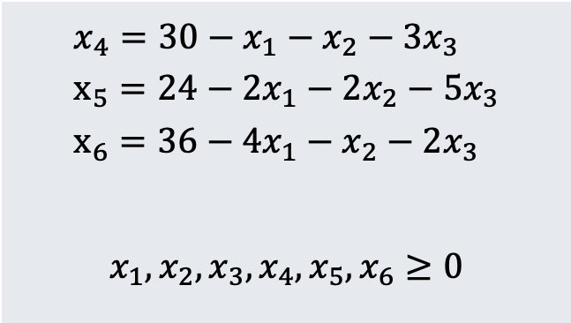



Simplex Algorithm Example
Step 1.a: Recall how Slack Forms are represented as matrices
c is coefficients of objective function:
$$c=\left(\begin{matrix}3 \\ 1 \\ 2\end{matrix}\right)$$
v is constant term of objective function (here v=0)
$$z=0+3x_{1}+x_{2}+2x_{3}$$
$${x_{4}=30−x}_{1}−x_{2}−3x_{3} \\ x_{5}=24−2x_{1}−2x_{2}−5x_{3} \\ x_{6}=36−4x_{1}−x_{2}−2x_{3}$$ $$x_{1},x_{2},x_{3},x_{4},x_{5},x_{6}≥0$$
b is constant terms of constraints:
$$b=\left(\begin{matrix}30 \\ 24 \\ 36\end{matrix}\right)$$
Basic Variables:
$$B=\{x_{4},x_{5},x_{6}\}$$
A is coefficients of non-basic variables in constraints:
$$A=\left(\begin{matrix}1 & 1 & 3 \\ 2 & 2 & 5 \\ 4 & 1 & 2\end{matrix}\right)$$
Non-basic Variables:
N$=\{x_{1},x_{2},x_{3}\}$
So, our implementation will use these variables when executing:
N, B, A, b, c, v

Slide 7

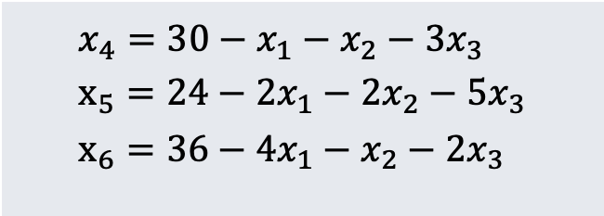
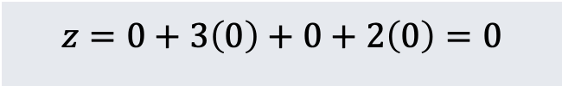
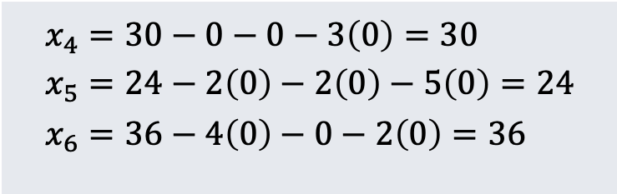

Simplex Algorithm Example
Step 2: Define / Find the Basic Solution and Basic Feasible Solution
$$z=0+3x_{1}+x_{2}+2x_{3}$$
Basic Solution: The solution in which all of the non-basic variables (here, $N=\{x_{1},x_{2},x_{3}\}$) are set to 0.
The Basic Solution is a Basic Feasible Solution if it is feasible (i.e., does NOT violate any constraints).
$${x_{4}=30−x}_{1}−x_{2}−3x_{3} \\ x_{5}=24−2x_{1}−2x_{2}−5x_{3} \\ x_{6}=36−4x_{1}−x_{2}−2x_{3}$$
$$z=0+3\left(0\right)+0+2\left(0\right)=0$$
**Here, the basic solution is indeed feasible because all basic variables are still non-negative. Objective function is 0 (which is not good…yet)
$$x_{4}=30−0−0−3\left(0\right)=30 \\ x_{5}=24−2\left(0\right)−2\left(0\right)−5\left(0\right)=24 \\ x_{6}=36−4\left(0\right)−0−2\left(0\right)=36$$

Slide 8
Simplex Algorithm Example
Step 2.a: What do we do if the basic solution is NOT feasible
We do have a method for finding a slack form that HAS a basic feasible solution from any arbitrary Linear Program in Standard Form. So, let’s let this method do the conversion to slack form for us AND have it guarantee that the basic solution is feasible
LP in Slack Form w/ Basic Feasible Solution (N, B, A, b, c, v)
Linear Program in Standard Form:
(A, b, c)
**We will look at how this works later on
INITIALIZE-SIMPLEX(A, b, c)
“Infeasible”

Slide 9

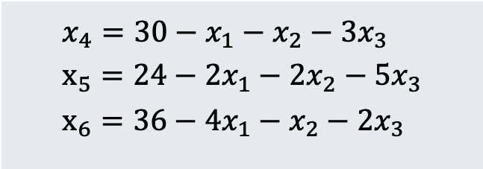
Simplex Algorithm Example
Step 3: Choose a non-basic variable and increase it as much as possible
$$z=0+3x_{1}+x_{2}+2x_{3}$$
Increasing any of these variables will increase the objective function. Let’s choose x₁ for now.
$${x_{4}=30−x}_{1}−x_{2}−3x_{3} \\ x_{5}=24−2x_{1}−2x_{2}−5x_{3} \\ x_{6}=36−4x_{1}−x_{2}−2x_{3}$$
As we increase x₁, all of these basic variables will decrease (and cannot go below 0). So…how much can we increase x₁?

Slide 10
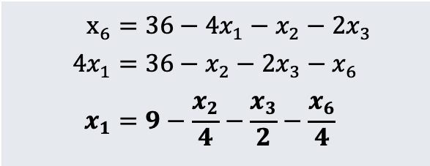
Simplex Algorithm Example
Step 3.a: Start swapping a basic and non-basic variable
$$z=0+3x_{1}+x_{2}+2x_{3}$$
We can increase x₁ by 30, 12, and 9 respectively.
Thus, the third constraint (x₆) is the tightest constraint, and so 9 is the most we can increase x₁
$${x_{4}=30−x}_{1}−x_{2}−3x_{3} \\ x_{5}=24−2x_{1}−2x_{2}−5x_{3} \\ x_{6}=36−4x_{1}−x_{2}−2x_{3}$$
$$x_{6}=36−4x_{1}−x_{2}−2x_{3} \\ 4x_{1}=36−x_{2}−2x_{3}−x_{6} \\ x_{1}=9−\frac{x_{2}}{4}−\frac{x_{3}}{2}−\frac{x_{6}}{4}$$
So, we want to switch x1 and x6 (make x1 basic and x6 non-basic). To do this, solve the third constraint for x1 first.

Slide 11
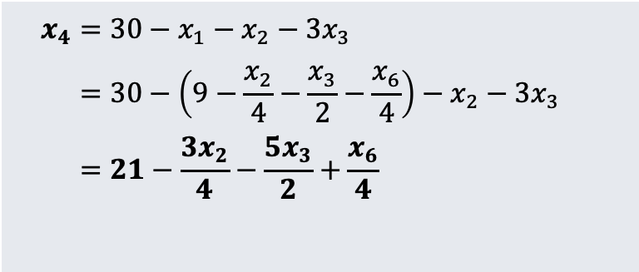
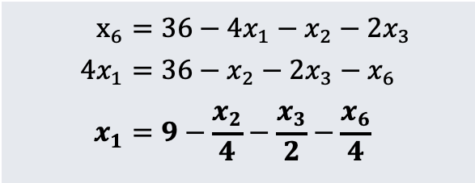
Simplex Algorithm Example
Step 3.b: Complete the swap
$$x_{6}=36−4x_{1}−x_{2}−2x_{3} \\ 4x_{1}=36−x_{2}−2x_{3}−x_{6} \\ x_{1}=9−\frac{x_{2}}{4}−\frac{x_{3}}{2}−\frac{x_{6}}{4}$$
$$x_{4}=30−x_{1}−x_{2}−3x_{3} \\ =30−\left(9−\frac{x_{2}}{4}−\frac{x_{3}}{2}−\frac{x_{6}}{4}\right)−x_{2}−3x_{3}−3x_{3} \\ =21−\frac{3x_{2}}{4}−\frac{5x_{3}}{2}+\frac{x_{6}}{4}$$
To remove x₁ as a non-basic variable from ALL other equations (including objective function), substitute this new equation for x₁ in all others and simplify them.
Example: Substituting and simplifying for equation x₄

Slide 12

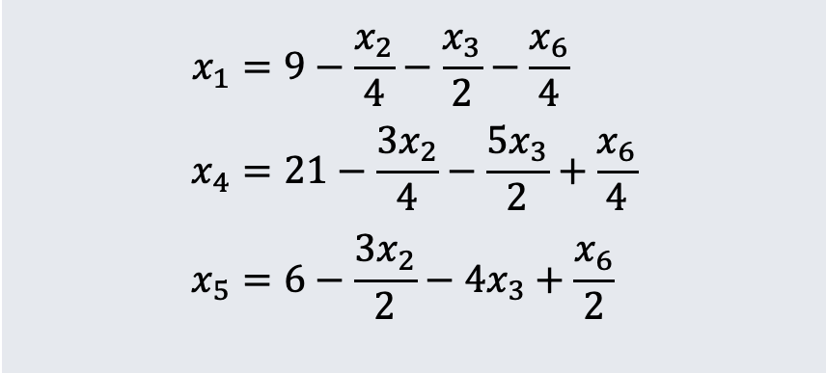
Simplex Algorithm Example
Step 3.c: Do this for EVERY equation (objective and all constraints) to get new Linear Program
$$z=27+\frac{x_{2}}{4}+\frac{x_{3}}{2}−\frac{3x_{6}}{4}$$
$$x_{1}=9−\frac{x_{2}}{4}−\frac{x_{3}}{2}−\frac{x_{6}}{4} \\ x_{4}=21−\frac{3x_{2}}{4}−\frac{5x_{3}}{2}+\frac{x_{6}}{4} \\ x_{5}=6−\frac{3x_{2}}{2}−4x_{3}+\frac{x_{6}}{2}$$
Note several things: x₁ is now a basic variable and x₆ is now a non-basic variable The basic feasible solution now has objective value 27 (as expected if x₁ = 9 in original LP) This process (of swapping x₁ and x₆) is called a PIVOT

Slide 13
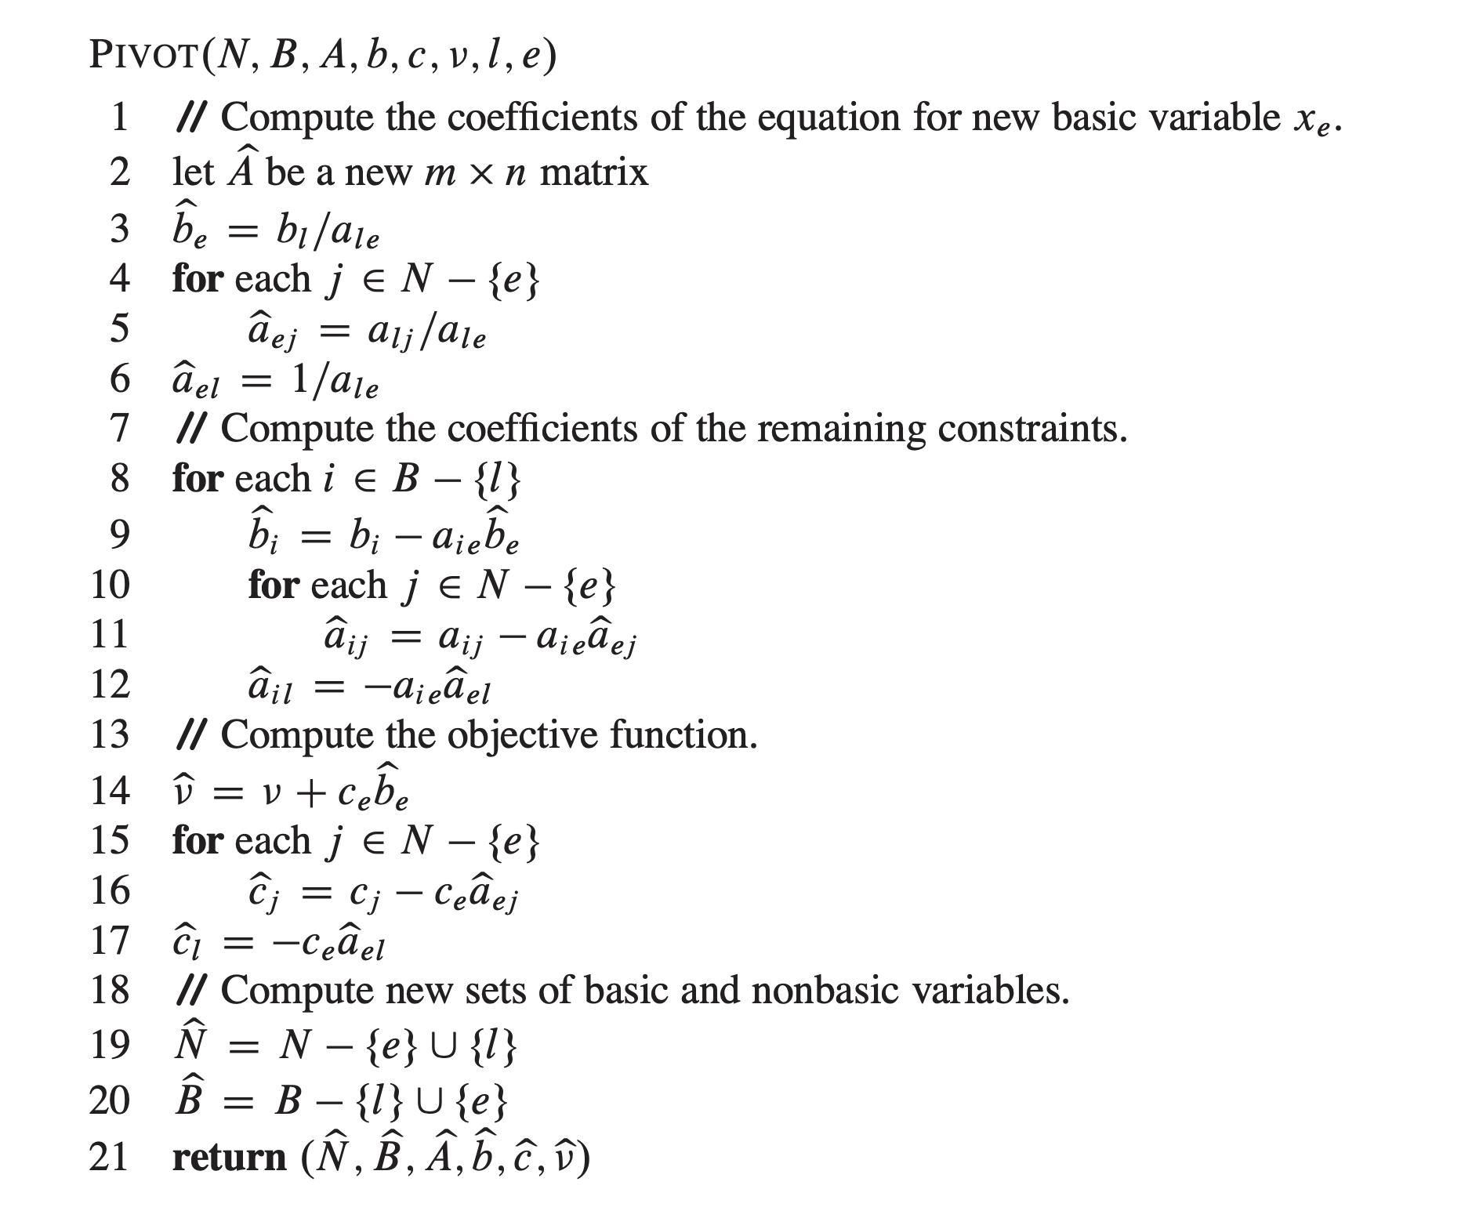
Generalizing the Pivot Method
Here is the general approach for the Pivot Operation
l is the leaving variable (e.g., x₆) and e is the entering variable (e.g., x₁)
**Note: Returns new slack form AFTER pivot is complete

Slide 14

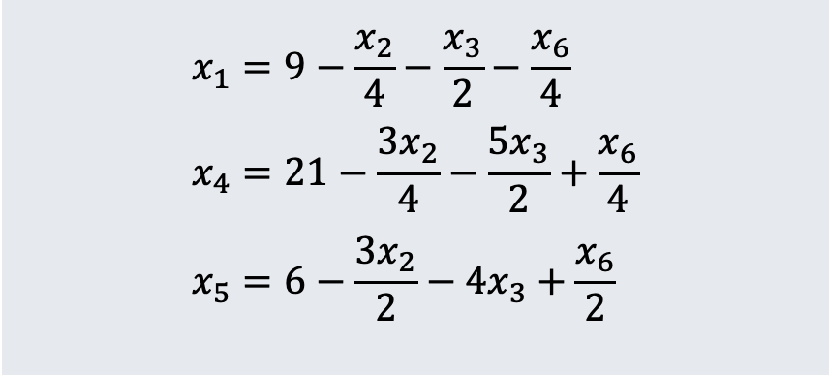
Simplex Algorithm Example
Step 4: Finish our example by increasing another non-basic variable
$$z=27+\frac{x_{2}}{4}+\frac{x_{3}}{2}−\frac{3x_{6}}{4}$$
Don’t choose x₆, this decreases the objective value. Let’s choose x₃
$$x_{1}=9−\frac{x_{2}}{4}−\frac{x_{3}}{2}−\frac{x_{6}}{4} \\ x_{4}=21−\frac{3x_{2}}{4}−\frac{5x_{3}}{2}+\frac{x_{6}}{4} \\ x_{5}=6−\frac{3x_{2}}{2}−4x_{3}+\frac{x_{6}}{2}$$
Which function constrains how much we can increase x₃ the most?
We can increase x₃ by 18, 42/5, and 3/2 respectively.
So…again the third constraint is the tightest one

Slide 15

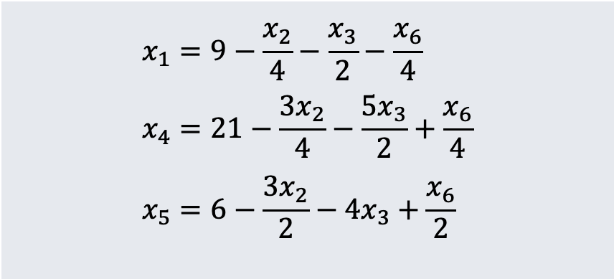
Simplex Algorithm Example
Step 4: Finish our example by increasing another non-basic variable
$$z=27+\frac{x_{2}}{4}+\frac{x_{3}}{2}−\frac{3x_{6}}{4}$$
So, x3 will be the entering variable and x5 will be the exiting variable.
Process:
- Solve x₅ equation for x₃ and simplify - Substitute value of x₃ in each other equation and simplify
$$x_{1}=9−\frac{x_{2}}{4}−\frac{x_{3}}{2}−\frac{x_{6}}{4} \\ x_{4}=21−\frac{3x_{2}}{4}−\frac{5x_{3}}{2}+\frac{x_{6}}{4} \\ x_{5}=6−\frac{3x_{2}}{2}−4x_{3}+\frac{x_{6}}{2}$$

Slide 16

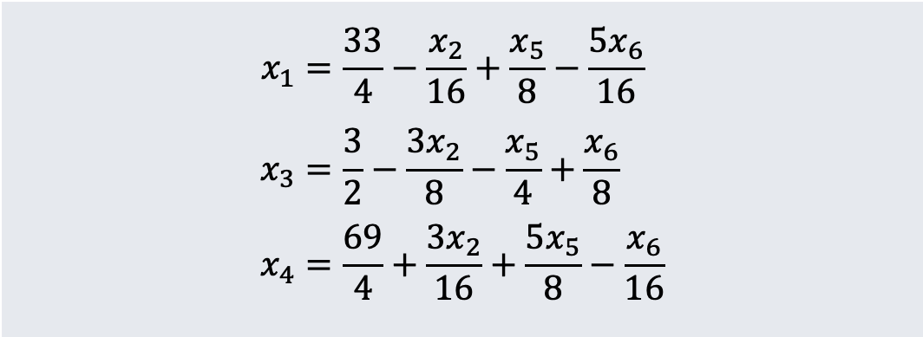
Simplex Algorithm Example
Step 4: Result of second pivot shown here (just trust me?)
$$z=\frac{111}{4}+\frac{x_{2}}{16}−\frac{x_{5}}{8}−\frac{11x_{6}}{16}$$
Objective value now 111/4
x₂ still has positive coefficient, so how much can we increase it by?
This time, we can increase x₂ by 4 at most (x₃ constraint is most tight)
$$x_{1}=\frac{33}{4}−\frac{x_{2}}{16}+\frac{x_{5}}{8}−\frac{5x_{6}}{16} \\ x_{3}=\frac{3}{2}−\frac{3x_{2}}{8}−\frac{x_{5}}{4}+\frac{x_{6}}{8} \\ x_{4}=\frac{69}{4}+\frac{3x_{2}}{16}+\frac{5x_{5}}{8}−\frac{x_{6}}{16}$$

Slide 17

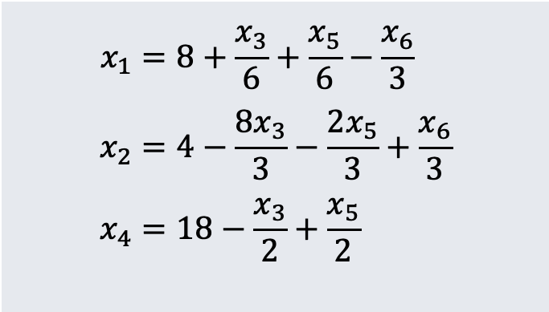
Simplex Algorithm Example
Step 5: Last Pivot (x2 enters and x3 leaves)
All coefficients in objective function are negative, so cannot pivot again!
$$z=28−\frac{x_{3}}{6}−\frac{x_{5}}{6}−\frac{2x_{6}}{3}$$
Basic feasible solution IS the optimal solution at this point.
Objective value is 28
$$x_{1}=8+\frac{x_{3}}{6}+\frac{x_{5}}{6}−\frac{x_{6}}{3} \\ x_{2}=4−\frac{8x_{3}}{3}−\frac{2x_{5}}{3}+\frac{x_{6}}{3} \\ x_{4}=18−\frac{x_{3}}{2}+\frac{x_{5}}{2}$$

Slide 18
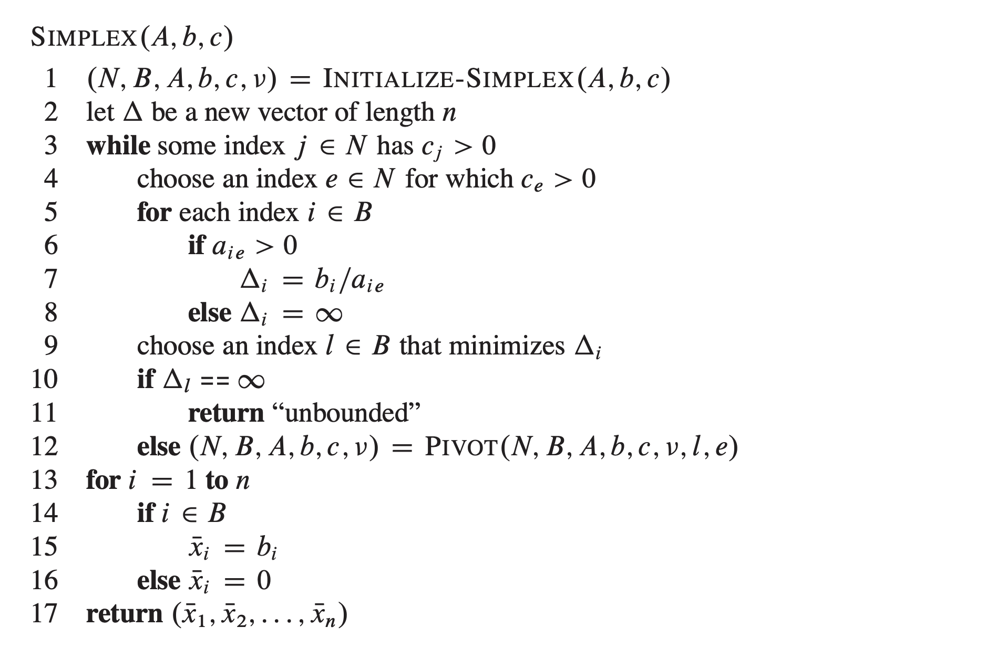
Simplex Algorithm Overview
Simplex Algorithm: The main idea is to iteratively increase a variable as much as possible, then re-arrange the linear program so that you can do this again. Algorithm Overview:

Slide 19

Notes about Simplex
Simplex is NOT guaranteed to terminate. LP could be degenerate, and cycle through a sequence of slack forms that all have the same objective value.
There IS a way to check if you are in a cycle pretty simply (see book)
Simplex is USUALLY fast, but can sometimes be $Ω(n^{c})$
Other LP Algorithms are guaranteed to be polynomial time, but we won’t study them here

Slide 20
How Does Initialize-Simplex Work?

Slide 21
Initialize-Simplex Overview
Basic Idea:
| Given a linear program in which the basic solution is NOT feasible | Introduce a new variable x₀ and add –x₀ to each constraint | Make –x₀ the objective function as well | Call Pivot (x0 is entering variable, exiting variable is basic var that is MOST negative) | The resulting LP is guaranteed to have a basic feasible solution | Run Simplex loop to find optimal solution to this new LP | If the optimal solution to this new LP sets x₀ to 0 |---| if x0 is basic |------| Perform one pivot to make it non-basic |---| Remove x0 from the solution’s slack form (set to 0) and restore original obj. func. |---| Return new slack form | Else |---| Return “infeasible”

Slide 22


Initialize-Simplex Example
Consider the following LP. Note that basic solution is NOT feasible
$$z=2x_{1}−x_{2}$$
Basic solution sets x₁ and x₂ to 0
But in second equation, 0 is not less than or equal to -4
$$2x_{1}−x_{2}≤2 \\ x_{1}−5x_{2}≤−4 \\ x_{1},x_{2}≥0$$

Slide 23





Initialize-Simplex Example
Step 1: Introduce variable x₀
$$z=−x_{0}$$
Change objective function to –x₀
Add a term –x₀ to each constraint, notice that $x_{0}$ must be non-negative!
$$2x_{1}−x_{2}−x_{0}≤2 \\ x_{1}−5x_{2}−x_{0}≤−4 \\ x_{1},x_{2, }x_{0}≥0$$
Equivalent slack form given by:
$$z=−x_{0}$$
$$x_{3}=2−2x_{1}+x_{2}+x_{0} \\ x_{4}=−4−x_{1}+5x_{2}+x_{0}$$

Slide 24


Initialize-Simplex Example
Lemma: The original Linear Program L is feasible if and only if this new Linear Program L_{aux} (shown below) has an optimal objective value of 0.
Equivalent slack form given by:
$$z=−x_{0}$$
$$x_{3}=2−2x_{1}+x_{2}+x_{0} \\ x_{4}=−4−x_{1}+5x_{2}+x_{0}$$
Why?
Suppose L has a feasible solution, then L_{aux} has a feasible solution setting x₀ to 0 (which eliminates all terms in L_{aux} except items already in L
Now suppose L_{aux} has a feasible solution, then x₀ must have been set to 0 and the remaining variable values must satisfy the original LP L

Slide 25





Initialize-Simplex Example
Note: You need to perform one pivot on $L_{aux}$ to make the initial basic solution feasible. This is guaranteed if you pivot with the MOST NEGATIVE slack variable.
Slack form: Basic solution NOT feasible ($x_{4}=−4$)
$$z=−x_{0}$$
$$x_{3}=2−2x_{1}+x_{2}+x_{0} \\ x_{4}=−4−x_{1}+5x_{2}+x_{0}$$
Slack form: Basic solution IS NOW feasible
$$z=−x_{4}−4−x_{1}+5x_{2}$$
$$x_{3}=6−x_{1}−4x_{2}+x_{4} \\ x_{0}=4+x_{1}−5x_{2}+x_{4}$$

Slide 26
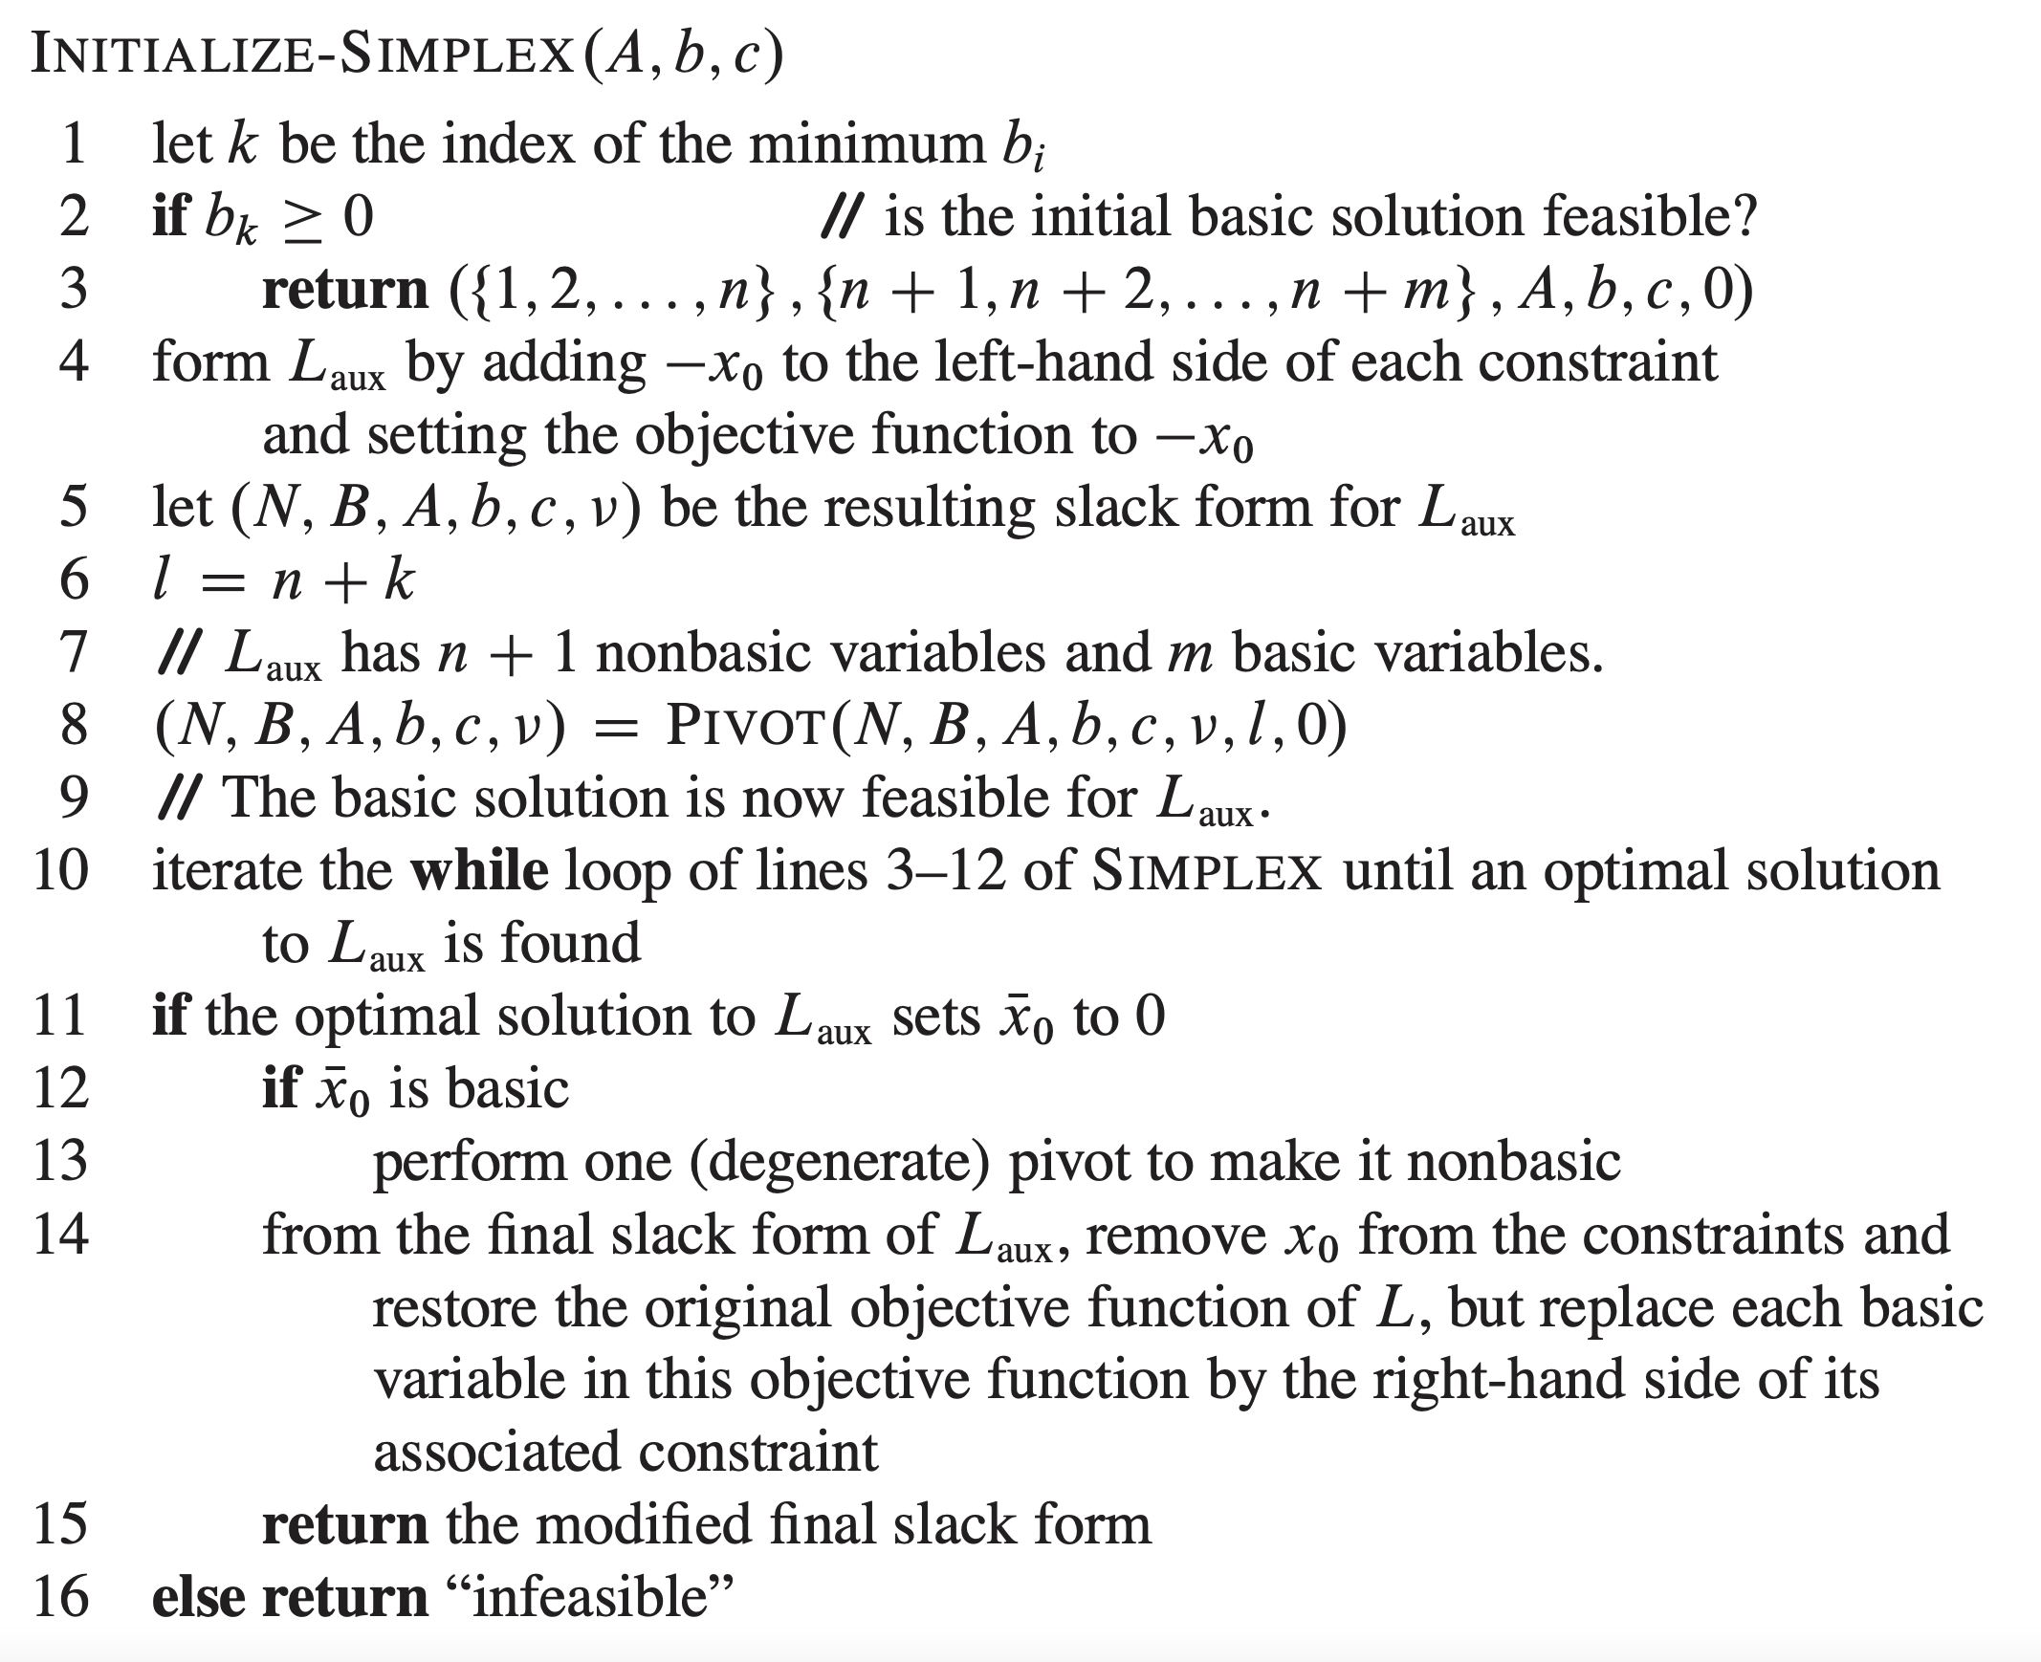
Initialize-Simplex Psuedo-Code
Initialize Simplex: Overview of the implementation of this initialization method

Slide 27
Conclusion

Slide 28
What do you need to know?
You need to be able to:
Formulate problems as linear programs
On your homework, craft the matrices for a LP and use a known LP algorithm like Simplex or something else.
Formulate LPs in standard and slack form and answer basic questions about it
Trace simple examples of the simplex algorithm running by hand
Understand what the basic feasible solution is and how to calculate it
Perform pivots manually by hand
Detect if an LP is unbounded
Find optimal solution to a simple LP by performing pivots by hand.
Understand the intuition behind the Laux program and why it helps find an initial basic feasible solution so that simplex can start working.

Slide 29
Conclusions
Linear Programming is a powerful technique for solving a wide range of problems.
To use, model your problem as a maximization / minimization problem and a set of linear constraints. You may need to convert to standard form or slack form.
Use a black box algorithm. We studied simplex, but many other exist that run in Polynomial Time.

