Slide 1
Computational Geometry
Advanced Algorithms Mark Floryan CLRS Ch. 33 and some outside readings

Slide 2
Introduction

Slide 3
Computational Geometry
Computational Geometry is a HUGE subject in computing involving algorithms for solving problems that can be expressed geometrically.
We will look at the following CG algorithms:
- Detecting if two line segments intersect - Detecting if any of multiple line segments intersect - Detecting if a given point is inside a given polygon - Finding the Intersection of two Polygons - Line horizon problem - Finding the Convex Hull (next slide deck) - Using the Quad-Tree data structure (next slide deck)

Slide 4
Line Intersection

Slide 5
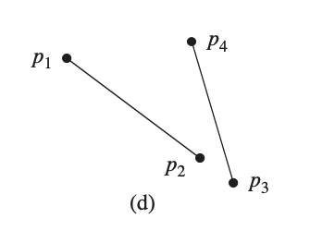

Computing If Two Lines Intersect
Line Intersection: Given two line segments defined by four points, return true iff the two segments intersect.
Input: $L_{1}=\overline{p_{1}p_{2}}$ and $L_{2}=\overline{p_{3}p_{4}}$
Obvious Approach: - Compute the equation $y=mx+b$ of each line - Get intersection point (if exists) - Check if intersection point on each segment Problems: - Uses division which can be slow - Division also imprecise if segments nearly parallel

Slide 6
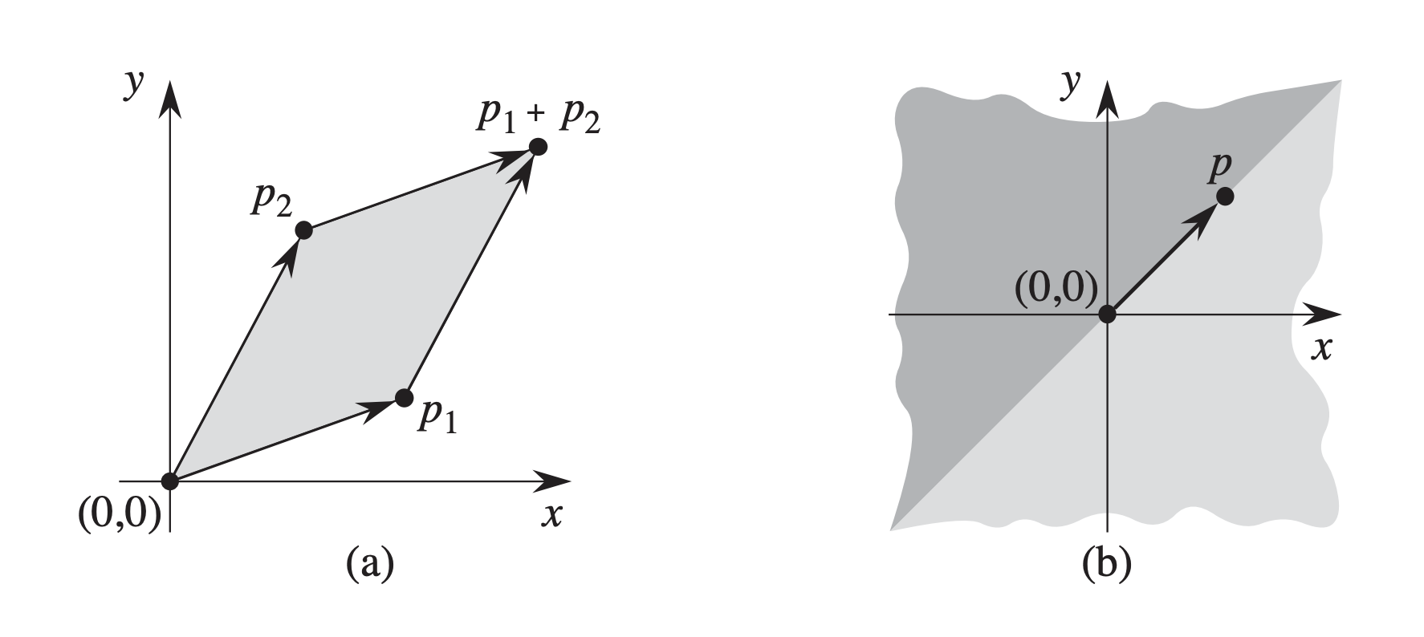

Aside: Cross Products
Line Intersection can be done in O(1) time and quite easily using cross products.
Cross Products can be defined as the determinant of a matrix:
$$p_{1} X p_{2}=det\left(\begin{matrix}x_{1} & x_{2} \\ y_{1} & y_{2}\end{matrix}\right) \\ =x_{1}y_{2}−x_{2}y_{1} \\ =−p_{2} X p_{1}$$
The cross product of p1 and p2 is the signed area of the parallelogram (a). This will be negative if the other vector is counter-clockwise from p, positive otherwise (b).

Slide 7

Direction of Turns
The sign of a cross product informs whether vectors from the origin to two points turns left or right:
$$p_{1} X p_{2}=det\left(\begin{matrix}x_{1} & x_{2} \\ y_{1} & y_{2}\end{matrix}\right) \\ =x_{1}y_{2}−x_{2}y_{1} \\ =−p_{2} X p_{1}$$
p₂
p₁
p₁
p₂
(0,0)
(0,0)
If p1 X p2 is positive, then p1 is clockwise from p2 with respect to the origin.
If p1 X p2 is negative, then p1 is counter-clockwise from p2 with respect to the origin.
**Note: Cross product of 0 indicates that the vectors are colinear

Slide 8



Examples: Direction of Turns
(-1,4)
(2,6)
(-2,4)
p₂
(5,3)
p₂
p₁
(6,3)
p₁
p₂
(1,3)
p₁
(0,0)
(0,0)
(0,0)
$$p_{1} X p_{2}=det\left(\begin{matrix}x_{1} & x_{2} \\ y_{1} & y_{2}\end{matrix}\right)$$
$$=det\left(\begin{matrix}5 & −1 \\ 3 & 4\end{matrix}\right) \\ =5(4)−3(−1) \\ =23$$
$$p_{1} X p_{2}=det\left(\begin{matrix}x_{1} & x_{2} \\ y_{1} & y_{2}\end{matrix}\right)$$
$$=det\left(\begin{matrix}1 & 2 \\ 3 & 6\end{matrix}\right) \\ =6(1)−3(2) \\ =0$$
$$p_{1} X p_{2}=det\left(\begin{matrix}x_{1} & x_{2} \\ y_{1} & y_{2}\end{matrix}\right)$$
$$=det\left(\begin{matrix}−2 & 6 \\ 4 & 3\end{matrix}\right) \\ =−2(3)−6(4) \\ =−30$$
Positive result = Right Turn!!
0 = Co-Linear!!
Negative result = Left Turn!!

Slide 9
Successive Vectors
In a moment, we will see that we are interested in successive vectors. Those in which the end of the first vector is the beginning of the next one
We are interested in the direction of the turn ONLY
p₂
p₁
p₁
p₀
p₂
(0,0)
(0,0)
Successive vectors in which the origin is (0,0)
Successive vectors in which the origin is NOT (0,0)

Slide 10
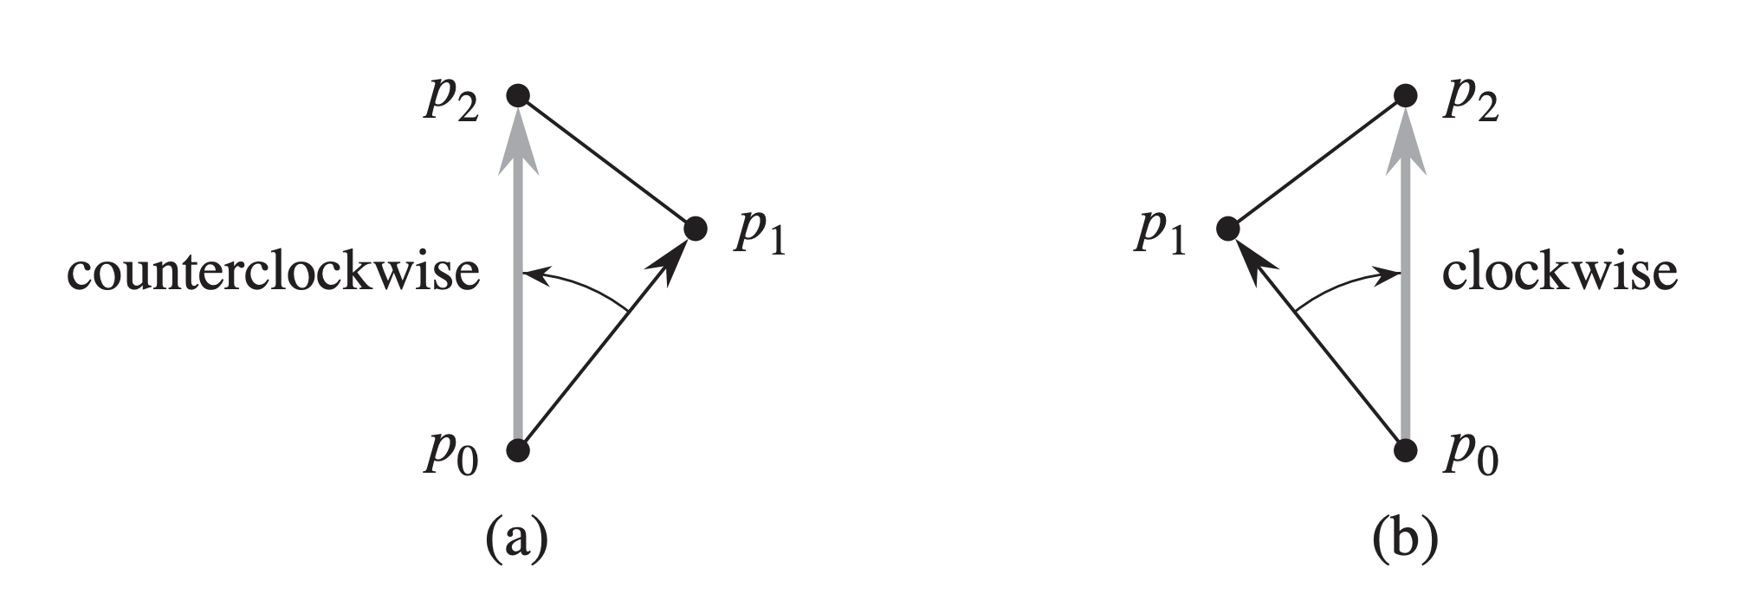
Successive Vectors
When dealing with successive vectors (or a sequence of three points p₀, p₁, p₂). Normalize p₀ to the origin (using subtraction) and use vectors (p₀,p₁) and (p₀,p₂) to find the direction of the turn.
$$\left(p_{1}−p_{0}\right)X\left(p_{2}−p_{0}\right)=\left(x_{1}−x_{0}\right)\left(y_{2}−y_{0}\right)−(x_{2}−x_{0})(y_{1}−y_{0})$$

Slide 11
Back to Line Intersection
To determine whether two line segments intersect, we observe the following:
Two lines intersect if at least one of the following is true: - Each segment straddles the other - An endpoint of one segment lies on the other
p₃
p₁
p₂
p₄
These two line segments straddle each other. We can defining straddling in terms of vector turns!
Straddling occurs if: - p₁, p₂, p₃ and p₁, p₂, p₄ make opposite turns - Same for p₃, p₄, p₁ and p₃, p₄, p₂

Slide 12
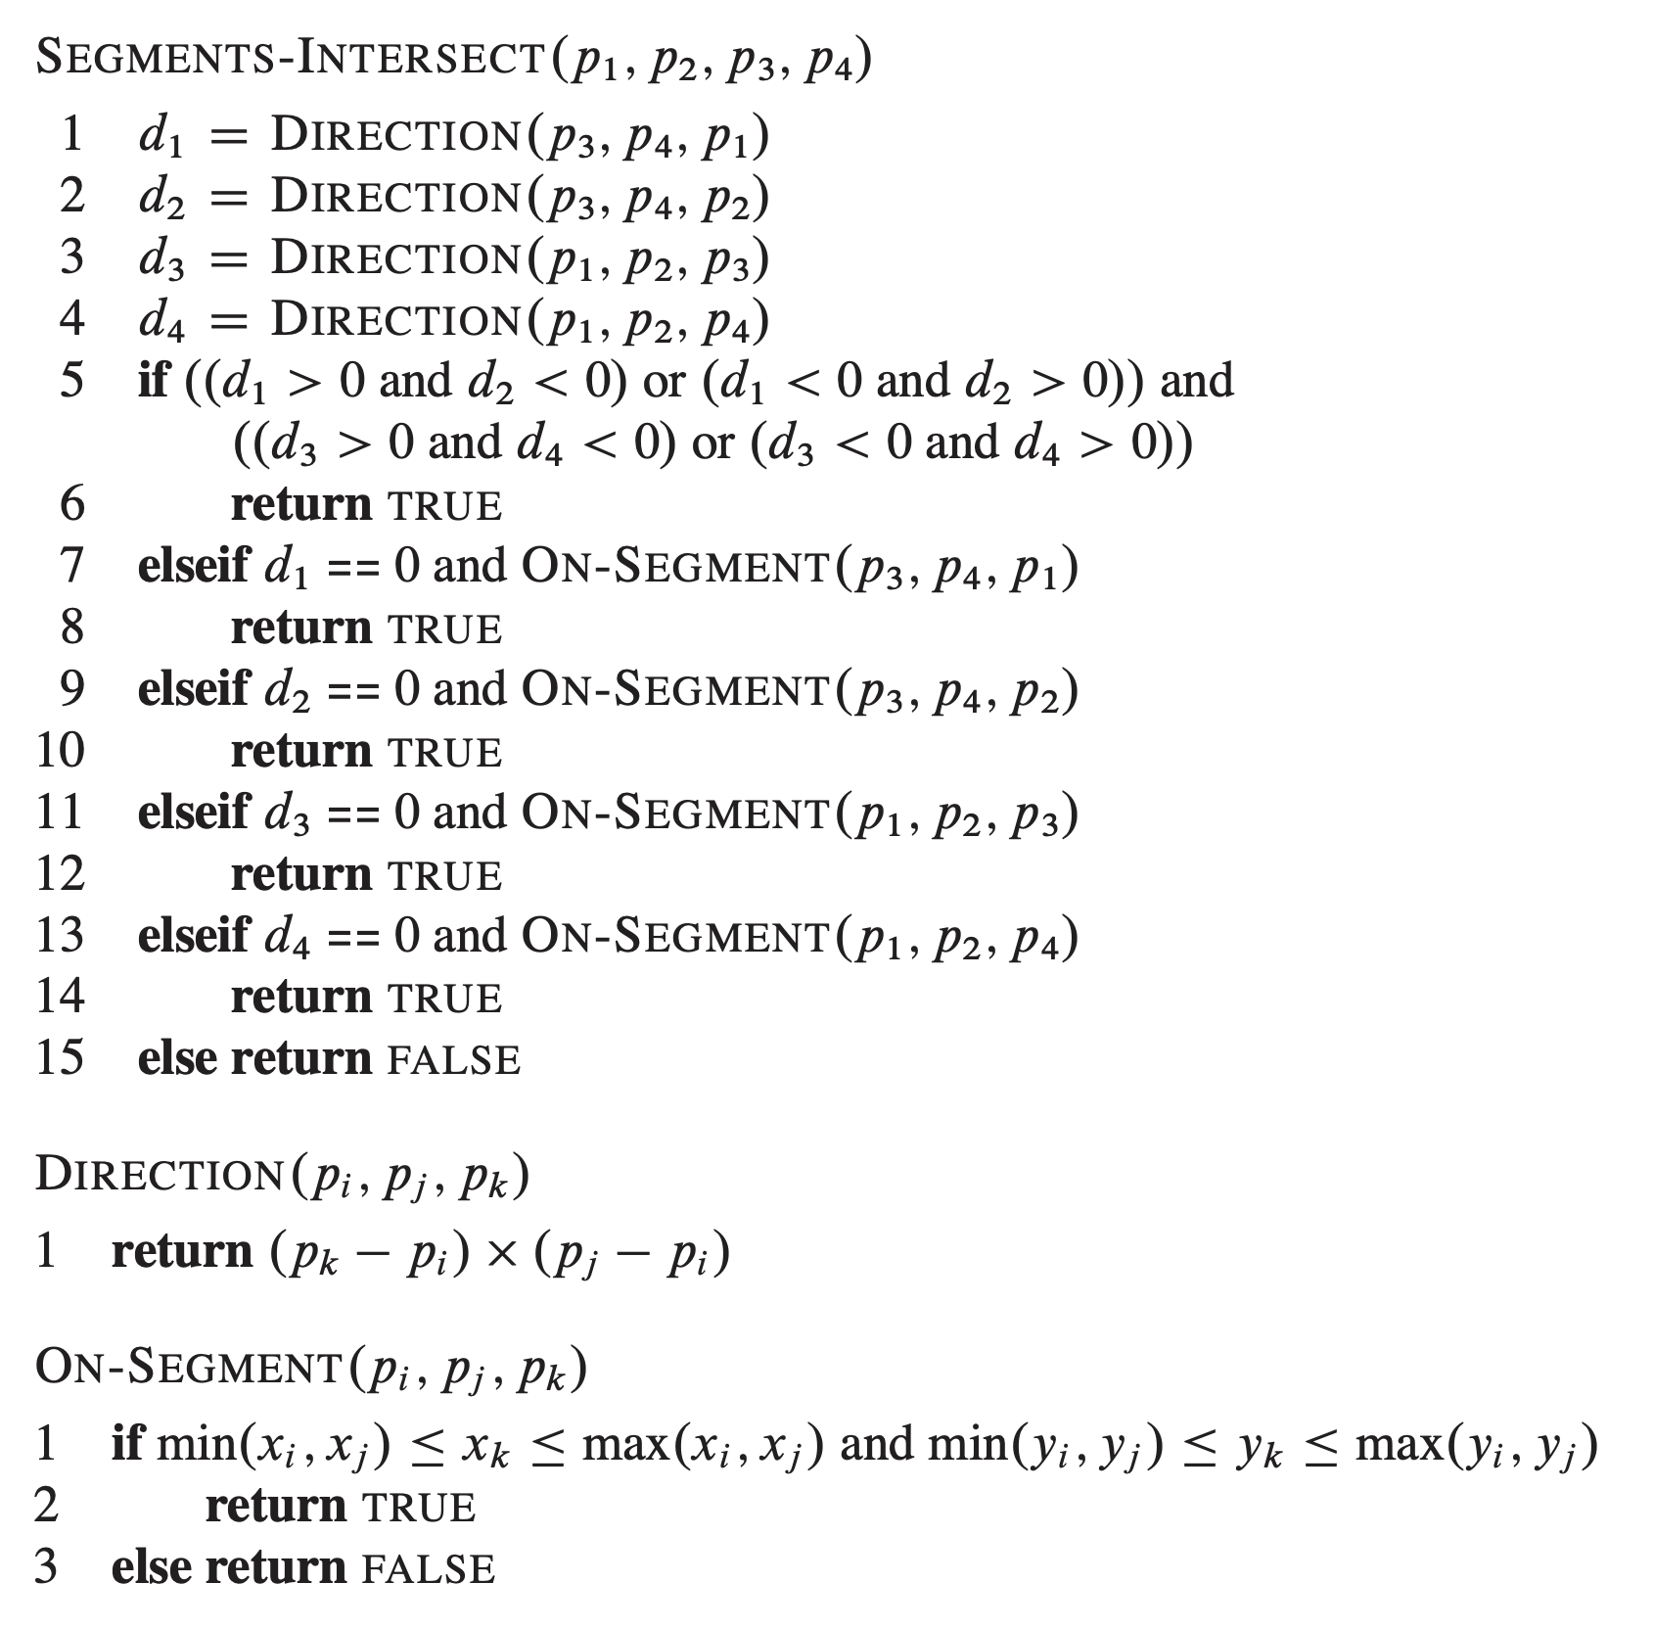
Line Segments Intersect: Code

Slide 13
Line Segments Intersect: Code
Direction gets cross-product (we are only really interested in the sign
If d₁ and d₂ have different signs AND d₃ and d₄ have different signs then the segments intersect.
Special cases, if one endpoint is one the other segment.
This method is simple because it is only invoked when three points are known already to be co-linear

Slide 14
Point-Polygon Intersection

Slide 15
Point-Polygon Intersection
A common computational geometry problem: Given a polygon P (defined by a set of points) and another point p, is p inside the polygon defined by P.
Variables of Interest:
P: points that make up the polygon. Note that these can be converted to line segments very easily.
p: point to test
Return: True iff point p is inside of polygon P

Slide 16
Point-Polygon Intersection Method 1: Ray-Casting

Slide 17
Method 1: Ray Casting
A common computational geometry problem: Given a polygon P (defined by a set of points) and another point p, is p inside the polygon defined by P.
What is the big insight we need here? How do we definitively prove or disprove the point is inside the polygon?
Idea 1: Try to get point to “escape” somehow? If we cross a line we have escaped!

Slide 18
Method 1: Ray Casting
A common computational geometry problem: Given a polygon P (defined by a set of points) and another point p, is p inside the polygon defined by P.
Key insight:
Cast a “ray” or long enough line segment out in one direction (usually right).
Point is inside the polygon if the ray intersects the polygon edges an odd number of times

Slide 19
Method 1: Ray Casting
inPolygon(points P[], point p):
segs[] = convert P to line segments maxX = maximum x-value in segs[] raySeg = [(p.x,p.y), (maxX+100, p.y)]
count = 0 for segment in segs: if intersects(raySeg, segment): count++
if count%2 == 0 return false else return true
There may be some problems with this pseudocode. What are some edge cases we need to consider?

Slide 20
Method 1: Ray Casting
Edge Case 1:
Our “ray” is collides with a vertex exactly!
What should the correct answer for each of these be? Why?

Slide 21
Method 1: Ray Casting
Edge Case 1:
Our “ray” is collides with a vertex exactly!
Solution:
Chose a side of the ray (top or bottom), count the vertex if the line segment is on that side of the ray.

Slide 22
Method 1: Ray Casting
Edge Case 2:
Our “ray” is co-linear with one of the line segments
What should the correct answer for each of these be? Why?

Slide 23
Method 1: Ray Casting
Edge Case 2:
Our “ray” is co-linear with one of the line segments
Two cases:
If p on line segment: return true
If p not on line segment, ignore this collision (note that the vertices will collide again and will be edge case 1)

Slide 24
Final Pseudocode
inPolygon(points P[], point p):
segs[] = convert P to line segments maxX = maximum x-value in segs[] raySeg = [(p.x,p.y), (maxX+100, p.y)]
count = 0 for segment in segs: if intersects(raySeg, segment): if p on segment: return true; //edge case 2 if p intersects lower vertex of segment: ignore intersection //edge case 1 else count++
if count%2 == 0 return false else return true

Slide 25
Final Pseudocode
inPolygon(points P[], point p):
segs[] = convert P to line segments maxX = maximum x-value in segs[] raySeg = [(p.x,p.y), (maxX+100, p.y)]
count = 0 for segment in segs: if intersects(raySeg, segment): if p on segment: return true; //edge case 2 if p not on segment but colinear: ignore intersection //edge case 2 if p intersects lower vertex of segment: ignore intersection //edge case 1 else count++
if count%2 == 0 return false else return true
For edge case 2, note that our line intersection code already checked for collinearity (determinant was 0) and the case where one endpoint was on the other line, so we can do so the exact same way or have that intersection function return a special value
For edge case 1, we can just check the y-values of the two end points of the segment to see which is the “lower” point among the two.

Slide 26
Point-Polygon Intersection Method 1: Turns

Slide 27
Method 2: Turns
A common computational geometry problem: Given a polygon P (defined by a set of points) and another point p, is p inside the polygon defined by P.
If the polygon is guaranteed to be convex, then we can use turns to solve this more simply.
Idea: Figure out which “side” of each edge the point is on..

Slide 28
Method 2: Turns
A common computational geometry problem: Given a polygon P (defined by a set of points) and another point p, is p inside the polygon defined by P.
If the polygon is guaranteed to be convex, then we can use turns to solve this more simply.
Idea: Figure out which “side” of each edge the point is on..

Slide 29
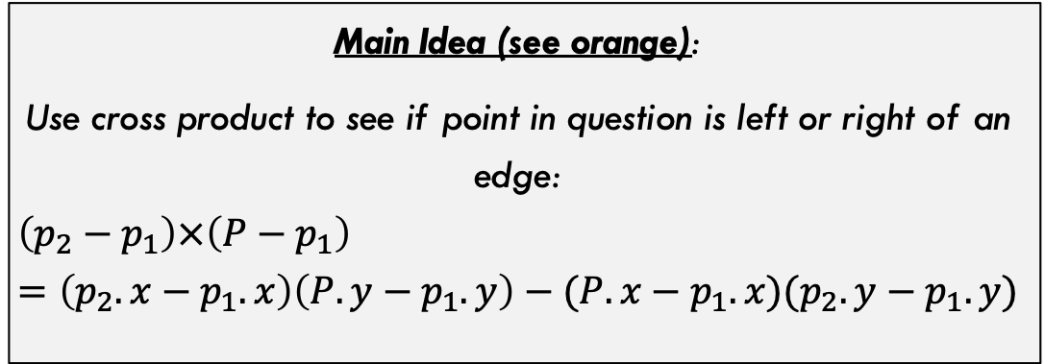
Method 2: Turns
A common computational geometry problem: Given a polygon P (defined by a set of points) and another point p, is p inside the polygon defined by P.
Prerequisites:
Points in polygon must be ordered (either clockwise or counter-clockwise)
p5
p4
p6
p3
p7
P
Main Idea (see orange):
Use cross product to see if point in question is left or right of an edge:
$$\left(p_{2}−p_{1}\right)×\left(P−p_{1}\right) \\ =\left(p_{2}.x−p_{1}.x\right)\left(P.y−p_{1}.y\right)−(P.x−p_{1}.x)(p_{2}.y−p_{1}.y)$$
p8
p2
p9
p1

Slide 30
Method 2: Turns
A common computational geometry problem: Given a polygon P (defined by a set of points) and another point p, is p inside the polygon defined by P.
Overall Approach:
Given counter-clockwise ordering of vertices For each edge in polygon (vertex and next vertex): Compute cross-product as per previous slide If cross-product is positive return FALSE If cross-product is zero: return TRUE if point is within bounds of this edge If cross-product is negative CONTINUE
Return TRUE
p5
p4
p6
p3
p7
P
p8
p2
p9
p1
What are some edge cases we need to consider? Floating point tolerance? Point is exactly on a vertex? Make sure to think through these and handle them.

Slide 31
Point-Polygon Intersection Method 3: Triangles

Slide 32

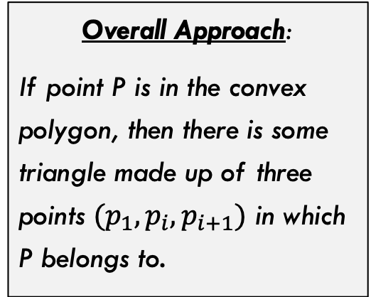
Method 3: Triangles
A common computational geometry problem: Given a polygon P (defined by a set of points) and another point p, is p inside the polygon defined by P.
p8
p7
Overall Approach:
If point P is in the convex polygon, then there is some triangle made up of three points $(p_{1}, p_{i},p_{i+1})$ in which P belongs to.
Let x be the point with the smallest x-coordinate (smallest y-coordinate if more than one)
p9
p6
p1
P
p5
p2
p3
p4
In this example, P is inside the triangle with i=5. $$(p_{1},p_{5},p_{6})$$

Slide 33
Method 3: Triangles
A common computational geometry problem: Given a polygon P (defined by a set of points) and another point p, is p inside the polygon defined by P.
p8
p7
Algorithm (Take 1):
Sort points counter-clockwise Let p1 be point with smallest x-val (smallest y if more than one) For i = 2 to n-1: if inTriangle(P, p₁, p_{i}, p_{i+1}): return True
return False
p9
p6
p1
P
p5
p2
p3
p4
Note that isInTriangle() can be done in constant time. You can look up various ways to implement this yourselves.

Slide 34

Method 3: Triangles
A common computational geometry problem: Given a polygon P (defined by a set of points) and another point p, is p inside the polygon defined by P.
p8
p7
Algorithm (Take 2):
??? We can do better ??
p9
p6
p1
P
p5
Note that given a triangle $(p_{1},p_{i}, p_{i+1})$, If the point is not inside the triangle but IS inside the polygon, then its polar angle relative to p₁ is either smaller or bigger then vector $(p_{i}−p_{1})$. Thus, we can binary search over the polar angles to find the only triangle that could feasibly work.
p2
p3
p4

Slide 35
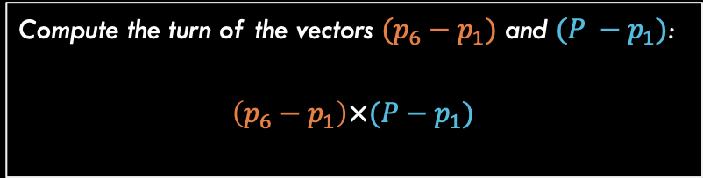

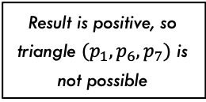
Method 3: Triangles
A common computational geometry problem: Given a polygon P (defined by a set of points) and another point p, is p inside the polygon defined by P.
Grab a point in the middle between $p_{1}$ and $p_{9}$ (we will use $p_{6}$).
p8
p7
p9
p6
p1
Result is positive, so triangle $(p_{1},p_{6},p_{7})$ is not possible
Compute the turn of the vectors $(p_{6}−p_{1})$ and $(P −p_{1})$:
$$\left(p_{6}−p_{1}\right)×(P−p_{1})$$
p5
P
p2
p3
p4

Slide 36


Method 3: Triangles
A common computational geometry problem: Given a polygon P (defined by a set of points) and another point p, is p inside the polygon defined by P.
p8
p7
p8
p7
p9
p6
p9
p6
Result is negative, so triangle $(p_{1},p_{4},p_{5})$ IS possible
Result is negative, so triangle $(p_{1},p_{5},p_{6})$ is NOT possible
p1
p1
p5
p5
P
P
p2
p2
p3
p3
p4
p4

Slide 37
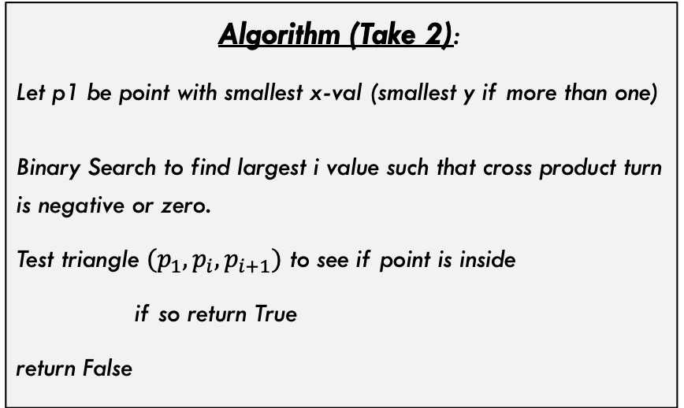
Method 3: Triangles
A common computational geometry problem: Given a polygon P (defined by a set of points) and another point p, is p inside the polygon defined by P.
p8
p7
Algorithm (Take 2):
Let p1 be point with smallest x-val (smallest y if more than one) Binary Search to find largest i value such that cross product turn is negative or zero.
Test triangle $(p_{1},p_{i},p_{i+1})$ to see if point is inside
if so return True
return False
p9
p6
p1
p5
P
p2
p3
p4
Any special cases to consider? What about optimizations that could speed this up a little in practice?

Slide 38
Multiple Line Intersection

Slide 39

Multiple Segment Intersection
Problem Statement: Given a set of line segments, return true iff at least one pair of segments intersects.
Naïve Algorithm: Call our line intersection method on every pair of segments. Runtime is $Θ(n^{2})$
We can achieve $o(n^{2})$ by using a sweep-line algorithm. Sweep lines are a common approach in computational geometry problems.
b
h
a
d
e
g
f
c
Example input, method should return true on this set of lines

Slide 40
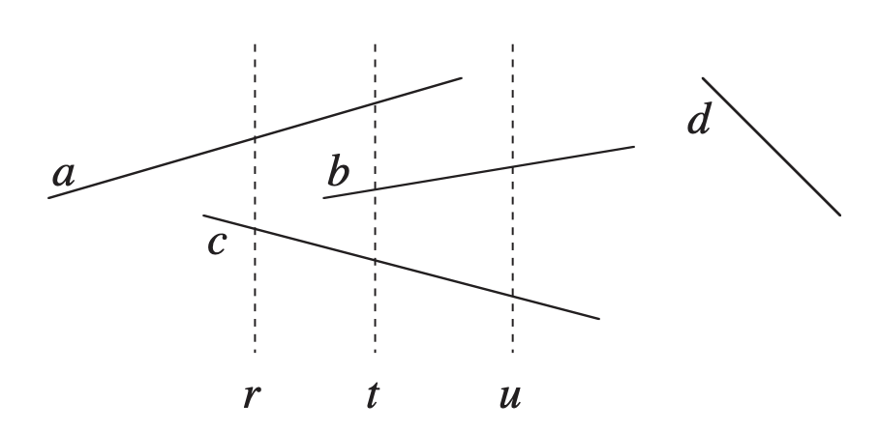

Multiple Segment Intersection
Sweep-Line Algorithm: Imagine a vertical line (called the sweep-line) which moves from left to right across the space. The image below shows an example with multiple possible sweep-line locations
Two lines (a and b) are comparable relative to a sweep-line at x-coordinate x’ if both lines intersect the sweep-line at that x-coordinate. a is above b (written as $a≽_{x′}b$) if the y-coordinate of a is higher than the y-coordinate of b at that particular x-coordinate.

Slide 41
Moving the Sweep Line
Problem Statement: Given a set of line segments, return true iff at least one pair of segments intersects.
Sweeping algorithms typically manage two data sets:
Sweep line status: Provides relationship information regarding objects the sweep-line intersects
Event-Point Schedule: Sequence of points that sweep line moves through, ordered usually by x-coordinate from left to right
b
h
a
d
e
g
f
c

Slide 42
Event-Point Schedule
Event-Point Schedule: Sequence of points that sweep line moves through, ordered usually by x-coordinate from left to right
b
h
For this algorithm we will be sorting the list of endpoints by increasing x-value. If two points have same x-value, we order them by increasing y-value.
a
d
e
g
f
c
For this example, the sweep line will visit x-coordinate of points: {a, c, e, b, d, g, f, h}

Slide 43

Sweep-Line Status
Sweep line status: Provides relationship information regarding objects the sweep-line intersects
We need a data structure that supports:
Insert(T, s) = insert segment s into T
Delete(T, s) = delete segment s from T
Above(T, s) = return the segment just above s in T
Below(T, s) = return the segment just below s in T
b
h
a
d
e
g
f
c
We can use a red-black tree to support these operations in $Θ(\log{n)}$ time each.
Note that two segments intersect if their relative order in T switches at any point

Slide 44
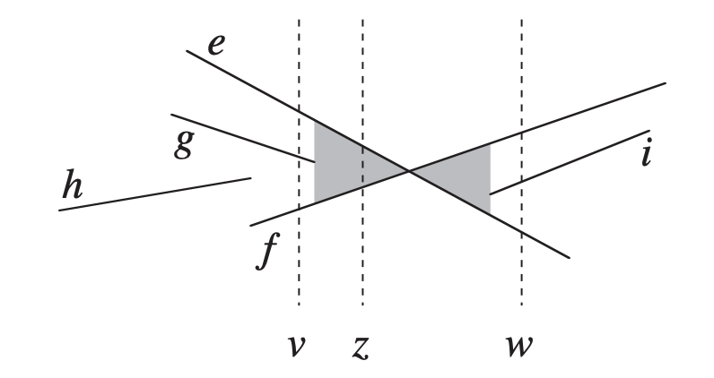
Multiple Segment Intersection
Algorithm Structure:
| Sort endpoints of segments by x-coordinate | For Sweep-line at each x-coordinate in order |--| if this endpoint is start of segment s |----| Insert s into T |--| If this endpoint is end of segment s |----| Delete s from T **As we go, need to check for intersections? How?
So, all we really need is some condition for when intersections occur as we sweep across. What are those conditions!!?

Slide 45
Conditions for Intersection
Two lines intersect if one of the following occurs:
When a segment is inserted into T, it intersects the line right above it or the line right below it in T
When s is about to be deleted from T, the segments above and below it in T could intersect each other (are the only candidates)
b
h
a
d
e
g
f
c

Slide 46
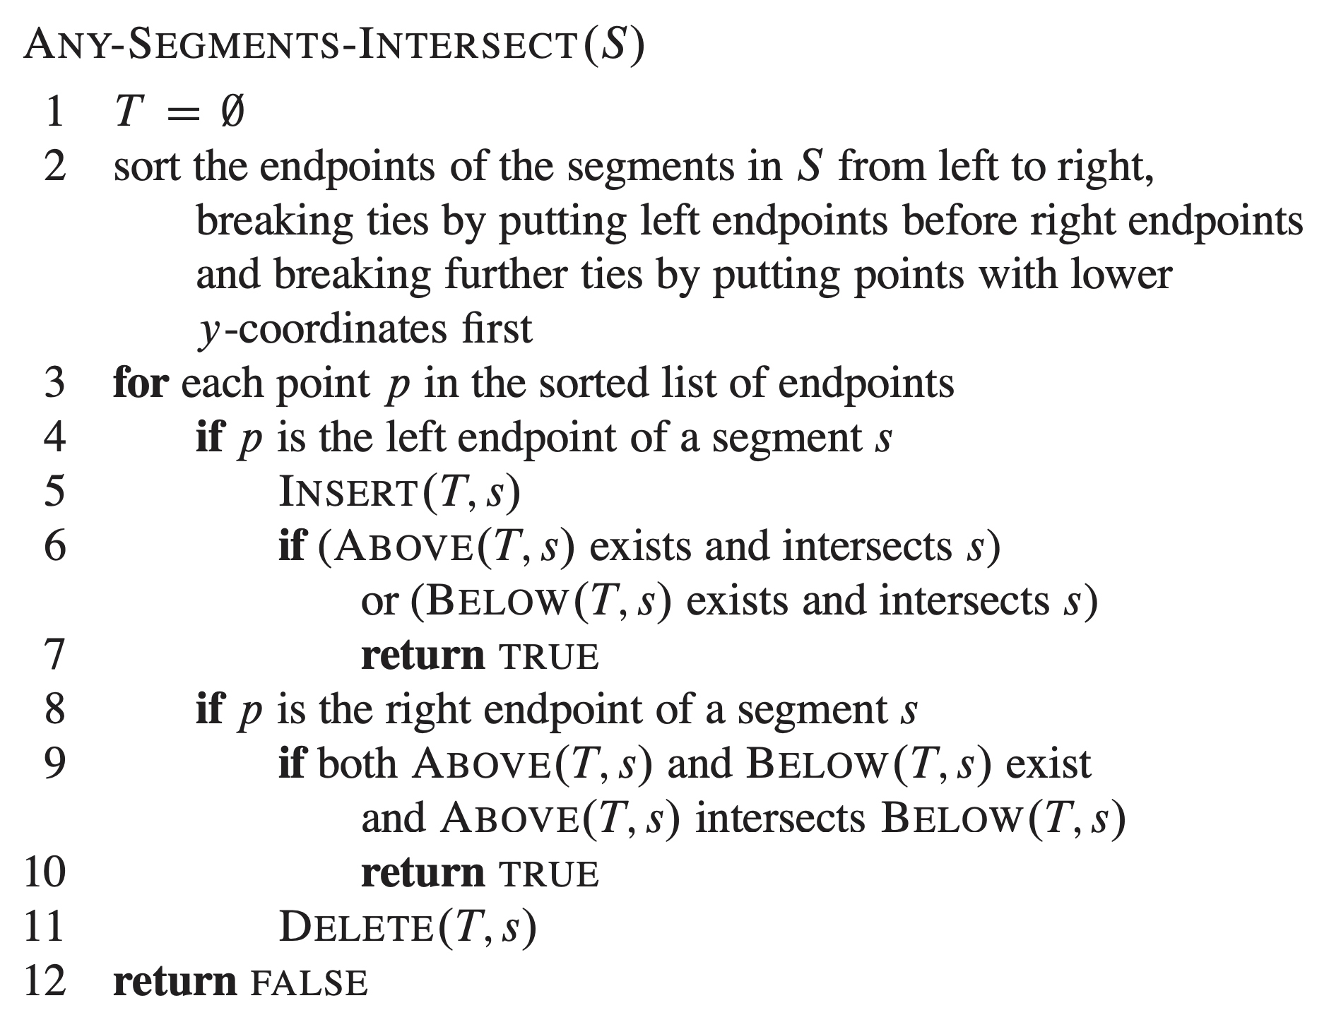
Multiple Segment Intersection
Problem Statement: Given a set of line segments, return true iff at least one pair of segments intersects.

Slide 47
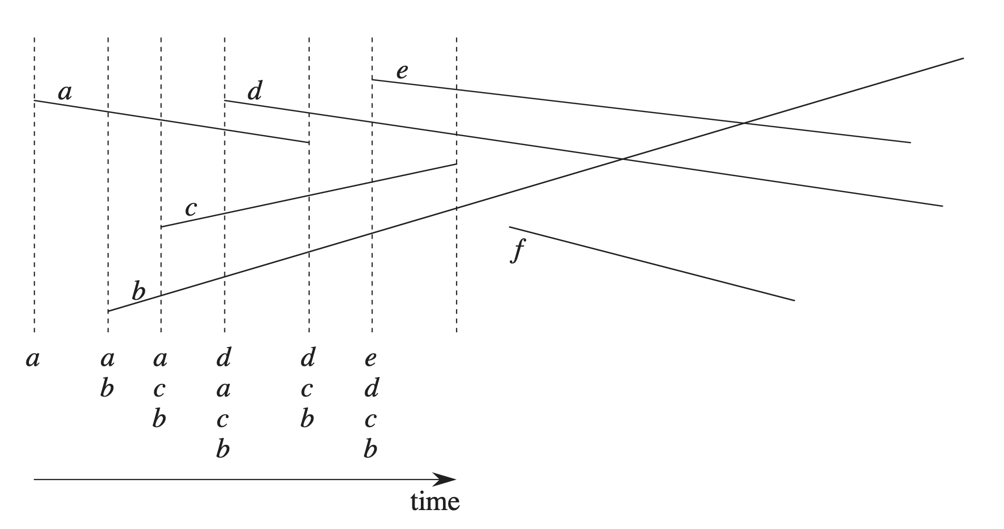
Multiple Segment Intersection
Let’s step through the algorithm together

Slide 48
Intersection of Polygons

Slide 49

Intersection of Polygons
Algorithm is pretty simple:
intersects(points P1[], points P2[]):
P1 intersects P2 if one of the following is true: Any point of one polygon is inside other Any edge of one polygon intersects another
Runtime (P1 size=n P2 size=m):
Point inside: (n*m) Edge check: (n*m)
$$Θ\left(n∗m\right)$$
We have subroutines for both of these now!

Slide 50
Line-Horizon Problem

Slide 51
Line-Horizon Problem
Common Robotics / AI Problem: A robot is operating in the world, and has multiple actions A[] that can be taken. Each action will produce some “reward” (a positive integer) for taking that action. The problem is that the reward received depends on one of two states the robot is in and the robot does not know what state it is currently in.
Y-axis is the amount of reward robot gets if they are in that state and take that action
action 2
Since robot does not know if it is in state 0 or 1, it maintains a probability distribution of what state it thinks it is in, and selects the action with the highest expected value.
action 1
0
1
The states the robot can be in (two states for simplicity here)

Slide 52
Line-Horizon Problem
Looking ahead: These robots end up “looking ahead”, and creating multiple lines which model not just one action, but the expected rewards for future actions later (don’t worry about details). We end up with a bunch of lines, and only the ones that are maximized at at least one point should be retained.
0
1
0
1
Now we have our problem statement: Given a list of lines L[] in the 2D plane, find the “horizon”. In other words, return the subset of lines H[] for which each line in H[] has the highest output value for some input x.

Slide 53

Line-Horizon Problem
Naïve Solution: Find all pair of intersection points I[] ($Θ(n^{2})$) and sort by x-value. For each range between intersection points, test each line to see which has the maximum value in that range (can optimize slightly by only checking intersection points involving the current highest line)
0
1

Slide 54
Line-Horizon Problem
$Θ(n log n)$ Solution: We can do this faster with a divide and conquer algorithm
Initialization: Sort by increasing slope.
Divide: Divide the list in half and recursively solve each half
0
1
0
1
0
1

Slide 55
Line-Horizon Problem
$Θ(n log n)$ Solution: We can do this faster with a divide and conquer algorithm
Return Value:
Format of return value will be slope and y-intercept of each line (sorted by slope) and a second array that stores the intersection points of the lines in order left to right (in this case, there are none.
Base Case:
If only one line, just return the line itself!
Return Value:
Lines = [5,1] Intersections = []
0
1

Slide 56
Line-Horizon Problem
$Θ(n log n)$ Solution: We can do this faster with a divide and conquer algorithm
Purple side returns something like::
Lines = [(-7,12), (-1,8)] Intersections = [0.24]
Green side returns something like::
Lines = [(0.5,6), (6,2), (8,-13)] Intersections = [0.46, 0.87]
0
1
Merge Step: Given solution to both halves, merge solutions in linear time
Main Idea: Walk the intersection points left to right until the right (green) lines start to dominate.

Slide 57
Line-Horizon Problem
$Θ(n log n)$ Solution: We can do this faster with a divide and conquer algorithm
Purple side returns something like::
L_Lines = [(-7,12), (-1,8)] L_Int = [0.24 ]
Green side returns something like::
R_Lines = [(0.5,6), (6,2), (8,-13)] R_Int = [0.46, 0.87]
leftIndex=0
rightIndex=0
0
1
At each loop iteration:
Take line at leftIndex and rightIndex
Evaluate each line at left most intersection min(L_Int[leftIndex], R_Int[rightIndex]
If left (purple) line greater than right (green) line:
increment index of whichever side is left-most (right now, purple)
Else
return ….

Slide 58
Line-Horizon Problem
$Θ(n log n)$ Solution: We can do this faster with a divide and conquer algorithm
Purple side returns something like::
L_Lines = [(-7,12), (-1,8)] L_Int = [0.24 ]
Green side returns something like::
R_Lines = [(0.5,6), (6,2), (8,-13)] R_Int = [0.46, 0.87]
leftIndex=1
rightIndex=0
0
1
At each loop iteration:
Take line at leftIndex and rightIndex
Evaluate each line at left most intersection min(L_Int[leftIndex], R_Int[rightIndex]
If left (purple) line greater than right (green) line:
increment index of whichever side is left-most
Else
return ….

Slide 59
Line-Horizon Problem
$Θ(n log n)$ Solution: We can do this faster with a divide and conquer algorithm
Purple side returns something like::
L_Lines = [(-7,12), (-1,8)] L_Int = [0.24 ]
Green side returns something like::
R_Lines = [(0.5,6), (6,2), (8,-13)] R_Int = [0.46, 0.87]
leftIndex=1
rightIndex=1
0
1
At each loop iteration:
Take line at leftIndex and rightIndex
Evaluate each line at left most intersection min(L_Int[leftIndex], R_Int[rightIndex]
If left (purple) line greater than right (green) line:
increment index of whichever side is left-most
Else
return L_Lines[0:leftIndex] + Rlines[rightIndex:] return L_int[0:leftIndex-1] + intersection(L_Lines[leftIndex], R_Lines[rightIndex]) + R_int[rightIndex:]

Slide 60
Line-Horizon Problem
$Θ(n log n)$ Solution: We can do this faster with a divide and conquer algorithm
Purple side returns something like::
L_Lines = [(-7,12), (-1,8)] L_Int = [0.24 ]
Green side returns something like::
R_Lines = [(0.5,6), (6,2), (8,-13)] R_Int = [0.46, 0.87]
leftIndex=1
rightIndex=1
0
1
Final return values:
Lines = [(-7,12), (-1,8), (6,2), (8,-13)] Int = [0.24, 0.45, 0.87]

Slide 61
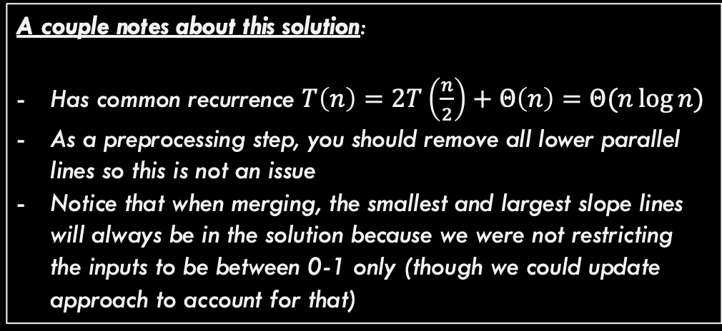
Line-Horizon Problem
$Θ(n log n)$ Solution: We can do this faster with a divide and conquer algorithm
A couple notes about this solution:
Has common recurrence $T\left(n\right)=2T\left(\frac{n}{2}\right)+Θ\left(n\right)=Θ(n\log{n})$
As a preprocessing step, you should remove all lower parallel lines so this is not an issue
Notice that when merging, the smallest and largest slope lines will always be in the solution because we were not restricting the inputs to be between 0-1 only (though we could update approach to account for that)
0
1

Slide 62
Conclusion

Slide 63
Conclusions
Some computational geometry approaches that we covered:
- Using turns (cross-product) to compute things like intersection - Checking various special cases (vertex falls on line segment, co-linearity, etc.) - Example of a line sweep algorithm - Example of divide and conquer to find a horizon - Combining these approaches to detect intersection of polygons
Next time:
- Convex Hull (a neat algorithm that uses rotational sorting) - Quad Trees (a data structure for storing geometric objects efficiently)

