Slide 1
Segment Trees
Advanced Algorithms Mark Floryan Material From: https://cp-algorithms.com/data_structures/segment_tree.html

Slide 2
Advanced Tree Structures
In this deck we will look at:
- Segment Trees

Slide 3
Motivation: Range Queries Over Arrays

Slide 4

Motivation
Goal: Given a list of integers $A=\{a_{1},a_{2},…,a_{n}\}$ and a function that operates on continuous ranges in A, called $f(l,r)$ where $l,r∈Z;l≤r$
Support the following operations:
1. Calculate (for any l,r) the value of $f\left(l,r\right)=f(a_{l},…,a_{r})$ in $O(\log{n)}$ time
2. Update the value of an element of A in $O(\log{n)}$ time.
3. Use no more than $O(n)$ memory (so no more than list A itself times a constant)
**Notice: This is the same motivation for Fenwick Trees, but Segment Trees will have some advantages / disadvantages

Slide 5
Why would we want this?
A = {5, 10, 1, 11, 29, 3, 2, 209, 85, 6, 9, 11}
Suppose: That f() is a function we care about over any range. Max and min (for stock prices), average (for sensor data), or sum (for sales)
Suppose: That our stream of integers are stock prices over time, or sensor data across many time points, or sales per day (etc.).
Perhaps our company needs to be able to pull f() over any arbitrary range in A thousands of time per day

Slide 6
Segment Trees

Slide 7
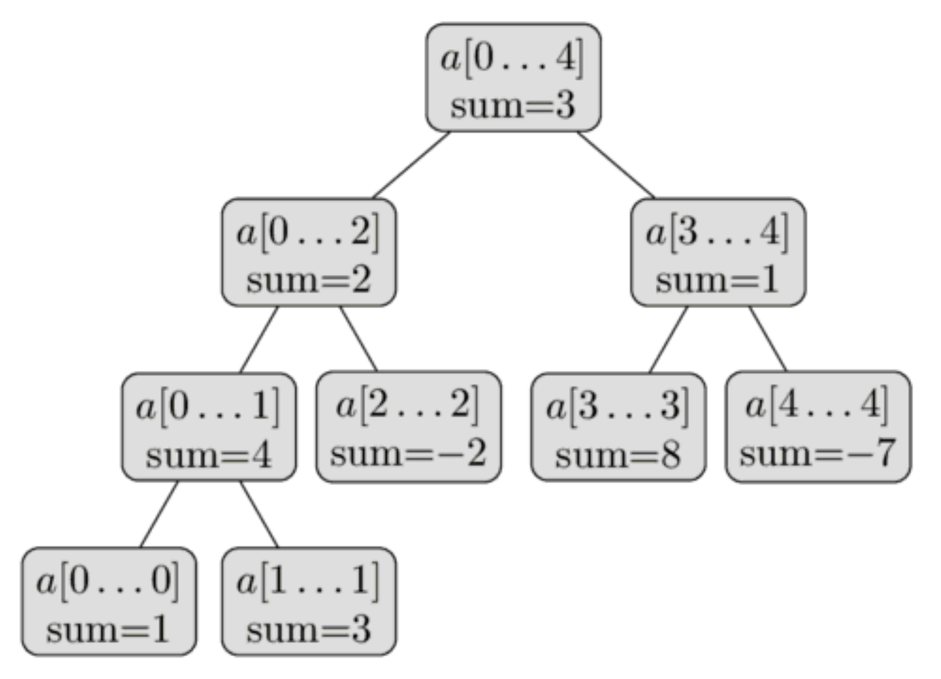
Segment Tree
Here, we are representing the following array:
A = {1, 3, -2, 8, -7}
Each node stores the f() of interest value for a subrange of the array
Leaf nodes store f(), here we are using sum, for a single element. Usually trivial to compute.

Slide 8

Segment Tree
Here, we are representing the following array:
A = {1, 3, -2, 8, -7}
How much storage does this take (note that we don’t store the sub-arrays, just the start and end indices, and f()
$$1+2+4+8+ …+2^{(\log_{2}{n})+1}<4n=Θ(n)$$

Slide 9
Constructing A Segment Tree
Before constructing ST, need to determine two things:
1. The value(s) that gets stored in the nodes (e.g., the sum of the nodes in the given range)
2. The merge operation, which determines the value(s) from #1 above, given the value(s) of the two children.
For sum, merge would simply be (child1 + child2)

Slide 10
Constructing A Segment Tree
Let’s step through constructing this tree:
A = {1, 3, -2, 8, -7}

Slide 11
Constructing A Segment Tree
Psuedo-code for Segment Tree Construction:
Node:
int left, right; int val; //can be different
ConstructSegTree(a[]):
ConstructRecurse(a, new Node(0, a.size-1));
ConstructRecurse(a[], curNode):
if(curNode.left == curNode.right):
set curNode.val to base case value
leftChild = new Node(curNode.left, mid); rightChild = new Node(mid+1, curNode.right); ConstructRecurse(a, leftChild); ConstructRecurse(a, rightChild); this.val = merge(leftChild, rightChild);

Slide 12
A quick Note on Representation
You can store Segment Trees the same way binary heaps are typically done. Use an array.
Left child = ((index+1)*2) - 1
Right child = (index+1)*2
^^These are a tad simpler if you index by 1 instead of 0
I’ll show these as trees in this slide deck though…
T = {3, 2, 1, 4, -2, 8, -7, 1, 3}

Slide 13
Range Queries

Slide 14
Range Queries
A = {1, 3, -2, 8, -7}
For now, let’s assume that our function f() that we care about is sum (as in the example to the left)
We want to answer queries of the form: sum(left, right)
Example: sum(2,4) = a[2]+a[3]+a[4] = -1

Slide 15
Range Queries
A = {1, 3, -2, 8, -7}
sum(left, right):
Three cases that could occur:
1. [left, right] is exact range of this node
2. [left, right] falls completely within left child or right child
3. [left, right] crosses the dividing line of this node

Slide 16
Range Query Example
A = {1, 3, -2, 8, -7}
Let’s step through:
sum(2, 4) //answer should be -1

Slide 17
Range Query Example
A = {1, 3, -2, 8, -7}
sum(2,4)
Let’s step through:
sum(2, 4) //answer should be -1 [2,4] Spans both children, so recurse on both children!

Slide 18
Range Query Example
A = {1, 3, -2, 8, -7}
sum(3,4)
sum(2,2)
Let’s step through:
sum(2, 4) //answer should be -1 [2,4] Spans both children, so recurse on both children!
sum(2, 2) [2,2] falls completely on right half, so recurse right!

Slide 19
Range Query Example
A = {1, 3, -2, 8, -7}
sum(3,4)
Let’s step through:
sum(2, 4) //answer should be -1 [2,4] Spans both children, so recurse on both children!
sum(2, 2) [2,2] falls completely on right half, so recurse right! [2,2] is now complete range, return -2
sum(2,2)

Slide 20
Range Query Example
A = {1, 3, -2, 8, -7}
returned -2
sum(3,4)
Let’s step through:
sum(2, 4) //answer should be -1 [2,4] Spans both children, so recurse on both children!
sum(2, 2) [2,2] falls completely on right half, so recurse right! [2,2] is now complete range, return -2
sum(3, 4) [3,4] is the entire range, so return 1

Slide 21
Range Query Example
A = {1, 3, -2, 8, -7}
returned -2
returned 1
Let’s step through:
sum(2, 4) //answer should be -1 [2,4] Spans both children, so recurse on both children!
sum(2, 2) [2,2] falls completely on right half, so recurse right! [2,2] is now complete range, return -2
sum(3, 4) [3,4] is the entire range, so return 1

Slide 22
Range Query Example
A = {1, 3, -2, 8, -7}
returned -2
returned 1
merge(-2,1)=-2+1=-1
Let’s step through:
sum(2, 4) //answer should be -1 [2,4] Spans both children, so recurse on both children!
sum(2, 2) [2,2] falls completely on right half, so recurse right! [2,2] is now complete range, return -2
sum(3, 4) [3,4] is the entire range, so return 1
Finally, merge the two return values

Slide 23
Three More Examples
A = {1, 3, -2, 8, -7}
Let’s step through:
sum(0,4)
sum(0,1)
sum(1,3)

Slide 24
Let’s pseudocode this…
A = {1, 3, -2, 8, -7}
sumQuery(left, right): sumQuery(root, l, r)
sumQuery(curNode, l, r):

Slide 25
Range Query Runtime

Slide 26
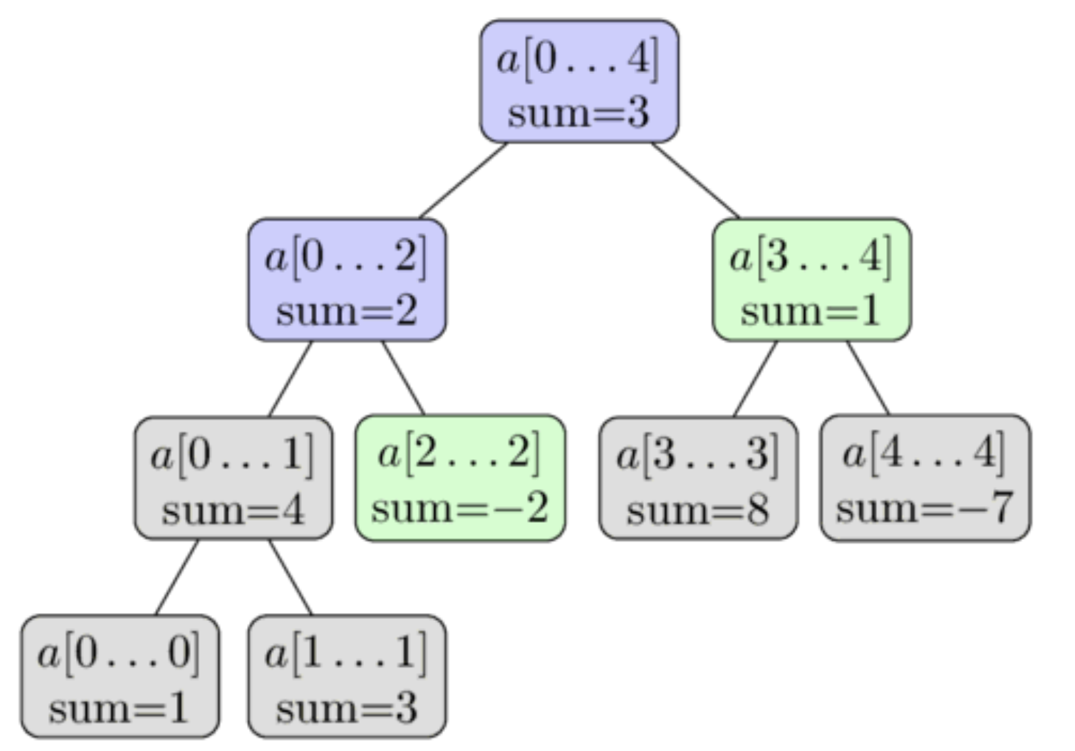

Range Query Runtime
A = {1, 3, -2, 8, -7}
What is the runtime of range queries?
Clearly it is $O(n)$ and $Ω(\log{n)}$
Will this actually happen? Consider sum(0, 4)
Or will this happen? Always? Just sometimes? If latter, how often?
Another representation of the execution of sum(2, 4) from earlier.

Slide 27
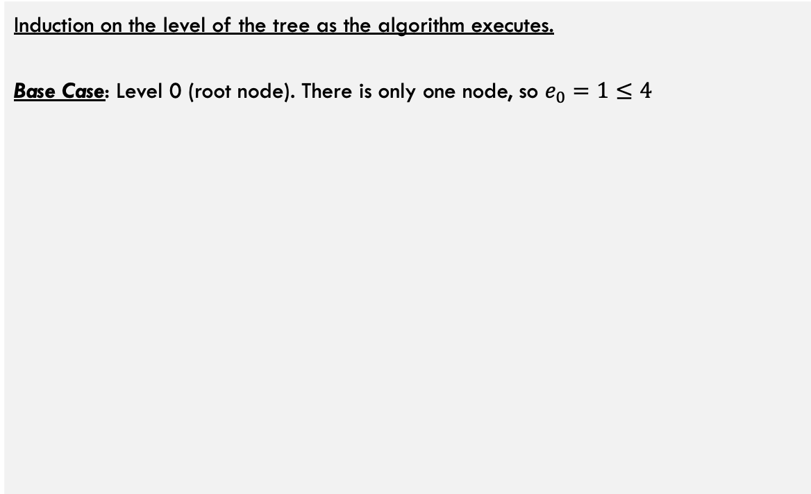

Range Query Runtime
Claim: As a range query on a segment tree executes. The number of nodes explored (let’s call it e_{i}) at each level (let’s call it i) of the tree is at most 4. $∀_{i≥0}0≤e_{i}≤4$
Induction on the level of the tree as the algorithm executes. Base Case: Level 0 (root node). There is only one node, so $e_{0}=1≤4$

Slide 28
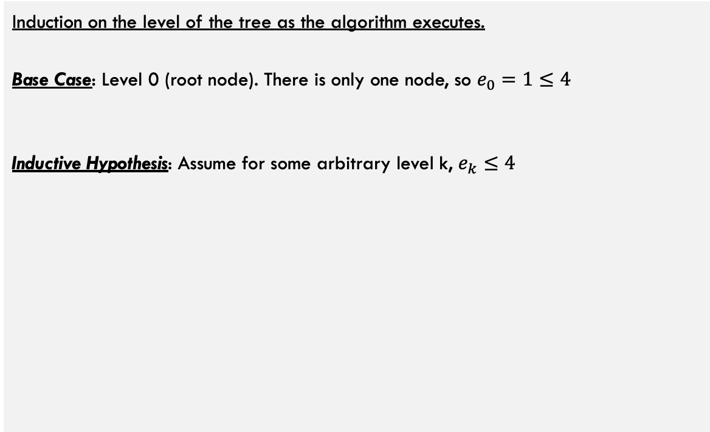
Range Query Runtime
Claim: As a range query on a segment tree executes. The number of nodes explored (let’s call it e_{i}) at each level (let’s call it i) of the tree is at most 4. $∀_{i≥0}0≤e_{i}≤4$
Induction on the level of the tree as the algorithm executes. Base Case: Level 0 (root node). There is only one node, so $e_{0}=1≤4$
Inductive Hypothesis: Assume for some arbitrary level k, $e_{k}≤4$

Slide 29
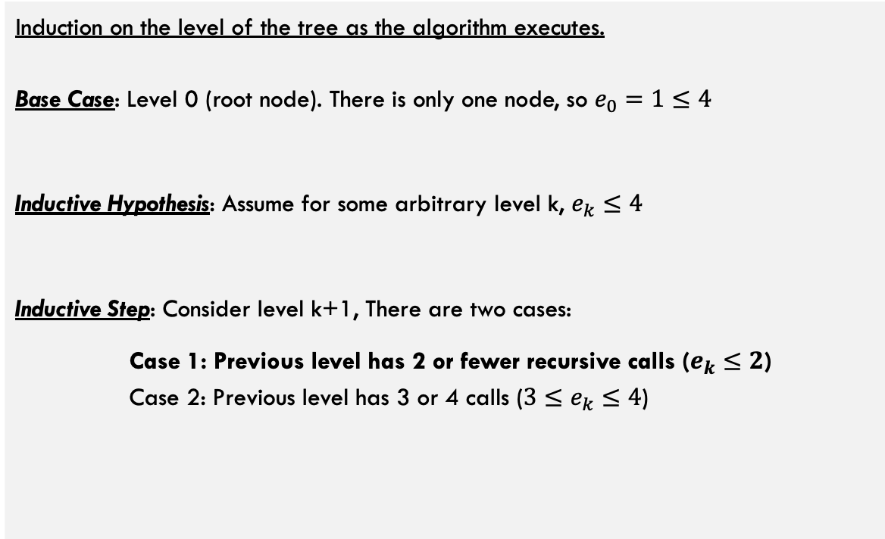


Range Query Runtime
Claim: As a range query on a segment tree executes. The number of nodes explored (let’s call it e_{i}) at each level (let’s call it i) of the tree is at most 4. $∀_{i≥0}0≤e_{i}≤4$
Induction on the level of the tree as the algorithm executes. Base Case: Level 0 (root node). There is only one node, so $e_{0}=1≤4$
Inductive Hypothesis: Assume for some arbitrary level k, $e_{k}≤4$
Inductive Step: Consider level k+1, There are two cases:
Case 1: Previous level has 2 or fewer recursive calls ($e_{k}≤2$) Case 2: Previous level has 3 or 4 calls (${3≤e}_{k}≤4$)
level k: $e_{k}=2$
Because level k only has at most 2 nodes traversed, each can make at most 2 recursive calls, so $e_{k}≤4$

Slide 30
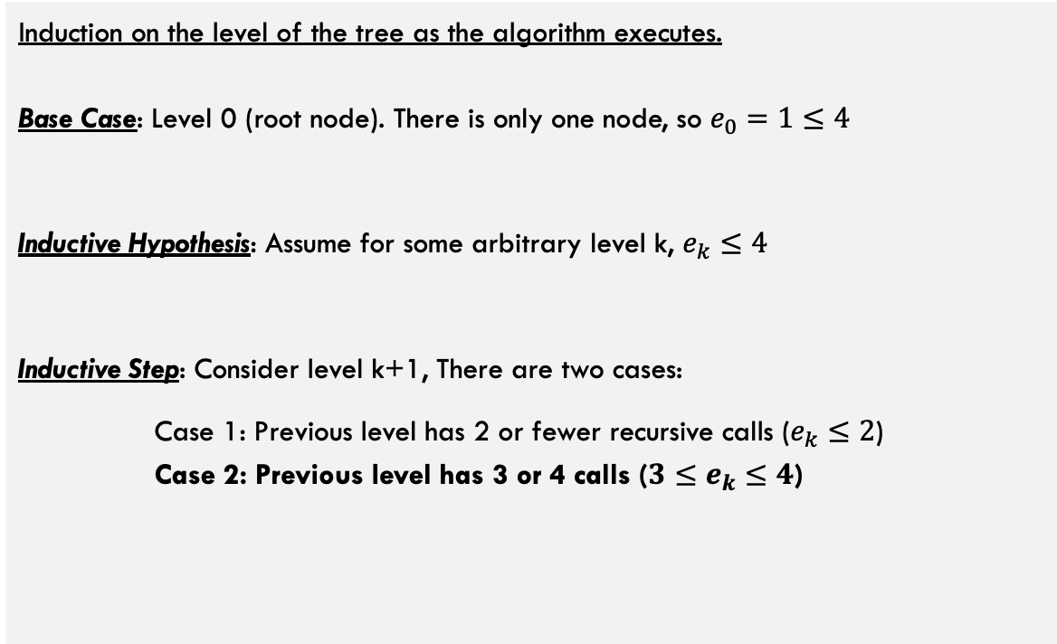


Range Query Runtime
Claim: As a range query on a segment tree executes. The number of nodes explored (let’s call it e_{i}) at each level (let’s call it i) of the tree is at most 4. $∀_{i≥0}0≤e_{i}≤4$
Induction on the level of the tree as the algorithm executes. Base Case: Level 0 (root node). There is only one node, so $e_{0}=1≤4$
Inductive Hypothesis: Assume for some arbitrary level k, $e_{k}≤4$
Inductive Step: Consider level k+1, There are two cases:
Case 1: Previous level has 2 or fewer recursive calls ($e_{k}≤2$) Case 2: Previous level has 3 or 4 calls (${3≤e}_{k}≤4$)
level k: $e_{k}=4$
2 outer nodes can produce at most 2 recursive calls each, so $e_{k+1}≤4$
Because original range is contiguous, inner ranges must span full range of inner blue nodes, so these won’t recurse at all!

Slide 31

Range Query Runtime
Claim: As a range query on a segment tree executes. The number of nodes explored (let’s call it e_{i}) at each level (let’s call it i) of the tree is at most 4. $∀_{i≥0}0≤e_{i}≤4$
Induction on the level of the tree as the algorithm executes. Base Case: Level 0 (root node). There is only one node, so $e_{0}=1≤4$
Inductive Hypothesis: Assume for some arbitrary level k, $e_{k}≤4$
Inductive Step: Consider level k+1, There are two cases:
Case 1: Previous level has 2 or fewer recursive calls ($e_{k}≤2$) Case 2: Previous level has 3 or 4 calls (${3≤e}_{k}≤4$)
Claim is proven! Because each level has at most 4 nodes traversed, and there are log(n) levels of the segment tree, the total nodes traversed is bounded by $\sum_{e_{i}}{4\log{n}}$

Slide 32
Update Queries

Slide 33
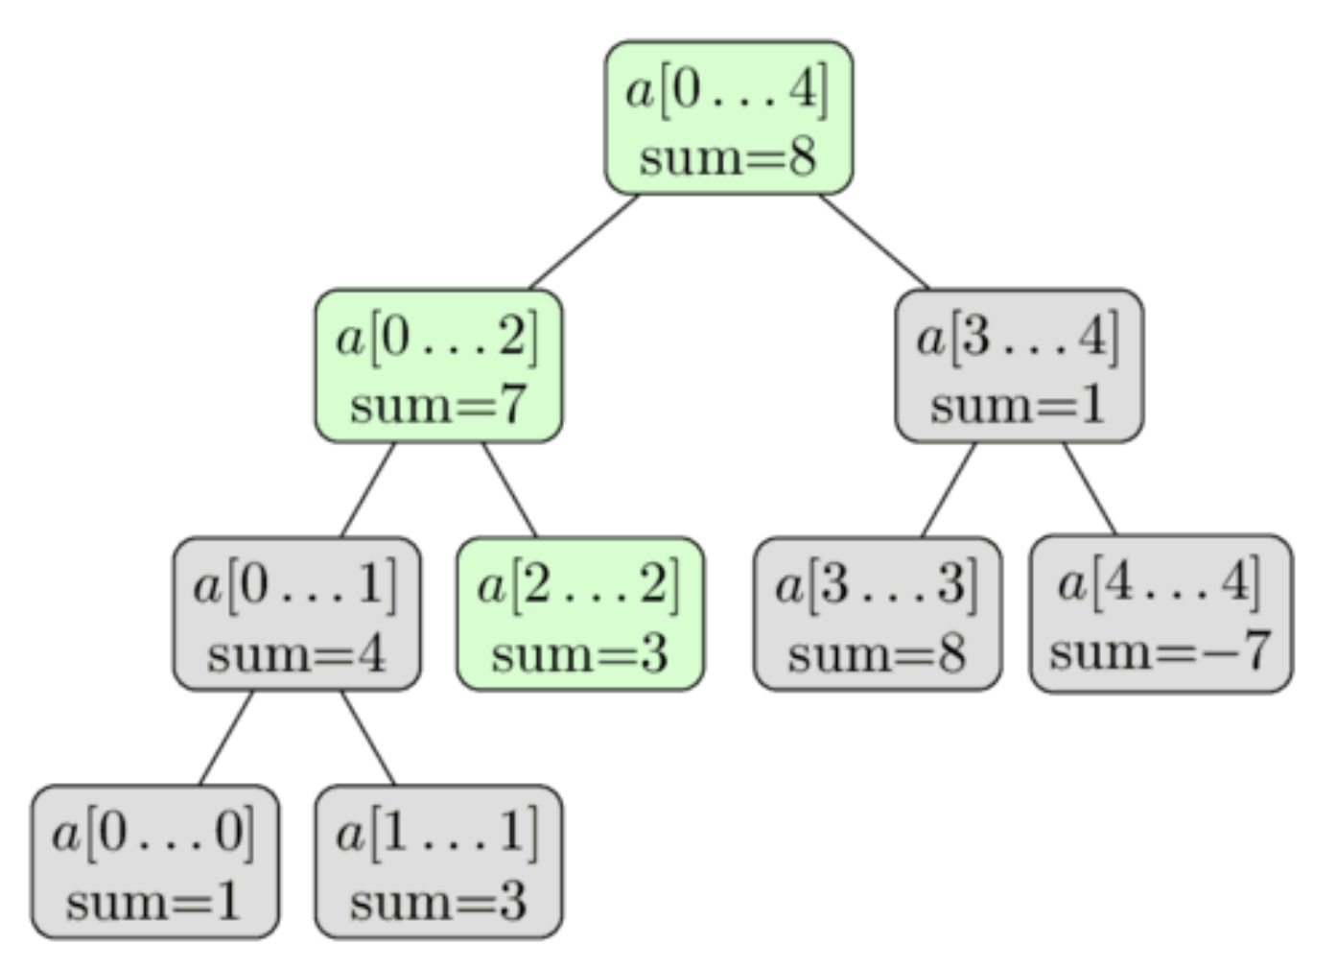
Update Query
A = {1, 3, -2, 8, -7}
A = {1, 3, 3, 8, -7}
update(2, 3)
Traverse the tree to find index 2
Make sure to call merge() to update value along the path as recursion returns

Slide 34
Two more quick Examples
A = {1, 3, 3, 8, -7}
Let’s step through:
update(3, 10)
update(0, 2)

Slide 35
More Examples

Slide 36
Number of 0’s and K’th 0
Given an array, we want to be able to query for the number of zero’s in any segment (range) AND also query for the location of the k’th zero.
1. What will we store in each node of the segment tree?
A = {1, 0, 0, -2, 0, 7, 0, 0, 3, 3, 1, 0, 1, 0, 0, 0, 0, 4}
2. How will we define the merge() operation?
3. How will we query for the k’th zero?
Try to solve this problem on your own!

Slide 37
Number of 0’s and K’th 0
Given an array, we want to be able to query for the number of zero’s in any segment (range) AND also query for the location of the k’th zero.
A = {1, 0, 0, -2, 0, 7, 0, 0, 3, 3, 1, 0, 1, 0, 0, 0, 0, 4}
Store: The number of 0’s in each segment in the node itself
Update: Only thing that matters is…did the new value become a 0 or change FROM a 0. Update num 0’s by 1 if so and merge up.
Merge: Simple, just add number of 0’s together
Query (# of 0’s): Simply query like we did with sum()
Query (k’th 0): If number of 0’s on left is k or larger, recurse left. Or search for the leftChild-k on right

Slide 38
Other Segment Tree Examples

Slide 39
Finding Maximal Sub-Segment
Given an array A, and a range [l .. r], find the subsegment [l’ .. r’] such that $l≤l′$ and $r≥r′$ and sum of [l’ .. r’] is maximal
1. What will we store in each node of the segment tree?
A = {1, 6, -3, -1, -1, 1, -5, 11, 12, 1, 1, 2, -4, -2, -8, 9, 11}
2. How will we define the merge() operation?
So maximal(2, 8) would return 23 because range [7 .. 8] (11+12) is the maximal sum within the range [2 .. 8].
3. How will we query?

Slide 40
Finding Maximal Sub-Segment
Given an array A, and a range [l .. r], find the subsegment [l’ .. r’] such that $l≤l′$ and $r≥r′$ and sum of [l’ .. r’] is maximal
Key Idea: Observe that the maximal sub-segment of a range is one of a few options given the solution to its two children.
L
T_{l}
T_{R}
R
L
T_{l}
Option 1: Solution is the max segment on left
Option 2: Solution is the max segment on right
T_{l}
R
Option 3: Solution is max suffix sum on left concatenated with max prefix sum on right (orange bars)

Slide 41
Finding Maximal Sub-Segment
L
T_{l}
T_{R}
R
L
T_{l}
Option 1: Solution is the max segment on left
Option 2: Solution is the max segment on right
T_{l}
R
Option 3: Solution is max suffix sum on left concatenated with max prefix sum on right (orange bars)
Each node should store:
Sum of segment: useful for computing other values below
Max prefix sum: for combining across splits
Max suffix sum: for combining across splits
Ans: The answer (max segment)
How to merge:
sum = L.sum + R.sum
pre = Max(L.pre, L.sum + R.pre)
suf = Max(R.suf, R.sum + L.suf)
ans = Max(L.ans, R.ans, L.suf + R.pre)

Slide 42
Conclusion

Slide 43
Conclusions
Strengths:
More intuitive than Fenwick trees for many applications
Binary Trees very easy to implement
Seems to work for a wider array of functions of interest
Only really have to focus on what to store and merge function, once you get those right the rest falls into place.
Weaknesses:
Uses a bit more memory than Fenwick Tree (because Fenwick tree isn’t really a tree and doesn’t have internal nodes
Does not take advantage of fast bit operations to traverse tree

