Slide 1
Approximation Algorithms
Advanced Algorithms Mark Floryan CLRS Ch. 35

Slide 2
Advanced Tree Structures
In this deck we will look at:
- Approximation Ratios - Vertex Cover Approximation - TSP Approximation - Set-Covering Approximation

Slide 3
Introduction: Approximation

Slide 4


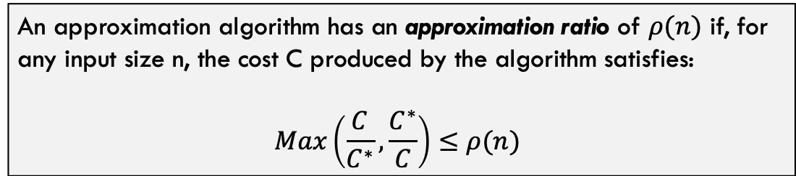

Approximation Ratios
$C^{∗}$ = Optimal Solution
Approximation Algorithm to Some Optimization Problem
$C$ = Approximated Solution
Input
$$NOT optimal solution(s)$$
Often, this problem is NP-Hard
An approximation algorithm has an approximation ratio of $ρ(n)$ if, for any input size n, the cost C produced by the algorithm satisfies:
$$Max\left(\frac{C}{C^{∗}},\frac{C^{∗}}{C}\right)≤ρ(n)$$

Slide 5


Some Definitions
$ρ(n)$-Approximation Algorithm
An approximation algorithm that achieves an approximation of $ρ(n)$ on all inputs
Approximation Scheme
An approximation algorithm that takes as input the instance of the problem and a value $ε>0$ such that for any fixed $ε$, the scheme is a $(1+ε)$-approximation algorithm.
Polynomial Time Approximation Scheme
A scheme is polynomial time if, for any fixed $ε>0$, the algorithm runs in polynomial time in terms of the input size n
Fully Polynomial Time Approximation Scheme
A scheme is fully polynomial time if it has a runtime that is polynomial in terms of $\frac{1}{ε}$.
For example, a fully polynomial time approximation scheme might have runtime $Θ\left({\left(\frac{1}{ε}\right)}^{2}n^{2}\right)$

Slide 6
Vertex-Cover

Slide 7
Recall Vertex-Cover
Given a Graph $G=(V,E)$, find the smallest set of nodes $V^{′}⊂V | ∀_{e=\left(u,v\right)∈E} \left(u∈V^{′}∨v∈V^{′}\right)$
This problem is NP-Hard
b
c
d
a
e
f
g
In other words, find the smallest set of nodes that touches every edge at least once
The purple nodes are the smallest solution for this graph

Slide 8
Proposed Algorithm for Vertex-Cover
Vertex-Approximation(G):
C = []
E’ = G.E
while E’ not empty:
let e=(u,v) be arbitrary edge from E’
C = C.append({u,v})
remove all edges in E’ incident on u or v
return C
b
c
d
a
e
f
g
Run this on the given graph a few times. What is the approximation ratio? Do we have a guaranteed ratio here?

Slide 9
Sample Execution
b
c
d
b
c
d
a
e
f
g
a
e
f
g
b
c
d
b
c
d
a
e
f
g
a
e
f
g
…last step is on next slide

Slide 10
Sample Execution
b
c
d
a
e
f
g

Slide 11
Sample Execution
Vertex-Approximation(G):
C = []
E’ = G.E
while E’ not empty:
let e=(u,v) be arbitrary edge from E’
C = C.append({u,v})
remove all edges in E’ incident on u or v
return C
b
c
d
a
e
f
g
This is just one way it could have turned out. Any thoughts on the limits of “how bad” or “how good” the approximation will be?

Slide 12

Approx-Vert-Cover: Analysis
Runtime is polynomial? Yes, it is $O({\left|E\right|}^{2})$
For each edge e we choose on this line, the solution definitely includes u or v, we always add both
Vertex-Approximation(G):
C = []
E’ = G.E
while E’ not empty:
let e=(u,v) be arbitrary edge from E’
C = C.append(e)
remove all edges in E’ incident on u or v
return C
We remove as many extra edges as we can here, but of course there could be 0 each time.

Slide 13
Approx-Vert-Cover: Analysis
Claim: Vertex-Approximation is a 2-approximation of vertex cover
Proof Part 1 (Correctness): The nodes returned by this algorithm are a valid vertex cover
Vertex-Approximation(G):
C = []
E’ = G.E
while E’ not empty:
let e=(u,v) be arbitrary edge from E’
C = C.append({u,v})
remove all edges in E’ incident on u or v
return C
This is self-evident. Every edge in E is either chosen in line 4 and both it’s nodes added to the solution OR removed in line 6 being incident to u or v.
Thus, every edge is incident on some node in the set C because we do not terminate until E’ is empty.
The algorithm returns a valid vertex-cover

Slide 14
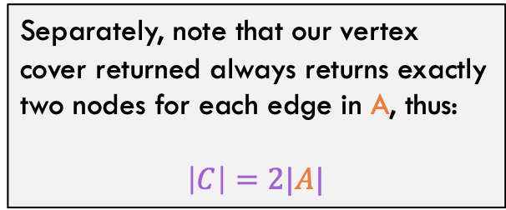
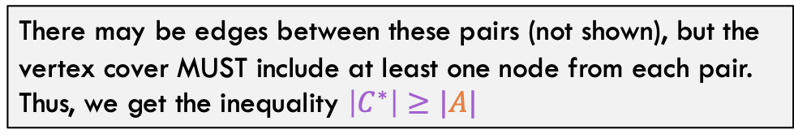
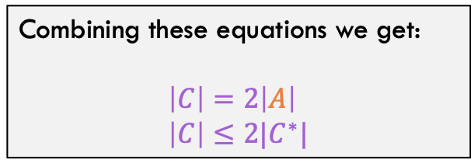
Approx-Vert-Cover: Analysis
Claim: Vertex-Approximation is a 2-approximation of vertex cover
Proof Part 2 (Ratio): The size of C is no more than twice the size of the optimal vertex-cover
Separately, note that our vertex cover returned always returns exactly two nodes for each edge in A, thus:
$$\left|C\right|=2|A|$$
Consider the set of edges A chosen in line 4 of the algorithm. Because other incident edges are removed in line 6, the lines in A form a set of disjoint pairs
a
b
c
d
e
f
Combining these equations we get:
$$\left|C\right|=2\left|A\right| \\ \left|C\right|≤2|C^{∗}|$$
There may be edges between these pairs (not shown), but the vertex cover MUST include at least one node from each pair. Thus, we get the inequality $\left|C^{∗}\right|≥|A|$

Slide 15
Traveling Salesperson

Slide 16

Recall Traveling SalesPerson Problem
Recall the traveling salesperson problem: Given a graph G and start node, what is the minimum cost tour (visit every node exactly once then return to start)
c
4
2
d
b
2
7
3
8
5
3
e
8
g
3
6
4
For our approximation, we are going to assume that the triangle inequality holds. For any three nodes u, v, w:
$$c\left(u,w\right)≤c\left(u,v\right)+c(v,w)$$
a
f
3

Slide 17
Recall Traveling SalesPerson Problem
c
4
2
d
b
2
7
3
8
5
3
e
8
g
3
6
4
a
f
3
Total Cost of this tour is: 3 + 2 + 2 + 3 + 7 + 4 + 3 = 24

Slide 18
Approximation for TSP
TSP-Approx(G, s):
Select any vertex r in G.V
MST T = prims-mst(G, r)
prev = T.preorder().first
for v in T.preorder().second : …
add (prev, v) to solution
add (prev, s) to solution
return solution
Basic Idea:
Calculate minimum spanning tree of G. Use pre-order traversal of this MST to define the tour for TSP

Slide 19
Approximation for TSP
Step 1:
Calculate MST of G (let’s root it at a)
TSP-Approx(G, s):
Select any vertex R in G.V
MST T = prims-mst(G, r)
prev = T.preorder().first
for v in T.preorder().second : …
add (prev, v) to solution
add (prev, s) to solution
return solution
c
4
2
d
b
2
7
3
8
5
3
e
8
g
3
6
4
a
f
3

Slide 20
Approximation for TSP
Step 1.5:
Re-arrange the MST to make it easier to view, remove unused edges
TSP-Approx(G, s):
Select any vertex R in G.V
MST T = prims-mst(G, r)
prev = T.preorder().first
for v in T.preorder().second : …
add (prev, v) to solution
add (prev, s) to solution
return solution
b
c
2
2
3
e
a
3
d
3
f
g
4

Slide 21
Approximation for TSP
Step 2:
Tour is just the pre-order traversal of the MST
TSP-Approx(G, s):
Select any vertex R in G.V
MST T = prims-mst(G, r)
prev = T.preorder().first
for v in T.preorder().second : …
add (prev, v) to solution
add (prev, s) to solution
return solution
b
c
2
2
3
e
a
3
d
3
f
g
4

Slide 22
Approximation for TSP
Rearrange to show tour: Cost is 3 + 4 + 8 + 3 + 3 + 2 + 3 = 26
3
b
a
c
2
How good / bad can this approximation be though?
3
3
d
f
3
g
8
e
4

Slide 23

Approximation for TSP: Analysis
c
d
2
b
2
So we get the inequality: $$c\left(T\right)≤c\left(H^{∗}\right)$$
3
e
g
3
4
a
f
3
Observation 1: The minimum spanning tree is a lower bound for the optimal tour. Why?

Slide 24

Approximation for TSP: Analysis
c
d
2
b
2
So we get the inequality: $$c\left(W\right)=2c\left(T\right) \\ 2c\left(T\right)≤2c(H^{∗})$$
3
e
g
3
4
a
f
3
But this walk is not a tour (it is an mst full walk), what about the tour that gets returned by the algorithm?
Observation 2: Consider the FULL WALK of T. Notice that the full walk traverses each edge exactly twice. Full walk is (a f g f a e d e c b c e a)

Slide 25
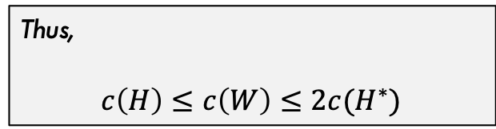

Approximation for TSP: Analysis
c
d
2
Consider the edge (g,e) with cost 8
The full walk goes from (g f a e) Direct edge goes from (g e) Due to triangle inequality: $$c\left(g,e\right)≤c\left(g,f\right)+c\left(f,a\right)+c\left(a,e\right) \\ 8≤10$$
b
2
3
e
8
g
3
4
a
f
3
Thus,
$$c\left(H\right)≤c\left(W\right)≤2c(H^{∗})$$
Observation 3: The cross edges never increase the cost of the “walk”

Slide 26
Set Cover

Slide 27
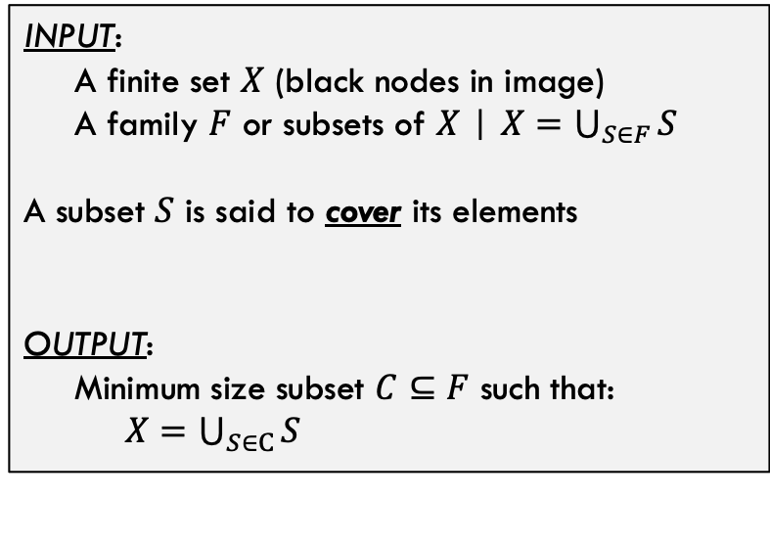






Set Cover Problem
$$S_{1}$$
Set Cover Problem Statement
INPUT:
A finite set $X$ (black nodes in image)
A family $F$ or subsets of $X$ | $X=\bigcup_{S∈F}{S}$ A subset $S$ is said to cover its elements
OUTPUT:
Minimum size subset $C⊆F$ such that: $X=\bigcup_{S∈C}{S}$
$$S_{2}$$
$$S_{6}$$
$$S_{5}$$
In other words, find the smallest group of subsets that include all the elements.
$$S_{3}$$
$$S_{4}$$

Slide 28







Set Cover Problem
$$S_{1}$$
Minimum cover is called $C^{∗}$, for this case, $C^{∗}$ is shown and $\left|C^{∗}\right|=3$
$$S_{2}$$
Set Cover is also NP-Hard, by the way.
$$S_{6}$$
$$S_{5}$$
$$S_{3}$$
$$S_{4}$$

Slide 29
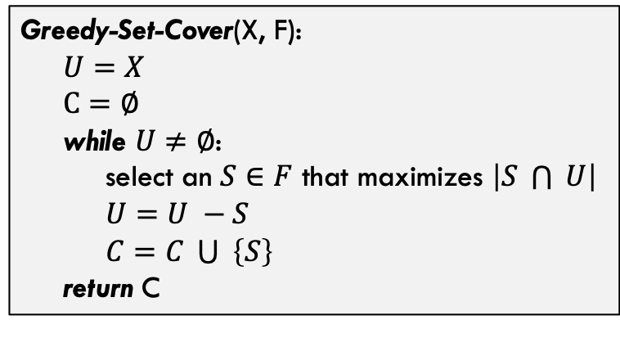
Approximating Set Cover
A greedy approximation for set cover
Greedy-Set-Cover(X, F): $U=X$ $C=∅$ while $U≠∅$: select an $S∈F$ that maximizes $\left|S \bigcap{ }U\right|$ $U=U −S$ $C=C \bigcup{ }\left\{S\right\}$ return C
How good of a cover will this produce? Any “gut” reactions?
… in other words, always select the subset that adds the most new (currently uncovered) elements to the cover
What is the runtime of this method?

Slide 30



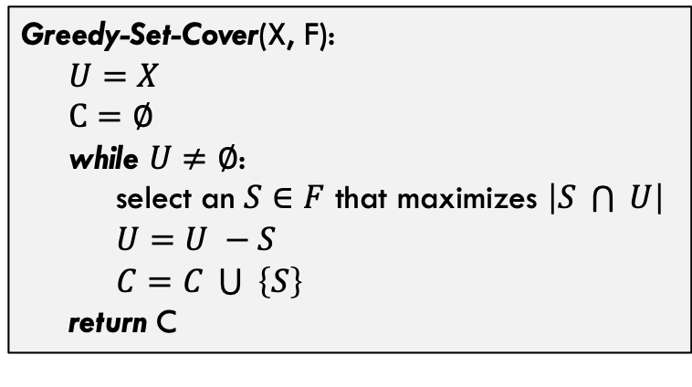




Approximating Set Cover
A greedy approximation for set cover
$$S_{1}$$
Greedy-Set-Cover(X, F): $U=X$ $C=∅$ while $U≠∅$: select an $S∈F$ that maximizes $\left|S \bigcap{ }U\right|$ $U=U −S$ $C=C \bigcup{ }\left\{S\right\}$ return C
$$S_{2}$$
Execution on test case gives:
Add $S_{1}$ first (adds six nodes to cover) Add $S_{4}$ next (adds three nodes to cover) Add $S_{5}$ next (adds two nodes to cover) Add $S_{6}$ last (adds one node to cover)
$$S_{6}$$
$$S_{5}$$
$$\left|C\right|=4>\left|C^{∗}\right|=3$$
$$S_{3}$$
$$S_{4}$$

Slide 31

Analysis
Theorem:
Greedy-Set-Cover(X, F) is a $ρ(n)$-approximation of set-cover where $ρ\left(n\right)=H(max⁡(\left|S\right| :S∈F)$
H() is a harmonic number (see next slide)

Slide 32
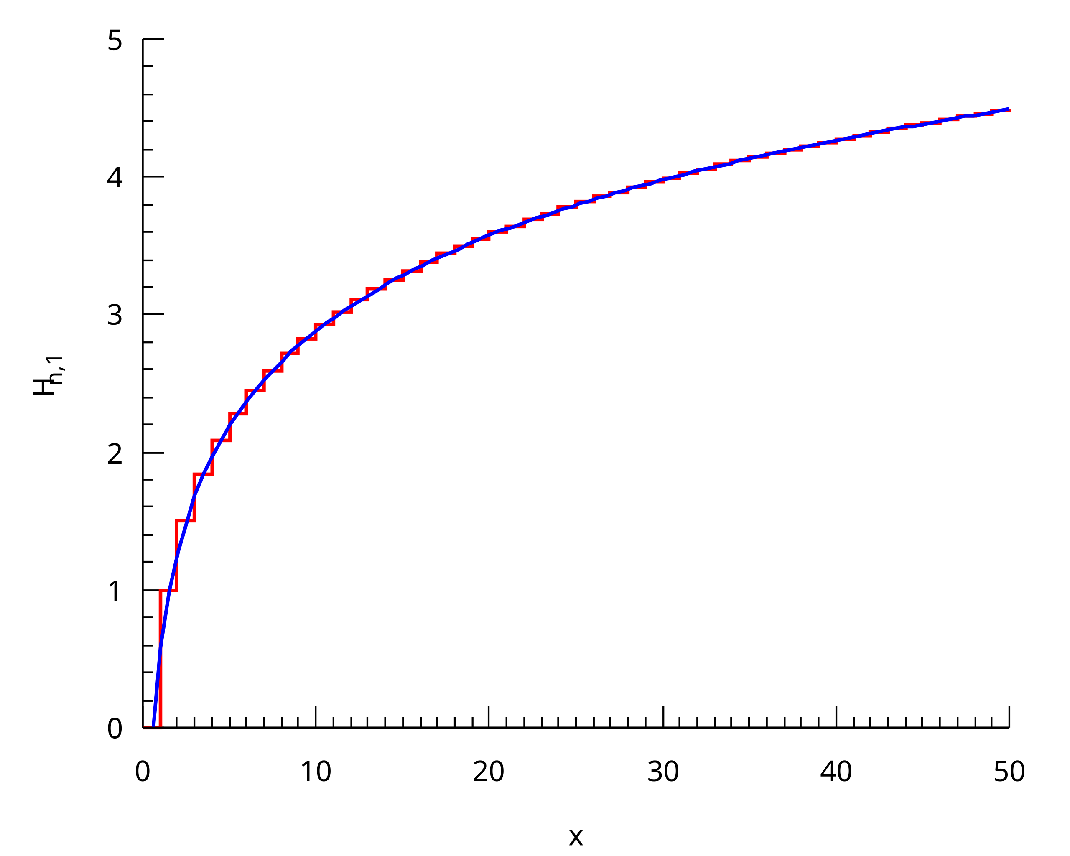
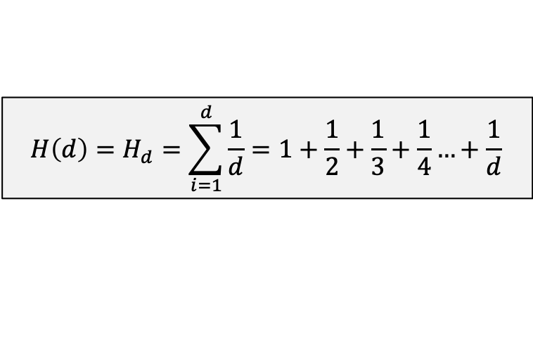

Aside: Harmonic Numbers
Harmonic Number:
$${H\left(d\right)=H}_{d}=\sum_{i=1}^{d}{\frac{1}{d}}=1+\frac{1}{2}+\frac{1}{3}+\frac{1}{4}…+\frac{1}{d}$$
Why? Well set cover algorithm seems to have a similar pattern. You keep adding a percentage of nodes that are left on each iteration.
Note that it is established that:
$$H_{d}=\ln{(d)}+O(1)$$
Harmonic number (x-axis) and value of summation H_d (y-axis). **source = Wikipedia

Slide 33




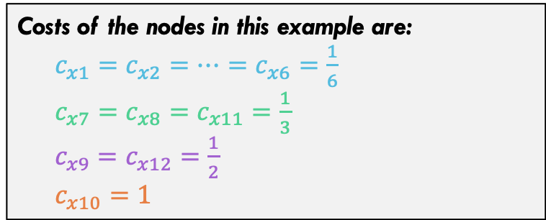



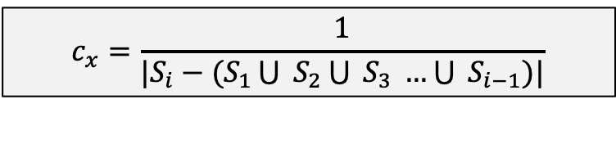











Analysis of Set Cover Greedy
$$S_{1}$$
Consider the following cost function
$$x_{1}$$
$$x_{2}$$
$$x_{3}$$
$$c_{x}=\frac{1}{|S_{i}−(S_{1}\bigcup{ S_{2}\bigcup{ S_{3} …\bigcup{ S_{i−1}}}})|}$$
Each set we add to the solution adds a cost of 1, but spread cost out among elements added. Each element has exactly ONE cost.
$$x_{4}$$
$$x_{5}$$
$$x_{6}$$
$$x_{7}$$
$$x_{8}$$
$$x_{9}$$
$$S_{2}$$
Costs of the nodes in this example are:
$c_{x1}=c_{x2}=…=c_{x6}=\frac{1}{6}$ $c_{x7}=c_{x8}=c_{x11}=\frac{1}{3}$ $c_{x9}=c_{x12}=\frac{1}{2}$ $c_{x10}=1$
$$S_{6}$$
$$x_{10}$$
$$x_{11}$$
$$x_{12}$$
$$S_{5}$$
$$S_{3}$$
$$S_{4}$$

Slide 34
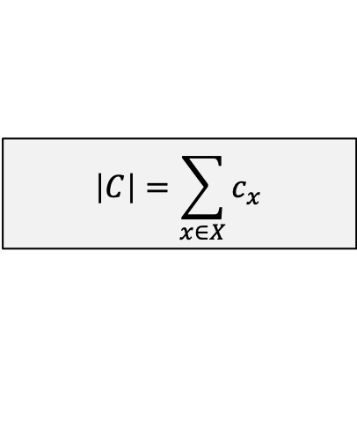

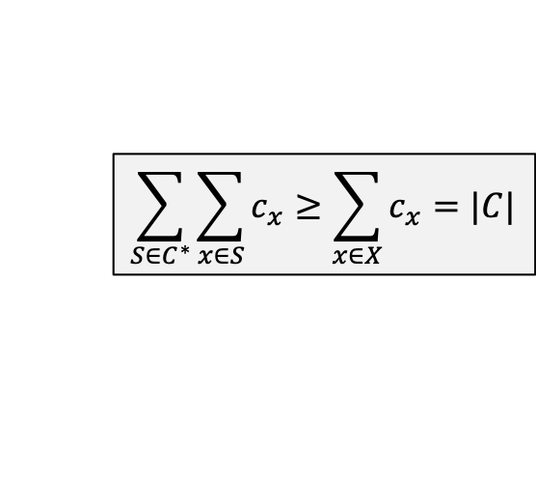
Analysis of Set Cover Greedy
$$S_{1}$$
Costs of the nodes in this example are:
$c_{x1}=c_{x2}=…=c_{x6}=\frac{1}{6}$ $c_{x7}=c_{x8}=c_{x11}=\frac{1}{3}$ $c_{x9}=c_{x12}=\frac{1}{2}$ $c_{x10}=1$
$$x_{1}$$
$$x_{2}$$
$$x_{3}$$
$$x_{4}$$
$$x_{5}$$
$$x_{6}$$
Note the following
$$x_{7}$$
$$x_{8}$$
$$x_{9}$$
$$S_{2}$$
$$\left|C\right|=\sum_{x∈X}{c_{x}}$$
Sum of costs equals total cost. In this case 4
$$\sum_{S∈C^{∗}}{\sum_{x∈S}{c_{x}}}≥\sum_{x∈X}{c_{x}}=|C|$$
Because left side duplicates some costs that right side does not
$$S_{6}$$
$$x_{10}$$
$$x_{11}$$
$$x_{12}$$
$$S_{5}$$
$$S_{3}$$
$$S_{4}$$

Slide 35
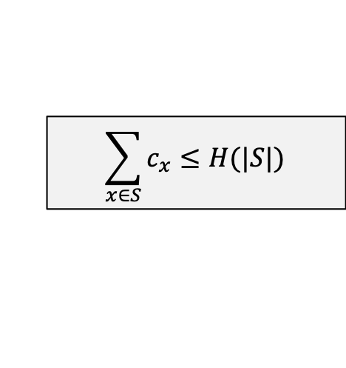
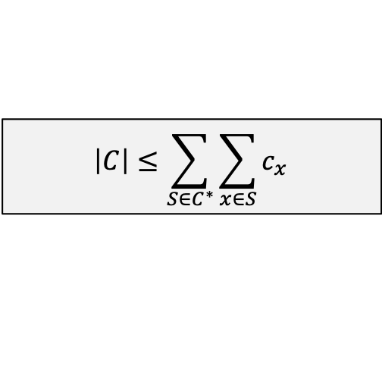

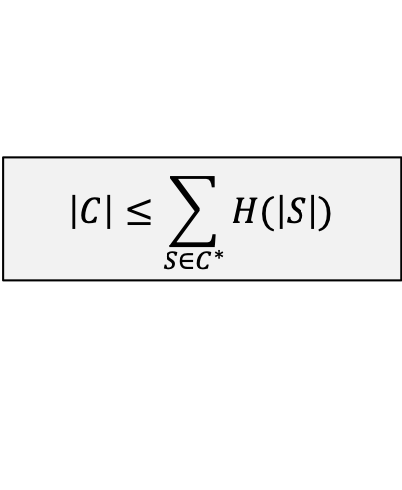
Analysis of Set Cover Greedy
From Previous Slide
$$\left|C\right|≤\sum_{S∈C^{∗}}{\sum_{x∈S}{c_{x}}}$$
$$\sum_{x∈S}{c_{x}}≤H(|S|)$$
Accept as true for now, will argue why in a moment
$$\left|C\right|≤\sum_{S∈C^{∗}}{H(\left|S\right|)}$$
…………………
$$\left|C\right|≤\left|C^{∗}\right| × H(\max\left(\left|S\right|:S∈F\right))$$
Q.E.D. if inequality assumed above is true

Slide 36










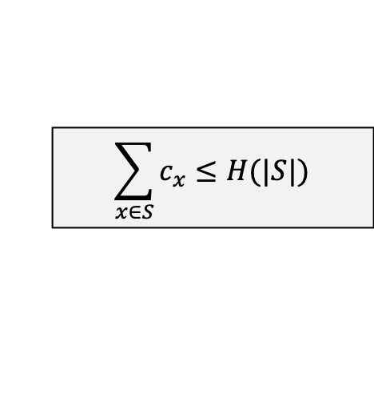













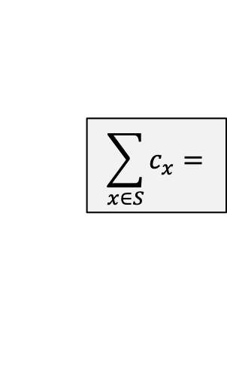


Analysis of Set Cover Greedy
Analysis on previous slide relies on the following inequality. Does it actually hold?
First, suppose that there is a set S with size |S| and algorithm adds all nodes from S “at once”
$$\sum_{x∈S}{c_{x}}≤H(|S|)$$
…
$$\sum_{x∈S}{c_{x}}=$$
$$\frac{1}{n}$$
$$\frac{1}{n}$$
$$\frac{1}{n}$$
$$\frac{1}{n}$$
$$\frac{1}{n}$$
$$\frac{1}{n}$$
$$\frac{1}{n}$$
$$\frac{1}{n}$$
$$+$$
$$+$$
$$+$$
…
$$+$$
$$+$$
$$+$$
$$<$$
$$<$$
$$<$$
$$<$$
$$<$$
$$<$$
$$<$$
$$=$$
$$\frac{1}{2}$$
$$\frac{1}{3}$$
$$\frac{1}{4}$$
$$\frac{1}{n−3}$$
$$\frac{1}{n−2}$$
$$\frac{1}{n−1}$$
$$\frac{1}{n}$$
$$H(\left|S\right|)=$$
$$1$$
$$+$$
$$+$$
$$+$$
…
$$+$$
$$+$$
$$+$$

Slide 37









Analysis of Set Cover Greedy
Analysis on previous slide relies on the following inequality. Does it actually hold?
Now, suppose one node gets added in the previous ”round” and S gets added next.
$$\sum_{x∈S}{c_{x}}≤H(|S|)$$
…
$$\sum_{x∈S}{c_{x}}=$$
$$\frac{1}{n−1}$$
$$\frac{1}{n−1}$$
$$\frac{1}{n−1}$$
$$\frac{1}{n−1}$$
$$\frac{1}{n−1}$$
$$\frac{1}{n−1}$$
$$\frac{1}{n−1}$$
$$\frac{1}{n+δ_{1}}$$
$$+$$
$$+$$
$$+$$
…
$$+$$
$$+$$
$$+$$
$$<$$
$$<$$
$$<$$
$$<$$
$$<$$
$$<$$
$$=$$
$$<$$
$$\frac{1}{2}$$
$$\frac{1}{3}$$
$$\frac{1}{4}$$
…
$$\frac{1}{n−3}$$
$$\frac{1}{n−2}$$
$$\frac{1}{n−1}$$
$$\frac{1}{n}$$
$$H(\left|S\right|)=$$
$$1$$
$$+$$
$$+$$
$$+$$
$$+$$
$$+$$
$$+$$

Slide 38






Analysis of Set Cover Greedy
Analysis on previous slide relies on the following inequality. Does it actually hold?
Now, suppose S is added “third”, OR after two nodes already added.
$$\sum_{x∈S}{c_{x}}≤H(|S|)$$
…
$$\sum_{x∈S}{c_{x}}=$$
$$\frac{1}{n−2}$$
$$\frac{1}{n−2}$$
$$\frac{1}{n−2}$$
$$\frac{1}{n−2}$$
$$\frac{1}{n−2}$$
$$\frac{1}{n−2}$$
$$\frac{1}{n−1+δ_{2}}$$
$$\frac{1}{n+δ_{1}}$$
$$+$$
$$+$$
$$+$$
…
$$+$$
$$+$$
$$+$$
$$<$$
$$<$$
$$<$$
$$<$$
$$<$$
$$=$$
$$<$$
$$<$$
$$\frac{1}{2}$$
$$\frac{1}{3}$$
$$\frac{1}{4}$$
…
$$\frac{1}{n−3}$$
$$\frac{1}{n−2}$$
$$\frac{1}{n−1}$$
$$\frac{1}{n}$$
$$H(\left|S\right|)=$$
$$1$$
$$+$$
$$+$$
$$+$$
$$+$$
$$+$$
$$+$$

Slide 39







Analysis of Set Cover Greedy
Analysis on previous slide relies on the following inequality. Does it actually hold?
Logic continues. What if last node is added by itself…
$$\sum_{x∈S}{c_{x}}≤H(|S|)$$
…
$$\sum_{x∈S}{c_{x}}=$$
$$\frac{1}{2+δ_{7}}$$
$$\frac{1}{3+δ_{6}}$$
$$\frac{1}{4+δ_{5}}$$
$$\frac{1}{n−3+δ_{4}}$$
$$\frac{1}{n−2+δ_{3}}$$
$$\frac{1}{n−1+δ_{2}}$$
$$\frac{1}{n+δ_{1}}$$
$$1$$
$$+$$
$$+$$
$$+$$
…
$$+$$
$$+$$
$$+$$
$$=$$
$$<$$
$$<$$
$$<$$
$$<$$
$$<$$
$$<$$
$$<$$
$$\frac{1}{2}$$
$$\frac{1}{3}$$
$$\frac{1}{4}$$
…
$$\frac{1}{n−3}$$
$$\frac{1}{n−2}$$
$$\frac{1}{n−1}$$
$$\frac{1}{n}$$
$$H(\left|S\right|)=$$
$$1$$
$$+$$
$$+$$
$$+$$
$$+$$
$$+$$
$$+$$

Slide 40
Analysis
Theorem:
Greedy-Set-Cover(X, F) is a $ρ(n)$-approximation of set-cover where $ρ\left(n\right)=H(max⁡(\left|S\right| :S∈F)$
Thus, it is proven!!

Slide 41
Conclusion

Slide 42
Conclusions
Basic Approximations:
Are very fast (often greedy) algorithms. Algorithm / implementation not difficult.
Analysis to figure out “how good” approximation is often much harder
We only scratched the surface in this slide deck.

