Slide 1
Approximation Algorithms
Advanced Algorithms Mark Floryan CLRS Ch. 35

Slide 2
Advanced Tree Structures
In this deck we will look at:
- Approximation Ratios - Vertex Cover Approximation - TSP Approximation - Set-Covering Approximation - Randomization and Linear Programming (maybe)

Slide 3
Introduction: Approximation

Slide 4
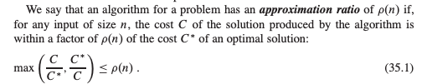
Approximation Ratios

Slide 5
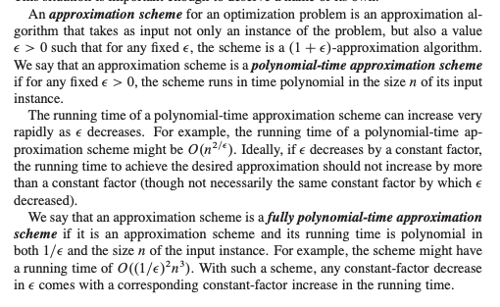
Some Definitions

Slide 6
Vertex-Cover

Slide 7
Recall Vertex-Cover
Show an example graph and it’s smallest vertex cover

Slide 8
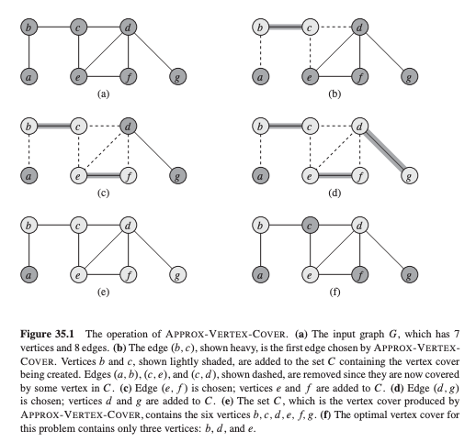
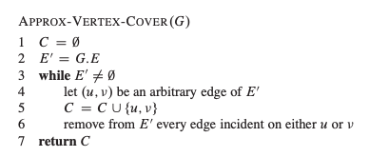
Approximating Vertex-Cover
Text box here

Slide 9
Approx-Vert-Cover: Analysis
Runtime is polynomial? Yes!
What is the approx. ratio??

Slide 10
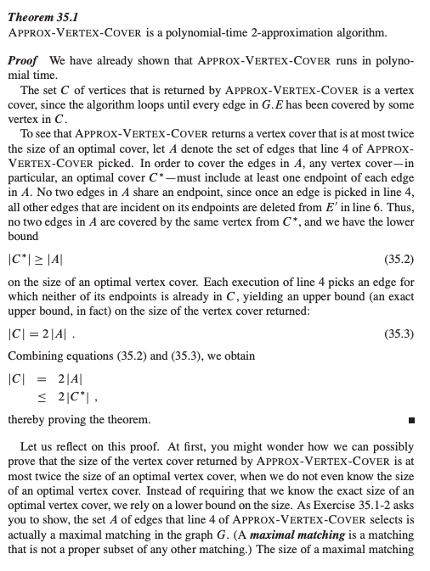
Approx-Vert-Cover: Analysis
What is the approx. ratio??

Slide 11
Traveling Salesperson

Slide 12
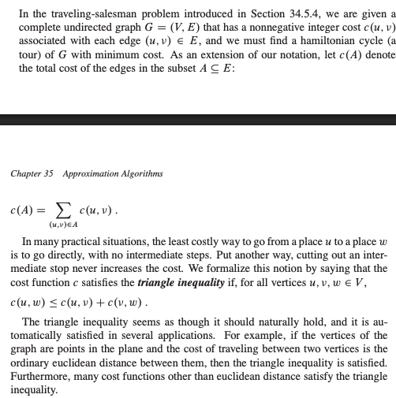
Recall Traveling SalesPerson Problem
How an example of the TSP problem…
Include triangle inequality assumption

Slide 13
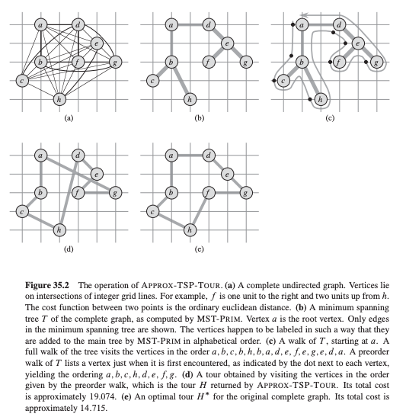
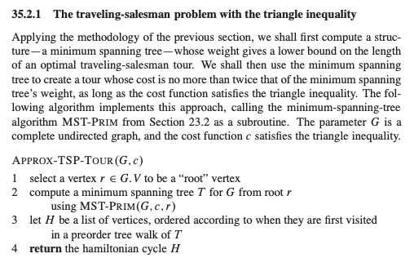
Approximation for TSP
Text Box

Slide 14
Approximation for TSP: Analysis
Runtime is polynomial? YES!!!

Slide 15
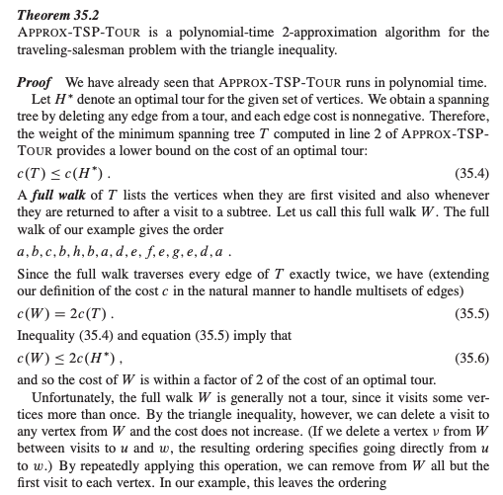
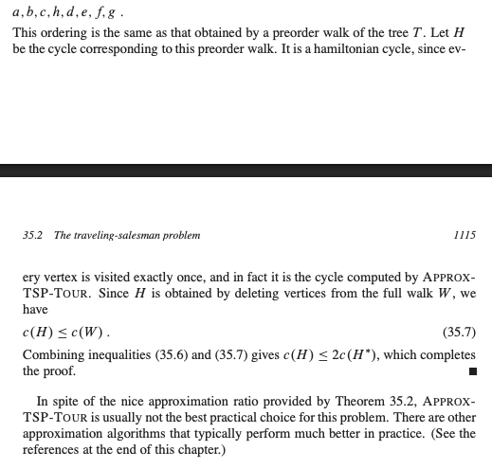
Approximation for TSP: Analysis
Approx ratio??

Slide 16
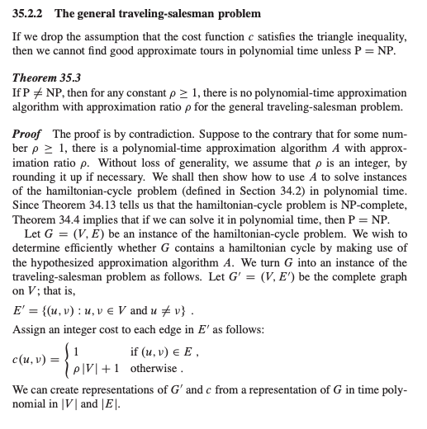
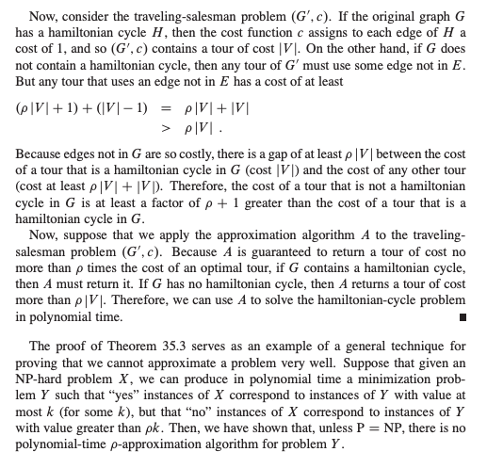
An Interesting Fact About This
Approx ratio??

Slide 17
Set Cover

Slide 18
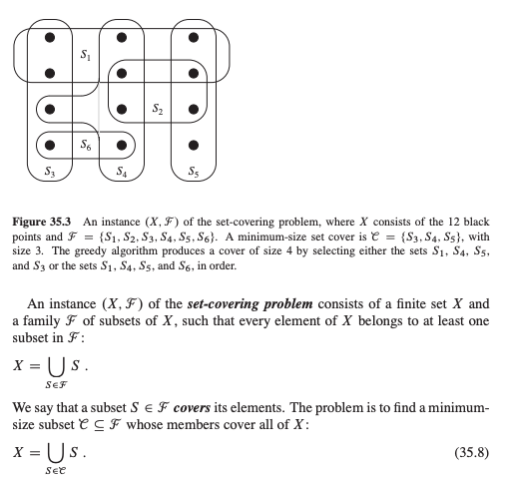
Set Cover Problem
Text Box

Slide 19
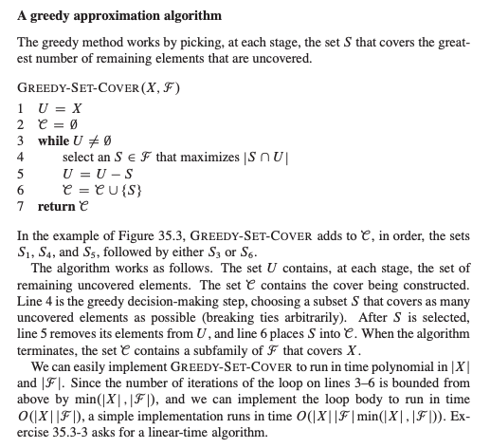
Approximating Set Cover
Text Box

Slide 20
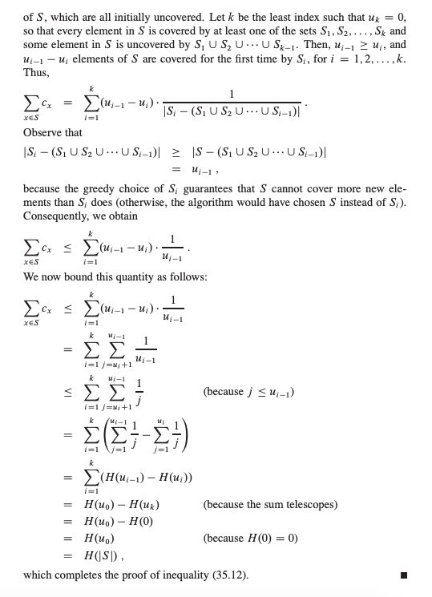
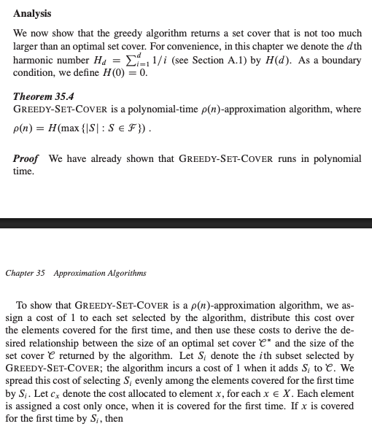
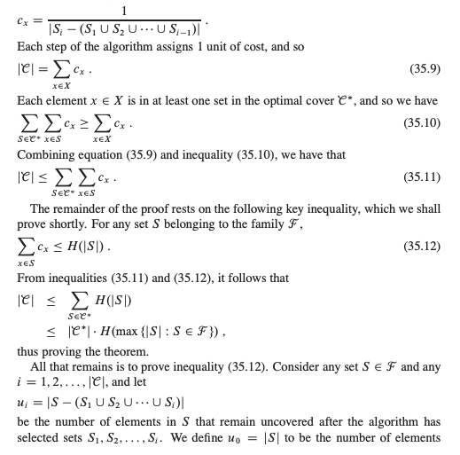
Analysis
Text Box

Slide 21
Randomization And Linear Programming

Slide 22
Conclusion

Slide 23
Conclusions
Van Emde Boas Tree:
Are very fast, and a function of the universe (u) size
Takes advantage of the binary representations of integers to improve runtime
Is NOT generalizable to sets of any objects / things

