Slide 1
Approximation Algorithms
Advanced Algorithms Mark Floryan CLRS Ch. 35

Slide 2
Advanced Tree Structures
In this deck we will look at:
- Approximation Ratios - Vertex Cover Approximation - TSP Approximation - Set-Covering Approximation - Randomization and Linear Programming (maybe)

Slide 3
Introduction: Approximation

Slide 4


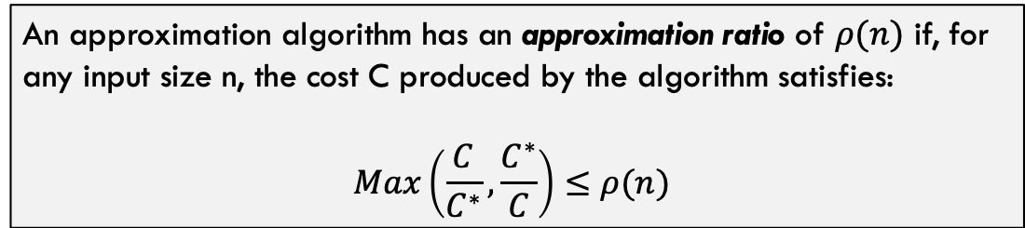

Approximation Ratios
$C^{∗}$ = Optimal Solution
Approximation Algorithm to Some Optimization Problem
$C$ = Approximated Solution
Input
$$NOT optimal solution(s)$$
Often, this problem is NP-Hard
An approximation algorithm has an approximation ratio of $ρ(n)$ if, for any input size n, the cost C produced by the algorithm satisfies:
$$Max\left(\frac{C}{C^{∗}},\frac{C^{∗}}{C}\right)≤ρ(n)$$

Slide 5


Some Definitions
$ρ(n)$-Approximation Algorithm
An approximation algorithm that achieves an approximation of $ρ(n)$ on all inputs
Approximation Scheme
An approximation algorithm that takes as input the instance of the problem and a value $ε>0$ such that for any fixed $ε$, the scheme is a $(1+ε)$-approximation algorithm.
Polynomial Time Approximation Scheme
A scheme is polynomial time if, for any fixed $ε>0$, the algorithm runs in polynomial time in terms of the input size n
Fully Polynomial Time Approximation Scheme
A scheme is fully polynomial time if it has a runtime that is polynomial in terms of $\frac{1}{ε}$.
For example, a fully polynomial time approximation scheme might have runtime $Θ\left({\left(\frac{1}{ε}\right)}^{2}n^{2}\right)$

Slide 6
Vertex-Cover

Slide 7
Recall Vertex-Cover
Given a Graph $G=(V,E)$, find the smallest set of nodes $V^{′}⊂V | ∀_{e=\left(u,v\right)∈E} \left(u∈V^{′}∨v∈V^{′}\right)$
This problem is NP-Hard
b
c
d
a
e
f
g
In other words, find the smallest set of nodes that touches every edge at least once
The purple nodes are the smallest solution for this graph

Slide 8
Proposed Algorithm for Vertex-Cover
Vertex-Approximation(G):
C = []
E’ = G.E
while E’ not empty:
let e=(u,v) be arbitrary edge from E’
C = C.append({u,v})
remove all edges in E’ incident on u or v
return C
b
c
d
a
e
f
g
Run this on the given graph a few times. What is the approximation ratio? Do we have a guaranteed ratio here?

Slide 9
Sample Execution
b
c
d
b
c
d
a
e
f
g
a
e
f
g
b
c
d
b
c
d
a
e
f
g
a
e
f
g
…last step is on next slide

Slide 10
Sample Execution
b
c
d
a
e
f
g

Slide 11
Sample Execution
Vertex-Approximation(G):
C = []
E’ = G.E
while E’ not empty:
let e=(u,v) be arbitrary edge from E’
C = C.append({u,v})
remove all edges in E’ incident on u or v
return C
b
c
d
a
e
f
g
This is just one way it could have turned out. Any thoughts on the limits of “how bad” or “how good” the approximation will be?

Slide 12

Approx-Vert-Cover: Analysis
Runtime is polynomial? Yes, it is $O({\left|E\right|}^{2})$
For each edge e we choose on this line, the solution definitely includes u or v, we always add both
Vertex-Approximation(G):
C = []
E’ = G.E
while E’ not empty:
let e=(u,v) be arbitrary edge from E’
C = C.append(e)
remove all edges in E’ incident on u or v
return C
We remove as many extra edges as we can here, but of course there could be 0 each time.

Slide 13
Approx-Vert-Cover: Analysis
Claim: Vertex-Approximation is a 2-approximation of vertex cover
Proof Part 1 (Correctness): The nodes returned by this algorithm are a valid vertex cover
Vertex-Approximation(G):
C = []
E’ = G.E
while E’ not empty:
let e=(u,v) be arbitrary edge from E’
C = C.append({u,v})
remove all edges in E’ incident on u or v
return C
This is self-evident. Every edge in E is either chosen in line 4 and both it’s nodes added to the solution OR removed in line 6 being incident to u or v.
Thus, every edge is incident on some node in the set C because we do not terminate until E’ is empty.
The algorithm returns a valid vertex-cover

Slide 14
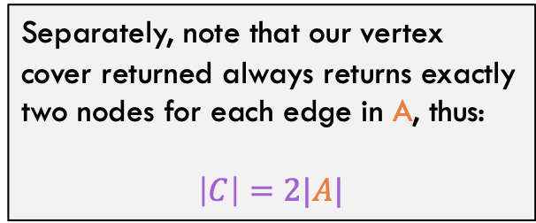
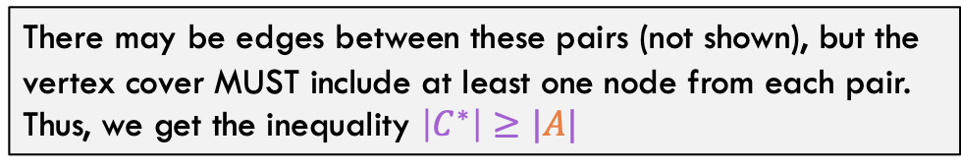
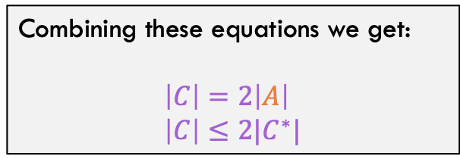
Approx-Vert-Cover: Analysis
Claim: Vertex-Approximation is a 2-approximation of vertex cover
Proof Part 2 (Ratio): The size of C is no more than twice the size of the optimal vertex-cover
Separately, note that our vertex cover returned always returns exactly two nodes for each edge in A, thus:
$$\left|C\right|=2|A|$$
Consider the set of edges A chosen in line 4 of the algorithm. Because other incident edges are removed in line 6, the lines in A form a set of disjoint pairs
a
b
c
d
e
f
Combining these equations we get:
$$\left|C\right|=2\left|A\right| \\ \left|C\right|≤2|C^{∗}|$$
There may be edges between these pairs (not shown), but the vertex cover MUST include at least one node from each pair. Thus, we get the inequality $\left|C^{∗}\right|≥|A|$

Slide 15
Traveling Salesperson

Slide 16

Recall Traveling SalesPerson Problem
Recall the traveling salesperson problem: Given a graph G and start node, what is the minimum cost tour (visit every node exactly once then return to start)
c
4
2
d
b
2
7
3
8
5
3
e
8
g
3
6
4
For our approximation, we are going to assume that the triangle inequality holds. For any three nodes u, v, w:
$$c\left(u,w\right)≤c\left(u,v\right)+c(v,w)$$
a
f
3

Slide 17
Recall Traveling SalesPerson Problem
c
4
2
d
b
2
7
3
8
5
3
e
8
g
3
6
4
a
f
3
Total Cost of this tour is: 3 + 2 + 2 + 3 + 7 + 4 + 3 = 24

Slide 18
Approximation for TSP
TSP-Approx(G, s):
Select any vertex R in G.V
MST T = prims-mst(G, r)
prev = T.preorder().first
for v in T.preorder().second : …
add (prev, v) to solution
add (prev, s) to solution
return solution
Basic Idea:
Calculate minimum spanning tree of G. Use pre-order traversal of this MST to define the tour for TSP

Slide 19
Approximation for TSP
Step 1:
Calculate MST of G (let’s root it at a)
TSP-Approx(G, s):
Select any vertex R in G.V
MST T = prims-mst(G, r)
prev = T.preorder().first
for v in T.preorder().second : …
add (prev, v) to solution
add (prev, s) to solution
return solution
c
4
2
d
b
2
7
3
8
5
3
e
8
g
3
6
4
a
f
3

Slide 20
Approximation for TSP
Step 2:
Tour is just the pre-order traversal of the MST
TSP-Approx(G, s):
Select any vertex R in G.V
MST T = prims-mst(G, r)
prev = T.preorder().first
for v in T.preorder().second : …
add (prev, v) to solution
add (prev, s) to solution
return solution
b
c
2
2
3
e
a
3
d
3
f
g
4

Slide 21
Approximation for TSP
Rearrange to show tour: Cost is 3 + 4 + 8 + 3 + 3 + 2 + 3 = 26
3
b
a
c
2
How good / bad can this approximation be though?
3
3
d
f
3
g
8
e
4

Slide 22

Approximation for TSP: Analysis
c
d
2
b
2
So we get the inequality: $$c\left(T\right)≤c\left(H^{∗}\right)$$
3
e
g
3
4
a
f
3
Observation 1: The minimum spanning tree is a lower bound for the optimal tour. Why?

Slide 23

Approximation for TSP: Analysis
c
d
2
b
2
So we get the inequality: $$c\left(W\right)=2c\left(T\right) \\ 2c\left(T\right)≤2c(H^{∗})$$
3
e
g
3
4
a
f
3
But this walk is not a tour (it is an mst full walk), what about the tour that gets returned by the algorithm?
Observation 2: Consider the FULL WALK of T. Notice that the full walk traverses each edge exactly twice. Full walk is (a f g f a e d e c b c e a)

Slide 24

Approximation for TSP: Analysis
c
d
2
Consider the edge (g,e) with cost 8
The full walk goes from (g f a e) Direct edge goes from (g e) Due to triangle inequality: $$c\left(g,e\right)≤c\left(g,f\right)+c\left(f,a\right)+c\left(a,e\right) \\ 8≤10$$
b
2
3
e
8
g
3
4
a
f
3
Observation 3: The cross edges never increase the cost of the “walk”

Slide 25
Set Cover

Slide 26
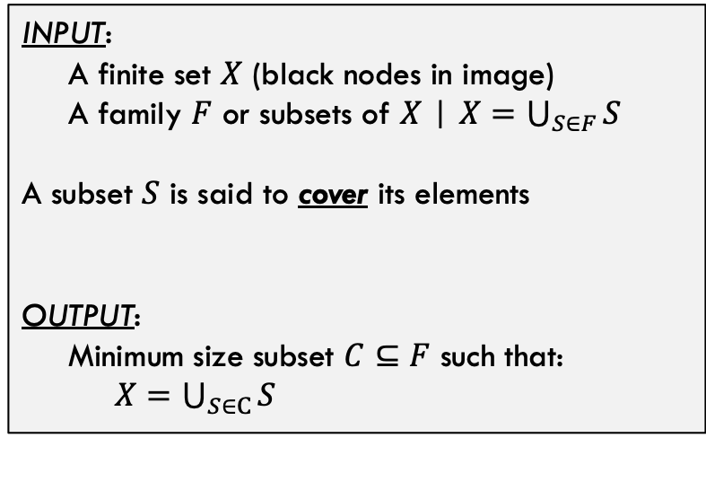






Set Cover Problem
$$S_{1}$$
Set Cover Problem Statement
INPUT:
A finite set $X$ (black nodes in image)
A family $F$ or subsets of $X$ | $X=\bigcup_{S∈F}{S}$ A subset $S$ is said to cover its elements
OUTPUT:
Minimum size subset $C⊆F$ such that: $X=\bigcup_{S∈C}{S}$
$$S_{2}$$
$$S_{6}$$
$$S_{5}$$
In other words, find the smallest group of subsets that include all the elements.
$$S_{3}$$
$$S_{4}$$

Slide 27







Set Cover Problem
$$S_{1}$$
Minimum cover is called $C^{∗}$, for this case, $C^{∗}$ is shown and $\left|C^{∗}\right|=3$
$$S_{2}$$
Set Cover is also NP-Hard, by the way.
$$S_{6}$$
$$S_{5}$$
$$S_{3}$$
$$S_{4}$$

Slide 28
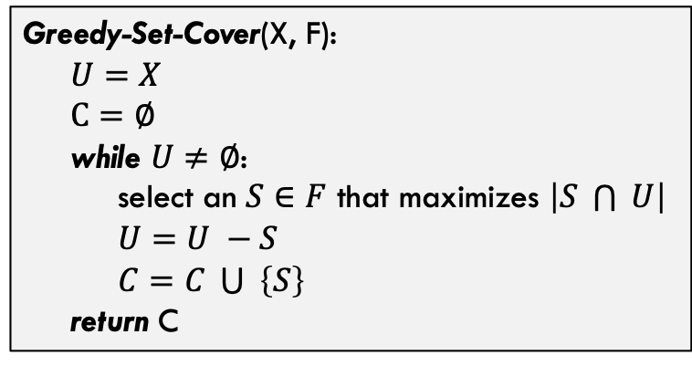
Approximating Set Cover
A greedy approximation for set cover
Greedy-Set-Cover(X, F): $U=X$ $C=∅$ while $U≠∅$: select an $S∈F$ that maximizes $\left|S \bigcap{ }U\right|$ $U=U −S$ $C=C \bigcup{ }\left\{S\right\}$ return C
How good of a cover will this produce? Any “gut” reactions?
… in other words, always select the subset that adds the most new (currently uncovered) elements to the cover
What is the runtime of this method?

Slide 29



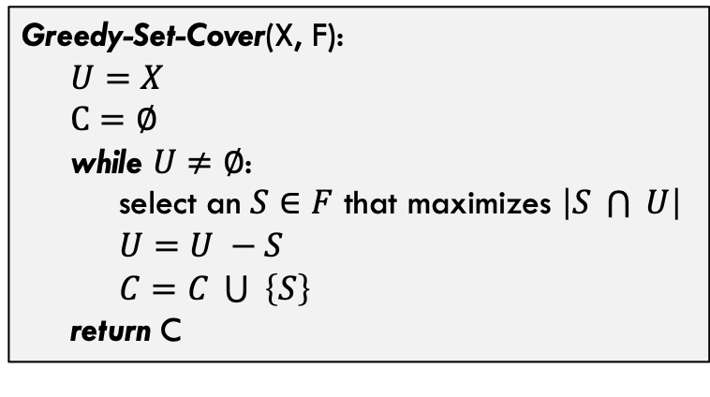



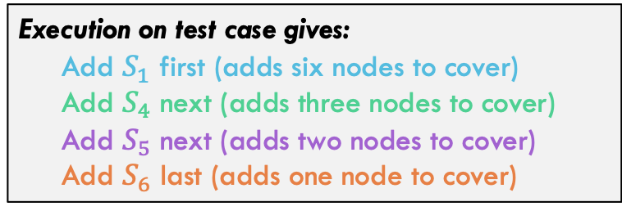
Approximating Set Cover
A greedy approximation for set cover
$$S_{1}$$
Greedy-Set-Cover(X, F): $U=X$ $C=∅$ while $U≠∅$: select an $S∈F$ that maximizes $\left|S \bigcap{ }U\right|$ $U=U −S$ $C=C \bigcup{ }\left\{S\right\}$ return C
$$S_{2}$$
Execution on test case gives:
Add $S_{1}$ first (adds six nodes to cover) Add $S_{4}$ next (adds three nodes to cover) Add $S_{5}$ next (adds two nodes to cover) Add $S_{6}$ last (adds one node to cover)
$$S_{6}$$
$$S_{5}$$
$$\left|C\right|=4>\left|C^{∗}\right|=3$$
$$S_{3}$$
$$S_{4}$$

Slide 30

Analysis
Theorem:
Greedy-Set-Cover(X, F) is a $ρ(n)$-approximation of set-cover where $ρ\left(n\right)=H(max⁡(\left|S\right| :S∈F)$
H() is a harmonic number (see next slide)

Slide 31
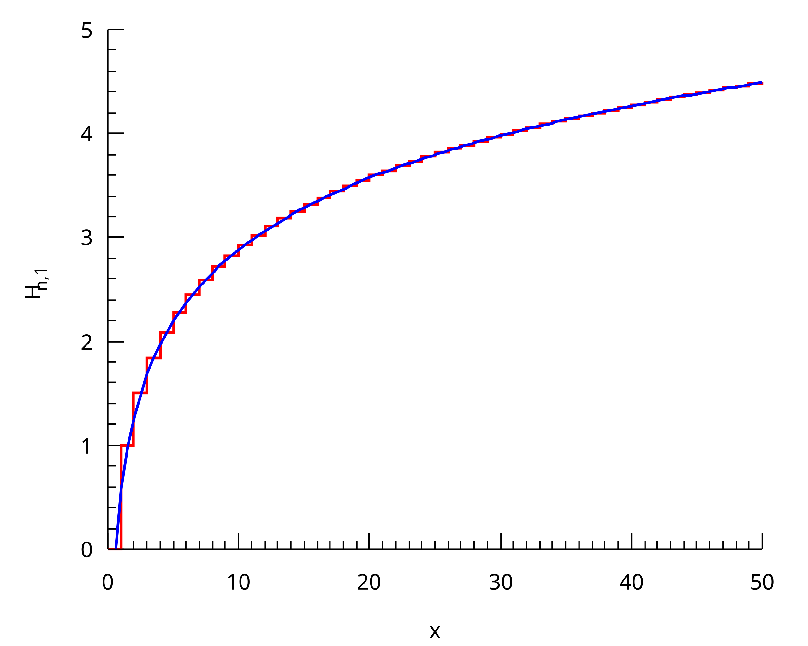
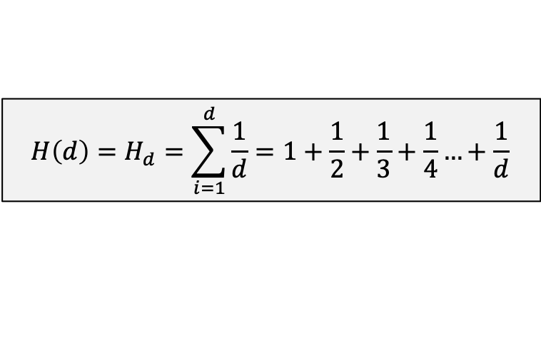

Aside: Harmonic Numbers
Harmonic Number:
$${H\left(d\right)=H}_{d}=\sum_{i=1}^{d}{\frac{1}{d}}=1+\frac{1}{2}+\frac{1}{3}+\frac{1}{4}…+\frac{1}{d}$$
Why? Well set cover algorithm seems to have a similar pattern. You keep adding a percentage of nodes that are left on each iteration.
Note that it is established that:
$$H_{d}=\ln{(d)}+O(1)$$
Harmonic number (x-axis) and value of summation H_d (y-axis). **source = Wikipedia

Slide 32




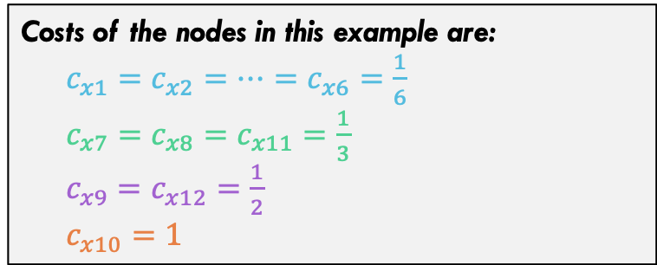



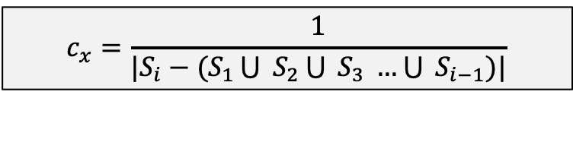











Analysis of Set Cover Greedy
$$S_{1}$$
Consider the following cost function
$$x_{1}$$
$$x_{2}$$
$$x_{3}$$
$$c_{x}=\frac{1}{|S_{i}−(S_{1}\bigcup{ S_{2}\bigcup{ S_{3} …\bigcup{ S_{i−1}}}})|}$$
Each set we add to the solution adds a cost of 1, but spread cost out among elements added. Each element has exactly ONE cost.
$$x_{4}$$
$$x_{5}$$
$$x_{6}$$
$$x_{7}$$
$$x_{8}$$
$$x_{9}$$
$$S_{2}$$
Costs of the nodes in this example are:
$c_{x1}=c_{x2}=…=c_{x6}=\frac{1}{6}$ $c_{x7}=c_{x8}=c_{x11}=\frac{1}{3}$ $c_{x9}=c_{x12}=\frac{1}{2}$ $c_{x10}=1$
$$S_{6}$$
$$x_{10}$$
$$x_{11}$$
$$x_{12}$$
$$S_{5}$$
$$S_{3}$$
$$S_{4}$$

Slide 33
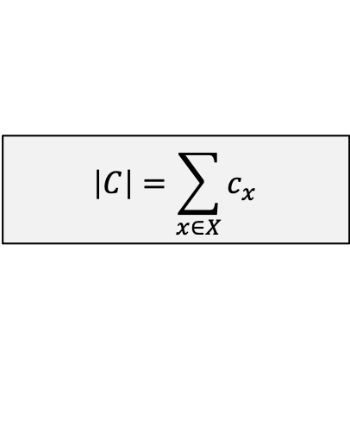

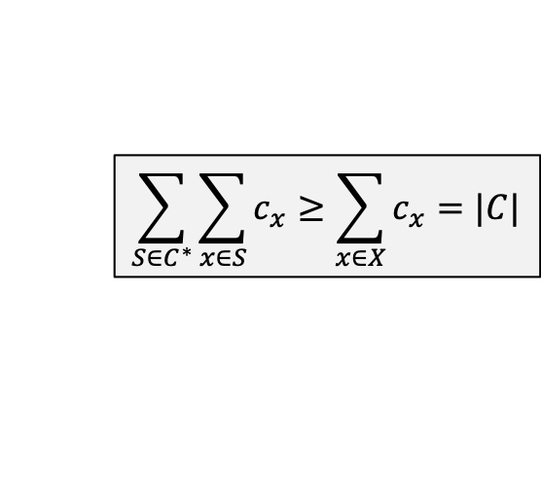
Analysis of Set Cover Greedy
$$S_{1}$$
Costs of the nodes in this example are:
$c_{x1}=c_{x2}=…=c_{x6}=\frac{1}{6}$ $c_{x7}=c_{x8}=c_{x11}=\frac{1}{3}$ $c_{x9}=c_{x12}=\frac{1}{2}$ $c_{x10}=1$
$$x_{1}$$
$$x_{2}$$
$$x_{3}$$
$$x_{4}$$
$$x_{5}$$
$$x_{6}$$
Note the following
$$x_{7}$$
$$x_{8}$$
$$x_{9}$$
$$S_{2}$$
$$\left|C\right|=\sum_{x∈X}{c_{x}}$$
Sum of costs equals total cost. In this case 4
$$\sum_{S∈C^{∗}}{\sum_{x∈S}{c_{x}}}≥\sum_{x∈X}{c_{x}}=|C|$$
Because left side duplicates some costs that right side does not
$$S_{6}$$
$$x_{10}$$
$$x_{11}$$
$$x_{12}$$
$$S_{5}$$
$$S_{3}$$
$$S_{4}$$

Slide 34
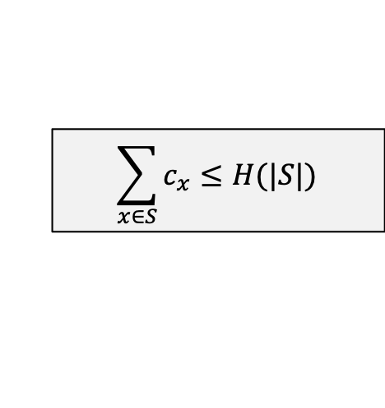
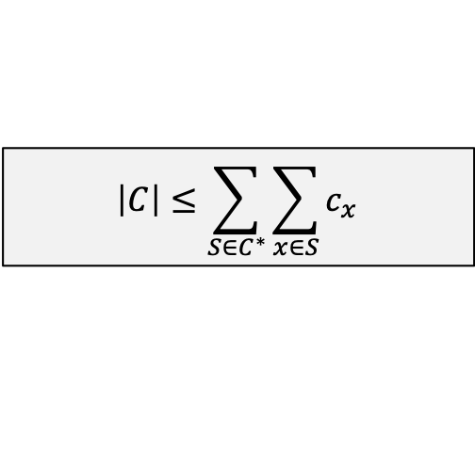

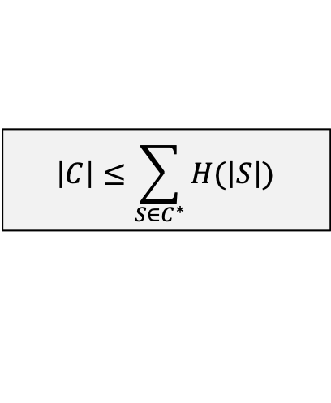
Analysis of Set Cover Greedy
From Previous Slide
$$\left|C\right|≤\sum_{S∈C^{∗}}{\sum_{x∈S}{c_{x}}}$$
$$\sum_{x∈S}{c_{x}}≤H(|S|)$$
Accept as true for now, will argue why in a moment
$$\left|C\right|≤\sum_{S∈C^{∗}}{H(\left|S\right|)}$$
…………………
$$\left|C\right|≤\left|C^{∗}\right| × H(\max\left(\left|S\right|:S∈F\right))$$
Q.E.D. if inequality assumed above is true

Slide 35










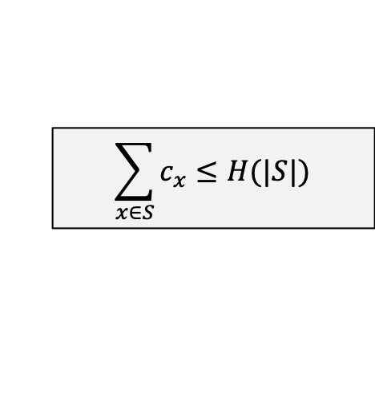






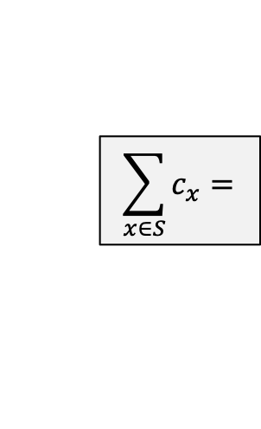








Analysis of Set Cover Greedy
Analysis on previous slide relies on the following inequality. Does it actually hold?
$$\sum_{x∈S}{c_{x}}≤H(|S|)$$
First, suppose that there is a set S with size |S| and algorithm adds all nodes from S “at once”
…
$$\sum_{x∈S}{c_{x}}=$$
$$\frac{1}{n}$$
$$\frac{1}{n}$$
$$\frac{1}{n}$$
$$\frac{1}{n}$$
$$\frac{1}{n}$$
$$\frac{1}{n}$$
$$\frac{1}{n}$$
$$+$$
$$+$$
$$+$$
$$+$$
$$+$$
$$+$$
…
$$+$$
$$\frac{1}{2}$$
$$\frac{1}{3}$$
$$\frac{1}{4}$$
$$\frac{1}{5}$$
$$\frac{1}{6}$$
…
$$\frac{1}{n}$$
$$H(\left|S\right|)=$$
$$1$$
$$+$$
$$+$$
$$+$$
$$+$$
$$+$$
$$+$$
$$+$$

Slide 36
Randomization And Linear Programming

Slide 37
Conclusion

Slide 38
Conclusions
Van Emde Boas Tree:
Are very fast, and a function of the universe (u) size
Takes advantage of the binary representations of integers to improve runtime
Is NOT generalizable to sets of any objects / things

