Slide 1
Approximation Algorithms Simulated Annealing
Advanced Algorithms Mark Floryan No Reading

Slide 2
Advanced Tree Structures
In this deck we will look at:
- Using Simulated Annealing to Approximate Problems with large search spaces

Slide 3
Motivation: Local Search Problems

Slide 4
Classical Search Vs. Local Search
Classical Search
Observable
Deterministic
Known Environment
Solution of sequence of actions
Local Search
All that matters is the solution state
Don’t care about solution path
Impossible to search whole space (too large)
Often continuous search space

Slide 5
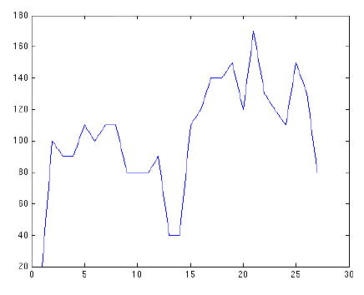
Local Search: Characteristics/Advantages
Goal: Find the maximum (or minimum) state among a huge number of states
For a given state s, value of that solution given by some value function v(s)
For all states s, there is some concept of “neighbor states”. States that are nearby / similar to the current one.

Slide 6
Local Search: Characteristics/Advantages
Step 1:
Generate a random (or arbitrary) start state. Evaluate its value.
start = randomSolution(); initValue = V(start)
…but what do we search next??

Slide 7
Technique 1: Random Walk
IDEA: Walk around the search space randomly
start = cur = randomSolution(); bestVal = v(start) While (i < numIterations): next = getNeighbor(cur) cur = next if(bestVal < v(cur)) bestVal = v(cur)
return bestVal

Slide 8
Local Search: Random Walk Improvement
IDEA: Walk a whole bunch of points around randomly
cur[1000] = { getRandom() } bestVal = maxVal(cur) While (i < numIterations): for each s < 1000: cur[s] = getNeighbor(cur[s]) if(bestVal < v(cur[s])) bestVal = v(cur[s])
return bestVal

Slide 9
Technique 2: Hill Climbing
IDEA: Only go to next state if it is better than current (variant with multiple points works too)
cur[1000] = { getRandom() } bestVal = maxVal(cur) While (i < numIterations): for each s < 1000: next = getNeighbor(cur[s]) if(v(next) > v(cur[s]) cur[s] = next if(bestVal < v(cur[s])) bestVal = v(cur[s])
return bestVal

Slide 10
Random Walk vs. Hill Climbing
Random Walk
Walks around randomly, so very good at exploring the search space.
Very good at finding the various “hills” in the search space.
NOT good at climbing up hills or optimizing any promising solution states.
Hill Climbing
Good at optimizing a solution state, due to climbing nature.
BAD at exploring various parts of search space.
Often stuck in local maxima.

Slide 11
Random Walk vs. Hill Climbing
Pseudo code for both algorithms
Given current state S Generate neighbor state S’: if (util(S’) > util(S)) move with probability p; else move with probability 1-p;
Repeat constant number of times
For hill-climbing, p=1.0 For random-walk, p=0.5

Slide 12
Simulated Annealing

Slide 13
Annealing
Annealing is the process used to temper or harden metals and glass by heating them to a high temperature and then gradually cooling them, thus allowing the material to reach a low-energy crystalline state.
Simulated annealing is just a search algorithm motivated by this idea.

Slide 14
Annealing
Idea!
What if system has a ‘temperature‘
At high temps, system explores much more, but at low temps, is more conservative (closer to hill-climbing)

Slide 15
Simulated Annealing
Choose random initial state, high initial temperature, and cooling rate
Choose random neighbor state
Randomly decide whether to move to neighbor based on temperature
Better neighbors have higher probability of being moved to. More detail later.
Reduce temperature
Repeat steps 2-5 until cooled

Slide 16
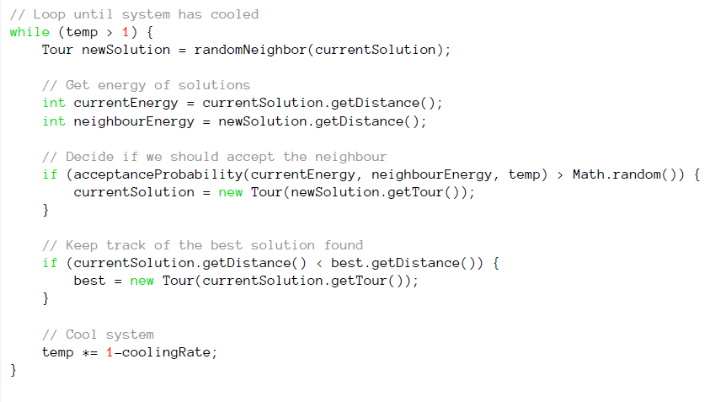
Simulated Annealing

Slide 17
Simulated Annealing
Example Animation (Wikipedia):
Simulated Annealing In Action

Slide 18
Simulated Annealing: Probability Function
Requirements:
Needs to be a function of ΔE where:
ΔE = Val(newState) – Val(curState)
Needs to give higher probability of moving to higher jumps
Needs to be a function of the temperature, which starts high and cools over time.
More likely to move to a worse state at higher temperatures.
As temp cools, becomes more conservative

Slide 19
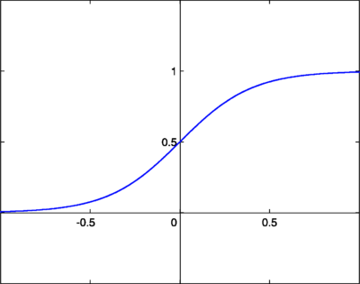

Simulated Annealing: Sigmoid Function
$y=\frac{1}{(1+e^{−x})}$
First attempt:
x = ΔE

Slide 20

Simulated Annealing: Sigmoid Function
$y=\frac{1}{(1+e^{−x})}$
Second attempt:
x = ΔE / T

Slide 21

Simulated Annealing: Sigmoid Function
$y=\frac{1}{(1+e^{−x})}$
X = ΔE / T
How does ΔE affect P?
How does T affect P?

Slide 22
Simulated Annealing

Slide 23
Choosing a Cooling Rate
No silver bullet
Generally, high temperature and low cooling rate are best

Slide 24
Simulated Annealing: Advantages
Can deal with arbitrary systems and cost functions
Is relatively easy to code, even for complex problems
Generally gives good solutions
Optimal? No! But often will return optimal solution in practice

Slide 25
Simulated Annealing: Complexity
O(1) Time
Why?
O(1) Space
Why?

Slide 26
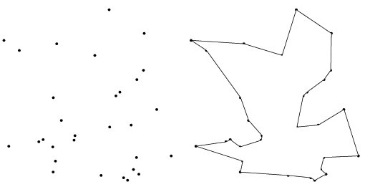
Simulated Annealing: TSP
We all know the Traveling Salesperson Problem.
This problem is NP-Complete
…but we can use SA to find very good solutions (not always optimal though).
How would we do this?

Slide 27
Simulated Annealing: TSP
Choose a random tour (i.e., a random order for the cities)
Pick a new candidate tour by finding a random neighbor tour (how to find this?)
Use sigmoid function to determine if you will follow that path or not
Function of temperature and difference in costs of tours
Keep track of best tour seen so far
Cool the temperature a bit
Repeat
Return best tour found at any time

Slide 28
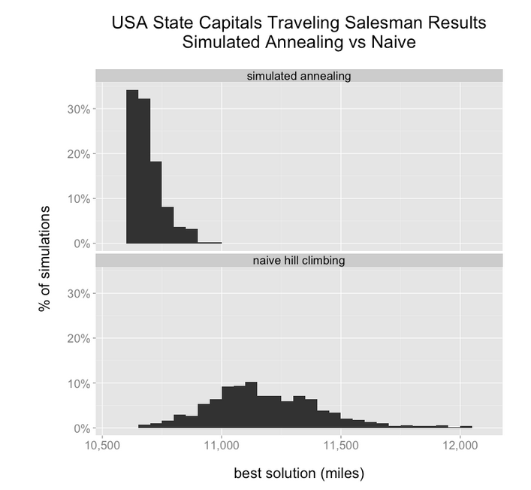
From: http://toddwschneider.com/posts/traveling-salesman-with-simulated-annealing-r-and-shiny/

Slide 29
Conclusion

Slide 30
Conclusions
Simulated Annealing:
Is an efficient method for finding good approximations to NP-Complete problems as well as many other types of problems.
Is quite general (only requires concept of solution state, value of solution, and neighbor states)
Is very fast, and speed can be tuned by changing internal variables (cooling rate, temperature, etc.)

