Slide 1

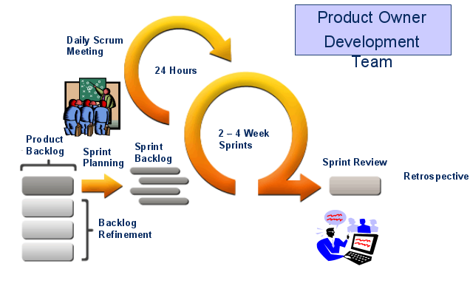
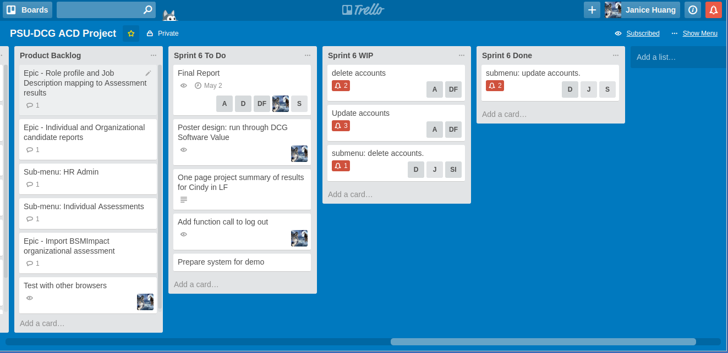
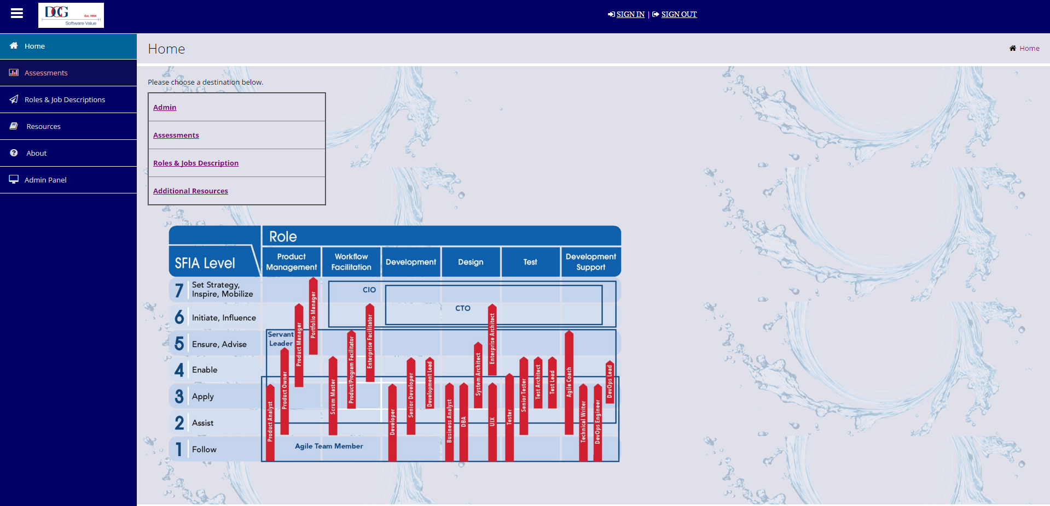
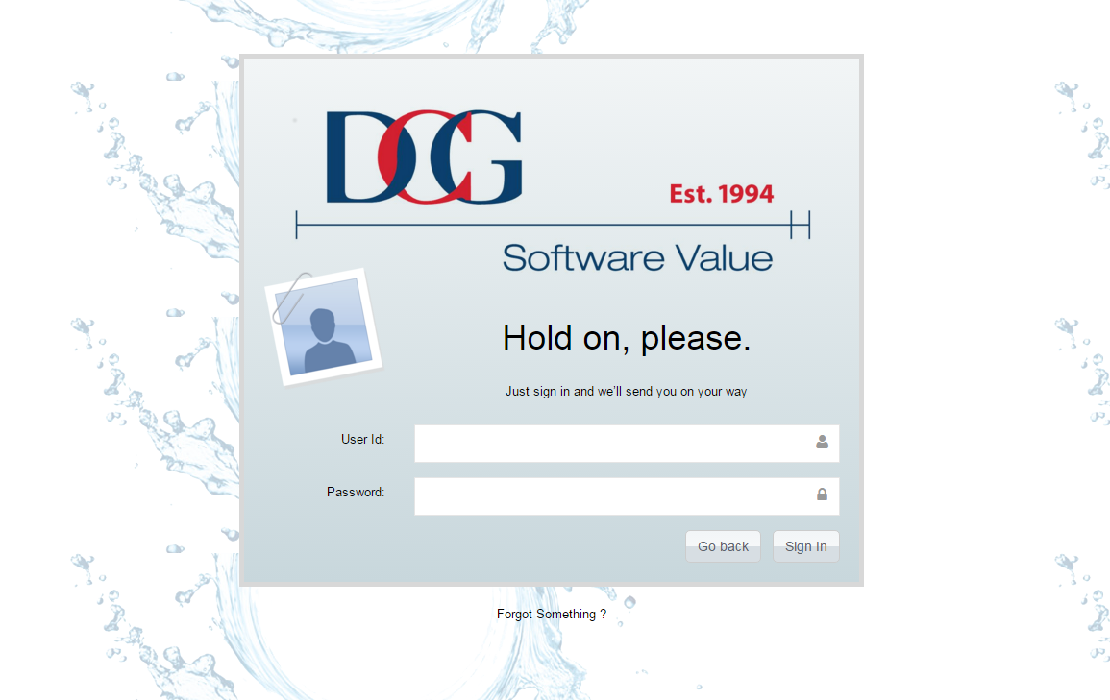
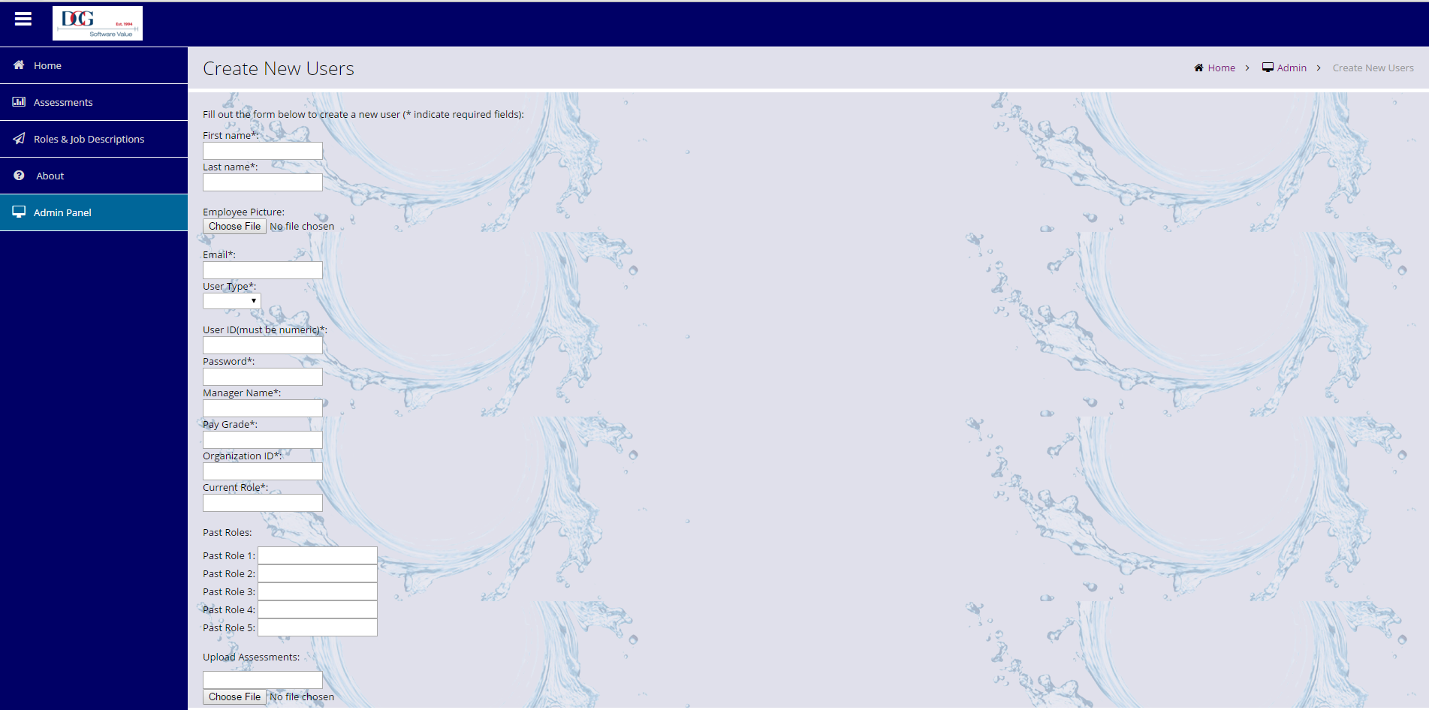
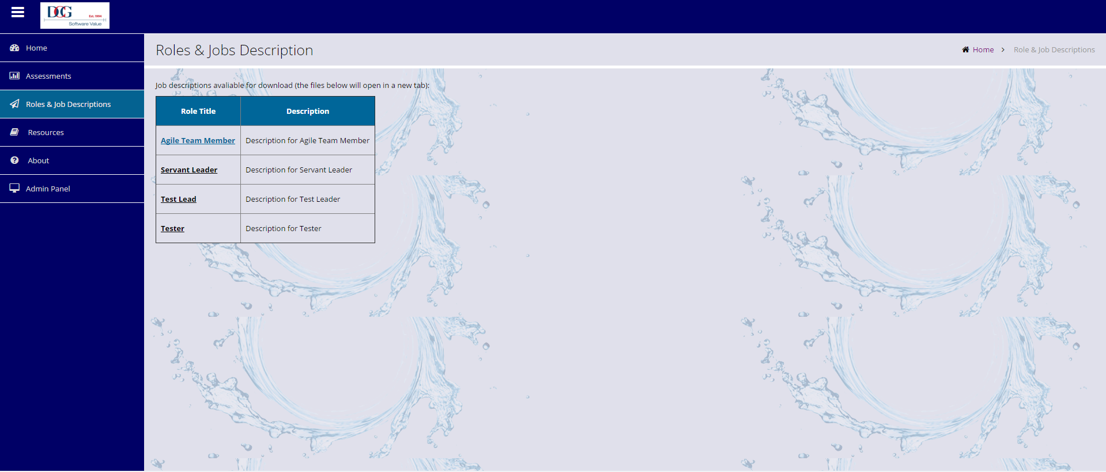
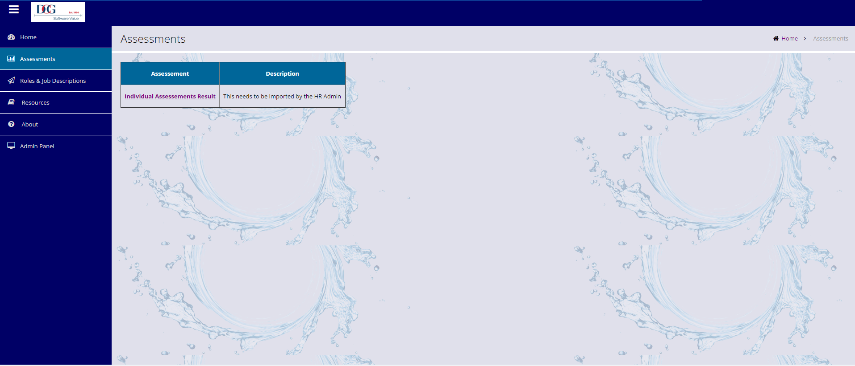
Agile Competency Development
By: Janice Huang, David Reidler, Sergey Ivanov, Dylan Fetch, Archan Shah
The goal:
This project aims to create a system to help HR departments at software companies using Agile development lifecycles. The system will keep track of training that employees receive and determine when the employees should receive promotions.
Software Development Lifecycle:
Since DCG Software Value consults for software companies that use Agile, they wanted us to use the Scrum methodology. We used Trello to manage our weekly tasks.
Software Stack:
To accomplish our goal, we used HTML5 on the front end and Linux, Apache, MySQL, and PHP on the back end.
Login:
On the login page a user can submit their user id and password in order to gain access to special privileges like viewing or creating accounts.
Admin:
On this page an administrator can create, update, or delete employee accounts
Home: The home page of the site is where a user can navigate to the other pages of the site
Roles & Job Descriptions:
On this page an employee can learn what other positions in the company entail and what skills they need to earn that position
Assessments:
On this page an employee can view scores of online assessments that they have taken

