Slide 1








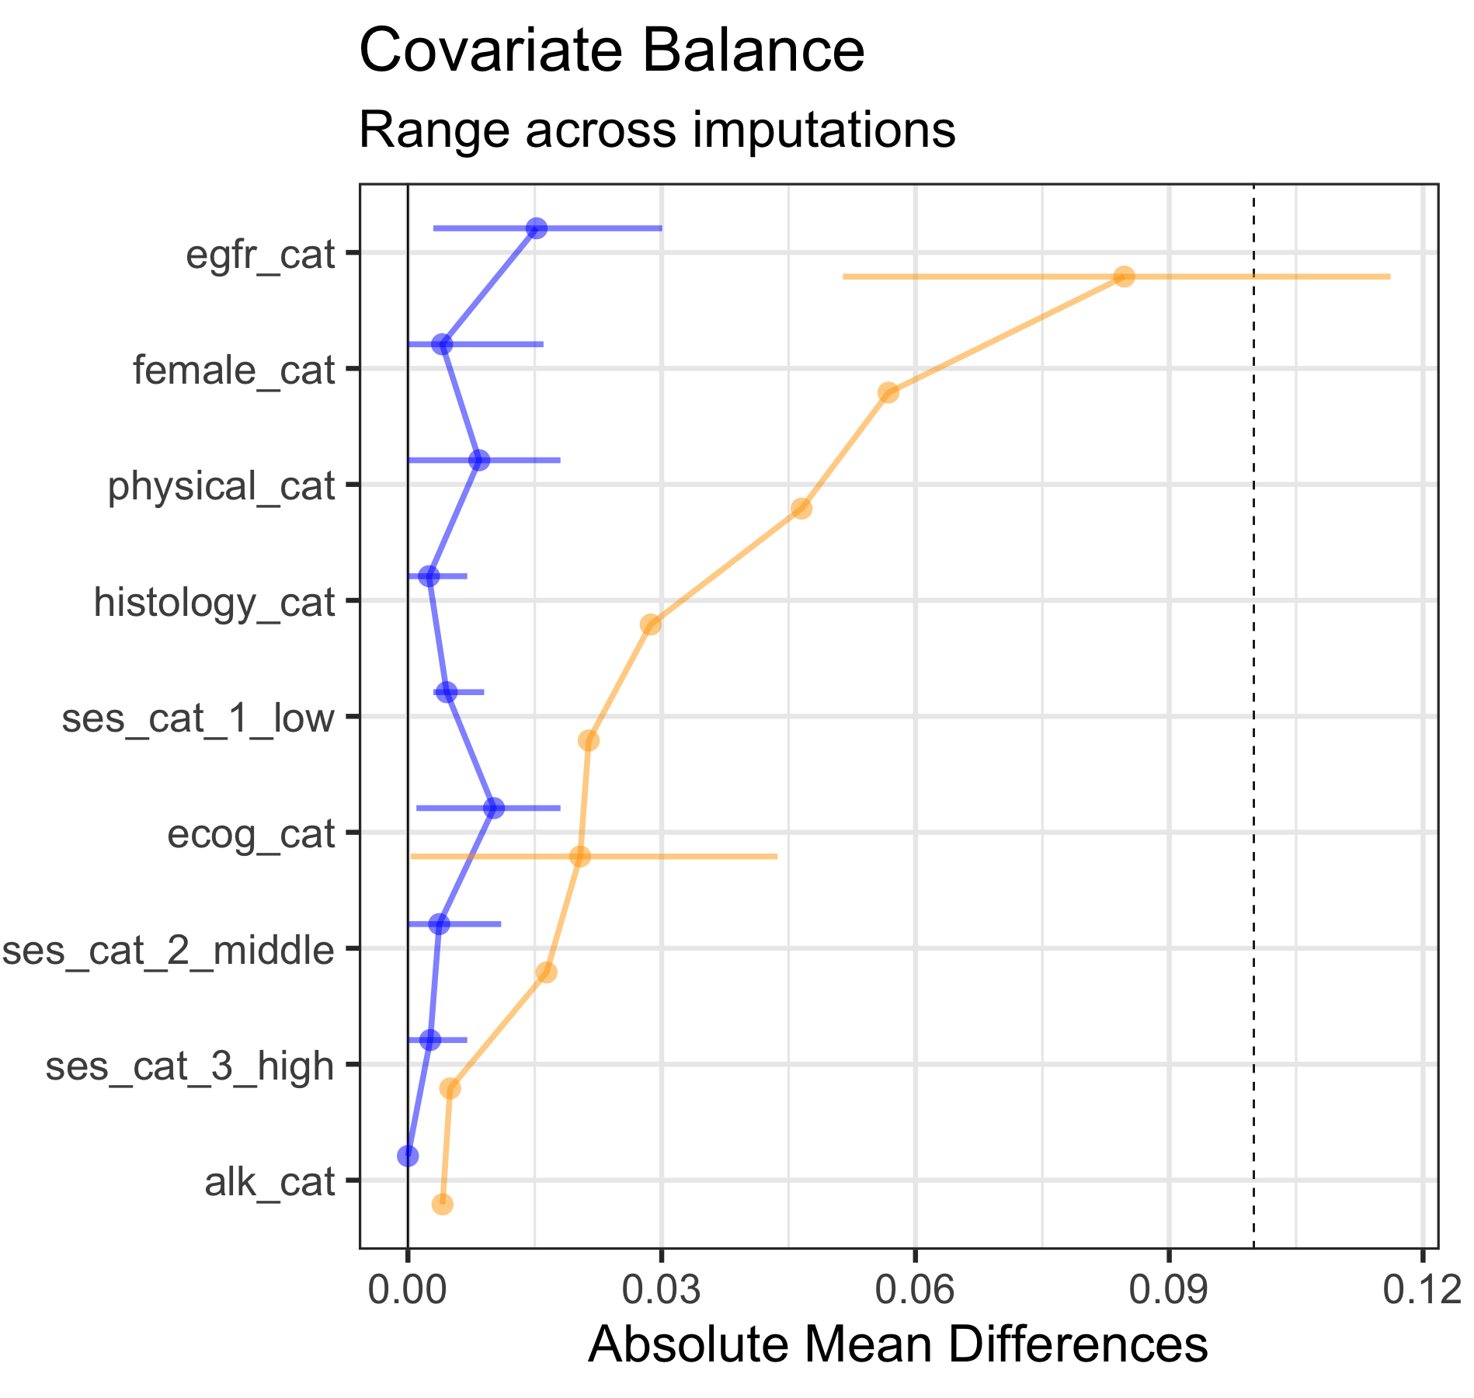

Trial selection process
MeSH term search for {cancer}
Use MeSH terms and free text search terms to query {cancer} trial NCT IDs in the AACT CITTI database (conditions, study titles, study description)
Filter all resulting NCT IDs are by pre-specified eligibility criteria
Last step involves a thorough feasibility assessment:
Is database fit-for-purpose?
Sample size calculations?
Do we achieve balance on baseline covariates?
Protocol development & registration
Extract all eligibility criteria from original trial protocol
Outline how eligibility criteria are emulated using the respective real-world database and use color-coding for investigator-assessed level of confidence on how well the criterion can be measured
Descriptives:
How long do patients stay in the initiated line of treatment and how many patients cross-over or switch treatments (compare to trial if reported)
Missing data: Structural missing data investigations using a principled approach – streamlined via smdi R package
Patterns (monotone, non-monotone)
Mechanisms (MCAR, MAR, MNAR)
Detail how the exposure (including the line of treatment) and outcome are measured and derived from each respective real-world database
Protocol is reviewed by FDA and expert panel
Protocol is registered
Shortlisted
candidates
Analysis
Pre-specified primary, secondary and sensitivity analyses within each imputed propensity score matched/weighted dataset
HR m₁
Feedback loop
HR m₂
HR m₃
Rubin’s rule
HR m…
Reporting
Dataset m₁
Dataset m₁
Imputation
If missing data evaluation results in conclusion that data can be imputed, create m imputed datasets (with m = ⦰ % of observed missing values)
Derive analytic cohort
Graphical depiction of study design
Dataset m₂
Dataset m₂
Dataset m₃
Dataset m₃
Dataset (with missing observations)
Dataset m…
Dataset m…
Assess balance and refine
Matched/
weighted
Imputed

