Slide 1
VRIDER · HACKATHON 2026 · OPENING
VRider
Dancea Andreea
Pârvulețu Janina
Țermure Madalina
Vârtaci Ruxandra
Boldișor Maria
Enache Emma

Slide 2



VRIDER · HACKATHON 2026 · OPENING
HOW WE MOTIVATE OURSELVES?
AND CHILDREN?
Do they see you exercising?
Do they have a reason to start?
Will a clinic visit motivate them?
We built an answer → VRider

Slide 3




THE SOLUTION · PRODUCT DESCRIPTION
VRider — Endless Runner Exergame
An endless runner game played on a stationary bike.
KEY DESIGN PRINCIPLE
The child never sees "heart rate 178 bpm." They see "your engine is at full power!" — clinical data remains exclusively for medical staff.
Pedaling cadence (RPM) directly controls the avatar’s speed. Heart rate — captured via the bike’s sensor — modulates the game world in real time.
RPM → speed
HR monitoring
Bot racing
Leaderboard
Pedal faster = run faster
Bike sensor feeds game engine
Fixed-speed rivals to beat
Anonymous, self-competitive
5-PHASE PROTOCOL
Rest
Warm-up
Effort
Recovery
Rest
~0 RPM
40–55
65–85
40–55
~0 RPM
0–30s
30s–2m
2–6m
6–8m
8–9m

Slide 4
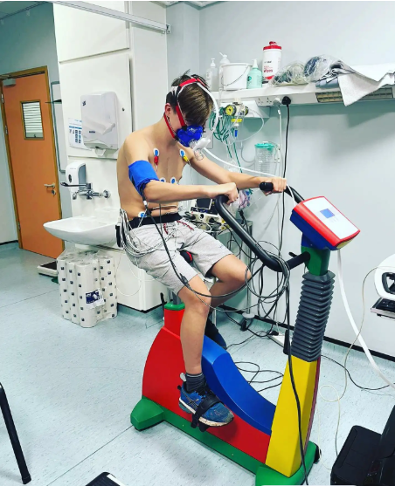

Slide 5



EVIDENCE · WHY GAMIFICATION WORKS
The Science Behind VRider
JMIR Meta-Analysis 2025
16 RCTs · 7,472 children aged 6–18. Gamification significantly increased moderate-to-vigorous physical activity (p=0.04).
University of Birmingham 2021
Exergames in PE classes improved not only fitness levels but also attitudes, emotions & long-term motivation toward exercise.
Morgan et al., 2023
Children who associate exercise with positive emotion are 3× more likely to remain physically active in adulthood.
Sample potential: 500–2,000 children/school-year · Protocol compliance: ↑3× vs clinical treadmill
Sources: Wang et al., JMIR Serious Games 2025 (meta-analysis, 16 RCTs, n=7,472) · Univ. Birmingham, Phys. Education & Sport Pedagogy, 2021 · Morgan et al., medRxiv 2023

Slide 6

LONG-TERM VISION · WHY THIS MATTERS
One Pedal at a Time
VRider is not just a game. It’s a trojan horse for preventive pediatric cardiology — disguised as entertainment.
Early Detection
Longitudinal Data
Stress test at age 11 can reveal latent cardiac issues before they become emergencies in adulthood.
A dataset of pediatric exertion profiles from ages 11–16 would be clinically unprecedented.
Behavioral Anchoring
Economic Impact
Children who associate exercise with positive emotion are 3× more likely to stay active as adults.
Childhood obesity costs $14B/year in direct healthcare. Prevention at scale could save billions.
Sources: WHO 2024 · Guthold et al. Lancet 2019 · Physical Activity Alliance 2024 · Wang et al. JMIR 2025 · Morgan et al. 2023 · Georgetown Health Policy Institute · Cleveland Clinic 2024 · DemandSage 2024

Slide 7
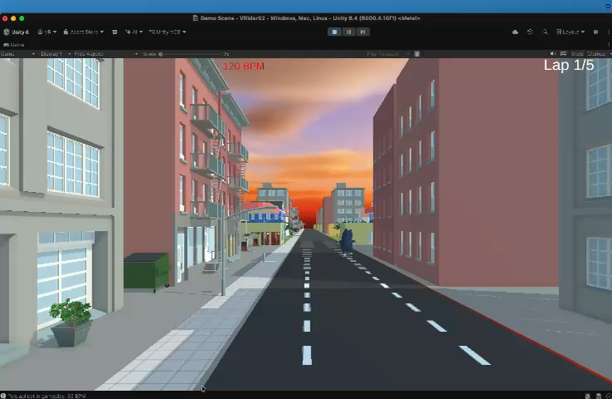

Slide 8
VRIDER
Where Heart Rate Meets High Score
A gamified cardiac stress test, built for children,
where the only "score" that matters is a healthy heart.
81%
1 game
∞
of teens fail WHO activity target
that makes the test feel like play
potential lives changed early
"If a child learns to love the feeling of physical achievement before they're old enough to fear a doctor's office, we've already won."

Slide 9
VRIDER
Thank you!

