Slide 1
Investigating Homophily in Deep Trade Agreements
Birds of the same feather trade together:
GRAD-E1426 Applied Network Analysis
Janine De Vera | 219848
Notes:
Homophily is a social network concept which says that people with similar characteristics have the tendency to form social ties with each other

Slide 2
Presentation Outline
1
Background and motivation
Revisiting the evolution of PTAs
2
Descriptive statistics
Illustrating the trade agreements network
3
Empirical analysis
Fitting an exponential random graph model
4
Conclusion
Understanding PTA formation

Slide 3

1
2
3
4
Revisiting the evolution of preferential trade agreements
Background and motivation
There has been an unprecedented rise in PTAs
PTAs have become deeper and broader in scope
Deep PTAs have a more holistic effect on economies
Boosts productivity in services sectors and facilitates development of diversified and resilient supply chains
More effectively promotes peace and stability and encourages democratic reforms
Agreements notified to the WTO grew sevenfold in the last three decades (1990-2022)
All WTO members are currently a party of at least one PTA
PTAs have gone beyond simply facilitating market access through taxes and tariffs
New forms of cooperation go beyond the mandate of WTO (data protection, intellectual property, human rights, environmental laws)
How are deep trade agreements formed?
What factors determine the choice of partners in deep PTAs?
Notes:
The number of agreements notified to the WTO has increased sevenfold from 50 in 1990 to 355 in 2022
Promoting peace and stability: Trade agreements can help to build political trust and promote peaceful relationships between nations. By committing to open trade and economic cooperation, countries can reduce the potential for economic conflicts and foster stability in the region.
Encouraging democratic reforms: Trade agreements can encourage countries to adopt and enforce rules that promote democratic values, such as human rights, labor standards, and environmental protection. This can lead to greater political liberalization and democratization in countries that participate in trade agreements.
Strengthening international institutions: Trade agreements can help to build strong, effective international institutions that promote global cooperation and coordination. By working together to establish common rules and standards, countries can strengthen international institutions like the World Trade Organization (WTO) and the International Monetary Fund (IMF).

Slide 4
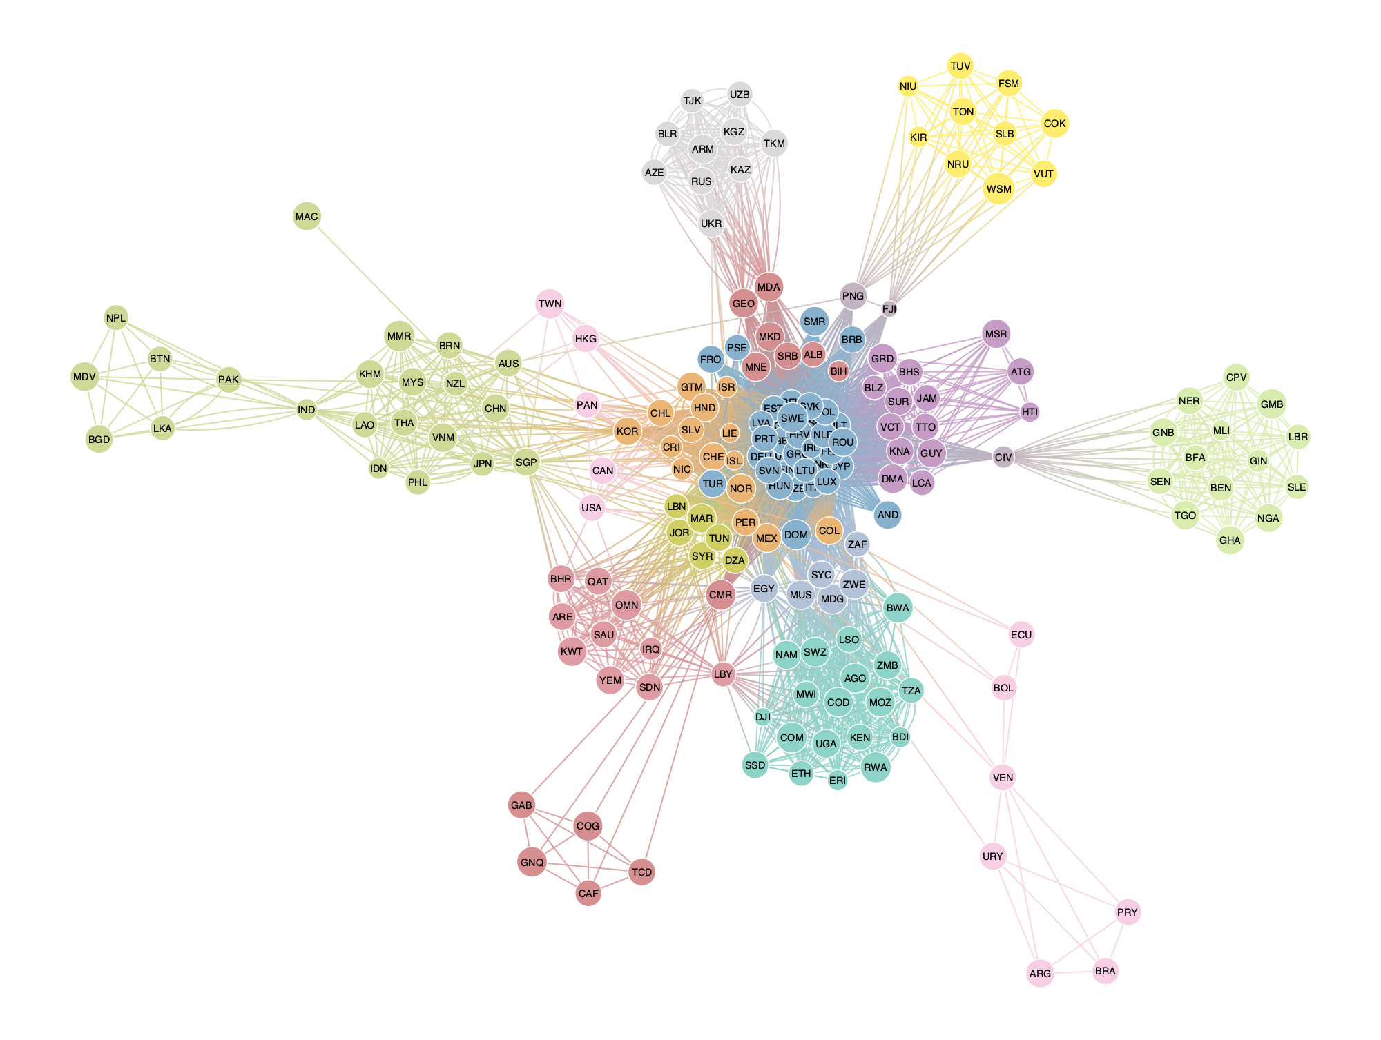
1
2
3
4
Illustrating the network of trade agreements
Descriptive statistics
Network features
189 countries
Region
261 trade agreements
Income class
3,141 bilateral partnerships
GDP
57 years
Political structure
PTA policy areas
Import tariffs
Non-tariff barriers
Behind-the-border policies
Services
Technology
6. Investment and capital
7. Labor
8. Other policies
9. Non-economic policies
Non-economic provisions
Environmental laws
Cultural cooperation
Data protection
Health
Human rights
Illicit drugs
Money laundering
Political dialogue
Terrorism

Slide 5
1
2
3
4
Illustrating the network of trade agreements
Descriptive statistics

Slide 6
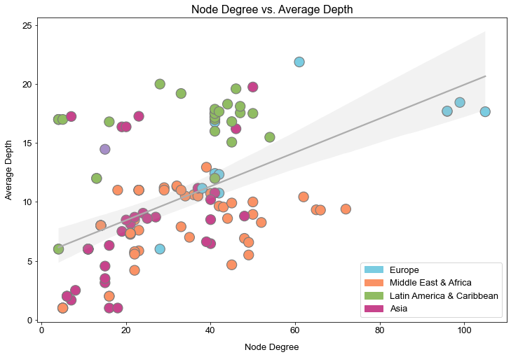
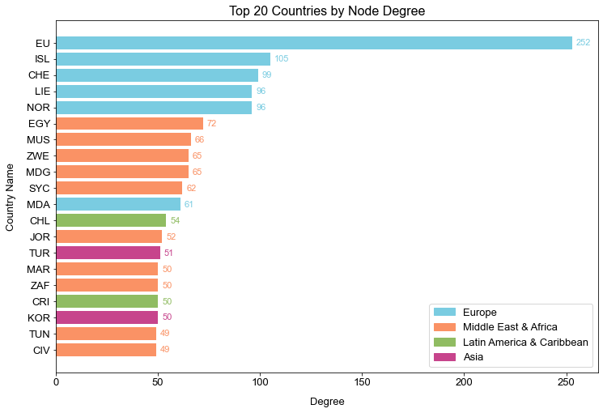
1
2
3
4
Illustrating the network of trade agreements
Descriptive statistics
Well-connected countries are more likely to sign deep trade agreements

Slide 7


1
2
3
4
Fitting an exponential random graph model
Empirical analysis
Gains from PTAs can be economic or political, so they are also bound to the economic and political characteristics of PTA partners
Economic
Net welfare gain to offset losses from trade diversion
Partnerships are dependent on the attributes of participants and countries are not indifferent to their trade partners
Geographic proximity, symmetry of economic size
Homophily
Political
In social networks is the tendency to form social ties according to the similarities in people’s attributes
Maximizing gross social welfare
Regime structure (democracies are likely for form PTAs with other democracies)

Slide 8
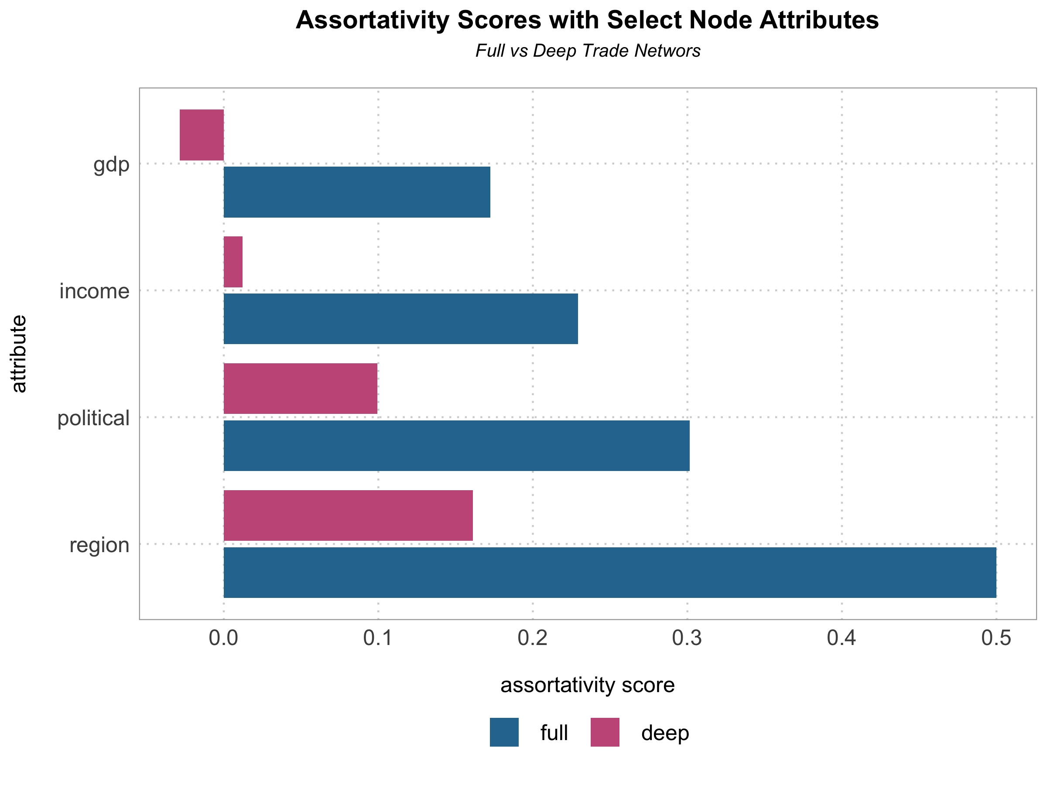
1
2
3
4
Fitting an exponential random graph model
Empirical analysis
Region
Regional classification of a node based on WB
Income class
Income classification of a node based on WB
Political institutions
Freedom House Democracy Index of a node based on Free in World: free, partly free, not free
GDP
Gross domestic product of a node in 2019
Notes:
The assortativity coefficient is positive if similar vertices tend to connect to each (based on some external property), and negative otherwise.

Slide 9
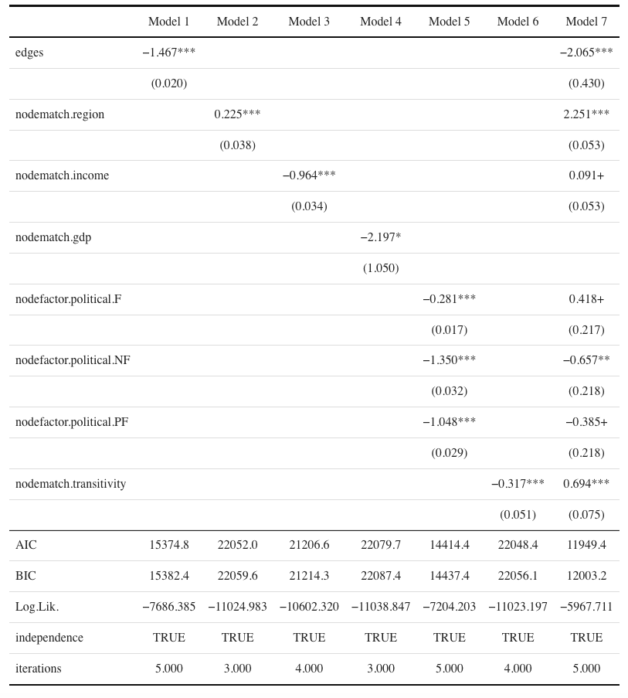
1
2
3
4
Fitting an exponential random graph model
Empirical analysis
Baseline model: probability of an edge being in the network
Using ERG to examine:
probability of observing a set of ties
how similarities in nodal attributes influence presence and absence of PTA links
Coefficients: likelihood (log-odds ratio) of tie formation with respect to the node attribute
Goodness-of-fit measures: AIC, BIC, log-likelihood for measuring how well models explain the data
Accounts for network structure
Notes:
Log-odds ratio = likelihood of a link for a unit change in a predicton; if it’s negative, then an event is less likely, if positive an event is more likely. This can be easily be converted into probabilities.
Edges – 11% | 13%
Transitivity measures the probability that the adjacent vertices of a vertex are connected. This is sometimes also called the clustering coefficient.
The local transitivity of a vertex is the ratio of the count of triangles connected to the vertex and the triples centered on the vertex.
The probability that the adjacent vertices of a vertex are connected; ratio of the count of triangles connected to the vertex and the triples centered on the vertex.

Slide 10
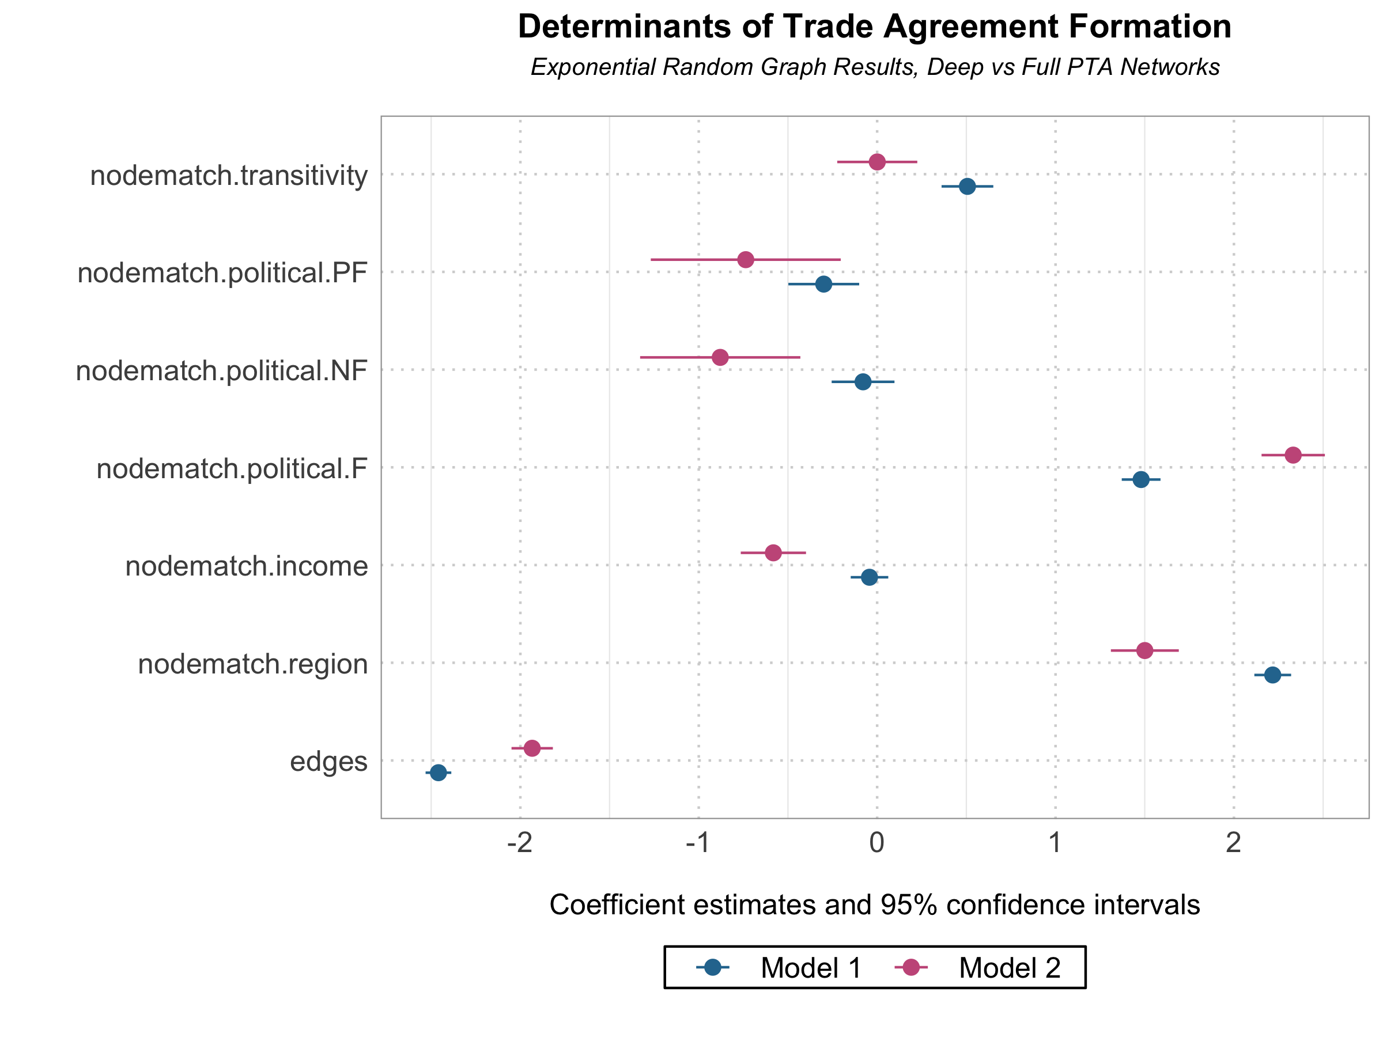
1
2
3
4
Fitting an exponential random graph model
Empirical analysis
Key insights on deep PTAs:
Political freedom is the most important determinant of deep PTA formation
PTA between countries in partially free and non-free countries are unlikely
In deep PTAs, links are more likely in countries with different income classes
Countries in the same region are likely to form ties, but less than the full network
Notes:
Full vs Deep:
Edges – 11% | 13%
Region – 90% | 82%
Income – 52% | 36%
Political (Free) – 60% | 91%
Political (Partially free) – 40% | 32%
Political (Not free) – 34% | 29%
Transitivity – 50% | 50%
Political (Free) – trade liberalizing PTAs are most likely to be formed between democracies, due to their trade policy profiles; democracies are less rent-seeking and more prone to promoting free-trade
Income – Trade scholars argue that PTAs are likely formed among countries with similar economic size; the opposite is true for deep trade networks. There may be significant economic gains from trading with a rich country – access to a larger market. But deep trade agreements are less concerned about trade creation but rather more relationship focused.

Slide 11
1
2
3
4
Understanding PTA formation
Conclusion
Deep trade agreements are different from earlier PTAs not just in their objectives but also in the way they are formed
Homophily in social networks can also be observed in trade agreement networks – countries with shared attributes are more likely to form PTAs
Political freedom is a major determinant of deep PTA formation: ties are more likely to be formed if partner countries are both democracies compared to if they belong to the same income class or region.
In general, this suggests that countries enter deep trade agreements for more than economic gains – there more consideration for political and social benefits of PTAs

