Slide 1
Automatic Code Review for SmartThings application using Static Analysis
정적 분석을 이용한 SmartThings 어플리케이션의 자동 코드 리뷰
Janine Cassandra Son¹ Byeong-Mo Chang² Kwanghoon Choi³ ¹ ²Division of Computer Science, Sookmyung Women’s University
³Dept. of Electronics and Computer Engineering, Chonnam National University janineson.it@gmail.com chang@sookmyung.ac.kr kwanghoon.choi@jnu.ac.kr

Slide 2



1. Research Goal
use static analysis to automate the code review process and
use metrics to evaluate SmartApp quality

Slide 3
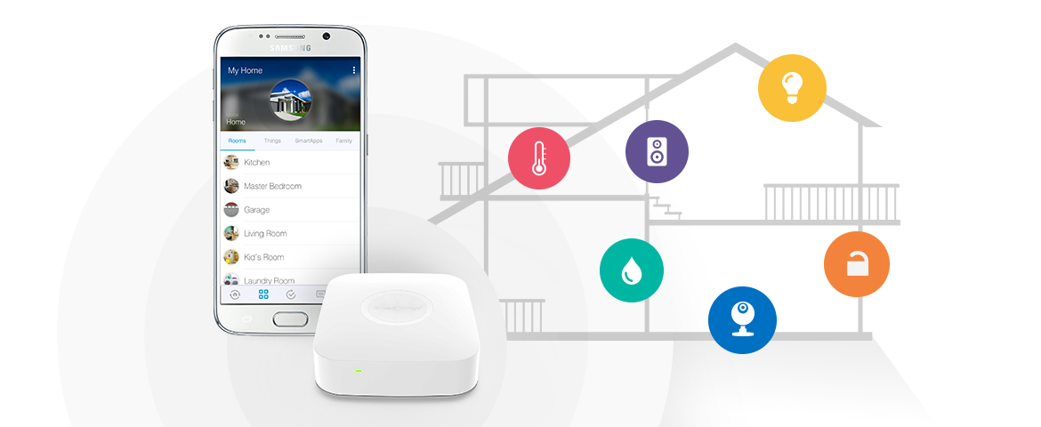

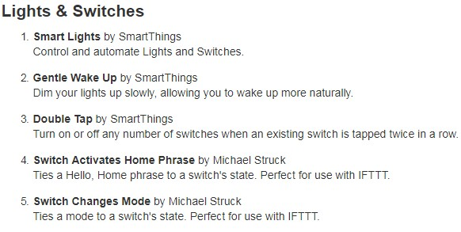

2. Background
SmartApps

Slide 4
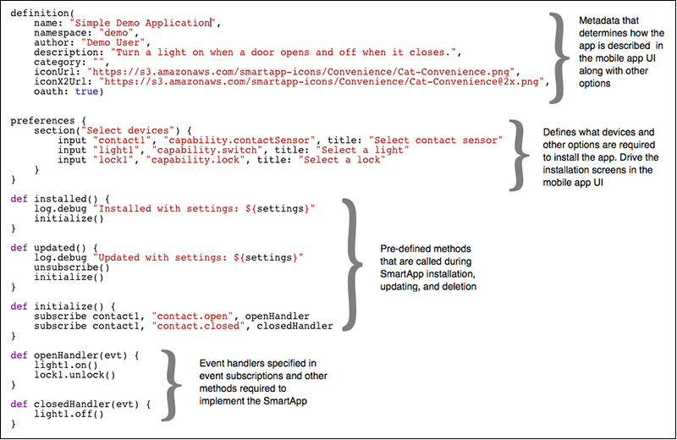

3. SmartApp Structure
Definition
Preferences
Predefined Callbacks
Event Handlers

Slide 5

4. Code Review Guidelines
30 SmartApp guidelines
21 implemented in CodeNarc
Can be implemented with Static Analysis
Do not submit unused code
Handle all if() and switch() cases
Use consistent return values
Be careful indexing into arrays
Handle null values
Avoid chained runIn() calls
Subscriptions should be clear
Document external HTTP requests
Do not hard-code SMS messages

Slide 6
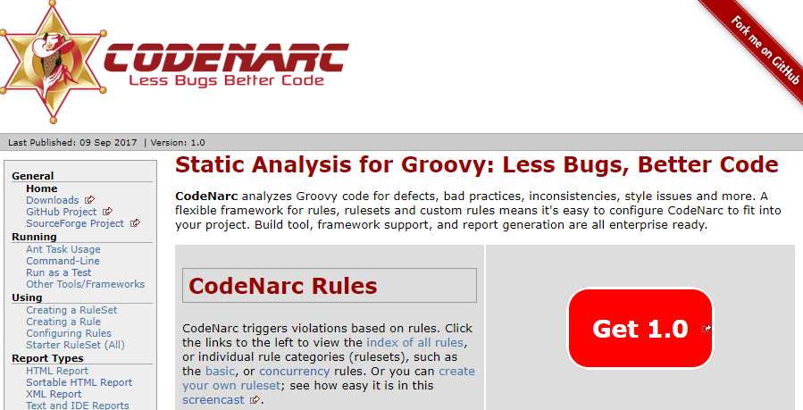
5. CodeNarc
348 rules for Groovy programs (general)
38 are applicable to SmartApps
+ 21 NEW rules added from Code Review Guidelines
Rules applicable to SmartApps
AssignmentInConditional
DeadCode
BrokenNullCheck
EmptyMethod
EmptySwitchStatement
EmptyTryBlock
ConstantIfExpression
ConstantTernaryExpression
DuplicateMapKey
Rule-based static analysis tool
open-source

Slide 7
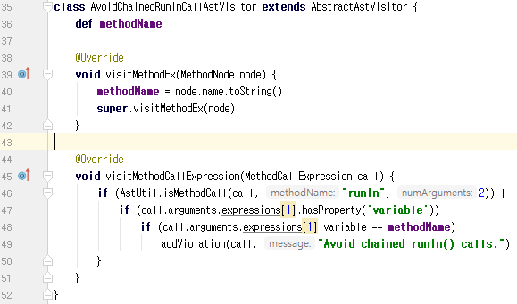
6. CodeNarc Implementation
Static Analysis
AST traversal
Adding NEW rule: AvoidChainedRunInCallRule

Slide 8
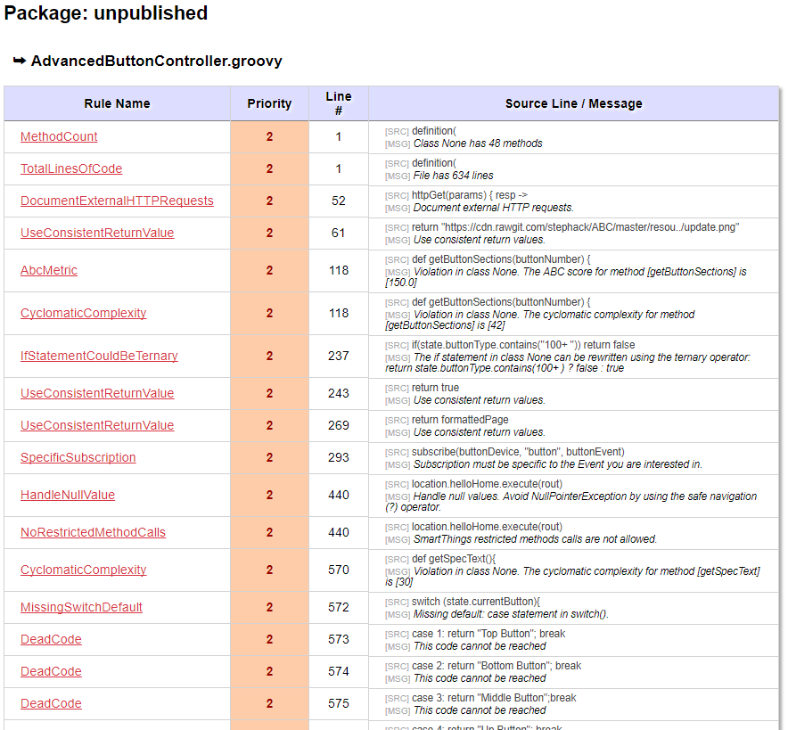
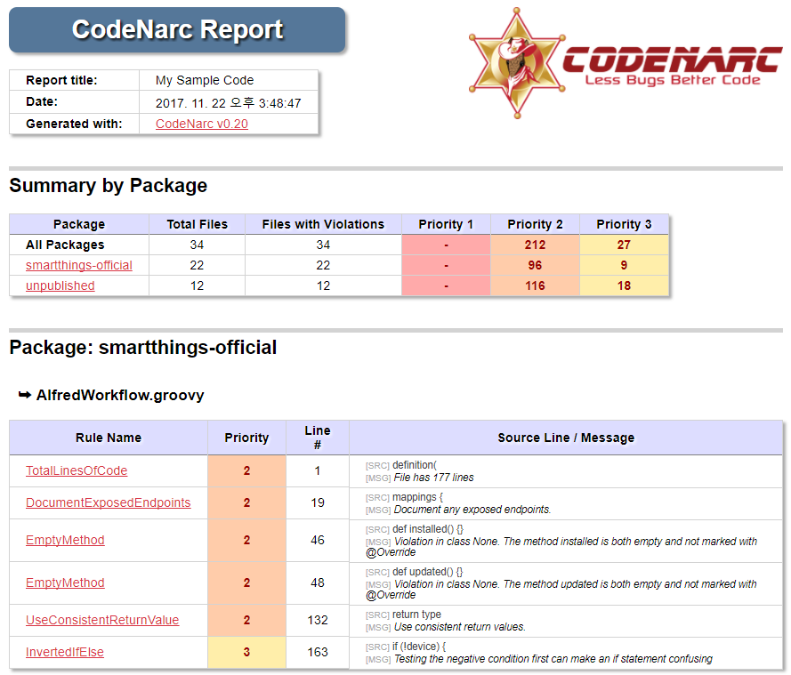
7. CodeNarc Report
Using custom rules – specific to SmartApps

Slide 9
8. Metrics and Quality Attributes
SmartApp
Subscription model
Default programming
language characteristics
Subscription model
Number of missing event handlers | Reliability
Number of unclear subscriptions | Security
Subscription model
METRIC | QUALITY
Cyclomatic Complexity | Maintainability
Number of nested block depth | Maintainability
Sandboxed Groovy environment
External system access
Sandboxed Groovy
Number of chained runIn calls | Reliability
Number of global variables | Reliability
External system access
Number of undocumented HTTP requests | Security
Number of hardcoded SMS messages | Security
Reliability: 41 Maintainability: 11 Security: 7

