Slide 1

Refactoring –
Hands-On Session 1
(Java/TypeScript)
By Dario Casadevall, and Janis Zisenis

Slide 2



Refactoring?
💩
Refactoring (noun): a change made to the internal structure of software to make it easier to understand and cheaper to modify without changing its observable behavior.
– Martin Fowler
Refactoring (verb): to restructure software by applying a series of refactorings without changing its observable behavior.
– Martin Fowler
⭐️

Slide 3
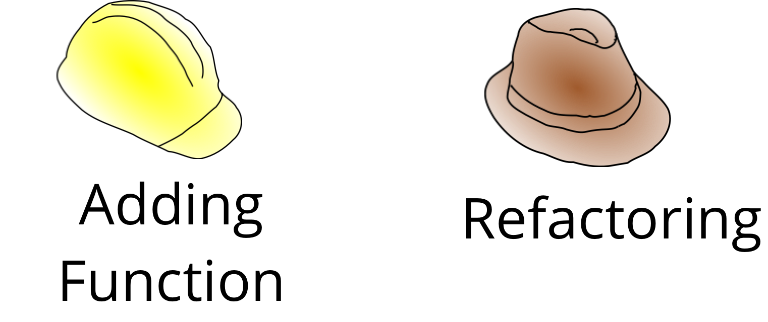
Why and When?
When you have to add a feature to a programm but the code is not structured in a convenient way, first refactor the program to make it easy to add the feature, then add the feature.
– Martin Fowler
Any fool can write code that a computer can understand. Good programmers write code that humans understand.
– Martin Fowler
When not?
If I run across code that is a mess, but I don’t need to modify it, then I don’t need to refactor it.
– Martin Fowler

Slide 4
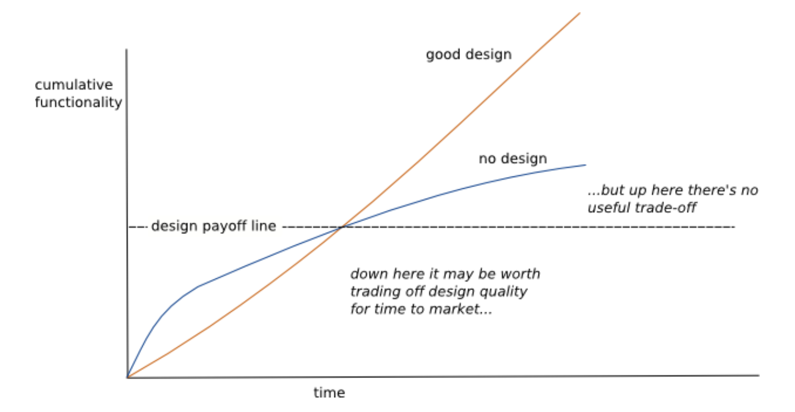
Design Stamina Hypothesis
The whole purpose of refactoring is to make us program faster, producing more value with less effort
– Martin Fowler

Slide 5
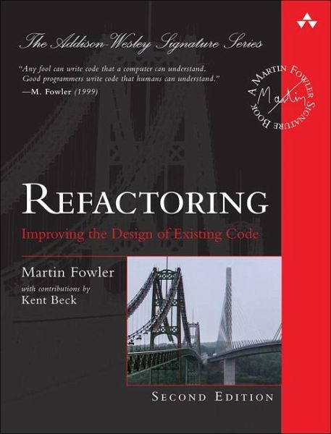
How To?
If someone says their code was broken for a couple of days while they are refactoring, you can be pretty sure they were not refactoring
– Martin Fowler
Refactoring changes the programs in small steps, so if you make a mistake, it is easy to find where the bug is.
– Martin Fowler

Slide 6

Example: Theater Billing
Time: 15 min
Form groups of three
Check out the repository
Decide for Java or TypeScript
Start refactoring
https://github.com/janisZisenisNetlight/Refactoring_Session1

Slide 7
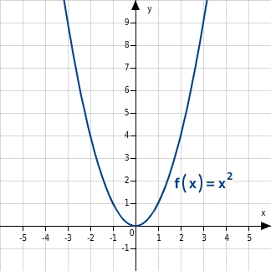












What does Maths has to do with it?
$$f\left(x,y\right)=5x^{2}+\frac{1}{\sqrt{y}}+2,5y−\sqrt{6,25y^{2}}−\frac{4x^{2,5}}{x^{0,5}}−\frac{\sqrt{y}}{y}$$
$$f\left(x,y\right)=5x^{2}+\frac{1}{\sqrt{y}}+2,5y−2,5y−\frac{4x^{2,5}}{x^{0,5}}−\frac{\sqrt{y}}{y}$$
$$square\left(x\right)=x^{2}$$
$$square\left(1\right)=1$$
$$f\left(x,y\right)=5x^{2}+\frac{1}{\sqrt{y}}−4x^{2}−\frac{\sqrt{y}}{y}$$
$$square\left(2\right)=4$$
$$square\left(3\right)=9$$
$$…$$
$$f\left(x,y\right)=x^{2}+\frac{1}{\sqrt{y}}−\frac{\sqrt{y}}{y}$$
$$f\left(x,y\right)=x^{2}+\frac{1}{\sqrt{y}}\frac{\sqrt{y}}{\sqrt{y}}−\frac{\sqrt{y}}{y}$$
$$f\left(x,y\right)=x^{2}+\frac{\sqrt{y}}{y}−\frac{\sqrt{y}}{y}$$
Simplify the following equation:
$$f\left(x,y\right)=5x^{2}+\frac{1}{\sqrt{y}}+\frac{15}{6}y−\sqrt{6,25y^{2}}−\frac{4x^{2,5}}{x^{0,5}}−\frac{\sqrt{y}}{y}$$
$$f\left(x,y\right)=x^{2}$$

Slide 8
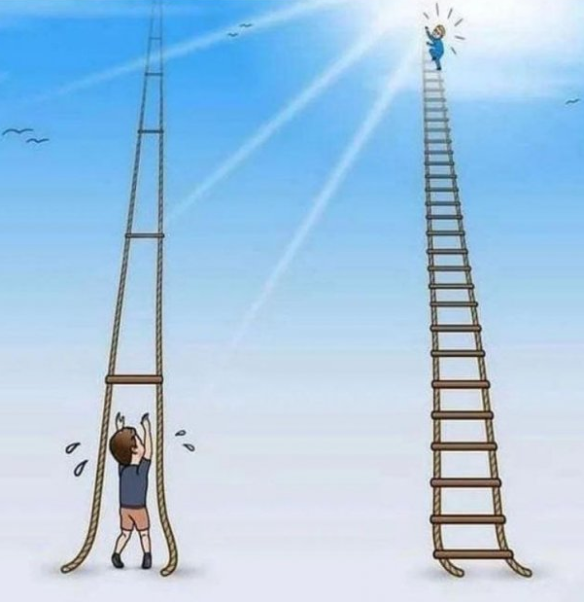
Example: Theater Billing
– Tiny Steps
Time: 30 min
Stay within your groups
Start over or go on with your refactoring

